Slide 1


POWER
Schools and
Colleges
Unit

Slide 2
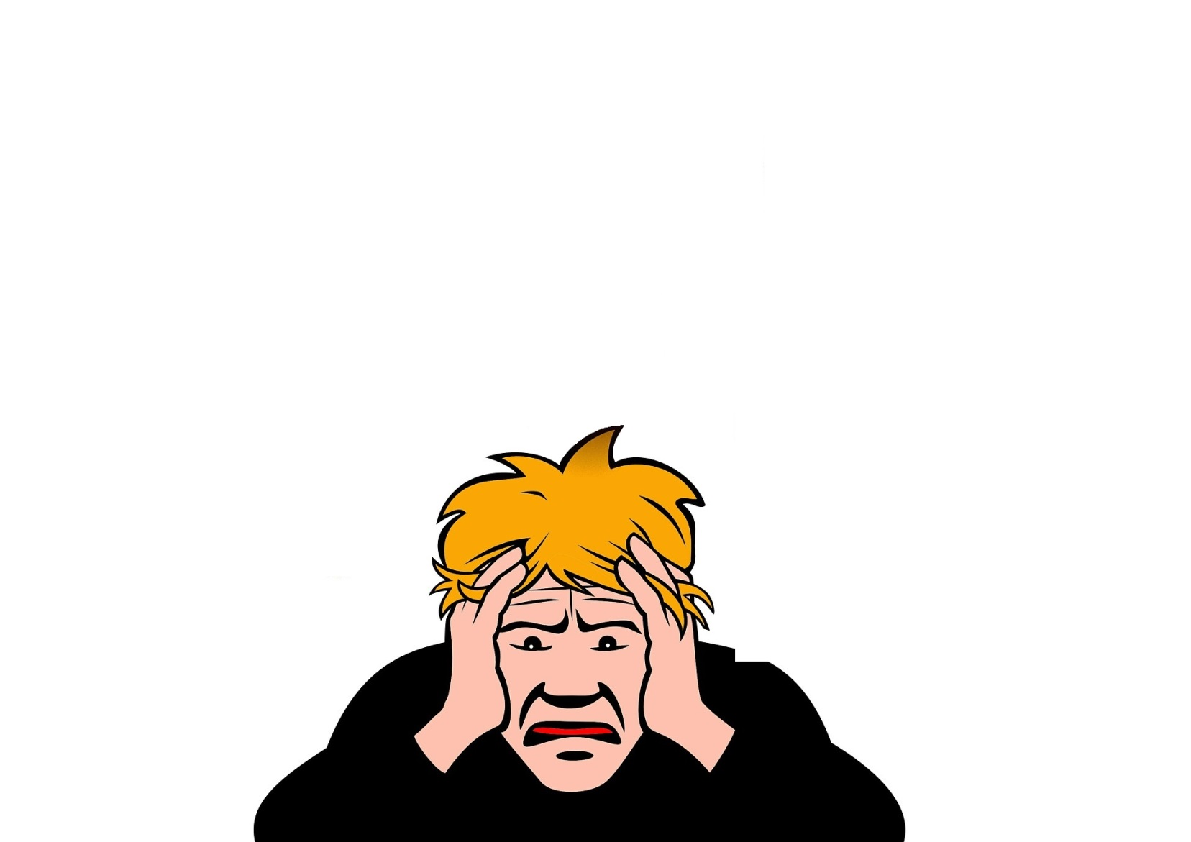

Challenge time
Take a seat!

Slide 3
POWER
Pentecost

Slide 4
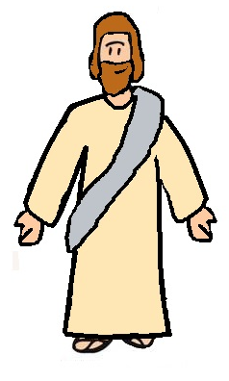
Jesus returns to Heaven

Slide 5
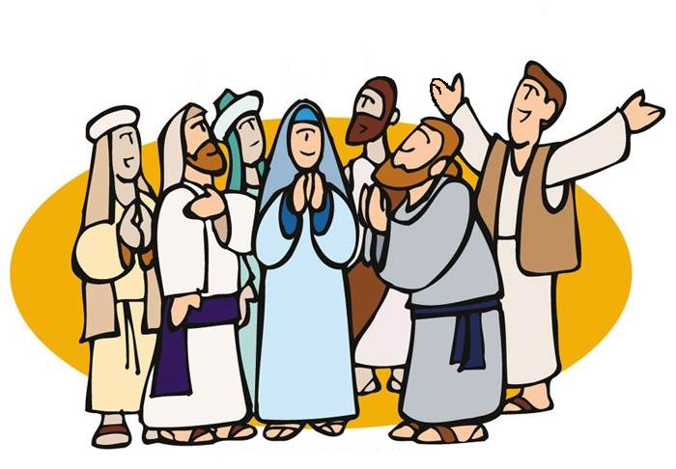

The disciples found
the power

Slide 6

Challenge and
Reflection
POWER
Can you find the power you need to succeed inside?

