Slide 1


Welcome
to
Assembly
Schools and
Colleges
Unit

Slide 2





What do you love the most?

Slide 3


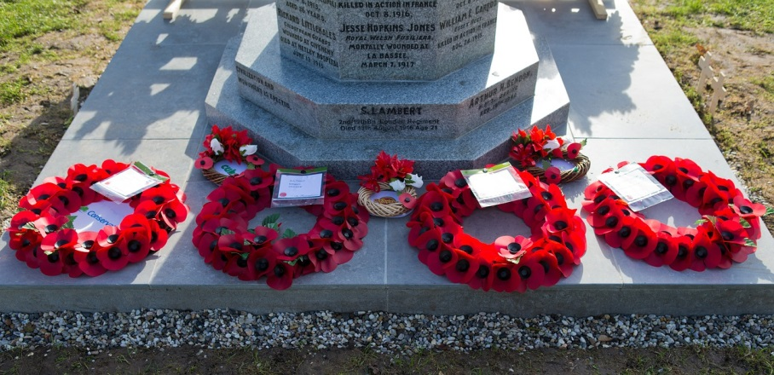
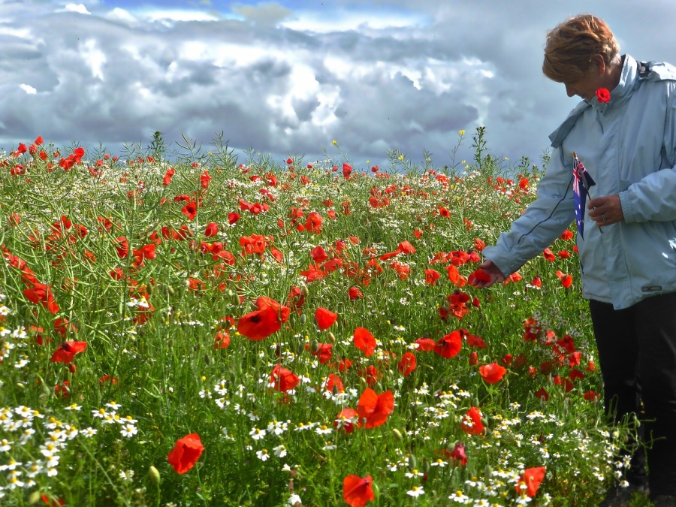

Slide 4

The greatest love
you can have
for your friends
is to give your life for them.
GNT

Slide 5

If you could say thank you,
what would you say?

Slide 6

Schools and
Colleges
Unit

