Slide 1

Welcome
to Assembly
Schools and
Colleges
Unit

Slide 2
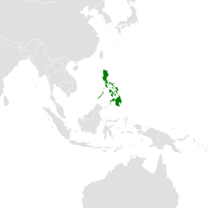
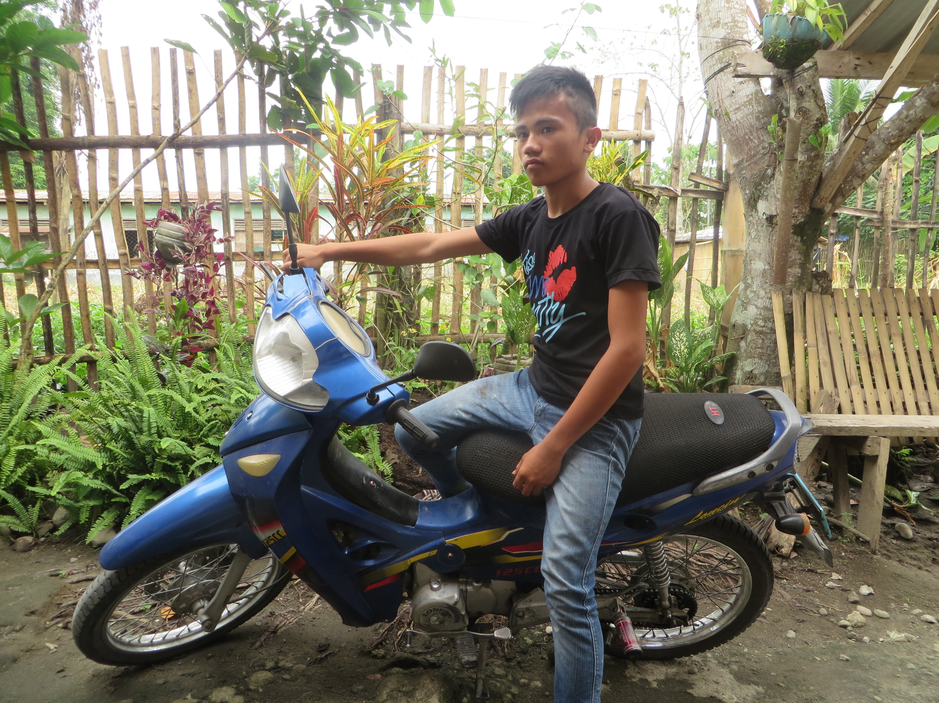

Jeferson

Slide 3

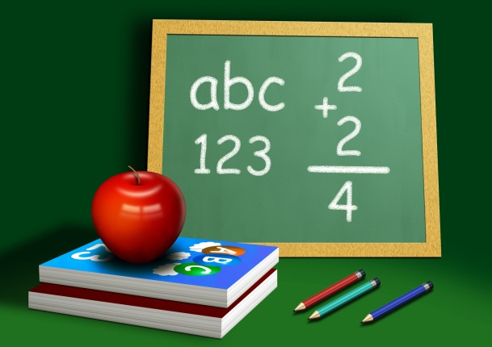


Option A
Option B
X
X

Slide 4
There is a job…
Option A
Option B
X
???

Slide 5

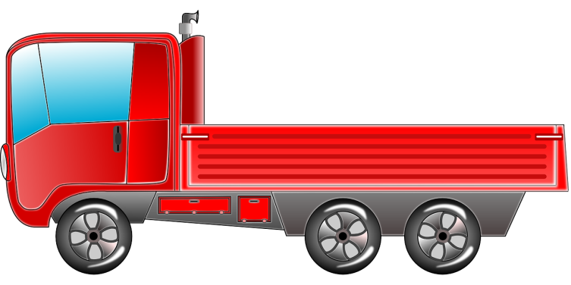





Option A
Option B

Slide 6
Option A
Option B

Slide 7
No farm
Far away
No language
Tricked

Slide 8

work all day
no bed
little money

Slide 9


Slide 10


Slide 11

What made the trick work?

Slide 12
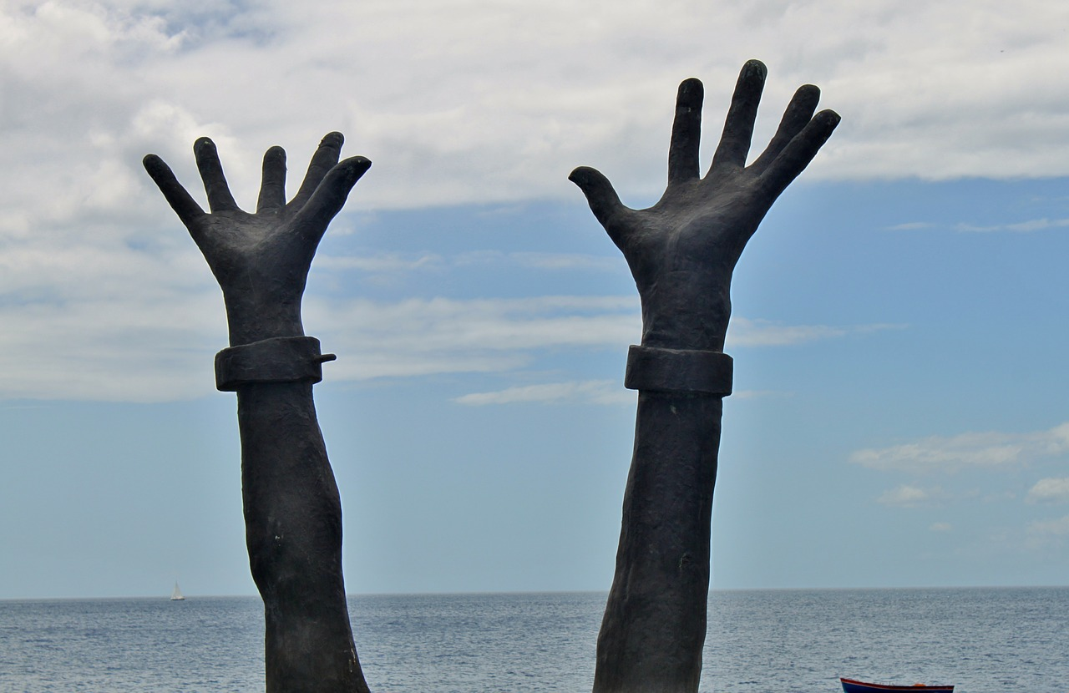
Speak up for those who cannot speak for themselves.
Protect the rights of all who are helpless
Proverbs 31:8

Slide 13
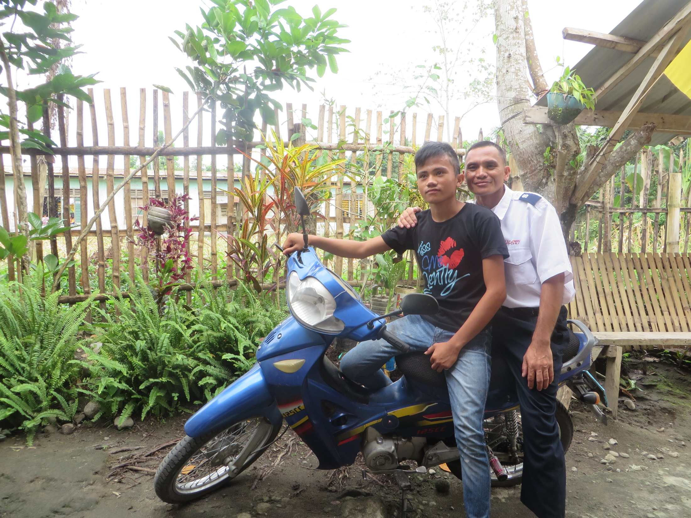

Slide 14
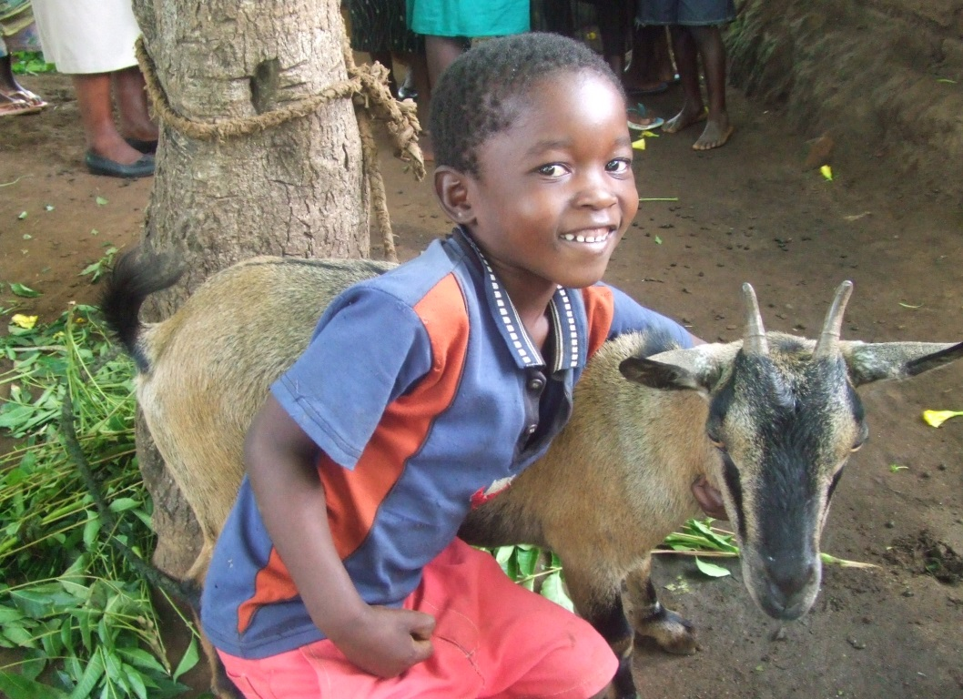
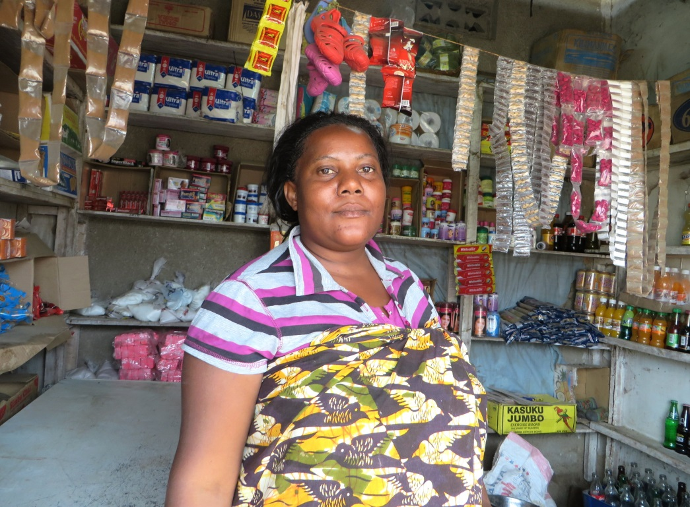
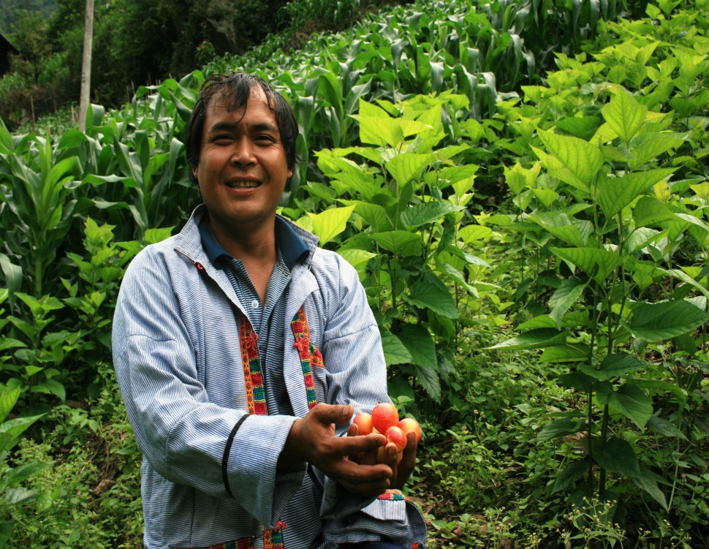
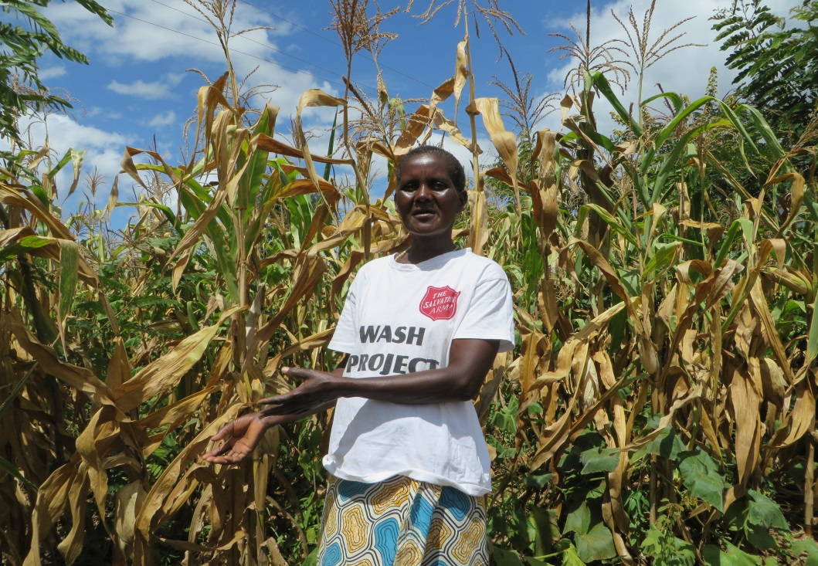

Slide 15
1817
In the UK, in 2014,
men and women were supported by The Salvation Army

Slide 16


What can
we do?
Option A
Option B

Slide 17
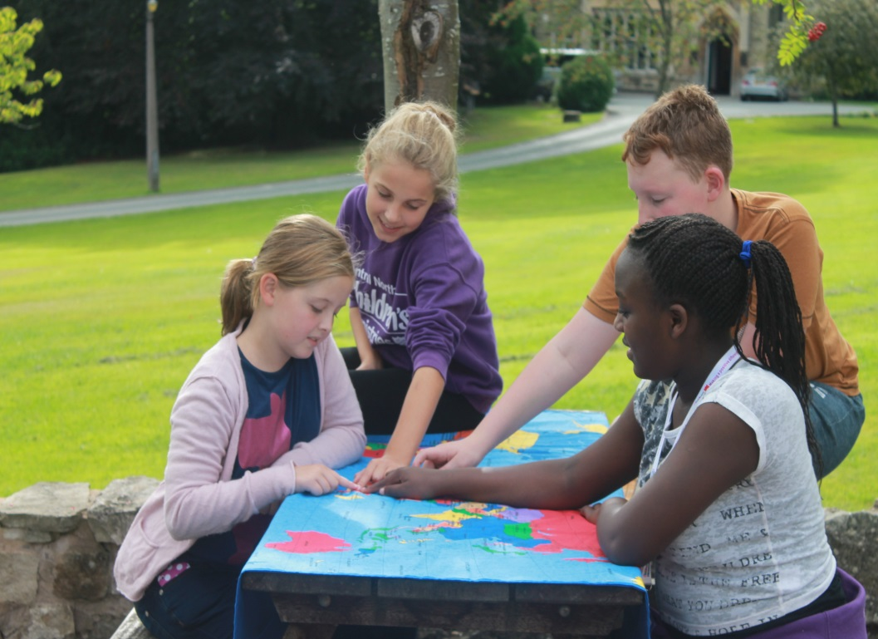

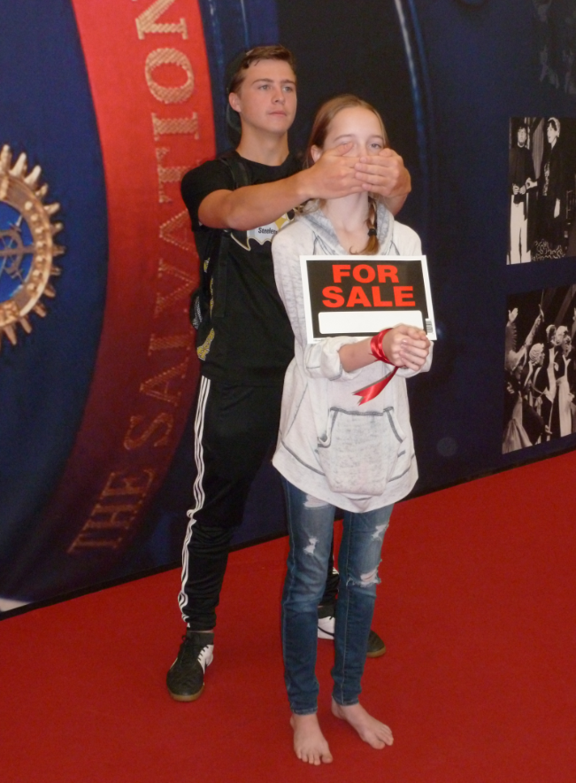
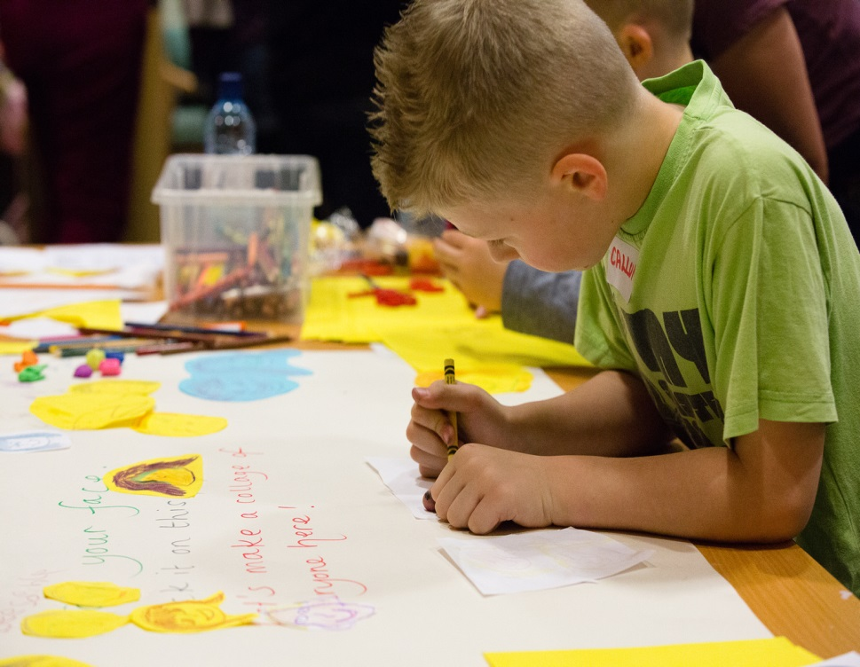

Slide 18
Schools and
Colleges
Unit

