Slide 1


Slide 2
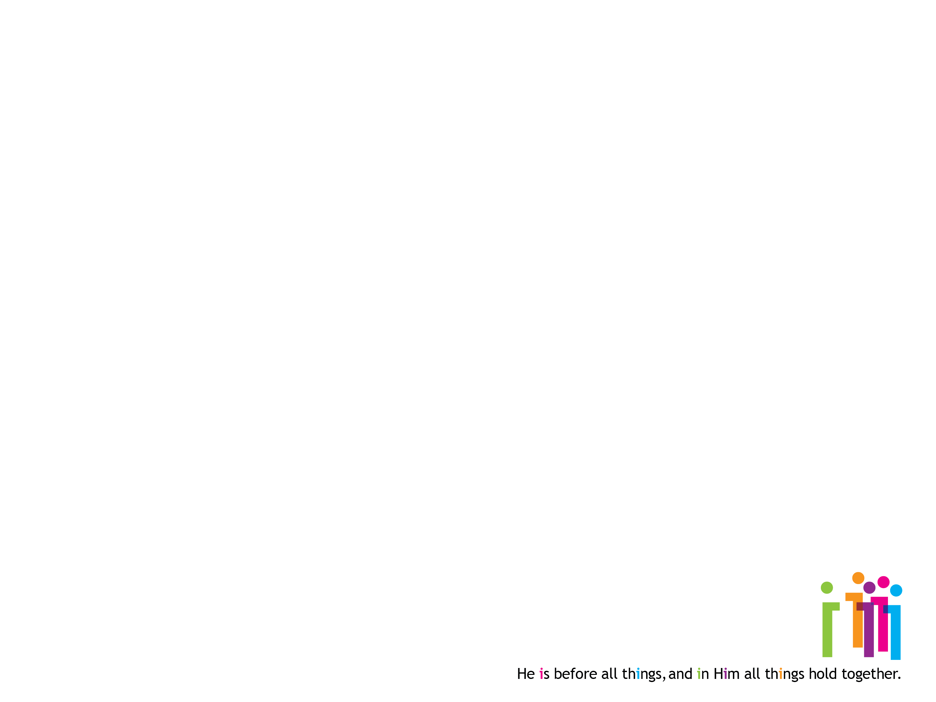
Vision and Commitment Sunday
He is before all things, and in Him all things hold together.
Colossians 1: 17 (NIV)

