Slide 1

What would you give up?
Schools and
Colleges
Unit

Slide 2
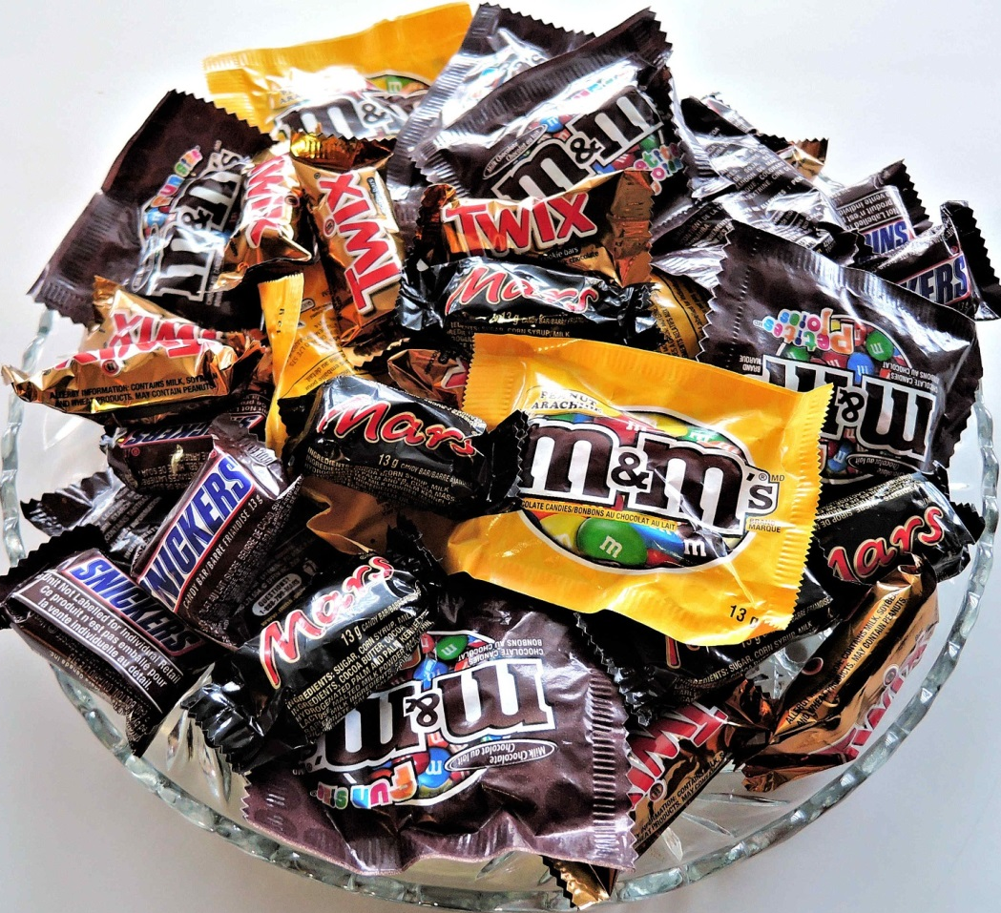
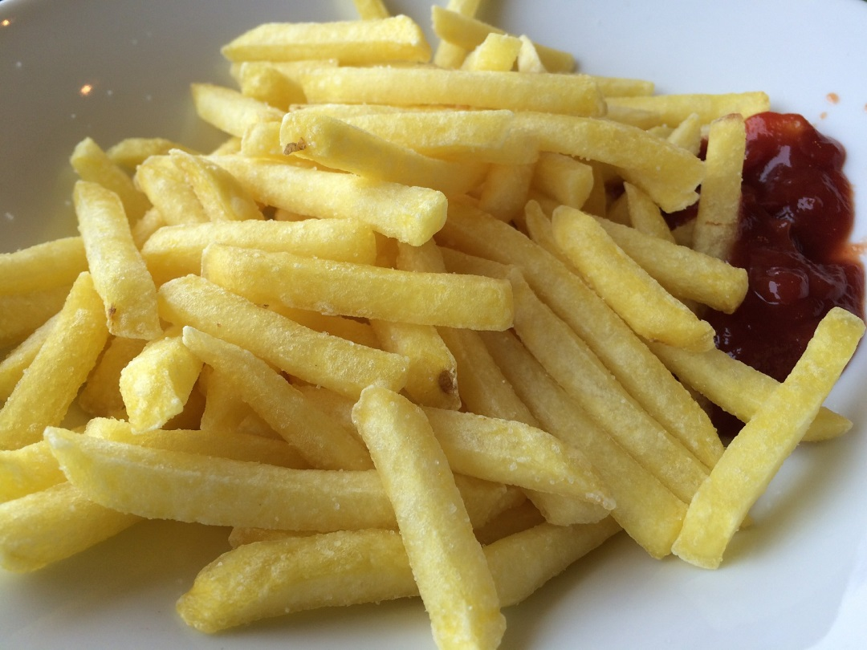
or
chocolate
chips

Slide 3
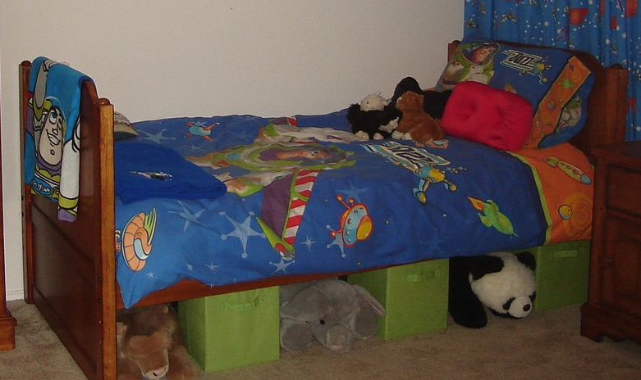
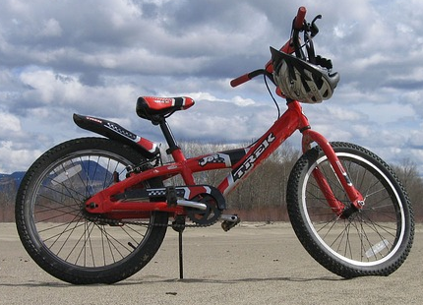
your bed
or
your bike

Slide 4
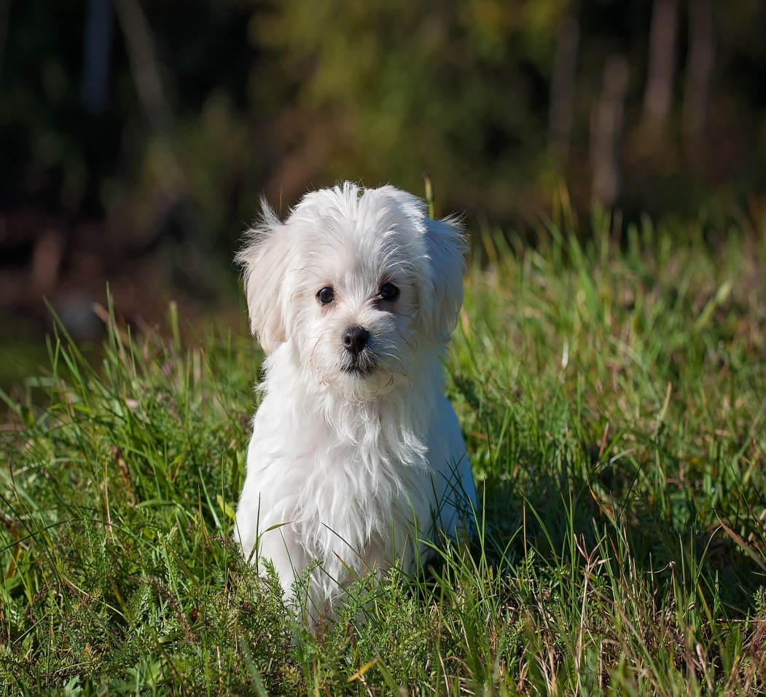

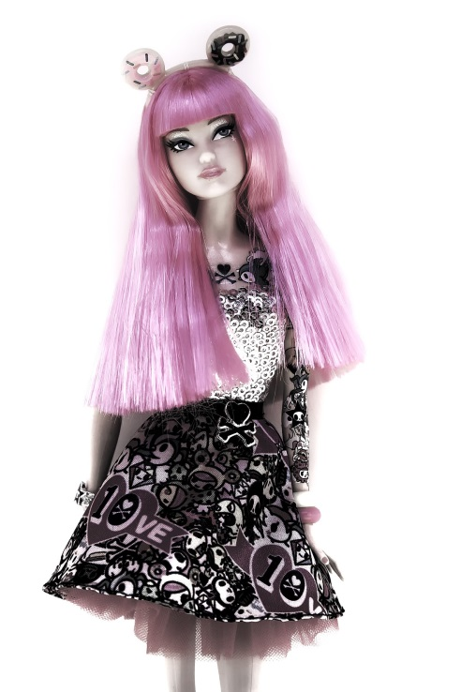

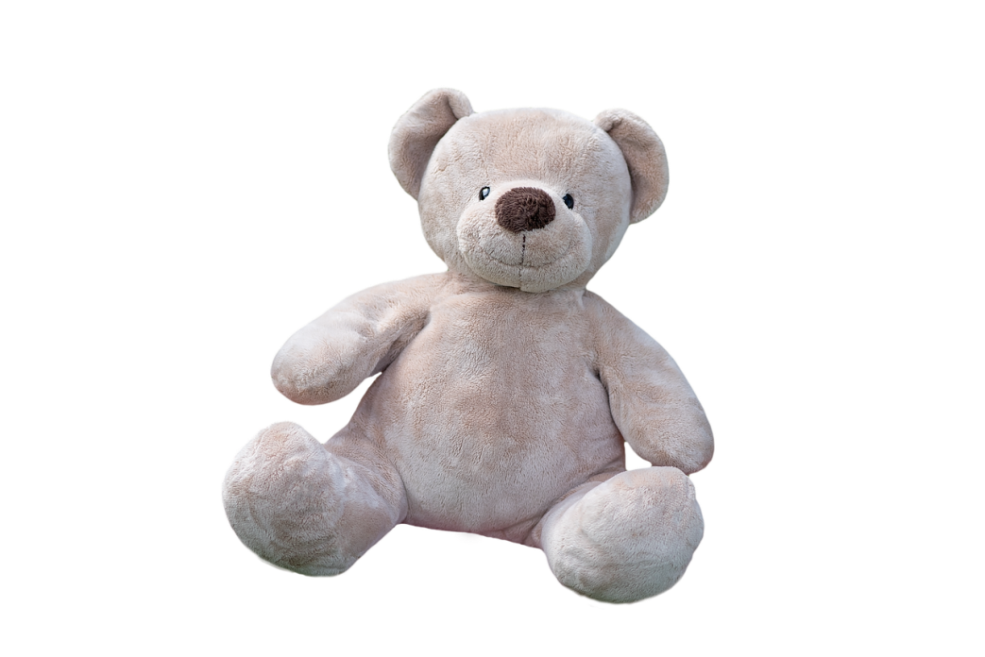
or
your pet
your favourite toy

Slide 5
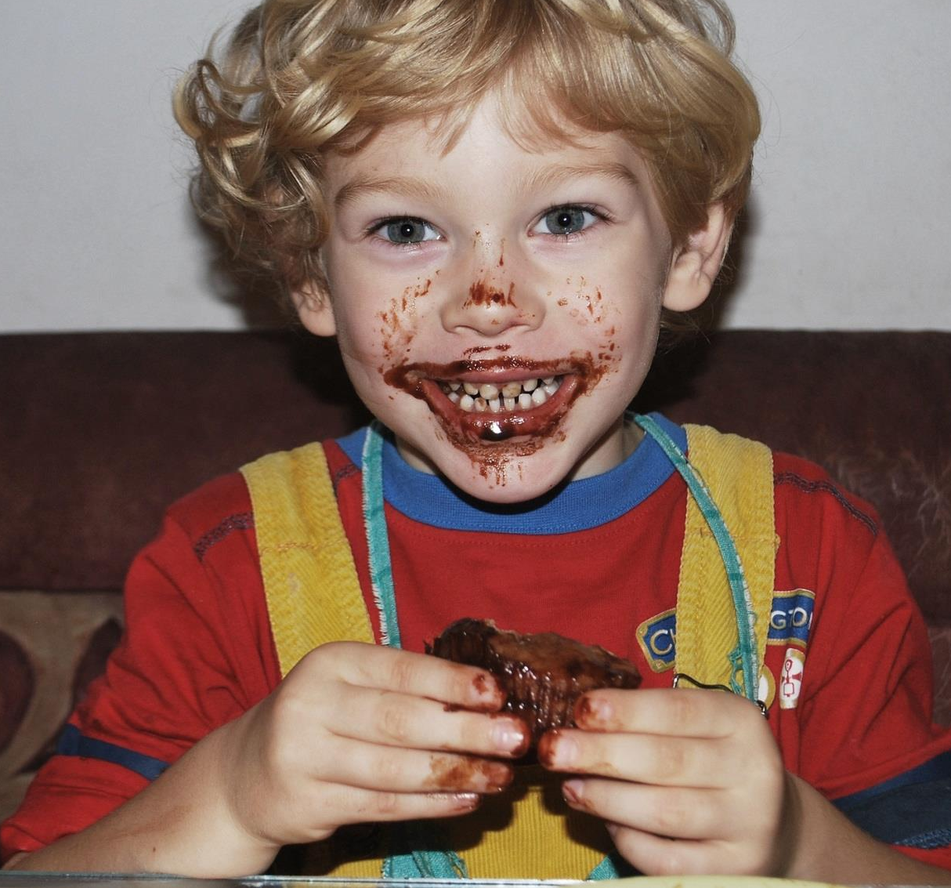
The last ever chocolate…
What would you do with it?

Slide 6


Could you if…?

Slide 7

This is how much God loved the world: He gave his Son, his one and only Son.
John 3:16 The Message

Slide 8
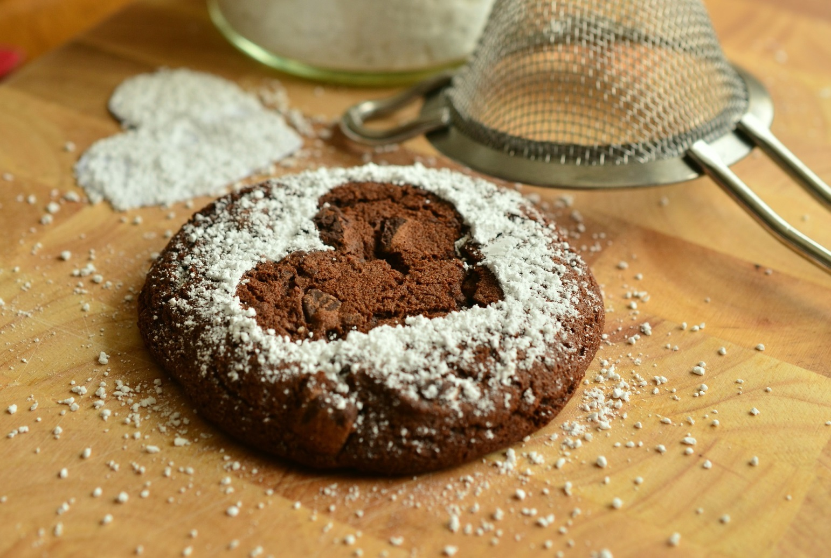
Think for a moment…

Slide 9
Schools and
Colleges
Unit

