Slide 1
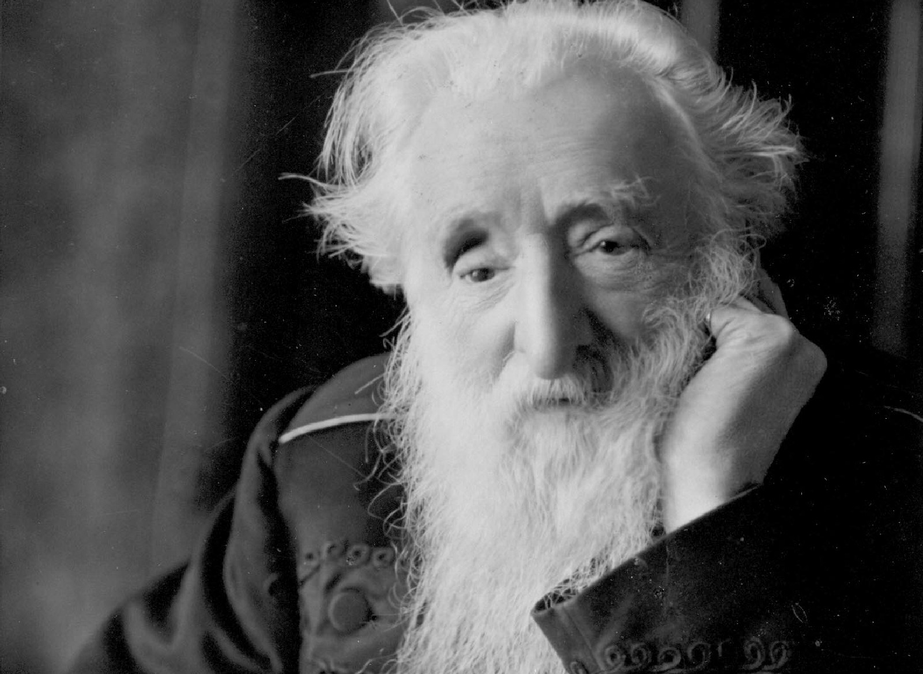

First Impressions
Schools and
Colleges
Unit

Slide 2
Learning Objectives
To identify key events in William Booth’s life
To reflect on the turning points in William Booth’s life

Slide 3
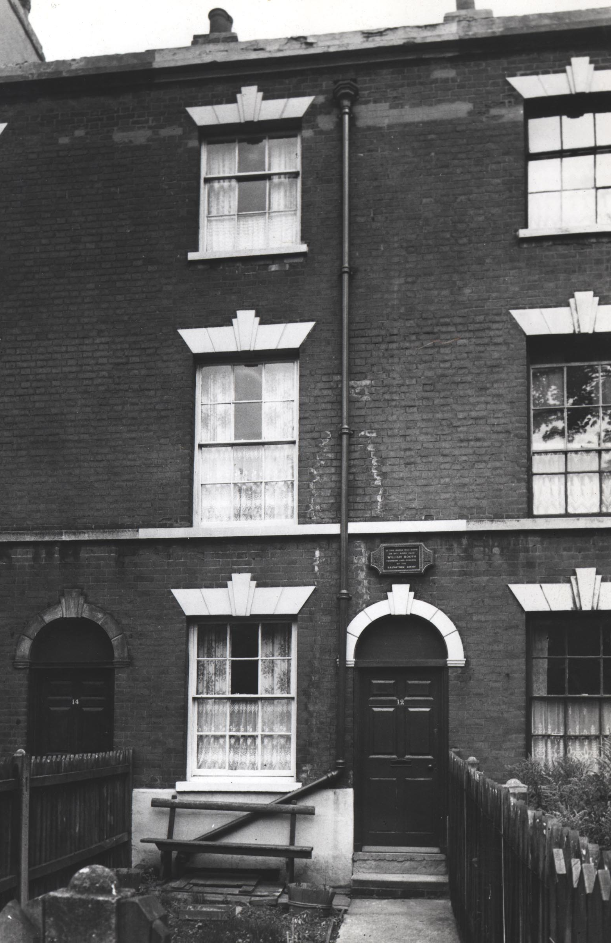
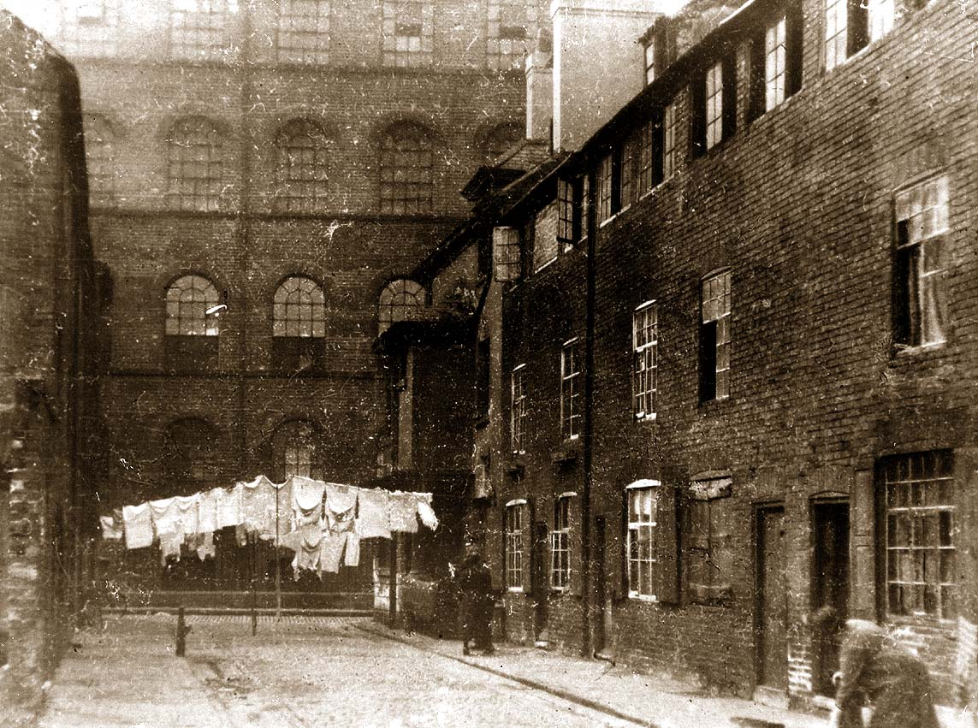
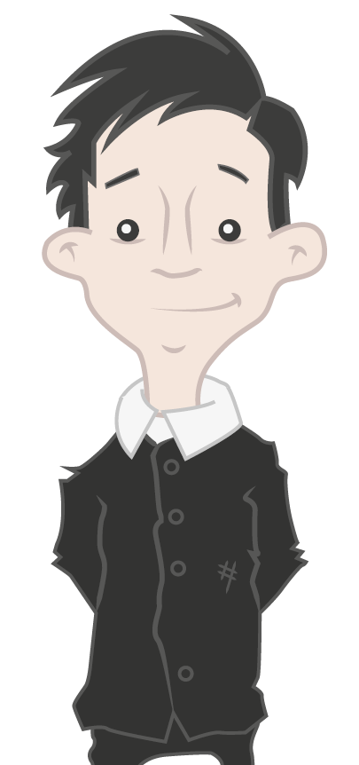
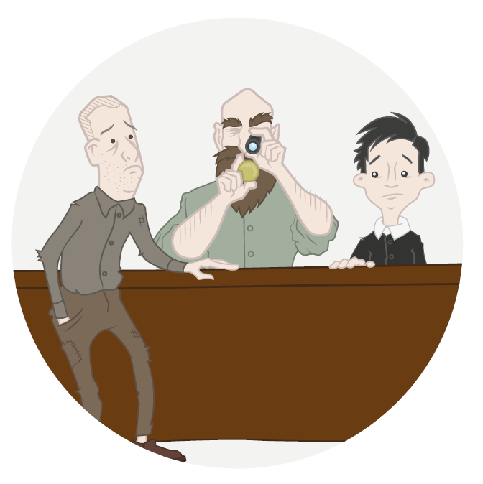
How might
Young William
be feeling?

Slide 4
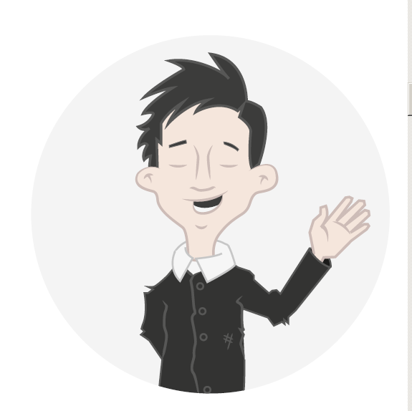
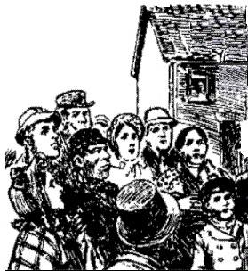
William’s
Turning Point
Becoming a
Christian

Slide 5
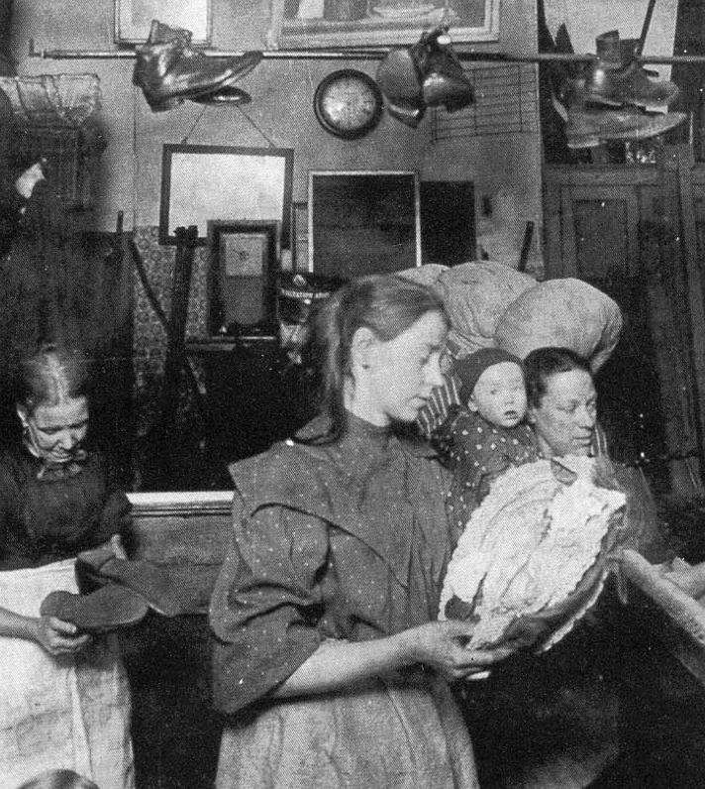

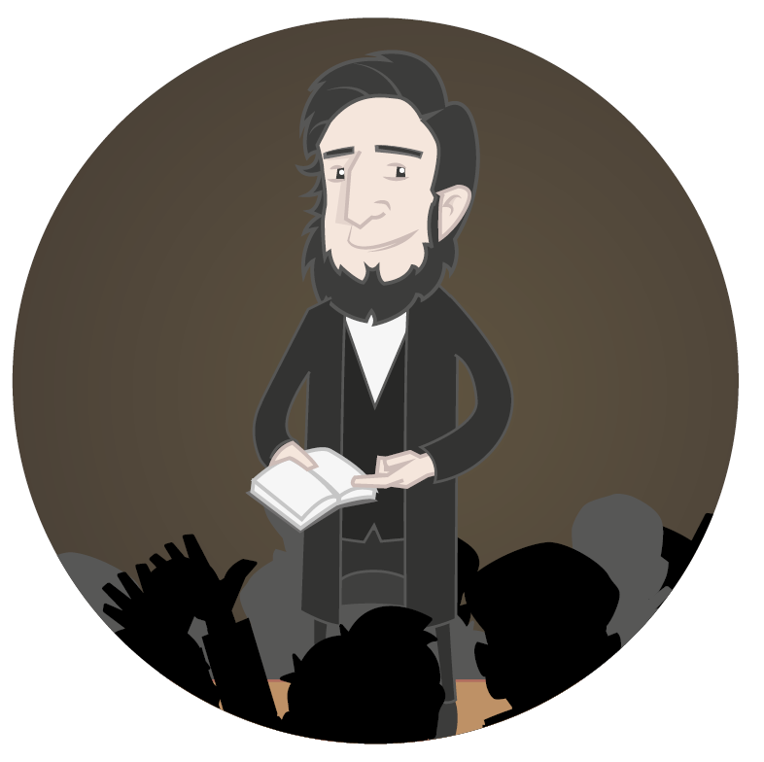
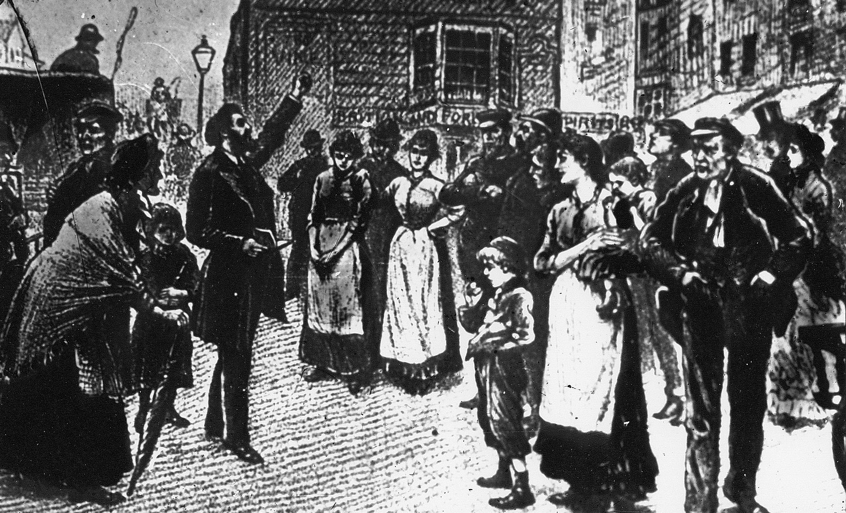
Life in London

Slide 6
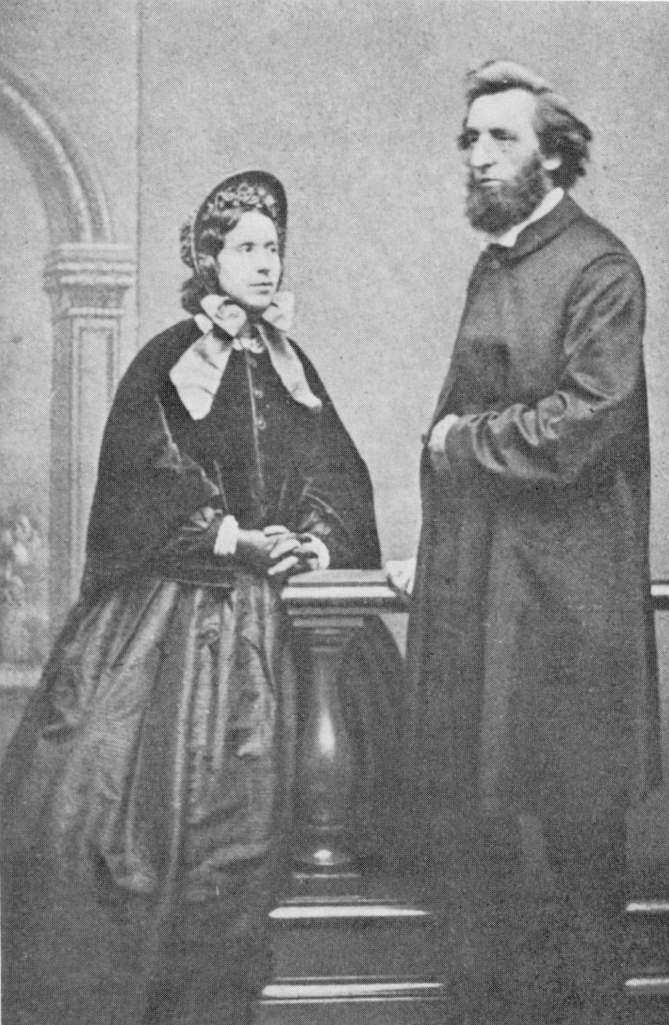
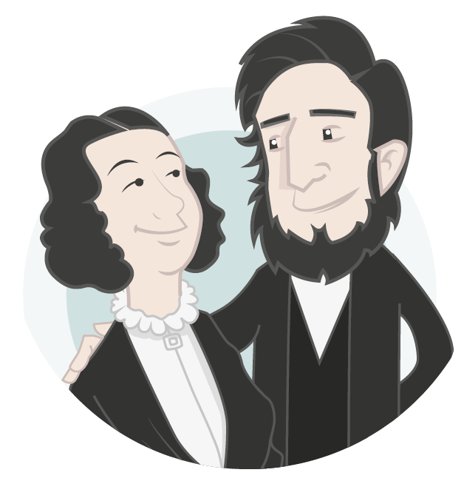
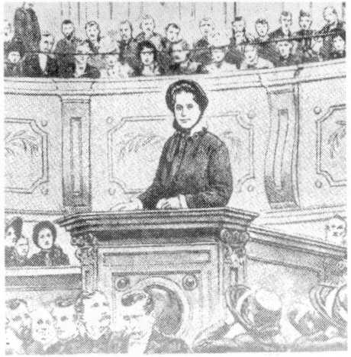
William’s
Turning Point
Meeting
Catherine

Slide 7
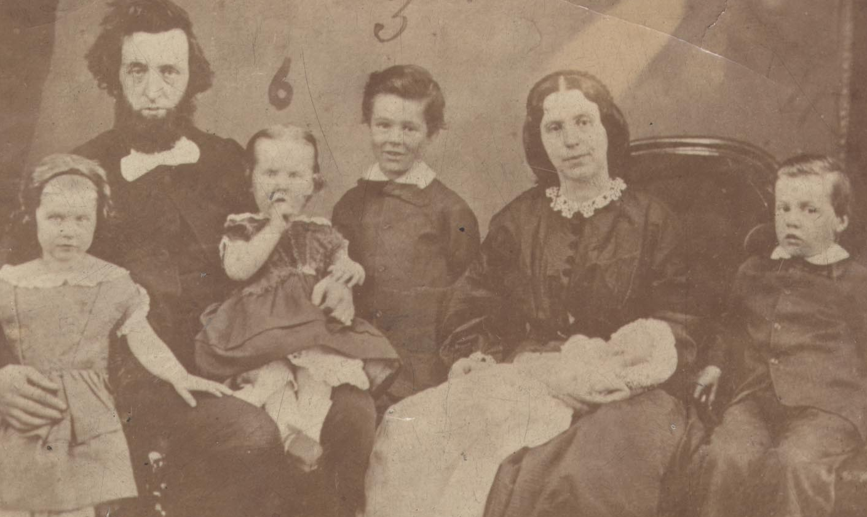
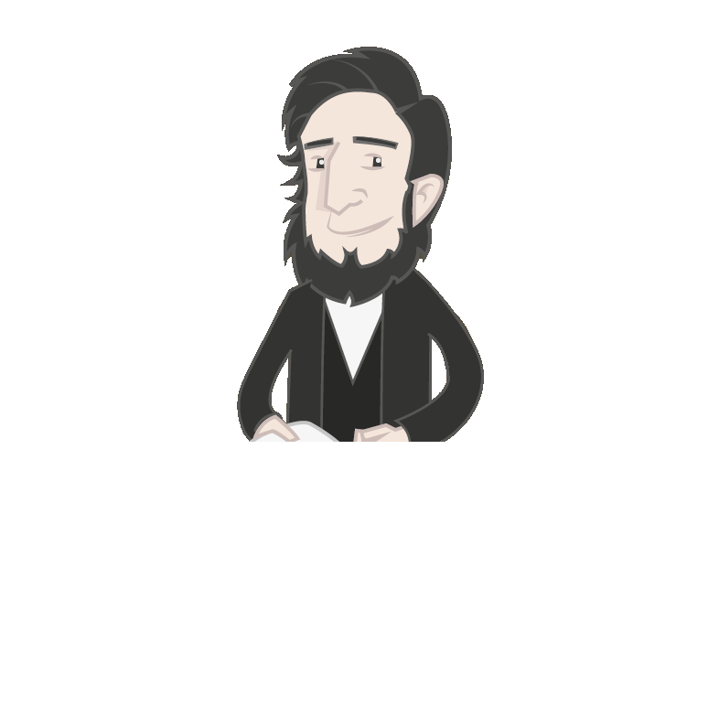
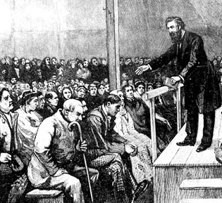
On their own

Slide 8
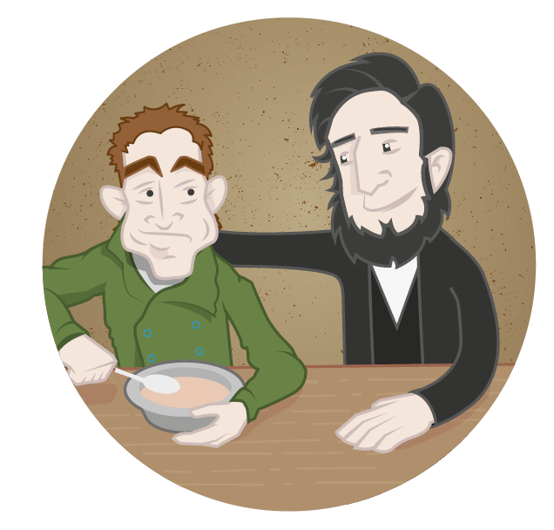
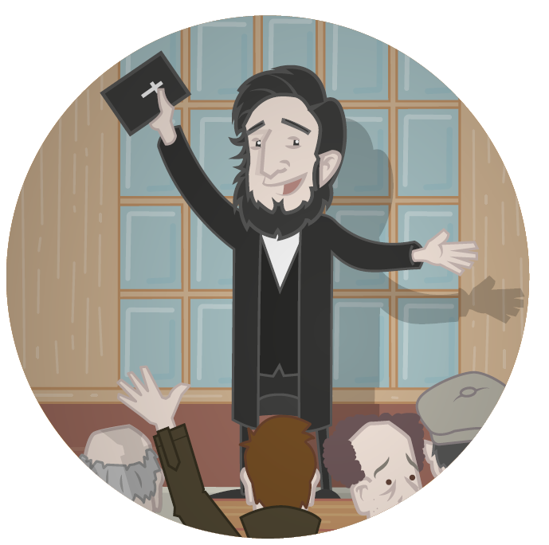
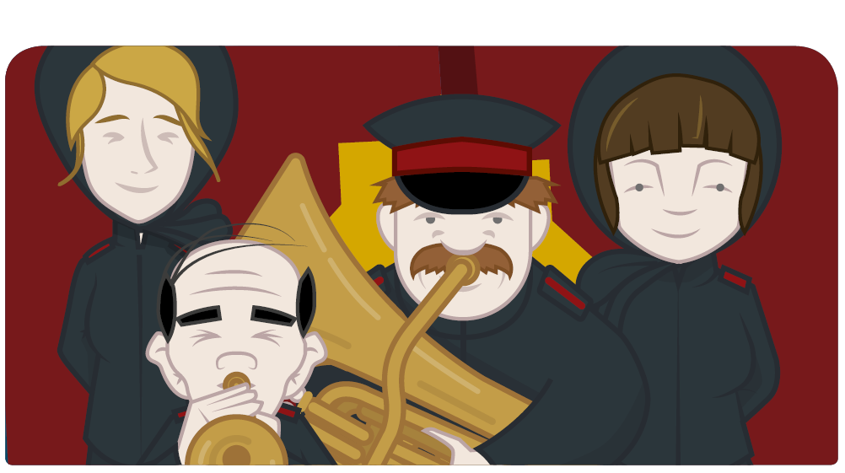
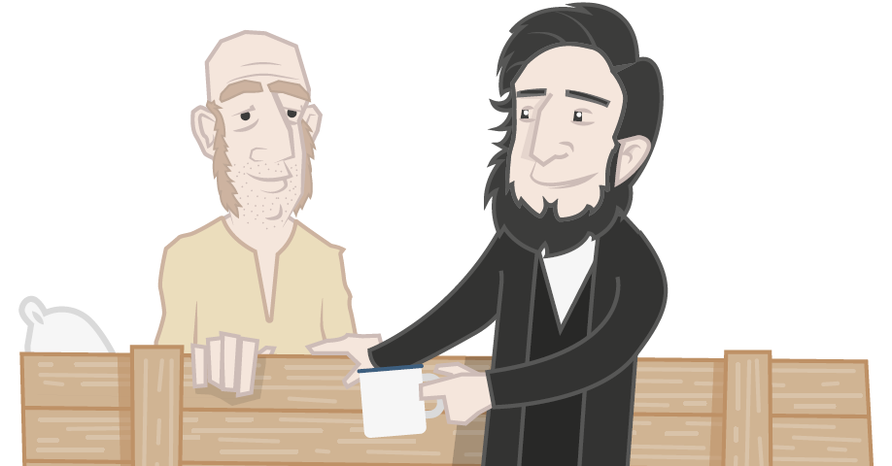
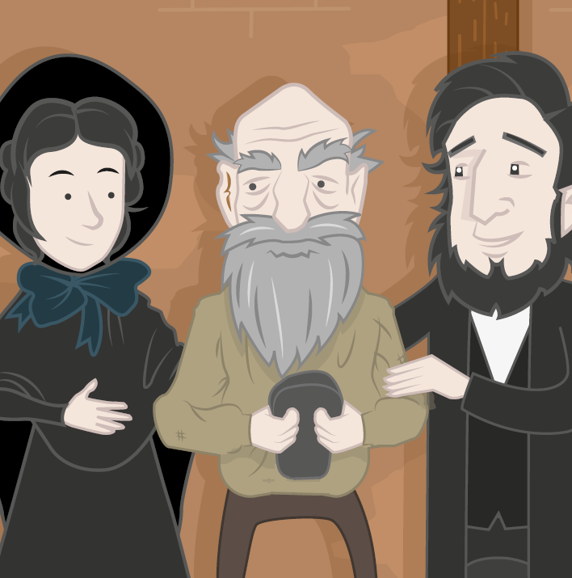
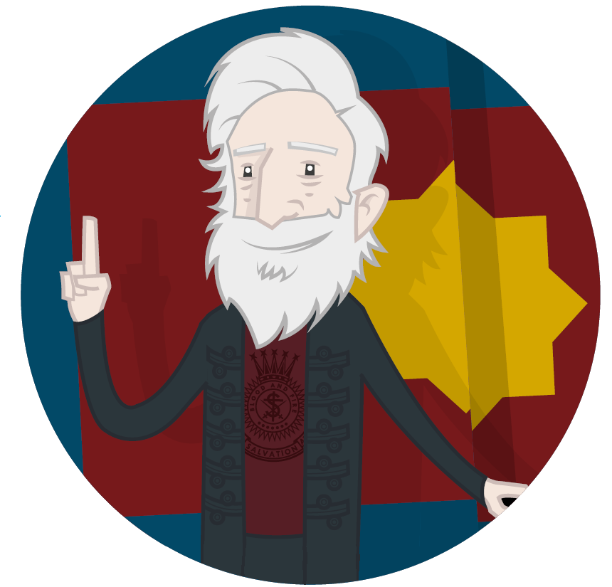
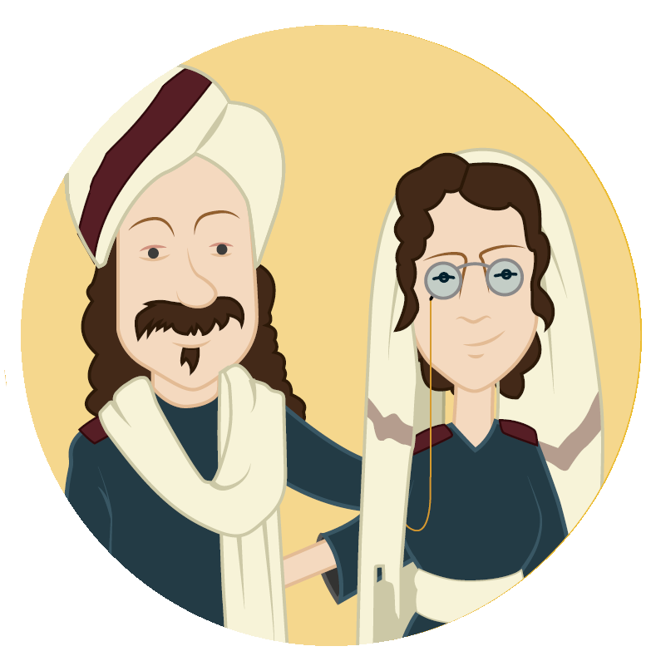
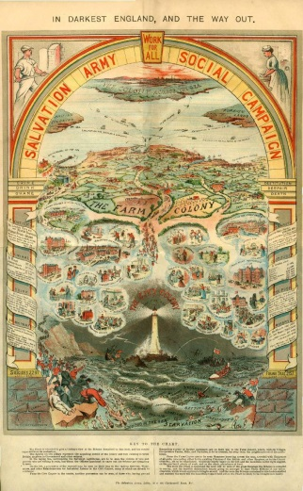
William’s
Turning Point
The Salvation Army

Slide 9
Learning Objectives
To identify key events in William Booth’s life
To reflect on the turning points in William Booth’s life

Slide 10
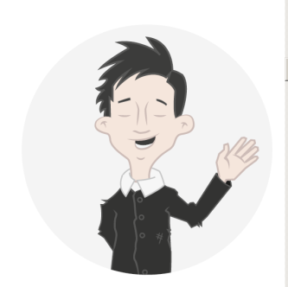

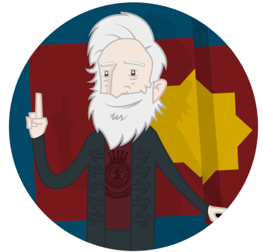
?
?
?
?
?
?

Slide 11
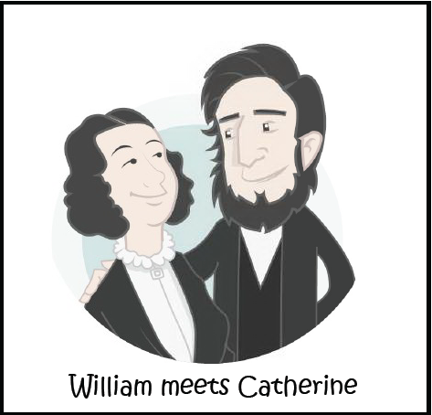
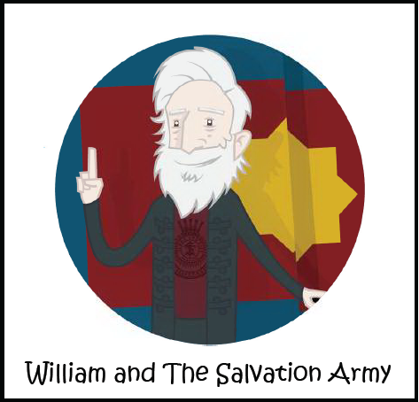
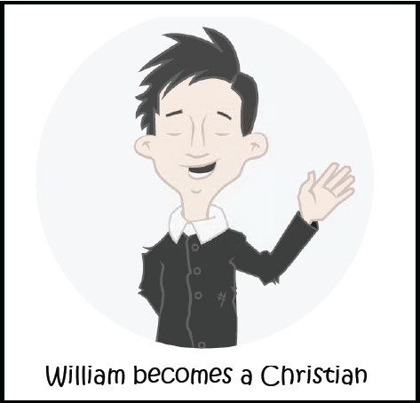
William’s turning points:
Coincidence? Luck?
Or a choice?
Which is the most
important turning point?
What would happen
if any if the turning
points were missing?
Why?

Slide 12


What was the
most
important
turning point?
Why?
Explain your
answer.
What else might have happened?

Slide 13

What turning points might we face in life?
A turning point is…
How do you recognise a turning point?

Slide 14
Learning Objectives
To identify key events in William Booth’s life
To reflect on the turning points in William Booth’s life

Slide 15


