Slide 1
Fight for the flag

Slide 2
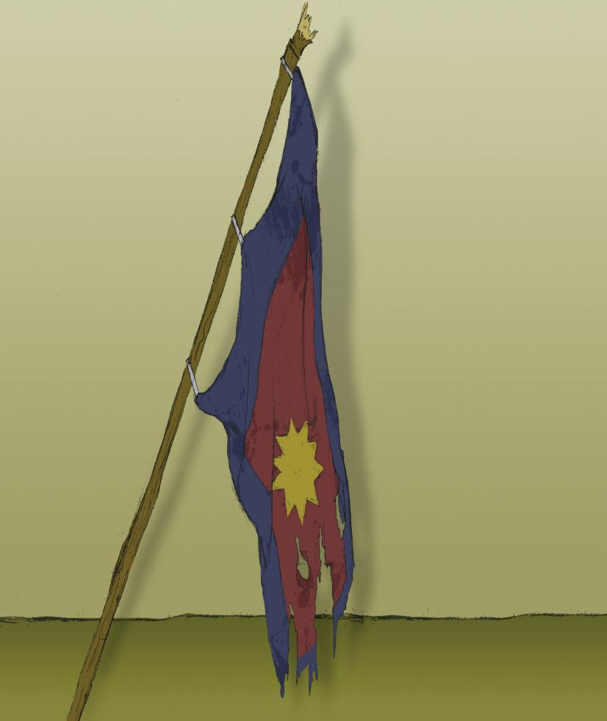
Once upon a time
there was a
Salvation Army
flag. The flag was
torn at the edges
and its faded
colours were
marked with filth.
Its pole was
battered and
scraped and
worn.

Slide 3
The flag had seen many faces;
the grimace of an enemy as well
as smiles of joy and elation from
passers-by.
This flag had a story to tell.

Slide 4
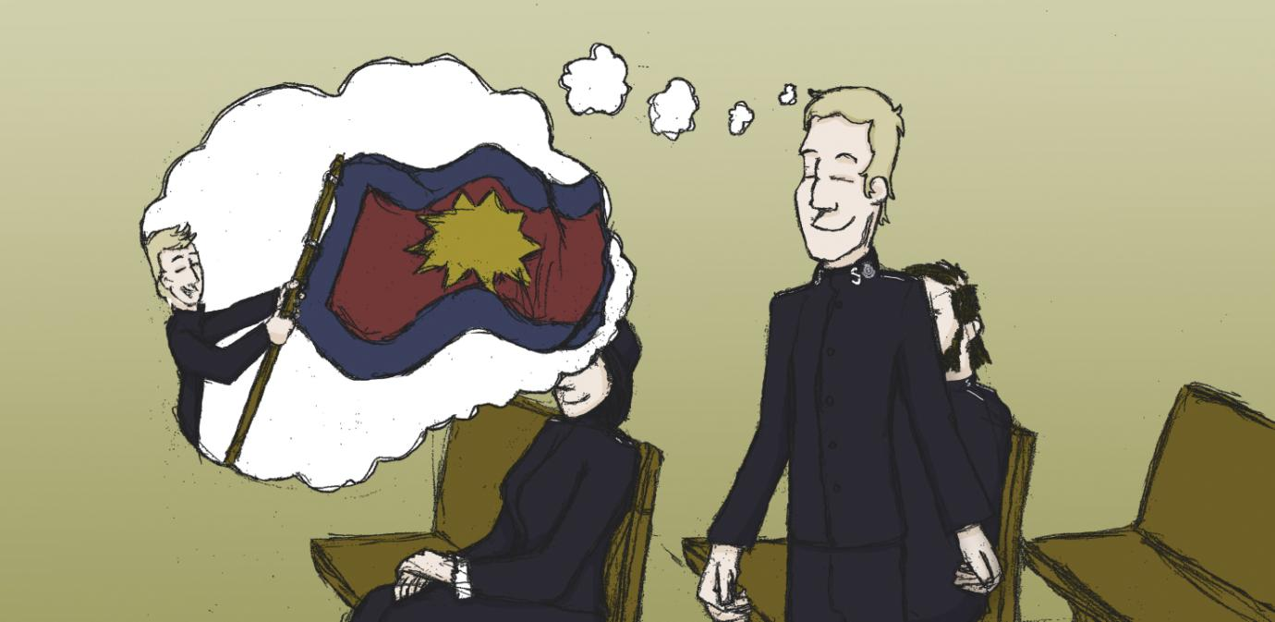
As soon as Frankie Filbert saw the flag he knew he had an
important job to do. He knew, there and then, that he must
be the one to carry the Salvation Army flag at the head of
the march next Sunday.

Slide 5
Frankie had listened intently to the captain who
had presented the flag in the evening meeting. He
had explained what each of the colours of the flag
represented.
Frankie heard how the red part of the flag
represented the blood of Jesus. It reminded
Frankie of how Jesus had died on a cross. Frankie
believed that Jesus had died so that he could be
forgiven for all the bad things he had done in the
past.

Slide 6
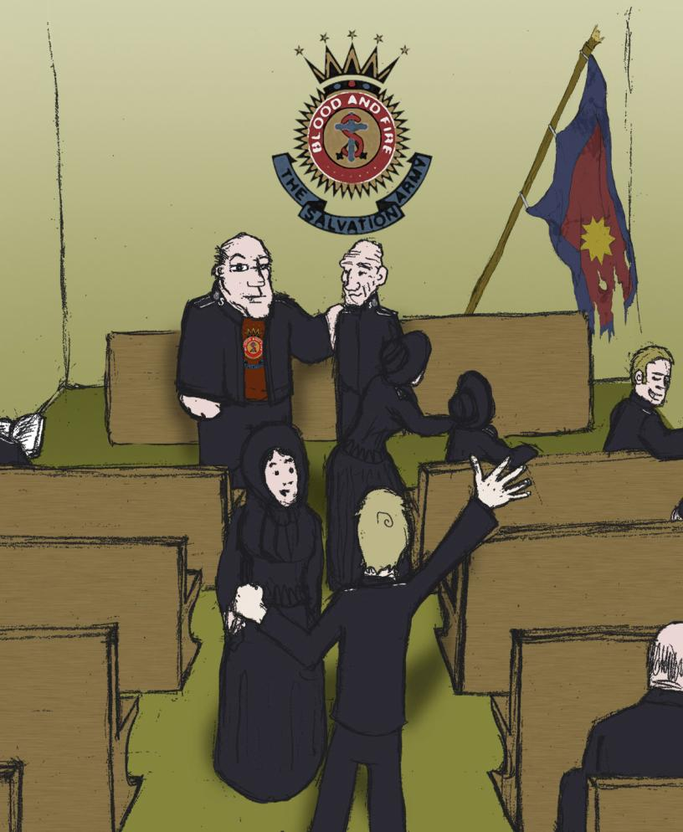
After the meeting,
Frankie was filled
with enthusiasm.
He rushed down to
the front of the
meeting hall and
hovered around the
captain. He had to
ask him about
carrying the flag
straight away.

Slide 7
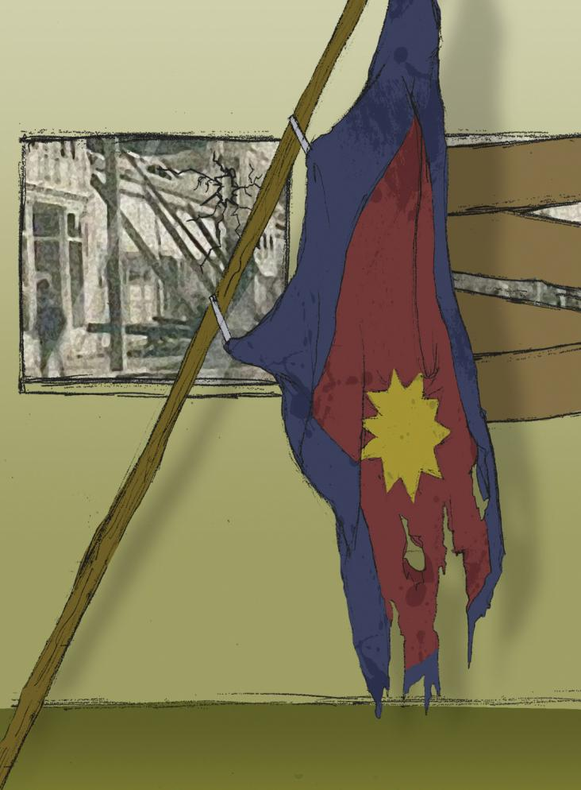
The captain hesitated
while he picked the right
words to let Frankie
down gently.
‘Mmmm. Well, you know,
Frankie, we’d love you to
carry the flag for us but
I’m rather worried about
your wheeziness. It’s
been so troublesome
lately and you’re not
getting any younger.’

Slide 8
B-b-but I don’t understand.’ Frankie was visibly upset. ‘I could do it,
Captain. The flag means everything to me. Just give me a chance.’
‘Of course, Frankie. Believe me, you are one of my most dedicated
soldiers. But it’s getting dangerous out there. The Skeleton Army
seems to want some sort of battle and I’m not willing to put you in the
middle of it all.’
‘Fit for nothing now. Too old to even carry a flag, eh?’ Frankie
mumbled as he trudged off.
Frankie’s wife, May, thought that the captain might respond in this way.
‘Don’t worry, dear. I’m sure there are other ways you can help the
captain.’
Doubt rose in her voice.

Slide 9
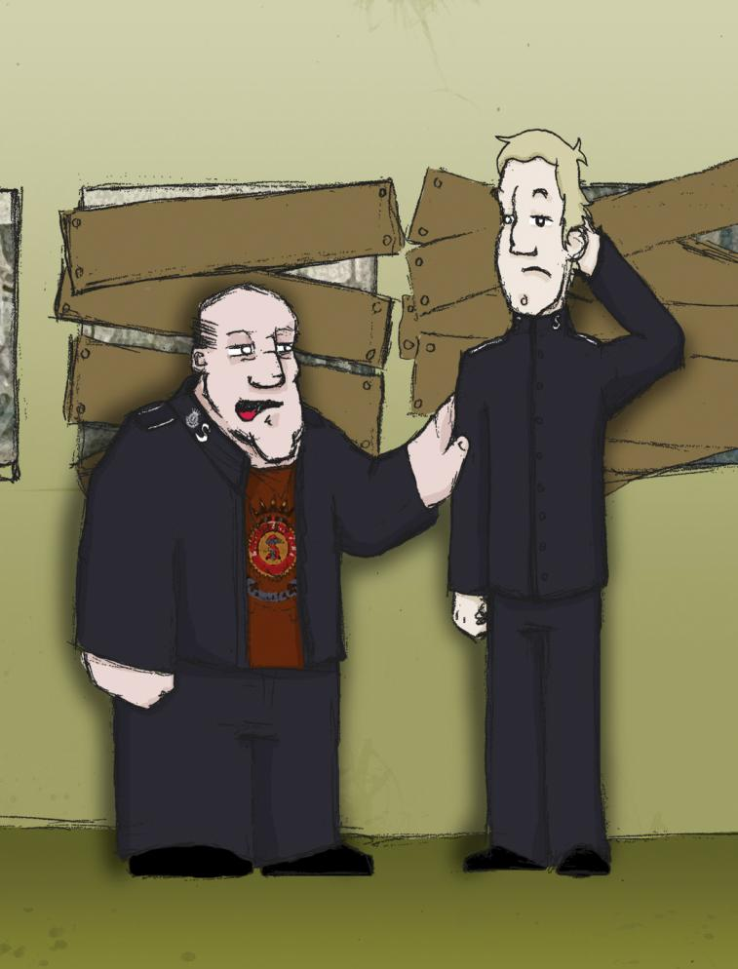
Unlike Frankie, the
captain knew that next
week’s march would
be tough. He’d
already had trouble
from the Skeleton
Army – two of the
windows in the hall
had had to be
boarded up because
of the shrieking mobs
that had been
throwing stones.

Slide 10
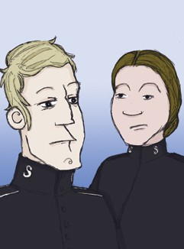
“Who is the Skeleton Army
anyway?” Frankie asked his
wife.
May explained to Frank that
the Skeleton Army was a
group of men who were
against The Salvation Army.
‘But why would anyone want
to be against all the good
that The Salvation Army
does?’ Frankie questioned.

Slide 11
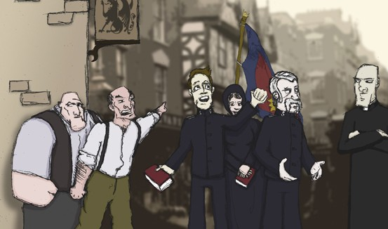
“I dunno, Frankie. You know what folks are like. Some of them don’t understand what we
are trying to do. I know, for a fact, that one of the parish clergymen is very suspicious of
us because we worship God in a different way. And then there’s the publicans - well, of
course, they’re going to hate us cos we tell people about the dangers of alcohol which
stops them drinking in their pubs. There’s no pleasing some people, eh?”
Frankie thought carefully about all this. He was rather worried about what would happen if the Skeleton Army decided to show up.

Slide 12
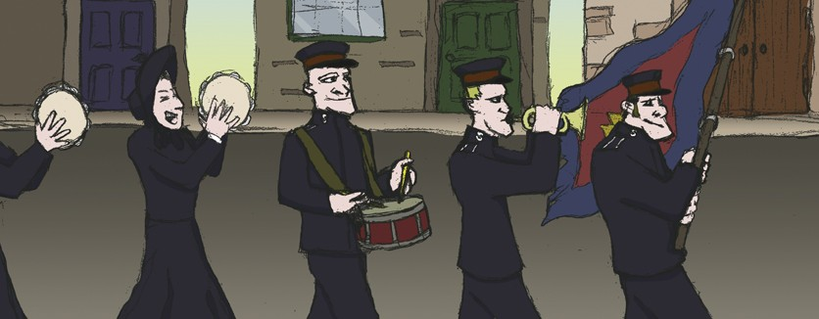
Nevertheless, the next week, the Salvation Army march was scheduled to go
ahead, as planned. All the members of the corps met at the Army hall before
they proceeded into the town. It truly was a splendid sight! The flag was
magnificent. Its colours reflected the pride and excitement of the soldiers who
marched beneath it. The band prepared to face any opposition they would
come up against. The singers raised their voices as they set off.

Slide 13
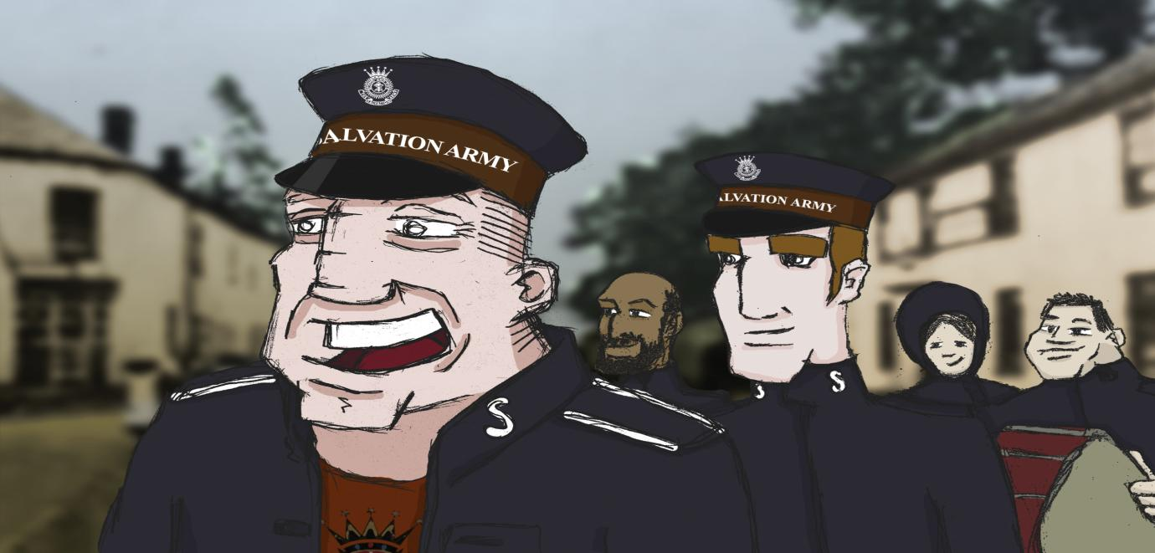
Few realised that Frankie had not shown up for the march. One person who had noticed their
missing comrade was the captain. Only he understood why Frankie might have decided to stay
away. The captain feared that he may have crushed Frankie’s enthusiasm.
As the procession streamed into the streets, it seemed the captain had been wrong. There was
no trouble in town tonight and no sign of the ‘Skeletons’. The Salvationists and their band
marched with vigour and enjoyed spreading God’s message to onlookers and interested
passers-by.

Slide 14
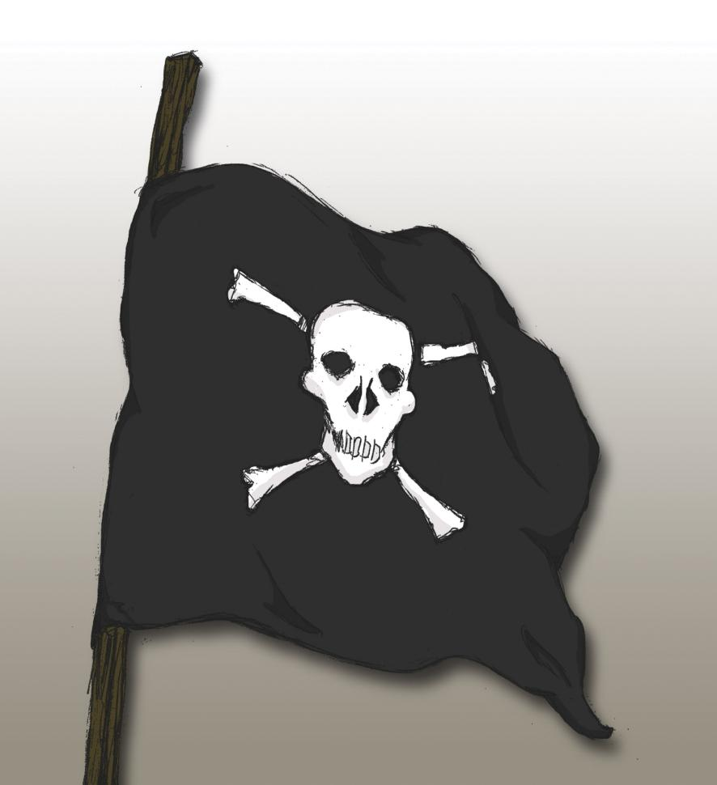
However,
unbeknown to
the band of
Salvation
Army soldiers,
there was
another flag
that was to
rival their own.

Slide 15
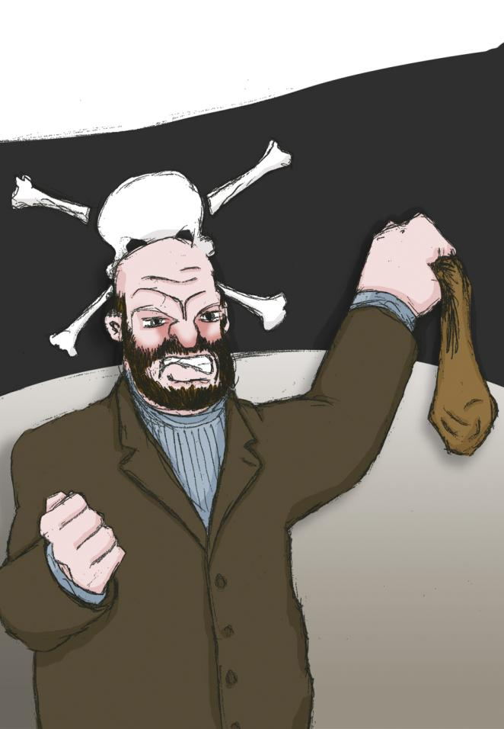
While The Salvationists set
off on their march, on the
other side of town the local
publican, who was very
popular in that area, was
offering a cash prize to the
first man who could bring
the hated Army flag into his
pub.
The Mayor had even made
a gift of a skull and cross
bones banner to The
Skeleton Army. It was
indeed a battle of the flags!

Slide 16
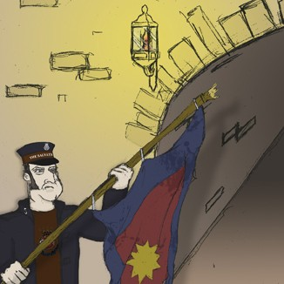
The Salvationists had
now reached a long,
railway tunnel and
prepared to march
through it.
‘Steady on, Alf. Bring
the flag down as we
come through the
tunnel. Wouldn’t want
to scrape it now!’

Slide 17
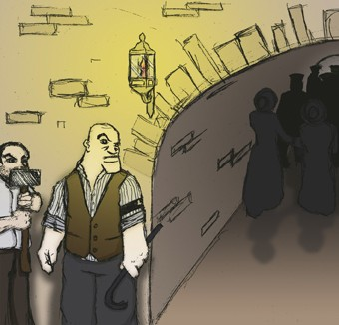
The flag was
lowered and the
band entered the
tunnel. The singing
stopped as they
passed beneath a
dim light. The only
sound that could be
heard now was the
steady rhythm of the
Salvationists’ feet as
they tramped on
tirelessly.

Slide 18
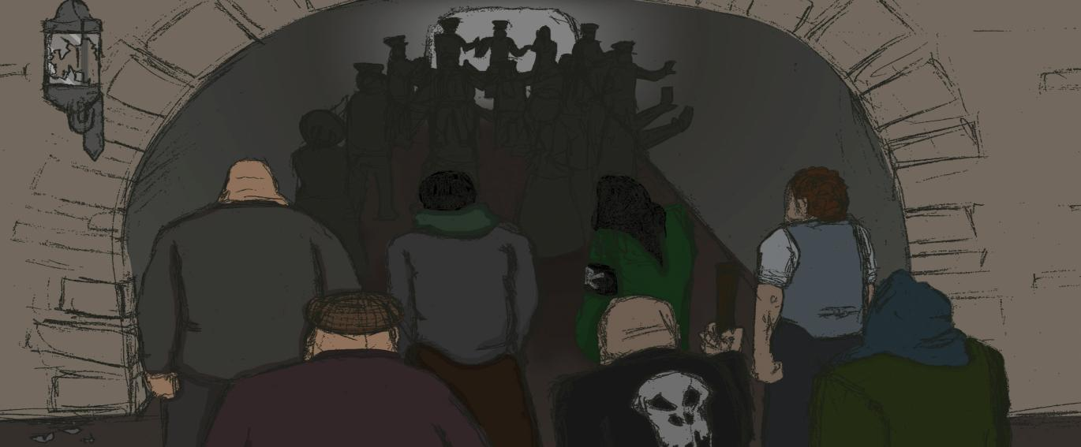
Thud!
‘What was that?’
Thud! Thud! Bang!
‘I don’t like the sound of that!’
As the thuds grew louder, the ‘Skeletons’ managed successfully to extinguish the only
street lamp in the arch. An eerie darkness enveloped the soldiers. The steady march had
now turned into a nervous shuffle. There was a momentary silence.
‘We’ve got company!’ the captain informed his troops.

Slide 19
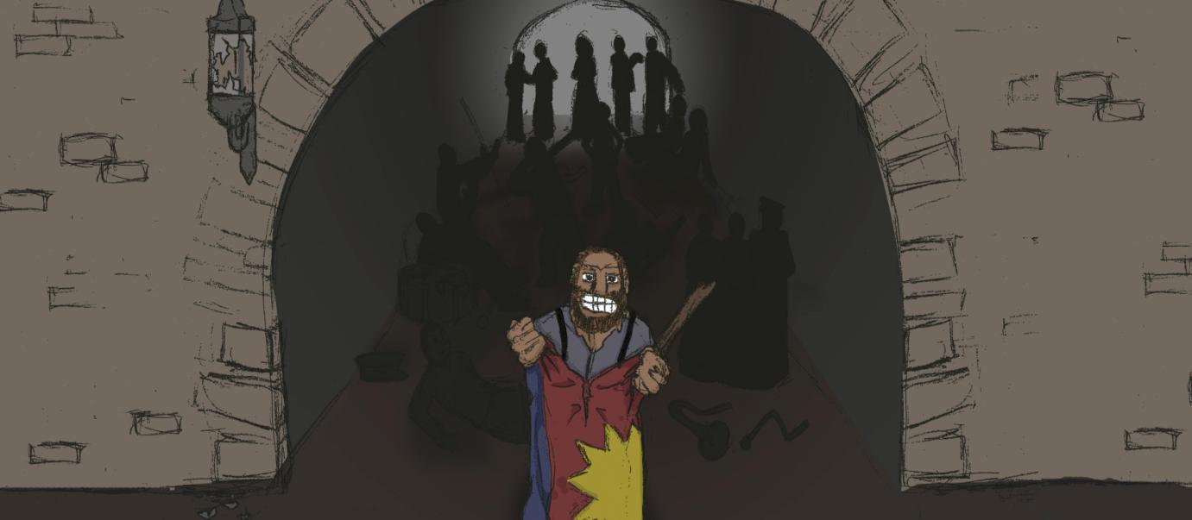
And then, without warning, the battle commenced.
The ‘Skeletons’ had risen up and were now
shouting themselves hoarse amid the echoes and
darkness. The Salvationists sprang into action.
They never hesitated.

Slide 20
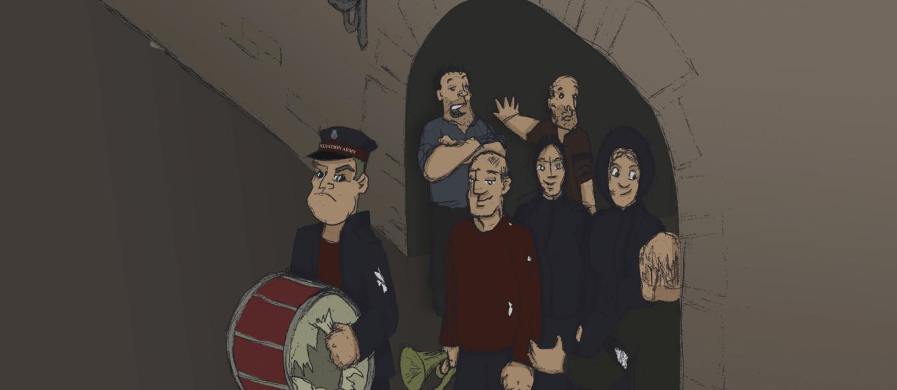
The taunts of the ‘Skeletons’ grew louder and, as one, the band
of Salvationists retaliated with a rousing chorus of ‘Glory
Hallelujah’. Their spirit would not be broken. As they emerged
from the tunnel their voices drowned out the jeers or chants that
had bothered them earlier. But one voice could be heard above
them all and this voice wasn’t singing.

Slide 21
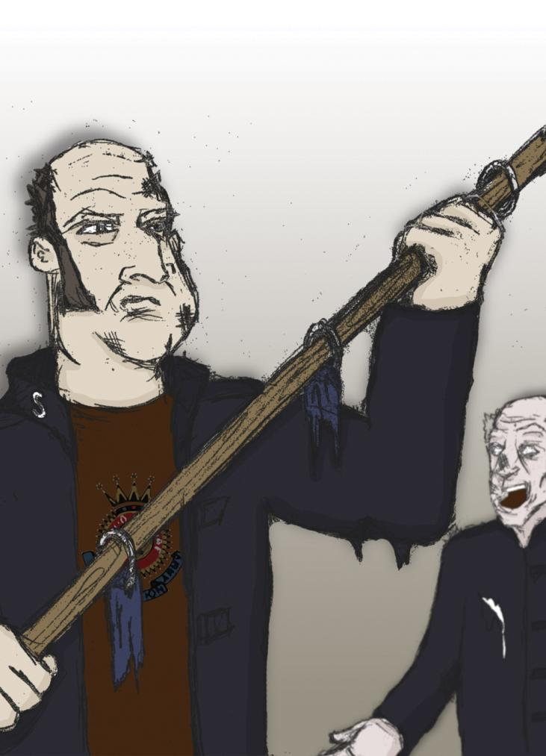
Where’s the flag?’
It was the strained voice
of Alf, the flag-carrier.
‘Speak up, friend, we
can’t hear you.’
‘The flag - it’s gone!’
At the sound of Alf’s voice,
the rousing chorus halted
and died down until there
was a hushed silence.

Slide 22
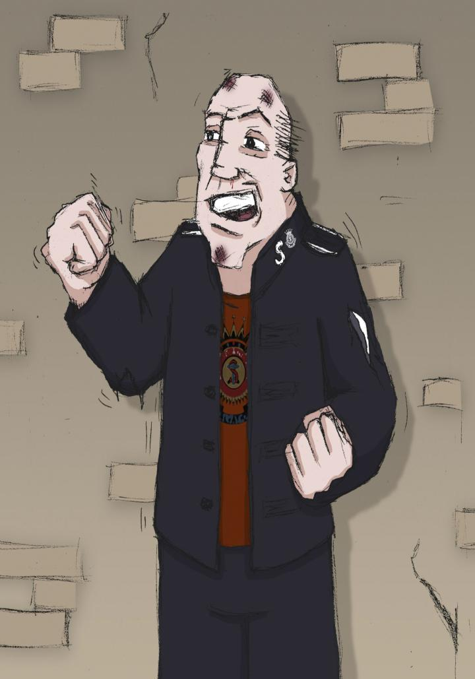
The captain roused
the stunned
Salvationists.
‘Never mind,
comrades,’ he
shouted, ‘they can’t
take our salvation.
Sing up! Sing up!’
And so they did.

Slide 23
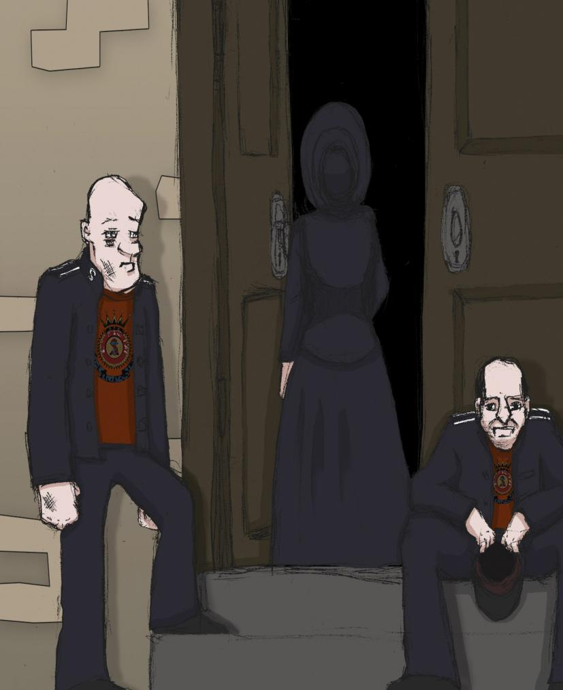
It was a saddened
group who
marched down the
hill back to their
hall.
‘The flag’s gone!’
was the cry as
they climbed the
steps to the hall for
their meeting.

Slide 24
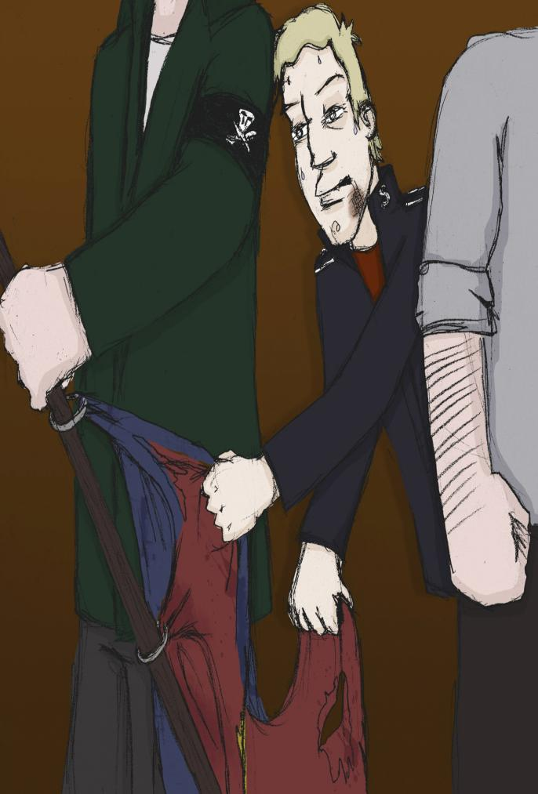
But it hadn’t.
Sensing that the
‘Skeletons’ would
make an attempt to
seize the dear old
flag, Frankie had
pushed his way
amidst the body of
attackers.

Slide 25
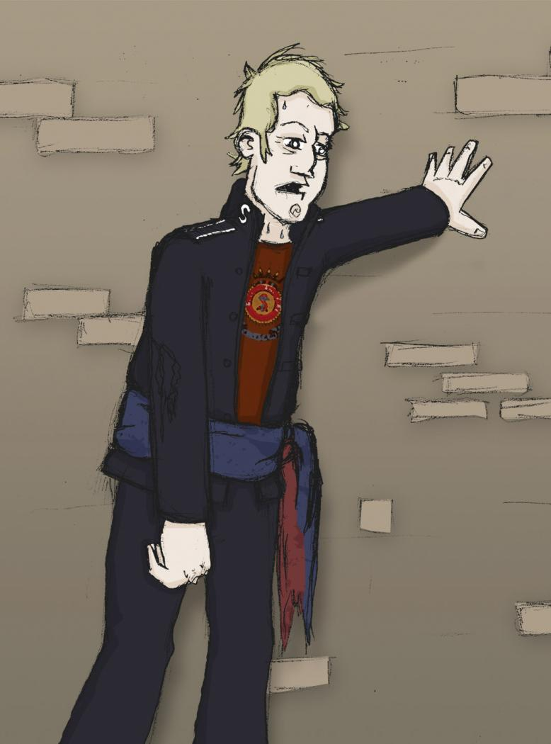
In the gloom the
‘Skeletons’ had not
recognised him and
assumed he was one of
them. Frankie had
slipped the flag off its
pole. He had torn it a bit
more in doing so but,
rolling it into a scarf, he
had wrapped it around
his waist and trailed
along in the wake of the
procession. Too wheezy
to sing or keep up with
the crowd, Frankie had
come along to the hall
down a side path.

Slide 26
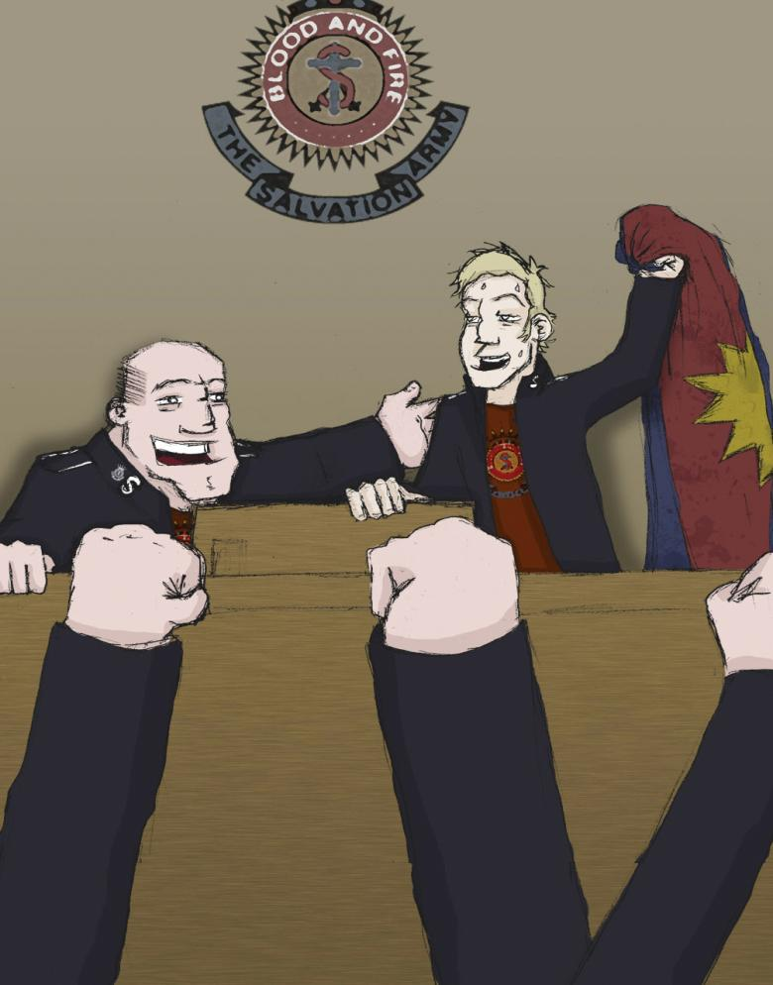
As the gloomy soldiers
filed into the hall,
Frankie appeared,
panting and
exhausted, waving the
colours from the
platform. How those
soldiers shouted, and
how the drummer
thumped and the
trumpets blared! And
how the captain
grinned to see his
dedicated soldier
fighting for the flag.

Slide 27
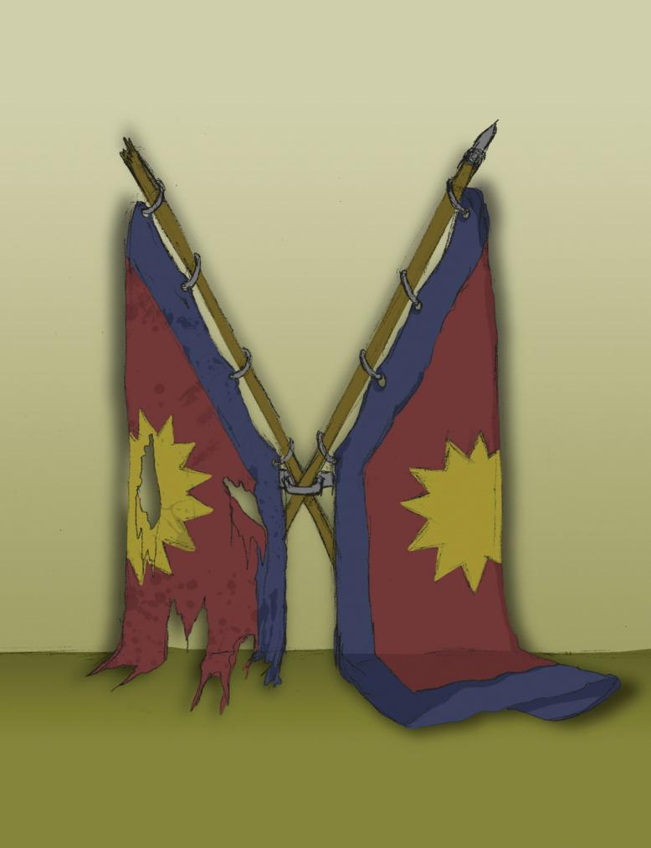
Soon after, a new flag
was presented to the
corps. A ceremony was
performed and the flag
displayed proudly on the
platform. But the new flag
did not inspire the
affection of those
Salvationists as did the
first, old, torn, faded, filth-
marked flag. It hung by
the side of the platform
for years, a relic of those
glorious days.

