Slide 1
HOMELESSNESS
AND THE SALVATION ARMY

Slide 2
What is The Salvation Army?

Slide 4
hole
HOMELESSNESS
AND THE SALVATION ARMY

Slide 5
THERE’S A HOLE IN MY LIFE
HOMELESSNESS
AND THE SALVATION ARMY

Slide 6
Bad relationships
Harmful addictions
Dangerous situation at home
Losing a job
Running out of money
HOMELESSNESS
AND THE SALVATION ARMY

Slide 7
HOMELESSNESS
AND THE SALVATION ARMY

Slide 8
What does it feel like to be homeless?
Cold
Cold
Sad
Worthless
Not a real person
Angry
Ashamed or guilty
Afraid
Lonely
HOMELESSNESS
AND THE SALVATION ARMY

Slide 9
HOMELESSNESS
AND THE SALVATION ARMY

Slide 10
HOMELESSNESS
AND THE SALVATION ARMY

Slide 11
HOMELESSNESS
AND THE SALVATION ARMY

Slide 12
HOMELESSNESS
AND THE SALVATION ARMY

Slide 13
HOMELESSNESS
AND THE SALVATION ARMY

Slide 14
HOMELESSNESS
AND THE SALVATION ARMY

Slide 15
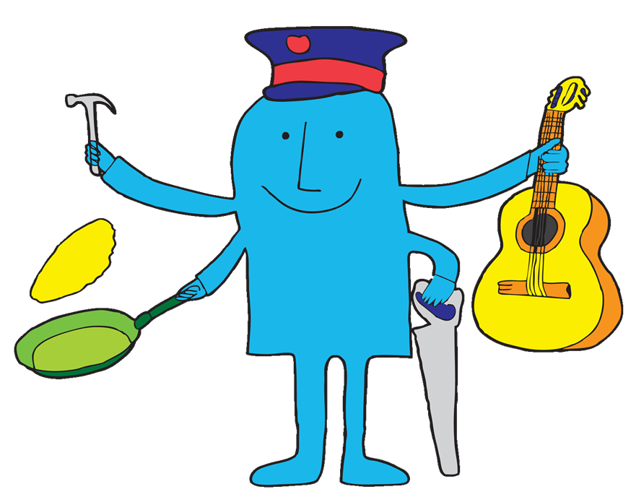
HOMELESSNESS
AND THE SALVATION ARMY

Slide 16
HOMELESSNESS
AND THE SALVATION ARMY

Slide 17
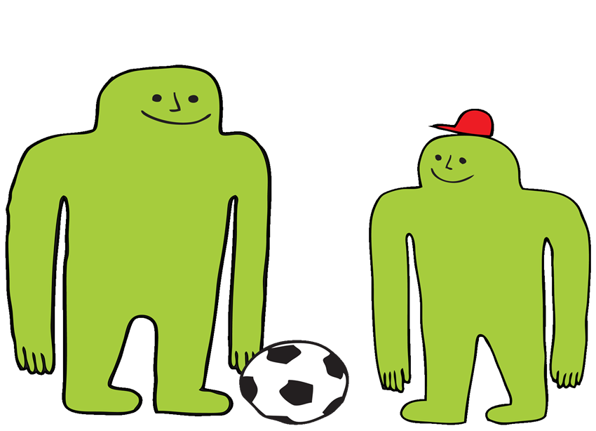
HOMELESSNESS
AND THE SALVATION ARMY

Slide 18
HOMELESSNESS
AND THE SALVATION ARMY

Slide 19
HOMELESSNESS
AND THE SALVATION ARMY

Slide 20
Salvation Army Lifehouses are all about purpose and relationships...and fun!
HOMELESSNESS
AND THE SALVATION ARMY

Slide 21
I’VE LOST THE HOLE NOW I’M WHOLE
HOMELESSNESS
AND THE SALVATION ARMY

Slide 22
www.salvationarmy.org.uk/homelessness
THE SALVATION ARMY IS A CHARITY AND A PART OF THE CHRISTIAN CHURCH

