Slide 1

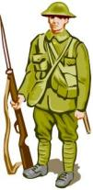

What do you know about…
The First World War?
Schools and
Colleges
Unit

Slide 2

What do you know about…
The Salvation Army?

Slide 3
Guess the Bible phrase
L
o
v
e
y
o
u
r
n
g
u
r
e
i
h
b
o
Who is your neighbour?
How do you show them love?

Slide 4
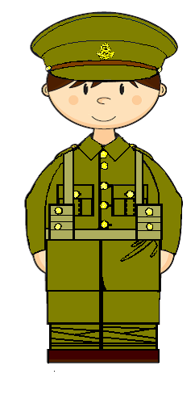
To know some of the ways that people were supported during the First World War.
To compare the aid given in the UK and in Germany.
To reflect on how you can show love to your neighbour during war time.
Lesson Objectives

Slide 5
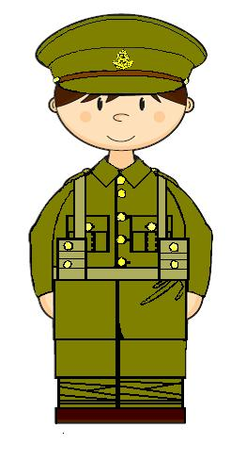
Private Tom Barker

Slide 6
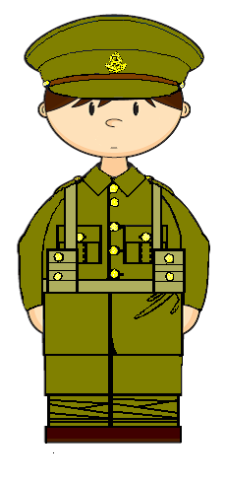
How will the boy come home?
lost a leg?
nightmares?
lost his eyesight?
nervous?
badly scarred
needs everything to be quiet?
bullet wound
needs to be alone?
no longer laughs or sings
hardly talks

Slide 7
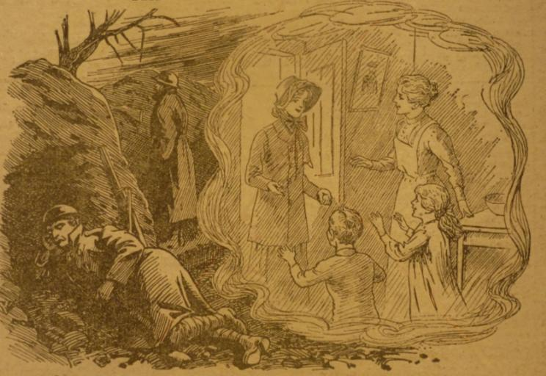
Home visits

Slide 8
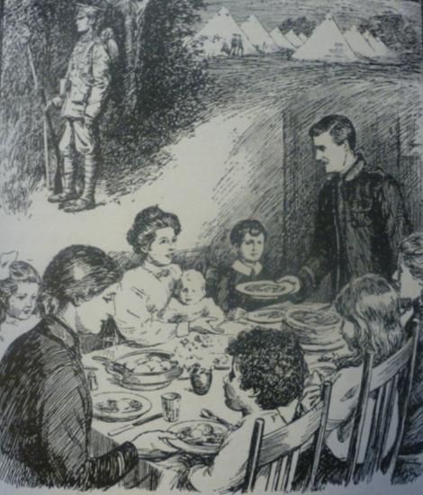
Will your Missus look after my issus?

Slide 9
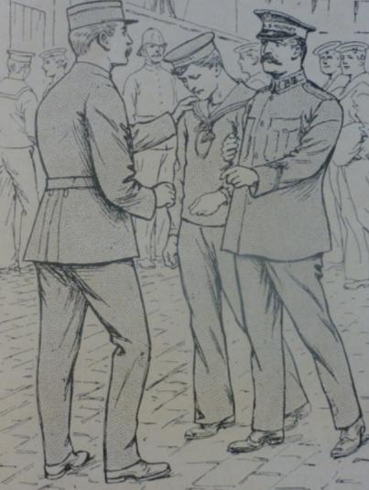
Train station patrols

Slide 10
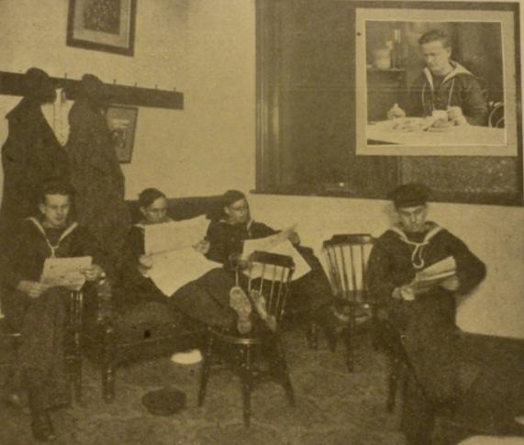
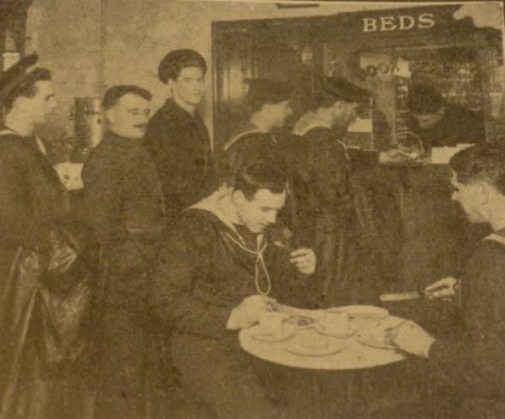
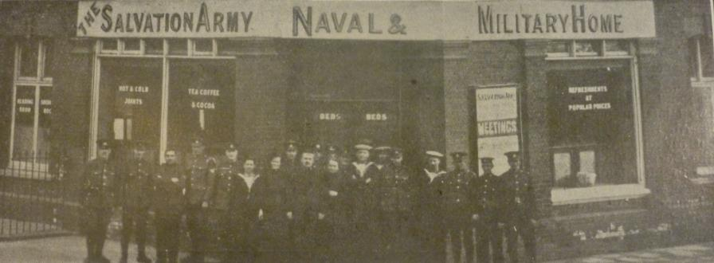
Homes

Slide 11
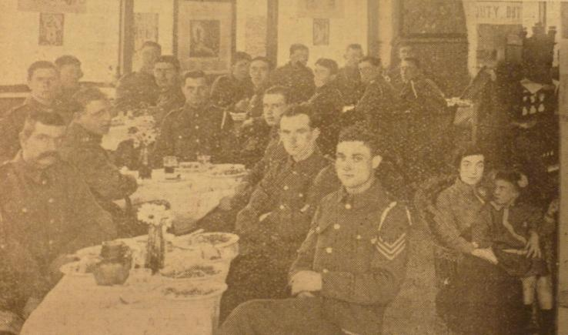
Families welcomed

Slide 12
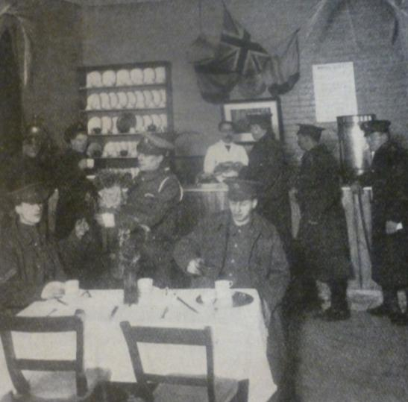
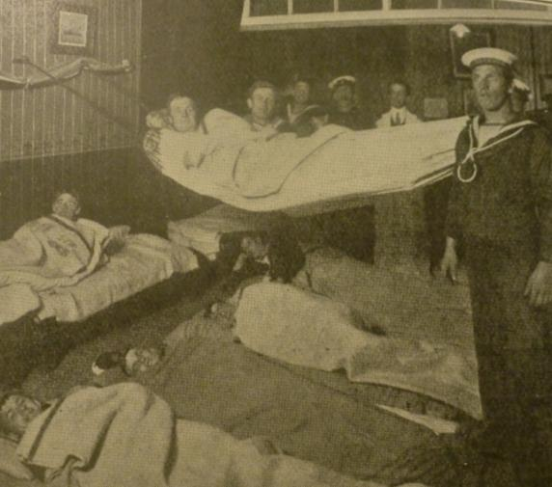
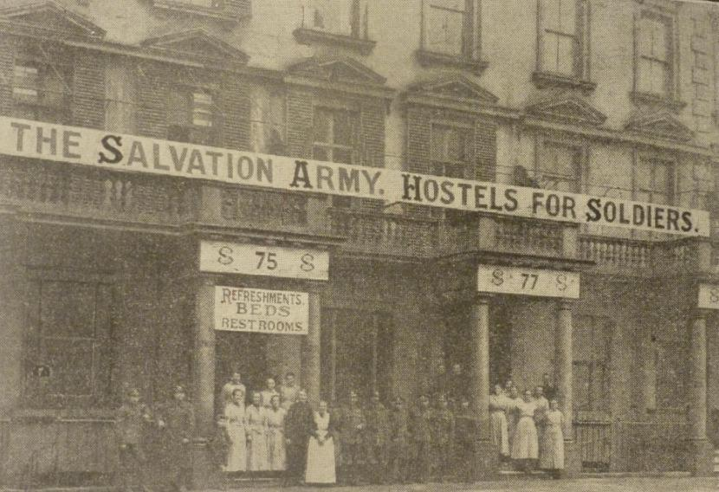
Hostels

Slide 13

Last Will
and
Testament
of
Will writing service

Slide 14
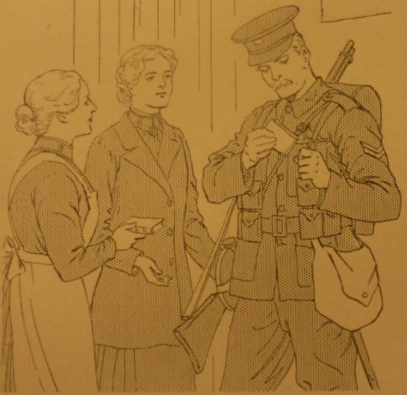
Books for service men

Slide 15
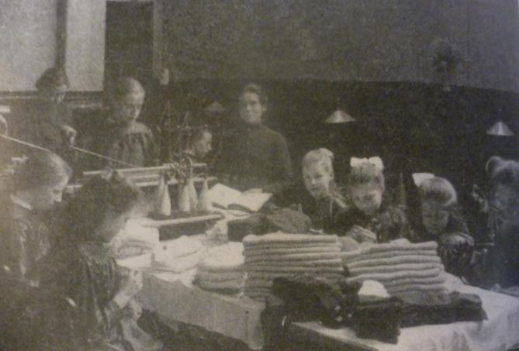
Clothes for servicemen

Slide 16
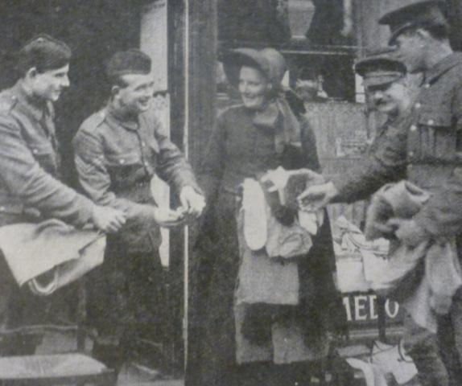
Parcels for soldiers

Slide 17
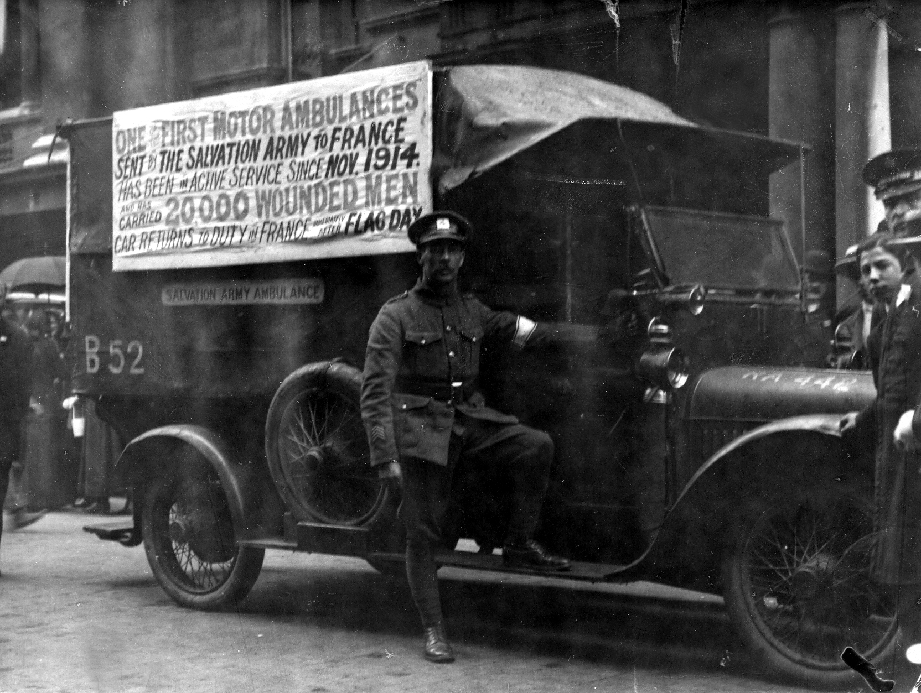
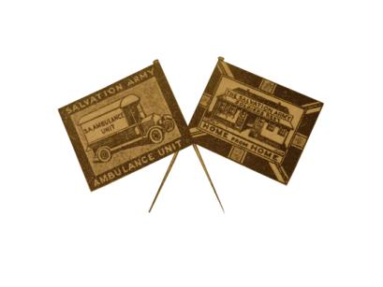
Fundraising

Slide 18
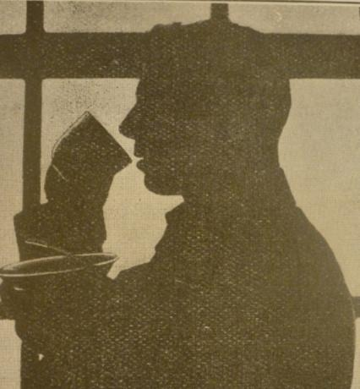
Canteens for munitions workers

Slide 19
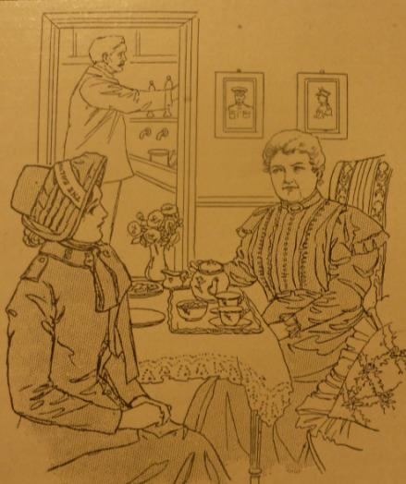
Missing soldiers

Slide 20
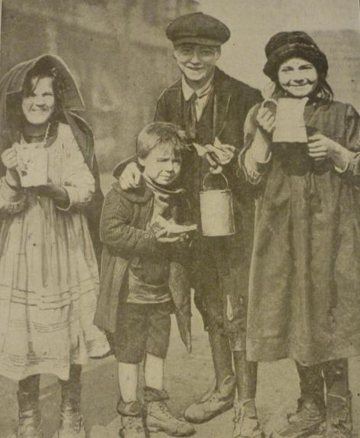
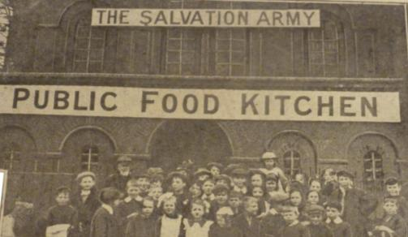
Public Kitchens

Slide 21
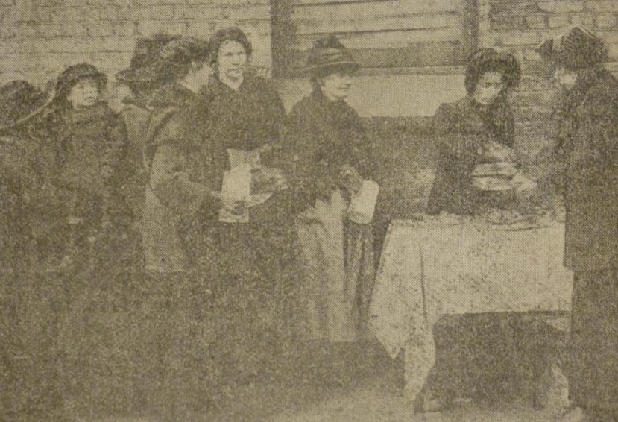
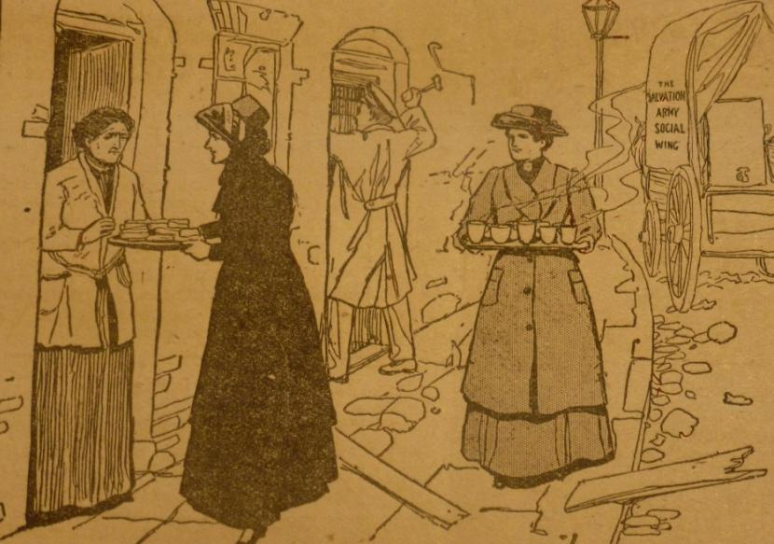
Emergency Response

Slide 22
Sort the cards by choosing one criteria from this list.
Which aid…
Supports soldiers and sailors
Needs a lot of time
Needs money
Can be done by anyone
Challenge
Which do you think is the most important? Or the most urgent?

Slide 23
Why do you think The Salvation Army tried to help people and soldiers?
Love your neighbour.

Slide 24
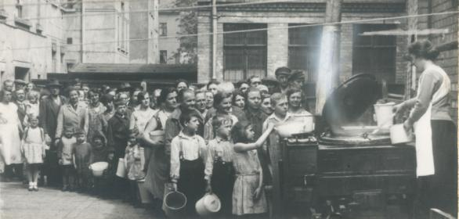
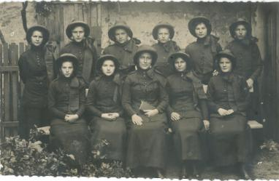
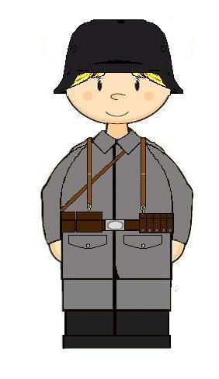
Germany

Slide 25
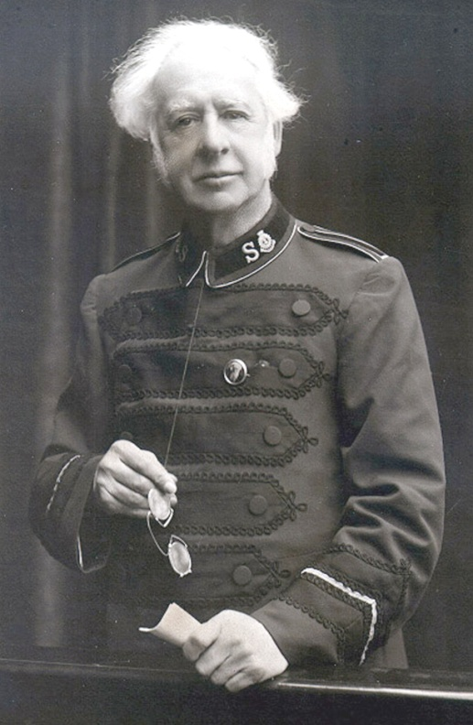
Love your neighbour?

Slide 26
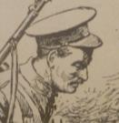
‘I know I must love my enemies but I do not see how I can quite do this, it is very difficult.
The world seems so full of hate.’

Slide 27
Love your neighbour?
What happened?
What do you think happened next?

Slide 28
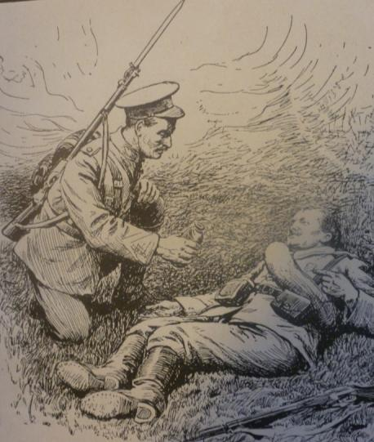
Love your neighbour?

Slide 29
To know some of the ways that people were supported during the First World War.
To compare the aid given in the UK and in Germany.
To reflect on how you can show love to your neighbour during war time.
Lesson Objectives
Can you do the thirty second challenge??

Slide 30
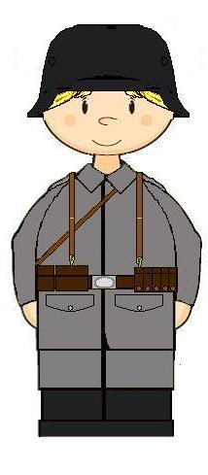
Schools and
Colleges
Unit

