Slide 1

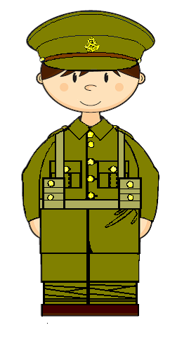
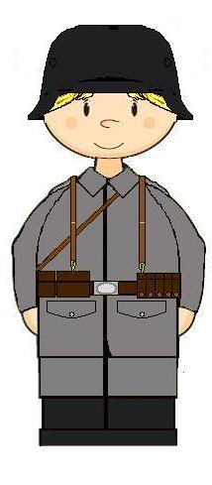
Love your neighbour

Slide 2







hungry
food
thirsty
drink
stranger
welcome

Slide 3
I was hungry and you gave me food
I was thirsty and you gave me drink
I was a stranger and you welcomed me

Slide 4
To recognise the challenges soldiers faced with their behaviour
To know some of the activities that happened in a Salvation Army hut
To reflect on why The Salvation Army tried to help soldiers
Lesson Objectives

Slide 5





How would you rate your behaviour??

Slide 6
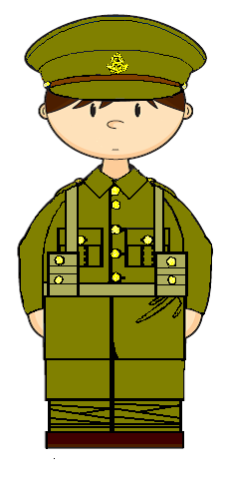
How will the boy come home?
lost a leg
nightmares
lost his eyesight
nervous
badly scarred
needs everything to be quiet
bullet wound
needs to be alone
no longer laughs or sings
hardly talks

Slide 7

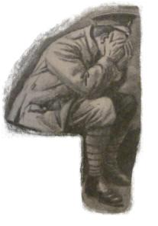
Are you coming back with good thoughts or with bad thoughts?

Slide 8
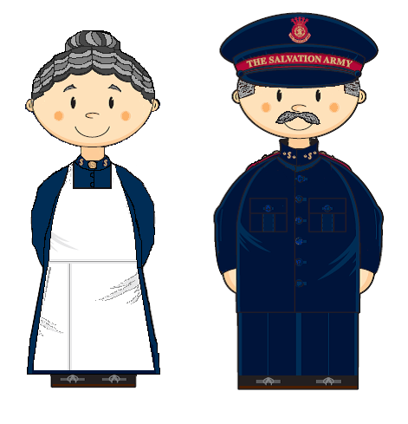
Salvation Army Huts

Slide 9



‘Pack up your Troubles’
http://www.youtube.com/watch?v=kXcs1Vv3YlE
‘Rock of Ages’
http://www.youtube.com/watch?v=gM7gt_cSxjw

Slide 10
Character card
You are……………
You will be …………………
Things to do…………………
Things you might say …………………

Slide 11
How did the huts try to help soldiers?
What do you think it might have been like for soldiers if there weren’t any huts?
Why do you think The Salvation Army tried to help the soldiers?
What do you think was the most important activity in the hut?

Slide 12
To recognise the challenges soldiers faced with their behaviour
To know some of the activities that happened in a Salvation Army hut
To reflect on why The Salvation Army tried to help soldiers
Lesson Objectives

Slide 13
Hut Chant
Then give them a cup of tea…

Slide 14
