Slide 1
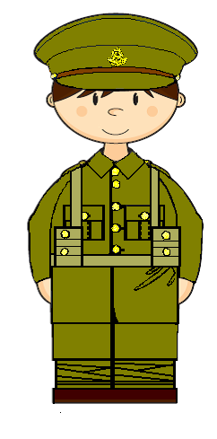
By the end of this lesson…

Slide 2
Love your neighbour
I was hungry and you gave me food
I was thirsty and you gave me drink
I was a stranger and you welcomed me

Slide 3
your neighbour
Love
I was hungry and you gave me food
action
I was thirsty and you gave me drink
I was a stranger and you welcomed me

Slide 4
Let us not love in word or speech,
Love
action
but in and in truth

Slide 5
To learn about the war work of men and women
To examine evidence and draw conclusions about war work
To reflect on the actions taken by The Salvation Army
Lesson Objectives

Slide 6
I had left the girls at the camp a few days ago and dropped by to see how they were settling in. When I arrived I was met by the colonel of the camp first. He was incensed with me. He kept shouting at me, ‘I had no business bringing those girls.’
It was a right proper dress-down and he was very rude. I have to admit I left as soon as I could, and avoided the place over the next few days.
Why was the colonel so angry?
Why did he not want women working so close to the front line?
What do you think?

Slide 7
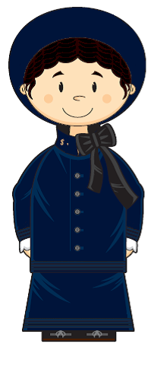
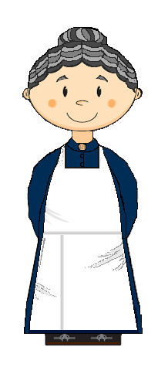

Slide 9
Feedback

Slide 10
What if…

Slide 11
I eventually headed back to the camp. I could not believe my bad luck as I saw the same colonel rushed up to me. I steeled myself, but, he seemed happier.
‘Where have you been? Hiding from me?’ he asked.
‘Can you blame me for not wanting to be shouted at again?’ I replied.
‘Ah yes,’ he said with a little smile. ‘You still had no business bringing them.’
‘But didn’t they do fine?’
‘Oh yes. Very fine, very fine indeed. But, Major, what if we lost them?’
I replied with, ‘My girls are soldiers.’
Why did the colonel still did not want the girls there?
What effect might they have had at the camp?

Slide 12
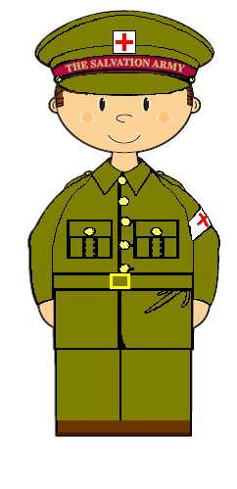

Slide 15
Feedback

Slide 17
What if…

Slide 18
To learn about the war work of men and women
To examine evidence and draw conclusions about war work
To reflect on the actions taken by The Salvation Army
Lesson Objectives

Slide 19
three
Tell me

Slide 20
By the end of this lesson…

