Slide 1
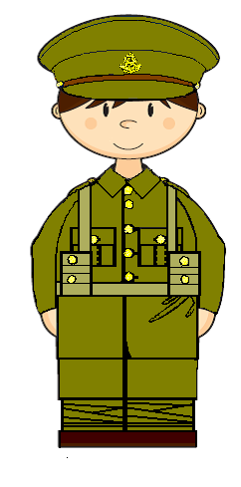
Heart
taerh
ot
to
ogd
God
ndha
to
hand
ot
anm
man
Which do you think is the most important? Or the most urgent?

Slide 2
To learn about how chaplains supported soldiers.
To reflect on the different ways soldiers were supported during the war by The Salvation Army.
To consider ways pupils would like to further develop the themes of this unit.
Lesson Objectives

Slide 3
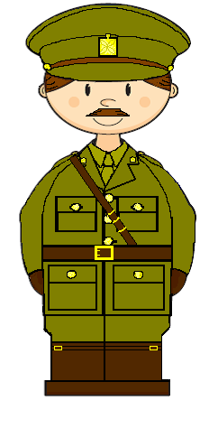

Slide 4
What is
a chaplain?
Challenge
Create a mini drama

Slide 5
What do you think it might haven like if there were no chaplains?
How did the chaplains try to help soldiers?
Why do you think the chaplains tried to help the soldiers?
What do you think was the most important duty of a chaplain?

Slide 6
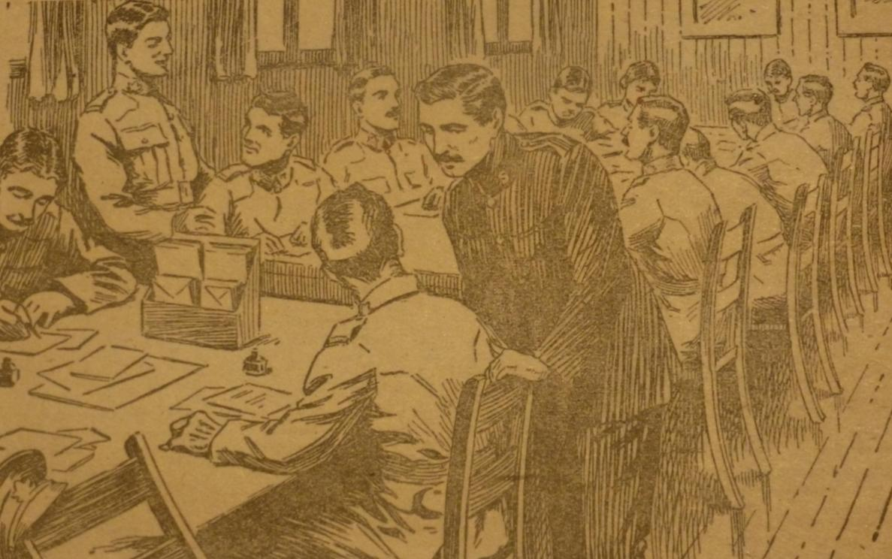

Slide 7
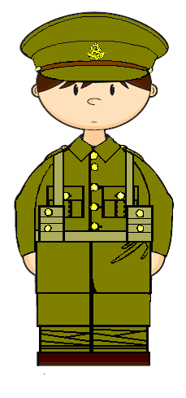
How will the boy come home?
lost a leg
nightmares
lost his eyesight
nervous
badly scarred
needs everything to be quiet
bullet wound
needs to be alone
no longer laughs or sings
hardly talks

Slide 8
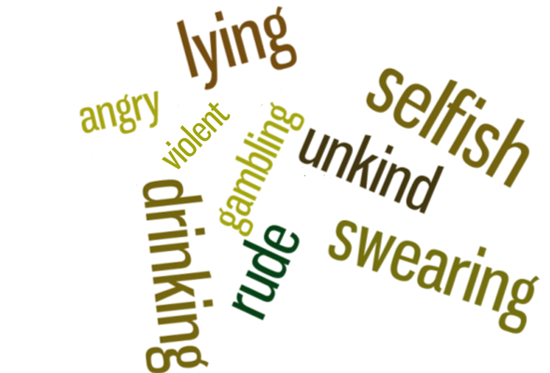
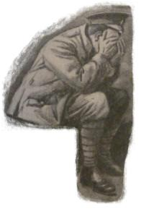

Slide 9
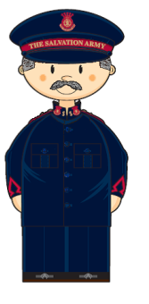
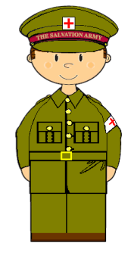
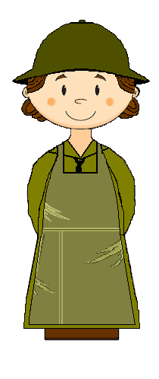
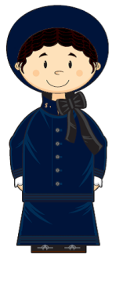
Ambulances
Huts
Band
UK Aid
Chaplains
Graves
Field
Kitchens
Hospital
Visiting

Slide 10
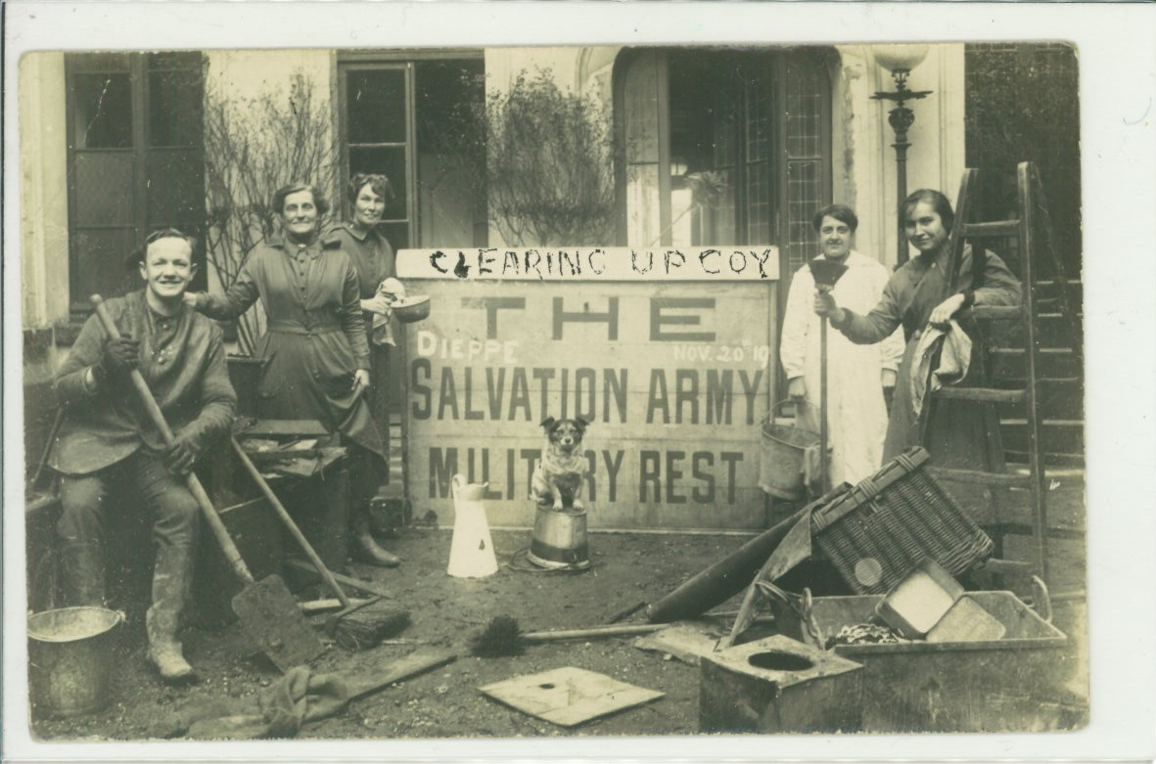
What next… for The Salvation Army?
Dieppe 1919

Slide 11
What next… for you?
?
Research
Create
Personal challenge

Slide 12
To learn about how chaplains supported soldiers.
To reflect on the different ways soldiers were supported during the war by The Salvation Army.
To consider ways pupils would like to further develop the themes of this unit.
Lesson Objectives

Slide 13
5 sentences
5 words
1 word

Slide 14
