Slide 1
Welcome!
Have you ever had someone make a promise and break it?
How did it make you feel?
Schools and
Colleges
Unit

Slide 2
A promise is…

Slide 3
Living with promises
Lesson Objectives
To learn about Salvation Army ceremonies
To reflect on the promises that members of The Salvation Army make

Slide 4
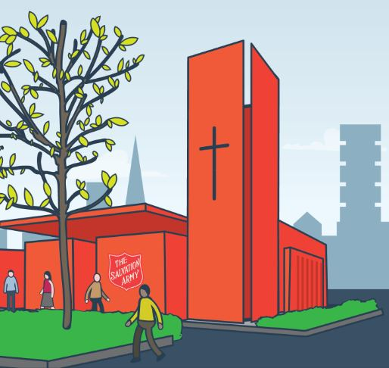
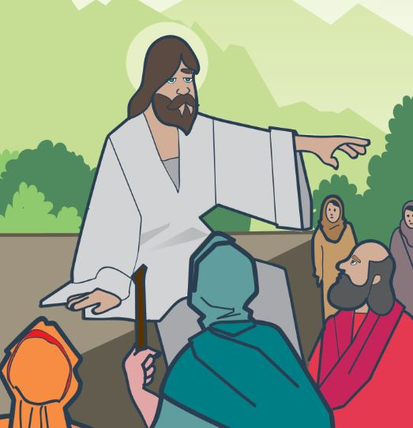
The Salvation Army

Slide 5
God’s Promises
love
safety
comfort
help
guidance
faithfulness

Slide 6
What promises might members of
The Salvation Army
make to God?

Slide 7
Promises
Be the best version of yourself
Love God
Love one another
Be an example for others

Slide 8
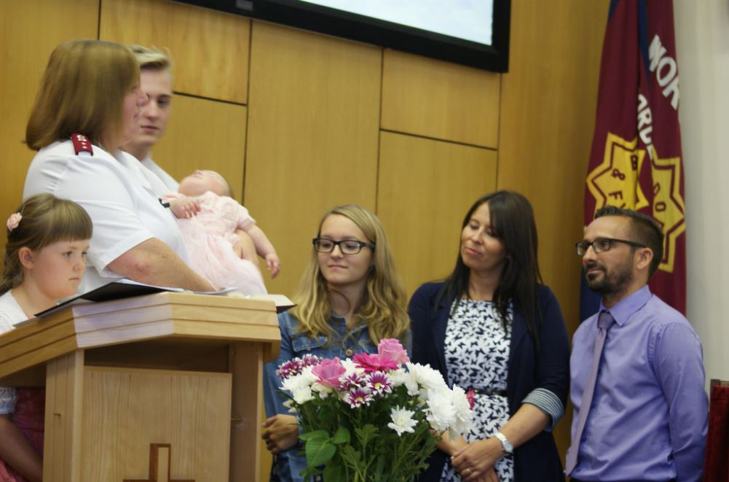
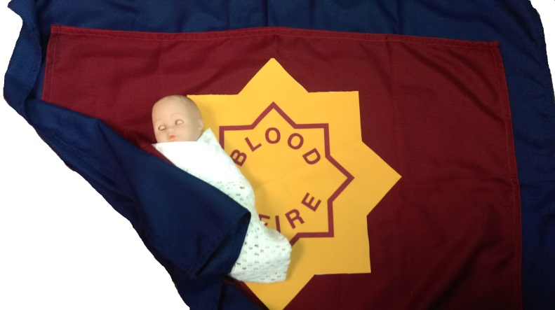
Dedication

Slide 9
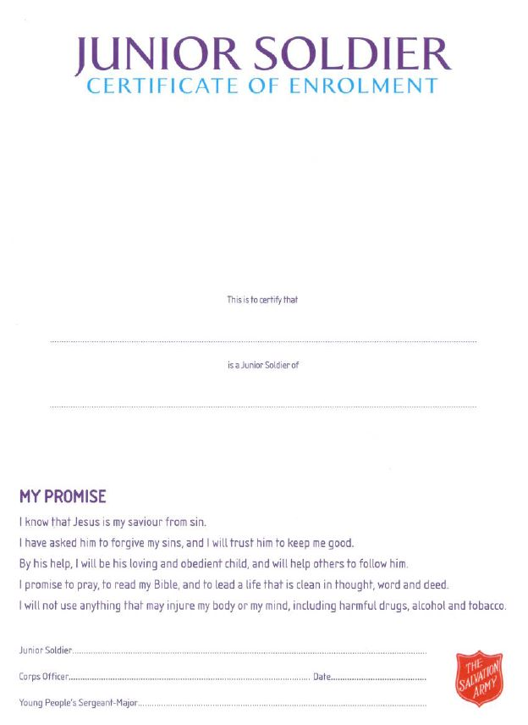
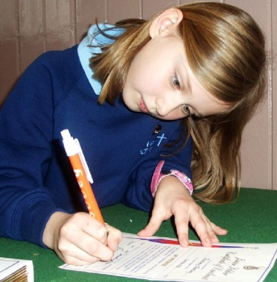
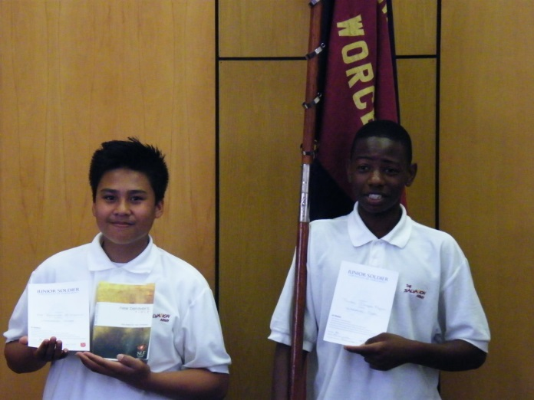
Junior Soldier
Schools and
Colleges
Unit

Slide 10
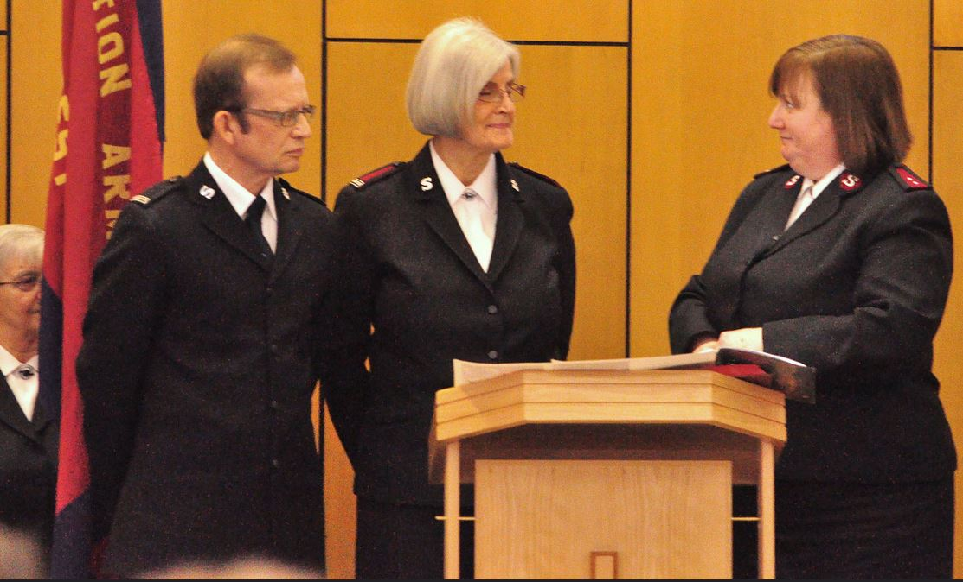
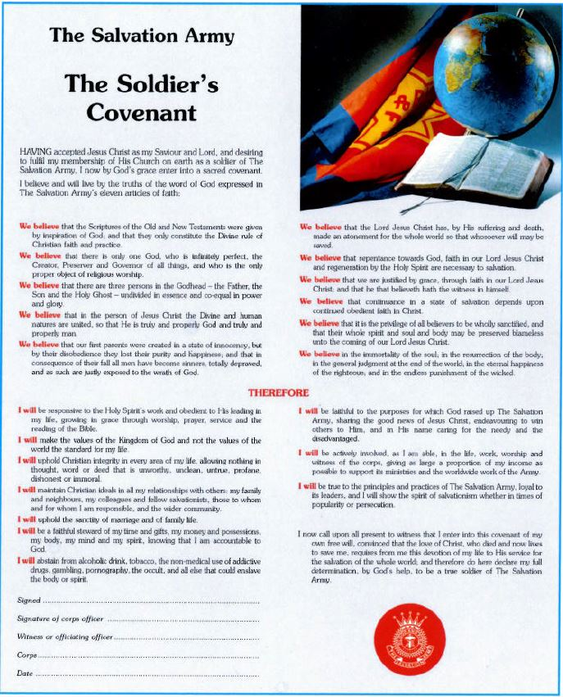
Soldier

Slide 11
Promises
Which one do you like the most?
Which one is the most important?

Slide 12
Promises
Choose one promise.
When might it be easier or harder to keep this promise?
Discuss with your partner.

Slide 13
Break a promise or keep a promise?

Slide 14
Living with promises
Lesson Objectives
To learn about Salvation Army ceremonies
To reflect on the promises that members of The Salvation Army make

Slide 15
Heart to God
Hand to man

Slide 16
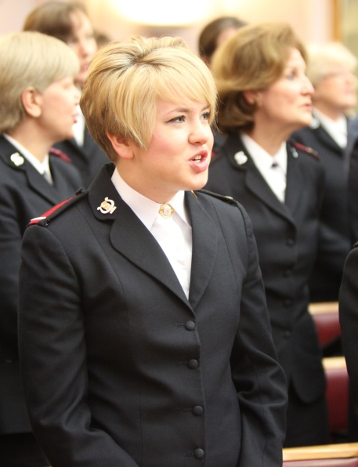
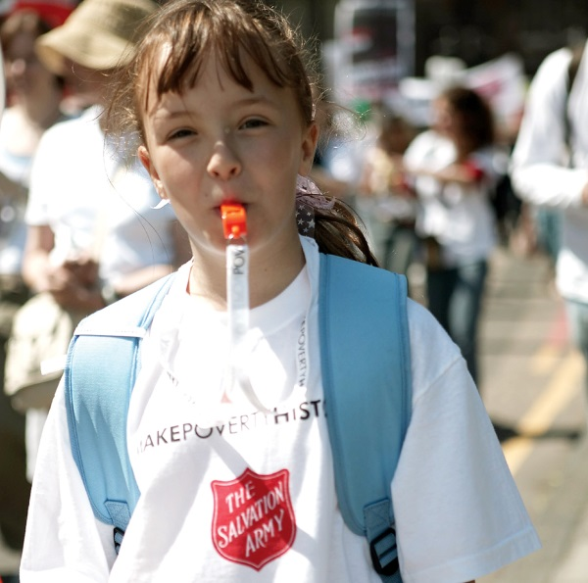
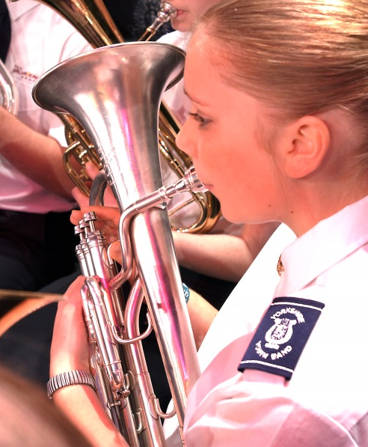
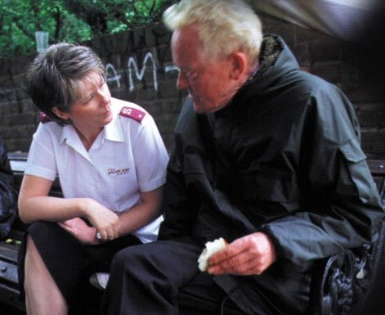
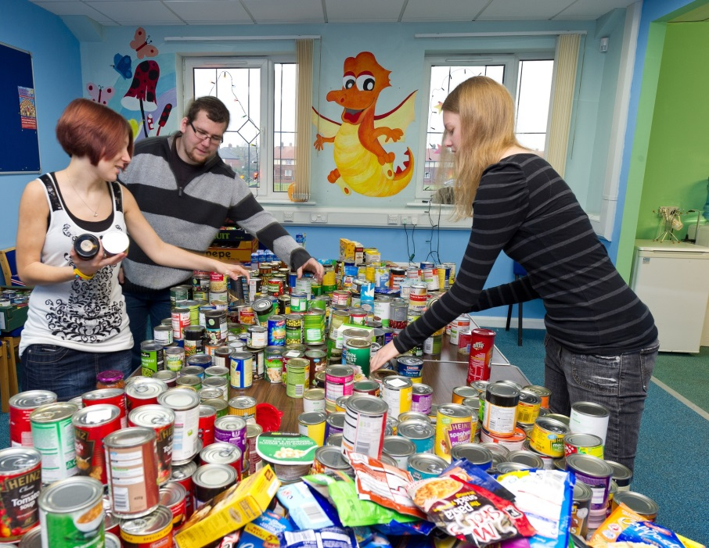
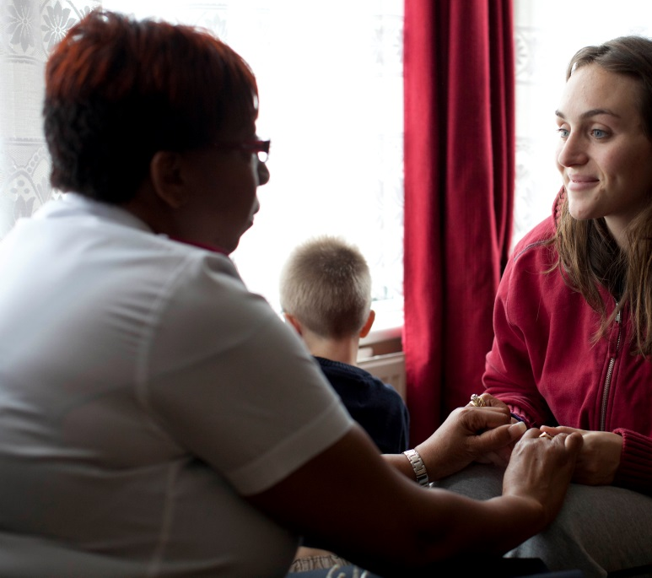
Faith in Action

Slide 17
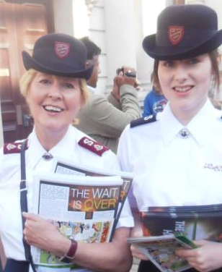
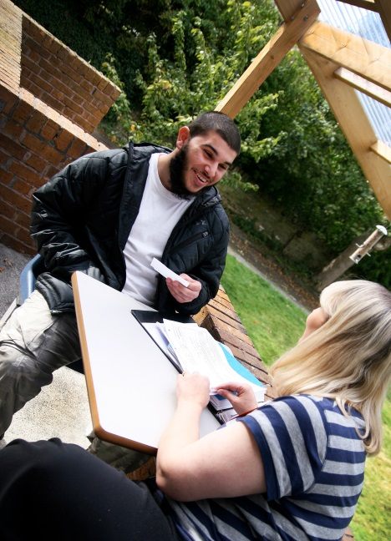
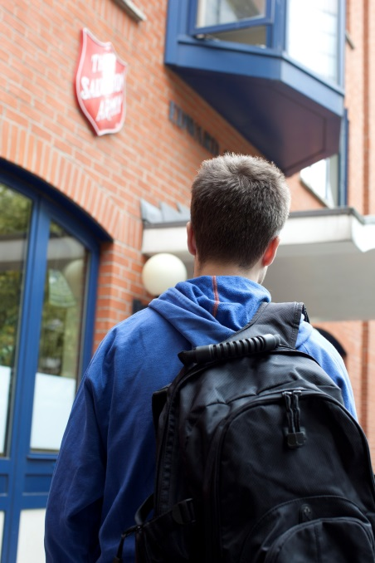
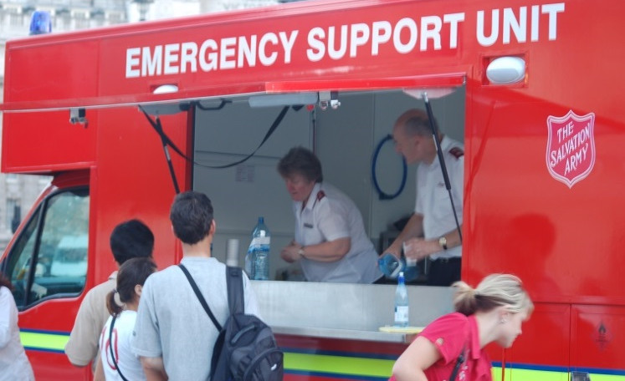
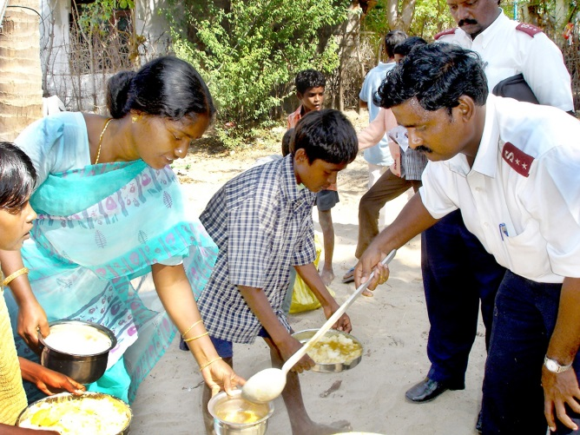
Faith in Action

Slide 18
Heart to God
Hand to man
Choose one promise card
No links? Not on the sheet!
Weaker links are
further away
Strong links are
closer
Select either Love God or Love one another.
Decide which Faith in Action cards show this promise.
Place the card close closer to the promise if there is a strong link.
Give reasons for your answers.

Slide 19
Why do Salvation Army members do these actions?
What do you think is the most important promise?

Slide 20
Living with promises
Lesson Objectives
To learn about Salvation Army ceremonies
To reflect on the promises that members of The Salvation Army make

Slide 21
Living with promises
Draw an image to represent your personal promise
Write a personal promise here
A promise from you to you
Schools and
Colleges
Unit

