Slide 1
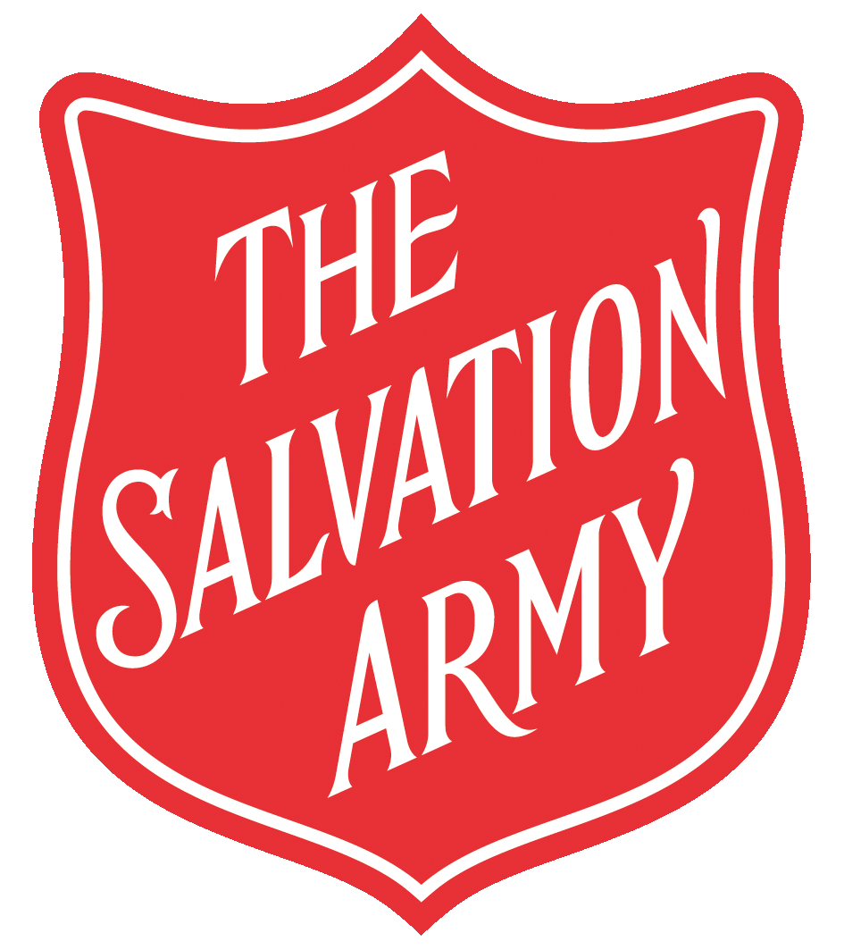

Slide 2


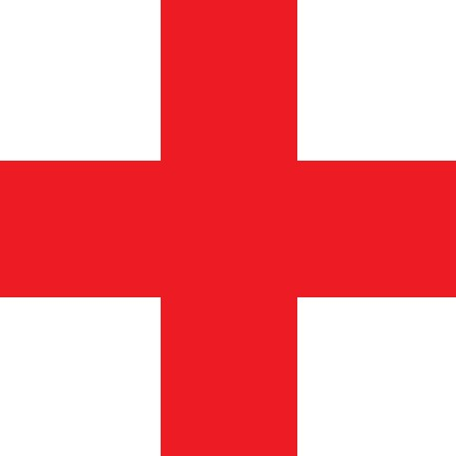




Slide 3
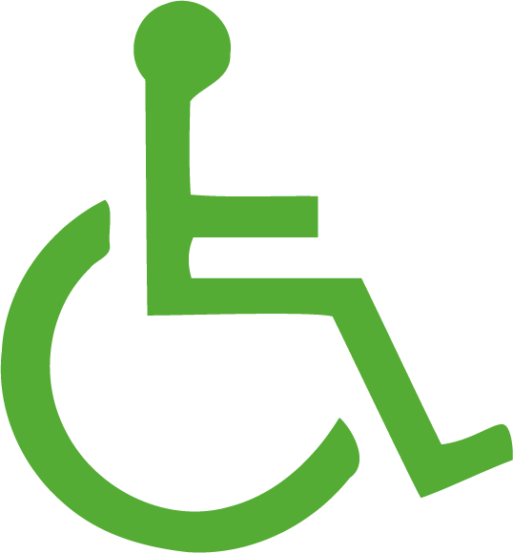



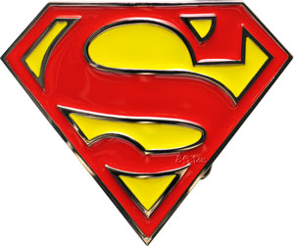
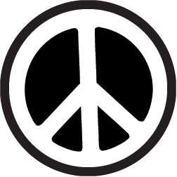

Slide 4
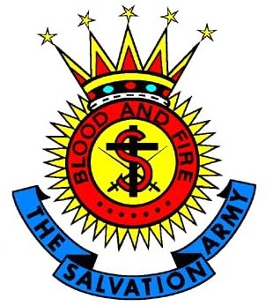

Slide 5
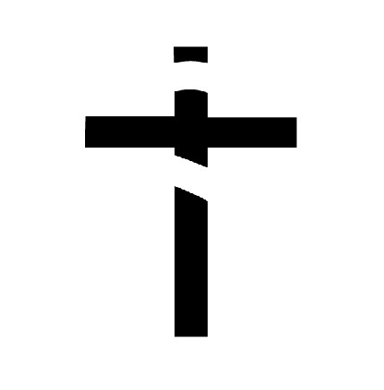
CROSS
Members of The Salvation Army believe that Jesus died on a cross to save people, and that he was brought back to life. This is their most important belief.

Slide 6

S
The ‘S’ stands for ‘Salvation’. Members want to offer salvation to others by telling people about God’s love and by loving and helping those in need.

Slide 7

SWORDS
The two swords represent fighting for God with words and actions.

Slide 8
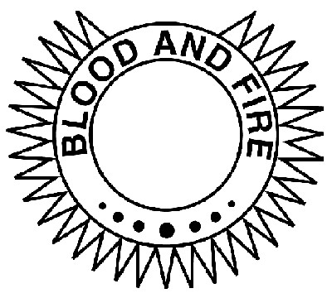
SUN
The sun is a symbol of light and fire, which represents God’s Spirit.
BLOOD & FIRE
A Salvation Army motto.

Slide 9
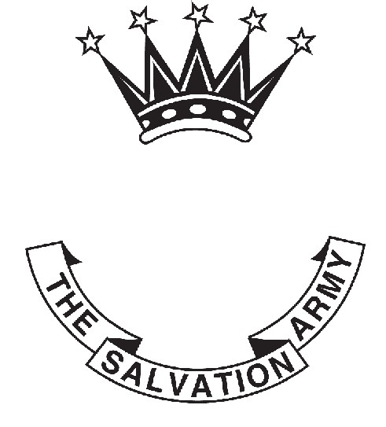
CROWN
The crown represents a reward from God which Christians will get in heaven.

Slide 10
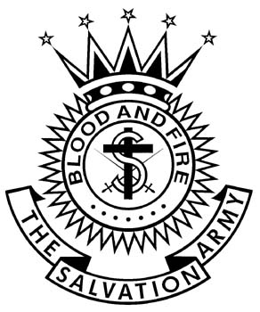

Slide 11
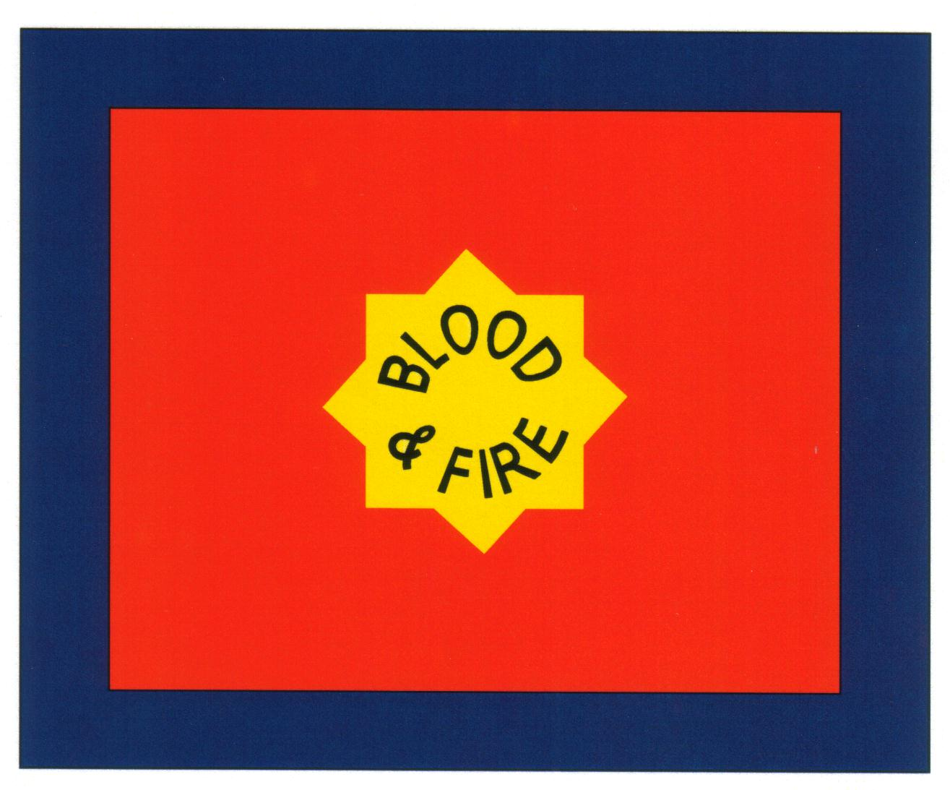

Slide 12
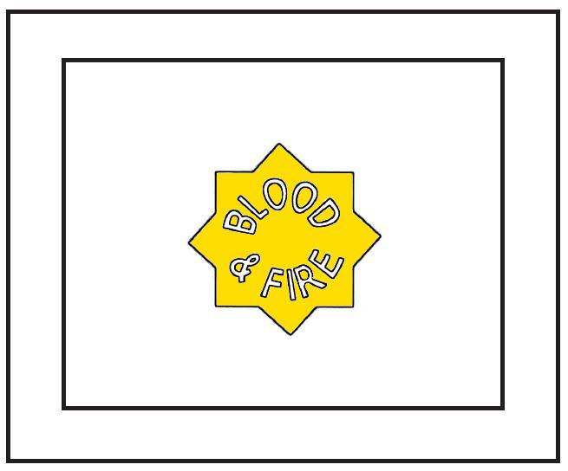
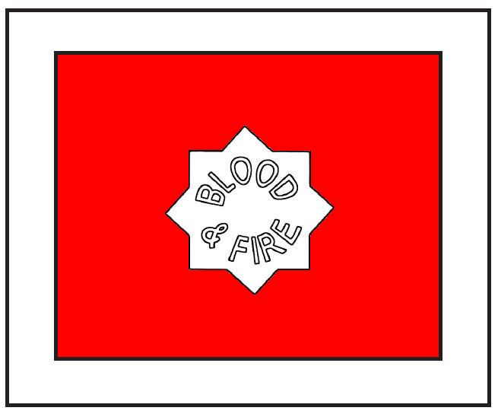
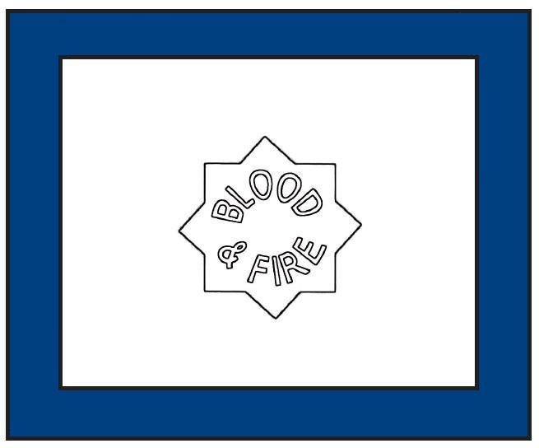
BLUE represents the purity of God.
RED stands for the blood of Jesus who died to save people.
YELLOW symbolises the light and fire of God’s Holy Spirit.

Slide 13
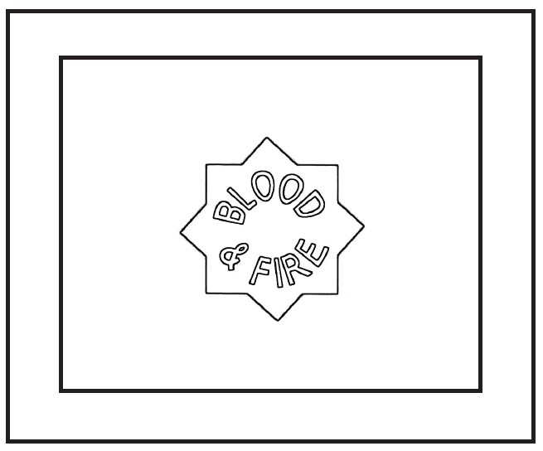

Slide 14
The shield symbolises the belief that God protects and saves people.

Slide 15
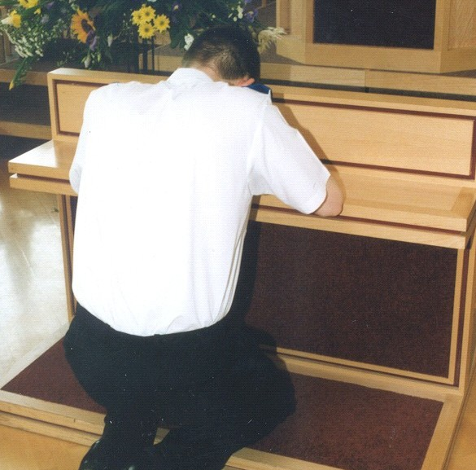
The mercy seat symbolises a place where people can meet with and talk to God in a special way.
It is found at the front of most Salvation Army churches.

Slide 16

The Salvation Army salute is a symbol which members sometimes use to greet each other, especially when they meet members from different countries. It shows they belong to the same church and have the same faith in God.

