Slide 1


What do you know
about a person
by looking
at a photograph?
Look for clues!
Schools and
Colleges
Unit

Slide 2
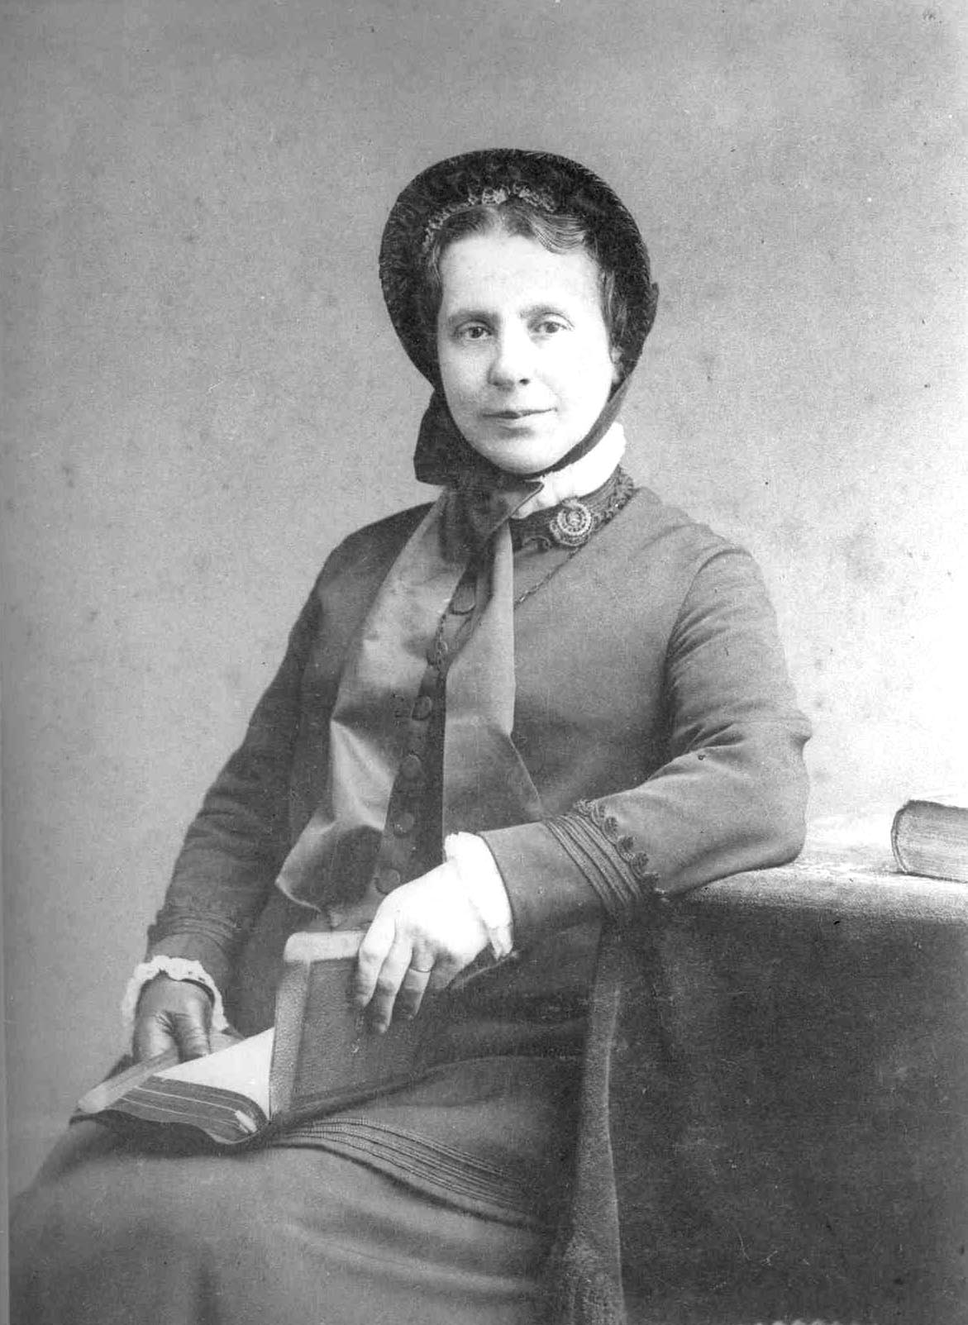
What did you find out?

Slide 3
Meet Catherine Booth
woman
special brooch
Victorian
married
reads books

Slide 4



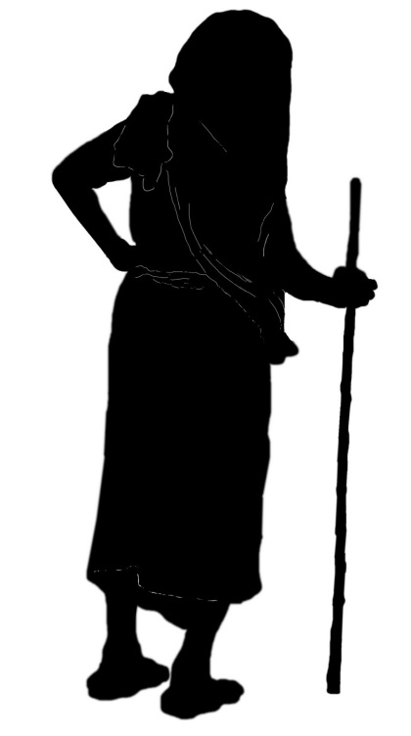
Find the Victorian!

Slide 5
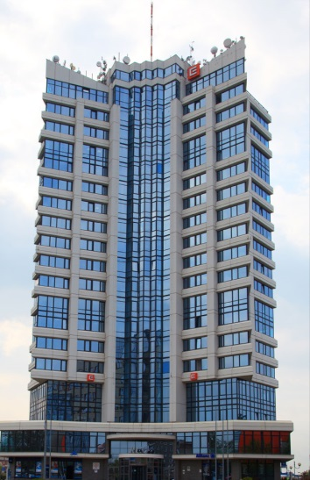
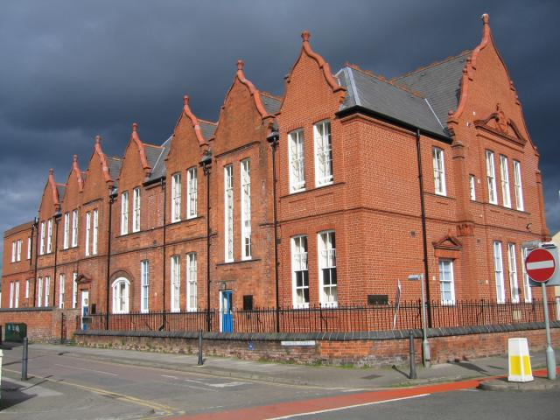
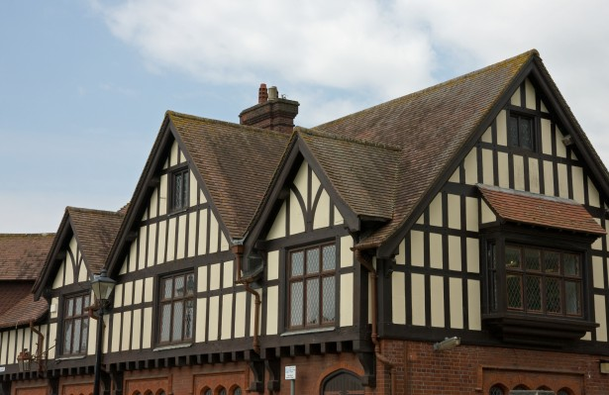
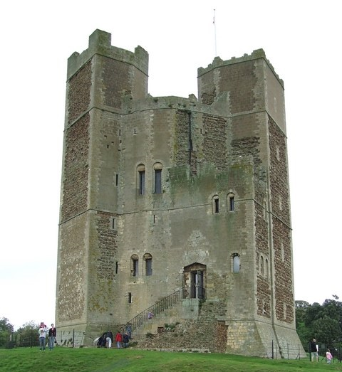
Find the Victorian!

Slide 6
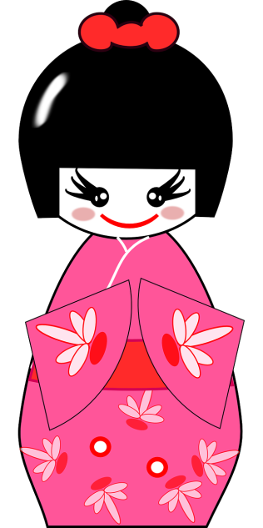
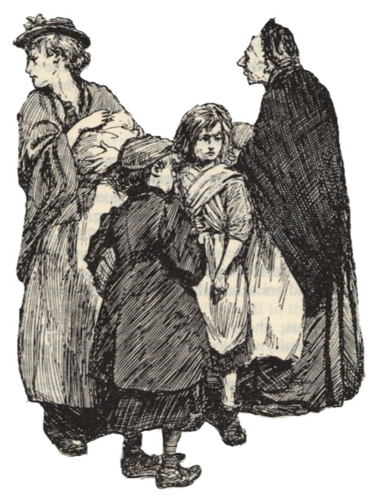
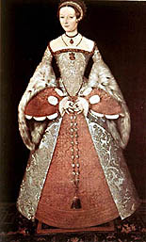
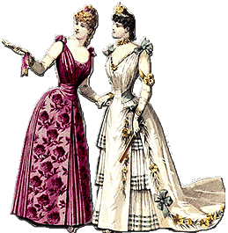
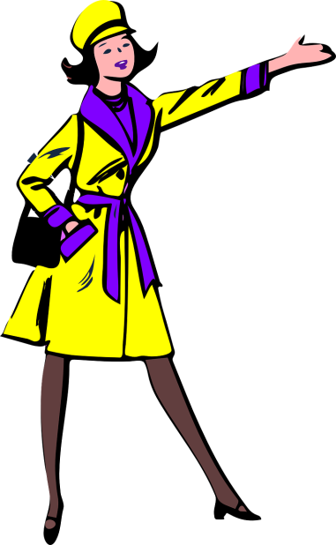
Find the Victorian!

Slide 7


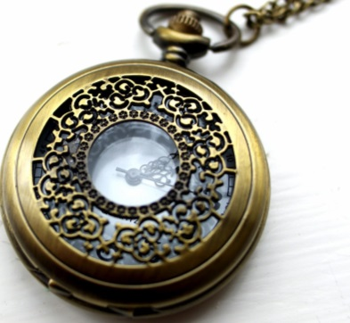


Find the Victorian!

Slide 8
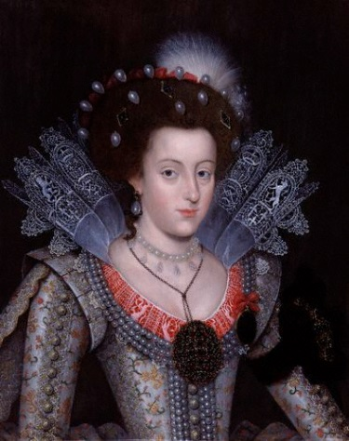
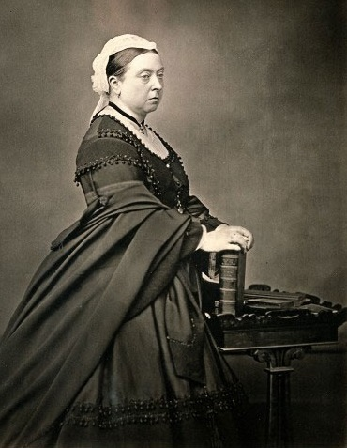
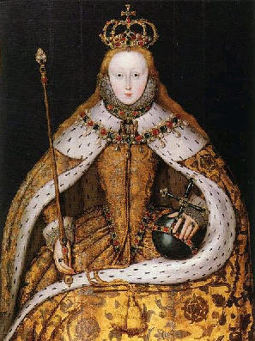
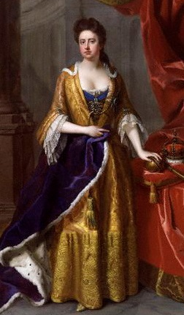
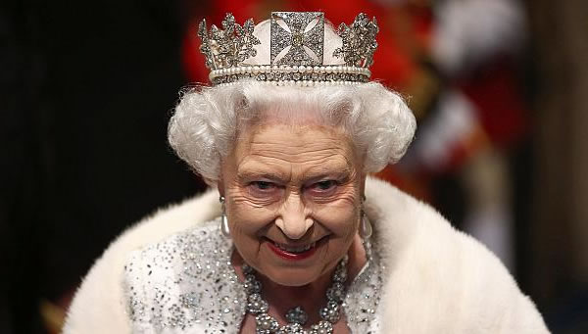
Find the Victorian!

Slide 9






Find the Victorian!

Slide 10

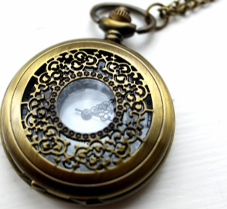
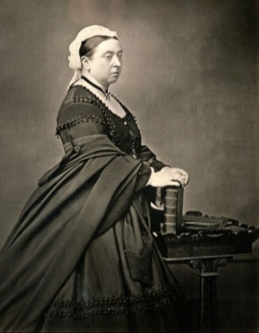



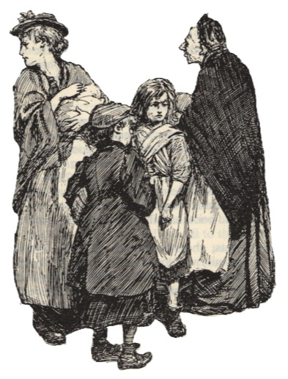
How well did you do?

Slide 11
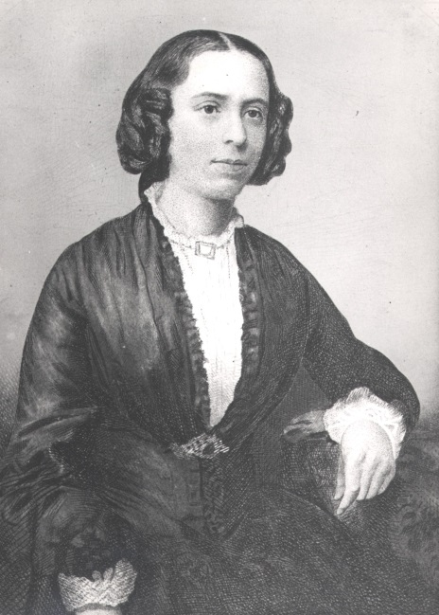
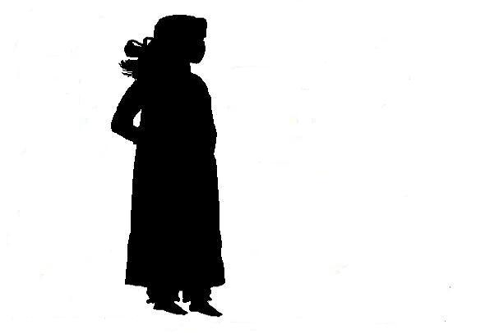
Learning Objectives
To learn about Catherine Booth’s life
To describe Catherine’s character based on her actions
To reflect on the reasons behind Catherine’s actions

Slide 12
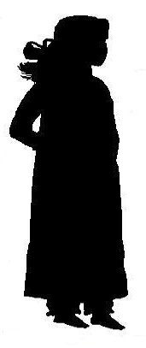
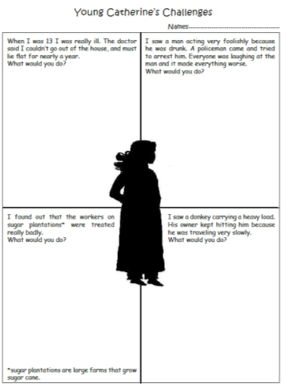
Young Catherine’s
Challenges
What you would do?
Discuss with a partner.
Record your ideas on the sheet

Slide 13


When I was 13 my back hurt a lot. The doctor said I couldn’t go out of the house, and must lie on my front, for nearly a year.
I left school and stayed in bed. I used the time to study and read. When I went back to school I was ahead of my class.
I saw a man acting very foolishly because he was drunk. A policeman came and tried to arrest him. Everyone was laughing at the man and it made everything worse.
I ignored everyone. I went up to the man and said I would be his friend, and I helped him walk to the police station.

Slide 14


I found out that the workers on sugar plantations were treated really badly.
I stopped eating anything with sugar in it. I persuaded lots of other people to protest too, and they also stopped eating sugar.
I saw a donkey carrying a heavy load. His owner kept hitting him because he was travelling very slowly.
I explained to the man that hitting the donkey was the wrong thing to do. The donkey was carrying too much. I helped him understand how to treat animals fairly.

Slide 15

How would you describe young Catherine’s character, based on her actions?

Slide 16


Learning Objectives
To learn about Catherine Booth’s life
To describe Catherine’s character based on her actions
To reflect on the reasons behind Catherine’s actions
Review progress

Slide 17
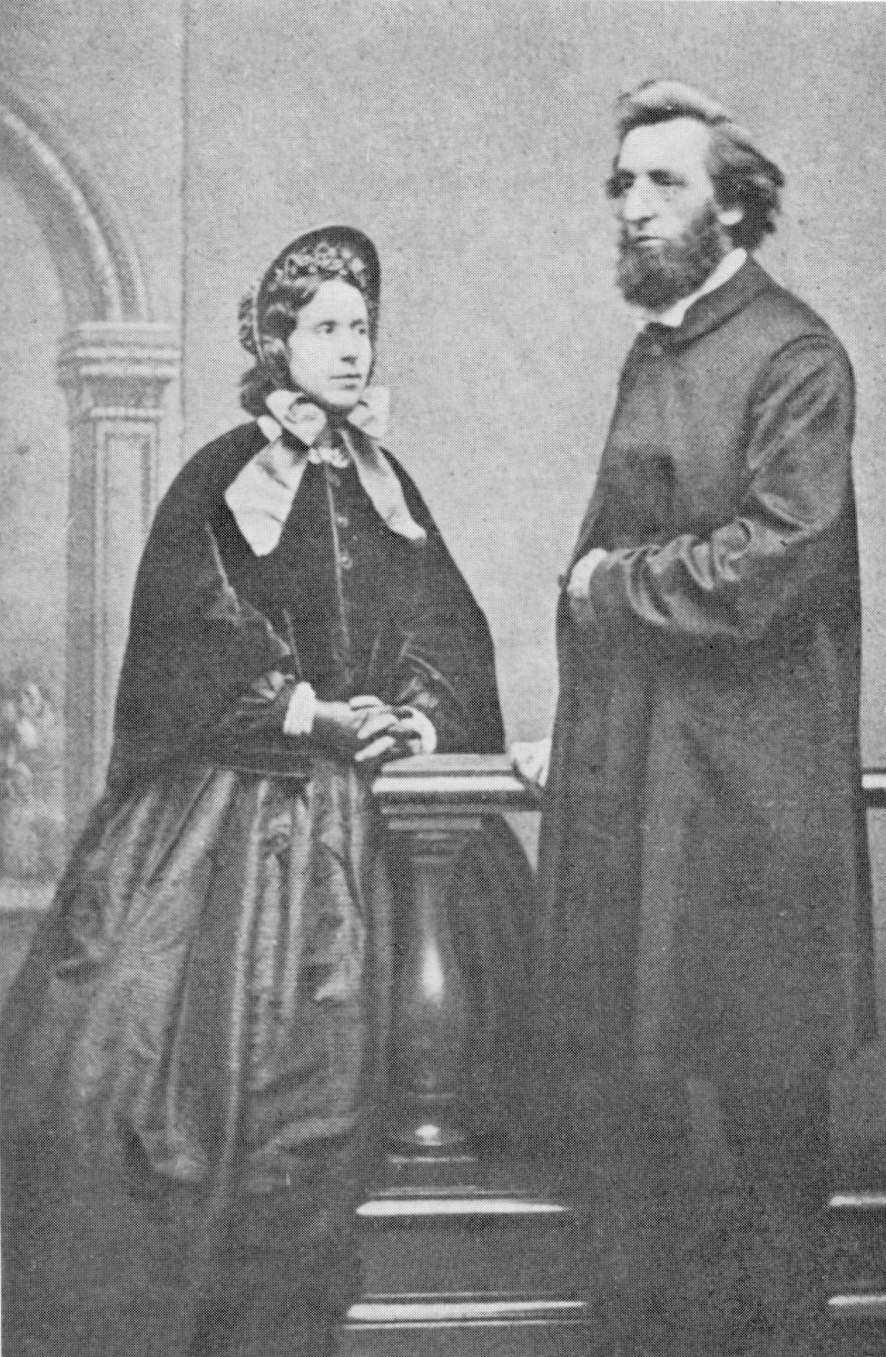
Catherine married William Booth

Slide 18
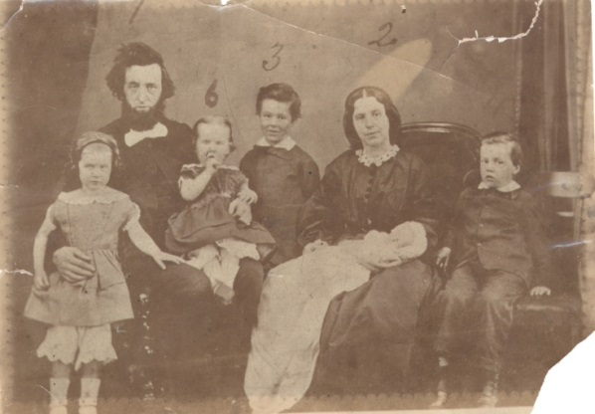
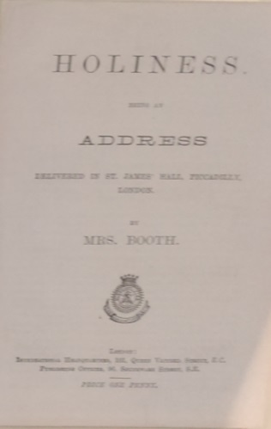
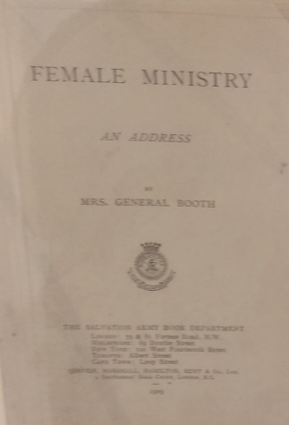
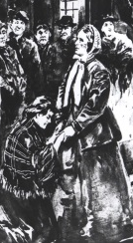
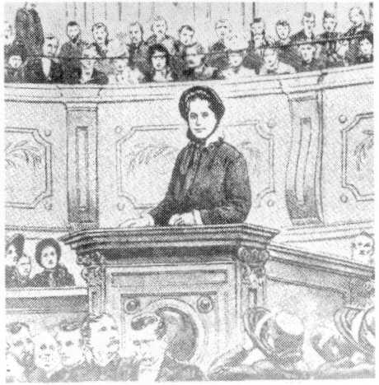
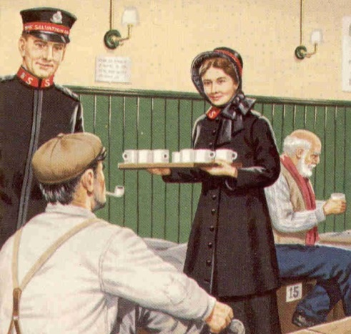
Catherine was busy!
Looked after the children and the house
Preached in churches
Organised food for the poor
Visited people and helped them
Studied the Bible
Wrote booklets about faith

Slide 19
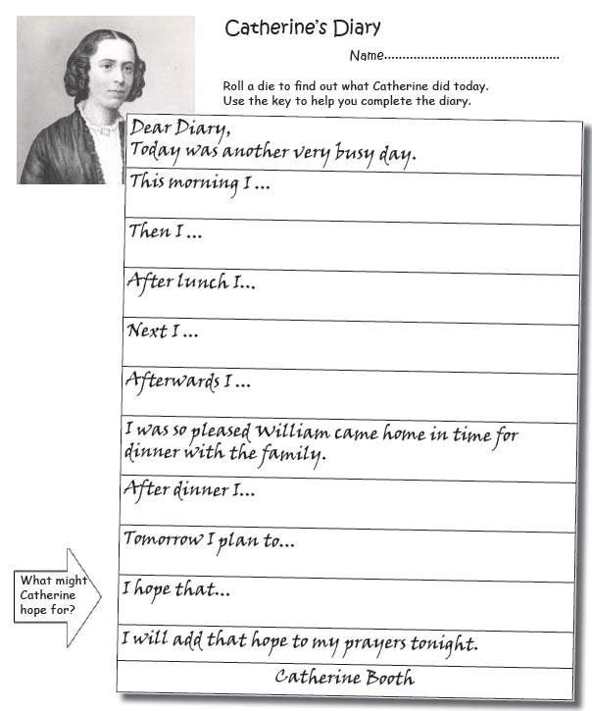
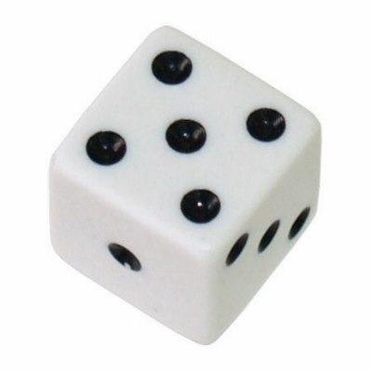
Imagine what Catherine might do in one day.
Can you recreate her diary?
Looked after the children and the house
Preached in churches
Organised food for the poor
Visited people and helped them
Studied the Bible
Wrote booklets about faith

Slide 20
How would you
describe Catherine
based on her actions?

Slide 21


Catherine Booth and
The Salvation Army

Slide 22
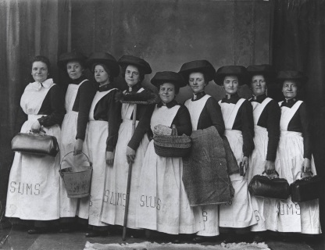
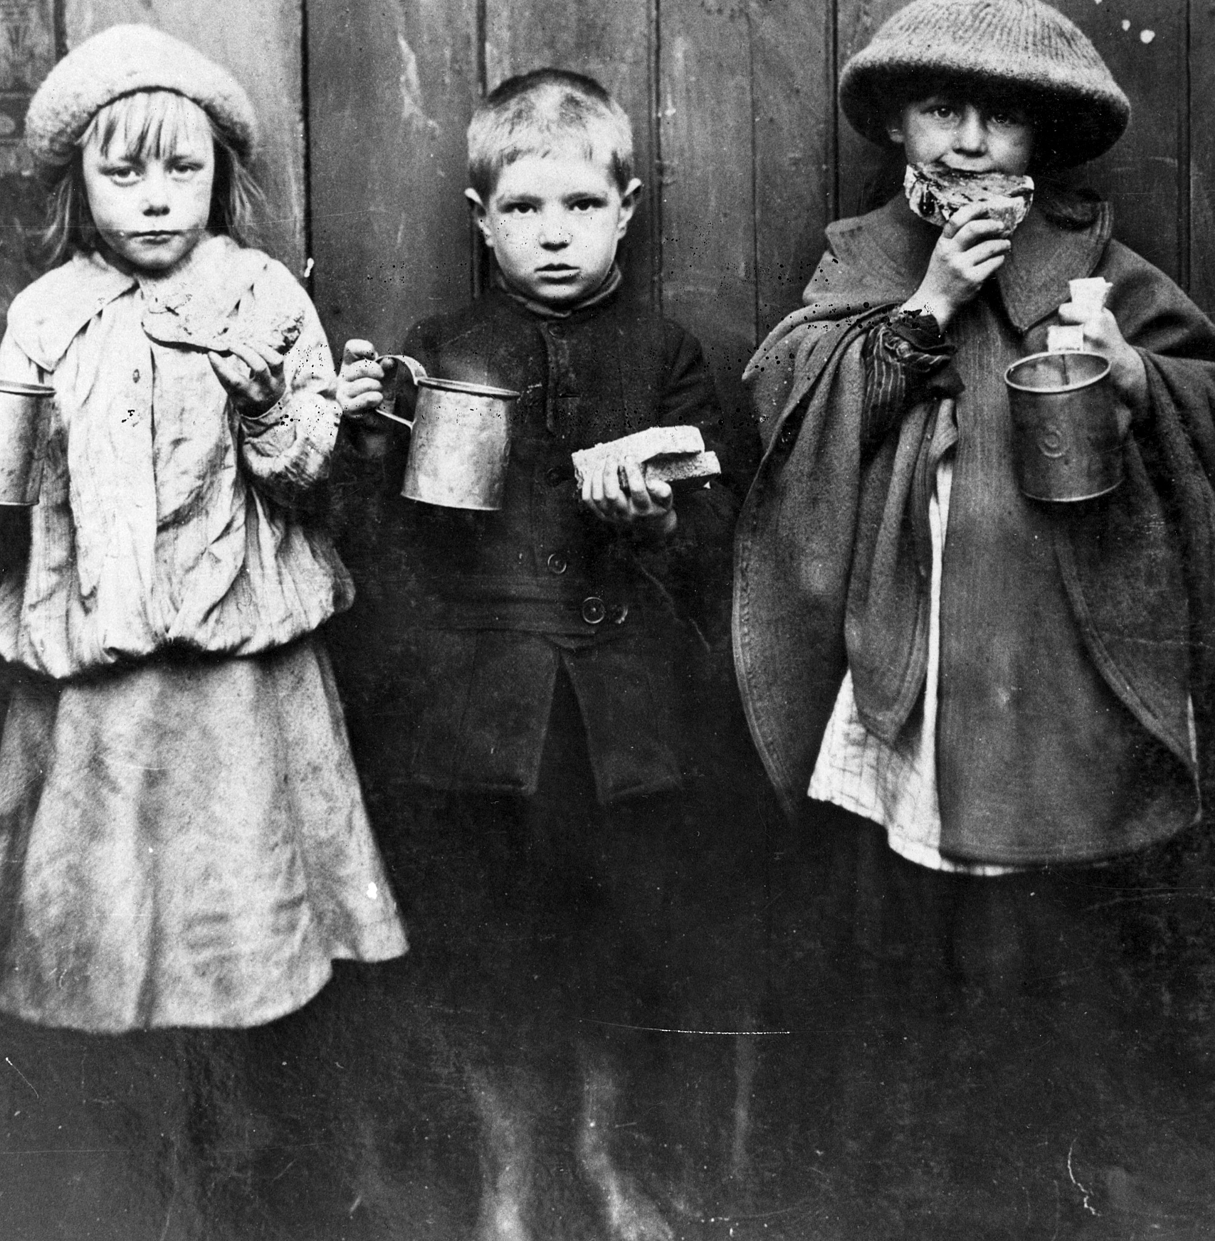
What did The Salvation Army do?
Helped people living in slums
Farthing breakfasts

Slide 23
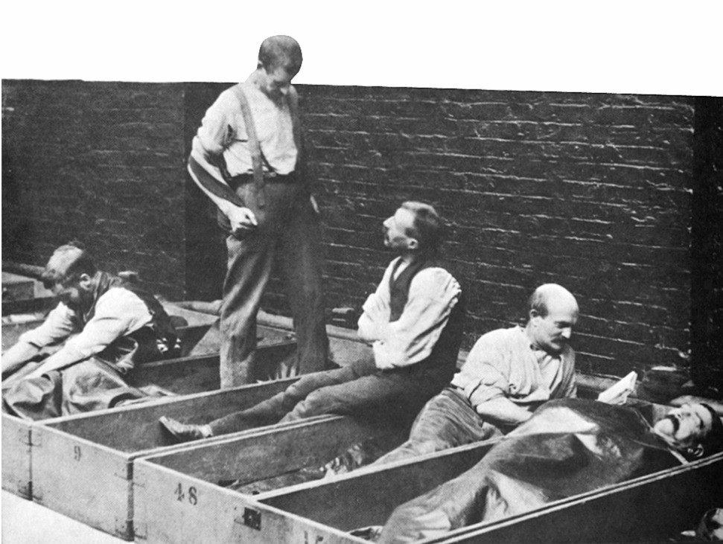
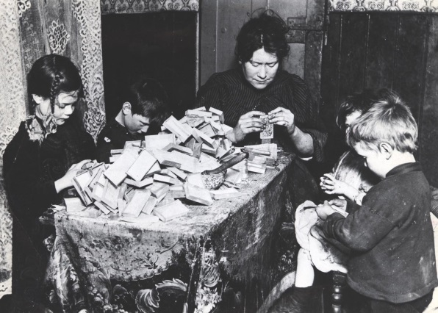

What did The Salvation Army do?
Shelter for homeless people
Better conditions for matchstick makers

Slide 24
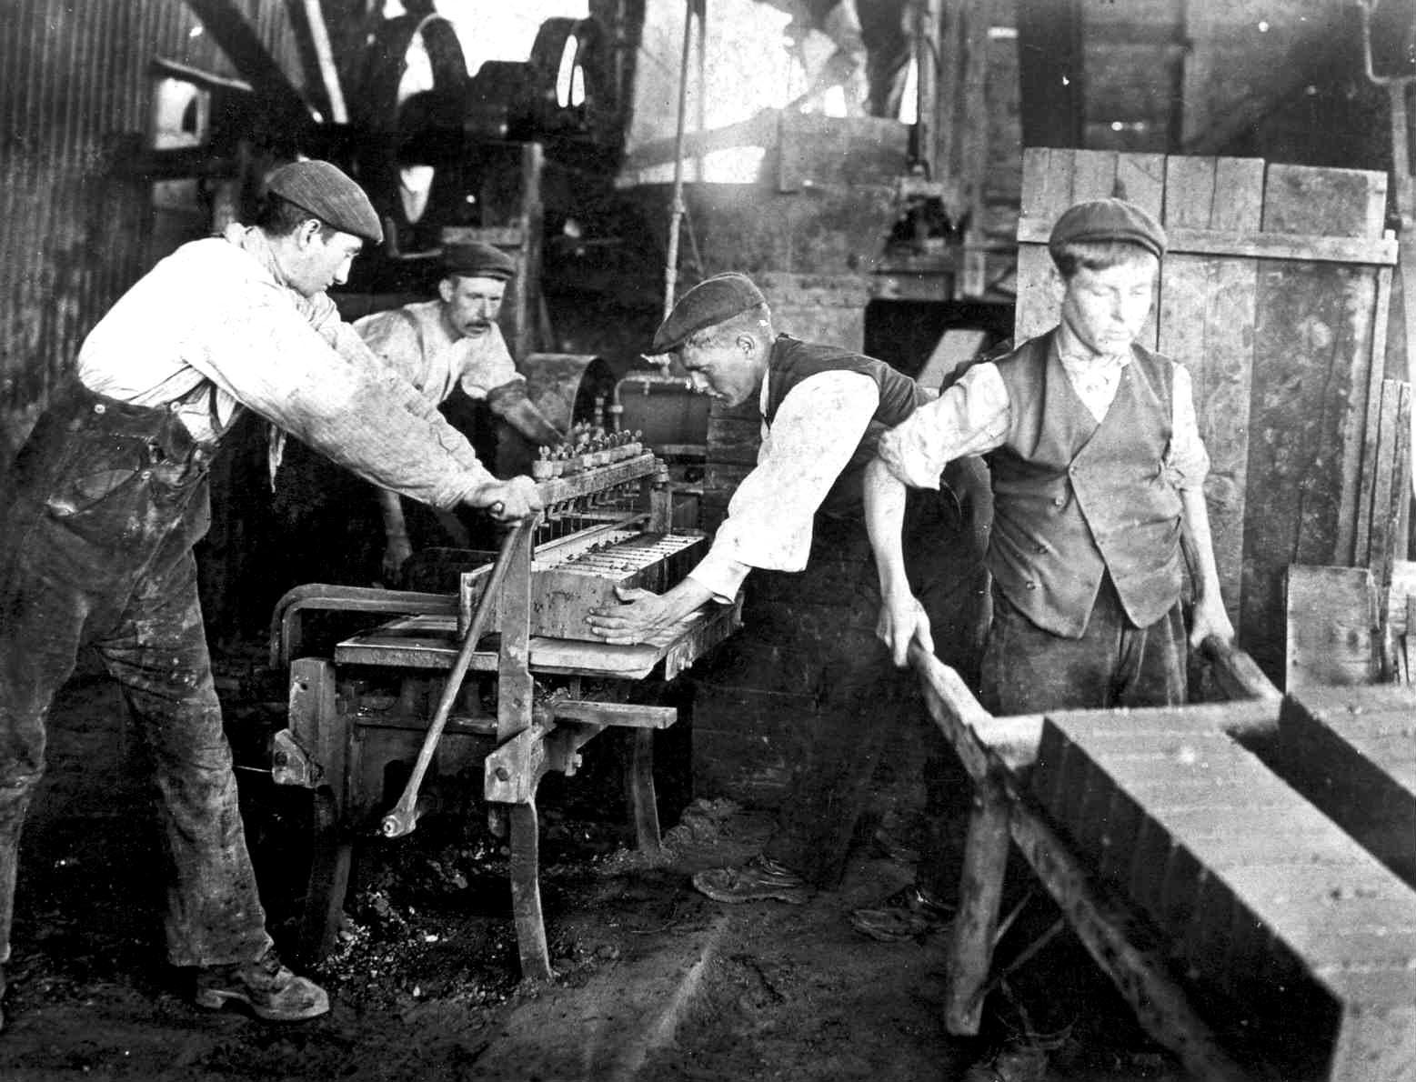
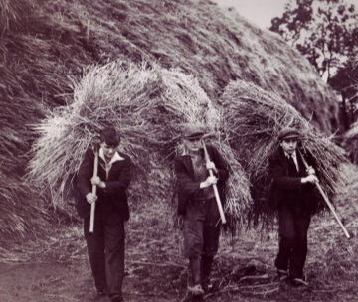
What did The Salvation Army do?
Helped people find employment
Told others of their faith

Slide 25
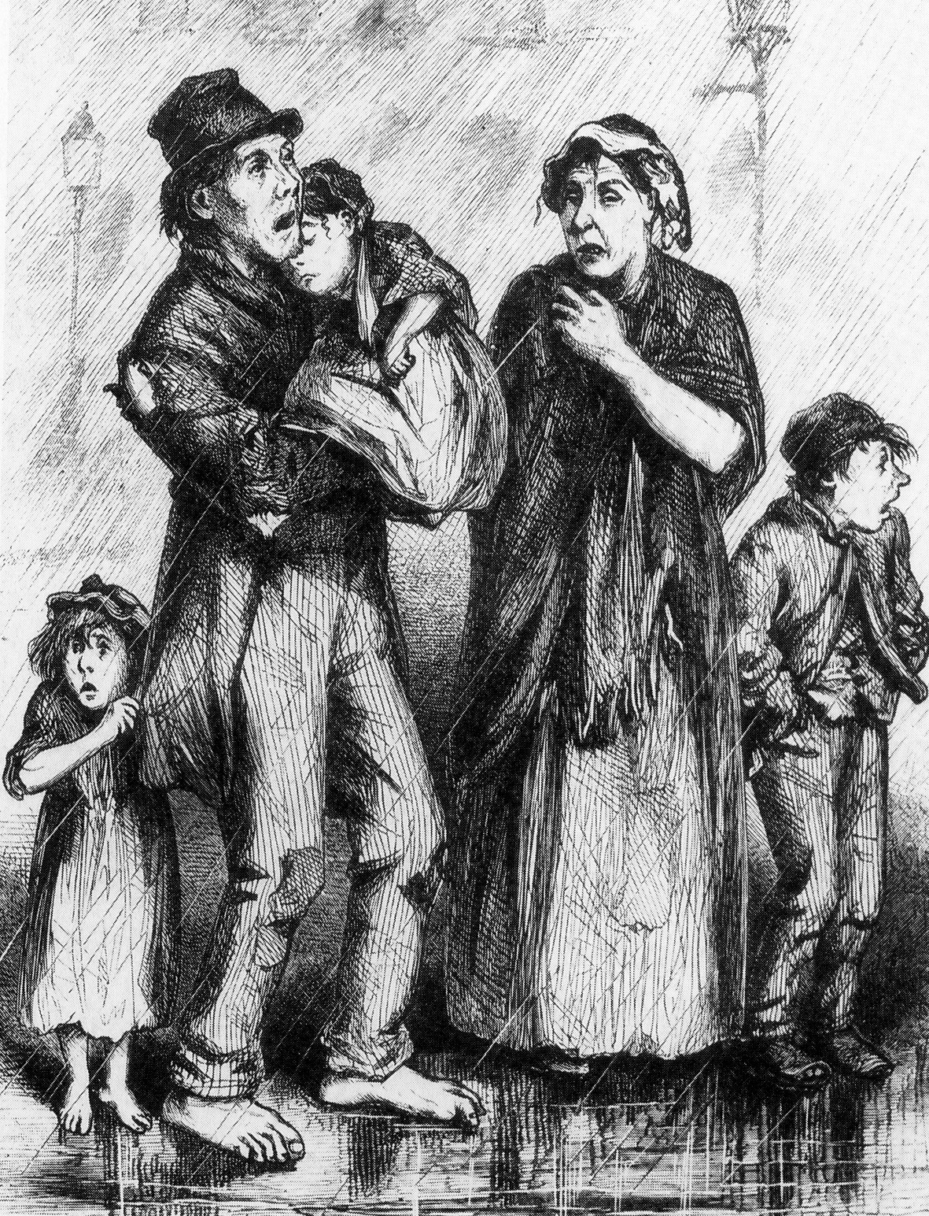
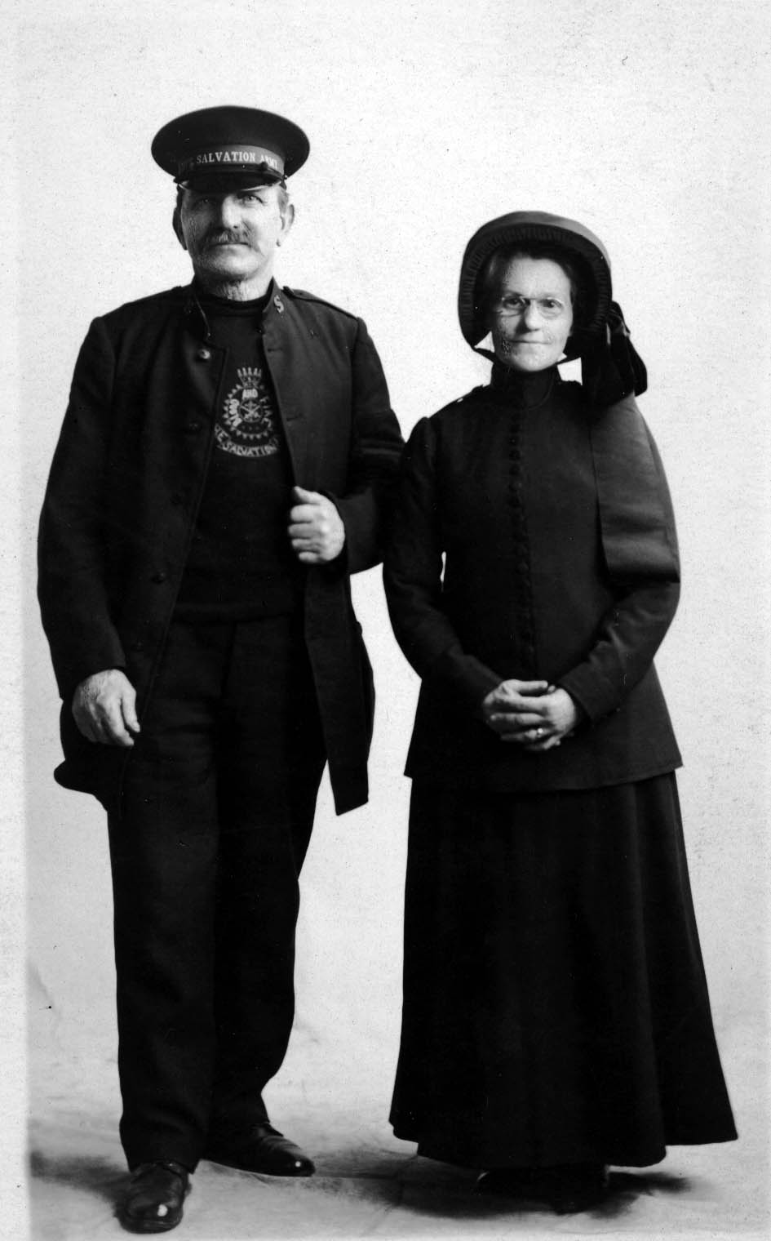
What did else did Catherine do?
Warned of the dangers of alcohol
Men and women to be treated equally

Slide 26
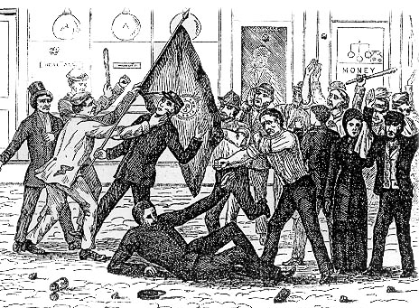
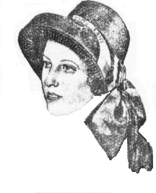

What did else did Catherine do?
Designed the bonnet
Designed the flag

Slide 27
Why do you think
Catherine was called
the Army mother?
Did Catherine make a difference?

Slide 28
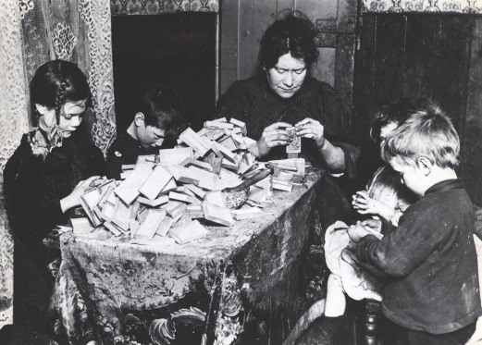


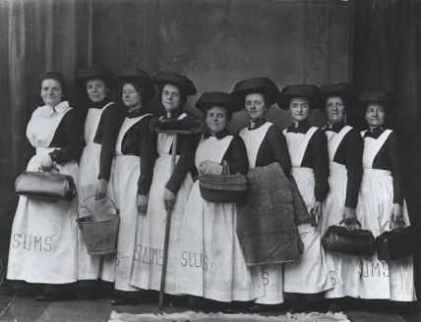
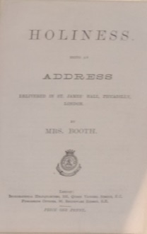


Slide 29
What do you think
are the reasons
behind Catherine’s actions?

Slide 30
Learning Objectives
To learn about Catherine Booth’s life
To describe Catherine’s character based on her actions
To reflect on the reasons behind Catherine’s actions
Plenary

Slide 31
1
question you would like
to know
2
things you will remember
3
things you have learnt
Schools and
Colleges
Unit

