Slide 1
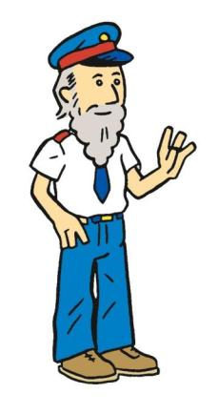
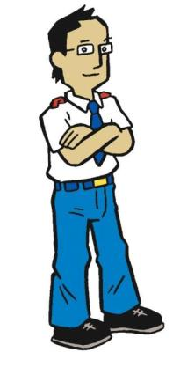
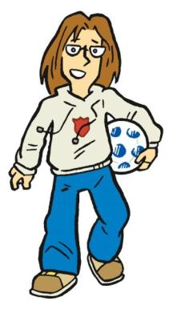
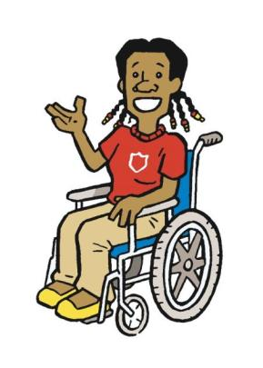
The Salvation Army
Sorting Cards

Slide 2
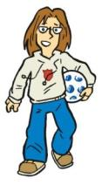
Look at all 18 cards carefully with a partner.
For each type of community work, try and find a card that matches it.
There might look like there is more than one answer, so clues will also be shown on the board.
Remember to ask if you are unsure what the heading means!

Slide 3
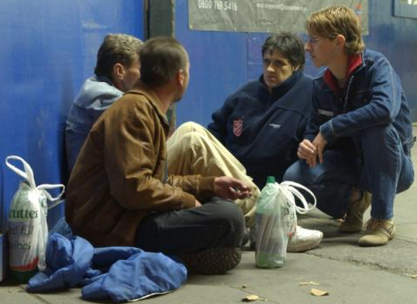
Find a card that represents…
Homelessness

Slide 4
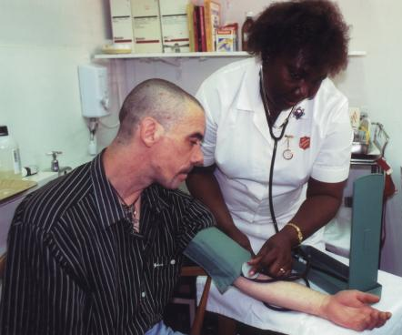
Find a card that represents…
Addiction

Slide 5
Find a card that represents…
Employment
Notes:
What is worship? (Use football fan illustration from UCV worship zone script.)

Slide 6
Find a card that represents…
Family Tracing

Slide 7
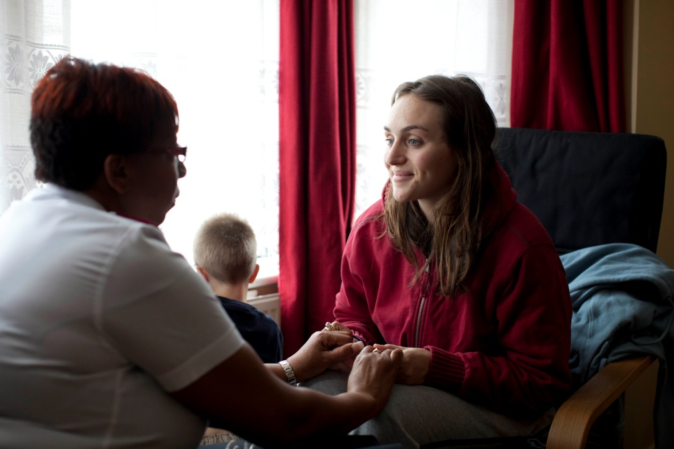
Find a card that represents…
Supporting Families

Slide 8
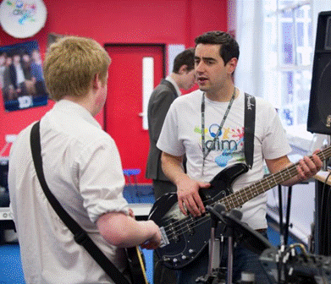
Find a card that represents…
Youth Groups

Slide 9
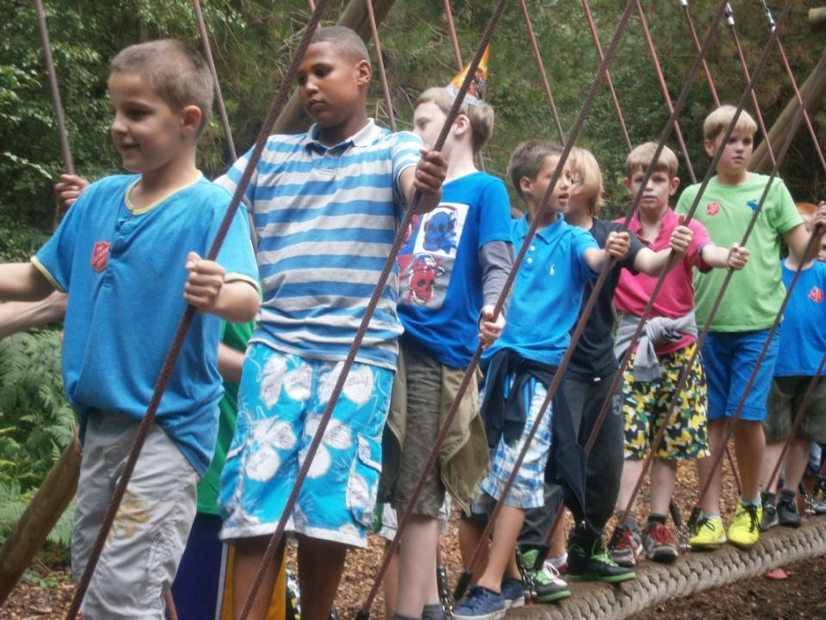
Find a card that represents…
Children’s Clubs
Notes:
What is worship? (Use football fan illustration from UCV worship zone script.)

Slide 10
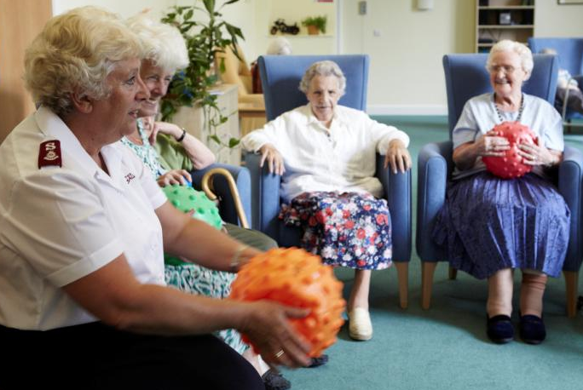
Find a card that represents…
Care Homes for the Elderly

Slide 11
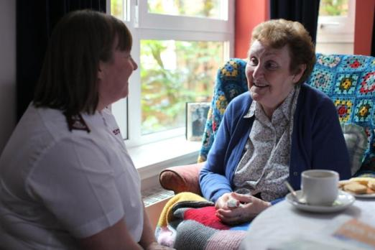
Find a card that represents…
Visiting People

Slide 12
Find a card that represents…
Community Projects

Slide 13
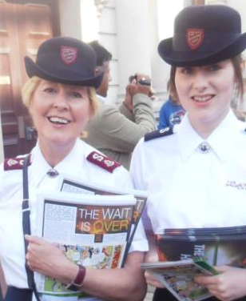
Find a card that represents…
Selling a Weekly Paper
Notes:
What is worship? (Use football fan illustration from UCV worship zone script.)

Slide 14
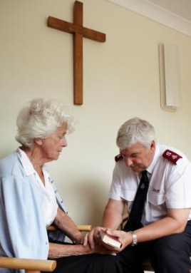
Find a card that represents…
Praying
The Salvation Army
AT WORK IN THE COMMUNITY

Slide 15
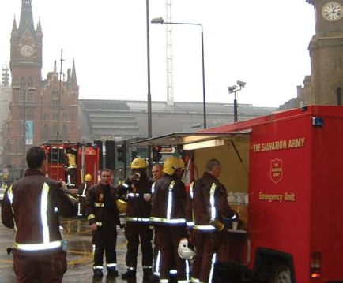
Find a card that represents…
Emergency Services

Slide 16
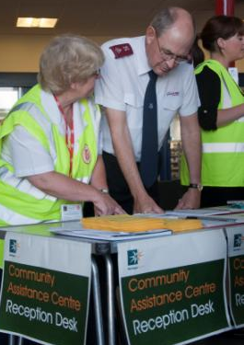
Find a card that represents…
Emergency Care
The Salvation Army

Slide 17
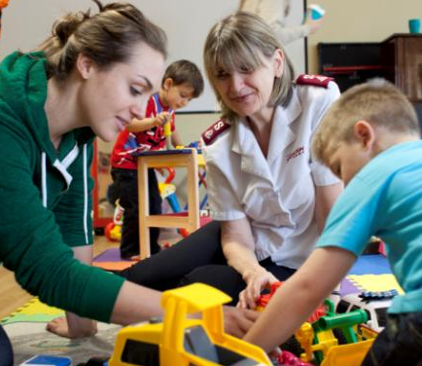
Find a card that represents…
Nursery and Toddler Clubs

Slide 18
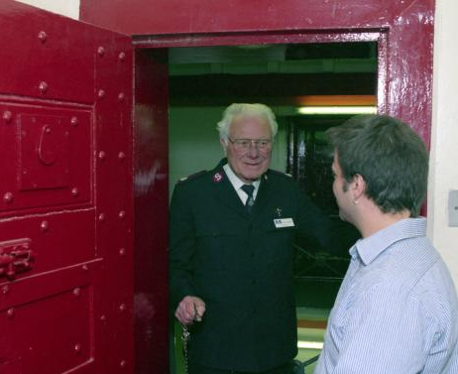
Find a card that represents…
Visiting Prisoners
Notes:
What is worship? (Use football fan illustration from UCV worship zone script.)

Slide 19
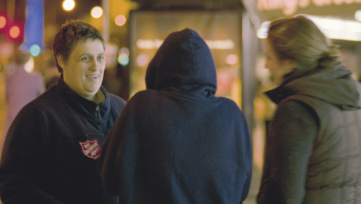
Find a card that represents…
Outreach

Slide 20
Find a card that represents…
Lifehouse

Slide 21
Can you find a card that shows…
Work with older people
Work with families
Helping emergency services
Caring for others
Listening to others
Looking after our environment
Youth groups
Giving meals
Be prepared to explain your choices – there may be different answers!
The Salvation Army
AT WORK IN THE COMMUNITY

Slide 22
Which cards show The Salvation Army at work in the community?
Sort the cards into two piles.
Yes
No
Which do you think is the most important?
The Salvation Army
AT WORK IN THE COMMUNITY

Slide 23
Sort the cards by choosing one criteria.
I would like to do
Yes
No
The Salvation Army
AT WORK IN THE COMMUNITY

Slide 24
I would like to do
Takes a lot of time
Expensive
Anyone could do
Difficult to do
Fun
The Salvation Army
AT WORK IN THE COMMUNITY

Slide 25
Sort the cards by choosing one criteria.
I would like to do
The Salvation Army
AT WORK IN THE COMMUNITY

Slide 26
Sort the cards by choosing two criteria.
I would like to do
Takes a long time
The Salvation Army
AT WORK IN THE COMMUNITY

Slide 27
Any Questions?
The Salvation Army
AT WORK IN THE COMMUNITY

