Slide 1

Schools and
Colleges
Unit

Slide 2

All wrongdoing
is sin
John 5:17 (NIV)
Schools and
Colleges
Unit

Slide 3

Atonement
(at-one-ment)
is the reconciliation of men and women to God through the death of Jesus.
Schools and
Colleges
Unit

Slide 4
This man was handed over to you by God’s deliberate plan and foreknowledge; and you, with the help of wicked men, put him to death by nailing him to the cross. But God raised him from the dead, freeing him from the agony of death, because it was impossible for death to keep its hold on him.
Acts 2: 23-24 (NIV)
Schools and
Colleges
Unit

Slide 5
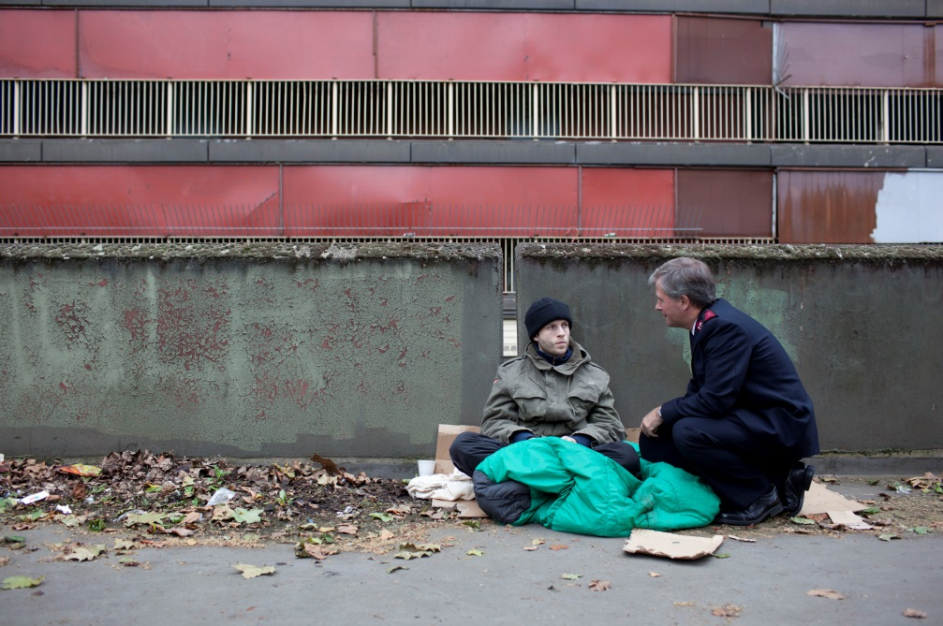
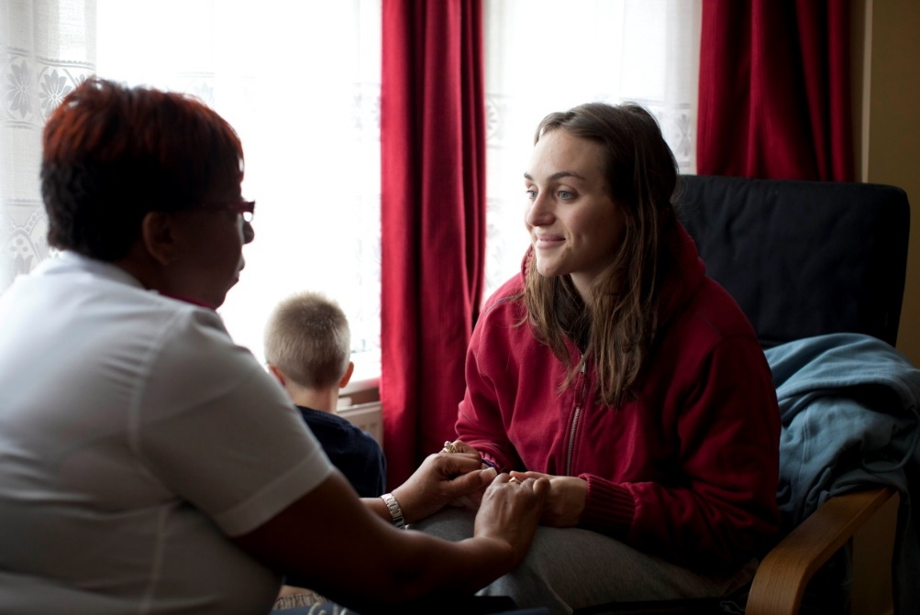
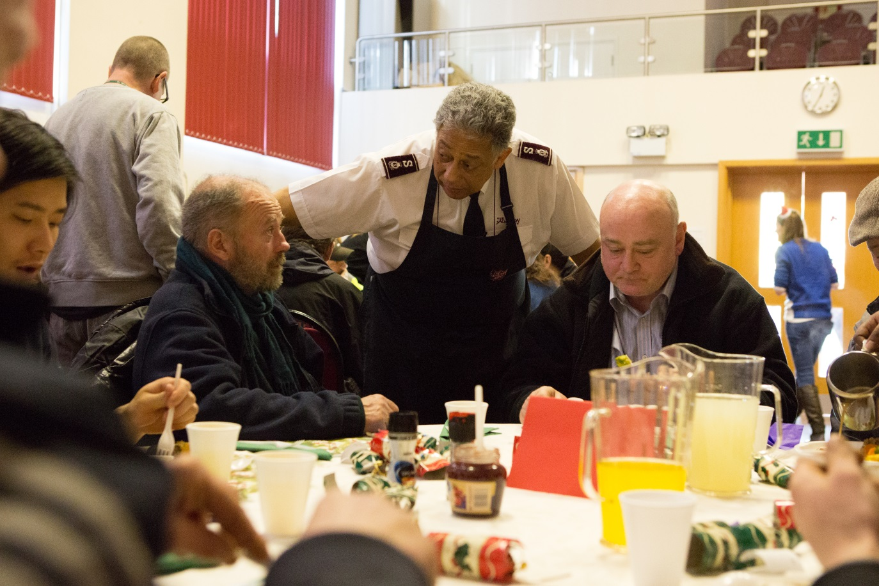

Slide 6
W
What’s holding you back from being free?
How can you be someone who helps people break free of the things holding them back?
Schools and
Colleges
Unit

Slide 7
Schools and
Colleges
Unit

