Slide 1


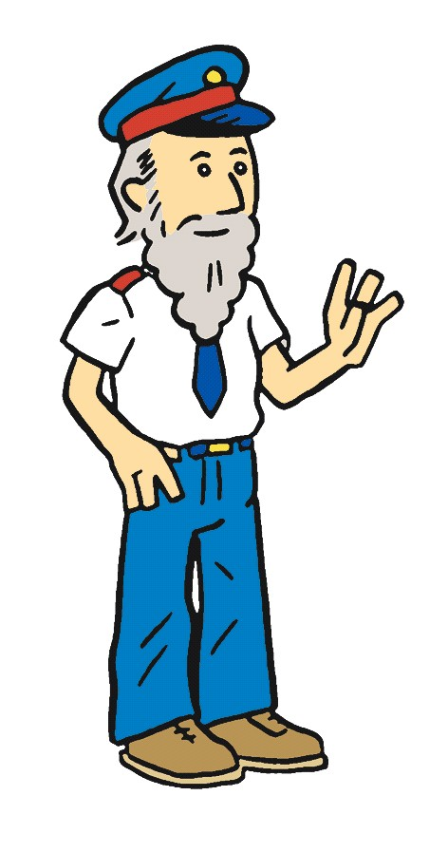
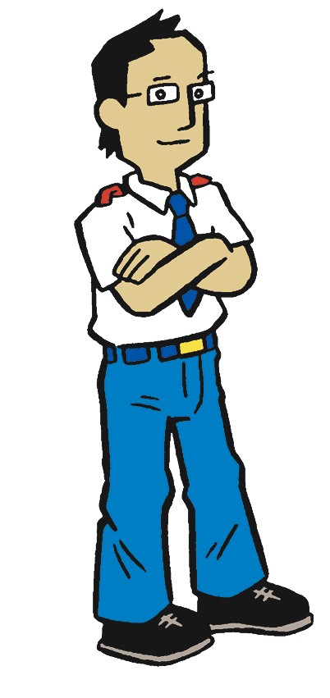
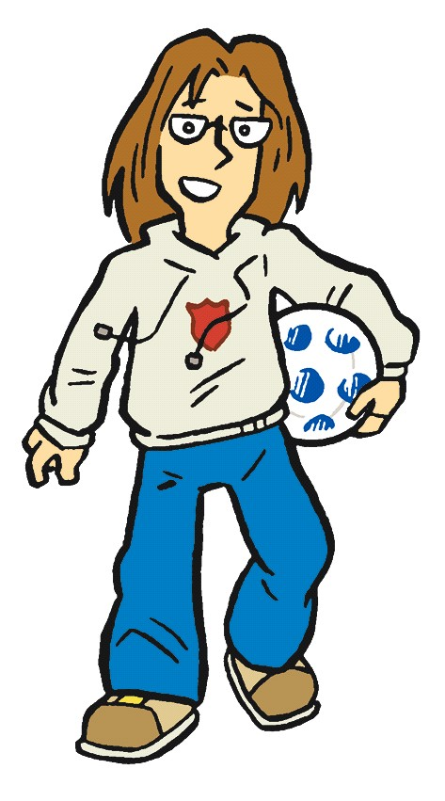
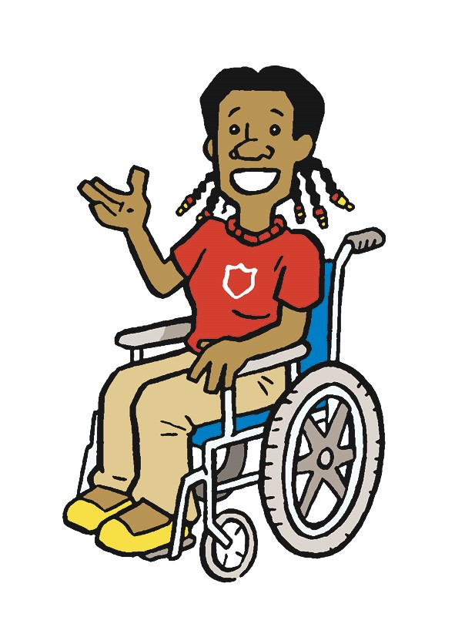

The Salvation Army

Slide 2

what do you know about
The Salvation Army?
The Salvation Army
AT WORK IN THE COMMUNITY

Slide 3
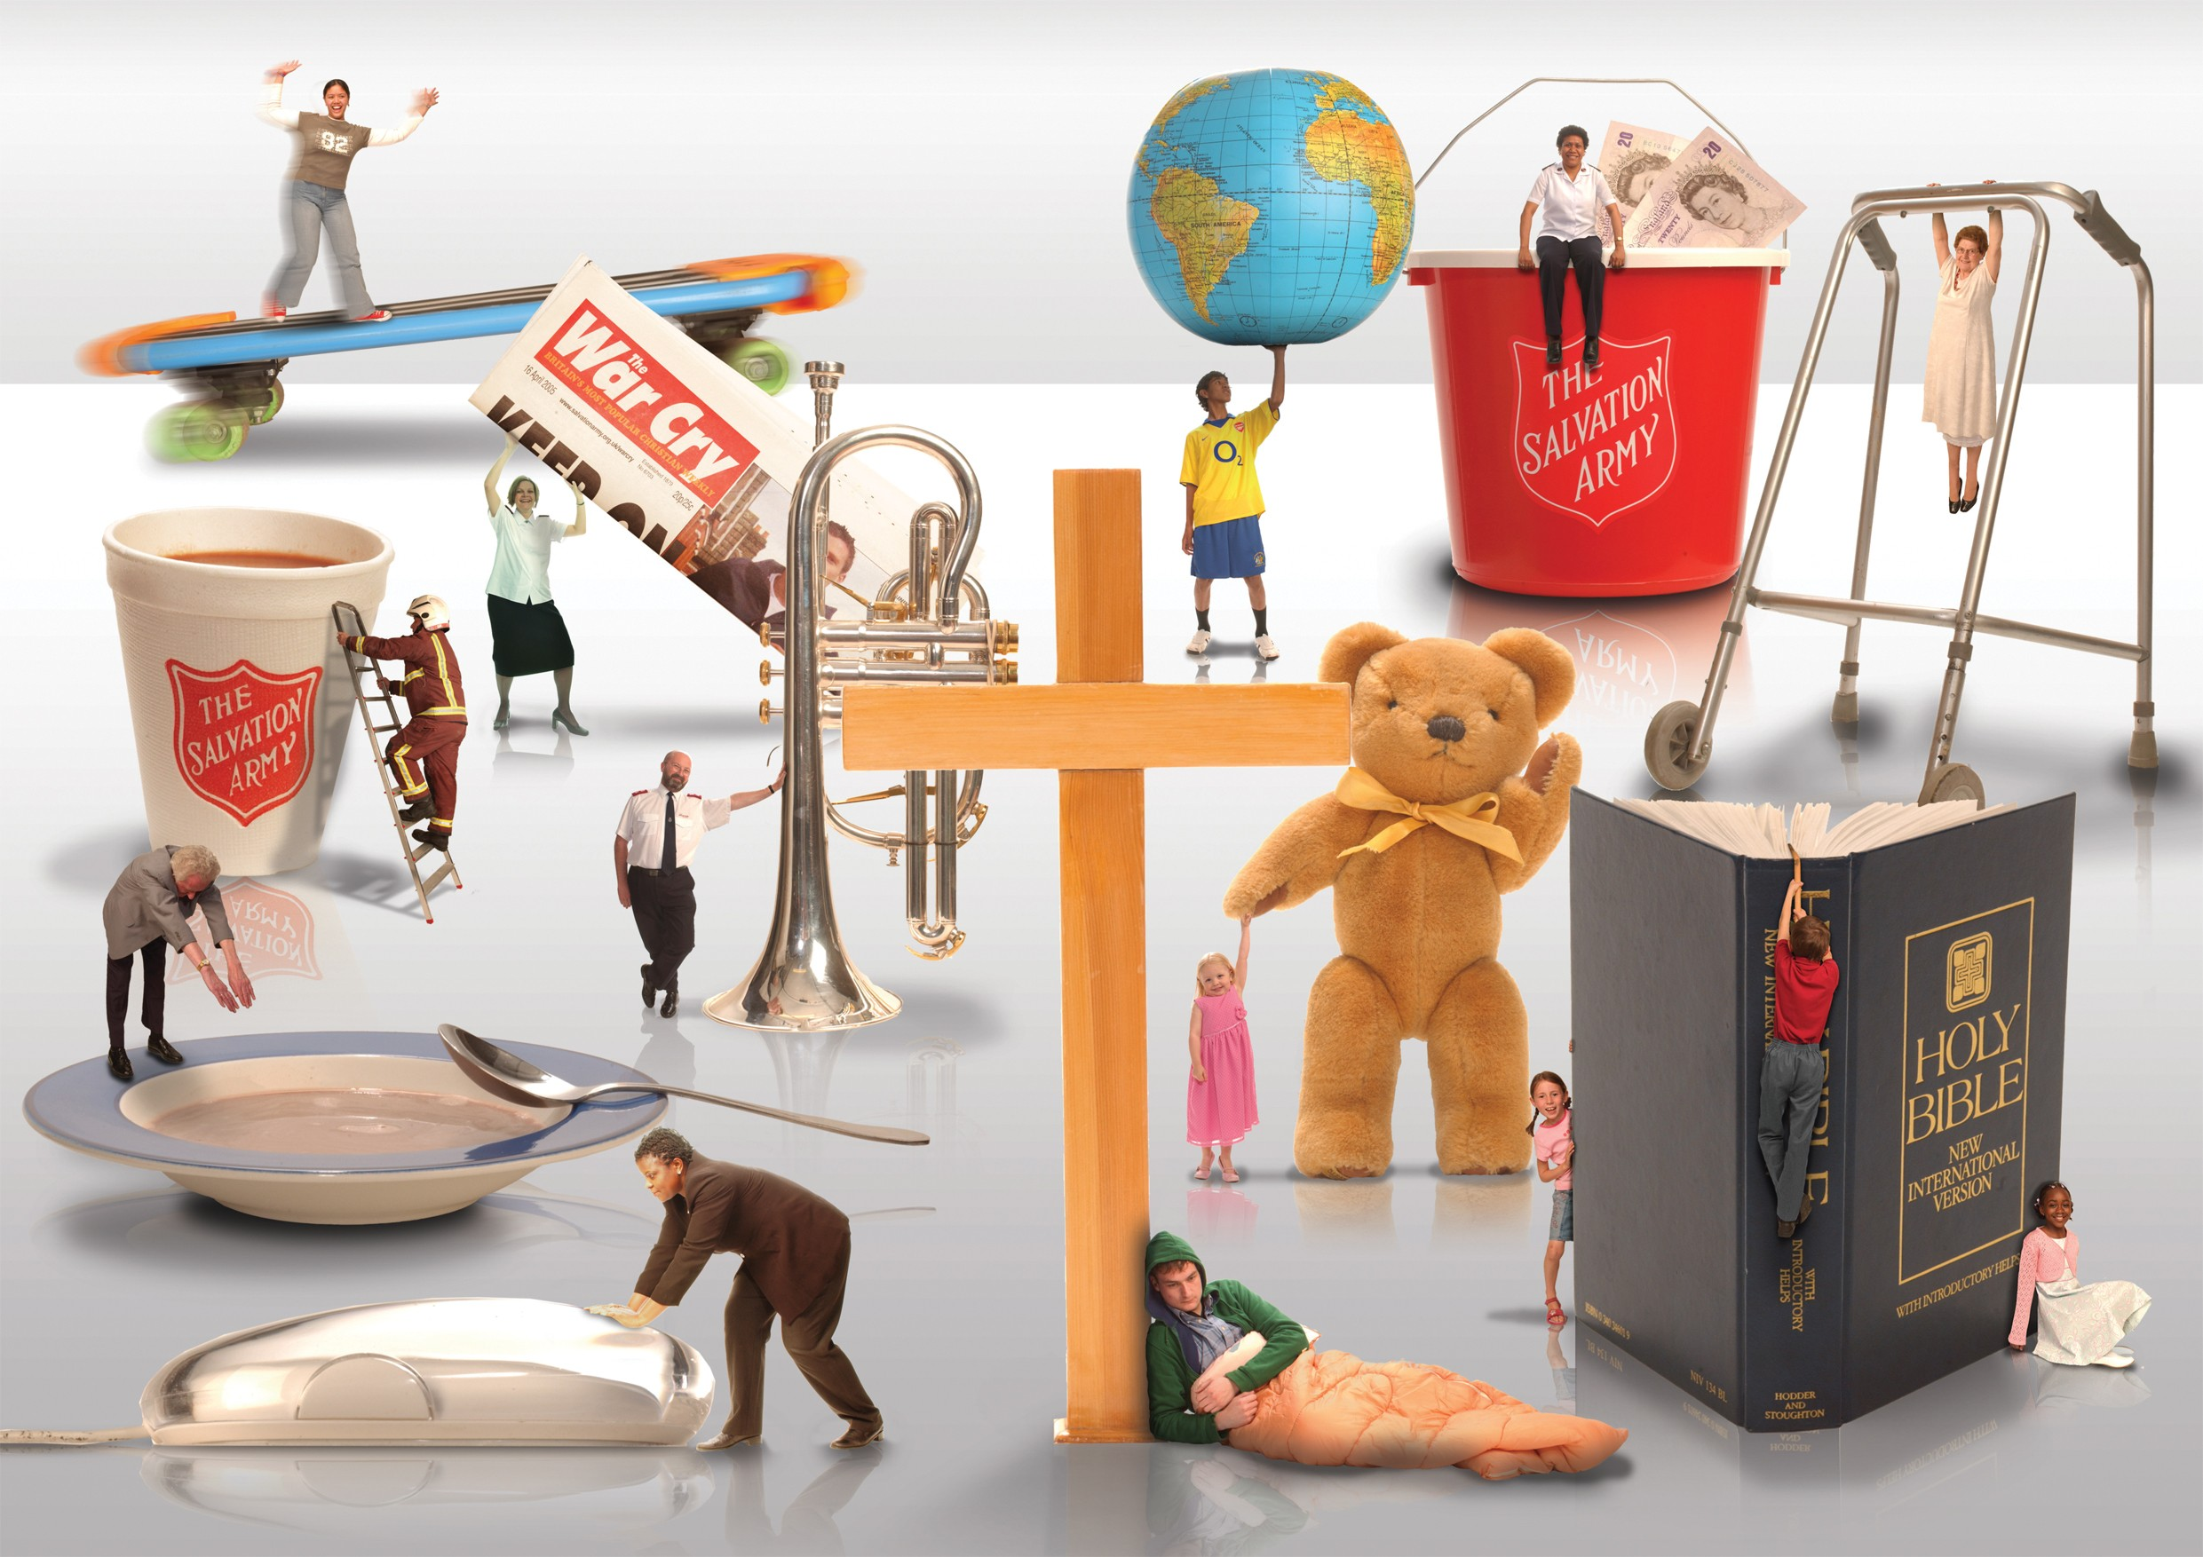
Notes:
What do you think this picture says about The Salvation Army?

Slide 4
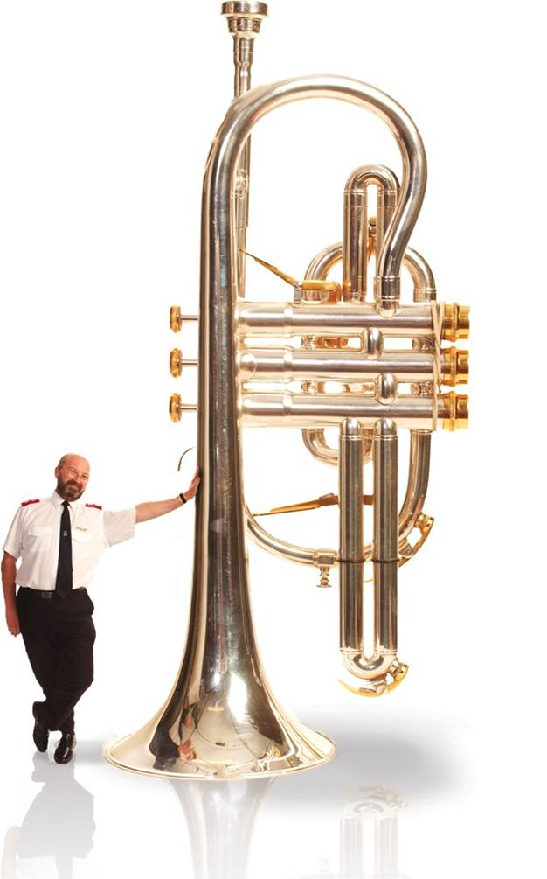

The Salvation Army is a church. Its members meet every Sunday to worship God. Salvation Army churches often have a brass band and praise God through music, but they worship in many other ways too.
The Salvation Army
AT WORK IN THE COMMUNITY

Slide 5

What is worship…?
The Salvation Army
AT WORK IN THE COMMUNITY
Notes:
What is worship? (Use football fan illustration from UCV worship zone script.)

Slide 6
what is worship like in
The Salvation Army?
The Salvation Army
AT WORK IN THE COMMUNITY
Notes:
Show UCV ‘Worship in The Salvation Army’ DVD clip and use accompanying questions from script.

Slide 7
Notes:
The Salvation Army in the Community…

Slide 8
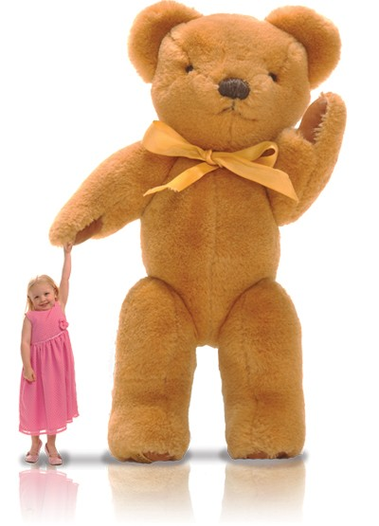

We support children and families through nurseries, parent-and-toddler groups and more.
The Salvation Army
AT WORK IN THE COMMUNITY

Slide 9
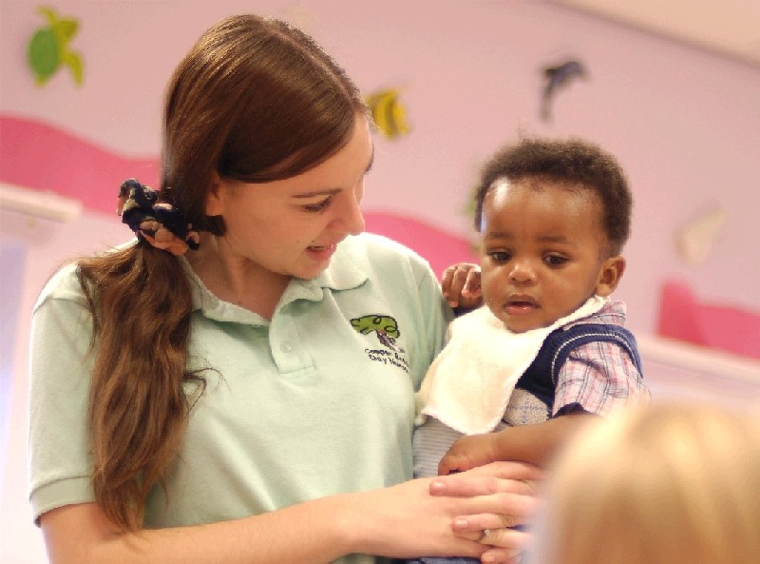
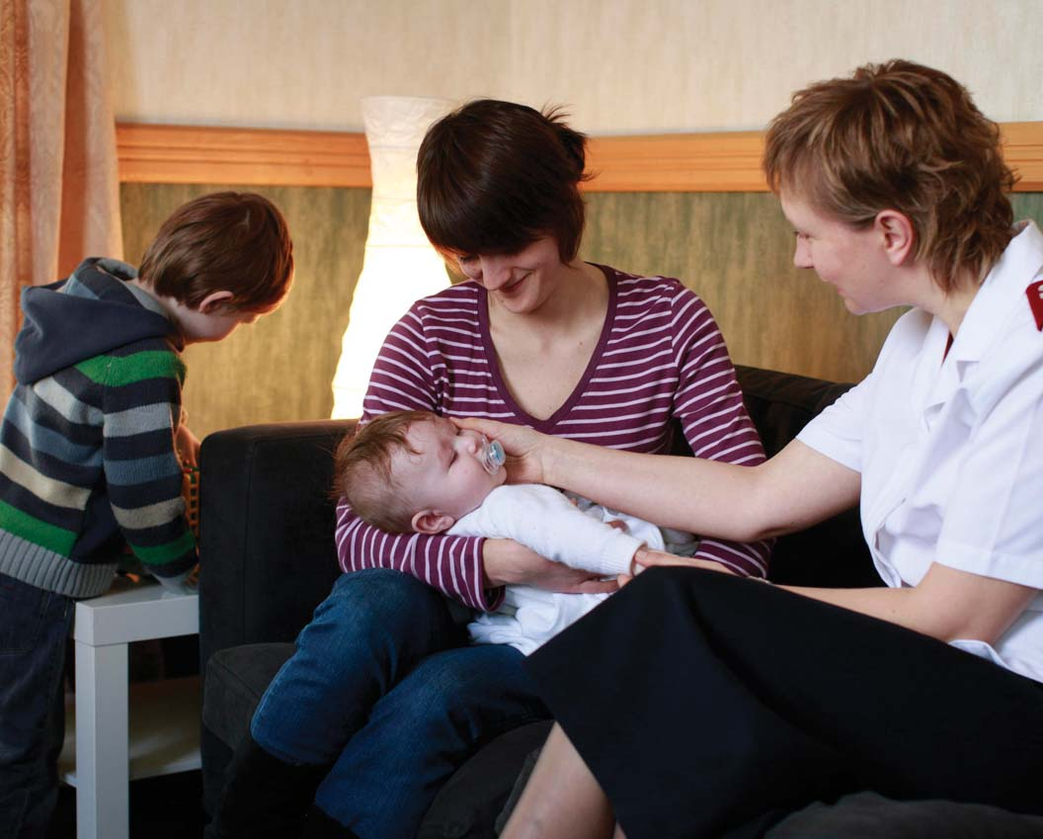
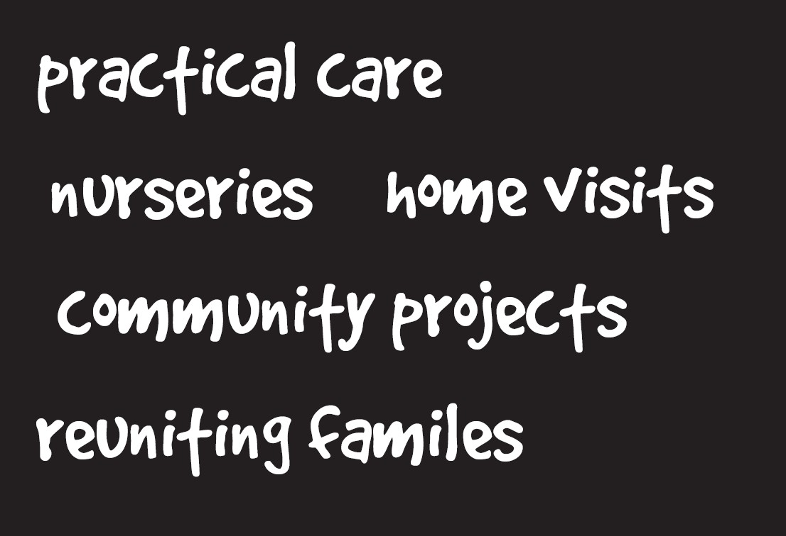



Slide 10


We support young people through youth clubs, drop-in centres and projects like Street Pastors.
The Salvation Army
AT WORK IN THE COMMUNITY

Slide 11
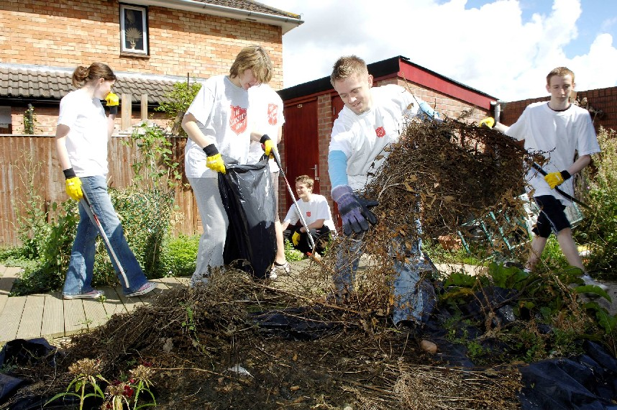


Slide 12
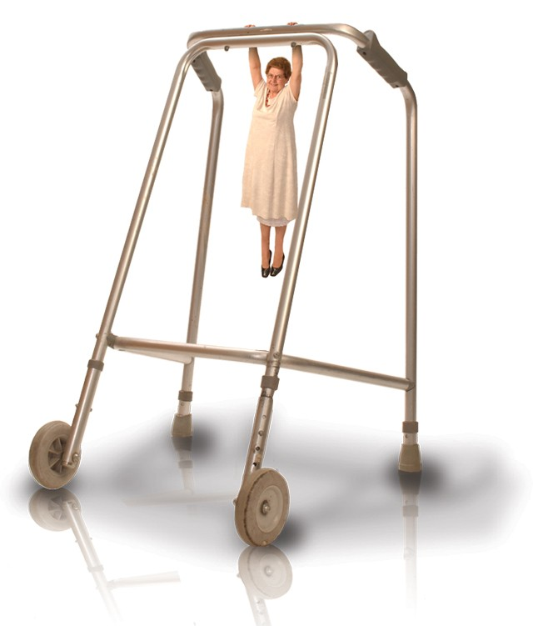
We support and care for older people by providing residential homes, friendship groups and home visits.
The Salvation Army
AT WORK IN THE COMMUNITY

Slide 13
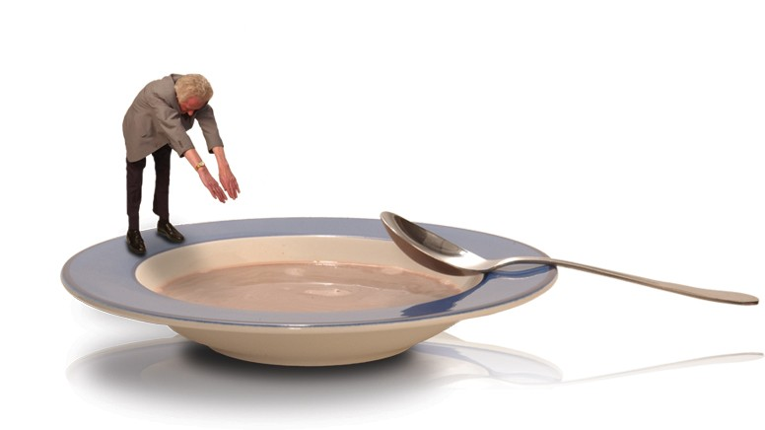
Many Salvation Army community centres have a lunch club or daytime activities for older people.
The Salvation Army
AT WORK IN THE COMMUNITY

Slide 14
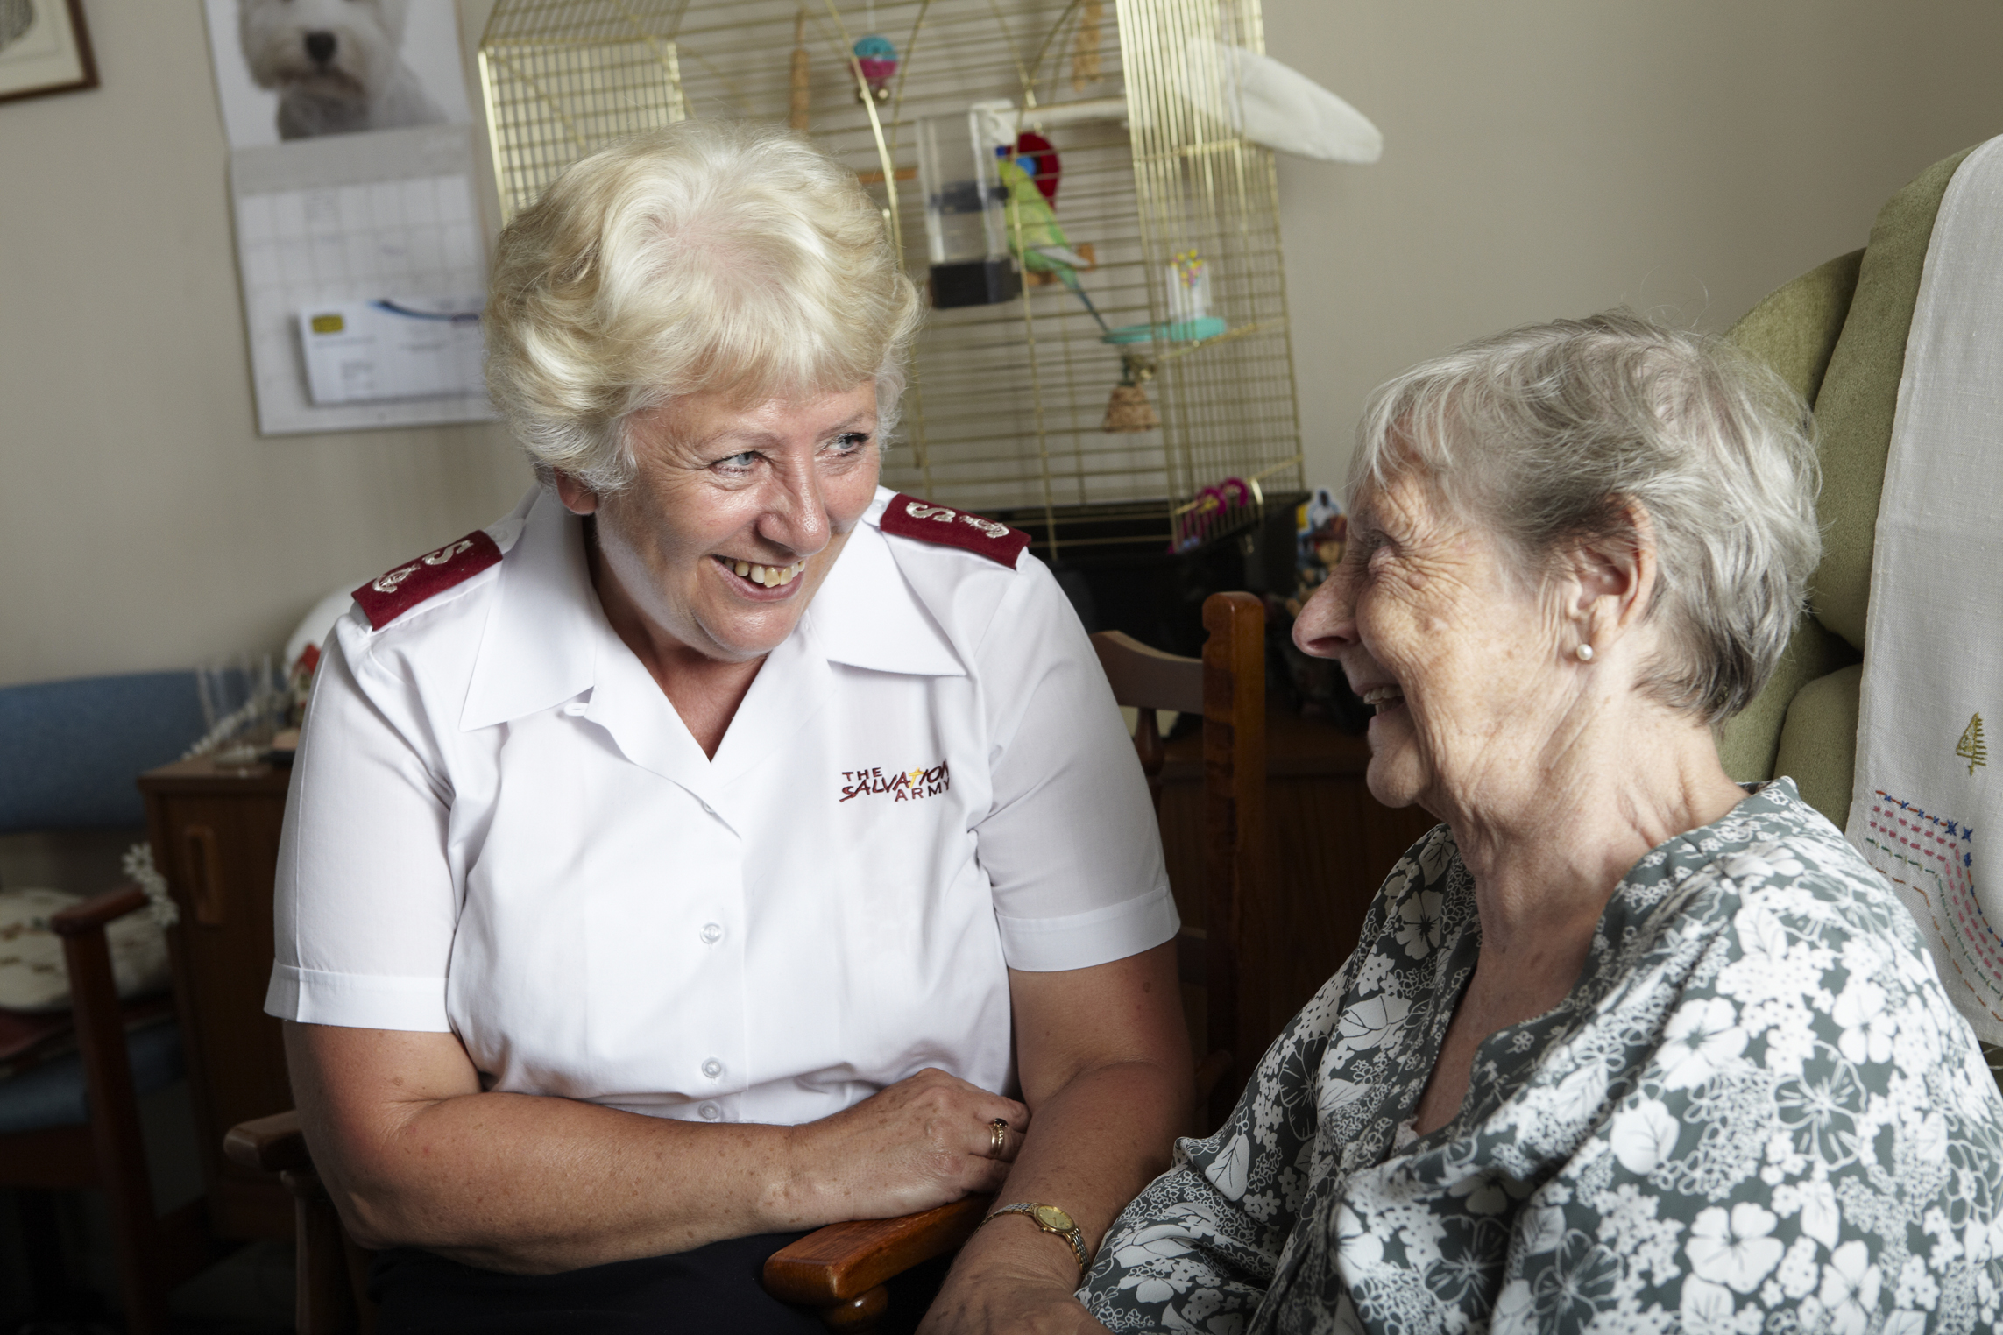
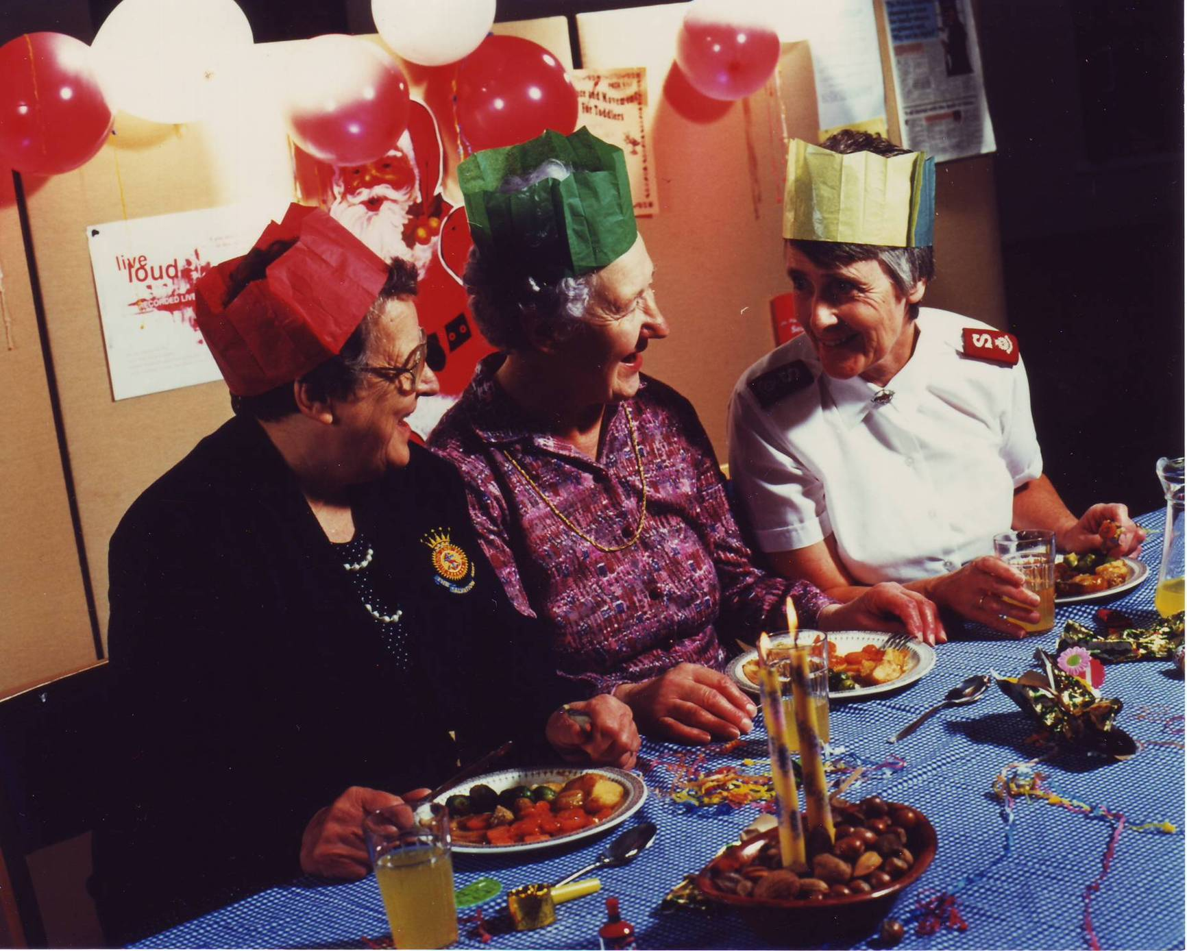


Slide 15
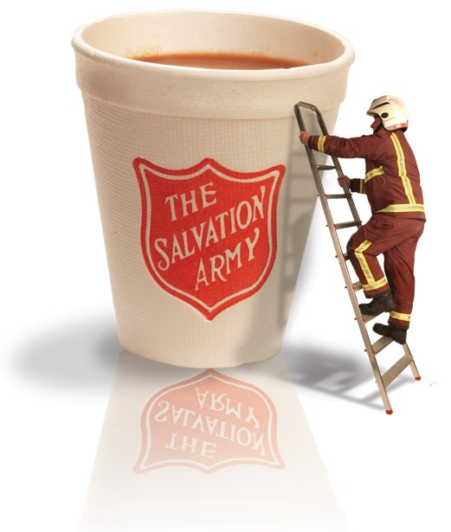
The Salvation Army helps in major emergencies such as floods, fires and train crashes.
The Salvation Army
AT WORK IN THE COMMUNITY

Slide 16
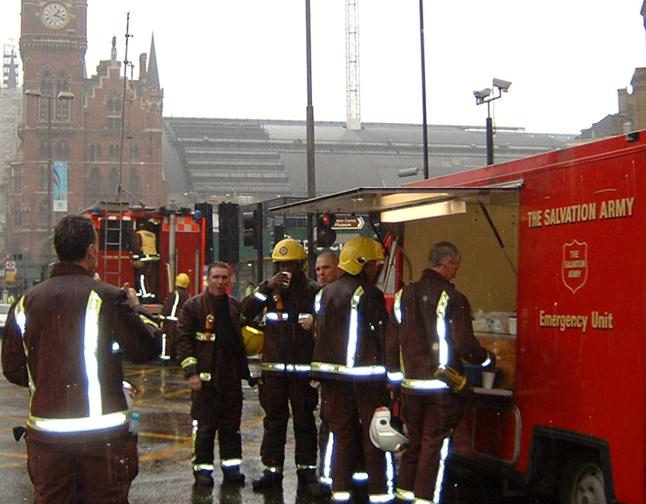
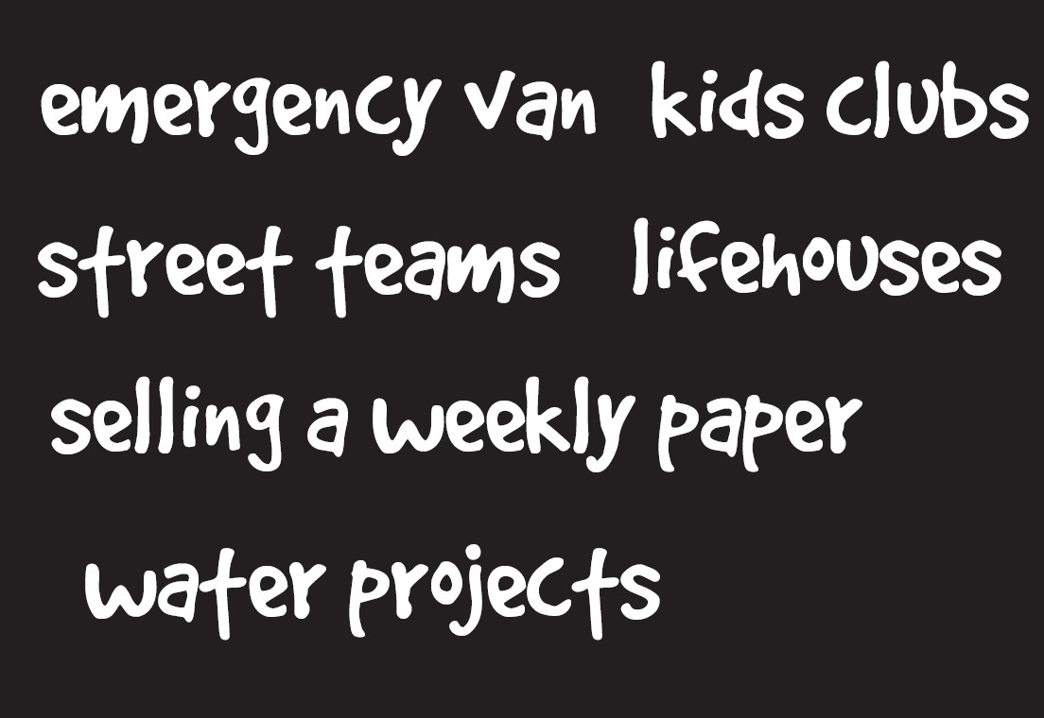

Slide 17
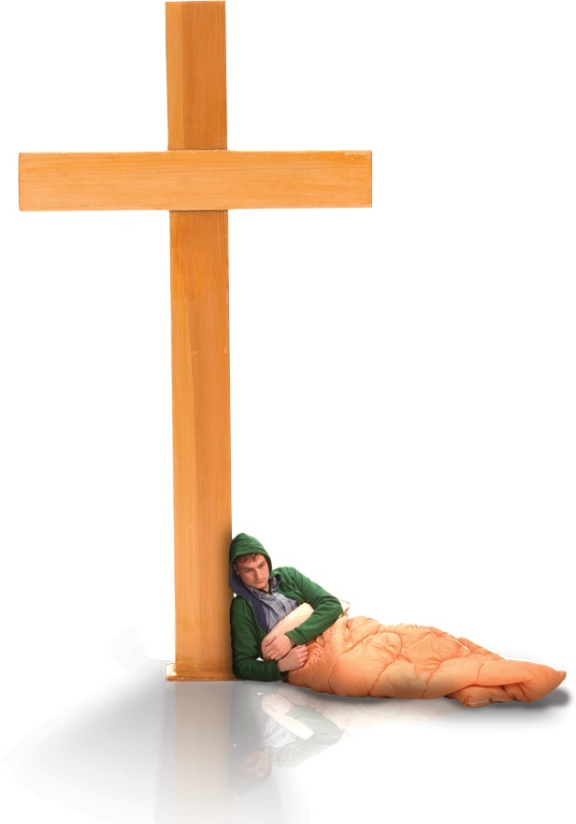

The Salvation Army is well known for helping people who are homeless. We have drop-in centres and residential centres for men, women and families.
The Salvation Army
AT WORK IN THE COMMUNITY

Slide 18
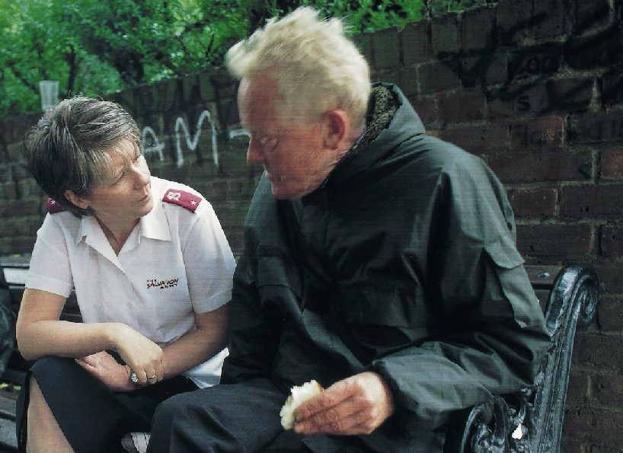
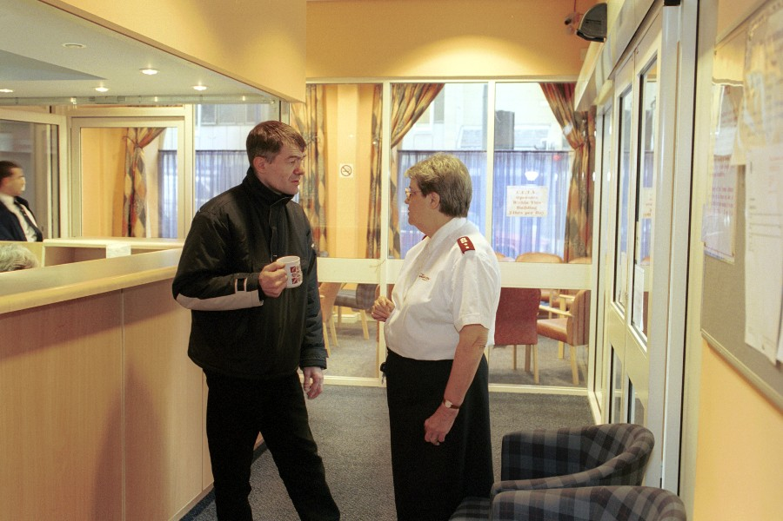

Slide 19
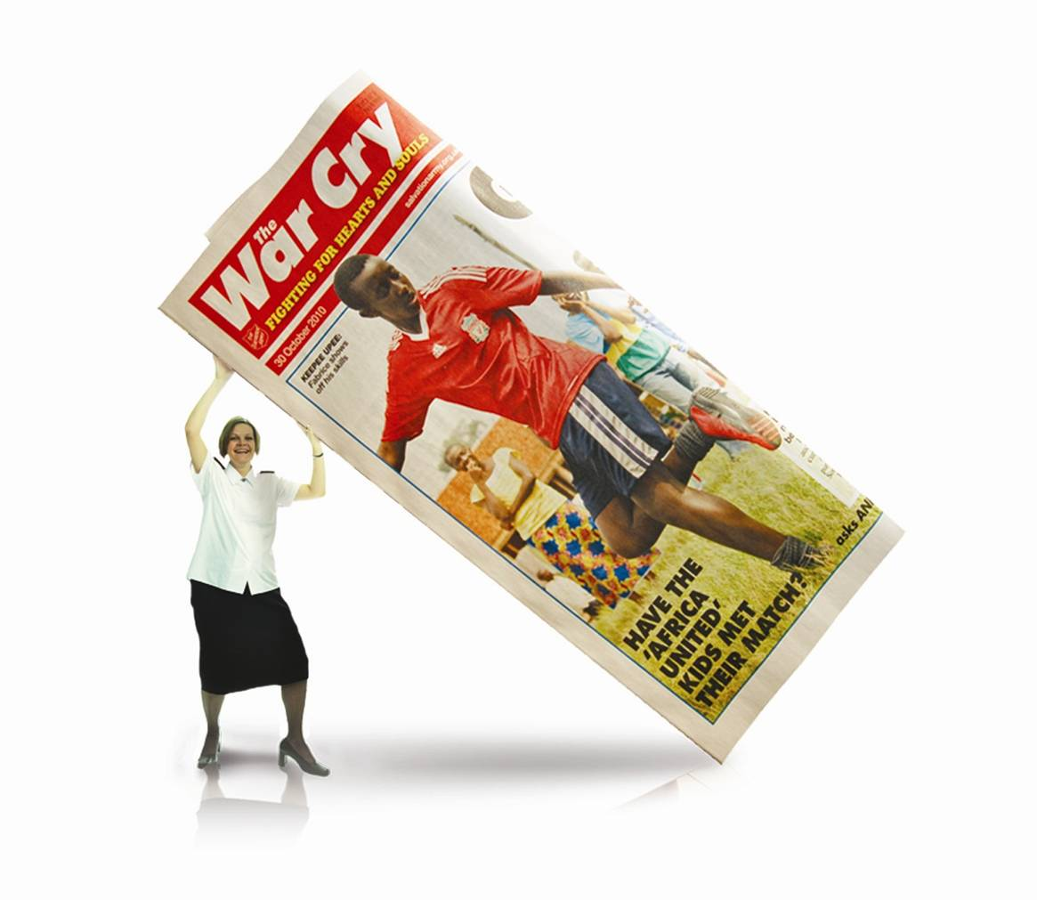
The War Cry is our weekly newspaper. It’s a good way of meeting people in the community and raising money for our work.
The Salvation Army
AT WORK IN THE COMMUNITY

Slide 20
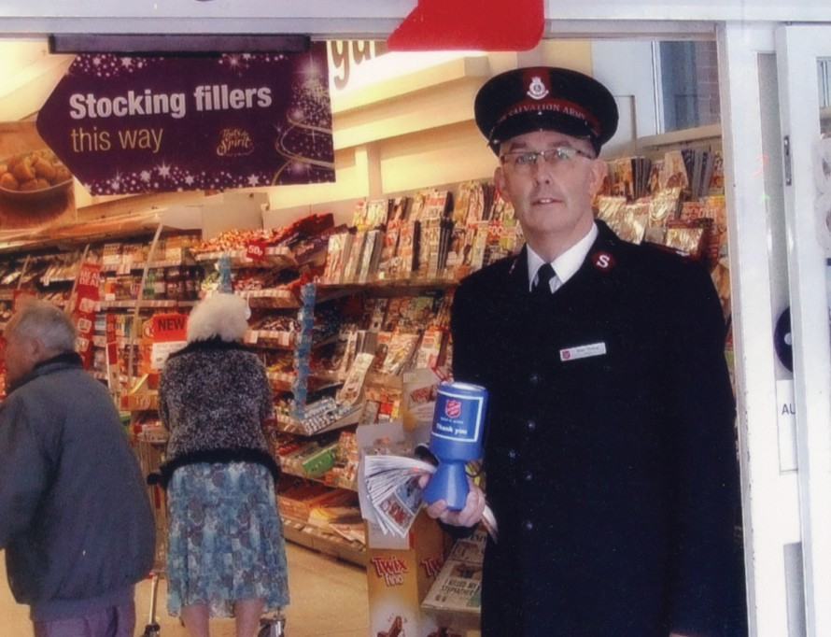

Slide 21

For more than 130 years The Salvation Army has been helping to reunite families through its Family Tracing Service.
The Salvation Army
AT WORK IN THE COMMUNITY

Slide 22
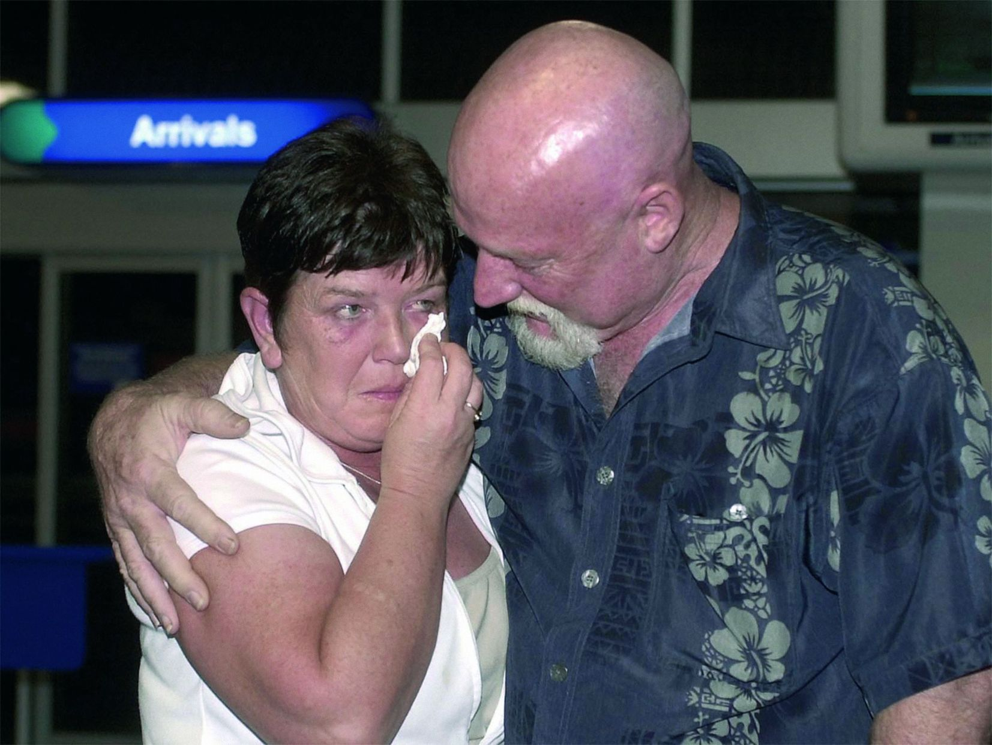

Slide 23
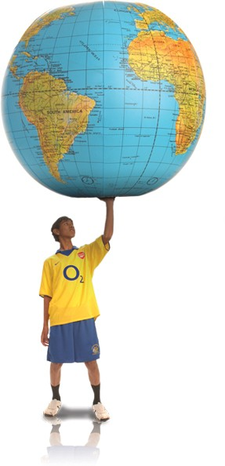
The Salvation Army works in communities all around the world…in over 130 countries.
The Salvation Army
AT WORK IN THE COMMUNITY

Slide 24
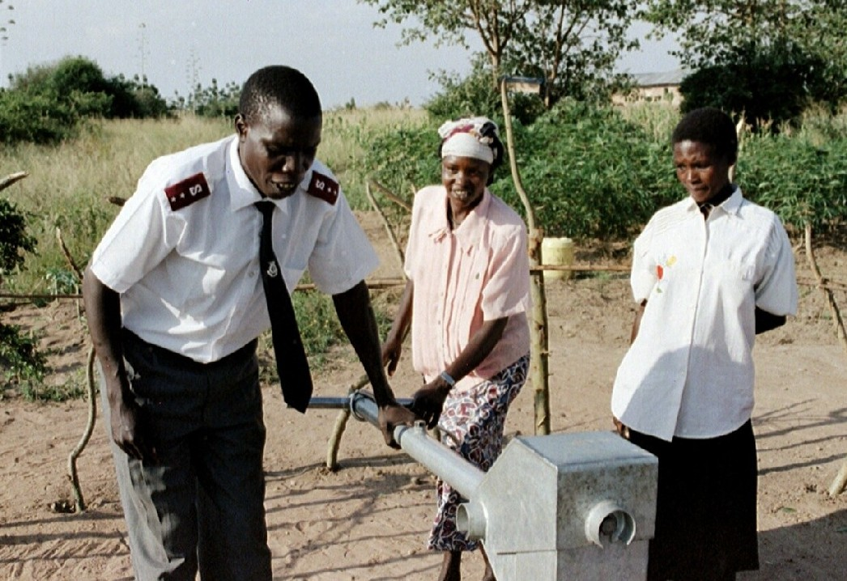
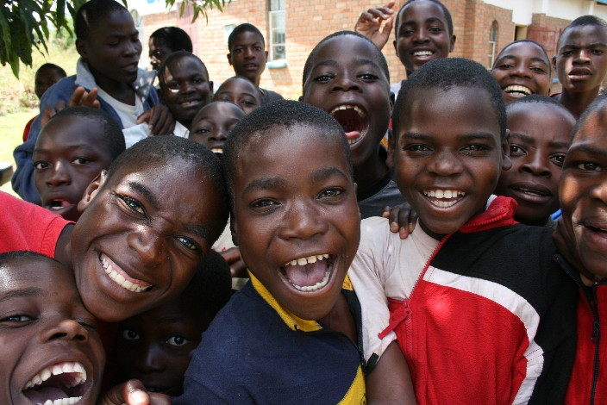


Slide 25

The Salvation Army’s work is motivated by our beliefs… …which come from the Bible.
The Salvation Army
AT WORK IN THE COMMUNITY

Slide 26


Jesus replied, " 'Love the Lord your God with all your heart and with all your soul. Love him with all your mind.' This is the first and most important commandment. And the second is like it. 'Love your neighbour as you love yourself.‘
The Bible, Matthew 22:36-39
(New International Reader’s Version)
Jesus said,
‘I was hungry and you fed me,
I was thirsty and you gave me a drink,
I was homeless and you gave me a room,
I was shivering and you gave me clothes,
I was sick and you stopped to visit,
I was in prison and you came to me...’
‘...Whenever you did one of these things
to someone
overlooked or ignored, that was me –
you did it to me.’
The Bible, Matthew 25 (The Message paraphrase)

Slide 27
The Salvation Army in…
(Name of town)
The Salvation Army
AT WORK IN THE COMMUNITY
Notes:
Optional slide for adding information about particular SA work in local community

Slide 28
Any questions…?
The Salvation Army
AT WORK IN THE COMMUNITY

