Slide 1
There’s a hole in my life
Homelessness and The Salvation Army

Slide 2
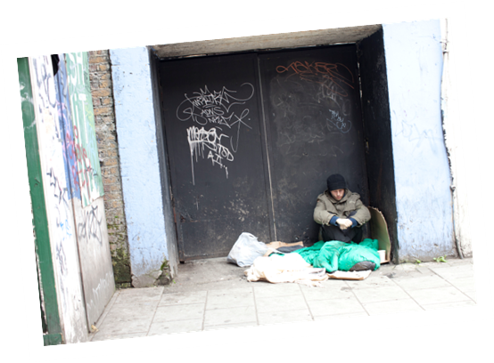
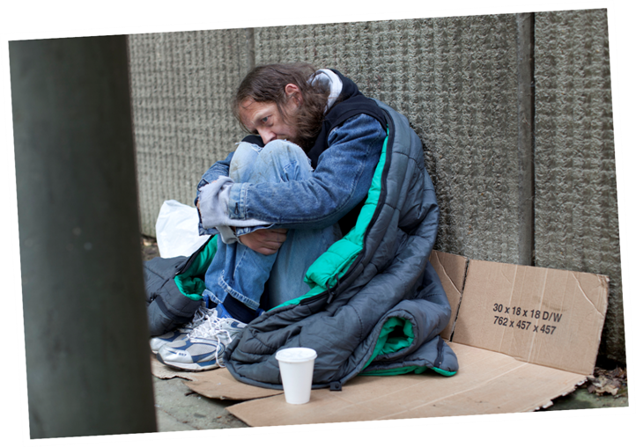

Slide 7
The Salvation Army has:
89 homeless projects
3000 people stay with us each night
Over 700 churches support and help homeless or vulnerable people in their community

Slide 8
51 % spend most of their time alone
26% have no close friends
54% abuse or neglect
96% are unemployed
37% have no qualifications
74% had psychological problems
36% had attempted suicide at least once.

Slide 9
Bad relationships
Harmful addictions
Dangerous situation at home
Losing a job
Running out of money

Slide 10
I’m bored
I’ve got nothing to get up for in the morning.
I have harmful habits.
I don’t know who I am anymore.
I don’t believe in myself.
I can’t see the future.

Slide 11
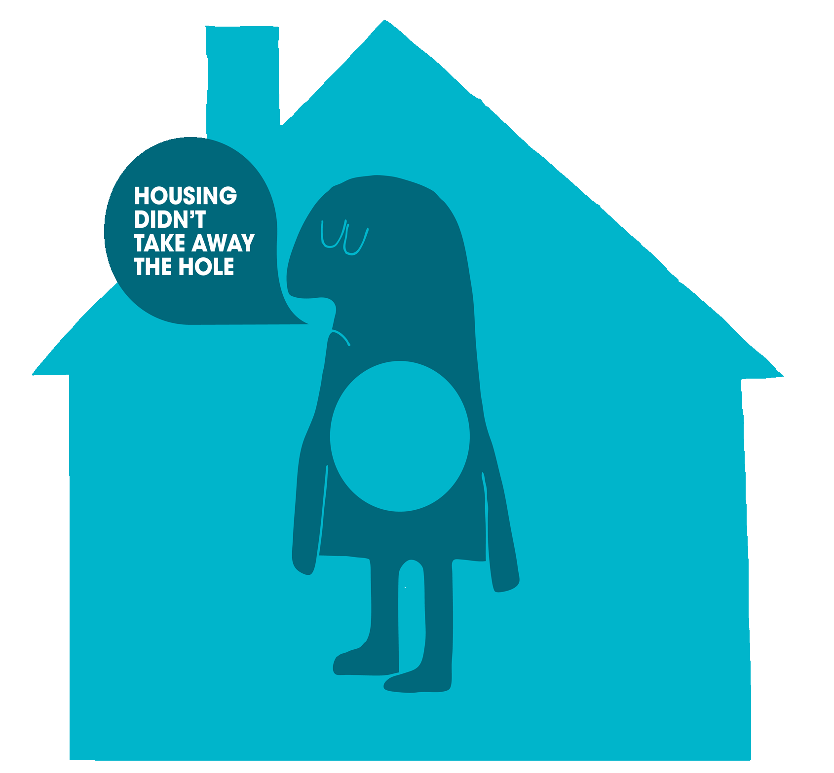
Giving someone a house is useful
but it’s not the answer to the problem.

Slide 12
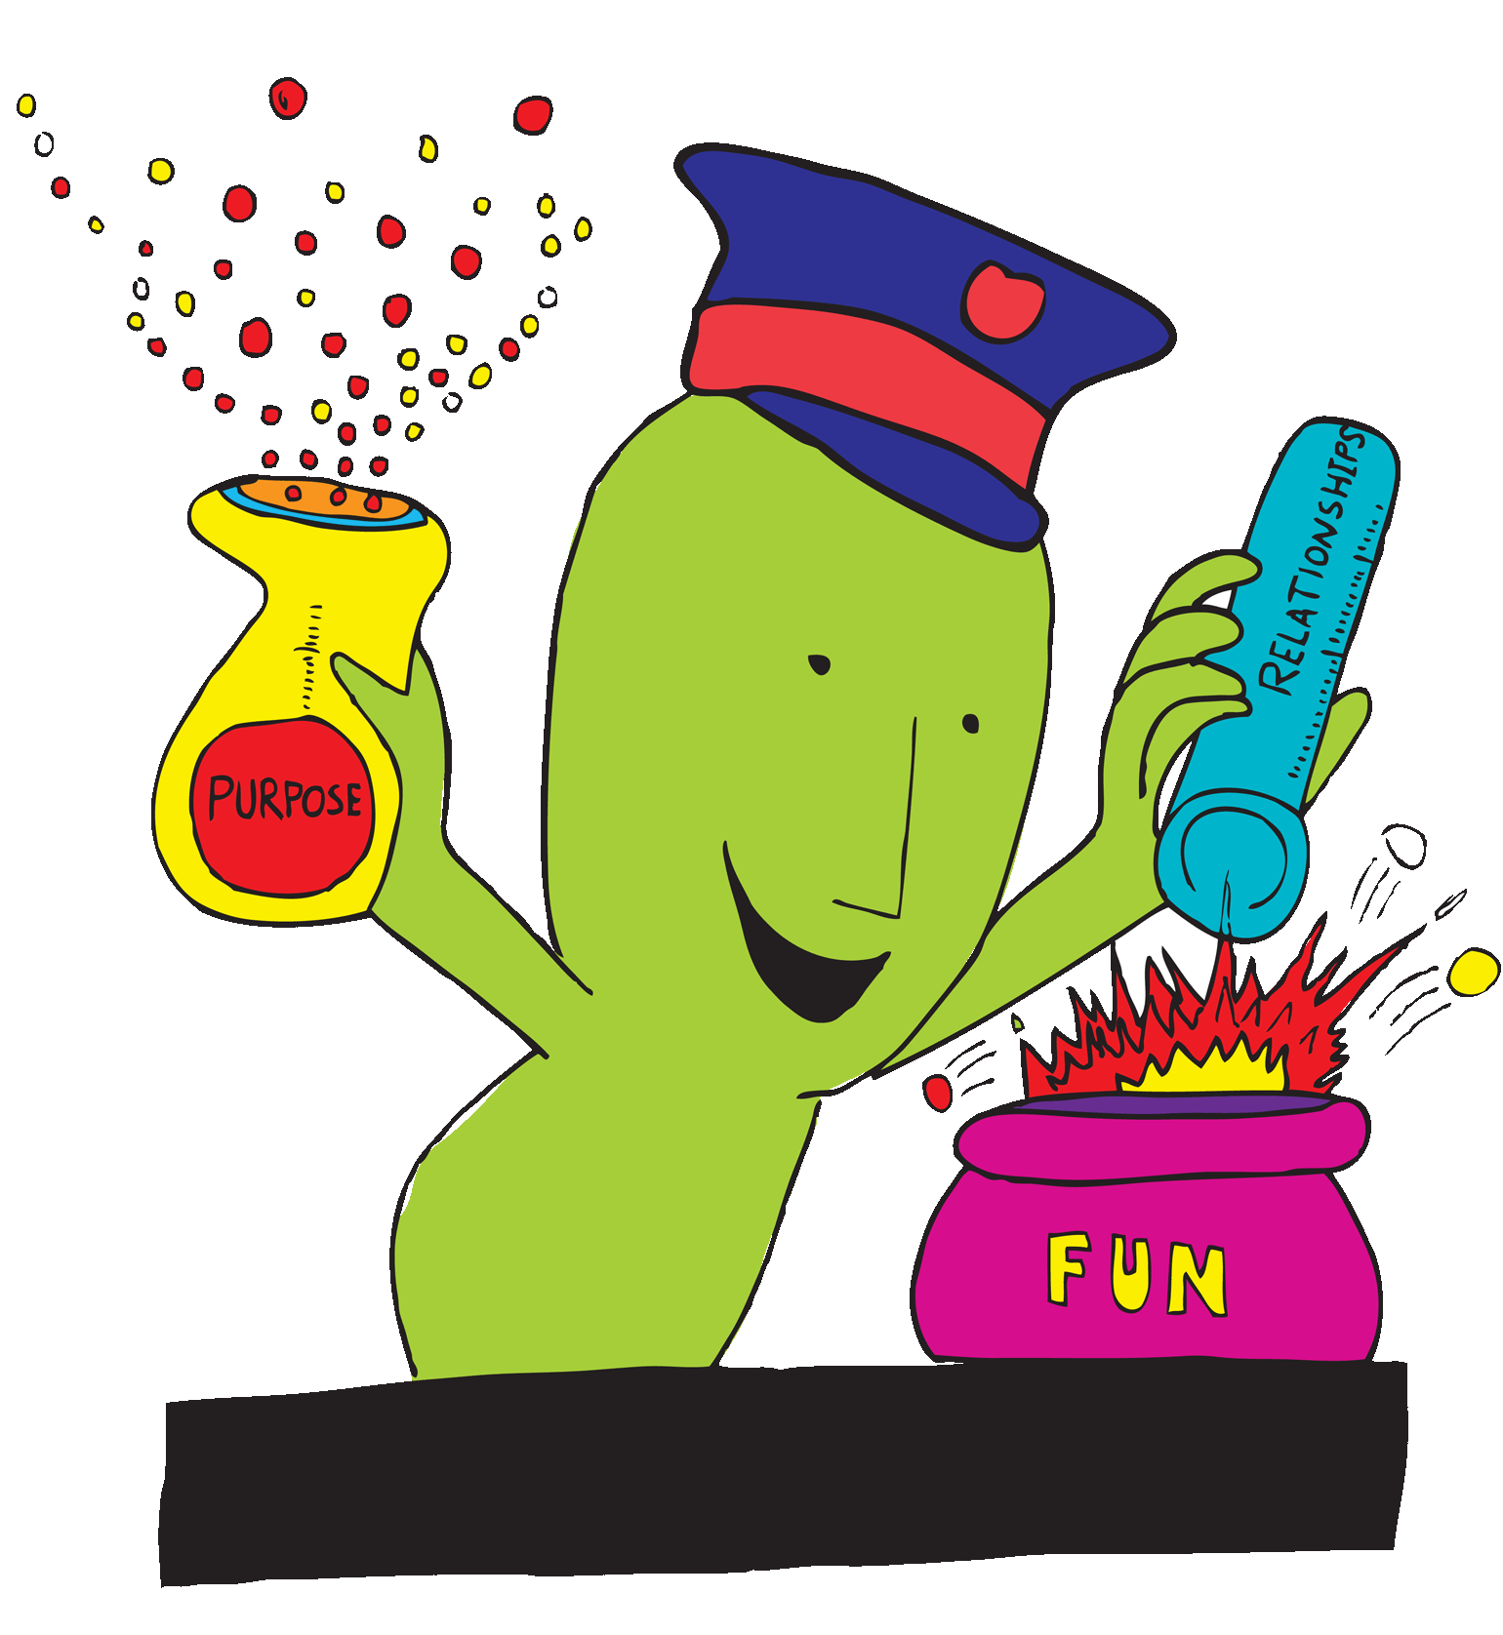
PURPOSE AND RELATIONSHIPS

Slide 13
I’ve lost the hole now I’m a whole person.

Slide 14
Goodbye.Thanks for listening!

