Slide 1
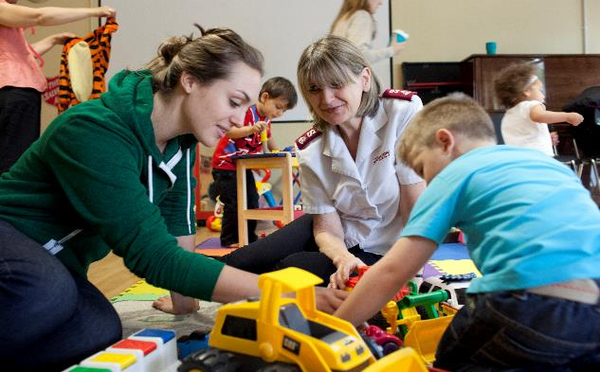
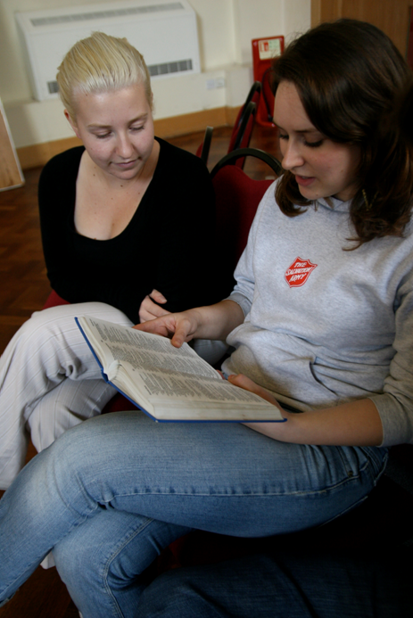
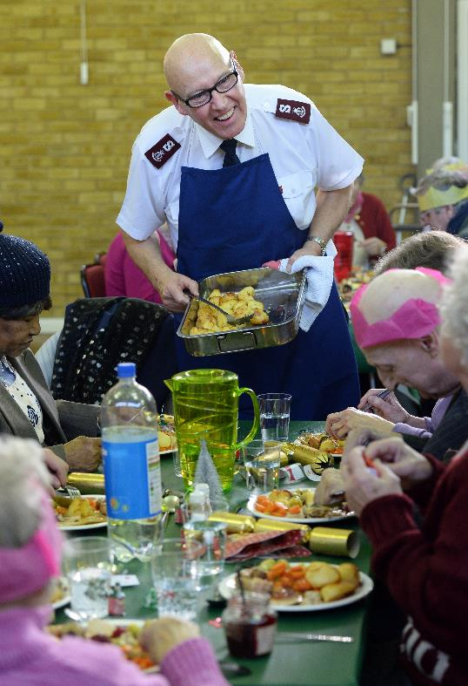
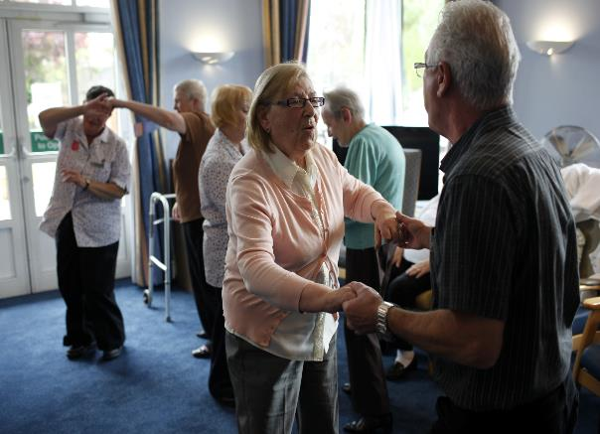


The Salvation Army today

Slide 2
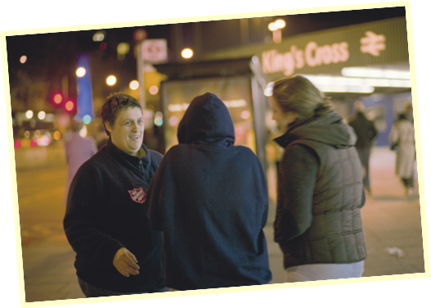
What do you know
about The Salvation Army?

Slide 3
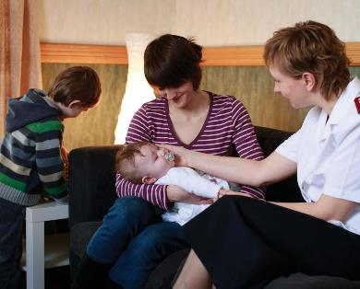

The Salvation Army is…
A Christian Church which strongly
believes in putting its beliefs
in action.
One of the largest and most diverse providers of social care in the UK and Ireland (after the government).

Slide 4
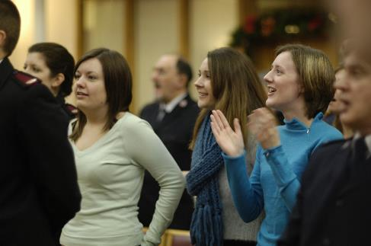

Churches
More than 700 Salvation Army churches in the UK and Ireland.
Over 15,000 in the world.
Protestant denomination.
Similar to Methodist with some unique military-style features.
4

Slide 5
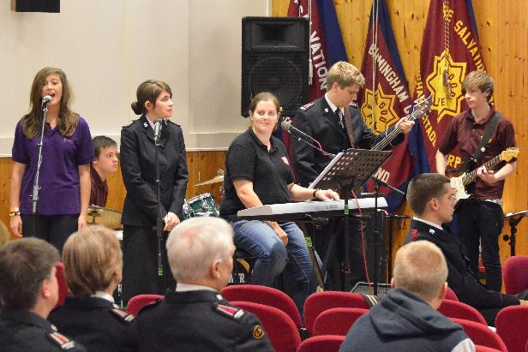
Worship
Worship services take place on Sundays.
Everyone is welcome.
Services can include singing, listening to music, Bible readings and teaching, prayers, dance and drama.
There is no set liturgy - worship can vary from church to church.

Slide 6
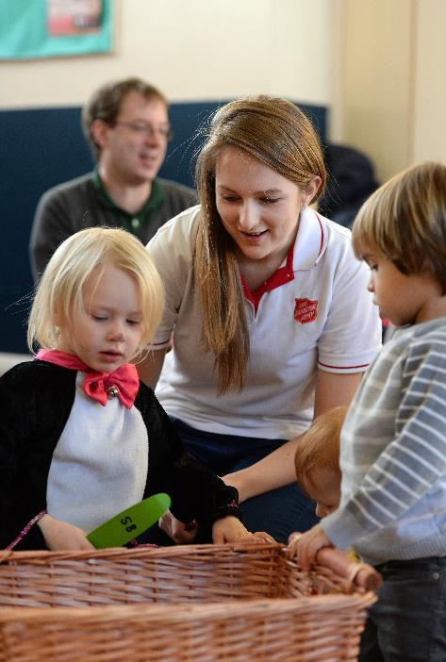

Support for children and families
Parent-and-toddler groups, nurseries, parenting classes.
Breakfast clubs and after-school clubs.
Family rehabilitation centres.
Safe houses.
Family Tracing Services

Slide 7

Work with young people
Street work - reaching young people at risk of falling into prostitution, drugs and crime.
Youth clubs, drop-in centres and holiday schemes for young people from disadvantaged backgrounds and low-income families.

Slide 8
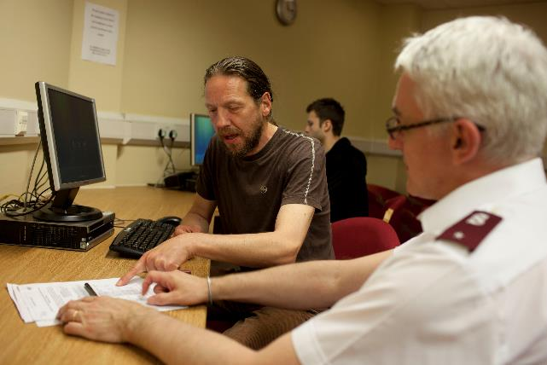
Tackling homelessness
One of the biggest providers of services to homeless people in
UK & Ireland.
More than just food and shelter.
Purpose and relationships are key.
Provide training in life skills, and support with gaining qualifications and finding work.
8

Slide 9
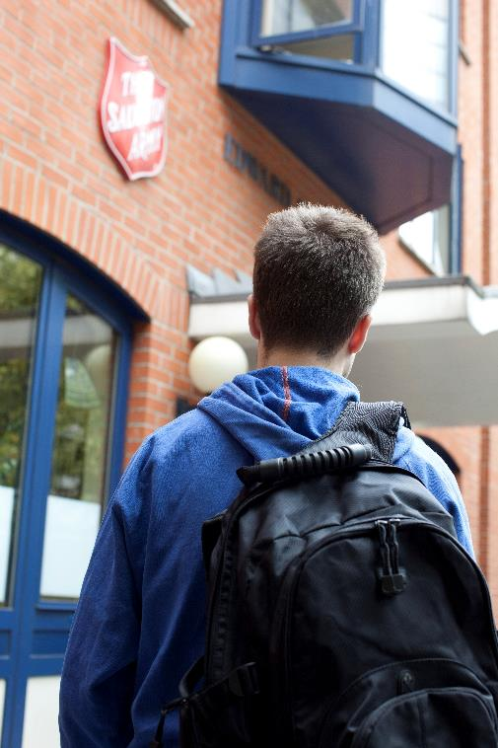

Tackling homelessness
More than 80 Homeless Projects, including:
62 Single Homeless Residential centres.
11 Families and Young People centres.
16 Day/Outreach services.
More than 3000 people stay with The Salvation Army each night.
9

Slide 10
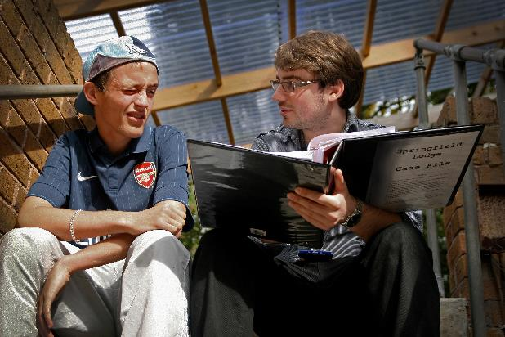
Hope in communities
Living and working in poor areas and helping to transform communities.
Running youth clubs and mentoring programmes for young people.

Slide 11
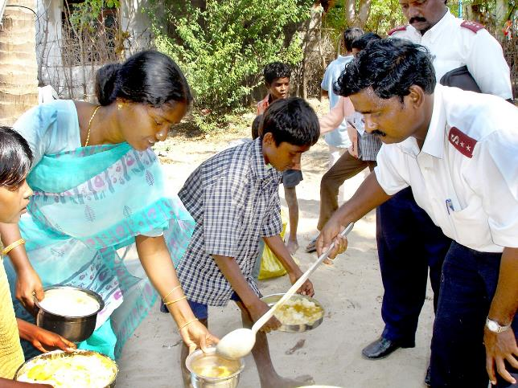

International work
The Salvation Army works in more than 120 countries.
Helping people to find ways out of poverty.
Disaster relief and rehabilitation.
Fighting against human trafficking and other forms of injustice

Slide 12
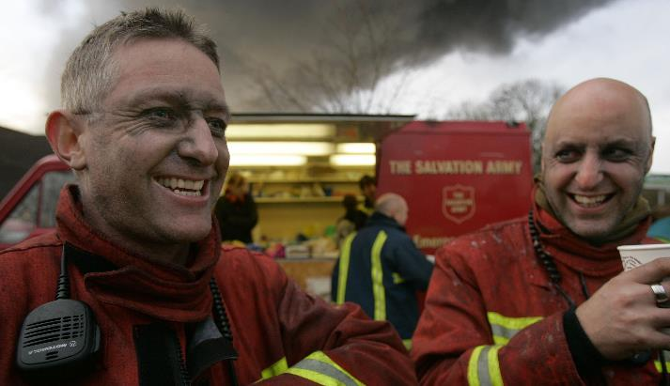
Caring for people in need
Emergency work – providing hot drinks, food and comfort to emergency workers and victims.
Providing food parcels and toys at Christmas to families in need.
Visiting prisoners and supporting their families.

Slide 13
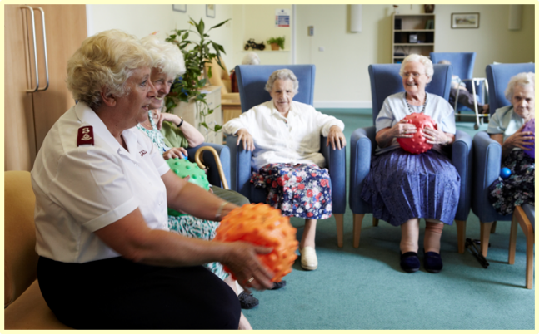

Care for older people
Lunch clubs providing meals and friendship for those who find it difficult to cook for themselves
Residential care homes for those who can no longer live on their own
Christmas Day meals for people who may not have families.

Slide 14
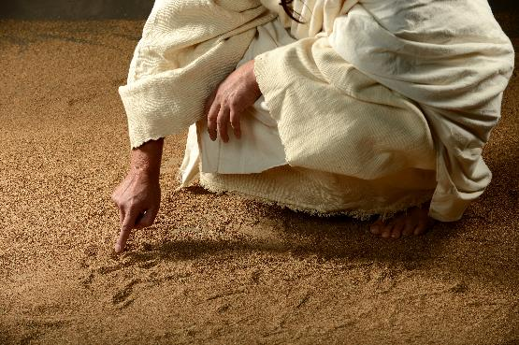

Jesus said:
I was hungry and you fed me,
I was thirsty and you gave me a drink,
I was homeless and you gave me a room,
I was shivering and you gave me clothes,
I was sick and you stopped to visit,
I was in prison and you came to me.
Matthew 25:36 (MSG)

Slide 15
The Salvation Army today

