Slide 1


A New Start…..

Slide 2

New Year’s Resolutions…
The majority of people give up on their resolutions before the end of January!

Slide 3
Psalm 130 : 3-4
As it turns out, forgiveness is your habit, and that’s why you’re worshiped.

Slide 4
Matthew 18 : 21-22
At that point Peter got up the nerve to ask, “Master, how many times do I forgive a brother or sister who hurts me? Seven?”
Jesus replied, “Seven! Hardly. Try seventy times seven. ”

Slide 5
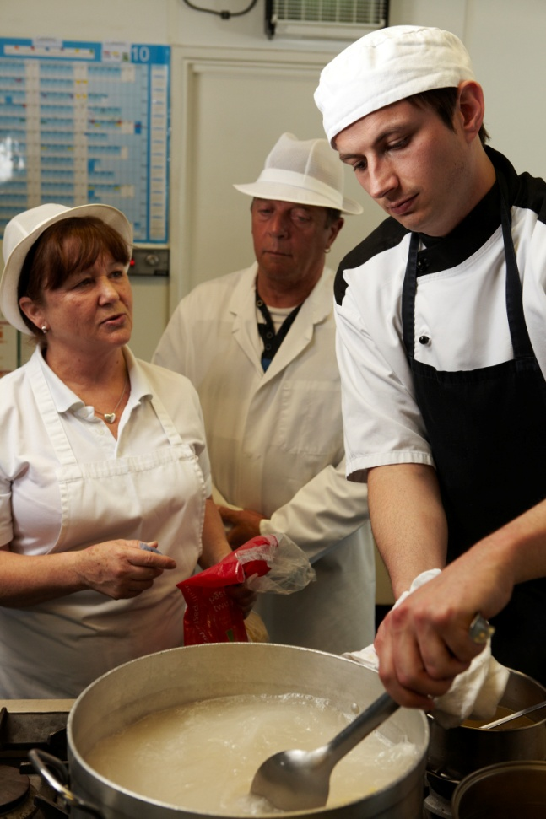
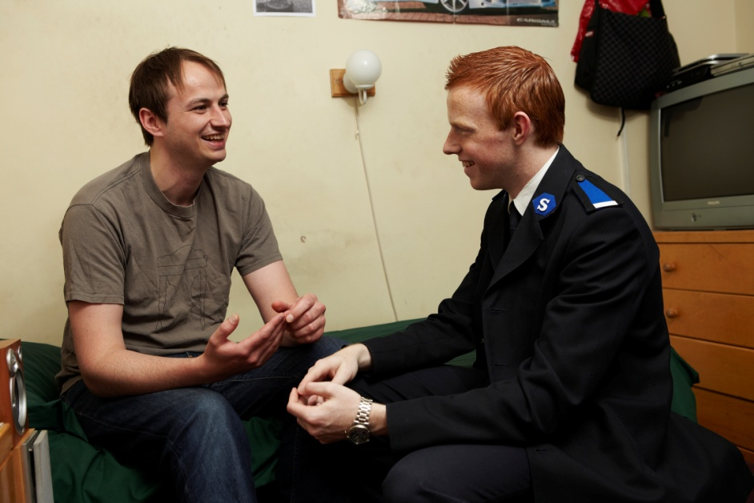
Second
Chances…

Slide 6
A New Start…..

