Slide 1
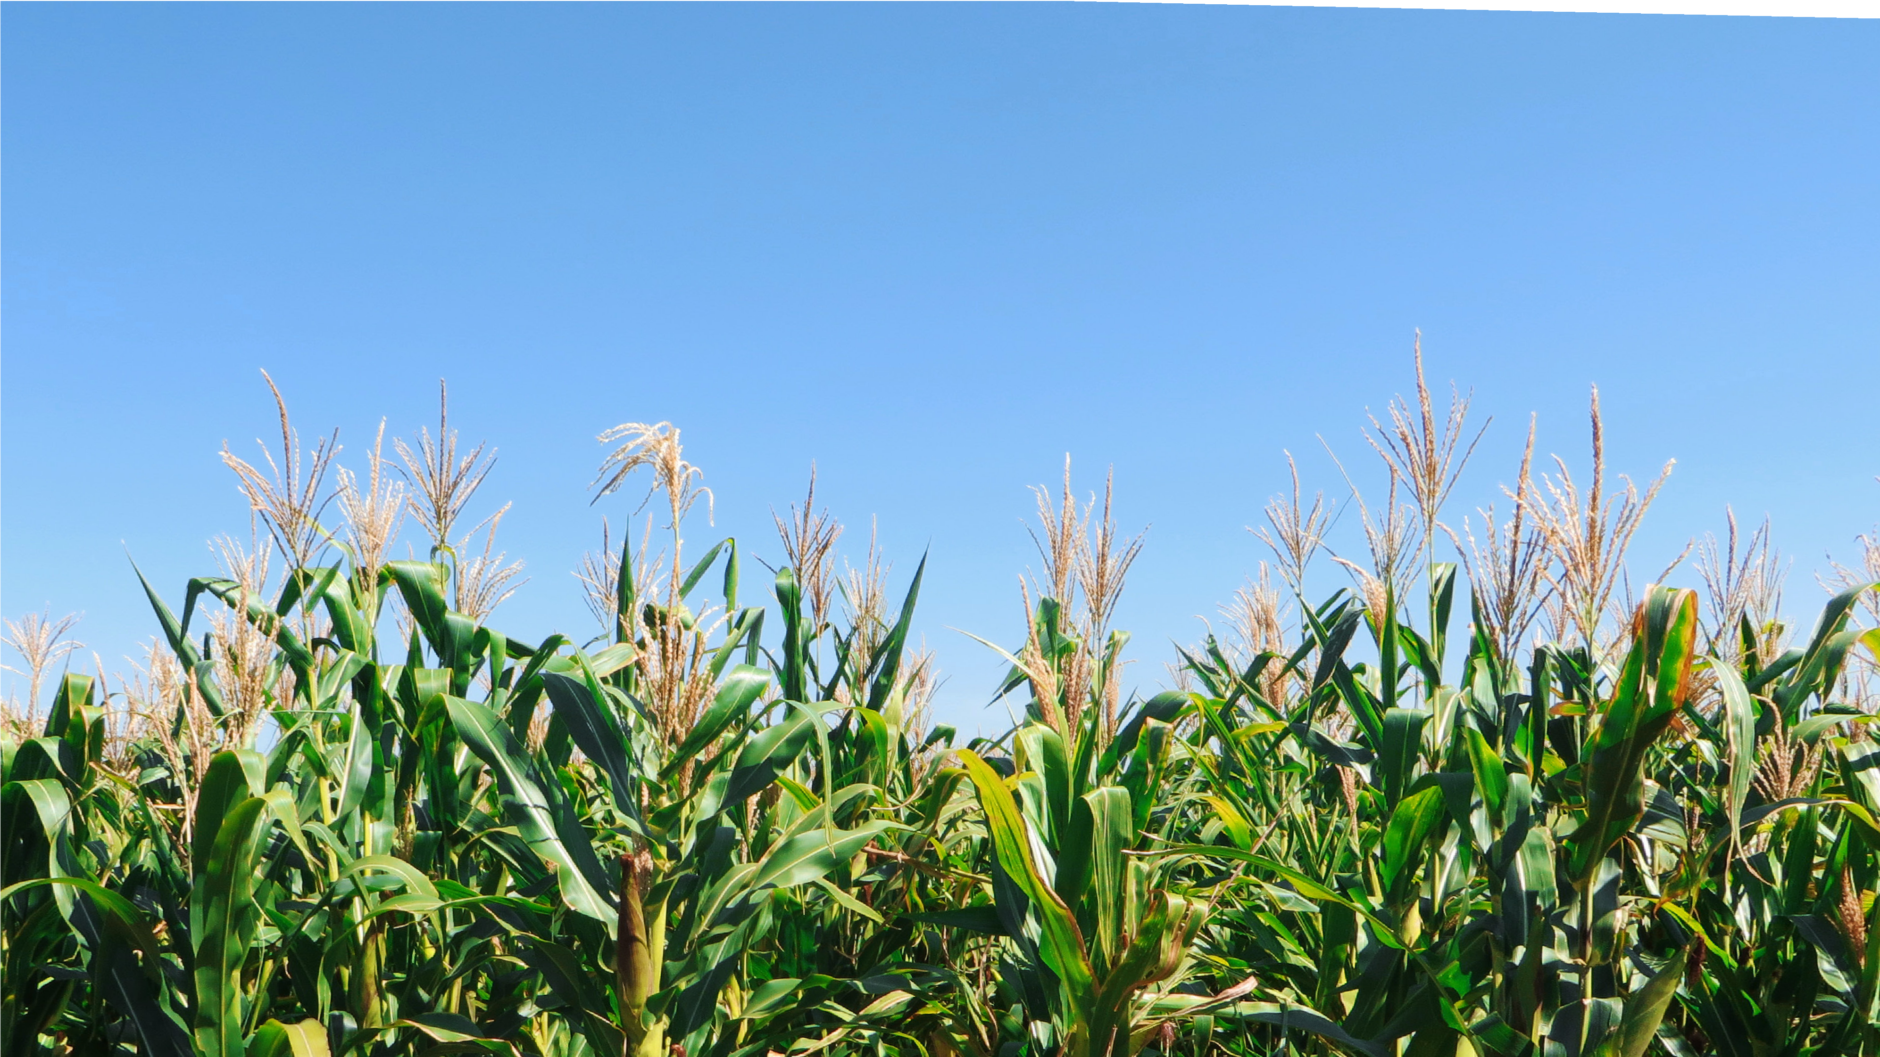

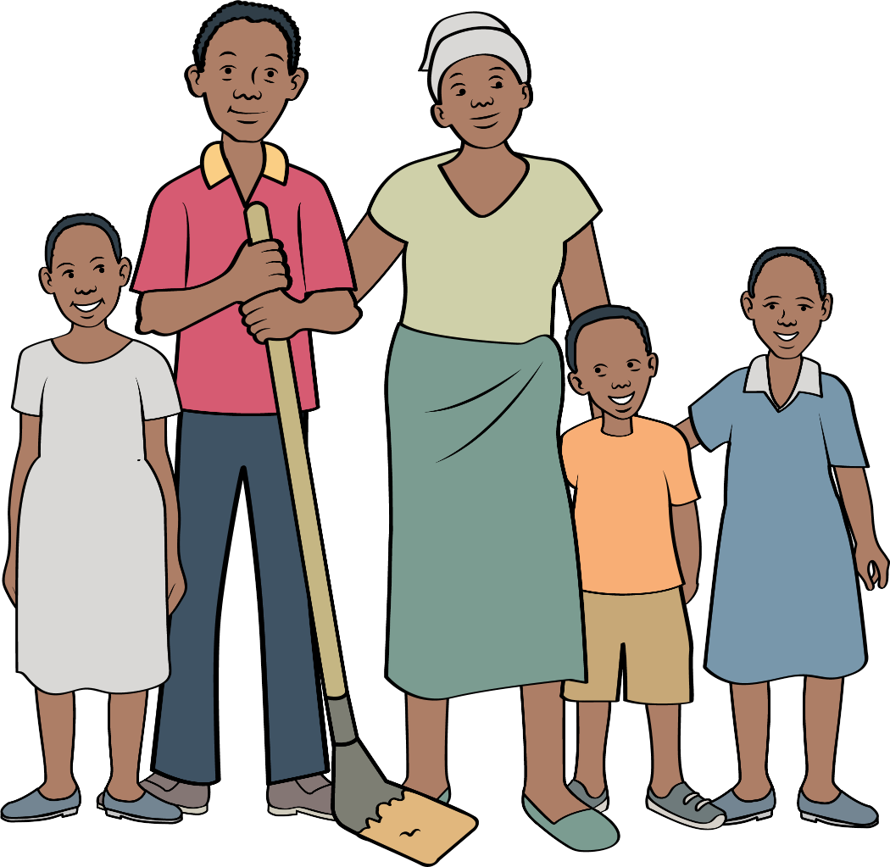

HELPING-HAND 2021
SALVATIONARMY.ORG.UK/FEEDINGHOPE
Support families and their communities, feeding hope to farmers now and for
generations to come.
International Development UK
International Development UK
In partnership with Family Ministries
The Salvation Army is a Christian church and registered charity No. 214779 in England and Wales, SC009359 in Scotland and CHY6399 in the Republic of Ireland.

Slide 2
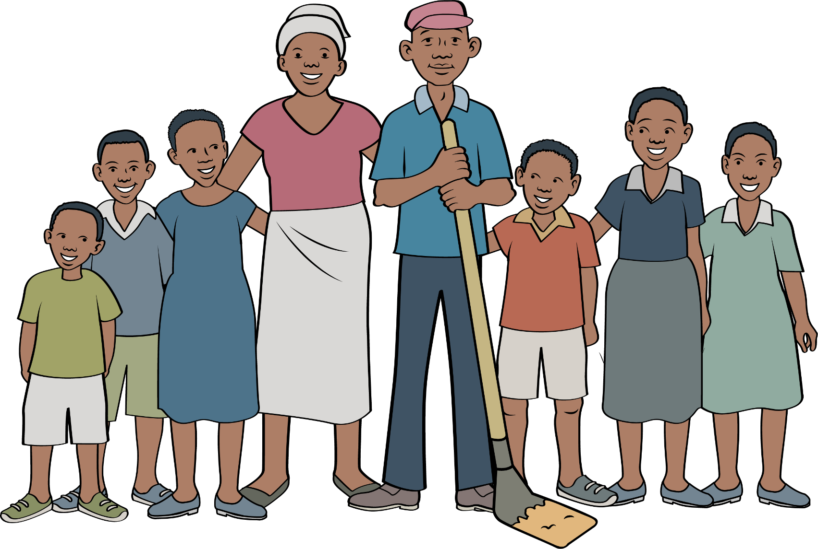
FEEDING HOPE
Focuses on farmers in Zimbabwe
What life is like for them and their families
Funds raised support projects all over the world
Notes:
Through the ‘Feeding Hope’ Campaign, you will get to know some farmers supported by the Salvation Army in Zimbabwe, although the funds we raise will support Food Sustainability Projects all over the world.
Food Security for everyone is a Global Sustainability Goal.

Slide 3
WHAT IS FOOD SECURITY?
Notes:
Food security, as defined by the United Nations’ Committee on World Food Security, means that all people, at all times, have physical, social and economic access to sufficient, safe and nutritious food that meets their food preferences and dietary needs for an active and healthy life.

Slide 4
WHAT IS FOOD INSECURITY?
Notes:
When person doesn’t have access to enough food they are classified as being ‘food insecure’. It is the state of being without reliable access to sufficient, safe and nutritious food.
Food insecurity is now a growing problem. For decades, the world has made huge progress in reducing the total number of people who experience food insecurity, but in recent years this trend has reversed.

Slide 5
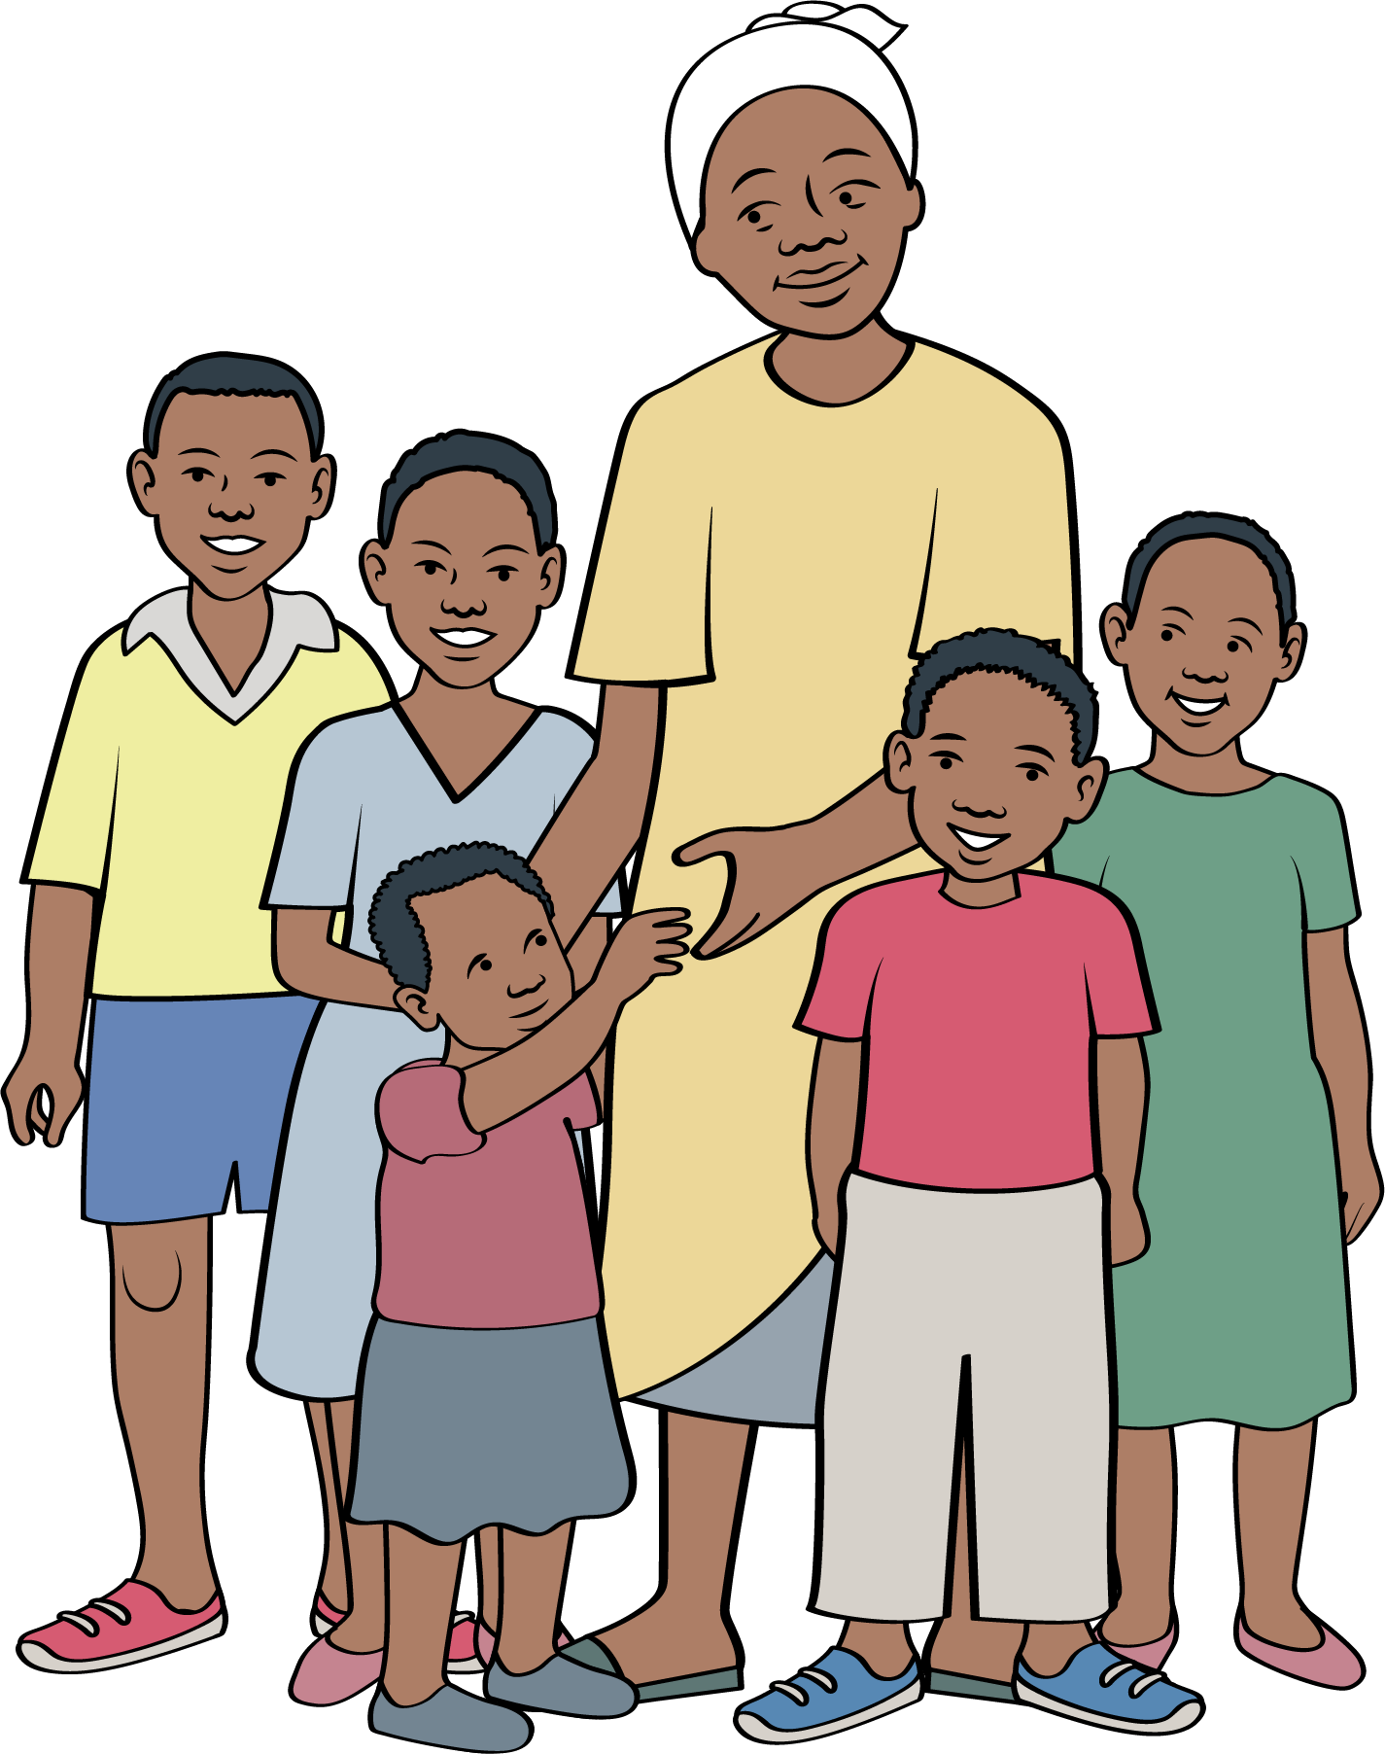
JANET
Notes:
Here’s Janet Mazura, a hard-working mother with her family of five children. She has inherited the family farm and traditional farming techniques from her mother. She is discovering that the traditional techniques are no longer suitable for the changing climate.
The struggles she faces with the farm reflect the struggles she faces at home. Unable to pay the school fees for her children and unable to provide nutritious food, she often goes without so that her children are as well fed as they can be.
This changes when she joins an agricultural training programme for farmers at her local corps.

Slide 6
JANET
Notes:
The Corps compound which is hosting the training has a small plot of land no bigger than Janet’s own that the Corps Officer has used to grow some maize using some new growing techniques.
It is already starting to produce a harvest bigger than Janet’s. She is intrigued and wants to find out more. Janet attends a few sessions run in the Corps hall and listens closely to the Corps Officer and an agriculturalist from a local university who is leading the sessions.
The techniques they are teaching are different from the ones that she has learnt as a child. She learnt how to better manage the water for her crops and recycle the nutrients back into the soil, so it doesn’t become depleted.

Slide 7

MULCHING
Ensure minimal disturbance to soil
Protects fertile top layer of soil
Conserves soil moisture
Soil fertility is increased
No need to purchase synthetic fertilizers
Notes:
MULCHING
The small-scale farmers are trained on the importance of mulching their crops while ensuring minimal disturbance of the soil.
This helps to protect the fertile top layer of soil from being eroded by rain or wind and conserves the soil moisture from evaporation.
When the mulch materials decay, soil fertility is increased and so farmers do not need to purchase expensive synthetic fertilizers.

Slide 8
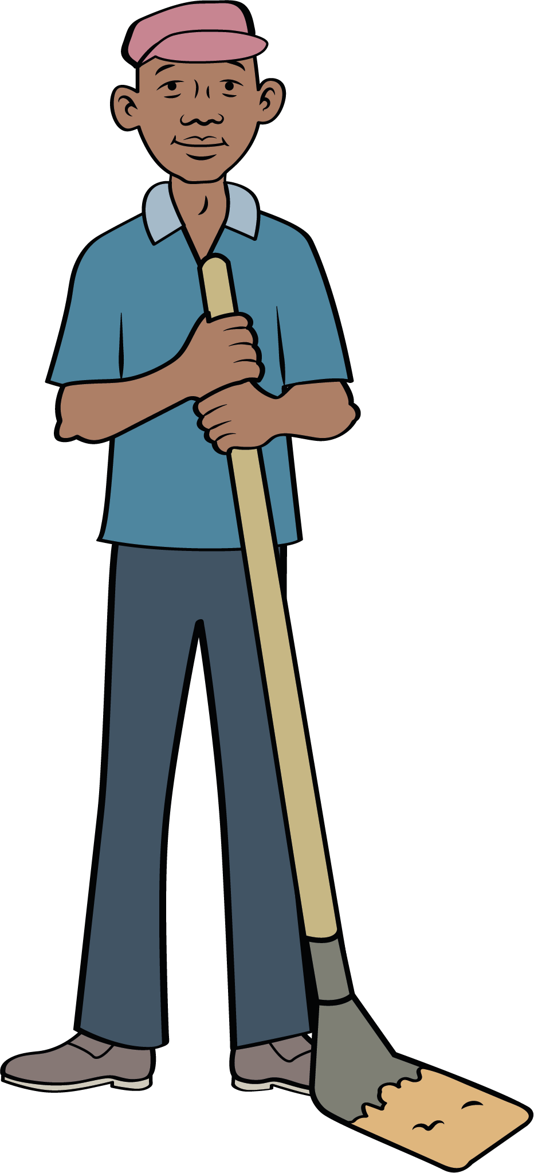
PLANTING & WEATHER
Precision using straight lines and holes –
How to grow diverse crops -
Crop seeds are planted at the onset of the rains -
Crops thrive before dry spell hits -
Saves farmers from laborious burden -
Reduces expenses on artificial fertilizer -
Notes:
PLANTING
The farmers are also trained how to plant their seeds with precision using straight lines and holes and how to grow diverse crops to ensure continued food production and nutrition. When the seeds are planted at the onset of the rains, the young plants can thrive before the dry spells hit. The combination of these methods ensure farmers are saved from the laborious burden of constantly cultivating their land and this reduces the expense and reliance on artificial fertilizer.

Slide 9
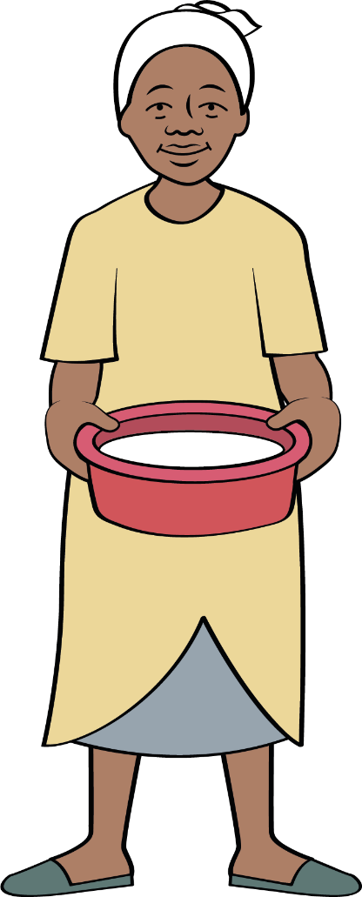
JANET
Notes:
Janet notices small changes at first: the soil seems to be able to hold more moisture than before, the seedlings look stronger, and more seeds have sprouted. The hope within her starts to grow – maybe this is the beginning of a bumper harvest. She continues to tend her crop and speaks with her friends who also attended the training – their crops are showing encouraging signs too. Things are looking up for Janet.
Finally, when it comes to the harvest, Janet cannot believe the results. Double what she has managed in the last year! For now, hunger is kept at bay for Janet and her large family. Janet is full of hope for the next growing season – she knows she might be able to grow even more next year. She has seen how small changes in the way she plants and nurtures her crops can make a huge difference. She has renewed hope for the future.

Slide 10
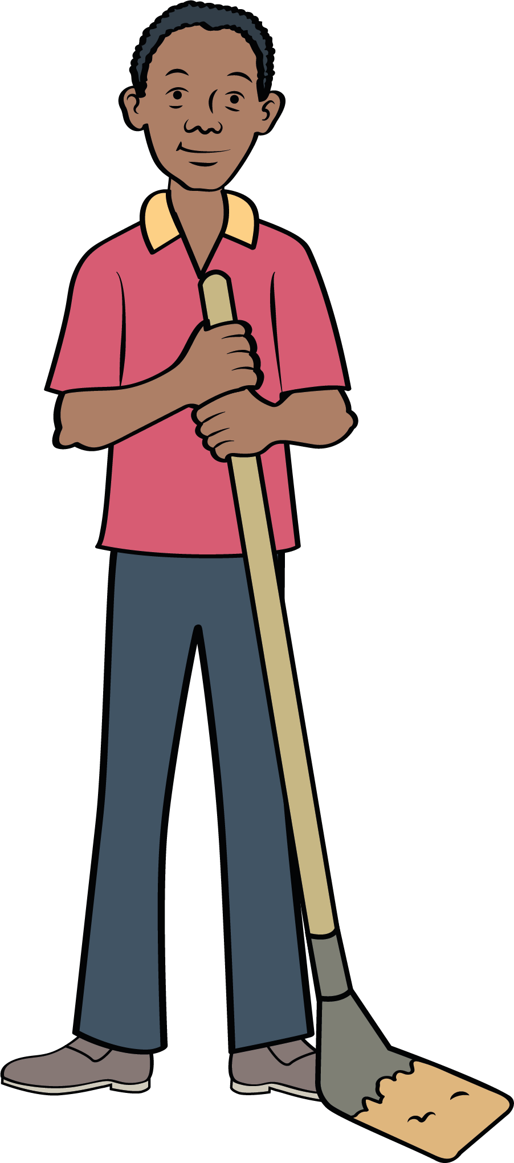
THE SALVATION ARMY & FOOD SECURITY
Training and confidence building
Ensuring individual families can thrive
Whole communities benefit
The Salvation Army can grow through planting of new corps
Notes:
Through its food security programmes around the world, The Salvation Army provides training and confidence building so that individual families from one generation to another can thrive, whole communities can benefit, and The Salvation Army can grow through the planting of new corps.
As you get to know the farmers and read more of their stories on the website, you will see how this ‘virtuous relationship’ between people, environment and The Salvation Army works.

Slide 11
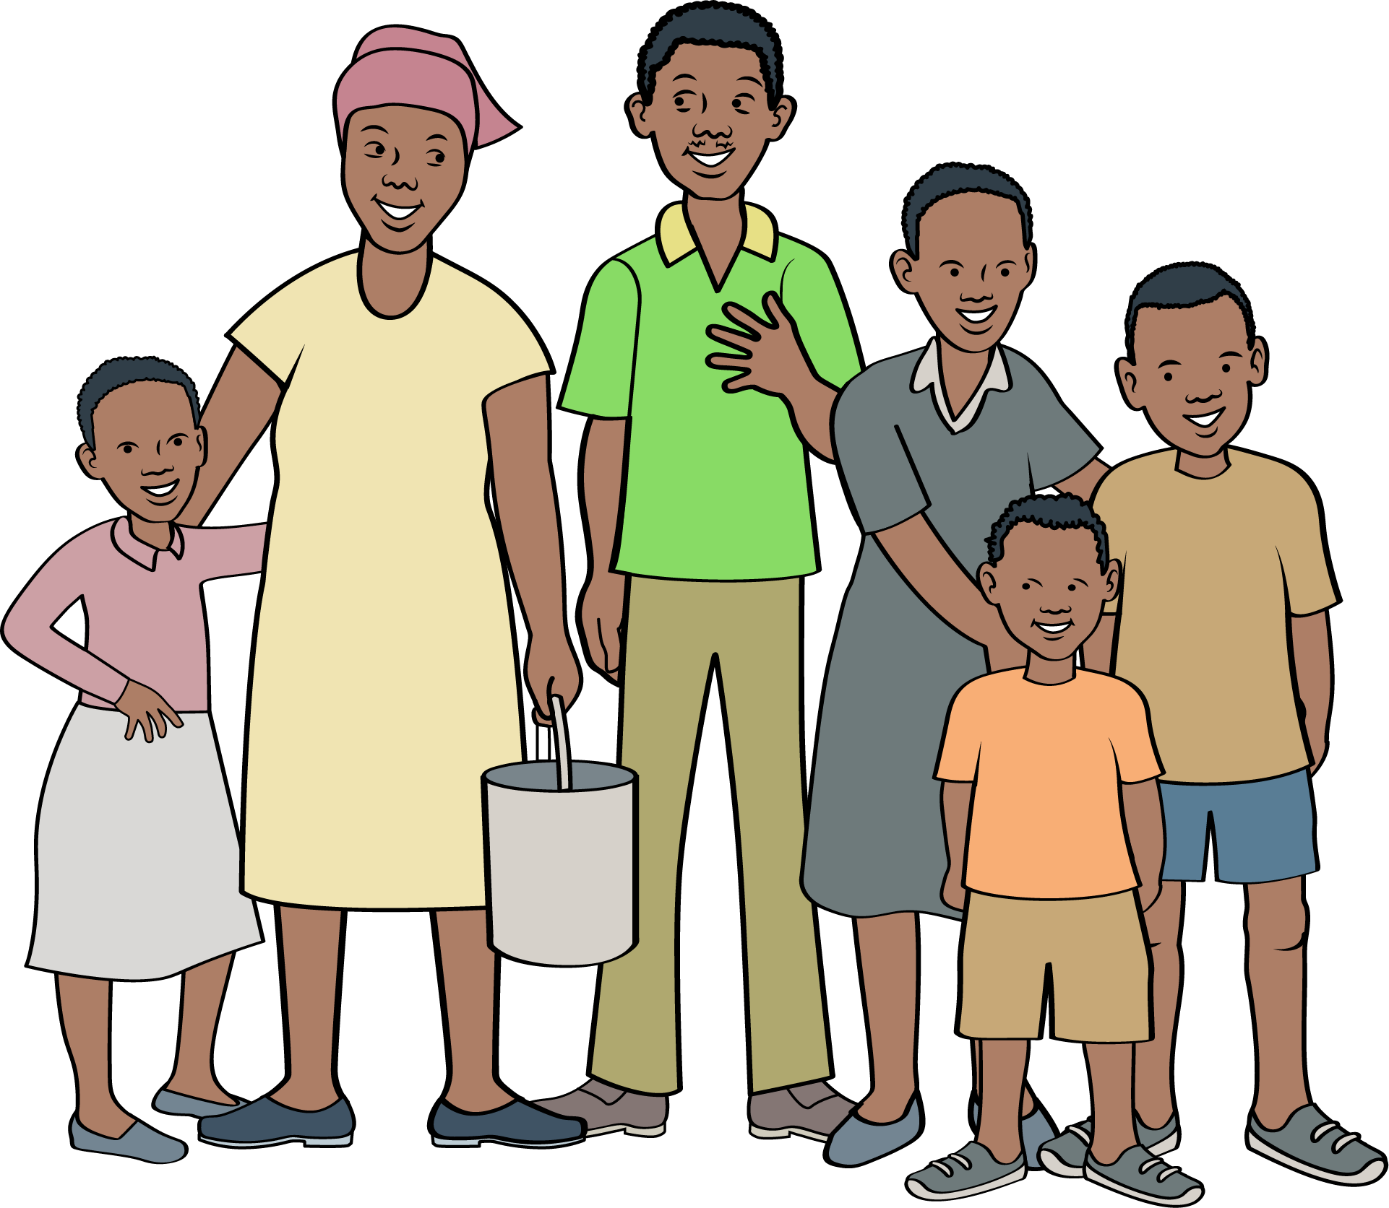
HOW YOU CAN HELP
Pray -
Engage with the resources –
Fundraise with others, on line or together –
Make a donation -
Notes:
A few ways you can help
There are many to include in prayers, you could…
Pray for TSA in Zimbabwe (and other territories we work in on food security projects)
Pray for the individual farmers
Pray for the families
Pray for the corps officers
Engage with our online resources
You can fundraise together - Social distance pizza night, online fashion show or bake off, plant up your own harvest and sell the produce – sweet peas, sunflowers, tomatoes, potatoes
Make a donation online by visiting our website www.salvationarmy.org.uk/feedinghope/

Slide 12
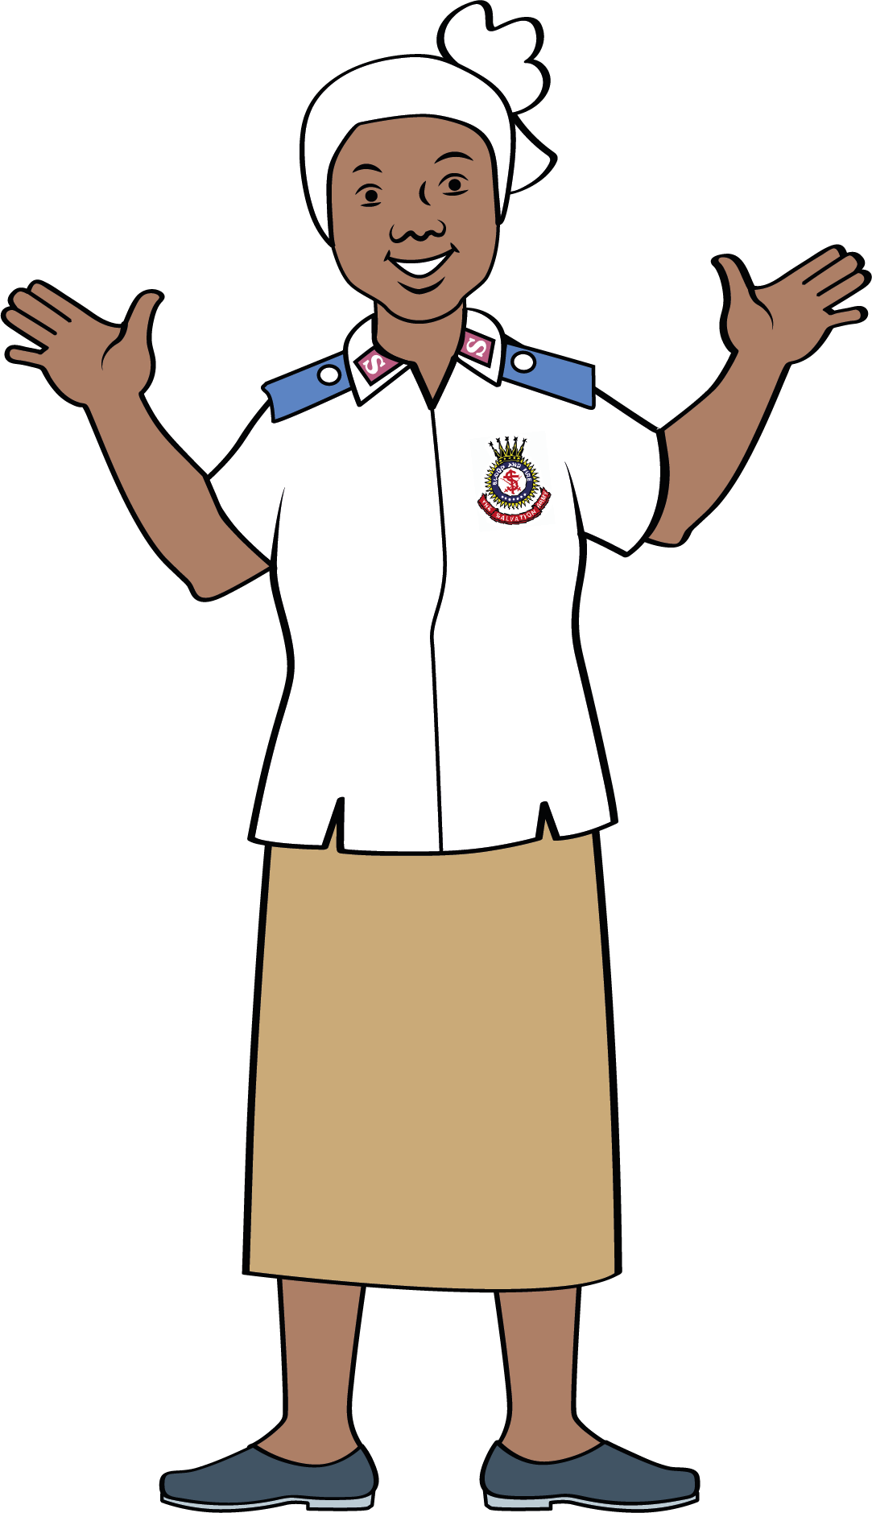




JOIN OUR ONLINE COMMUNITY
The Salvation Army ID Family Ministries
salvationarmyid
salvationarmyid
salvationarmyid
thesalvationarmyid
sarmyfm
ukifamily
familyministries
#feedinghope
Notes:
You can find both SAID UK and Family Ministries on social media! We’d love to find out what you are doing for Feeding Hope whether that be fundraising or through the resources you can find on our website www.salvationarmy.org.uk/feedinghope/

Slide 13
HELPING-HAND 2021
SALVATIONARMY.ORG.UK/FEEDINGHOPE
Support families and their communities, feeding hope to farmers now and for
generations to come.
International Development UK
International Development UK
In partnership with Family Ministries
The Salvation Army is a Christian church and registered charity No. 214779 in England and Wales, SC009359 in Scotland and CHY6399 in the Republic of Ireland.

