Slide 1
Tell me …
KS2 Lesson: Caring During Coronavirus

Slide 2
Learning objectives:
To learn about the work of The Salvation Army during the pandemic.
To consider why The Salvation Army helps people.

Slide 3
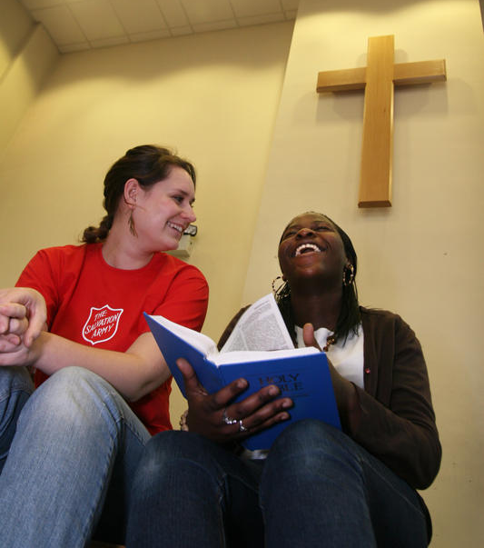
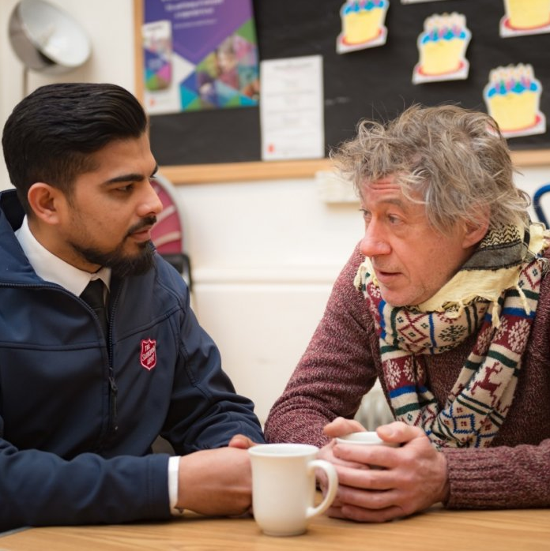
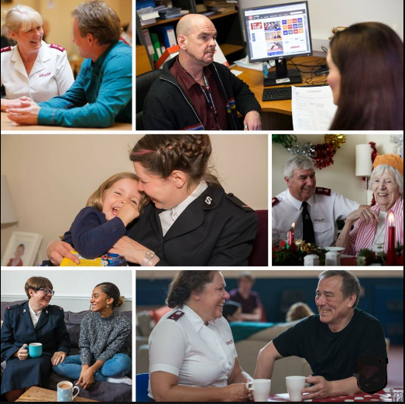
What do you know about The Salvation Army?
What is it?
What does it do?

Slide 4
What does The Salvation Army do?
Let’s find out!

Slide 5
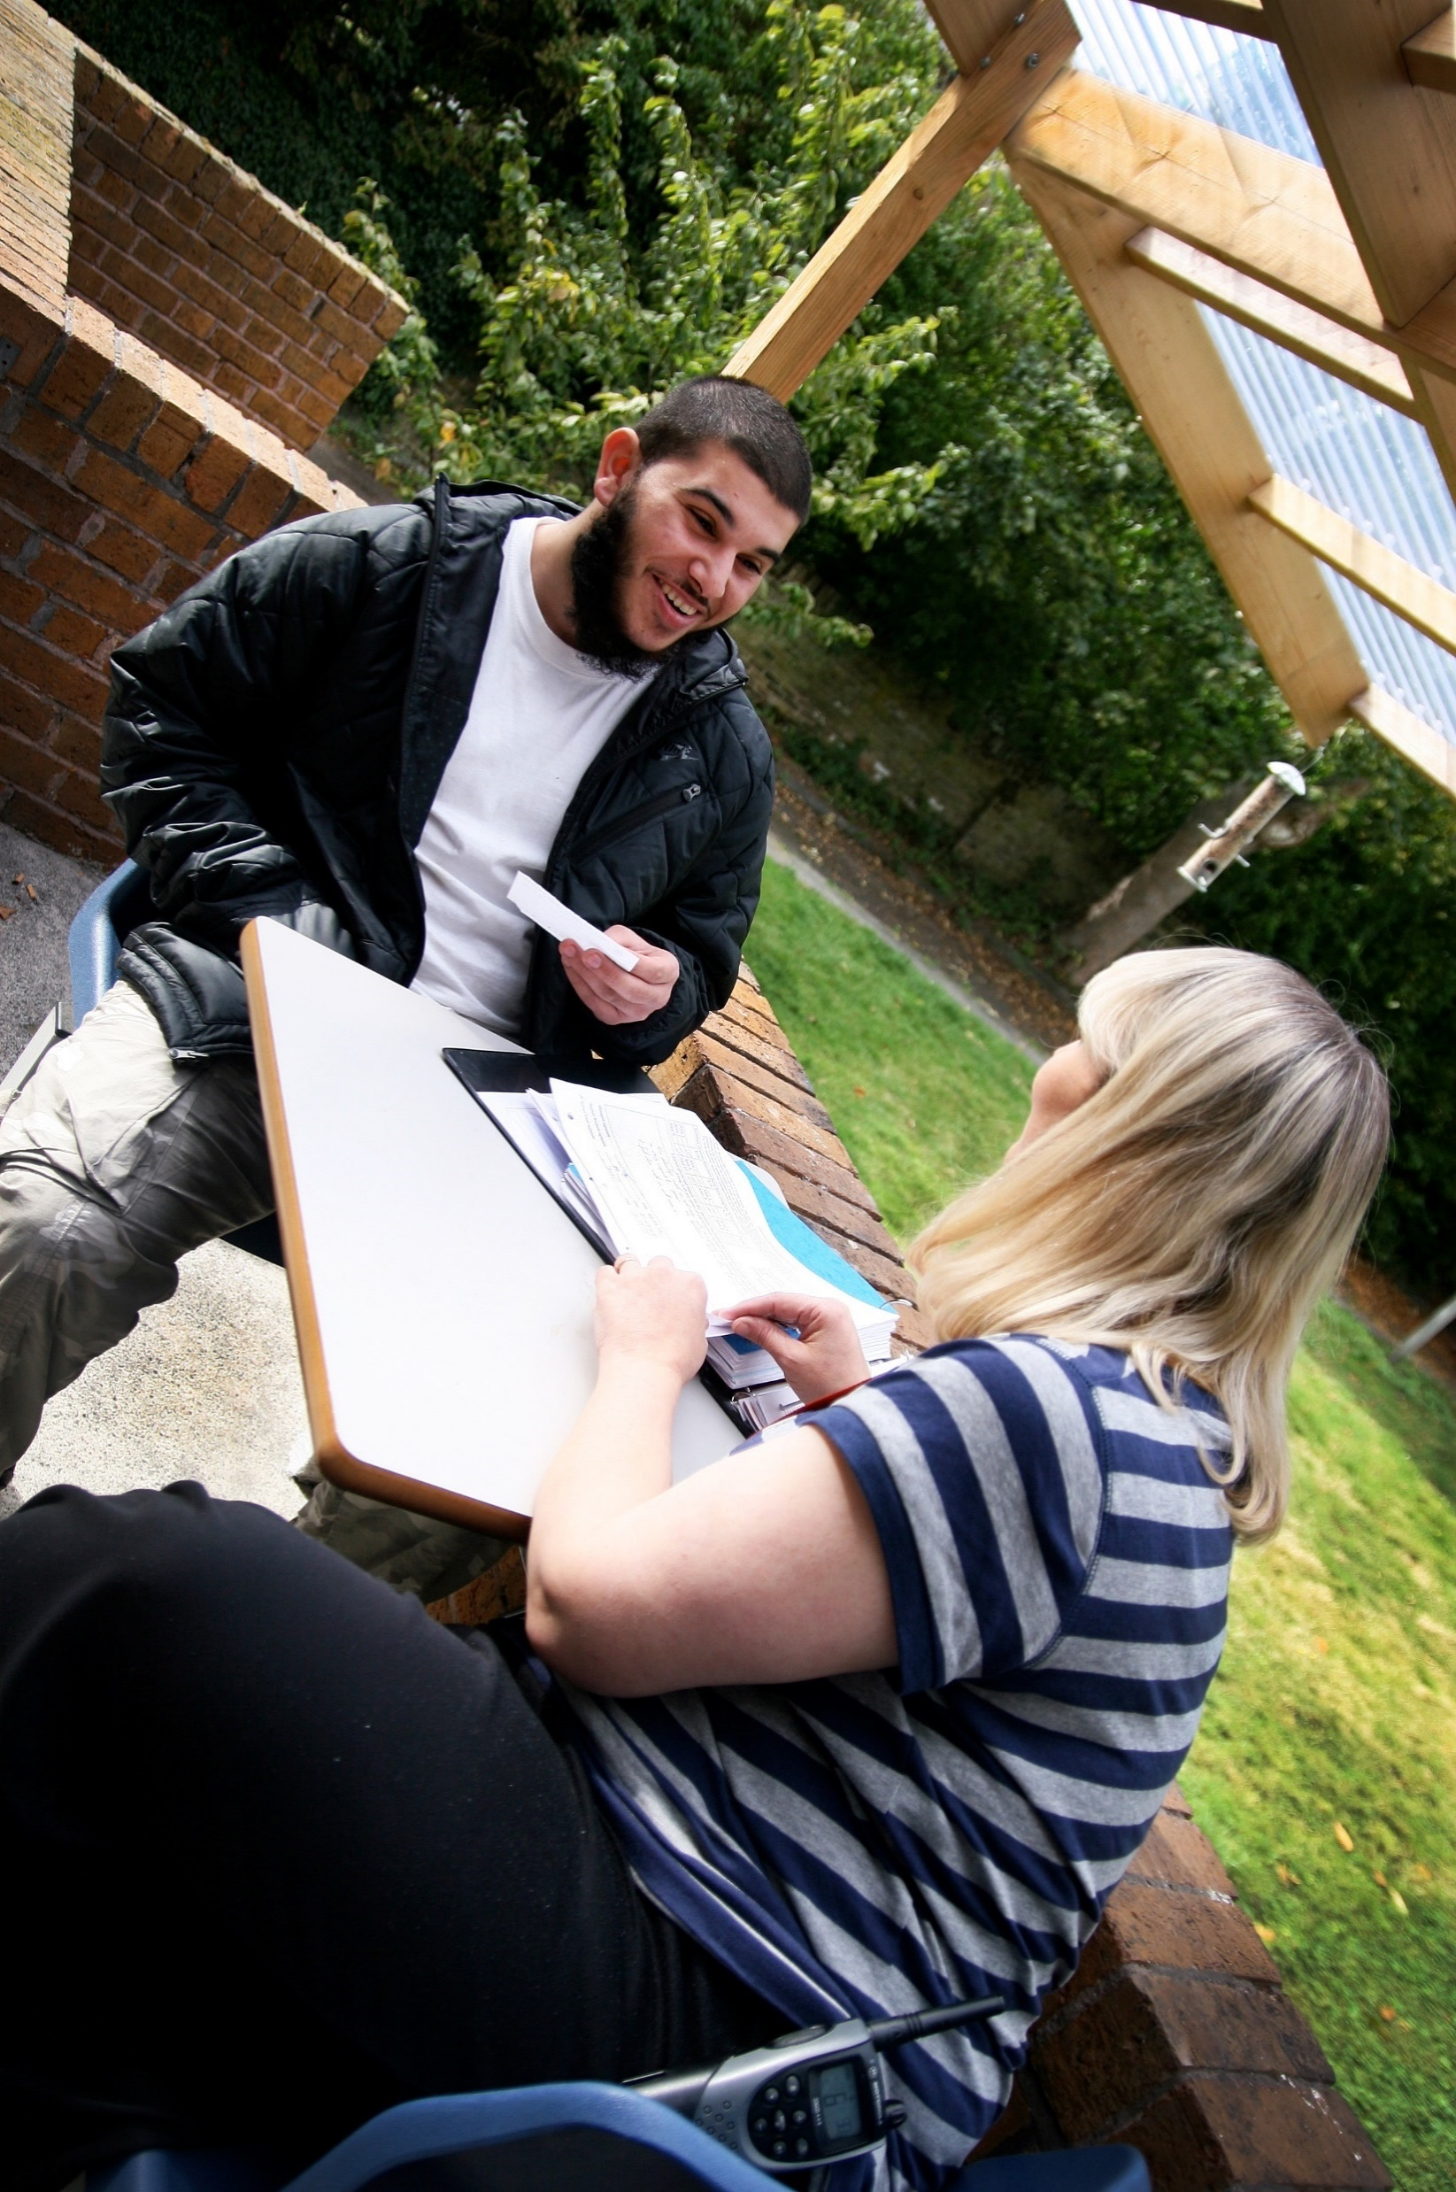
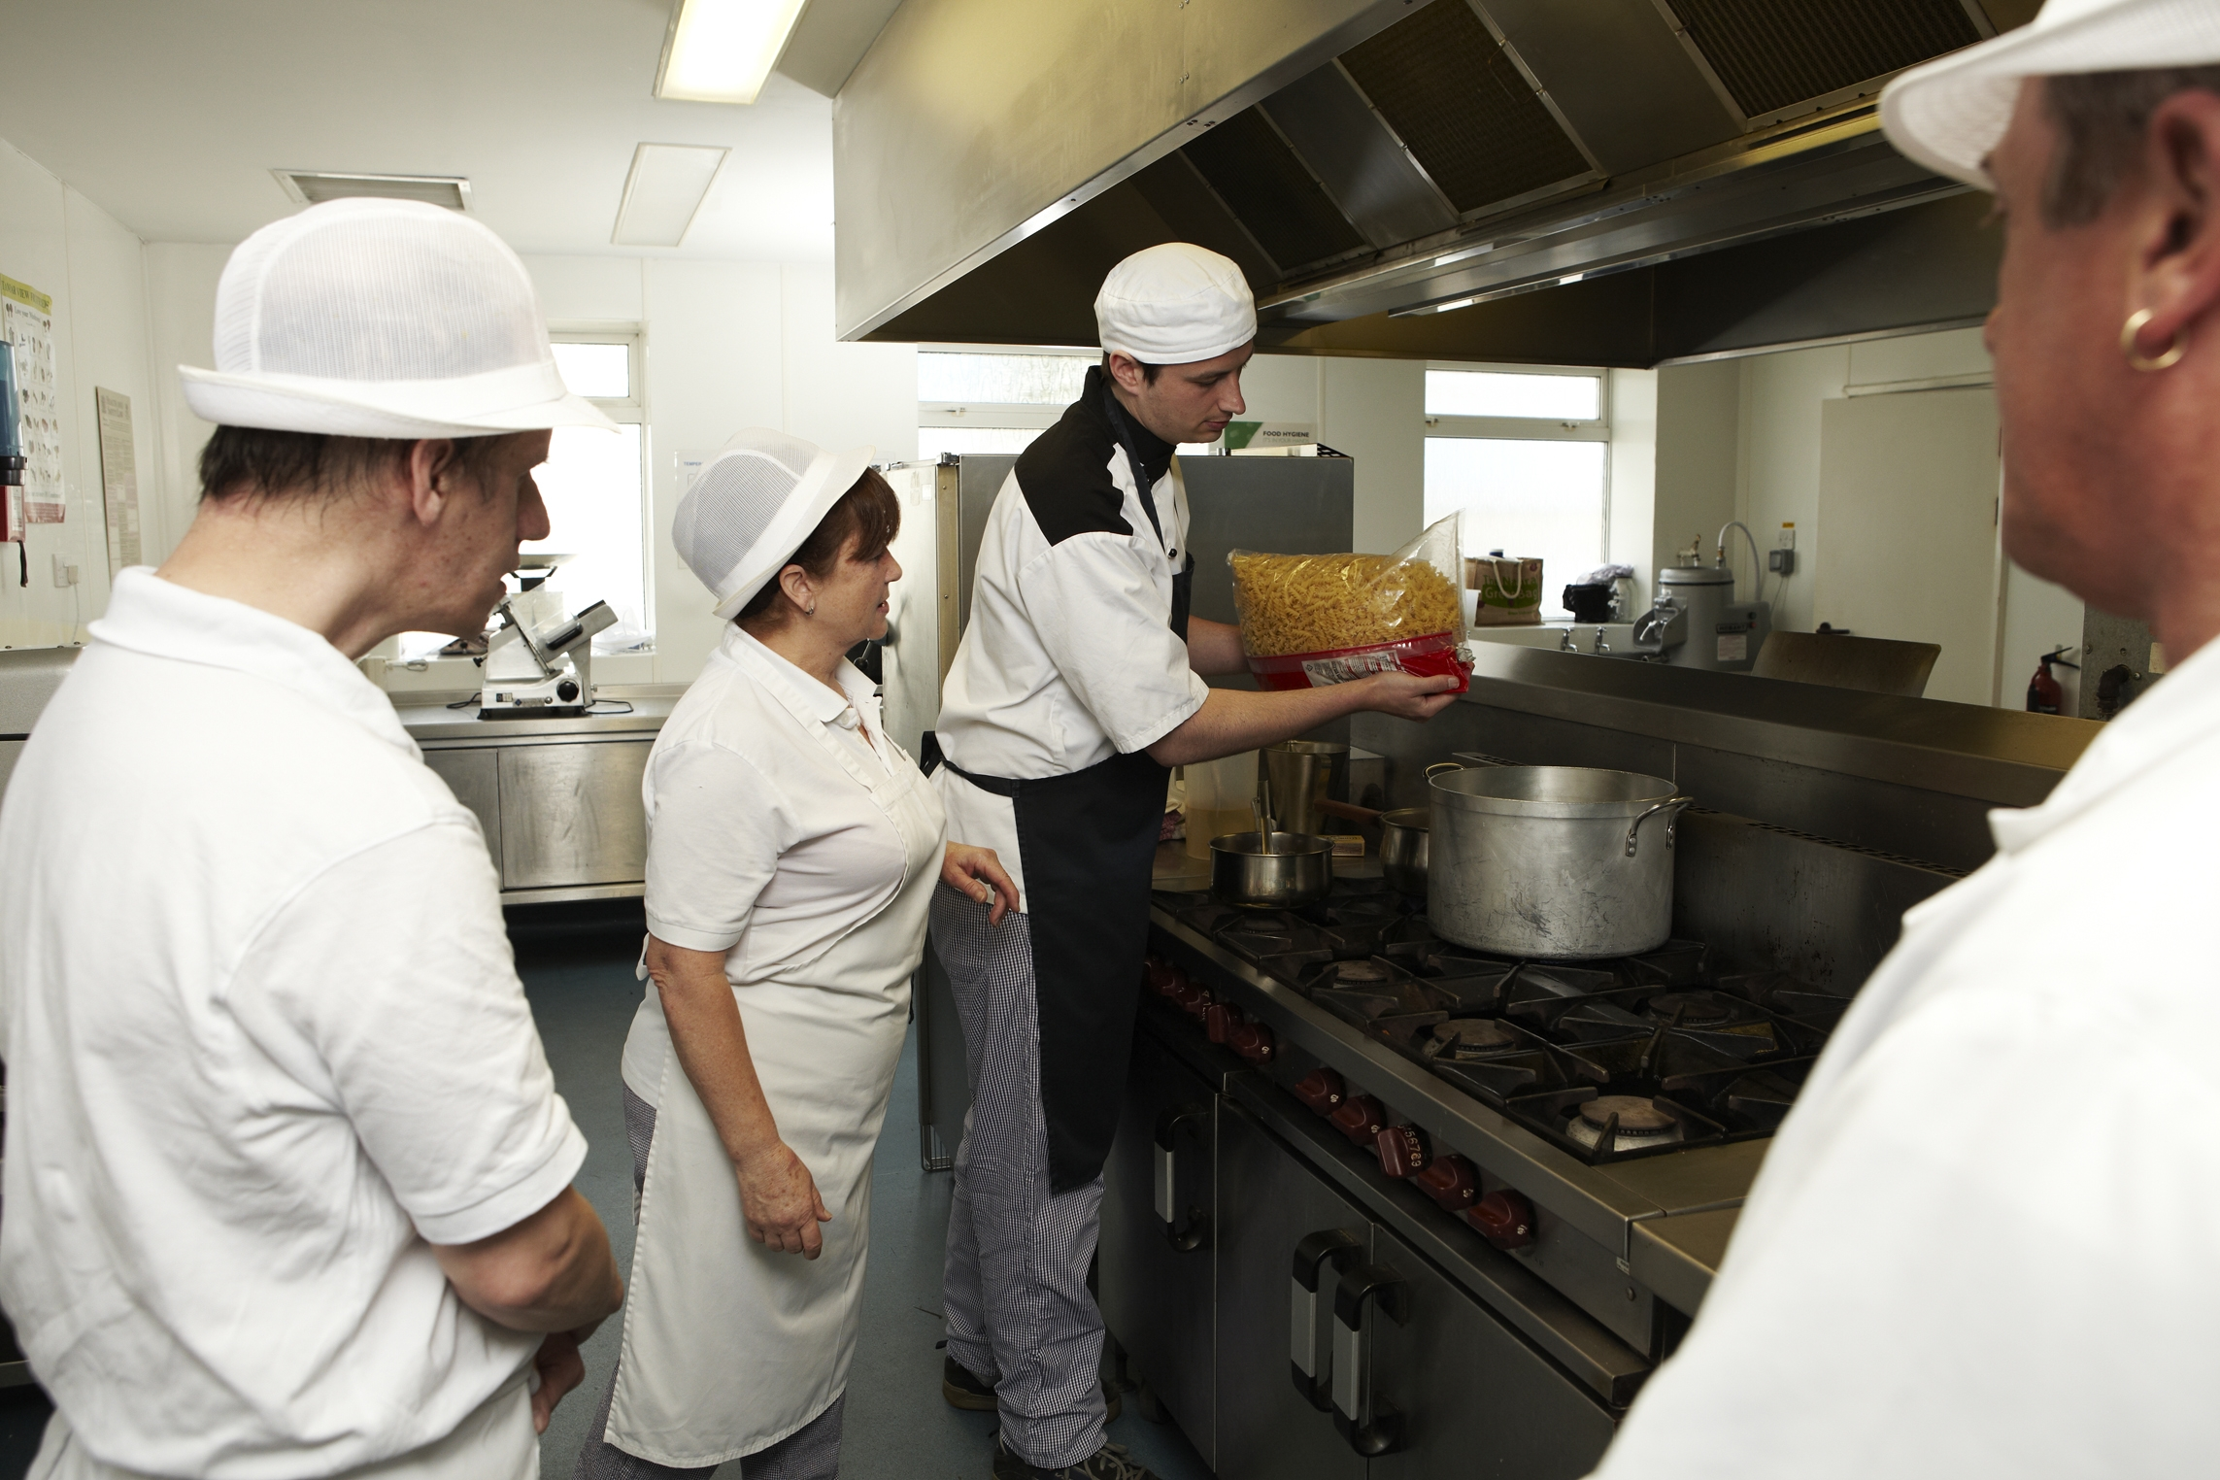
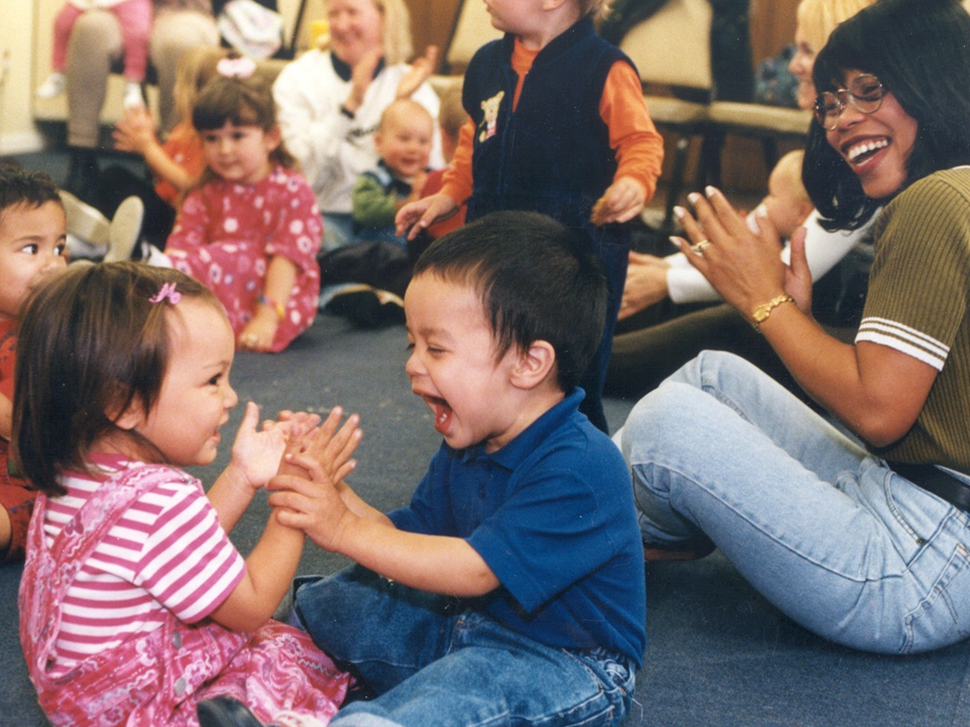
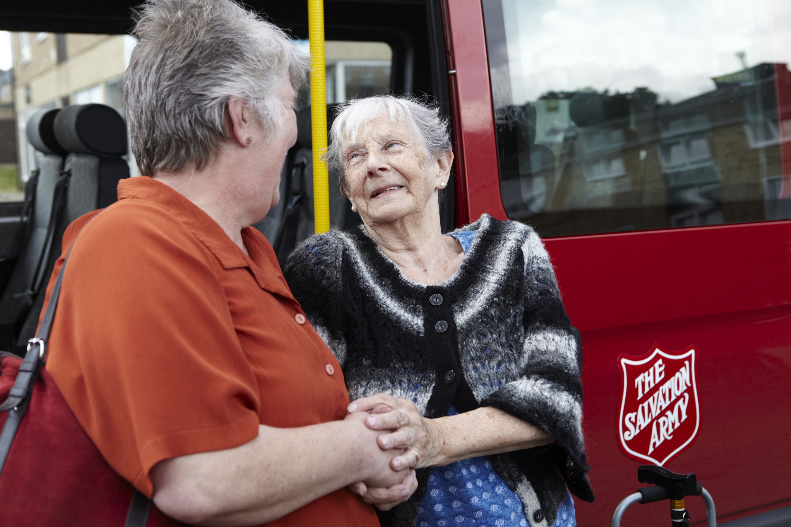
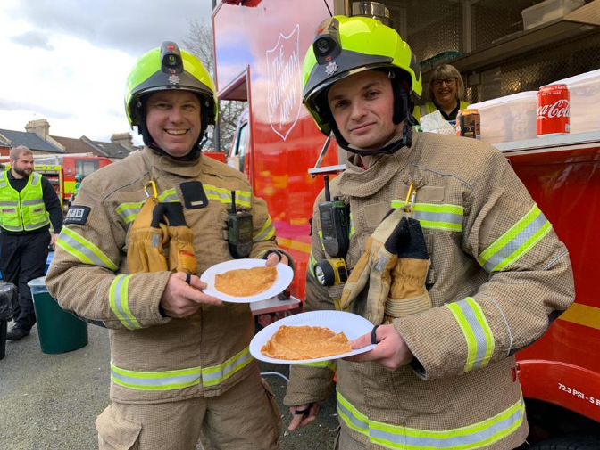
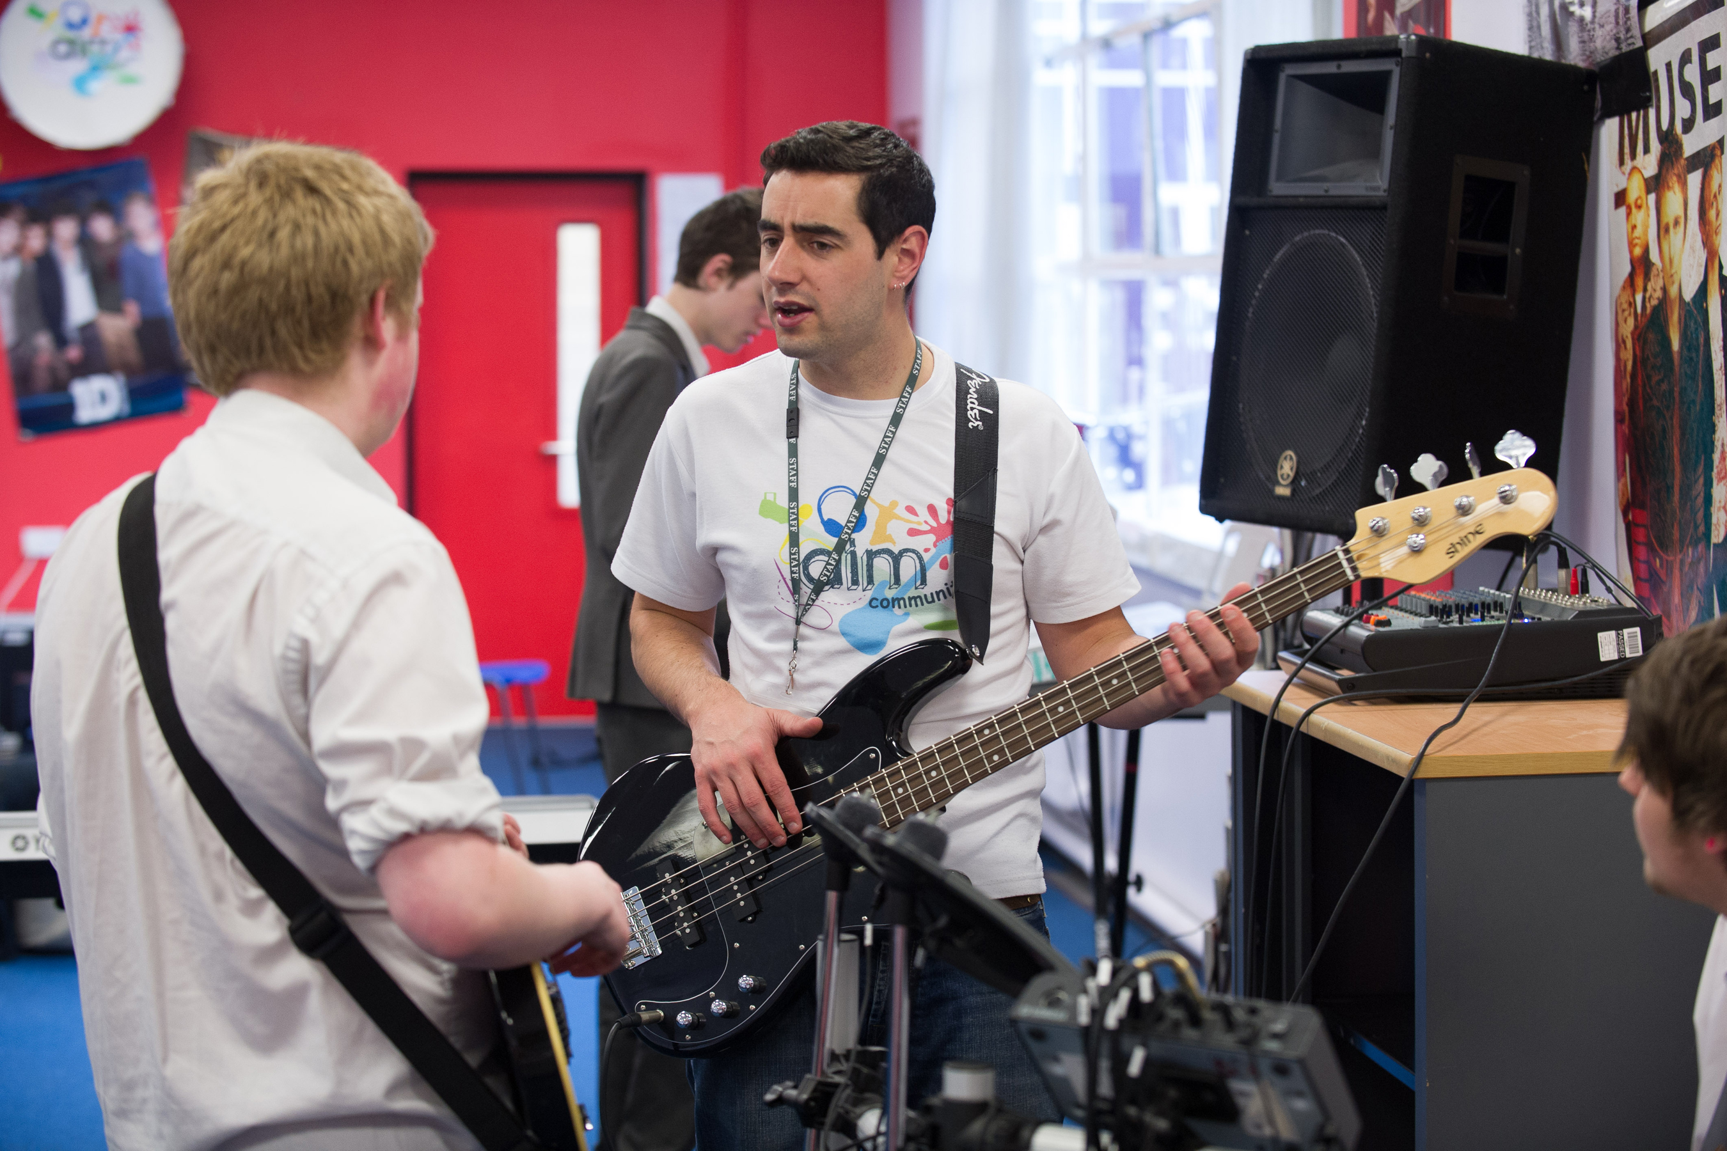
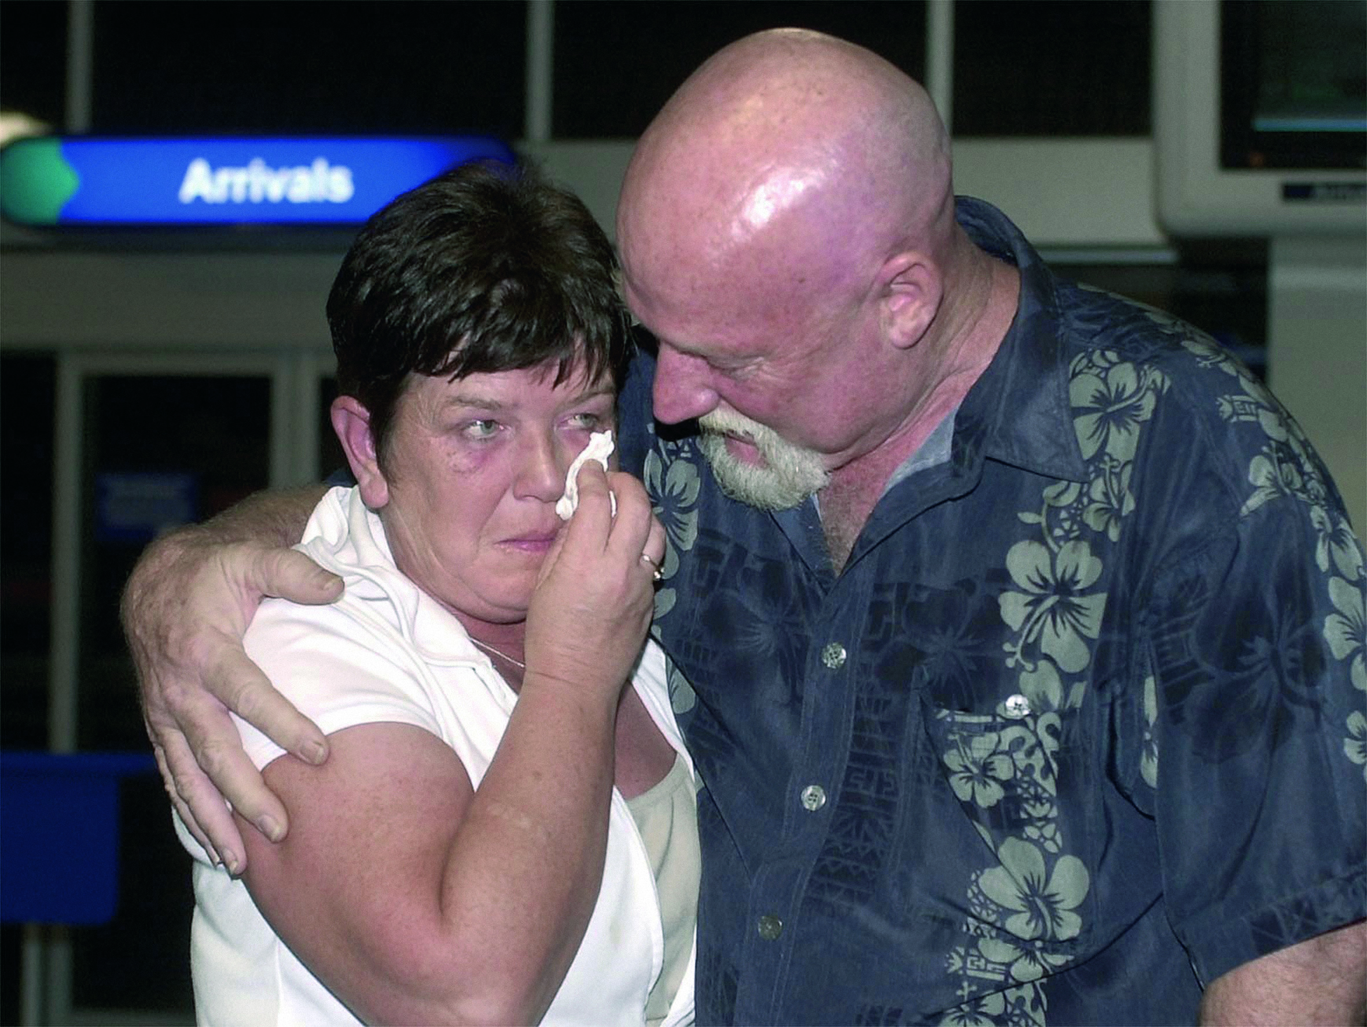
What does The Salvation Army do?
1
2
3
4
5
6
8
7

Slide 6
How is The Salvation Army helping people during the pandemic?
The Salvation Army's Response to Coronavirus in Watford - YouTube
Feeding Homeless People During Coronavirus | The Salvation Army - YouTube
Serving the NHS | The Salvation Army – YouTube____________________

Slide 7
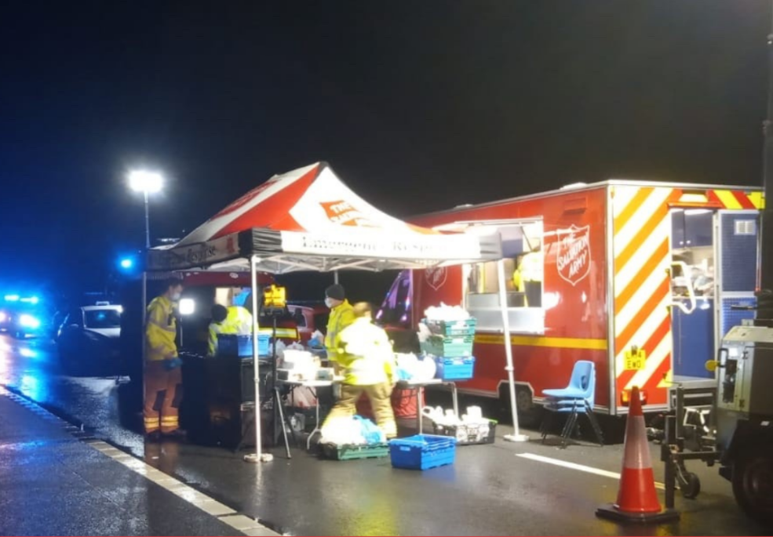
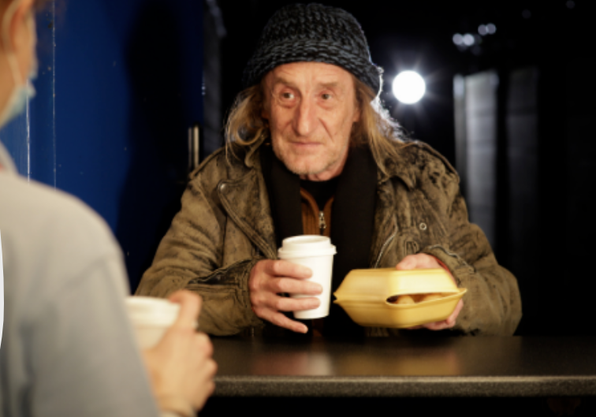
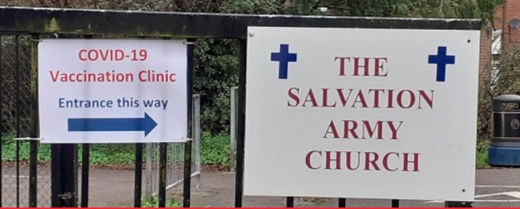
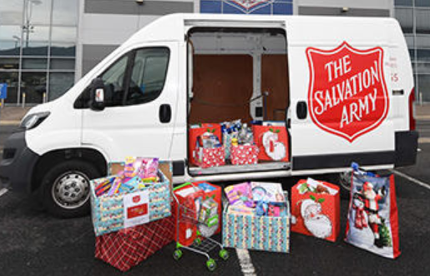
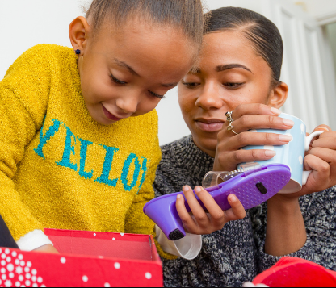
What else is The Salvation Army doing?
More food parcels and fighting against holiday hunger
Emergency support – for emergency services, stranded lorry drivers…
Campaigning for ‘everyone in’ and off the streets
Adapting church buildings
Record breaking Christmas toy appeal

Slide 8
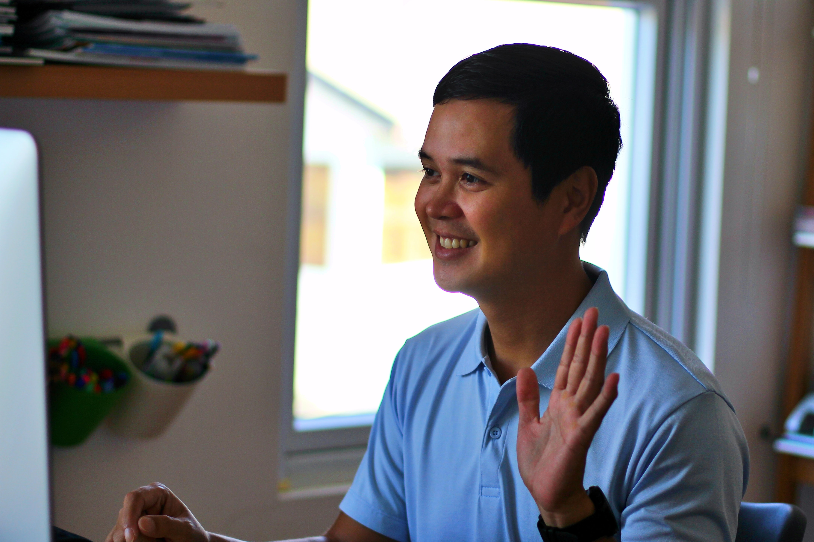
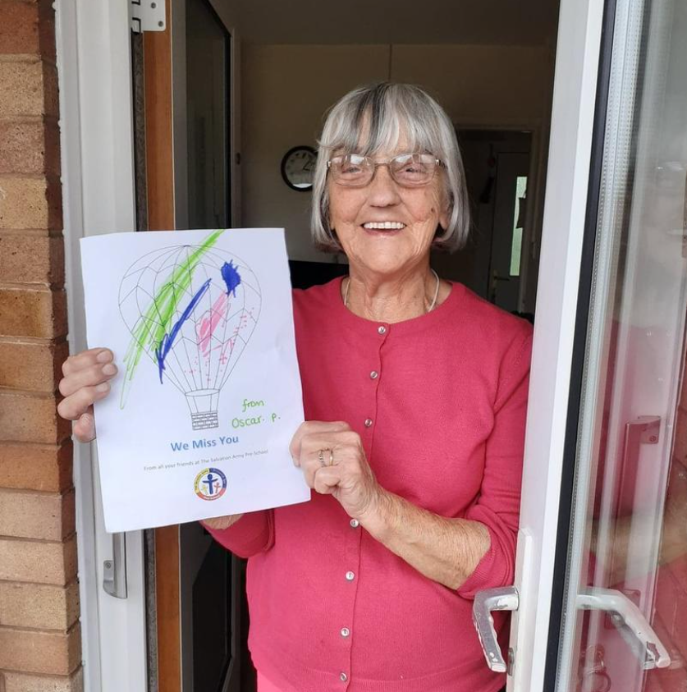
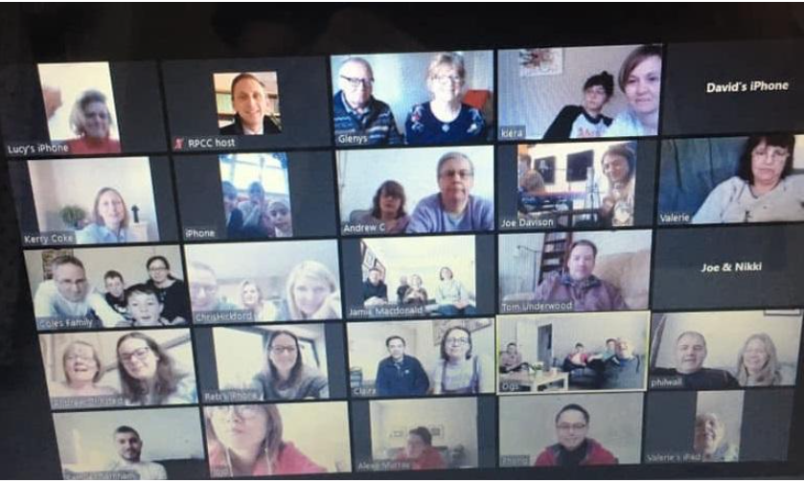
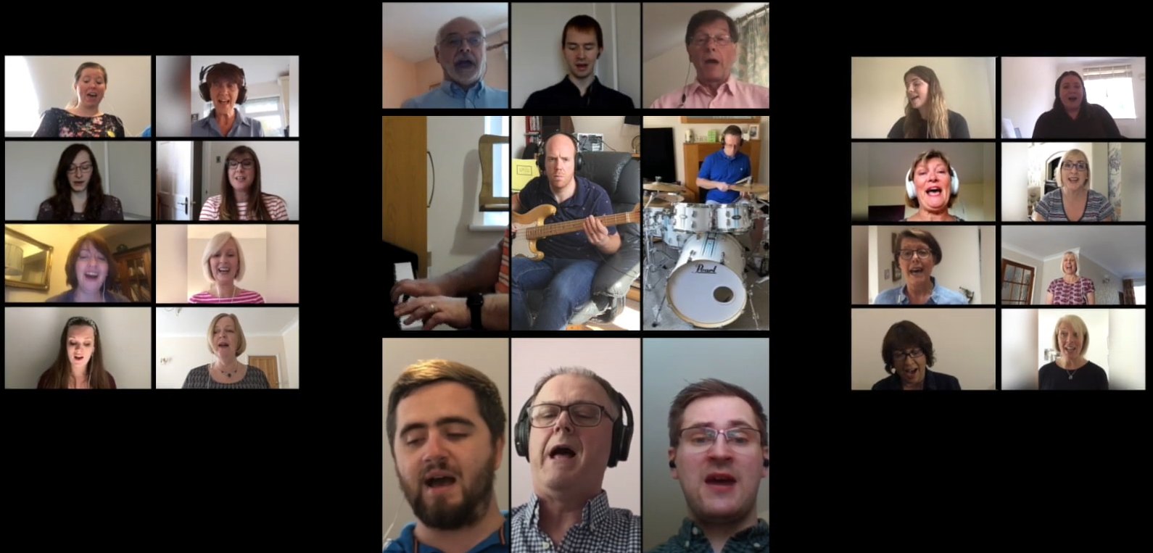
What else is The Salvation Army doing?
Online support – counselling and advice for employment, debt and addiction
Doorstep visiting and phoning people who are lonely, isolated or vulnerable
Working internationally to keep everyone safe from Covid
Virtual church
Online worship

Slide 9
What is The Salvation Army doing in my local area?

Slide 10
Why does The Salvation Army help people?
What are your thoughts?

Slide 11
The work of The Salvation Army
The mission of The Salvation Army

Slide 12
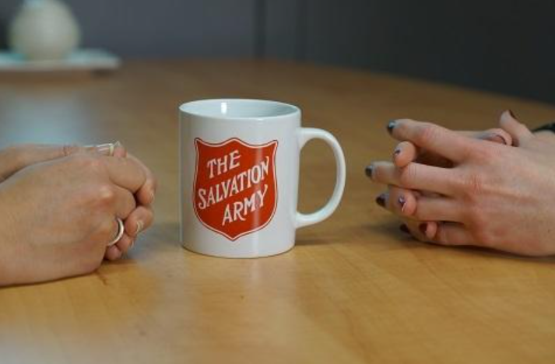

Slide 13
Supportig older people during the pandemic in Droitwich_____

Slide 14
Learning objectives:
To learn about the work of The Salvation Army during the pandemic.
To consider why The Salvation Army helps people.

Slide 15
Tell me …
One thing you learned
One thing that puzzled you
One thing you want to find out more about
One thing you want to tell someone else about

Slide 16
Who …
What …
Why …
How …
Where …

Slide 17
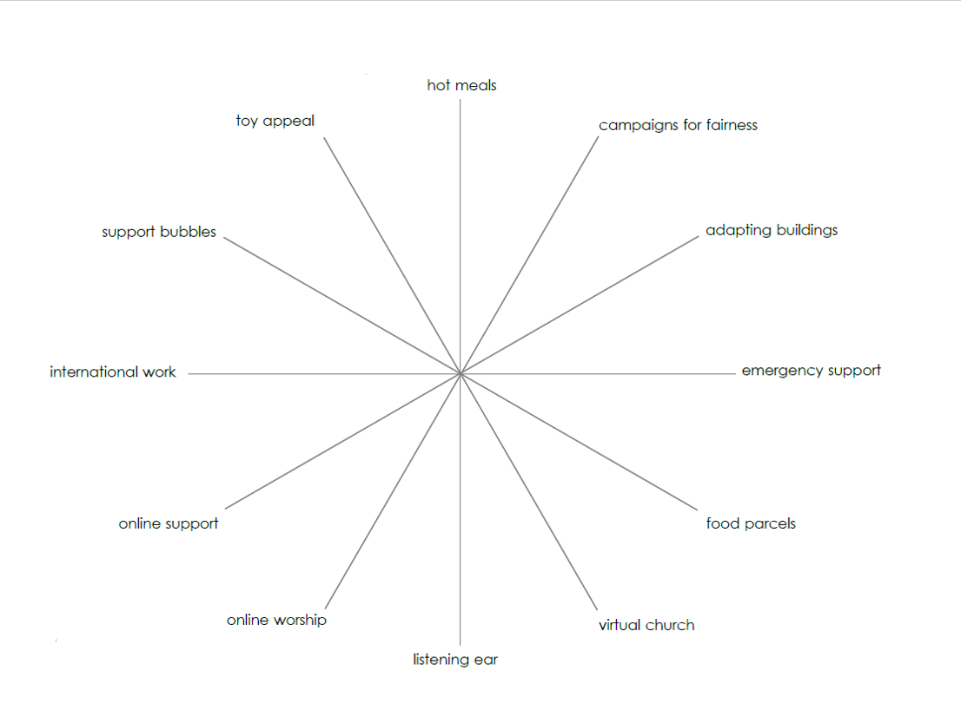
How important is the work of The Salvation Army during the pandemic?

