Slide 1
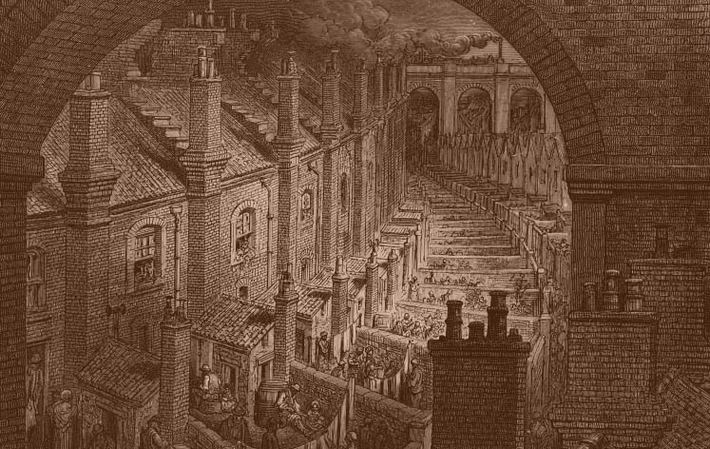

The Story of The Salvation Army in
Victorian England
The Story of The Salvation Army in
Victorian England

Slide 2
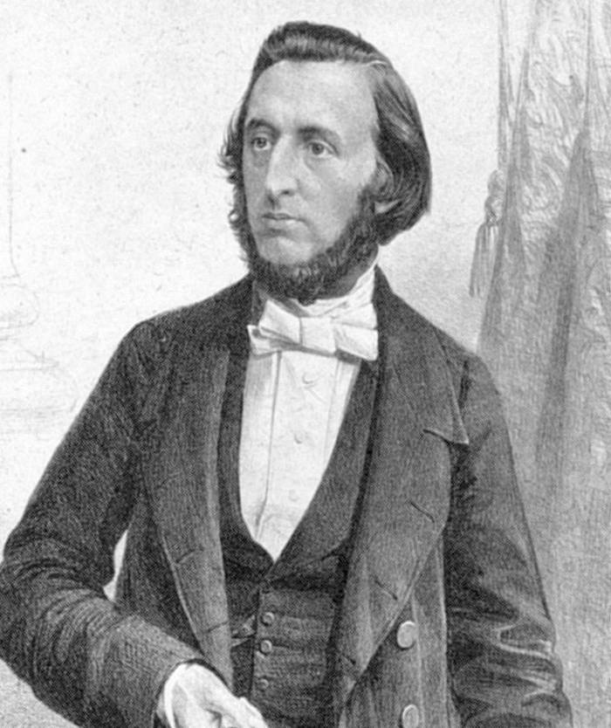
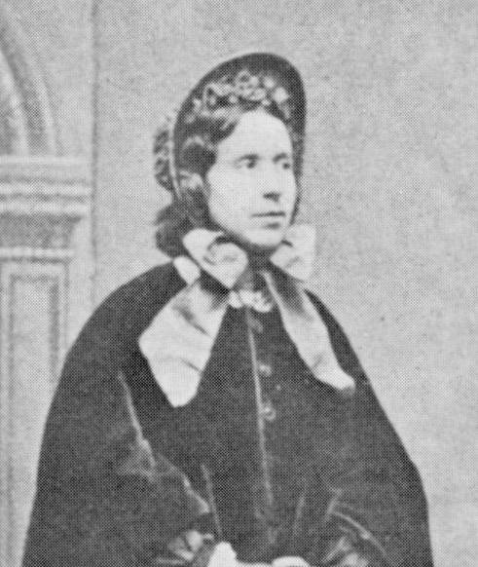
William Booth
Catherine Booth
The Story of The Salvation Army in
Victorian England

Slide 3
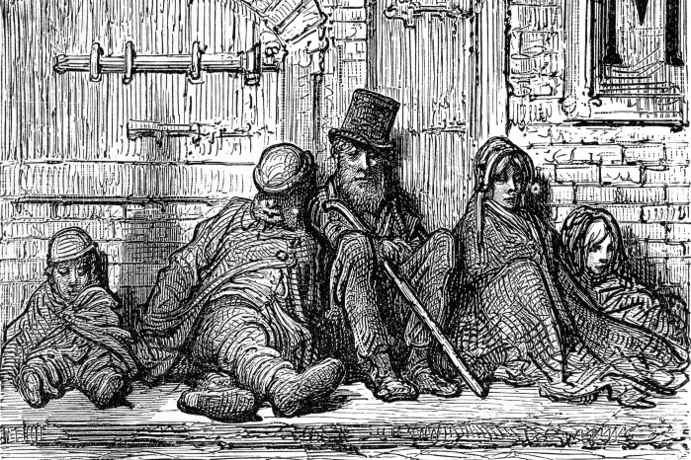
Pawnbroker’s shop
The Story of The Salvation Army in
Victorian England
Notes:
William Booth was born on 10th April 1829 in a poor part of Nottingham. Even though his mother and father didn’t have much money, they paid for William to go to a good school. In those days, many families could not afford to send their children to school because they were too poor. William had to leave school when was 13 years old because his family ran out of money. He found work in a pawnbroker’s shop as an apprentice. William didn’t like his job, but it showed him how hard life was for poor people. William saw families selling their most valuable things to buy food and clothes. He also saw many people spend this money getting drunk to try and forget their misery. He wished he could do more to help.

Slide 4
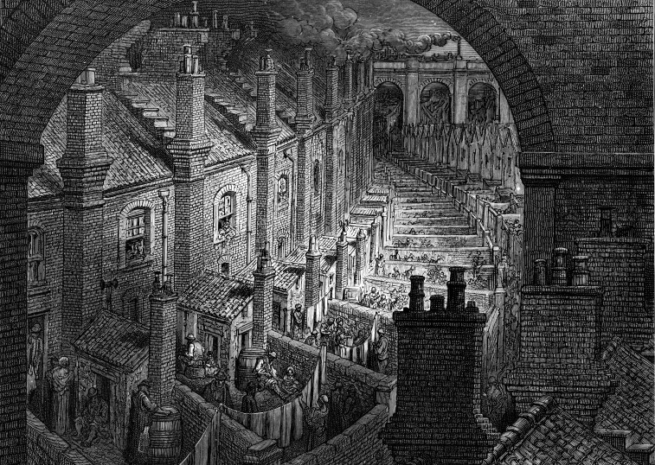
The Story of The Salvation Army in
Victorian England
Notes:
Poverty was a huge problem in Victorian Britain. In London alone there were nearly one million people in desperate need. This was mainly because of a massive growth in population. Many people had no chance of getting work as there were not enough jobs to go around. With no work there was no money. Without money people couldn’t pay for food or a place to stay. Many people had moved from the countryside into towns and cities to try and find work in the many new factories which were being built. Often large families had to crowd into tiny, badly-built houses. Thousands of people lived in damp, filthy conditions. These families ate poor quality food and people became sick with cholera and typhoid, which you catch from dirty water, many people died from these diseases.

Slide 5
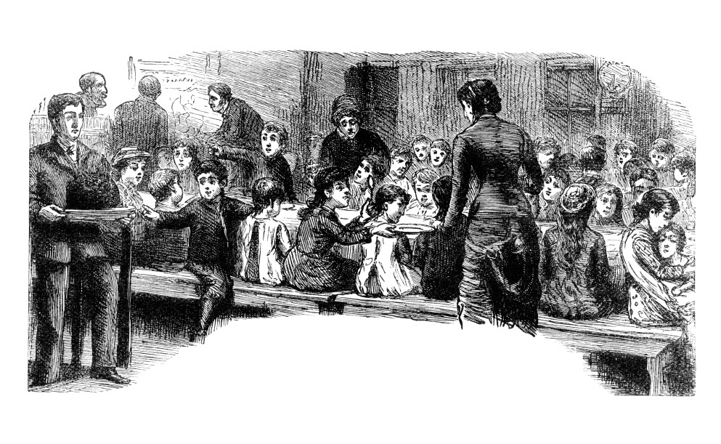
The Story of The Salvation Army in
Victorian England
Notes:
Many people worked long hours for very little money. Children were sent to work too, sometimes doing dangerous jobs. Often if people couldn’t find work and had no money to pay their rent they were sent to the workhouse or had to live on the streets. In the 1834 a new law had been passed which discouraged people from giving help to poor and destitute people. People with no jobs or homes were only given help by the government if they went to live in a special workhouse. Work houses were places where people were made to work very hard often doing unpleasant jobs. Old people, disabled people and orphaned children could also be sent to workhouses. People wore uniforms and ate the same tasteless food everyday. Families were split up so they lived and worked in different places. Family members could be punished if they tried to talk to each other.

Slide 6
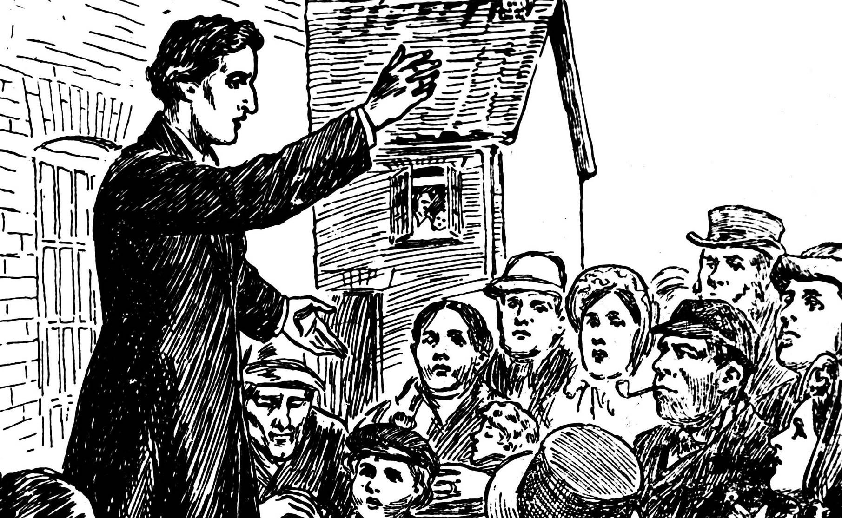
The Story of The Salvation Army in
Victorian England
Notes:
When he was 15 a friend took William to church and he heard about Jesus, and about how much God loved him. He felt as if God was right there beside him, talking just to him. He became a Christian and determined that God should have all there was of William Booth. Soon after this when he was still only 15 – William went with a group of others into the poorest part of Nottingham to talk to people about God’s love. Surprisingly, they listened to him, and he saw men who’d happily spend all the family’s money on alcohol, turning to God and giving up drinking.

Slide 7
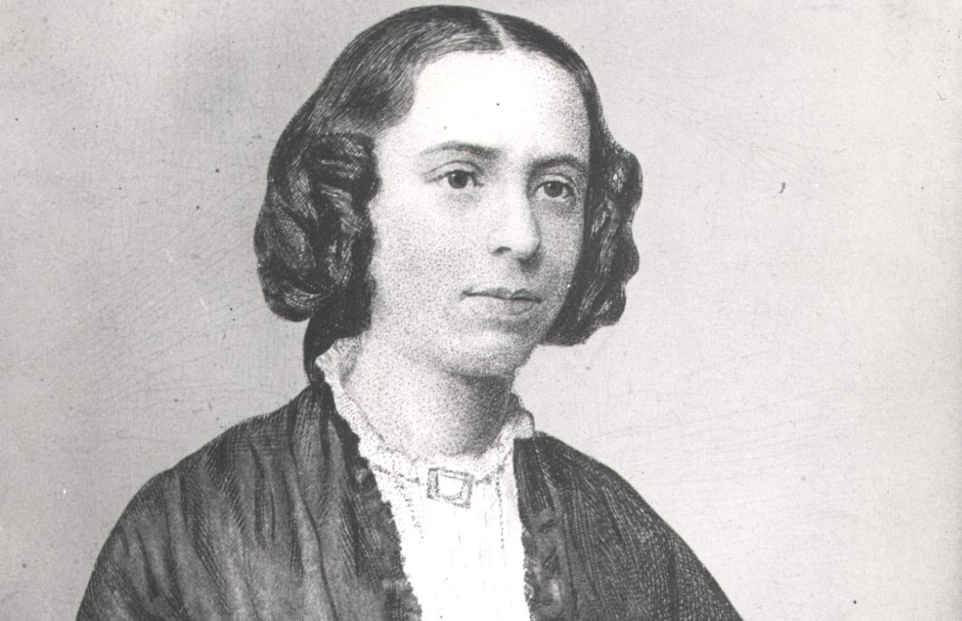
The Story of The Salvation Army in
Victorian England
Notes:
Catherine Mumford was born in Derbyshire in 1829 and moved to London with her family. Catherine was a shy young woman who had strong beliefs and opinions. She was concerned about the welfare of animals, about the dangers of alcohol, and she thought that women should be equal with men in church. These were radical views for a woman in the 1800s. Catherine especially loved to read and to learn, she had read the Bible 8 times by the time she was 12 years old.

Slide 8
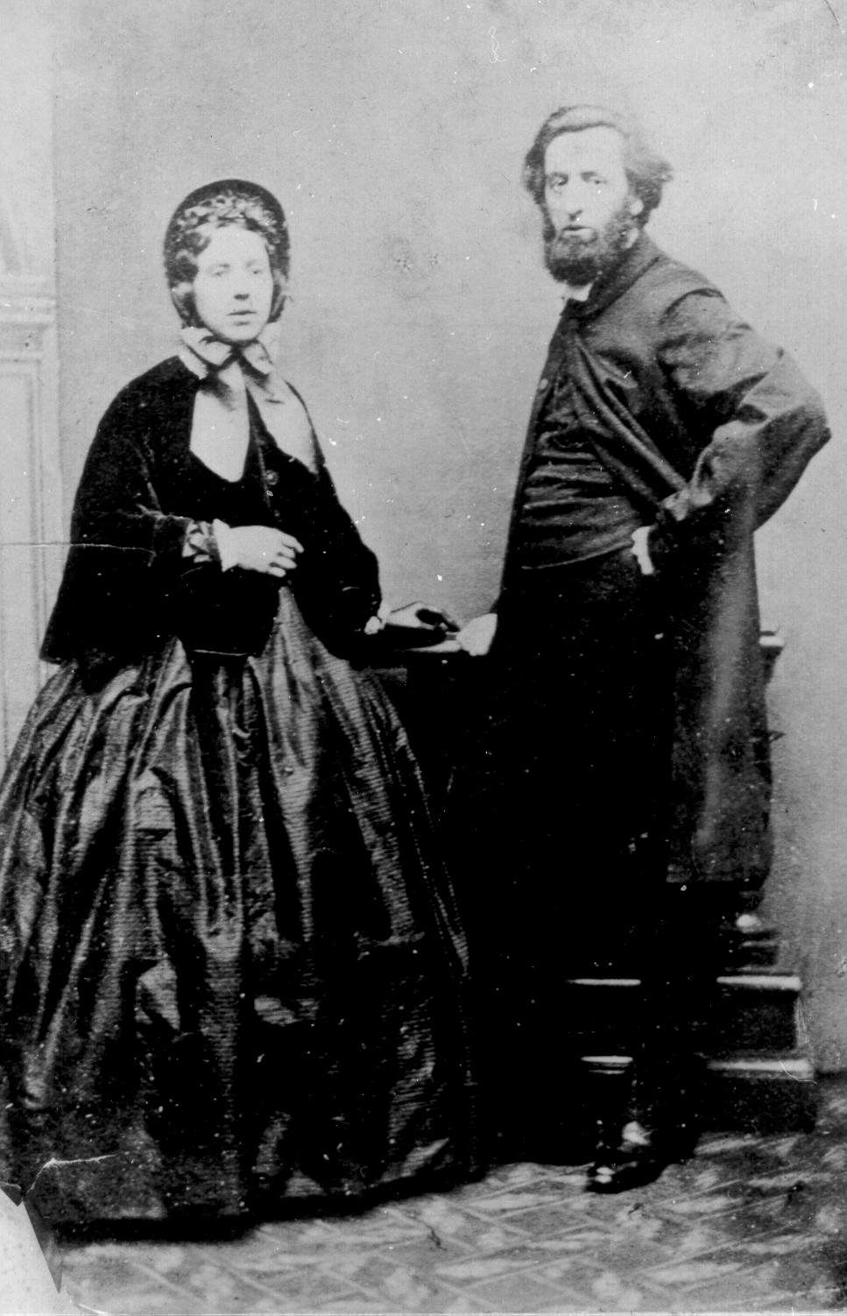
The Story of The Salvation Army in
Victorian England
Notes:
When William grew up he left his job and moved to London. He became a preacher in the Methodist Church. William met Catherine whilst he was preaching in her church. When Catherine heard William speak she was so impressed she just had to meet him. William wasn’t quite as well-educated as Catherine but he was very passionate about his beliefs. He felt strongly about his Christian faith, and had a great concern for the poor and was a man of action. When he had an idea, he usually made it happen!

Slide 9
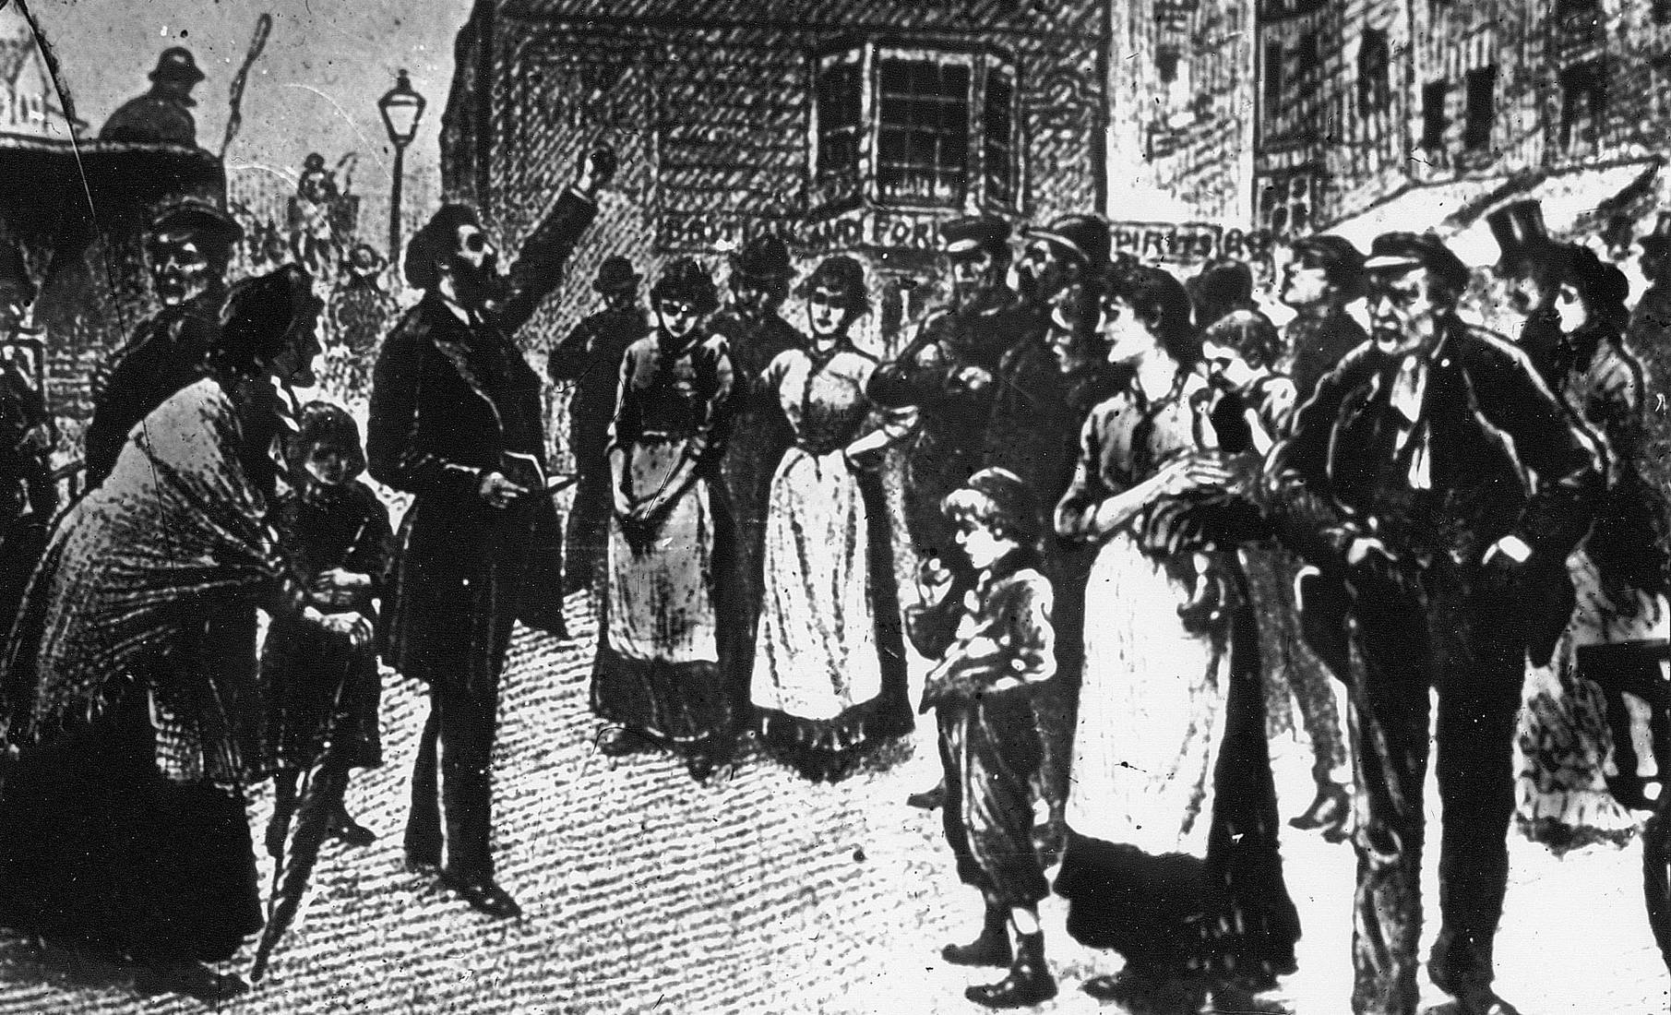
The Story of The Salvation Army in
Victorian England
Notes:
Catherine and William got married in 1855. After a while William realised that he wasn’t happy preaching to people who already believed in God. He really wanted to preach to people who had never heard of God, or who didn’t go to church. So he became an evangelist. He preached on street corners and outside pubs. He wanted people to know that God loved them. After they left the Methodist church they spent four years travelling to preach all over England.

Slide 10
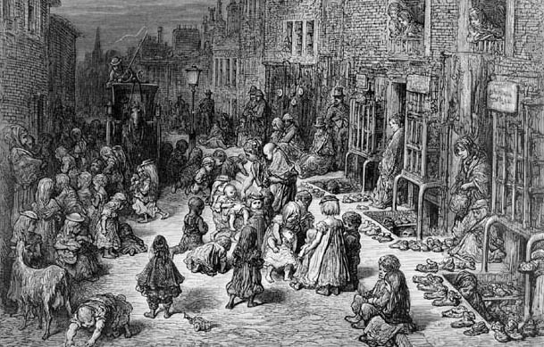
The Story of The Salvation Army in
Victorian England
Notes:
By the time William and Catherine moved back to London In 1865 they had six children. The Booth family decided to move to a poor part of London. Late one night William was walking home, looking at all the poor people around him. Children were drinking beer and begging for food. People had no jobs and were living in squalor. It seemed as if no one really cared. William went home and told Catherine that he had found his destiny and in time they became a part of a new movement called 'The Christian Mission'. William and Catherine began their mission of preaching to and helping the poor in London, including those who had been turned away from other churches for being too smelly and dirty.

Slide 11
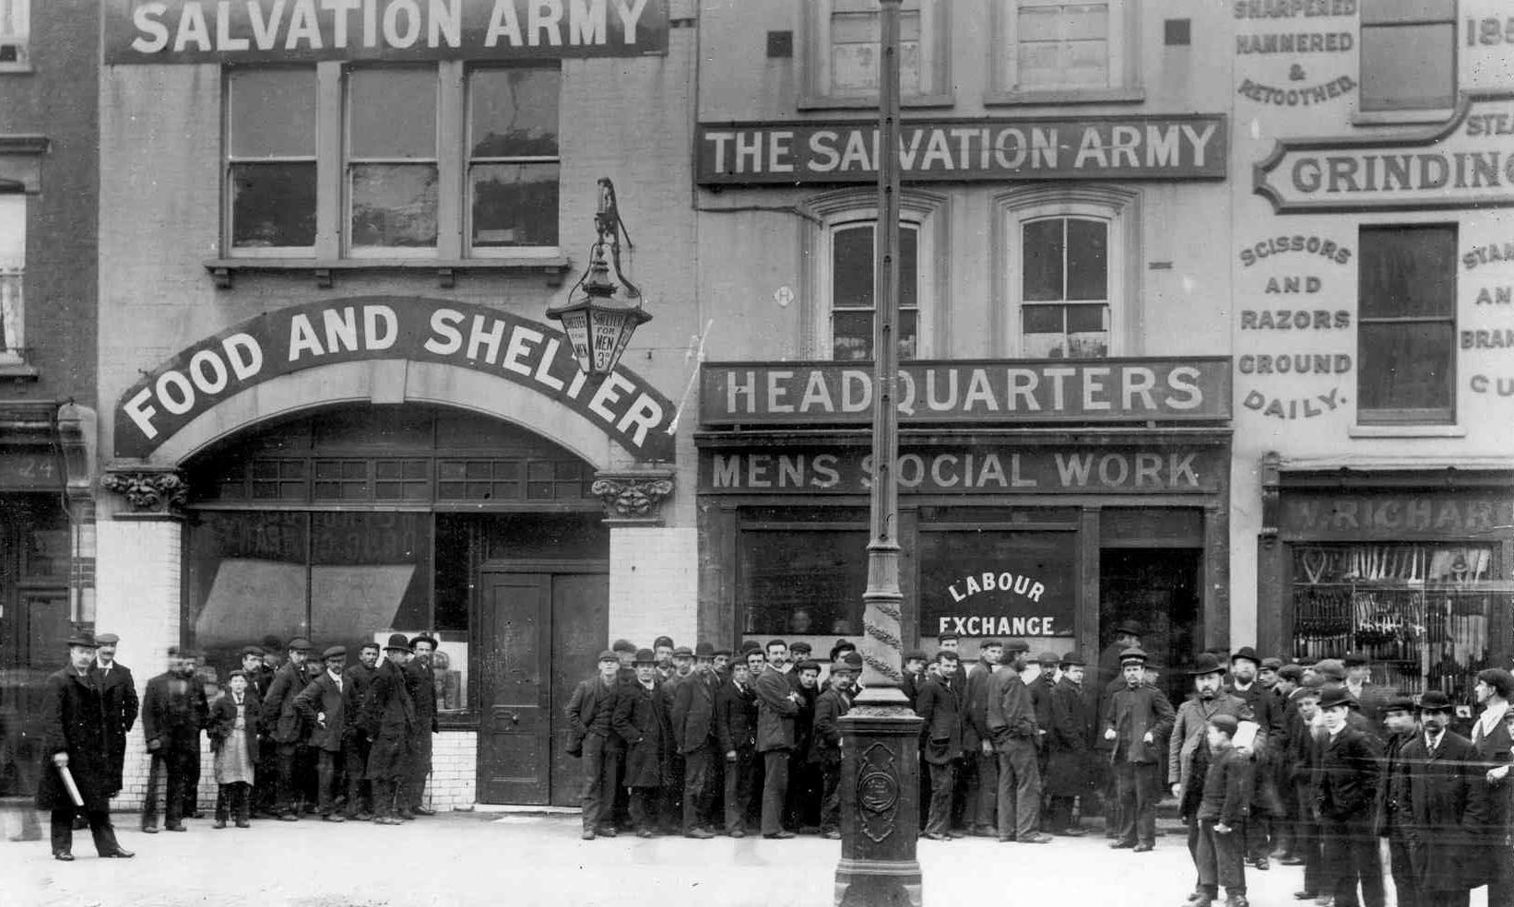
The Story of The Salvation Army in
Victorian England
Notes:
The Christian Mission was so well organised that people thought they were like an army. Then William Booth had an idea. He changed their name to The Salvation Army! Lots of people joined – they wanted to be part of this new kind of church. They found uniforms to wear and Catherine designed a flag. General Booth (as he was now known) realised that people would not listen to his message if they were hungry and cold. He opened food stores and shelters for people to stay in, and from then on The Salvation Army became known for its care of the poor and needy.

Slide 12
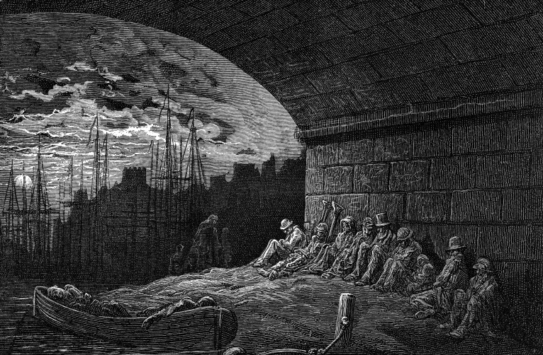
The Story of The Salvation Army in
Victorian England
Notes:
Late one night, William noticed lots of people sleeping under bridges in London. He felt so sorry for them that he asked his son, Bramwell, to do something. Bramwell found an old building and set up The Salvation Army’s first night shelter. The men who stayed there were given food, a bed and help to find work.

Slide 13
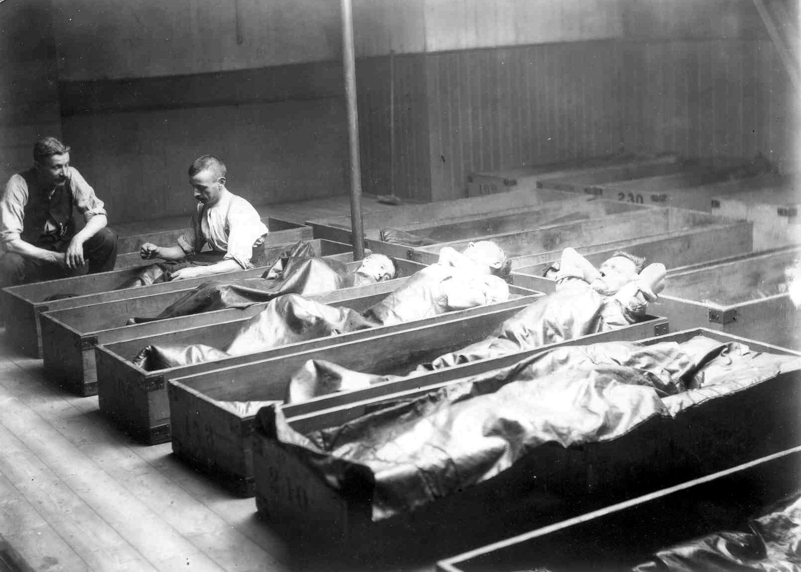
The Story of The Salvation Army in
Victorian England
Notes:
One of the first Salvation Army hostels for men. What do you think this picture says about The Salvation Army?

Slide 14
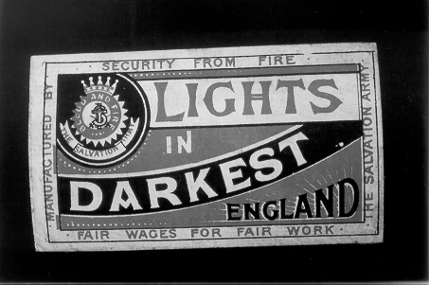
The Story of The Salvation Army in
Victorian England
Notes:
What do you think this picture says about The Salvation Army?

Slide 15
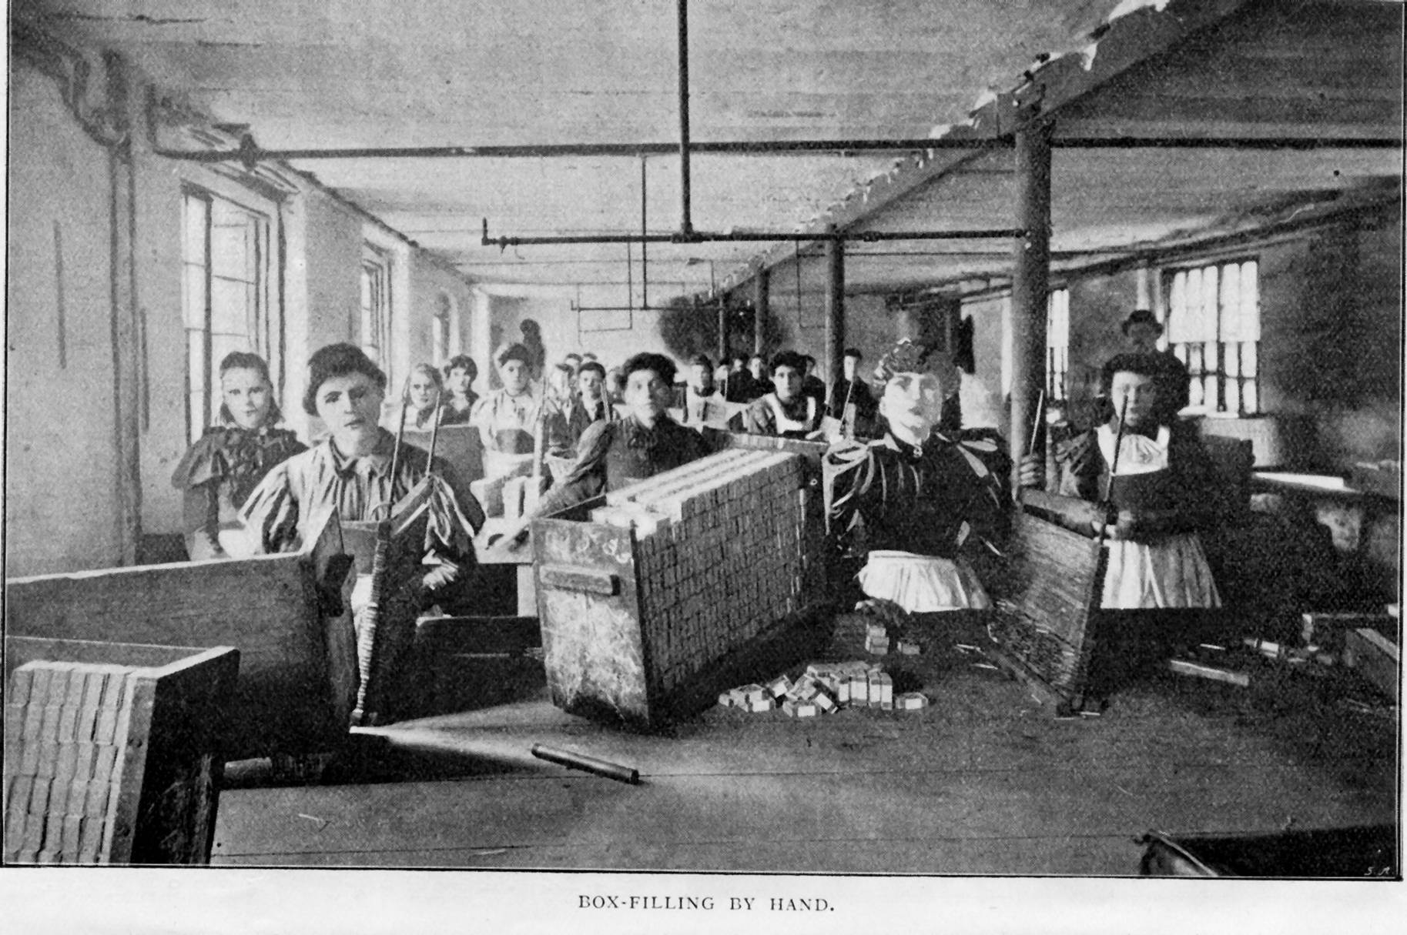
The Salvation Army’s Match Factory
The Story of The Salvation Army in
Victorian England
Notes:
What do you think this picture says about The Salvation Army?

Slide 16
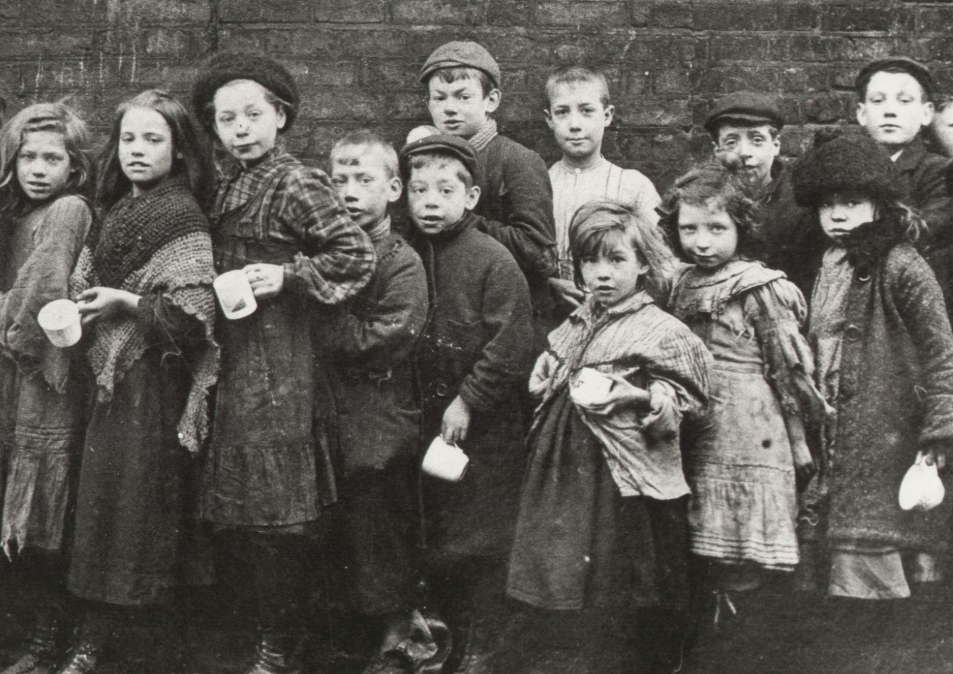
The Story of The Salvation Army in
Victorian England
Notes:
What do you think this picture says about The Salvation Army?

Slide 17
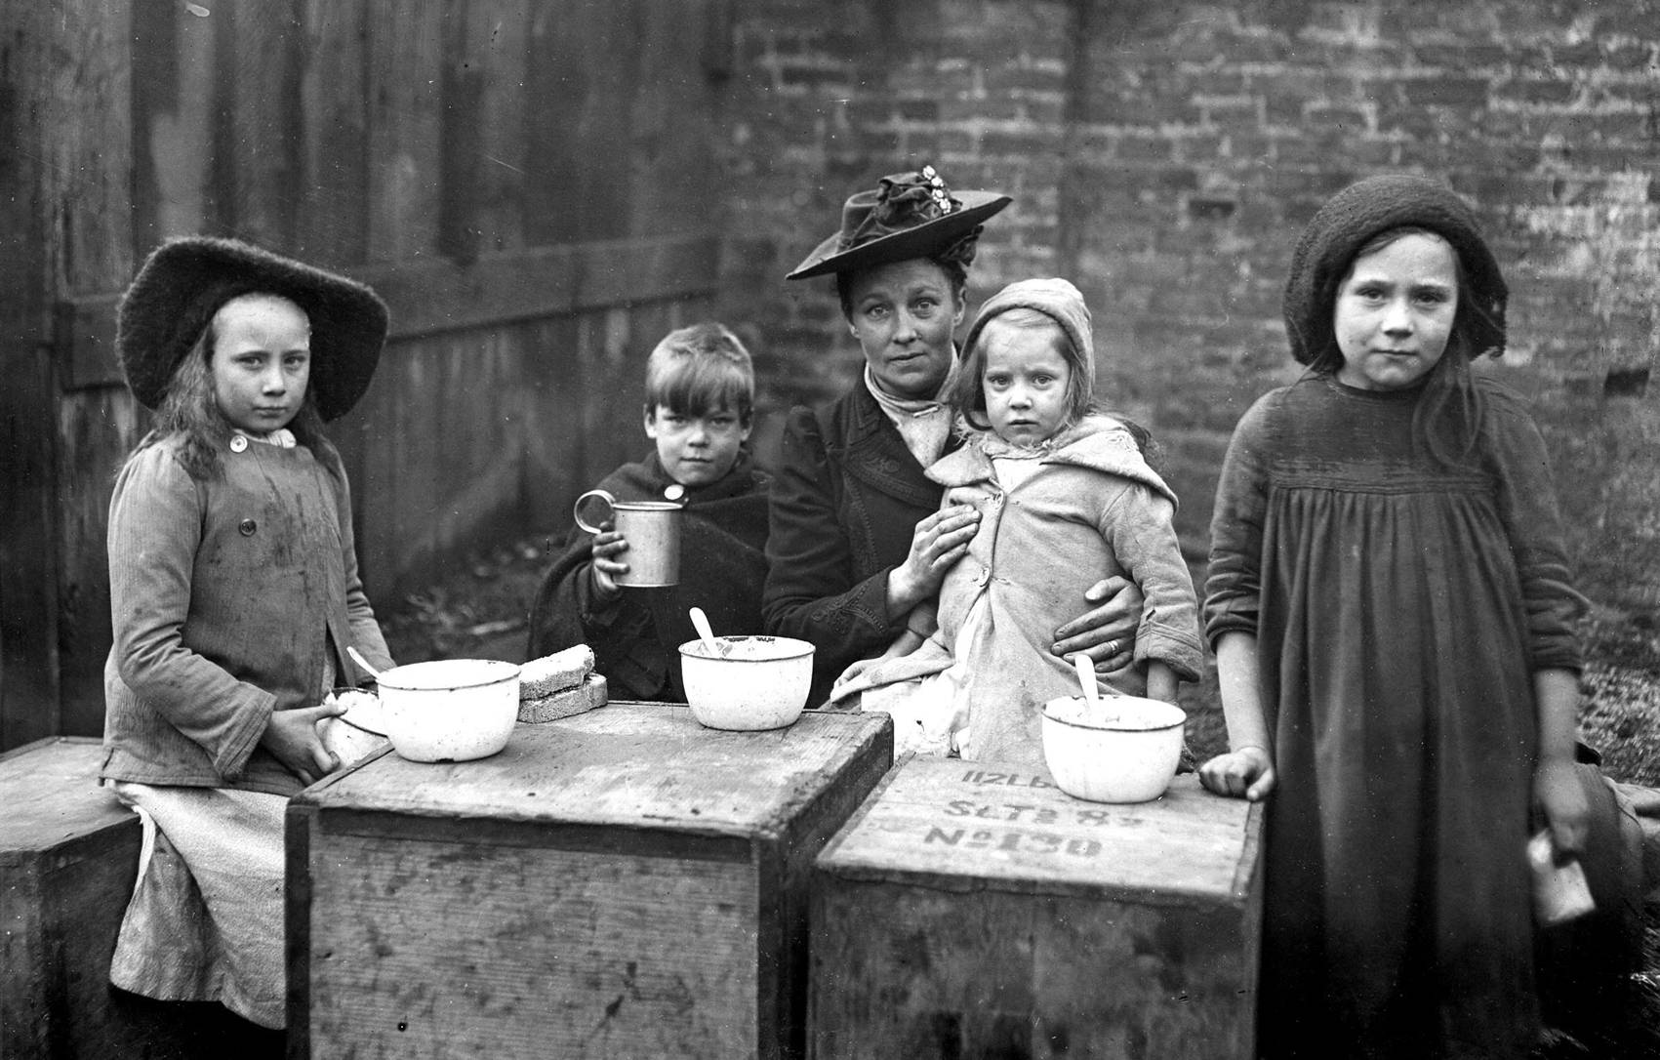
The Story of The Salvation Army in
Victorian England
Notes:
What do you think this picture says about The Salvation Army?

Slide 18
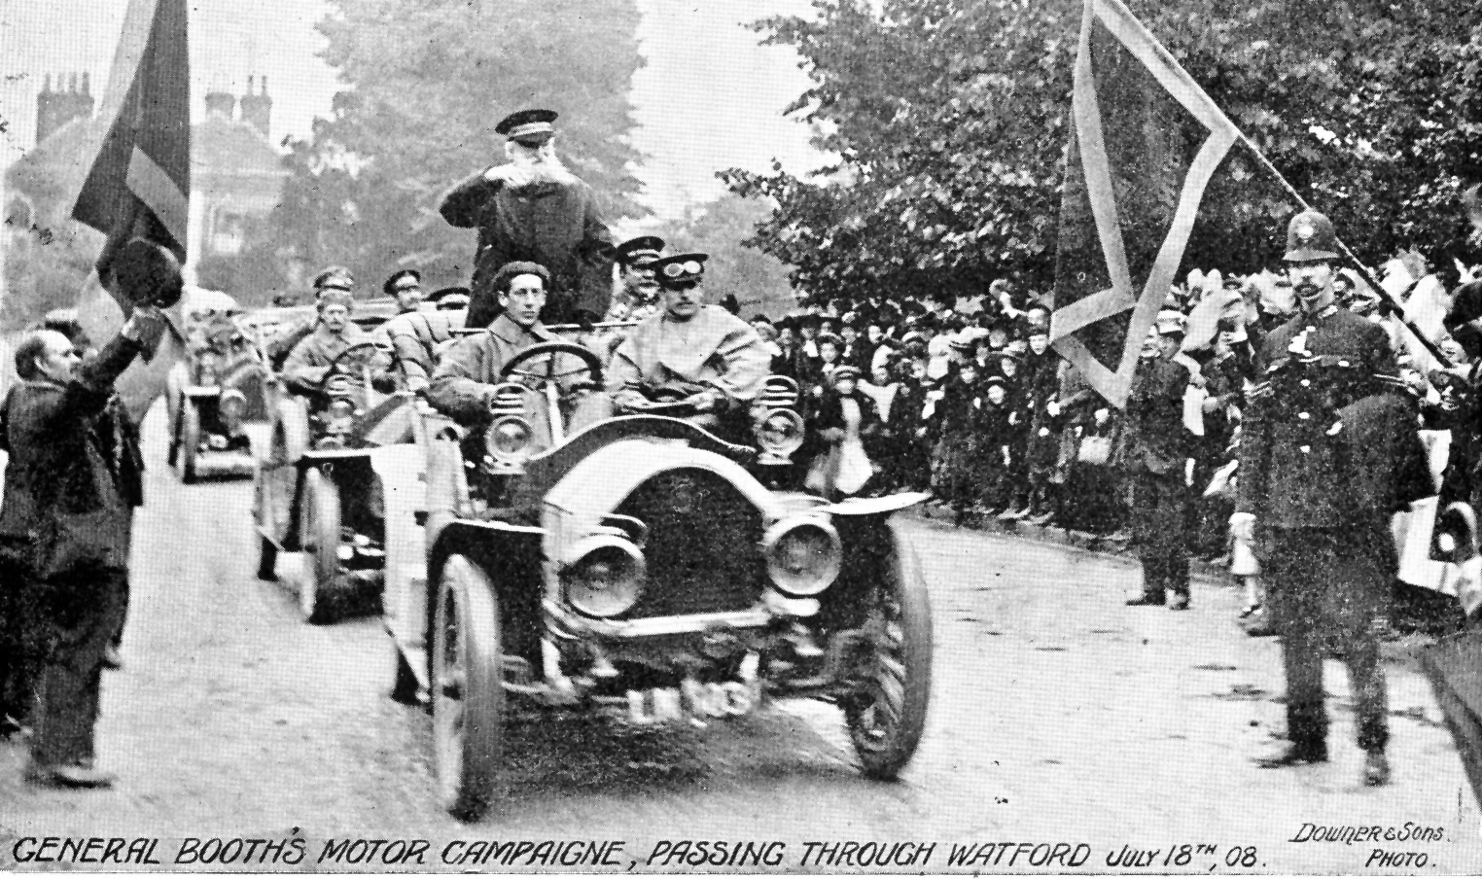
The Story of The Salvation Army in
Victorian England
Notes:
Catherine became very sick and died in 1890. 36,000 people came to London for Catherine Booth’s memorial service, showing how loved and respected she was by so many people. Although William was terribly upset, he knew he must keep working for God.
By 1899 The Salvation Army had served 27 million cheap meals, given shelter to 11 million homeless people, found jobs for 90,000 unemployed people and traced 7,000 missing persons.

Slide 19
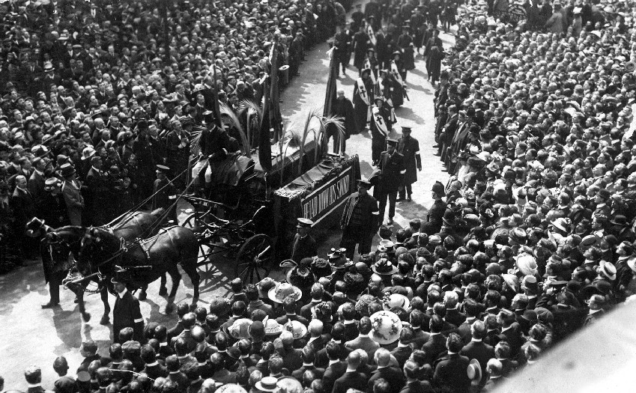
The Story of The Salvation Army in
Victorian England
Notes:
When William Booth died aged 83 in August 1912, 40,000 people came to his memorial service to show how thankful they were for all he had done. The Salvation Army had now spread to 58 countries around the world. Why do you think so many people came to William Booth’s memorial service and funeral procession?

Slide 20
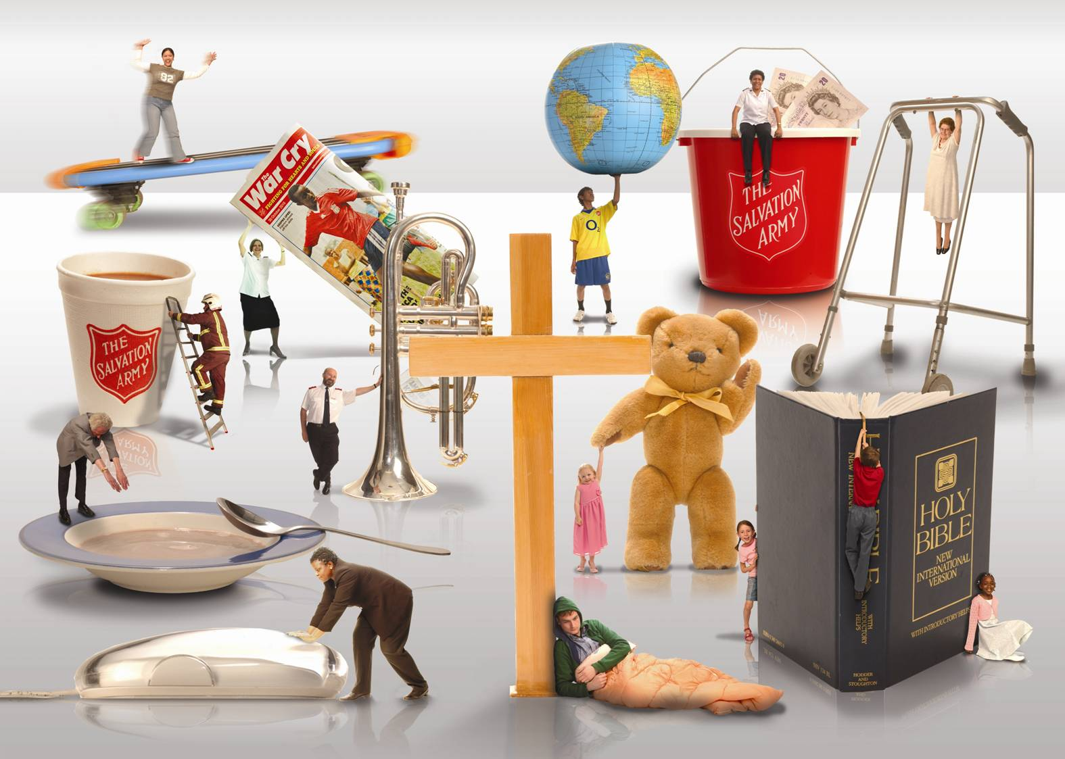
The Salvation Army Today

