Slide 1
The Rainbow
and
The Salvation Army
How The Salvation Army helped people during the pandemic

Slide 2
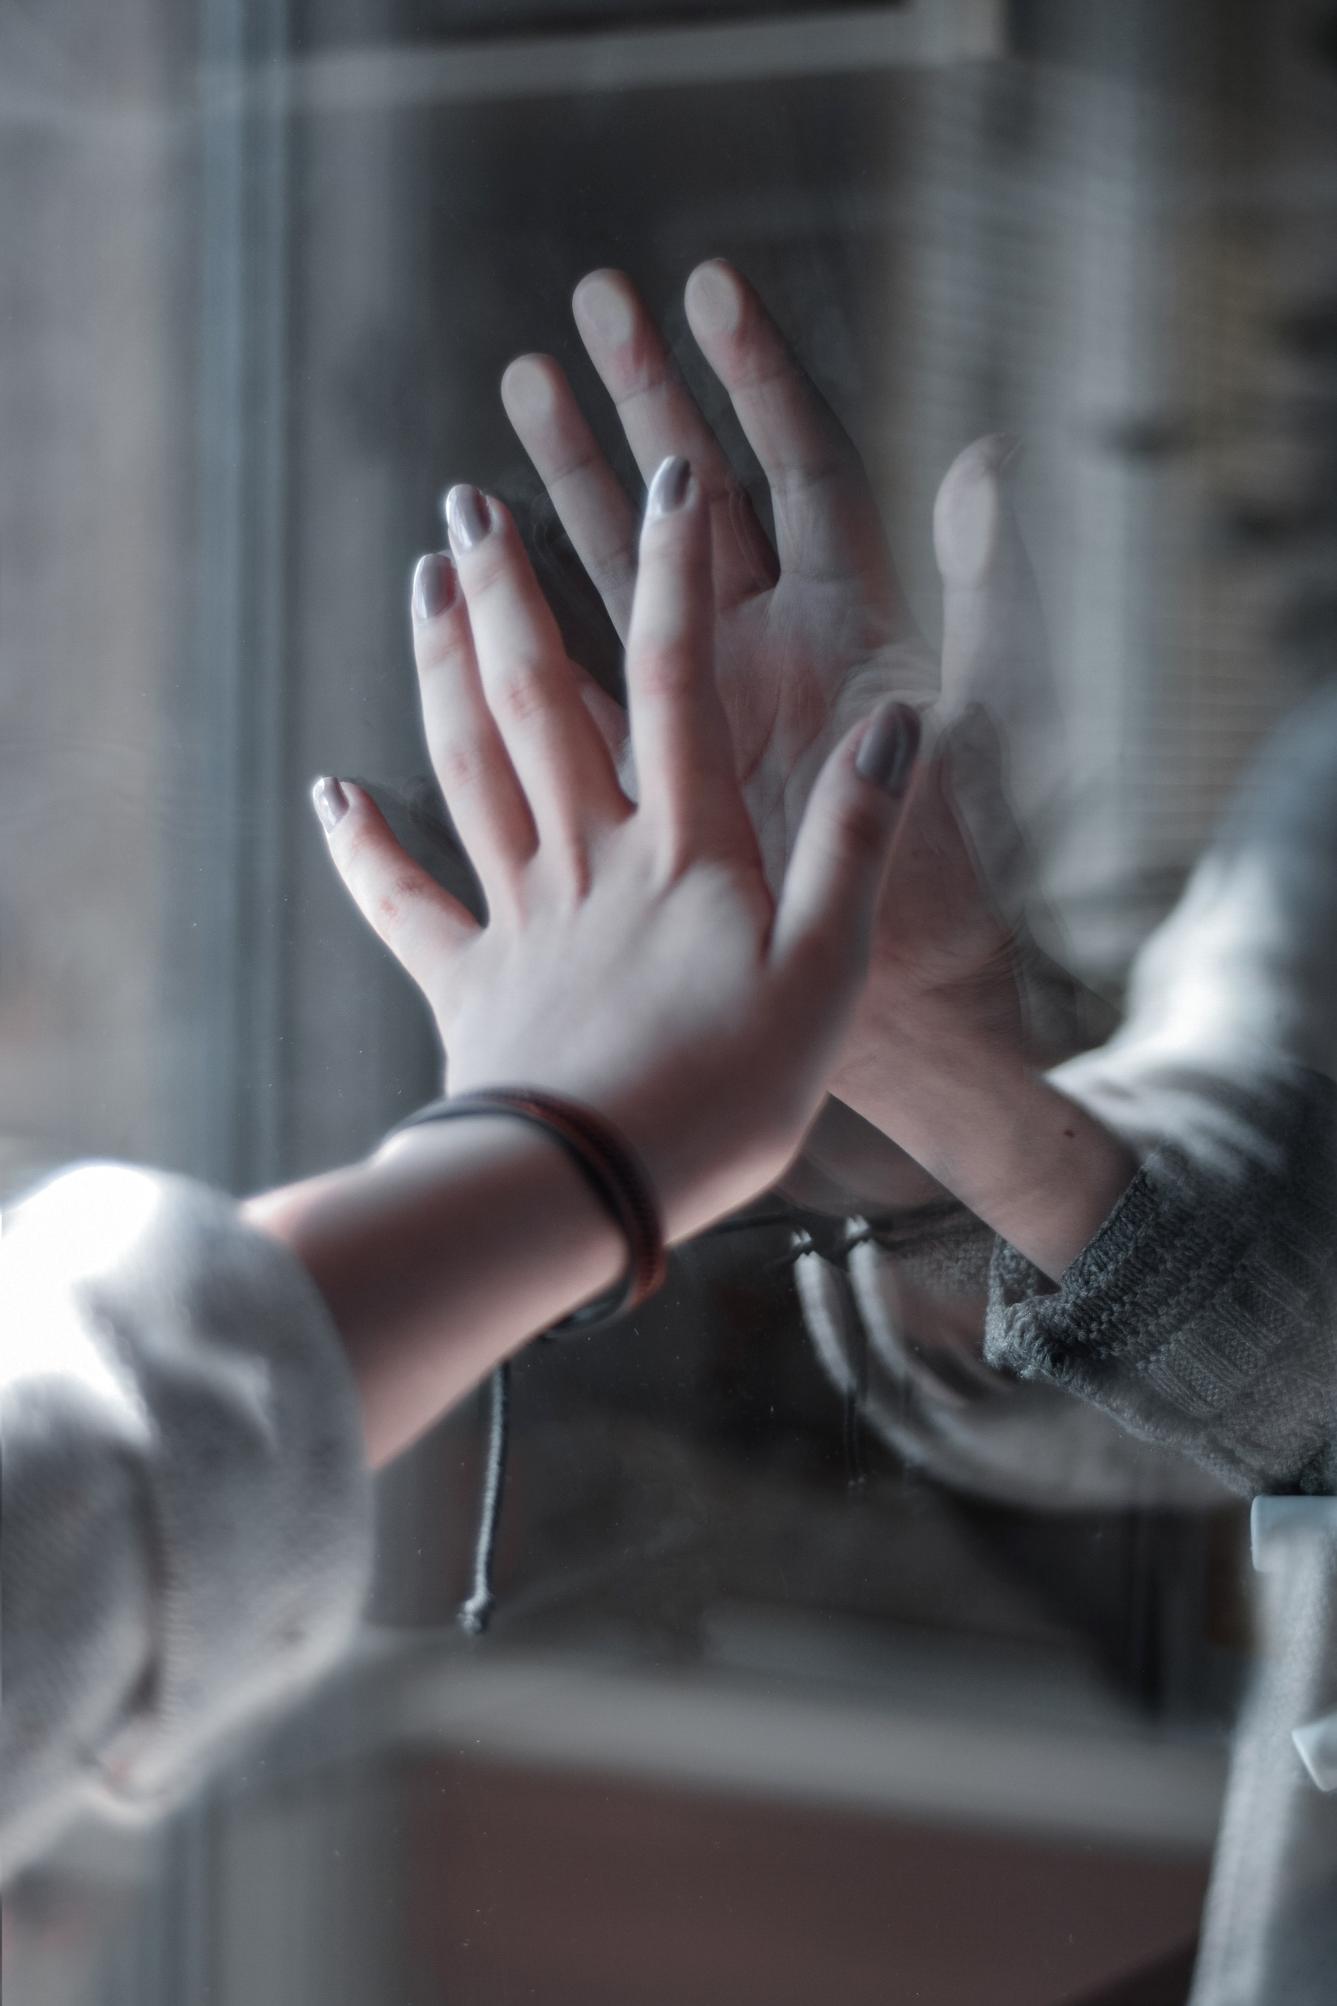
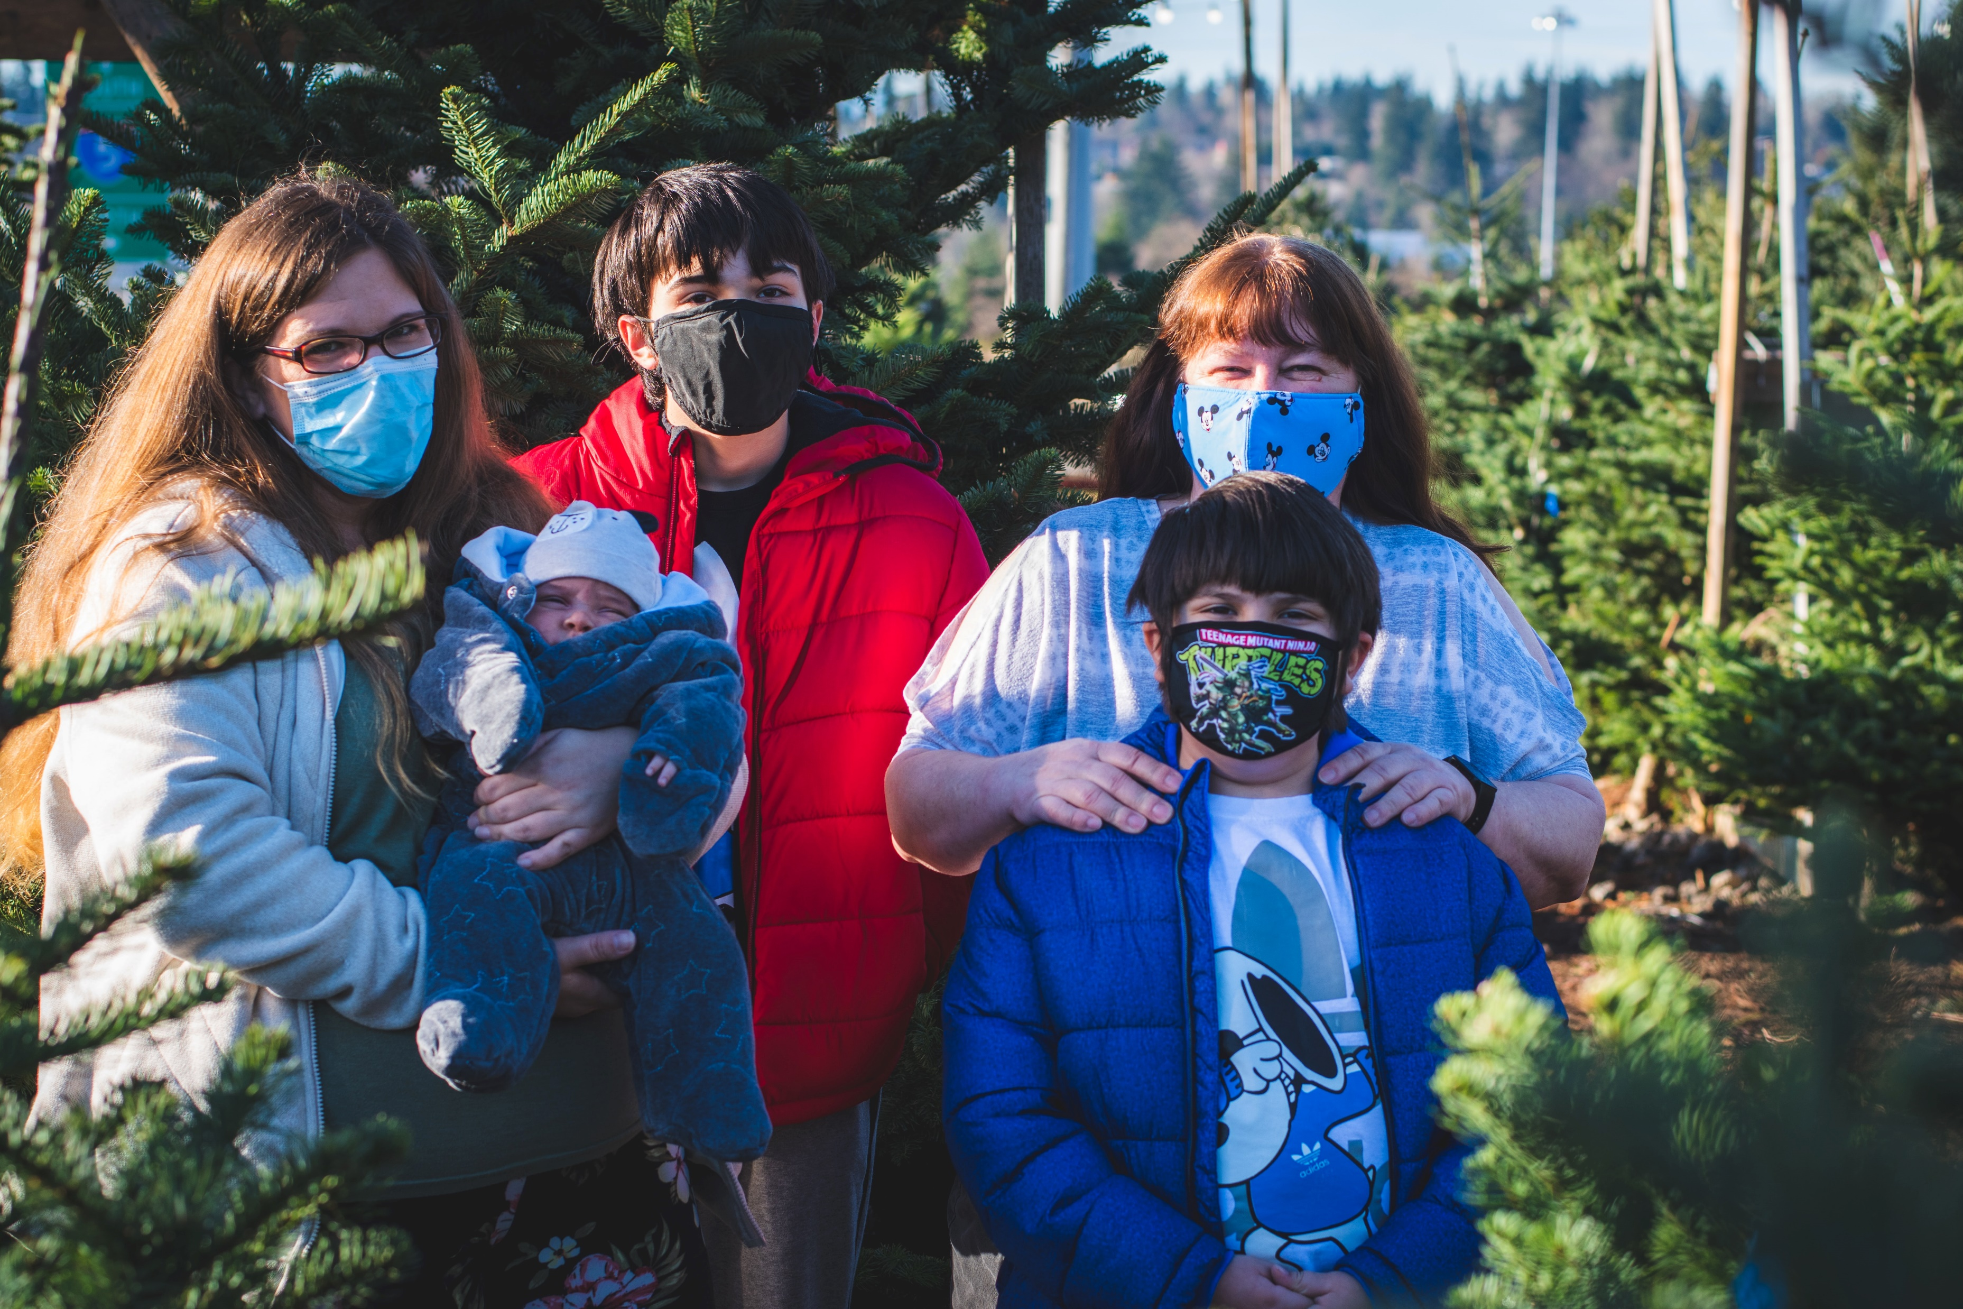
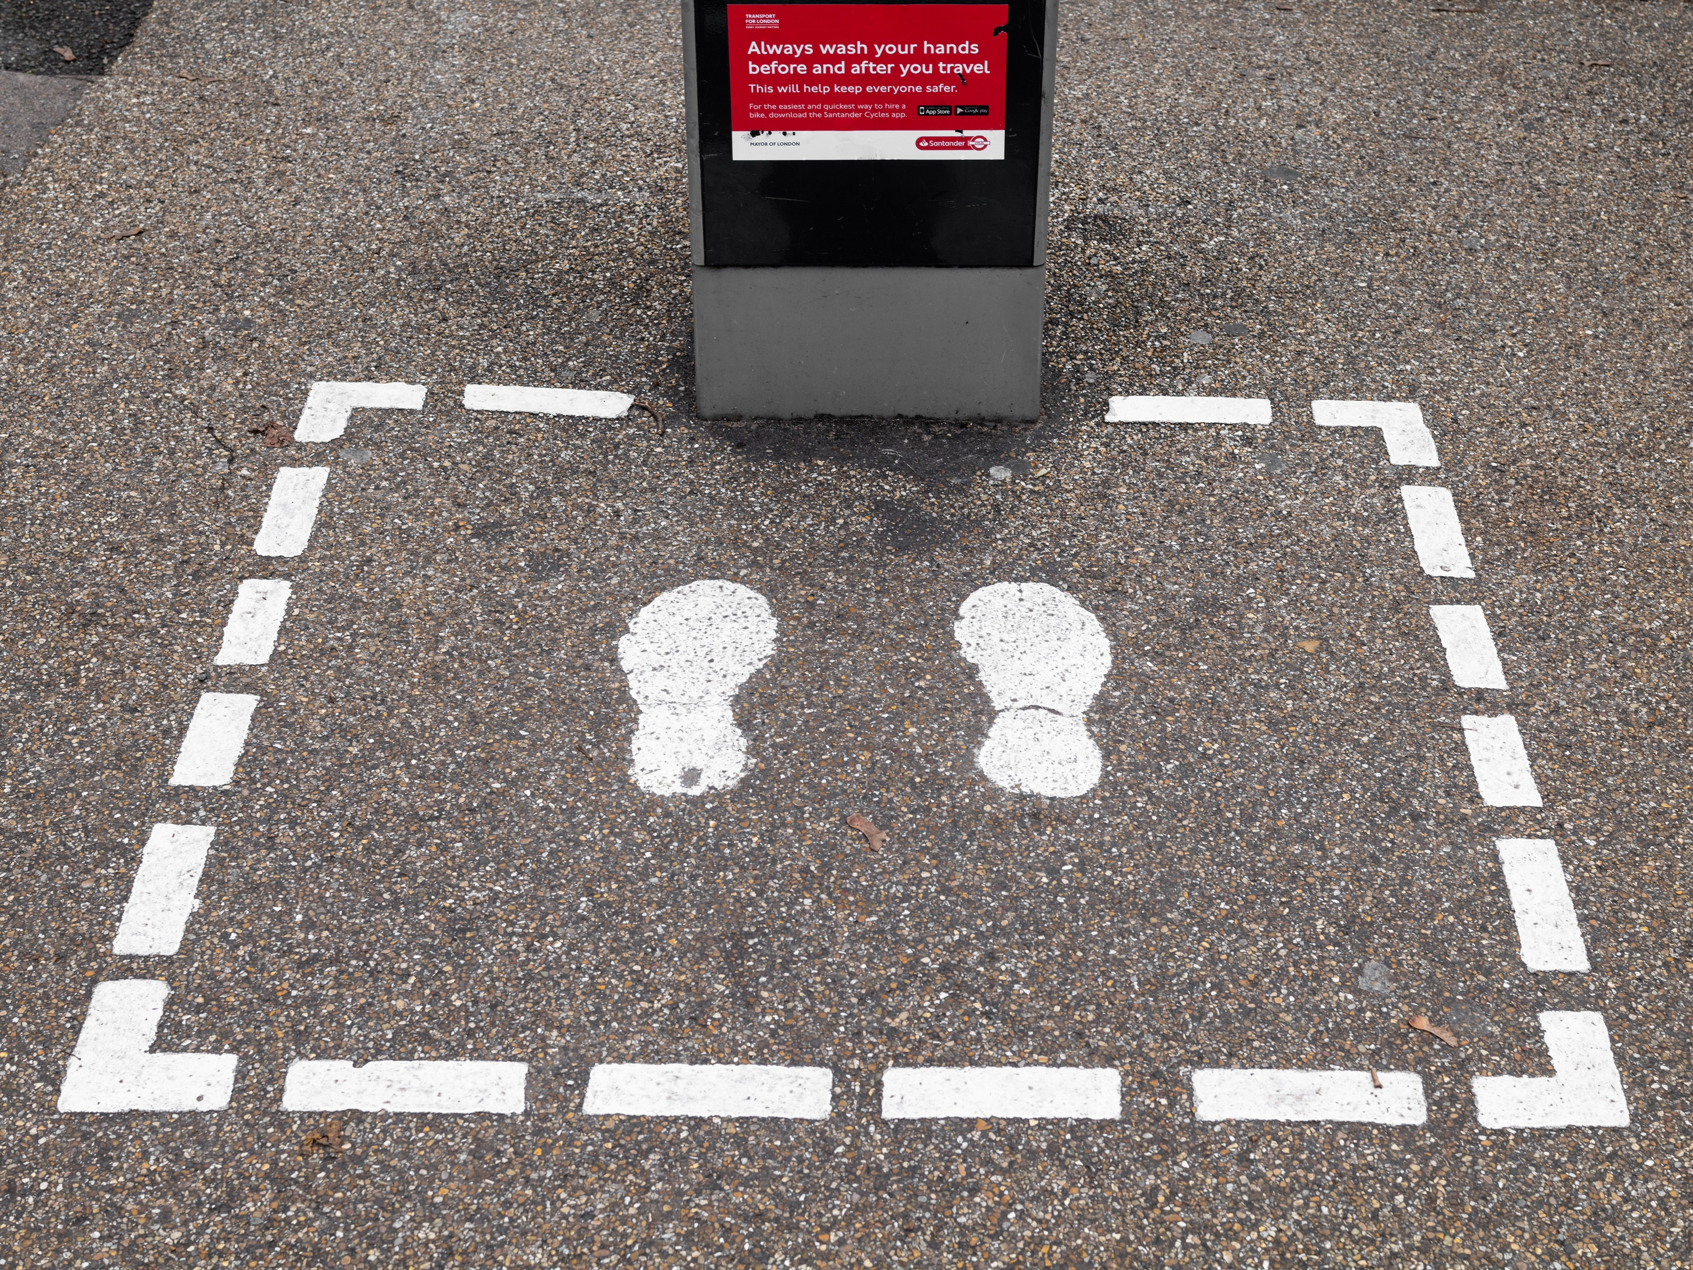
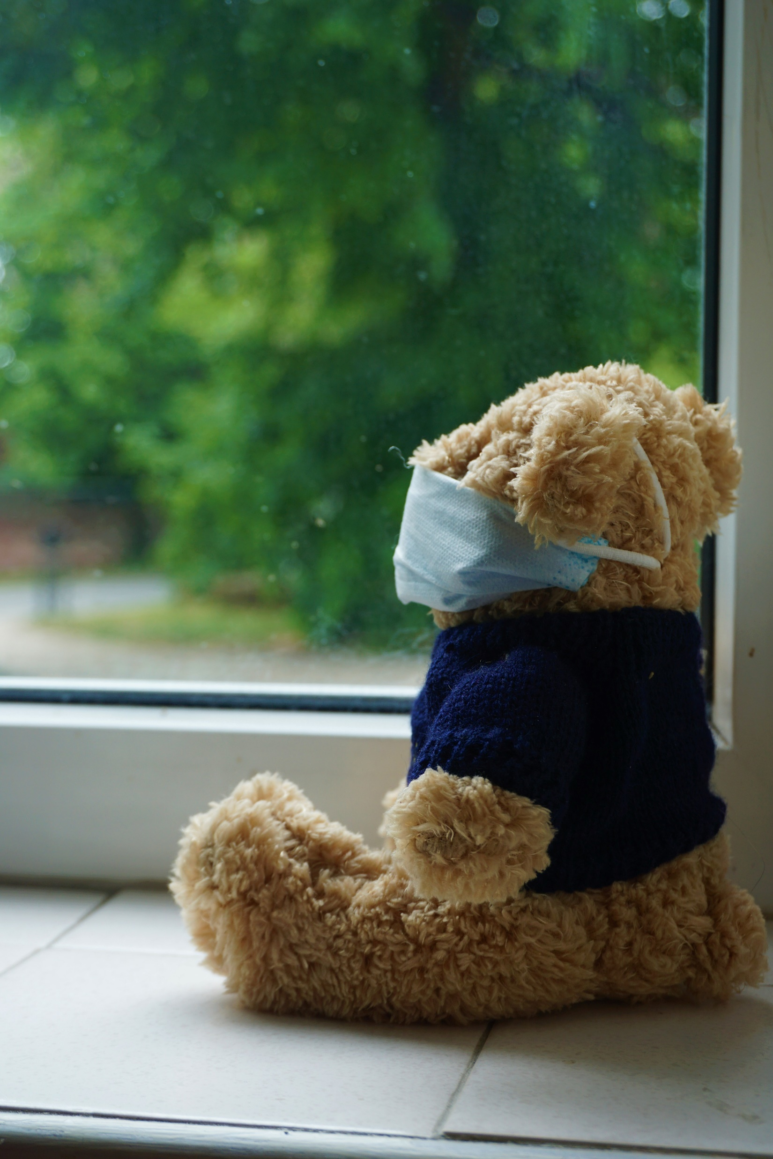
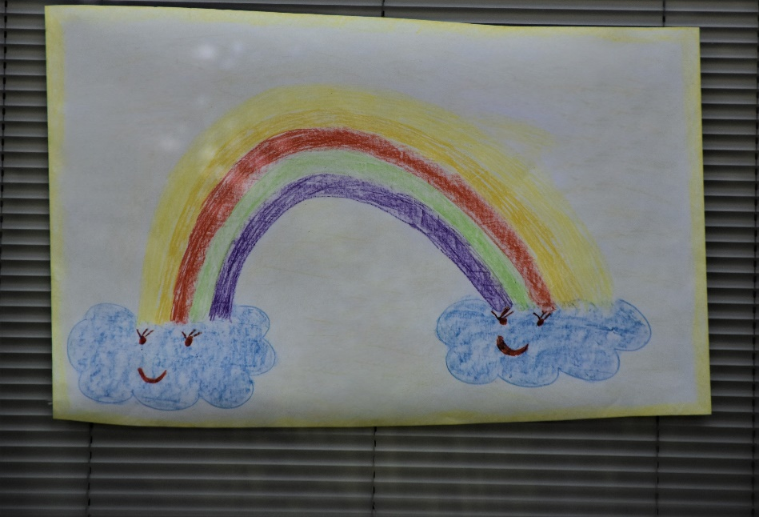
There was a time when we wore masks,
And everyone kept their distance.
A virus had come; made some people sick
Because we had no resistance.
We stayed at home, no school, no work;
Put teddies in our window.
But many found this life too hard,
So we also put up a rainbow.

Slide 3
A rainbow is bright, a rainbow is light,
A rainbow is a message of hope.
If we’re kind to each other, and love one another,
We are a message of hope.

Slide 4
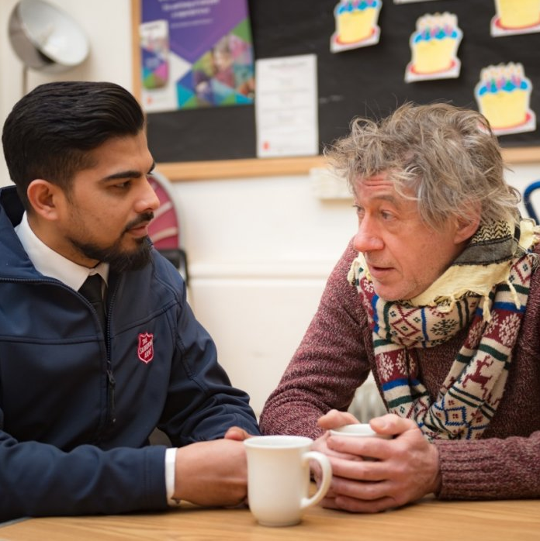
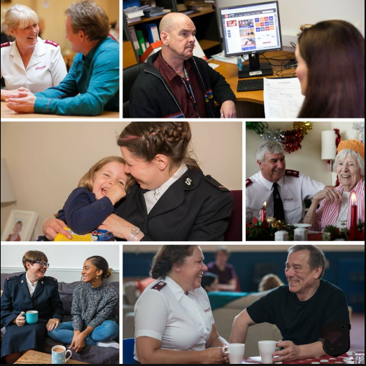
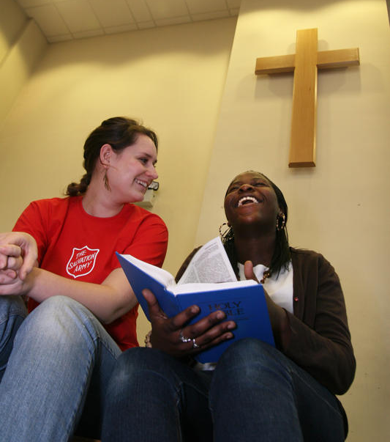
The Salvation Army believes in God
And helping people in need.
But keeping working in this new world?
Was a mammoth challenge indeed.
And so, inspired by rainbow colours,
Is the story of what we did:
Of helping people around us;
Loving others, like Jesus said.

Slide 5
A rainbow is bright, a rainbow is light,
A rainbow is a message of hope.
If we’re kind to each other, and love one another,
We are a message of hope.

Slide 6
RED
rough sleepers
and
runners
and

Slide 7
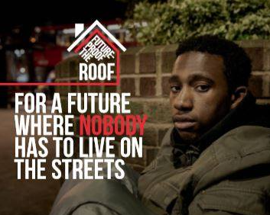
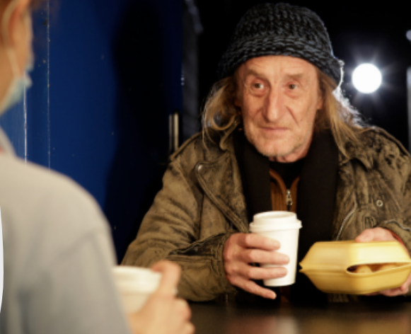
Rough sleepers had no place to go;
They live their life outside.
So on the streets hot meals we gave;
And worked to bring them inside.

Slide 8
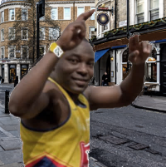
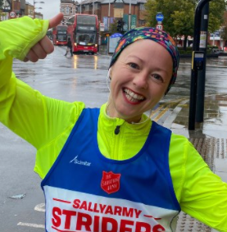
Runners who’d run the marathon
Who wanted to fundraise,
Ran at home, in streets, alone.
Giving money in new ways.

Slide 9
A rainbow is bright, a rainbow is light,
A rainbow is a message of hope.
If we’re kind to each other, and love one another,
We are a message of hope.

Slide 10
ORANGE
online support
online
church
and

Slide 11
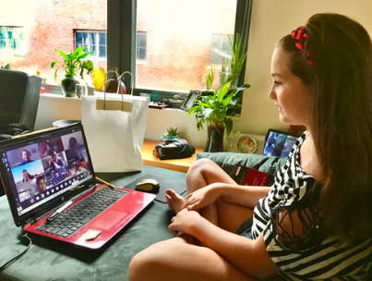
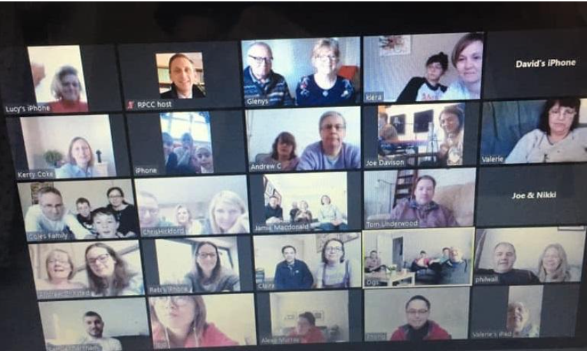
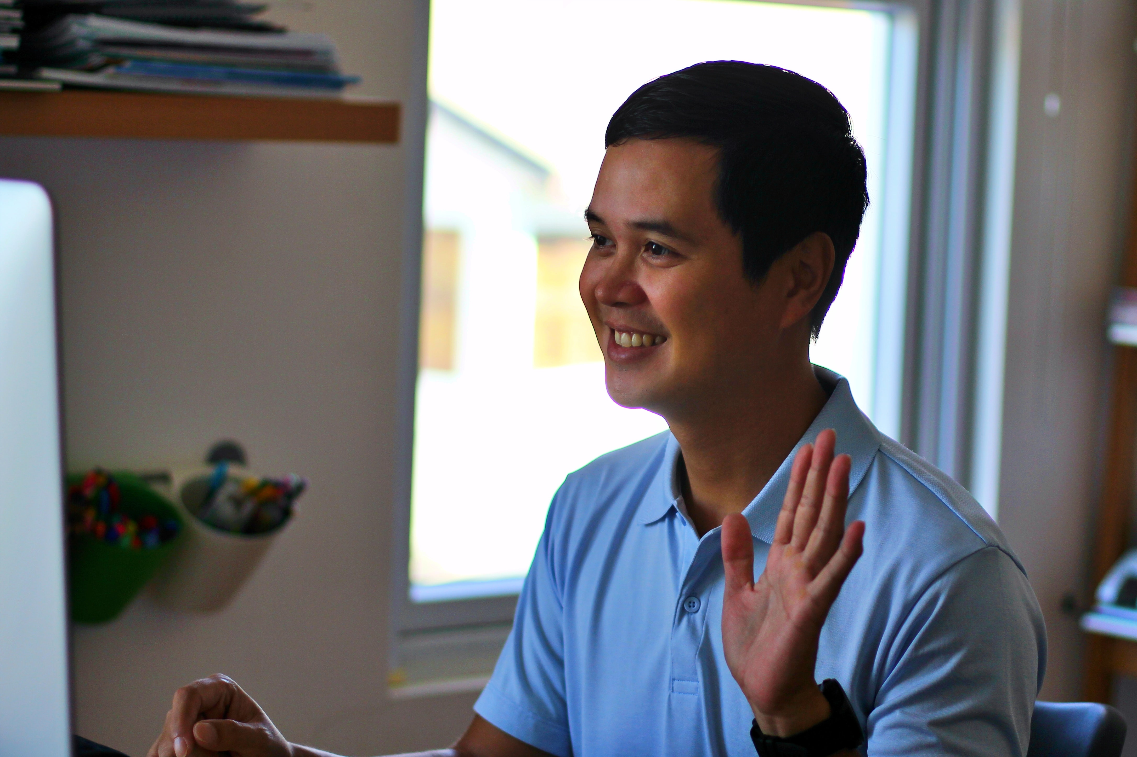
From young to old and in-between
We connected all online.
And so our clubs and services
Kept going – all was fine!

Slide 12
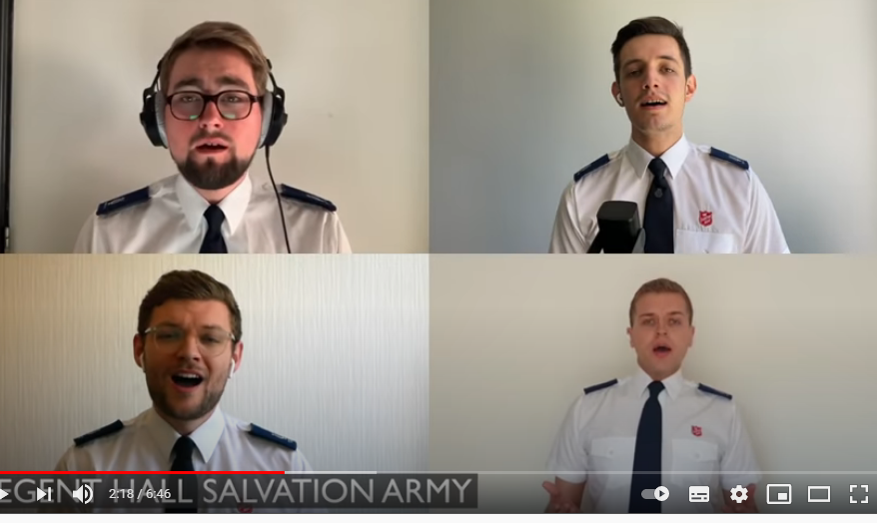
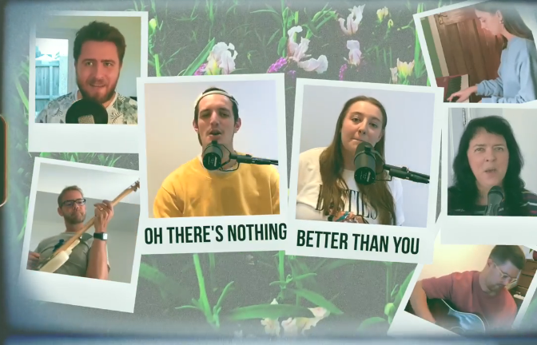
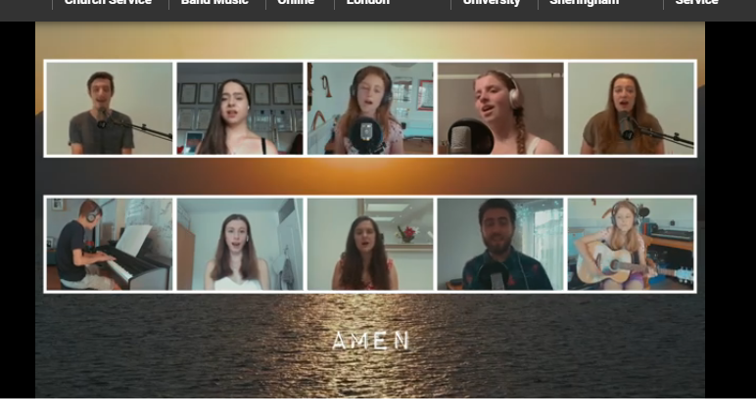
Our church connected virtually,
We sang and gave God praise.
We prayed for help and guidance
For us all in these days.

Slide 13
A rainbow is bright, a rainbow is light,
A rainbow is a message of hope.
If we’re kind to each other, and love one another,
We are a message of hope.

Slide 14
YELLOW
young people

Slide 15
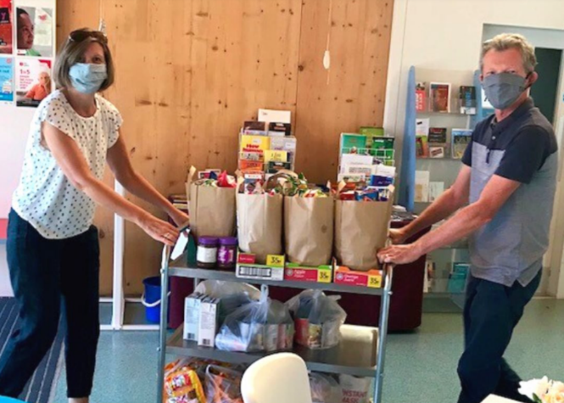
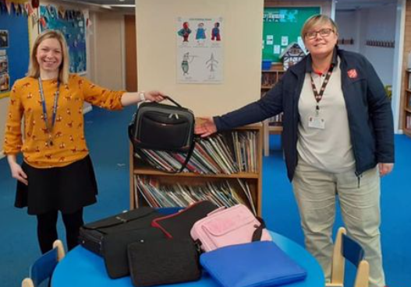
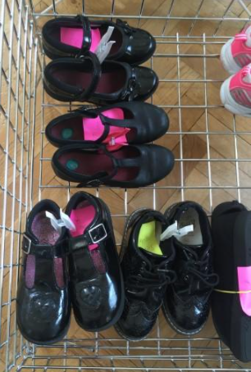
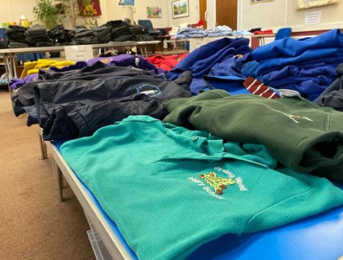
Our church was helping lots of kids
With breakfasts every day,
And clothing, games and spare laptops
For schoolwork and for play.

Slide 16
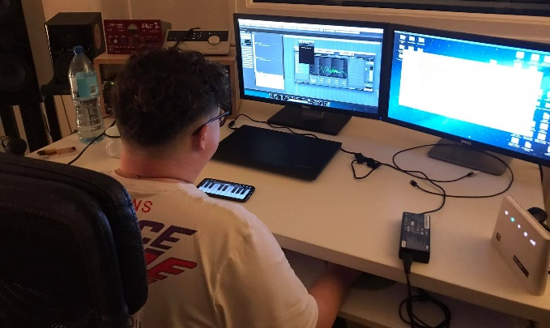
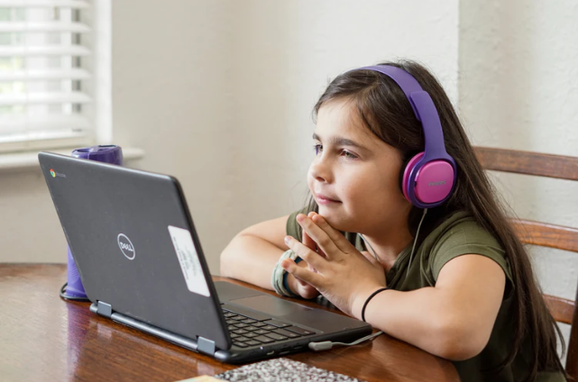
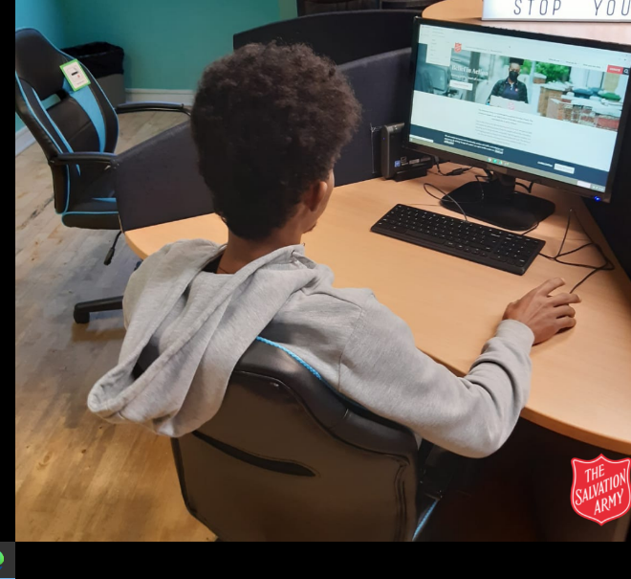
We helped young people to meet up
In our clubs – all online,
Plus training, and time to chat,
To check that they were fine.

Slide 17
A rainbow is bright, a rainbow is light,
A rainbow is a message of hope.
If we’re kind to each other, and love one another,
We are a message of hope.

Slide 18
GREEN
giving

Slide 19
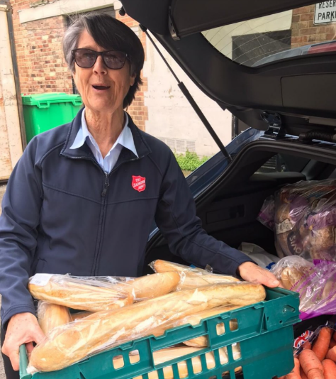
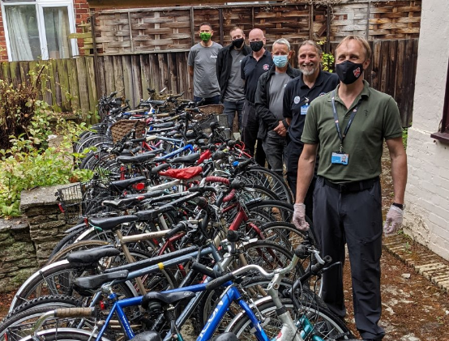
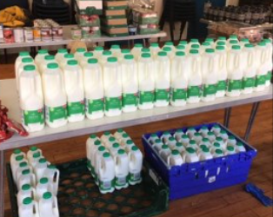
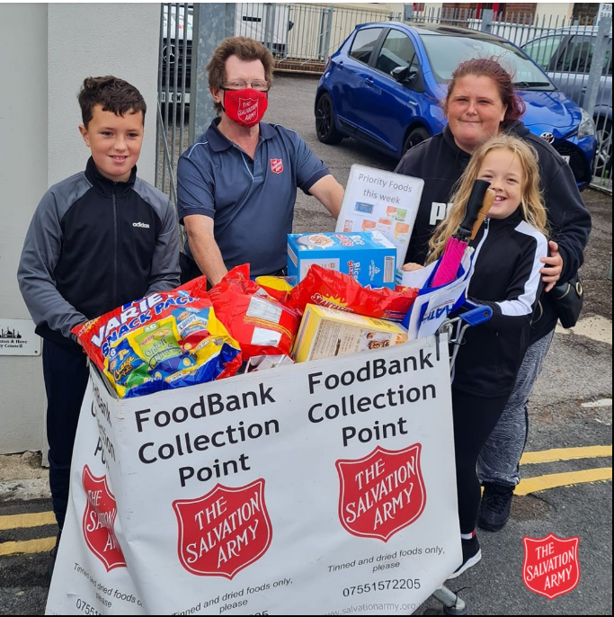
People gave us lots of things
So we could pass them on:
Food parcels, clothes – and furniture!
The list goes on and on.

Slide 20
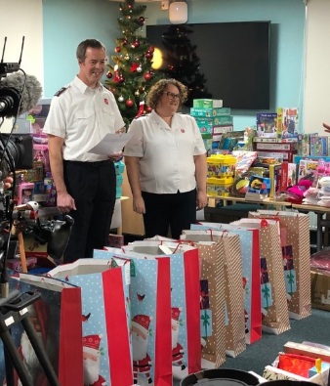
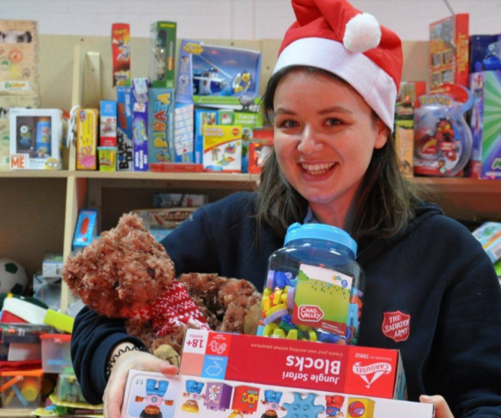
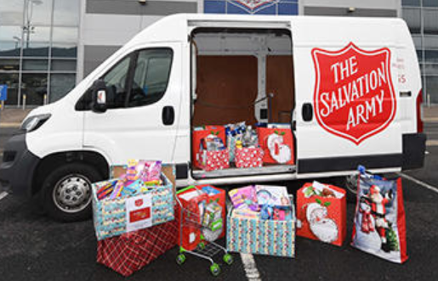
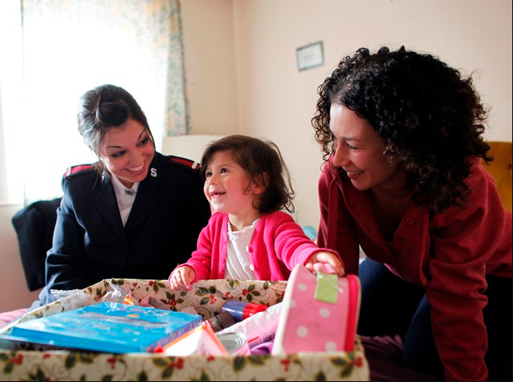
And when it can to Christmas time,
Our toy appeal went wild!
For families who were struggling,
A toy for every child.

Slide 21
A rainbow is bright, a rainbow is light,
A rainbow is a message of hope.
If we’re kind to each other, and love one another,
We are a message of hope.

Slide 22
BLUE
beating the blues
brews
and

Slide 23
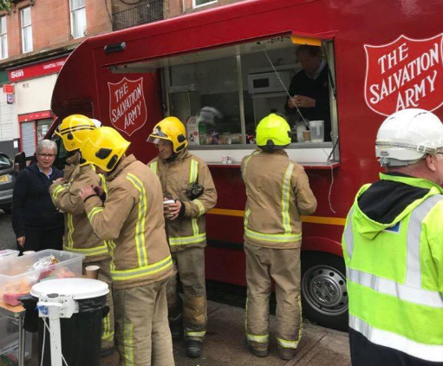
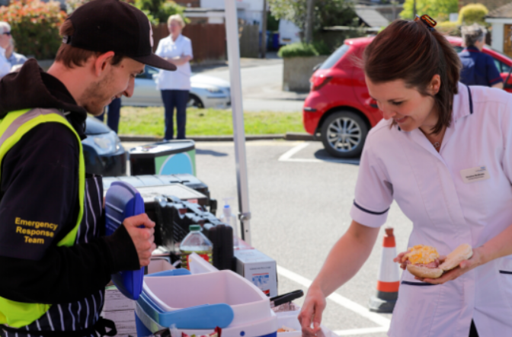
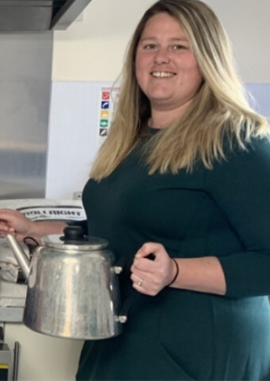
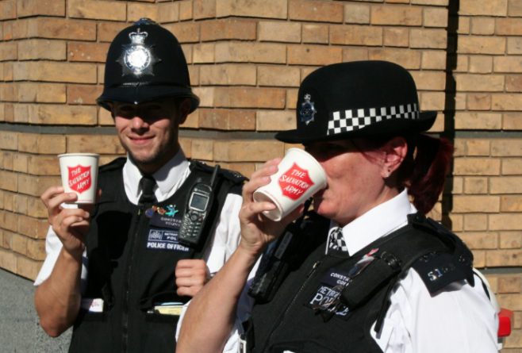
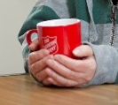
Our vans cheer people in emergencies
With chats and tea – a brew.
It helped keep people’s spirits up,
Like NHS workers too.

Slide 24
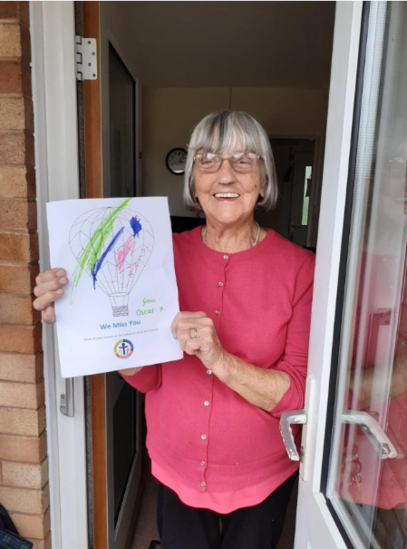
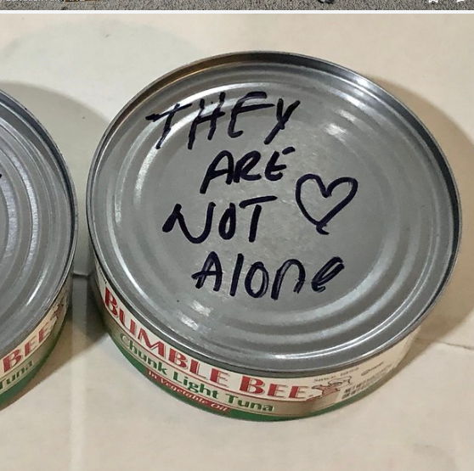
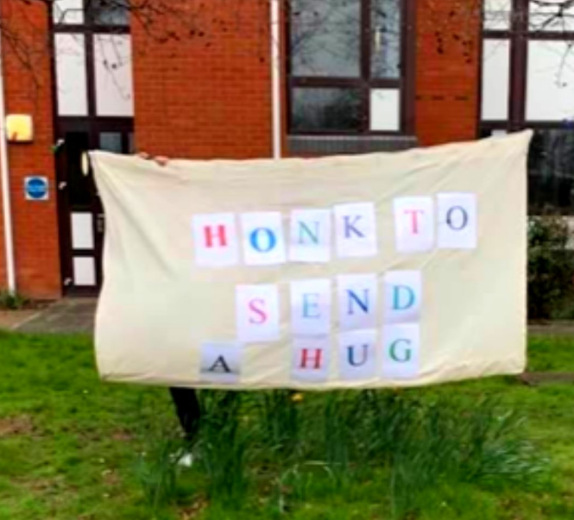
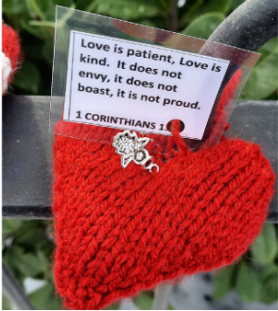
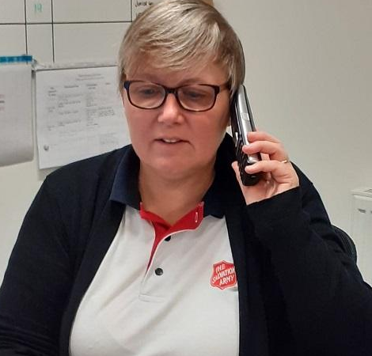
We reached out to the vulnerable –
People alone all day.
And sent out hopeful messages:
‘We can do it, you’ll be okay.’

Slide 25
A rainbow is bright, a rainbow is light,
A rainbow is a message of hope.
If we’re kind to each other, and love one another,
We are a message of hope.

Slide 26
INDIGO
international

Slide 27
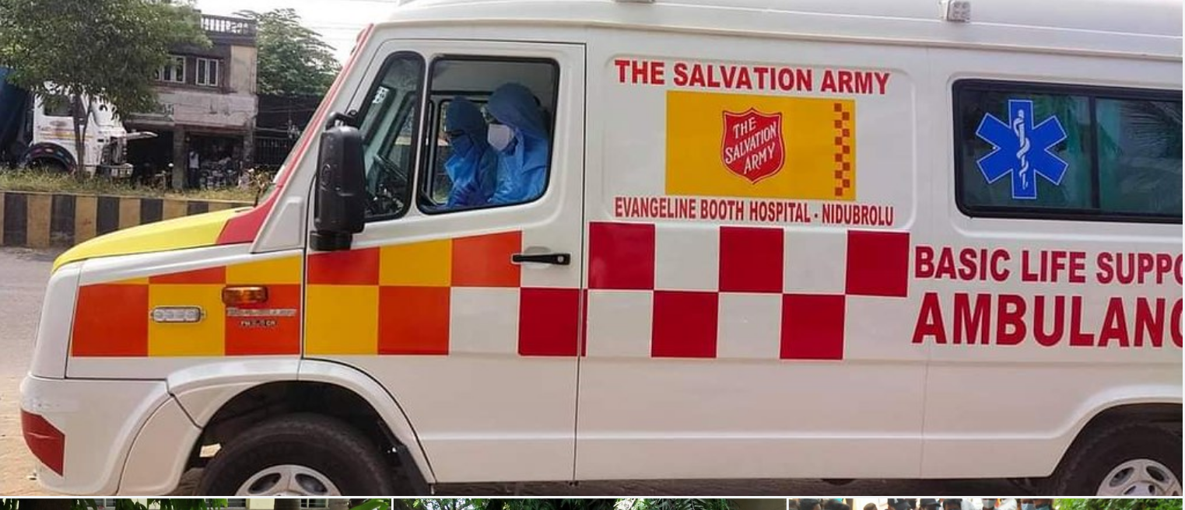
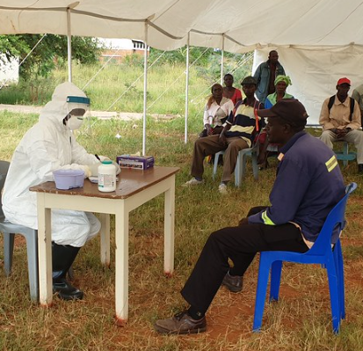
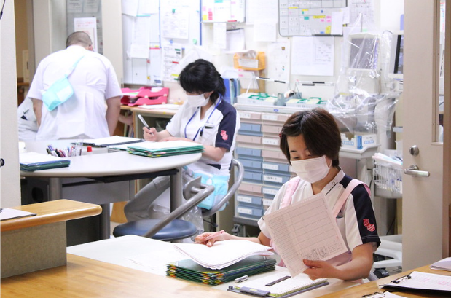
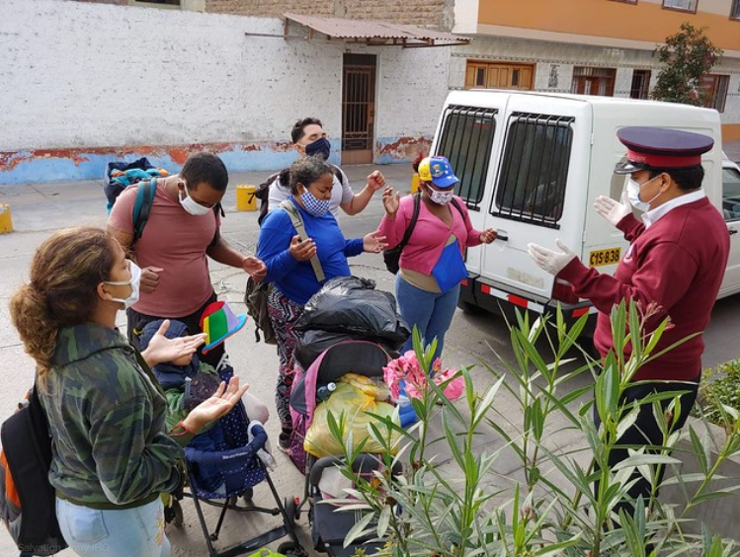
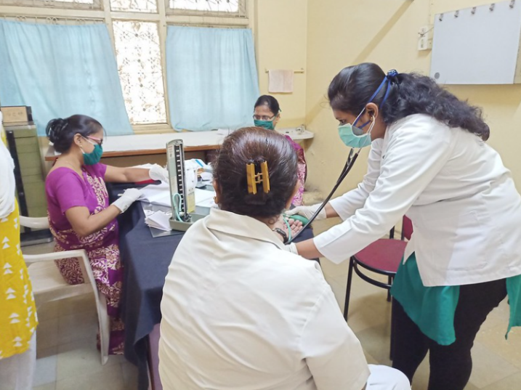
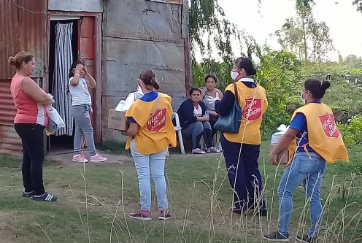
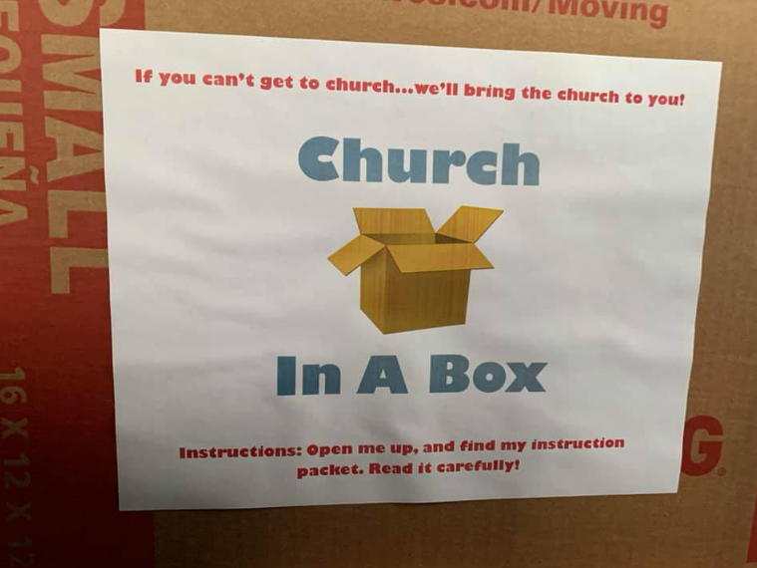
Our church is international,
Our work is worldwide too.
With schools, and clinics and hospitals,
Our work just grew and grew.

Slide 28
We made sure people round the world
Had the facts that they’d all need
To keep them safe, plus masks and soap;
Giving supplies at speed.

Slide 29
A rainbow is bright, a rainbow is light,
A rainbow is a message of hope.
If we’re kind to each other, and love one another,
We are a message of hope.

Slide 30
VIOLET
volunteers
and
vaccine

Slide 31
With so much work to get done,
Our volunteer numbers grew.
So many hands to cook and help,
We’re grateful to them – thank you!

Slide 32
And finally the vaccine came;
You could get it at our church.
We made sure no one in our communities
Was left out in the lurch.

Slide 33
A rainbow is bright, a rainbow is light,
A rainbow is a message of hope.
If we’re kind to each other, and love one another,
We are a message of hope.

Slide 34
When you help each other, like a family,
Putting others at the front of your mind,
You makes a difference in the world
By being thoughtful and kind.
We all need some hope and help
So life is good and true.
So what can you do to help others?
Can you be a rainbow too?

Slide 35
A rainbow is bright, a rainbow is light,
A rainbow is a message of hope.
If we’re kind to each other, and love one another,
We are a message of hope.

