Slide 1
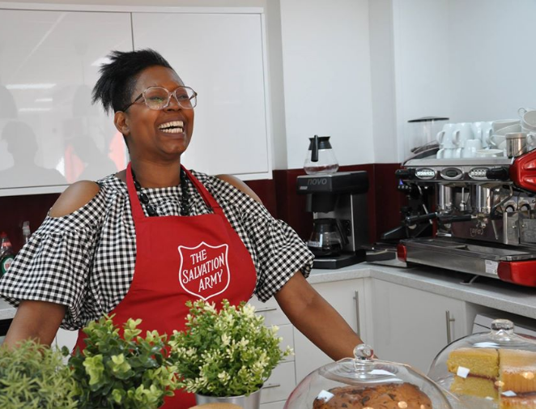
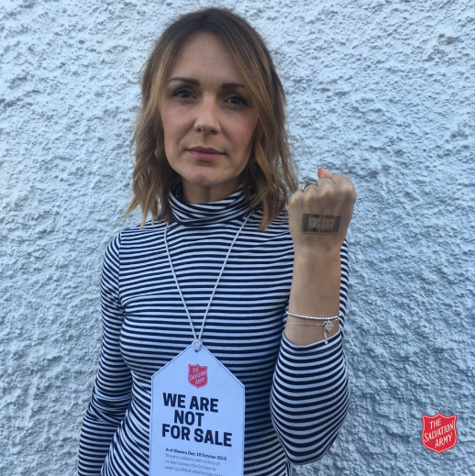
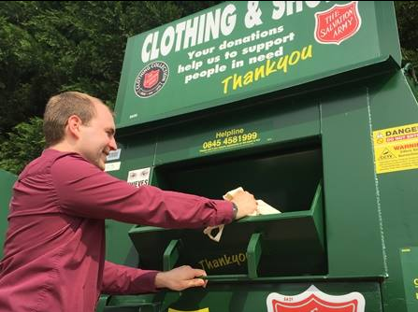
Faith in action

Slide 2
Food banks

Slide 3
Drop-in centres

Slide 4
Training

Slide 5
Emergency support

Slide 6
Clubs

Slide 7
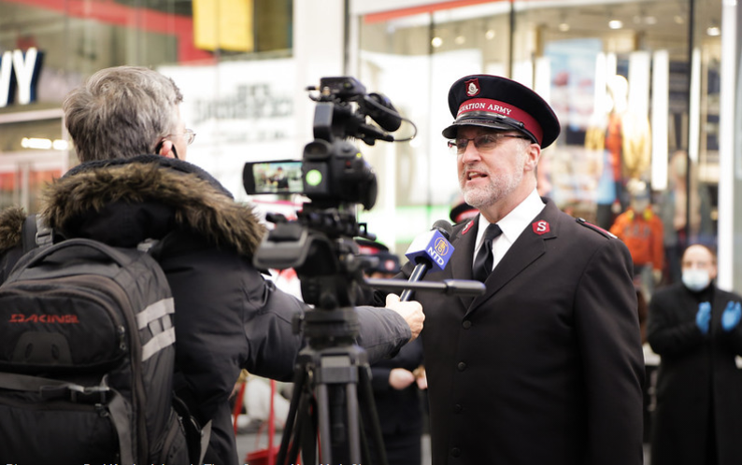
Campaigning for fairness

Slide 8
Modern slavery

Slide 9
Lifehouses

Slide 10
International

