Slide 1
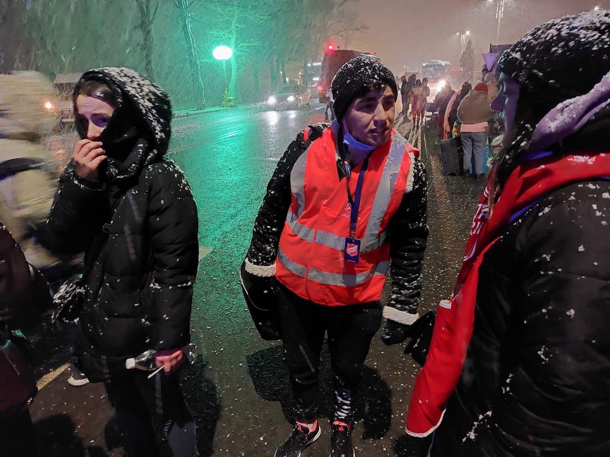

Ukraine Crisis

Slide 2
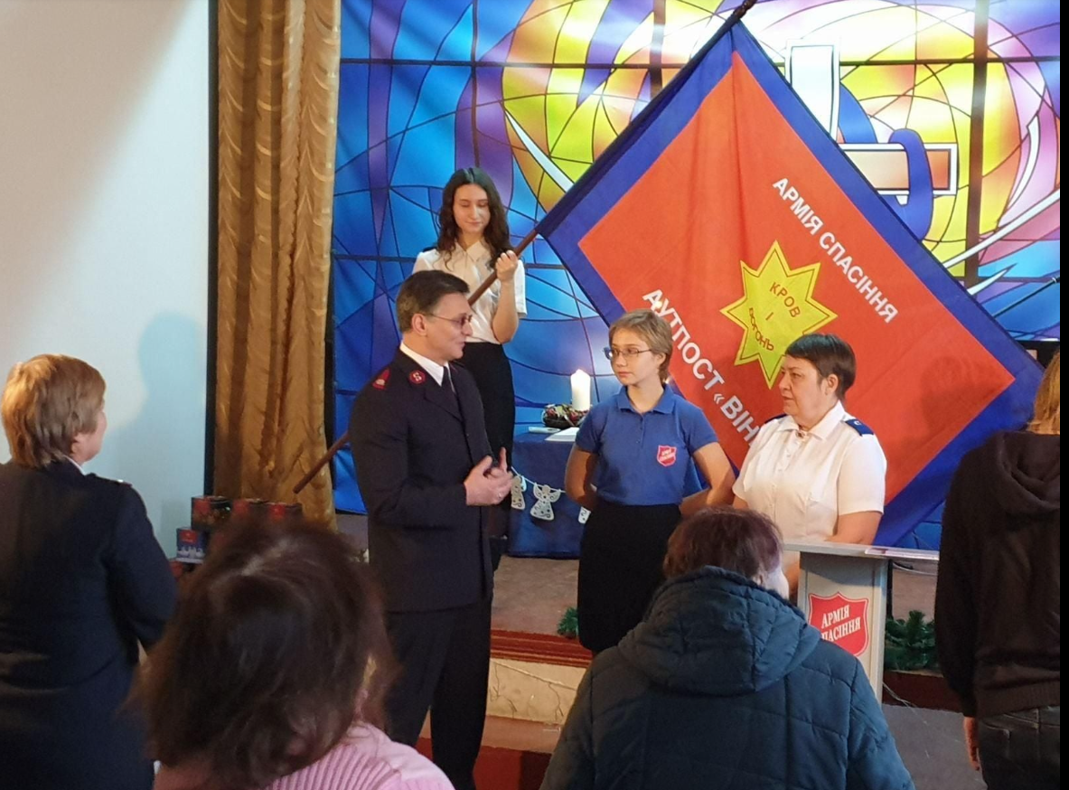
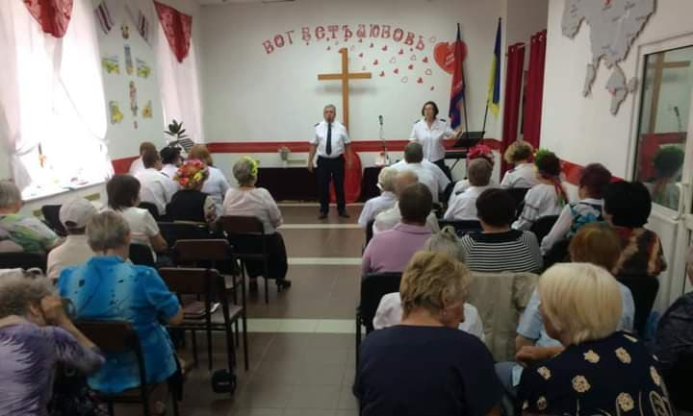
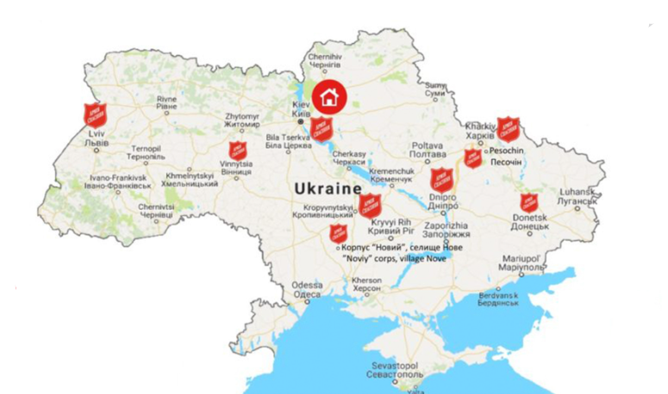

Ukraine
Before the crisis

Slide 3
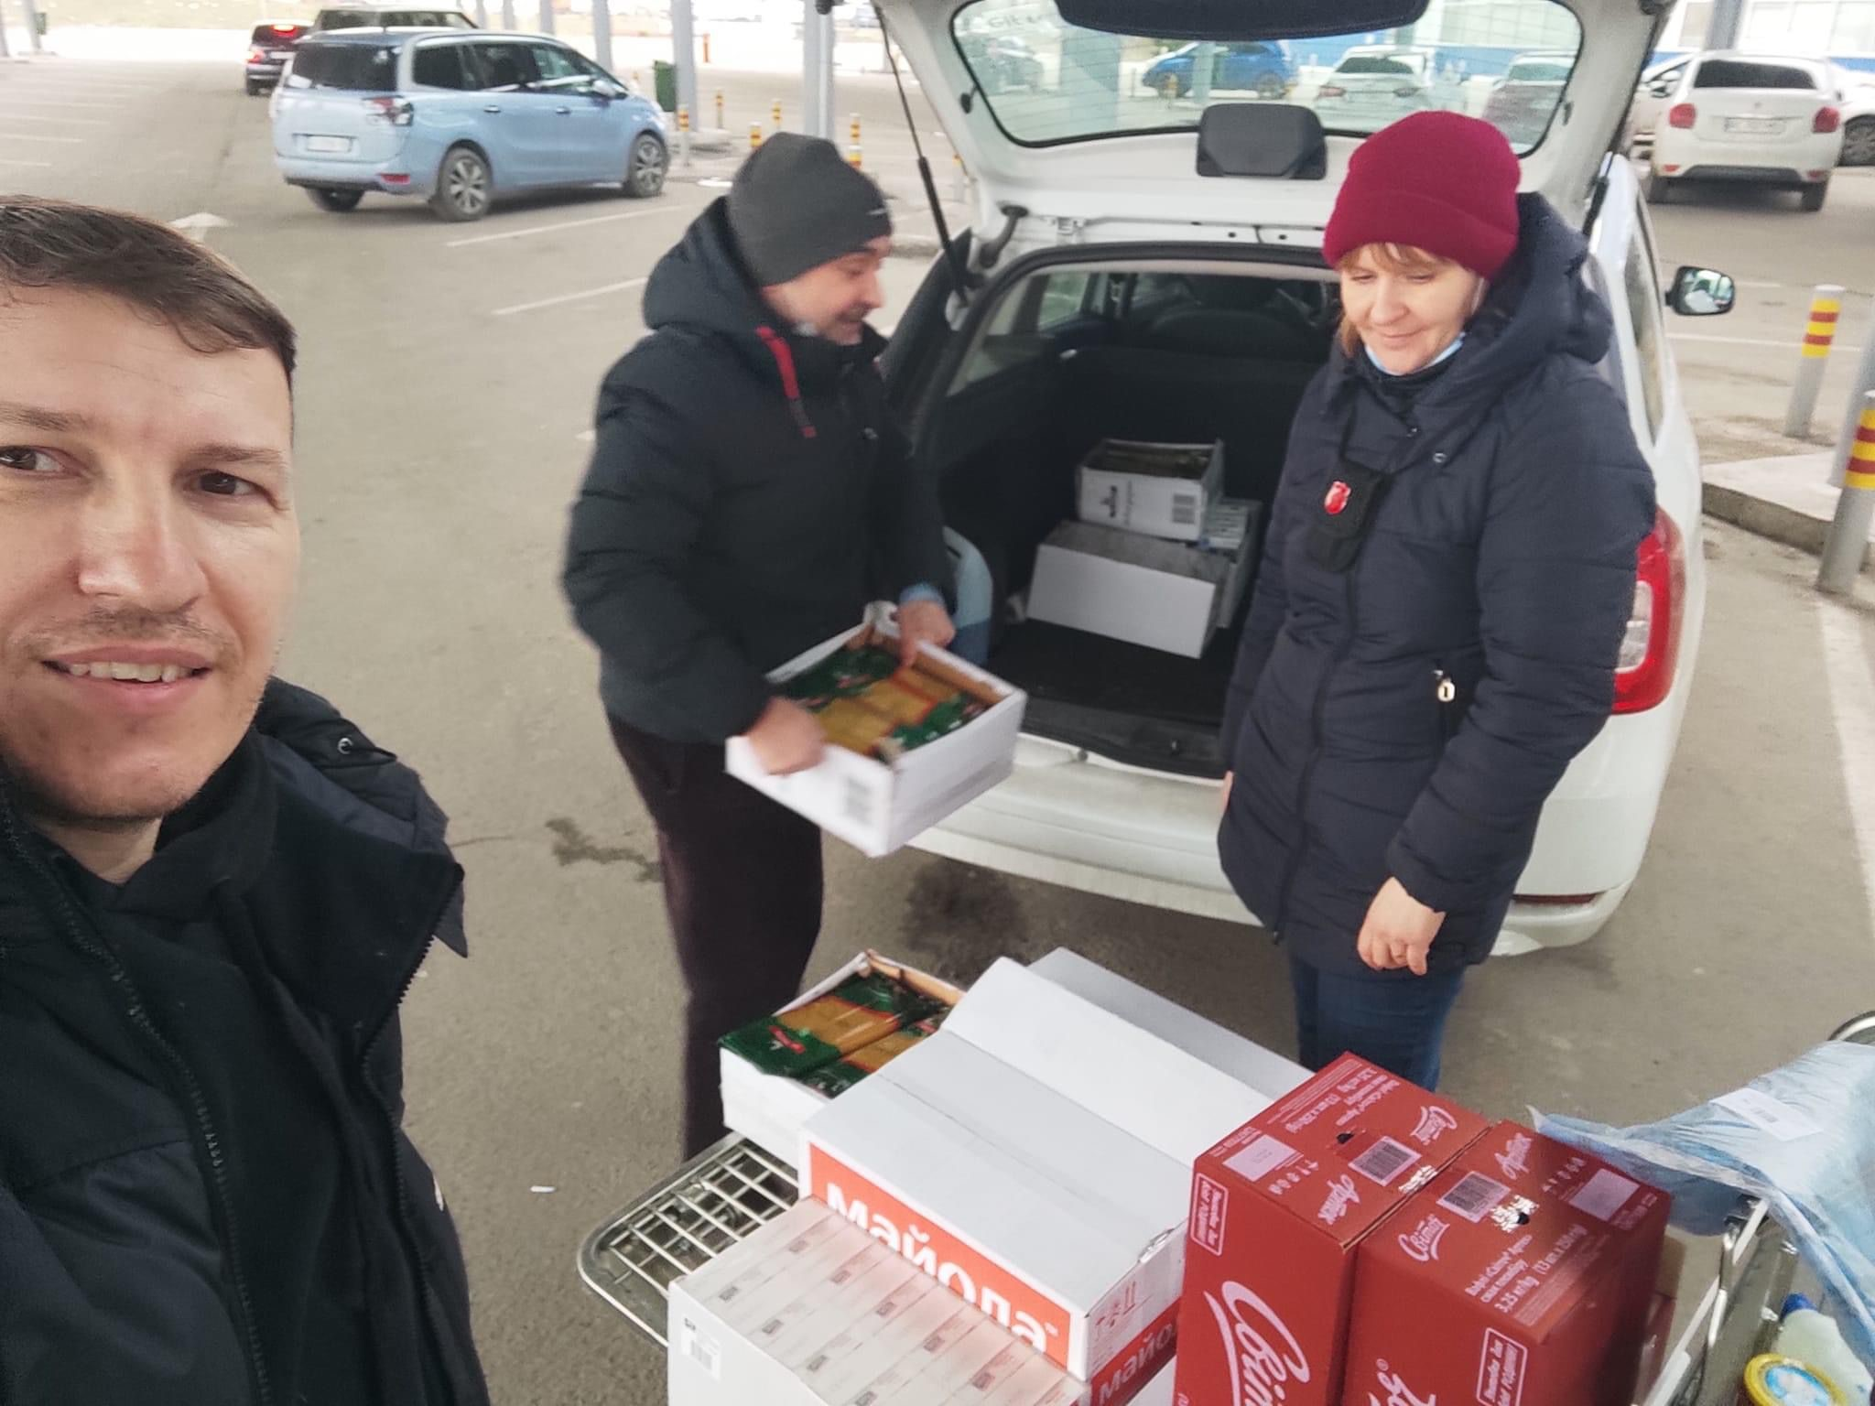
Ukraine
Emergency supplies

Slide 4
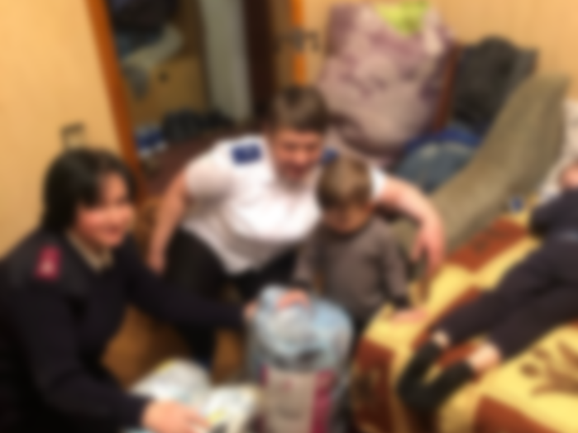
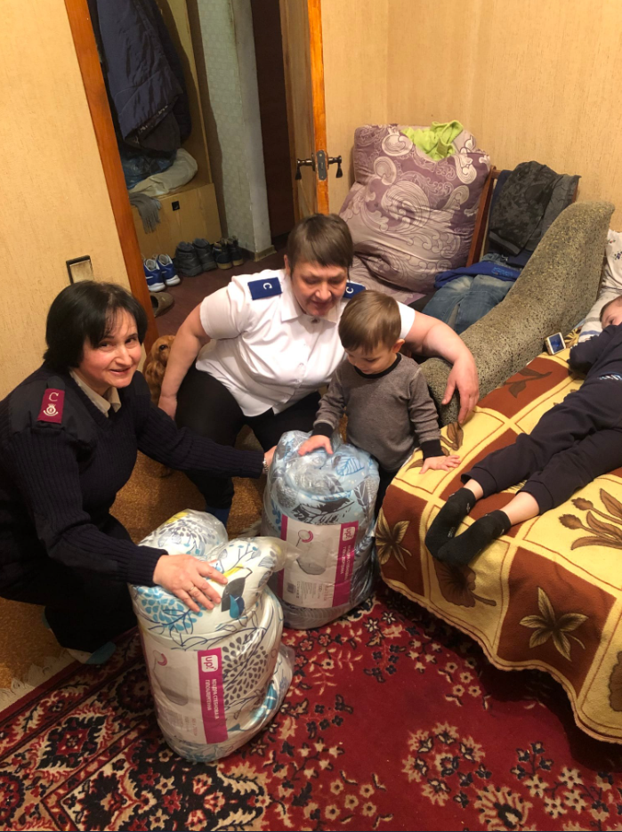
Ukraine
Staying with communities

Slide 5
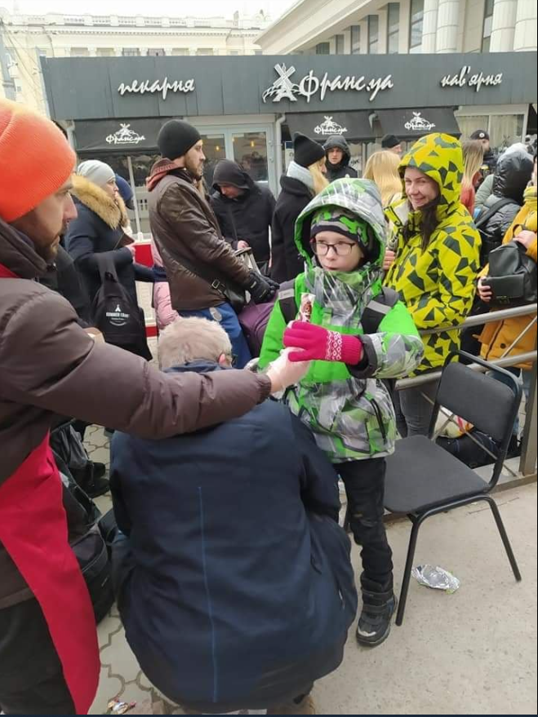
Ukraine
Giving hope

Slide 6
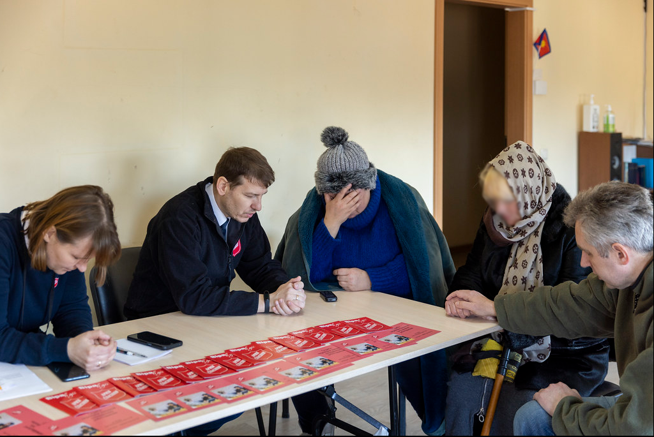
Ukraine
Praying

Slide 7
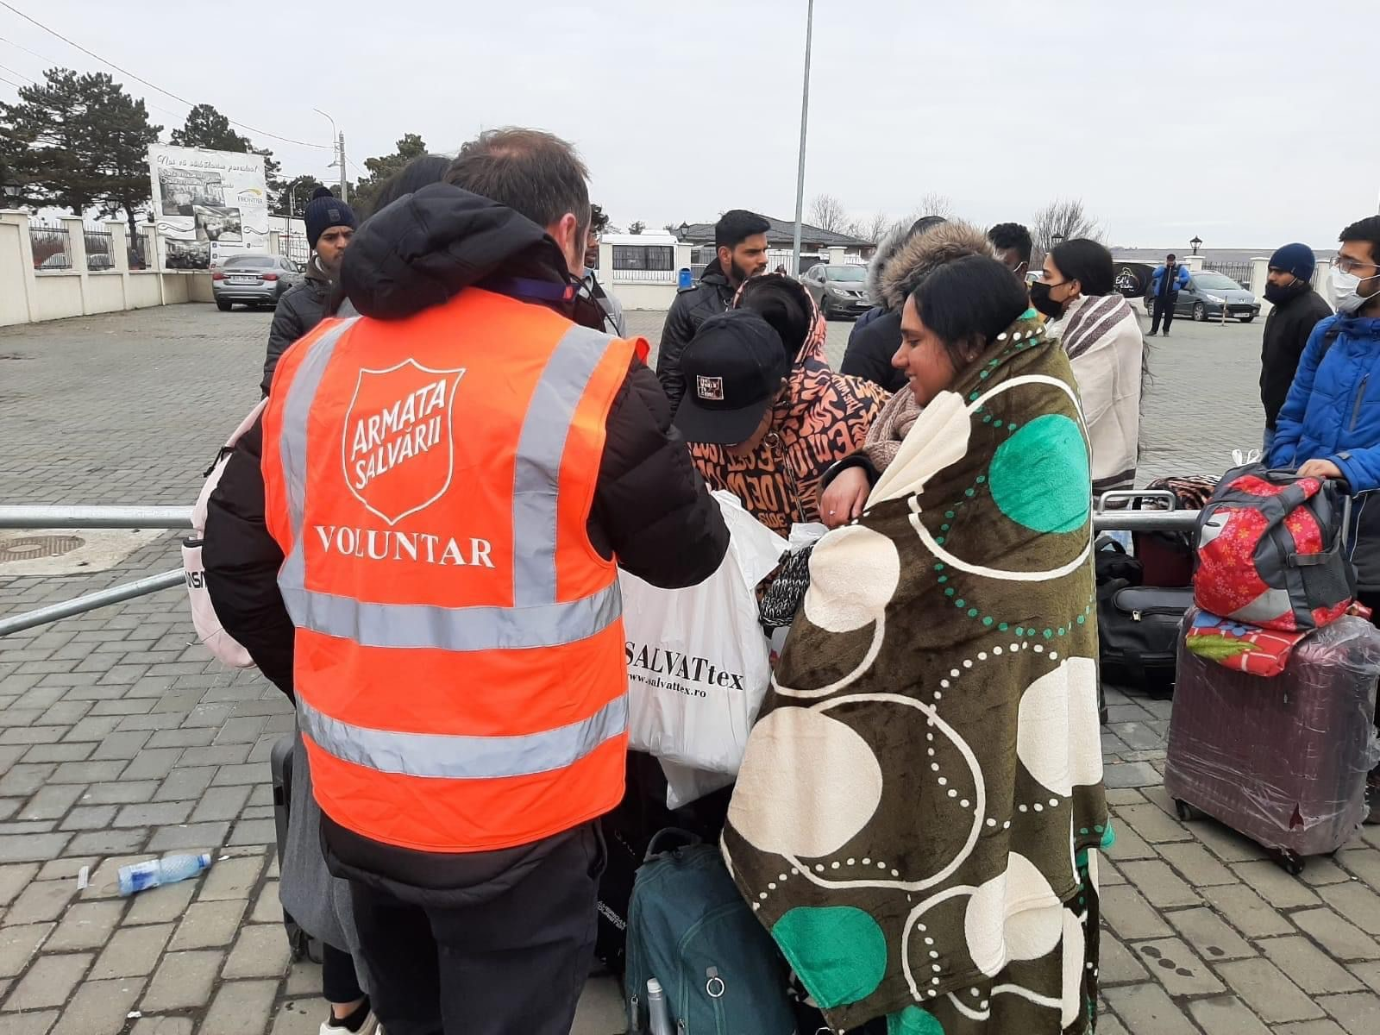

Romania
At the border

Slide 8
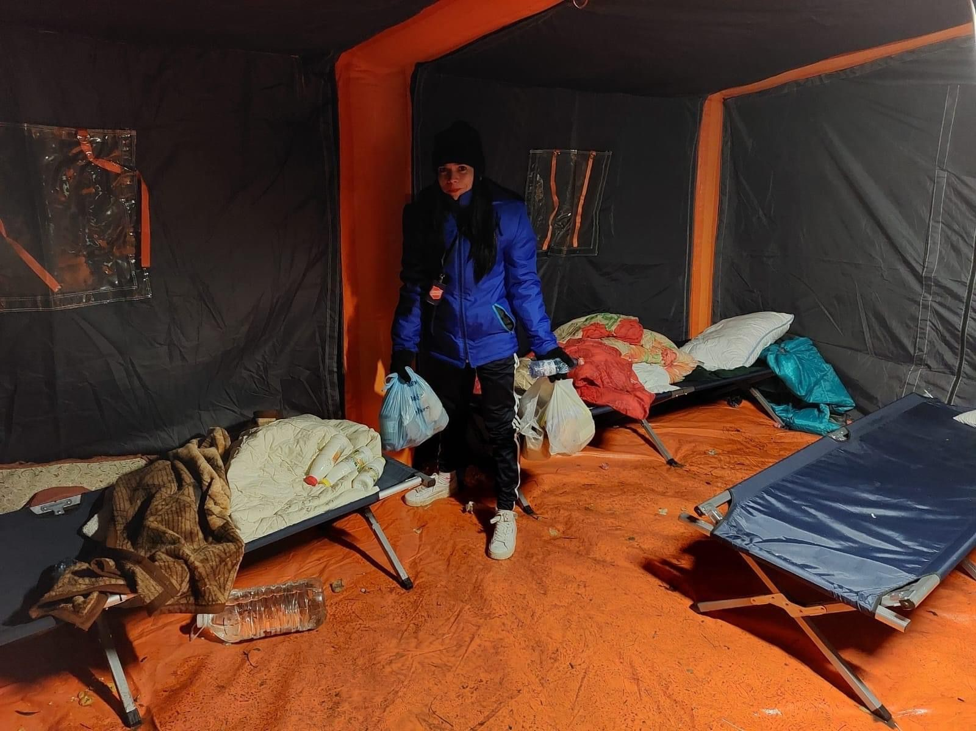
Romania
Emergency shelter

Slide 9
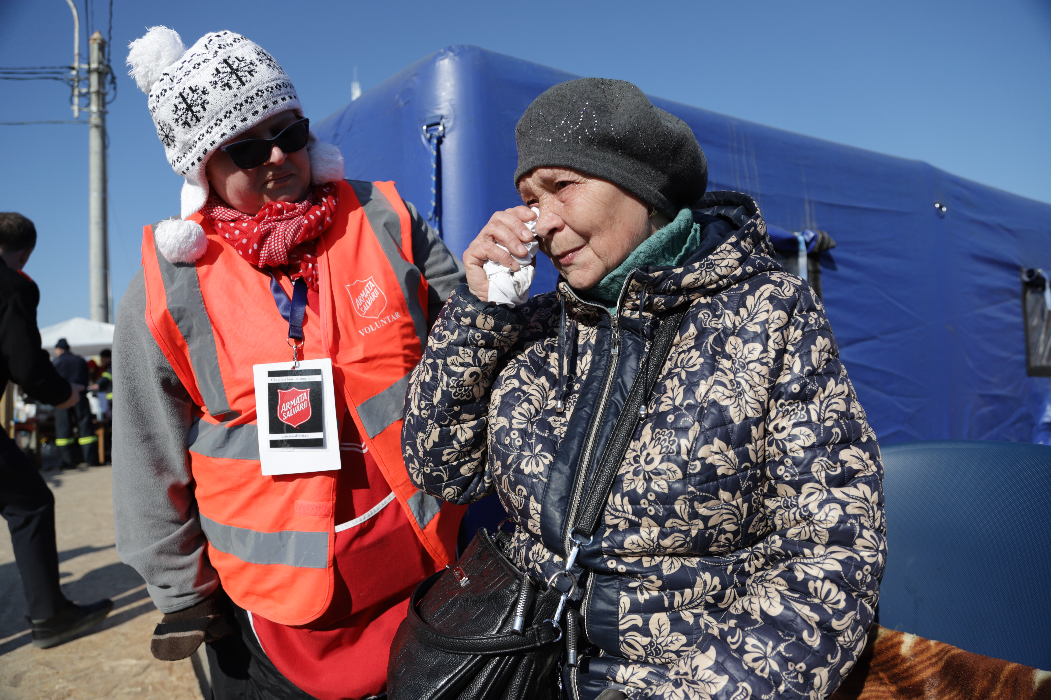
Romania
Emotional support

Slide 10
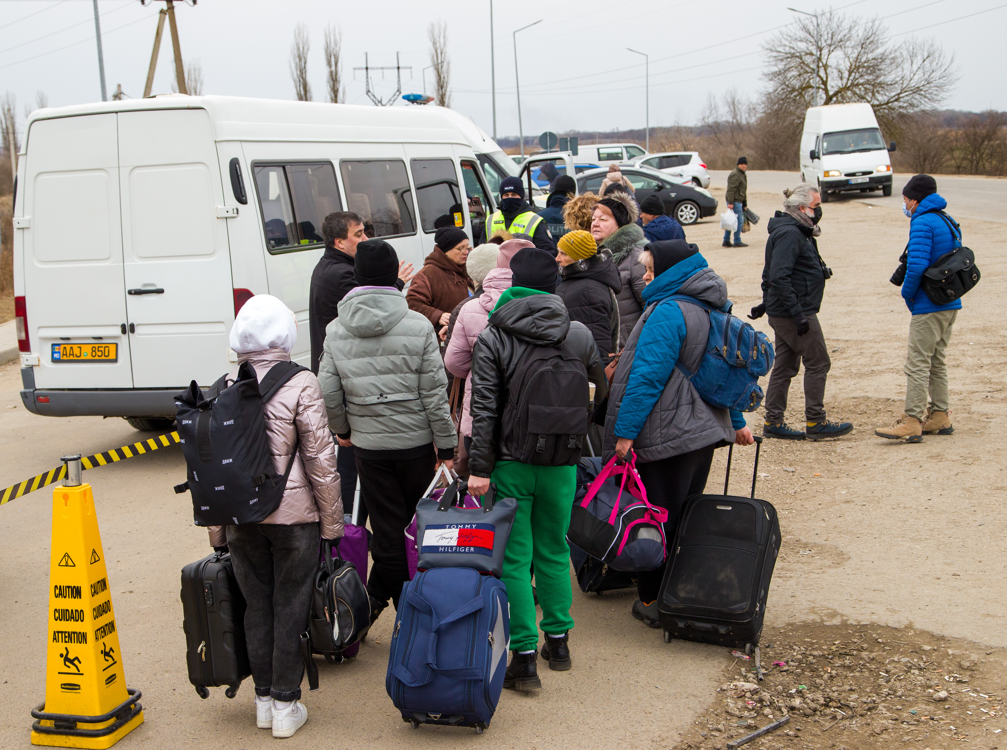
Moldova
Transport

Slide 11
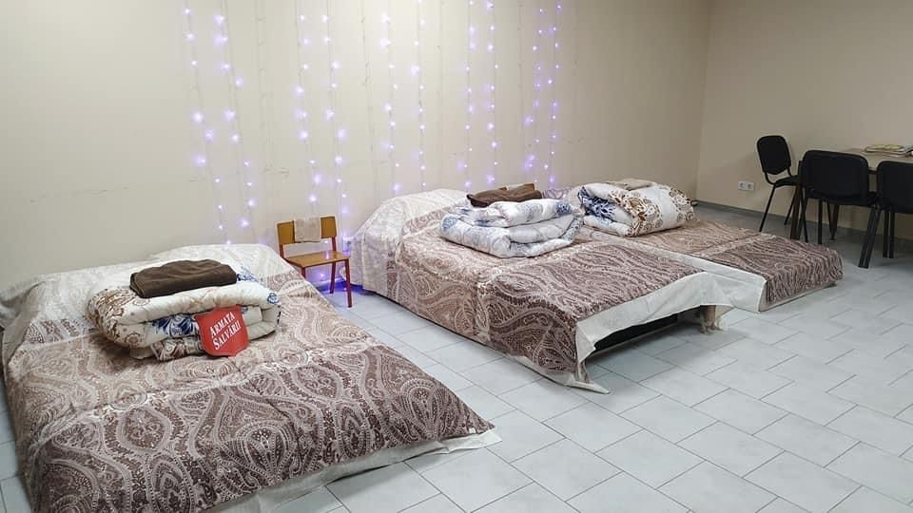
Moldova
Temporary accommodation

Slide 12
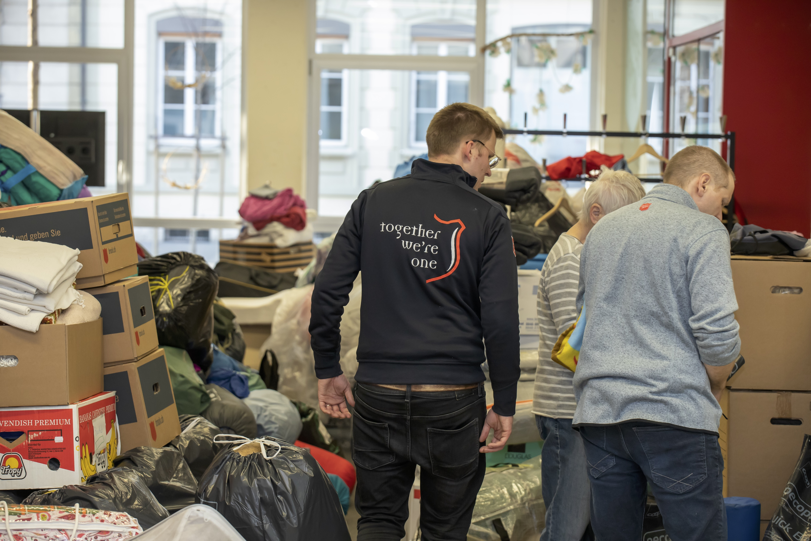

Hungary
Sorting donations

Slide 13
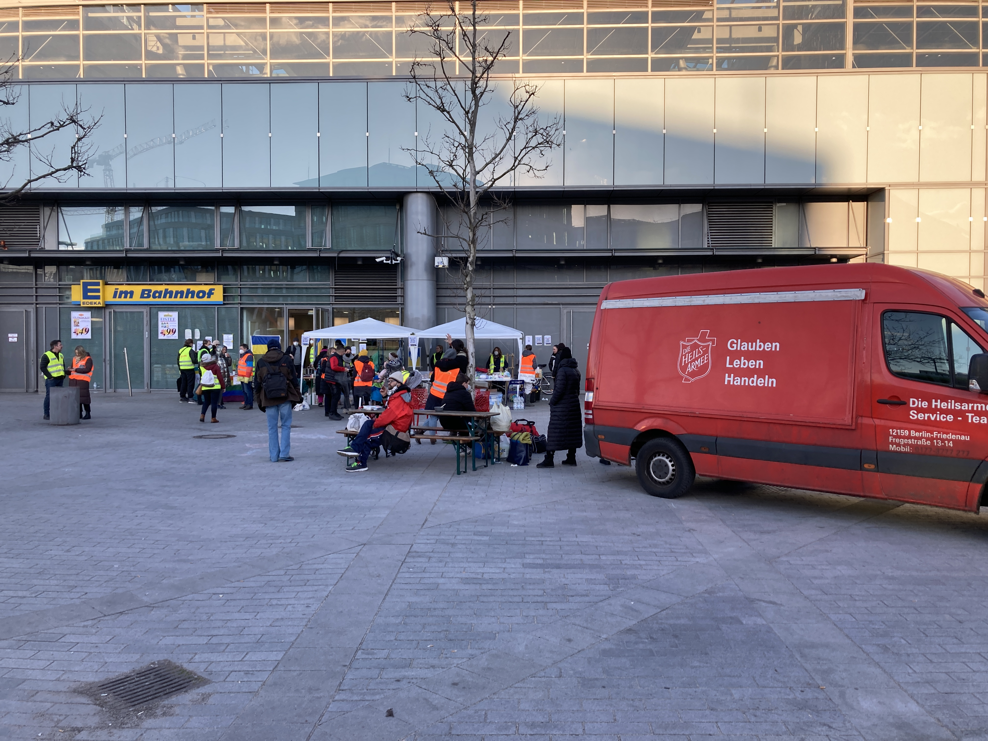

Germany
Welcoming

Slide 14
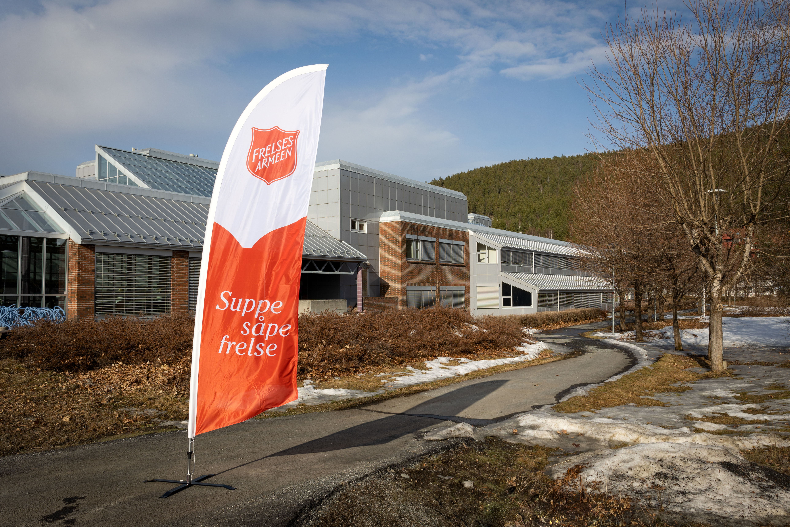

Norway
Accommodation for 700

Slide 15
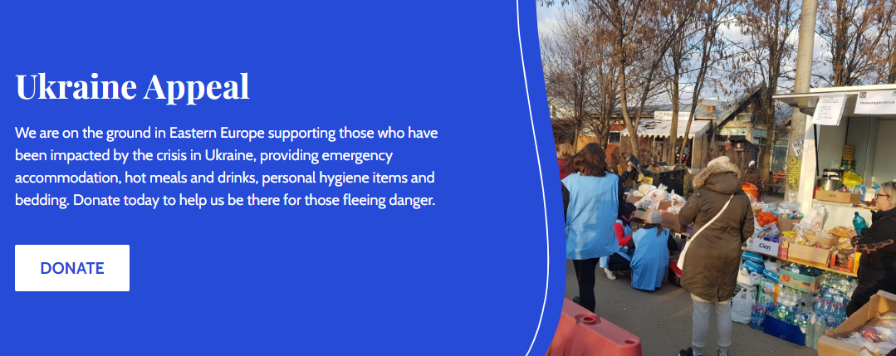

UK & Ireland
Fundraising

Slide 16
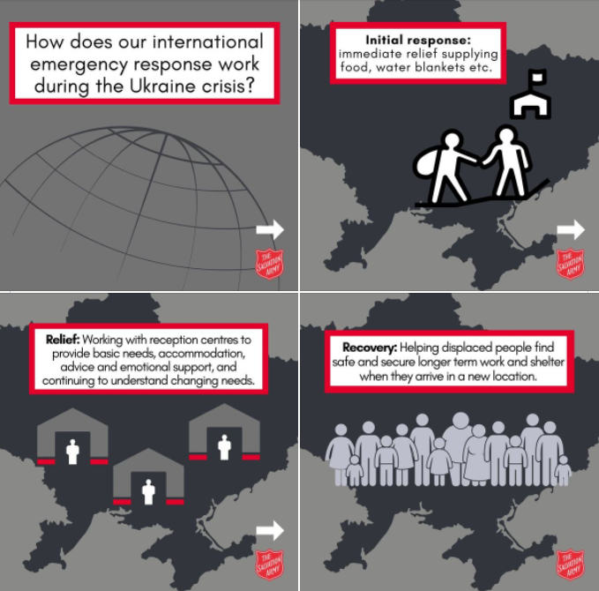
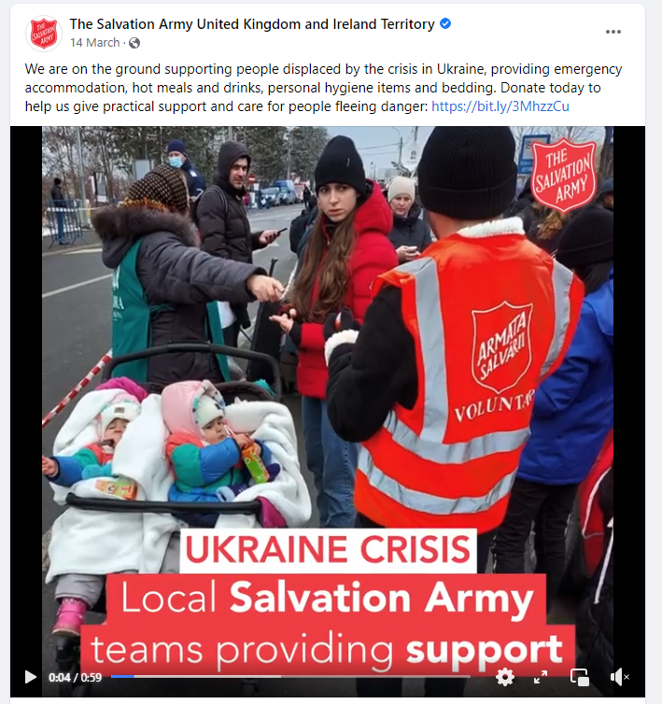
UK & Ireland
Information

Slide 17

UK & Ireland
Homes for Ukraine

Slide 18
UK & Ireland
In our area

