Slide 2
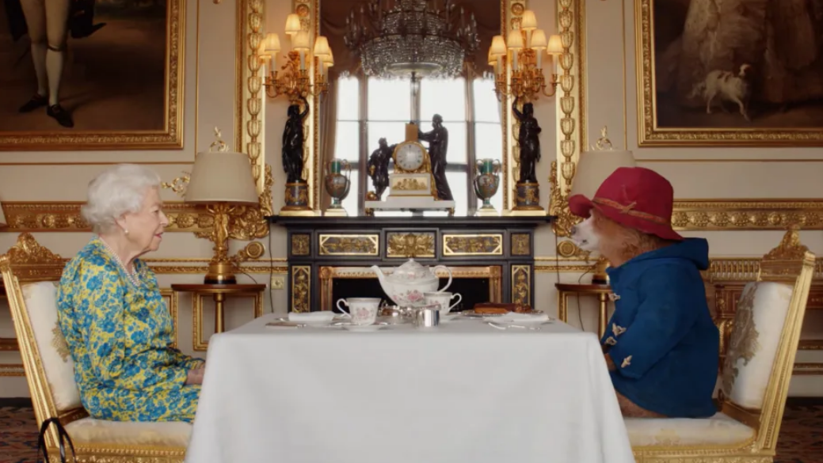

Slide 5
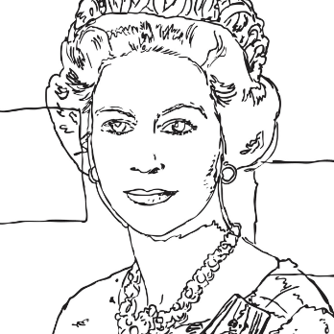

Slide 6
My Father’s house has many rooms; if that were not so, would I have told you that I am going there to prepare a place for you? And if I go and prepare a place for you, I will come back and take you to be with me that you also may be where I am. (John 14:2-3)

