Slide 1


Slide 2
How many of you have seen a rainbow?

Slide 3
How many of you have seen these kinds of rainbows?

Slide 4
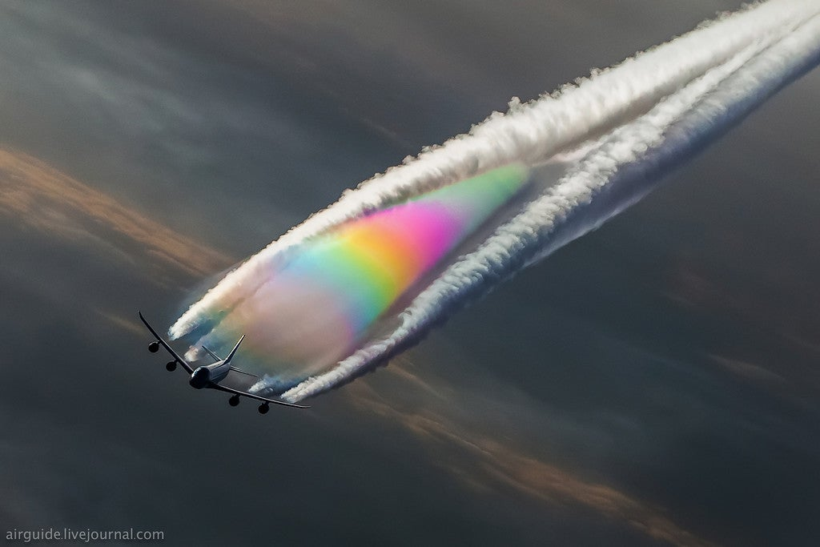
Contrails

Slide 5
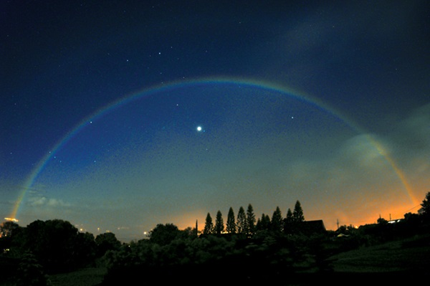
Moonbow

Slide 6
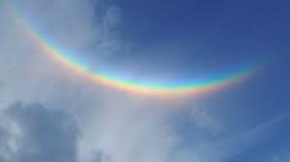
Upside down rainbow

Slide 7
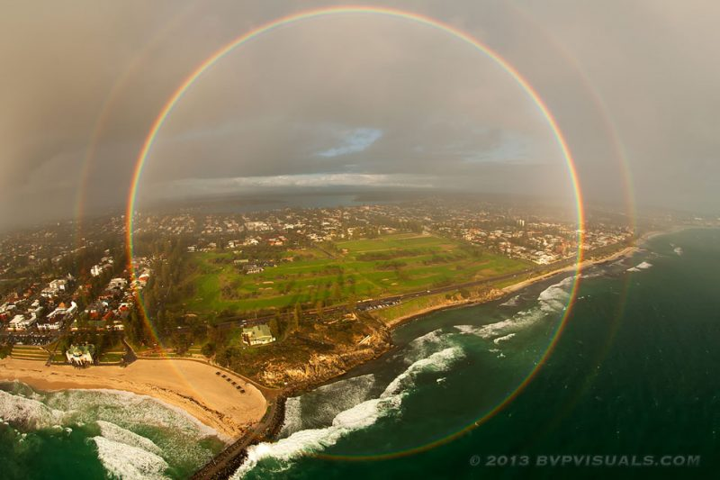
Full circle rainbow

Slide 8
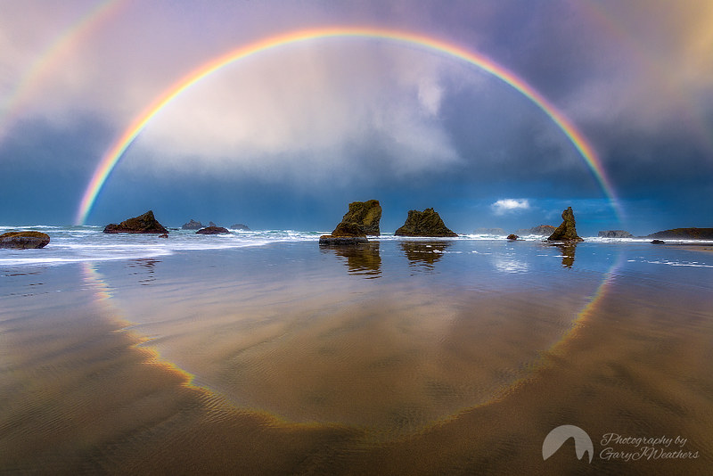
Reflection rainbow

Slide 9
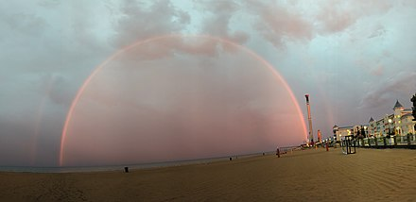
Monochrome rainbow

Slide 10
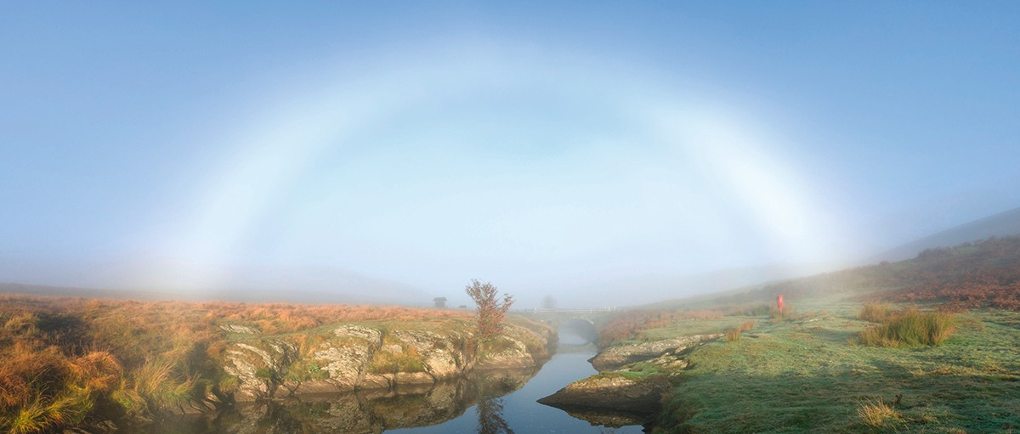
Fogbow rainbow

Slide 11
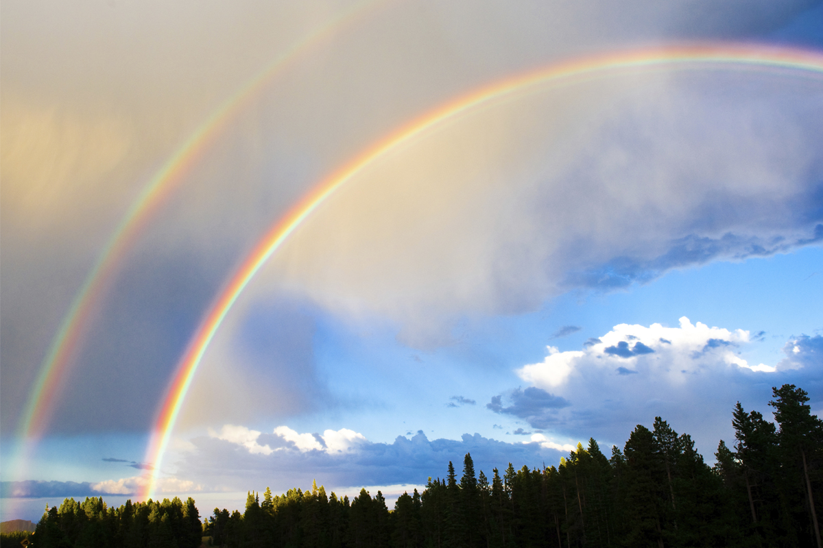
Double rainbow

Slide 12
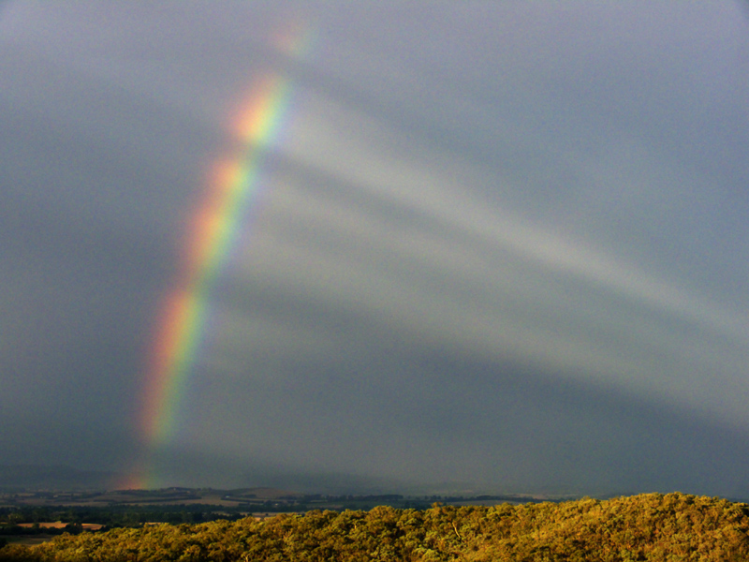
Rainbow wheel

Slide 13
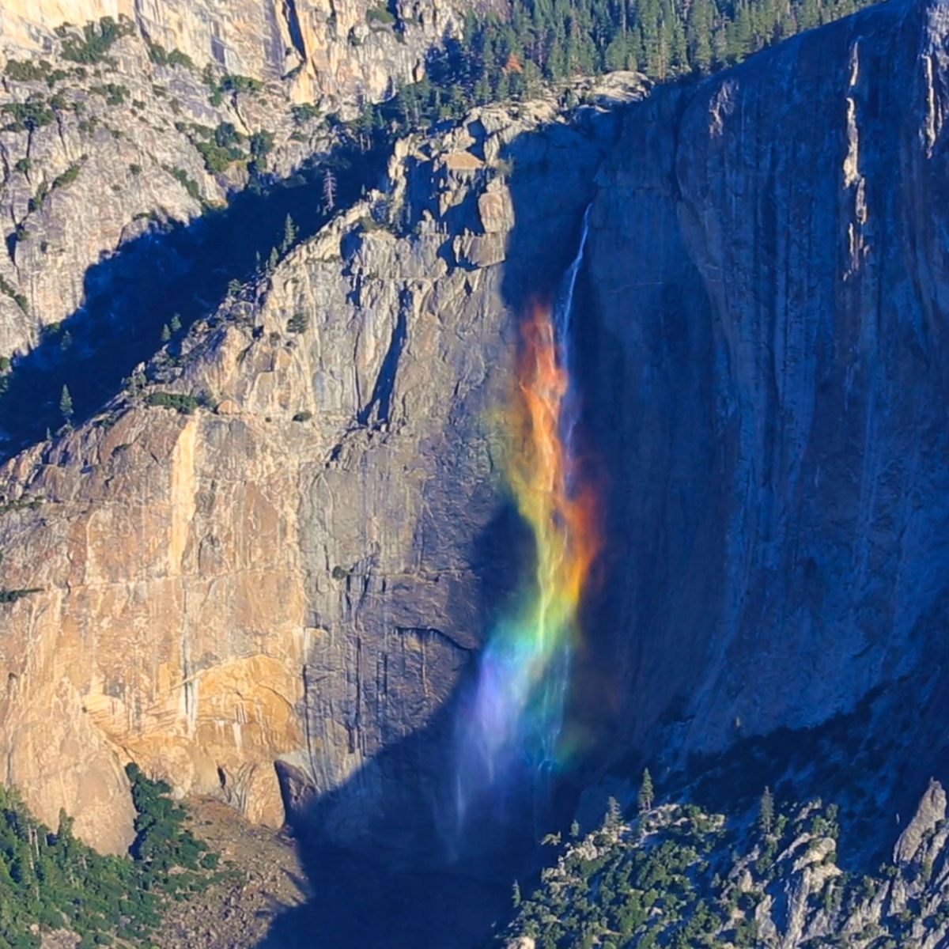
Waterfall rainbow

Slide 14
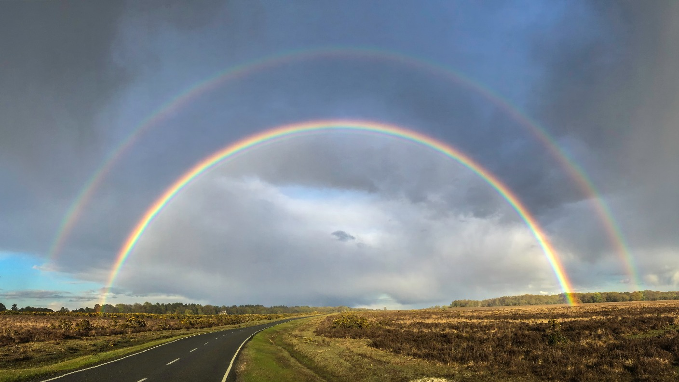
Alexander’s dark band rainbow

Slide 15
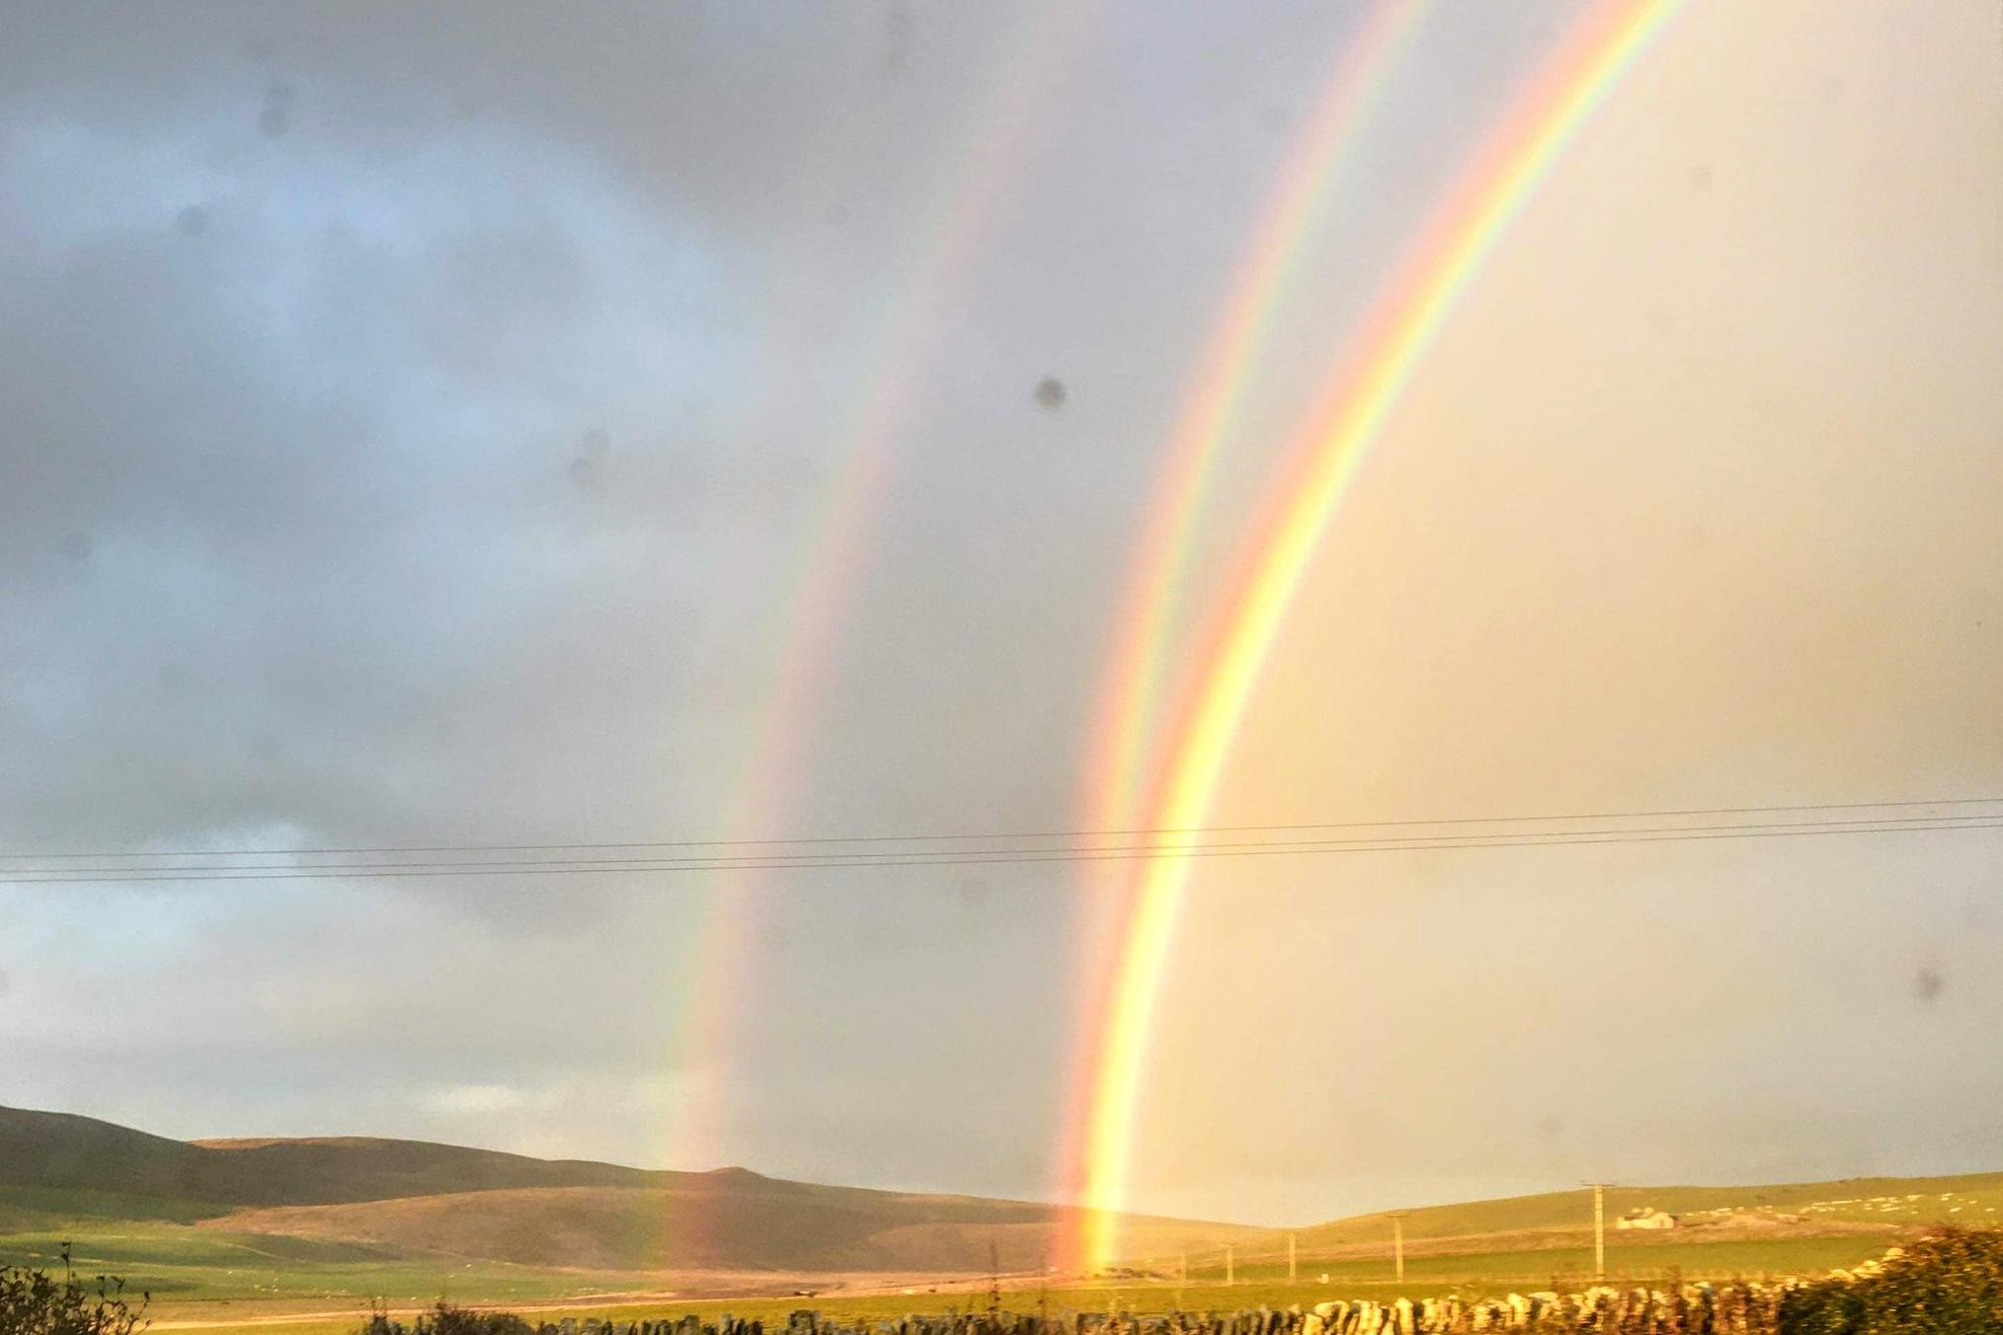
Twinned rainbow

Slide 16
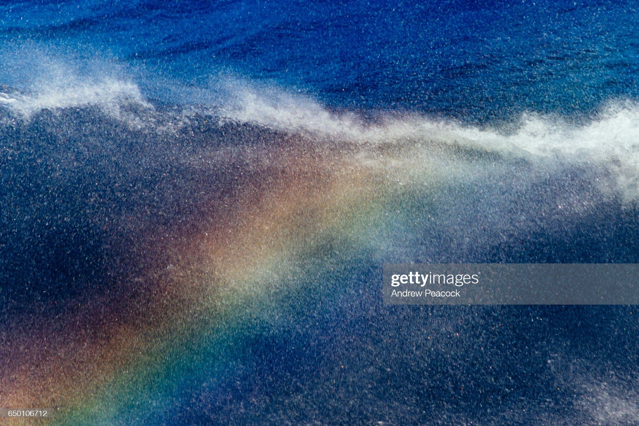
Sea spray rainbow

Slide 17
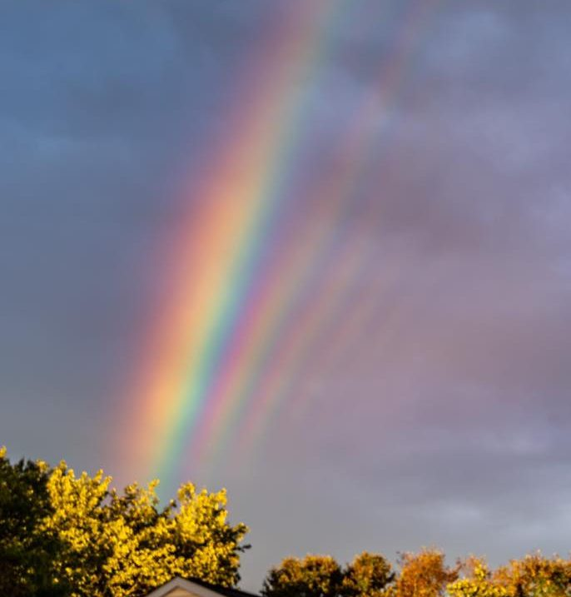
Supernumerary rainbow

Slide 18
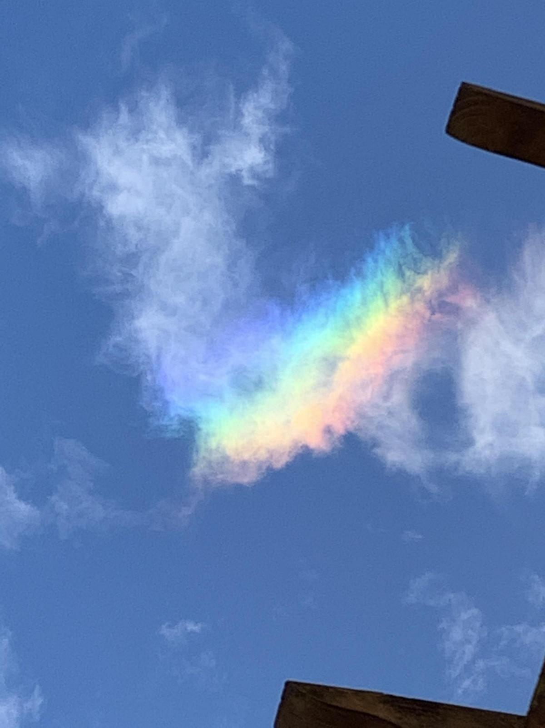
Rainbow cloud

