Slide 1
Welcome to Assembly

Slide 2
rough sleepers

Slide 3
temporary accommodation

Slide 4
hidden homeless

Slide 5
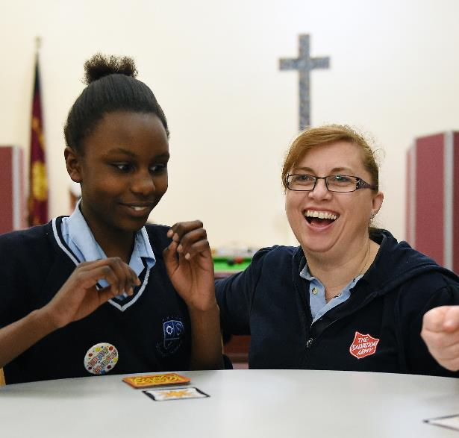
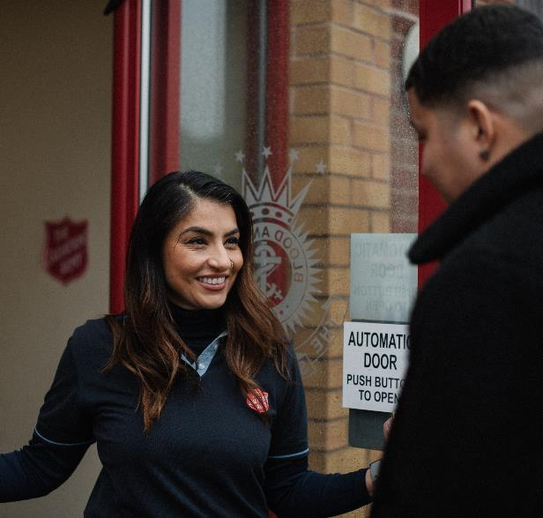
The Salvation Army

Slide 6
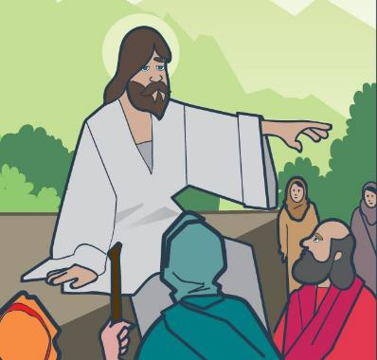
‘I was hungry,
and you gave me food.
I was thirsty,
and you gave me something to drink.
I was alone and away from home,
and you invited me into your house.’
Matthew 25:35

Slide 7
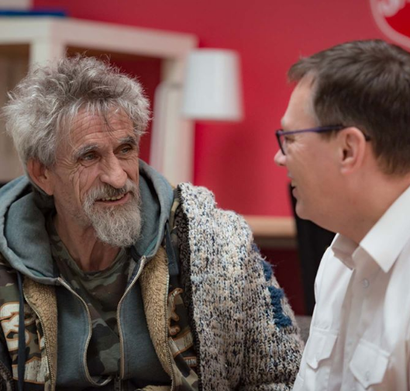
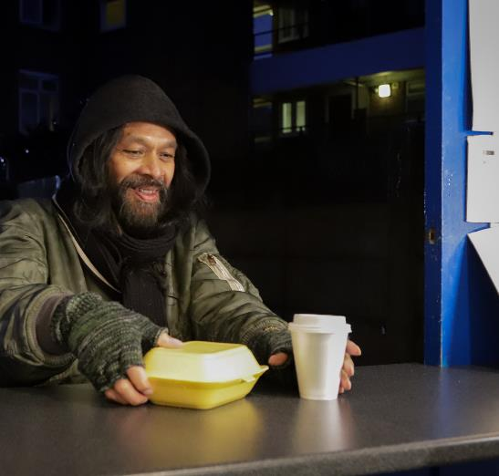
helping rough sleepers

Slide 8
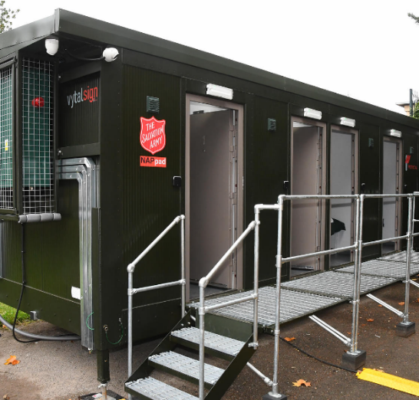
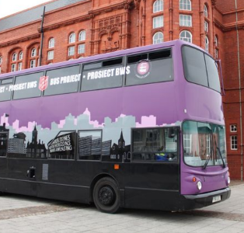
helping rough sleepers

Slide 9
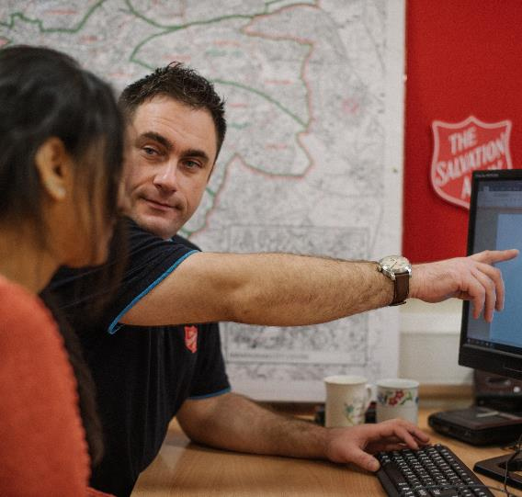
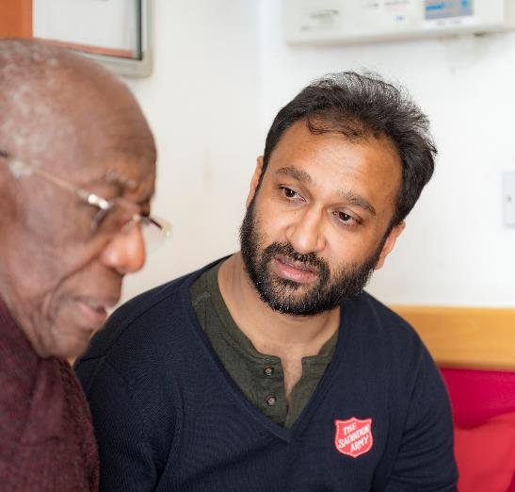
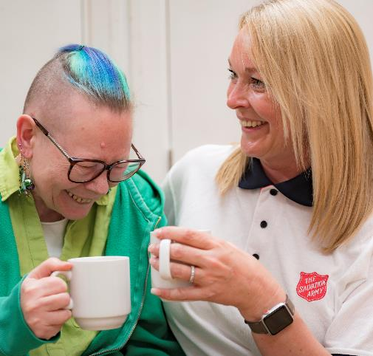
Lifehouses

Slide 10
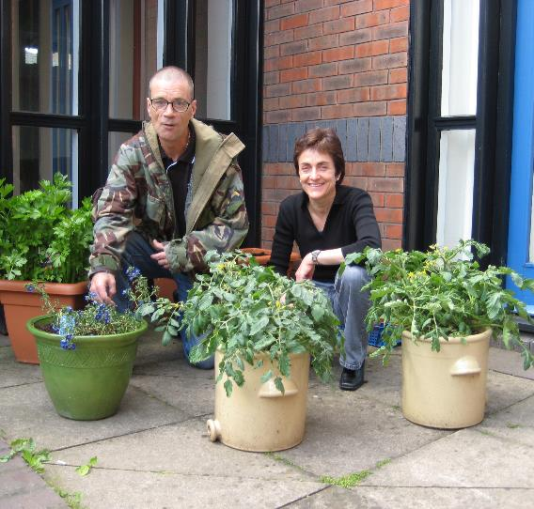
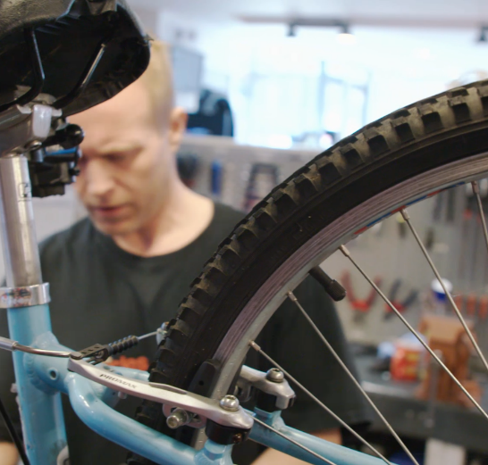
Lifehouses

Slide 11
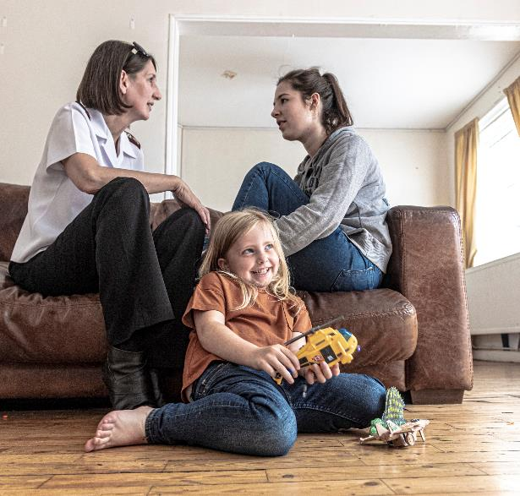
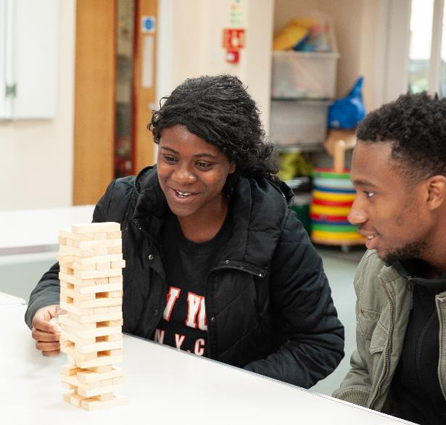
accommodation

Slide 12
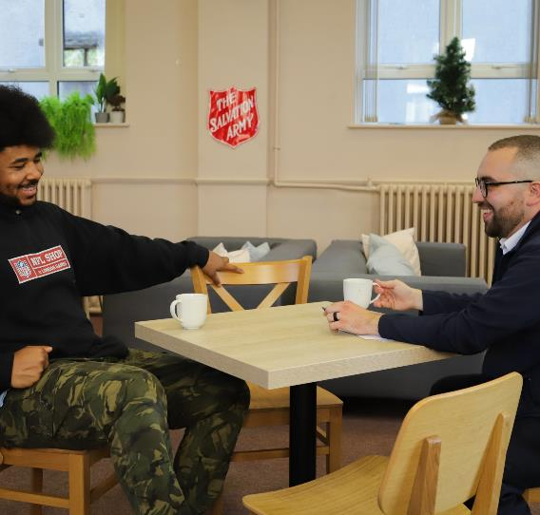
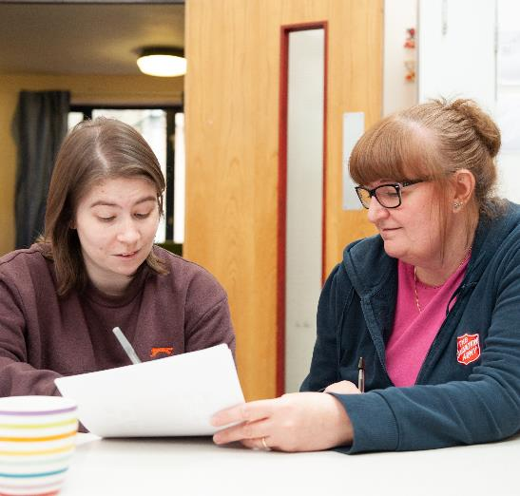
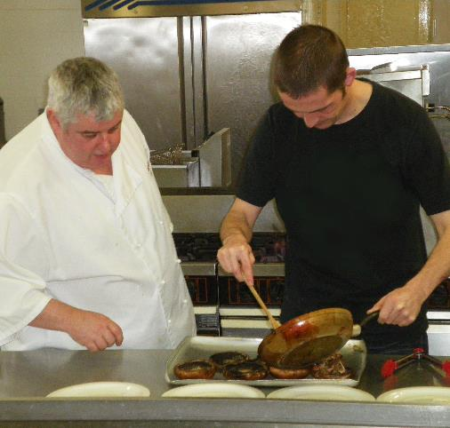
prevention

Slide 13
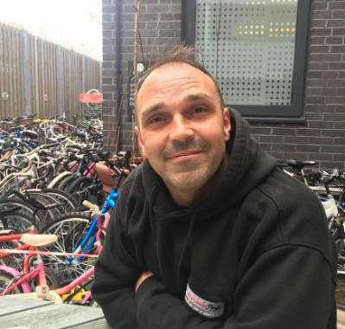
meet Alan
‘While I was homeless
The Salvation Army looked after me.
They gave me food, clothes and sleeping bags.
I now volunteer at the Lifehouse with The Sandwich People.
I really enjoy it because they make me feel so welcome.
They are so helpful and always go the extra mile .
Everyone here makes you feel you’re part of something.’

Slide 14
reflection

