Slide 1
Employment: Guess the job

Slide 2
Employment: Guess the job

Slide 3
Employment: Guess the job

Slide 4
Employment: Guess the job

Slide 5
Employment: Guess the job

Slide 6
Employment: Guess the job

Slide 7
Employment: Guess the job

Slide 8
Employment: Guess the job

Slide 9
Employment: Guess the job

Slide 10
Employment: Guess the job

Slide 11
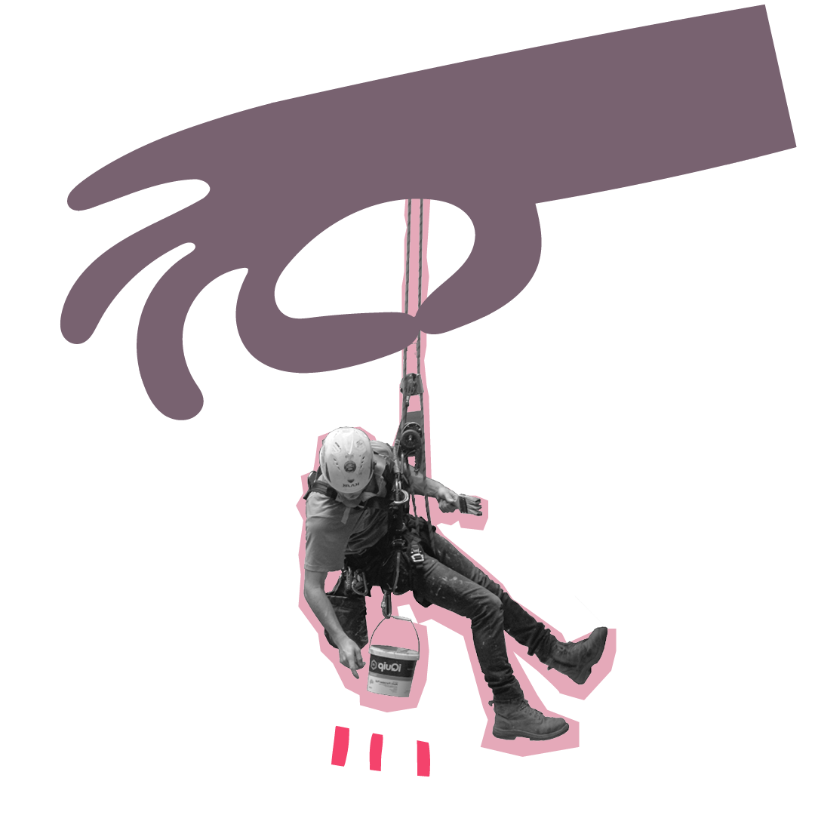
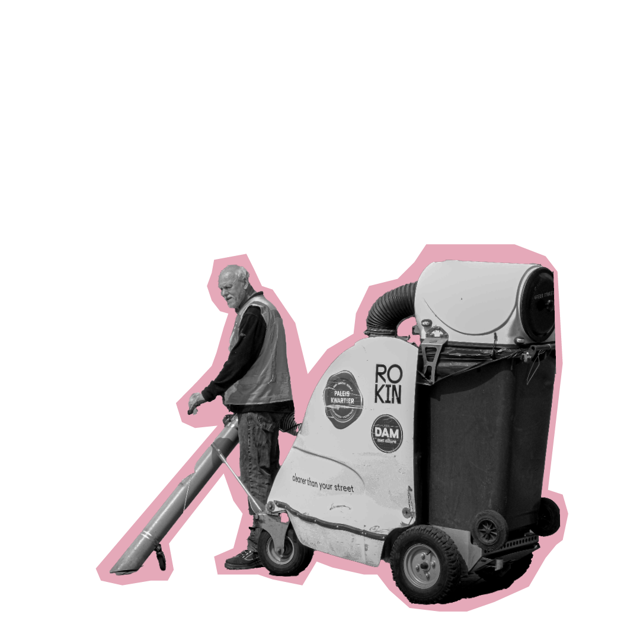
Employment and The Salvation Army
To highlight the impact the pandemic had on employment
To understand how The Salvation Army helps people to find employment

Slide 12
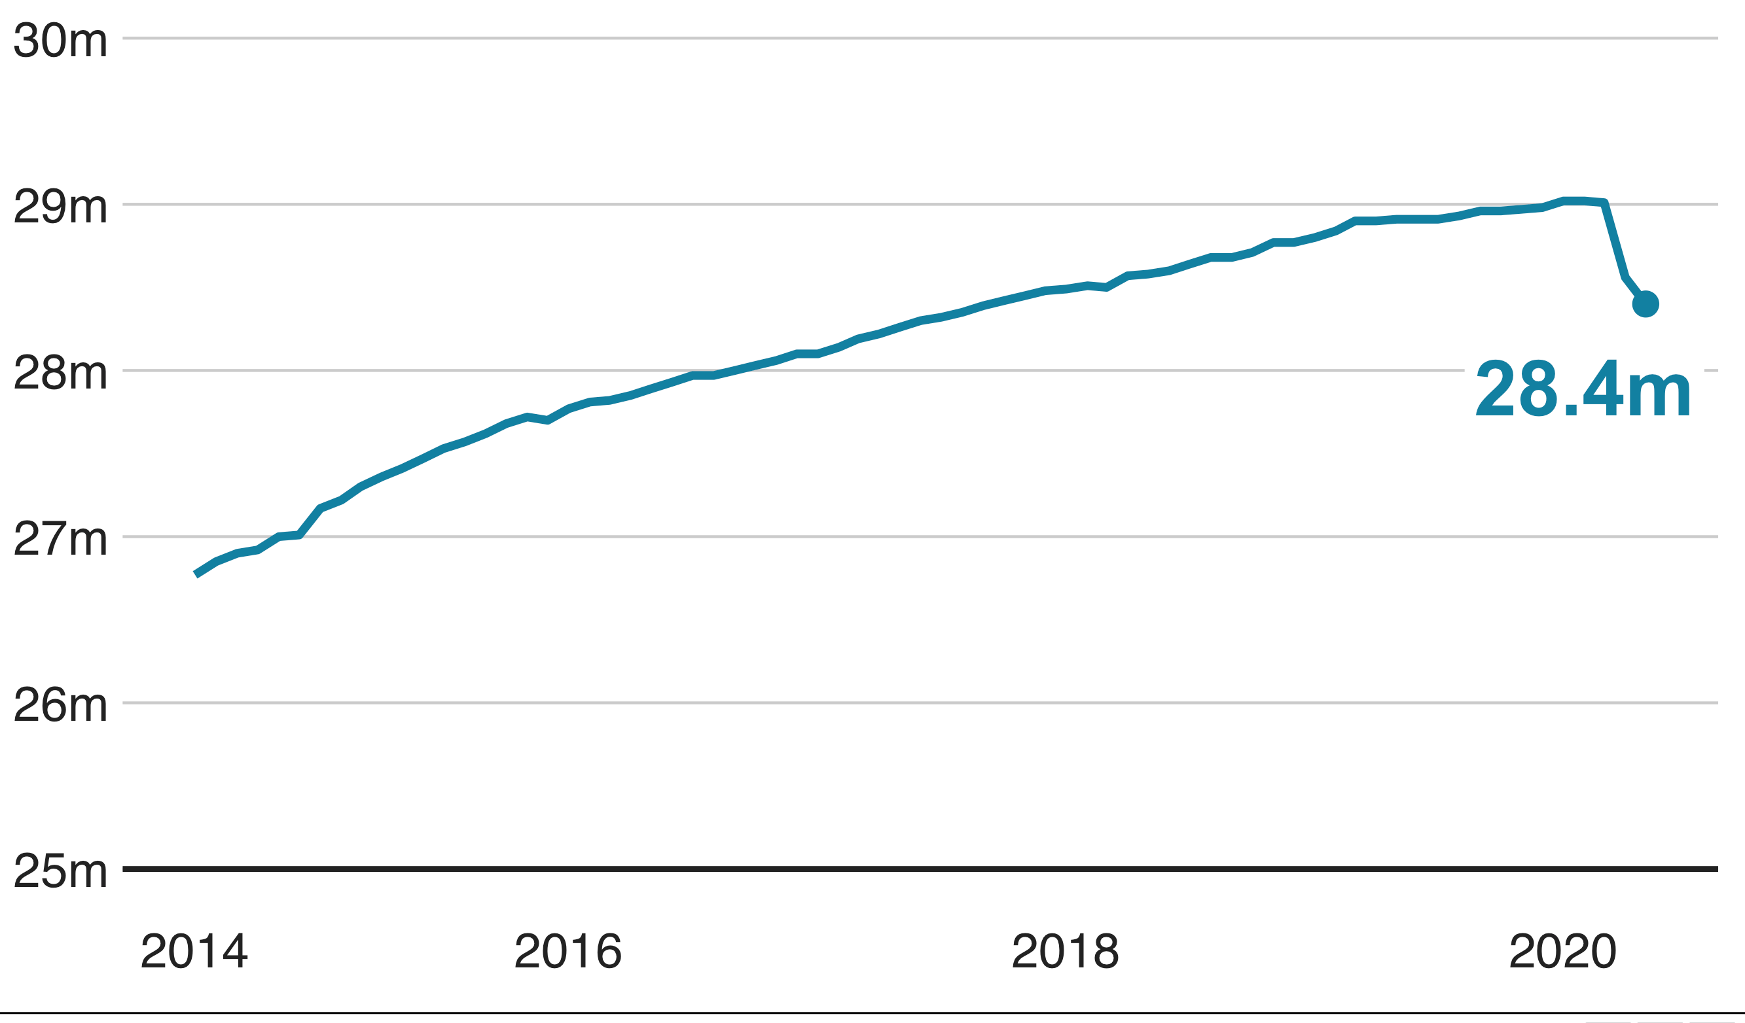
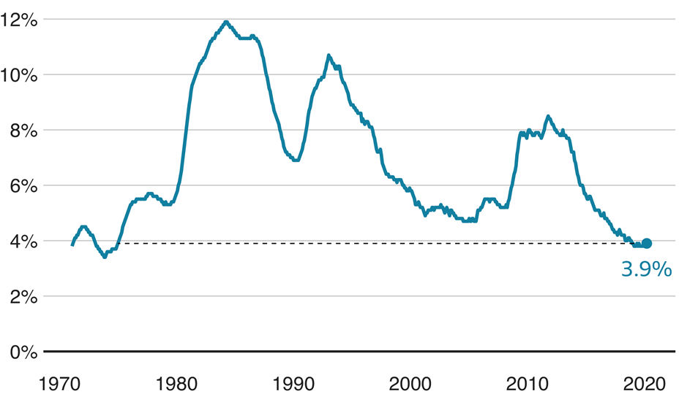
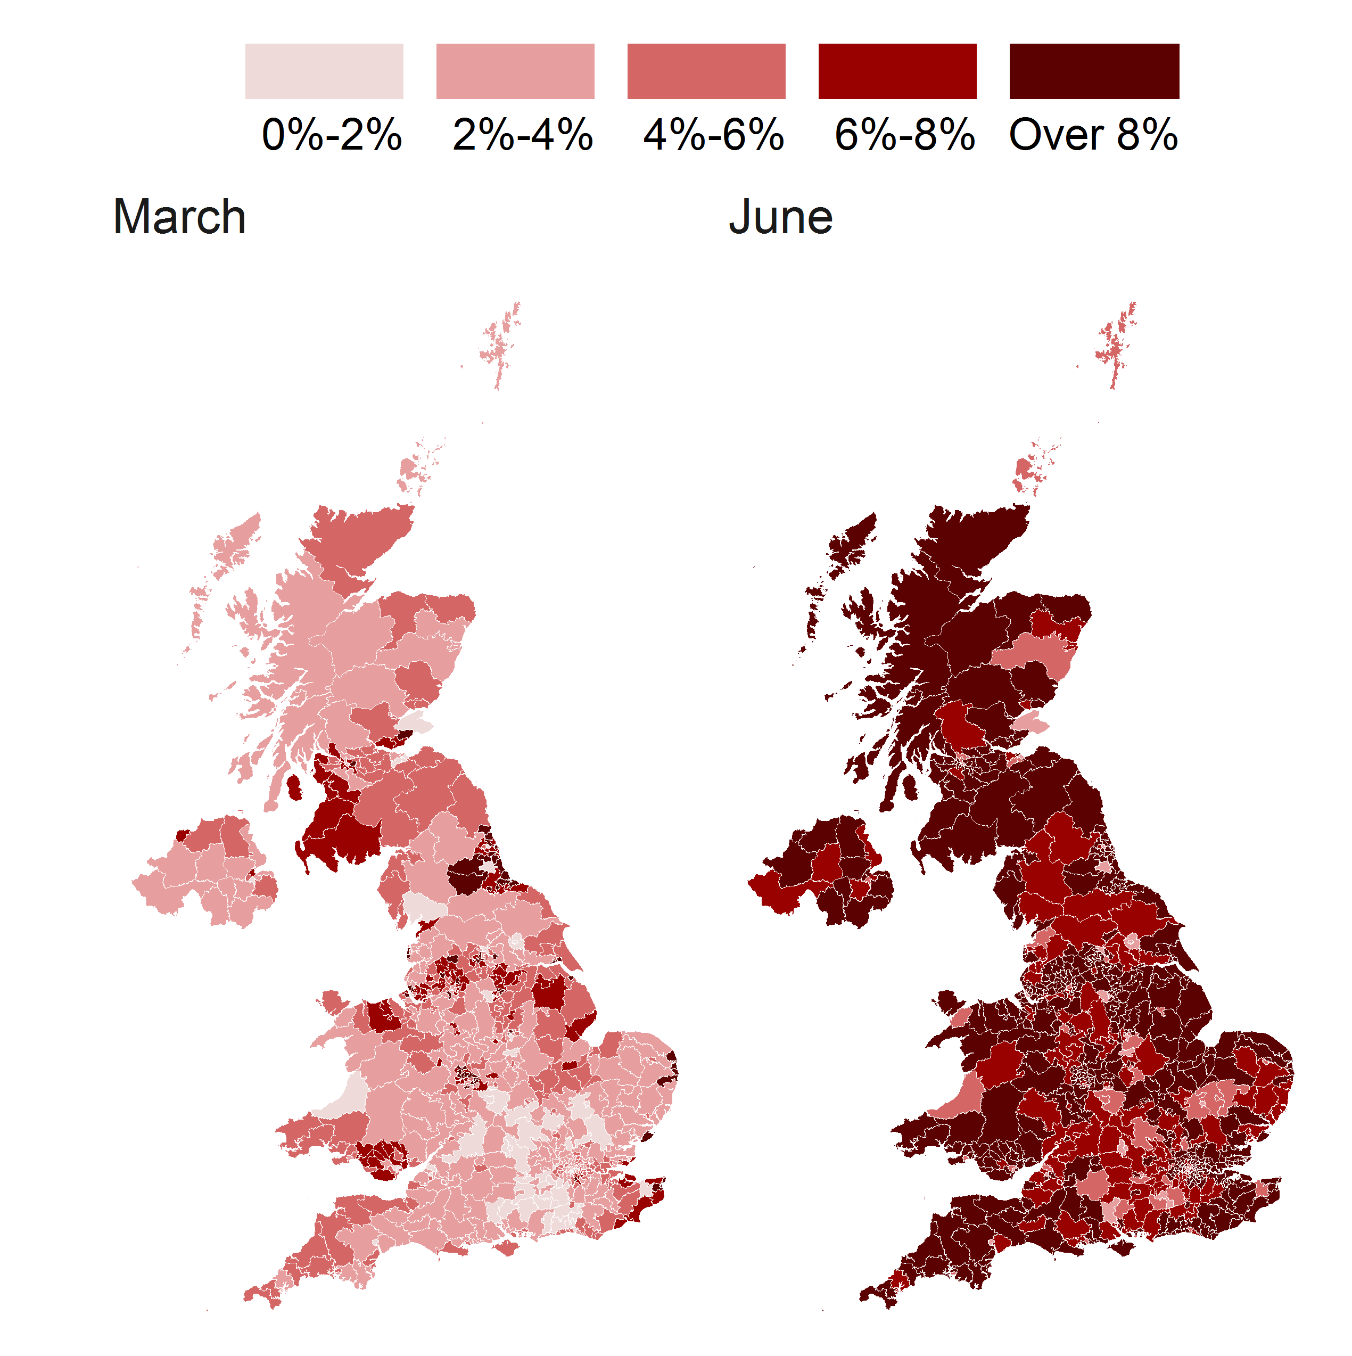
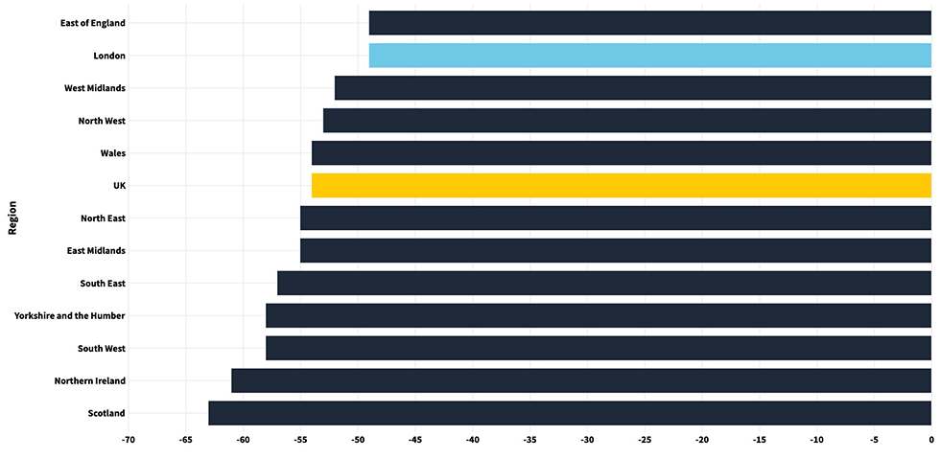
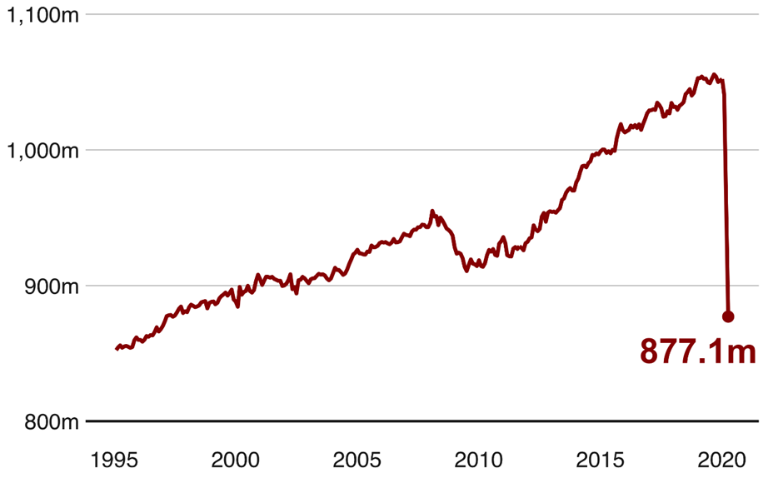
Employment : Data analysis (pandemic focus)

Slide 13
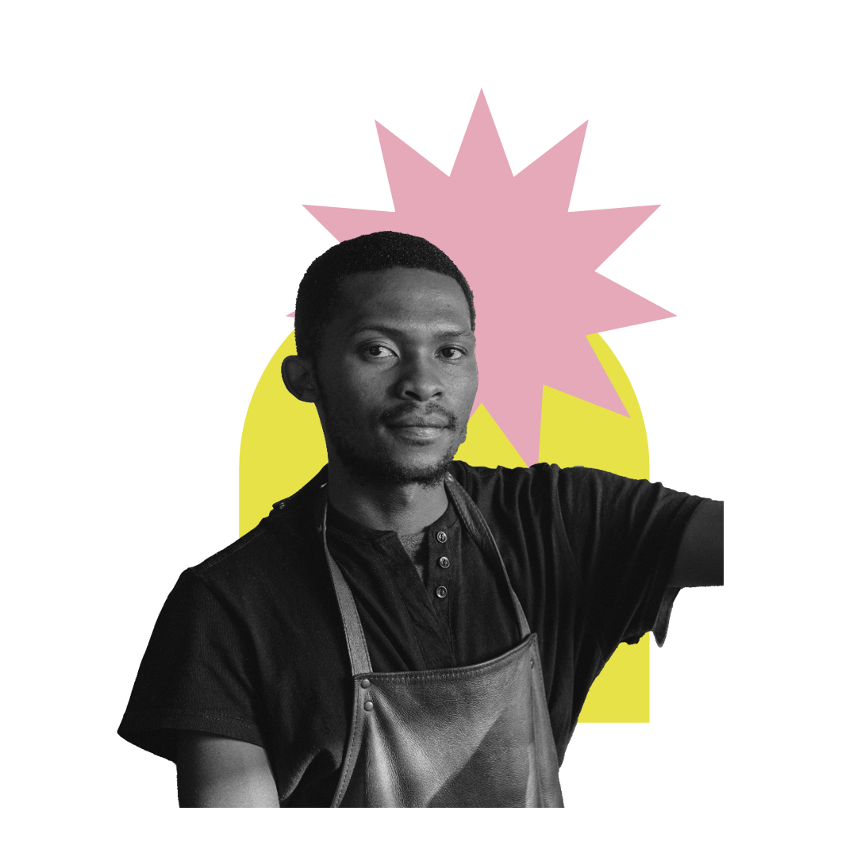
The Salvation Army…
Is a place where retired soldiers go
T F
Is a church
T F
Is a charity
T F
Is about 60 years old
T F
Have church services on a Sunday
T F
Only use brass instruments in their services
T F
Only helps people that are Christians
T F
Everyone wears uniform
T F
Employment: The Salvation Army
Notes:
1. While the ‘Army’ may make you think this is true, Founder William Booth coined the name ‘Salvation Army’ as an indication of how serious the movement was in showing God’s love!
4. 158 years old (The Salvation Army was founded in 1865)
5. As well as midweek events for members and the community
6. You may have seen brass bands associated with The Salvation Army, and while these are still played, we also have choirs and modern music too.
7. We help the community irrespective of age, sex or race as a reflection of Jesus‘ teachings
8. Salvation Army ministers (officers) do, but only when they’re working – a bit like a priest in other churches. Members (or soldiers) can choose to wear a uniform for church, but they don’t have to.

Slide 14
Employment
More than 650 locations
Learning progressions and qualifications
Assisted job search
Digital inclusion
Benefits advice and support
Listening ear
Work placements
Develop and run social enterprises
Tailored support
Training opportunities
One-to-one support
Employment Plus
Employment: Employment
Notes:
https://www.salvationarmy.org.uk/employment-plus/how-we-help

Slide 15
training opportunities
one-to-one support
tailored support
learning progressions and qualifications
assisted Job Search
Digital Inclusion
benefits advice and support
listening ear
work placements
develop and run social enterprises
Employment: The most important work?
Notes:
Barriers jobseekers face can be as simple as needing to improve communication skills, learning how to email, transport, health or improving language proficiency.

Slide 16
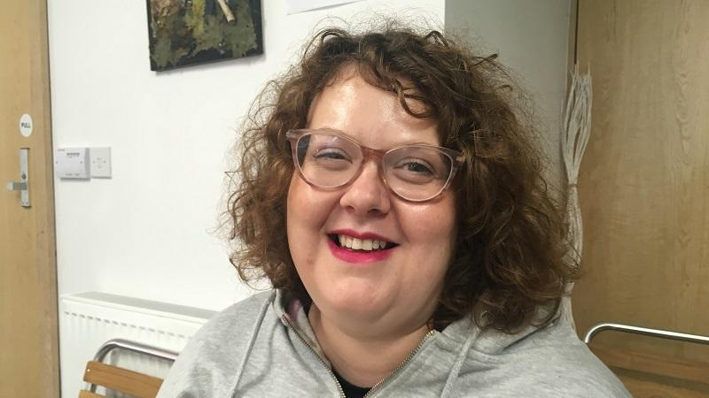
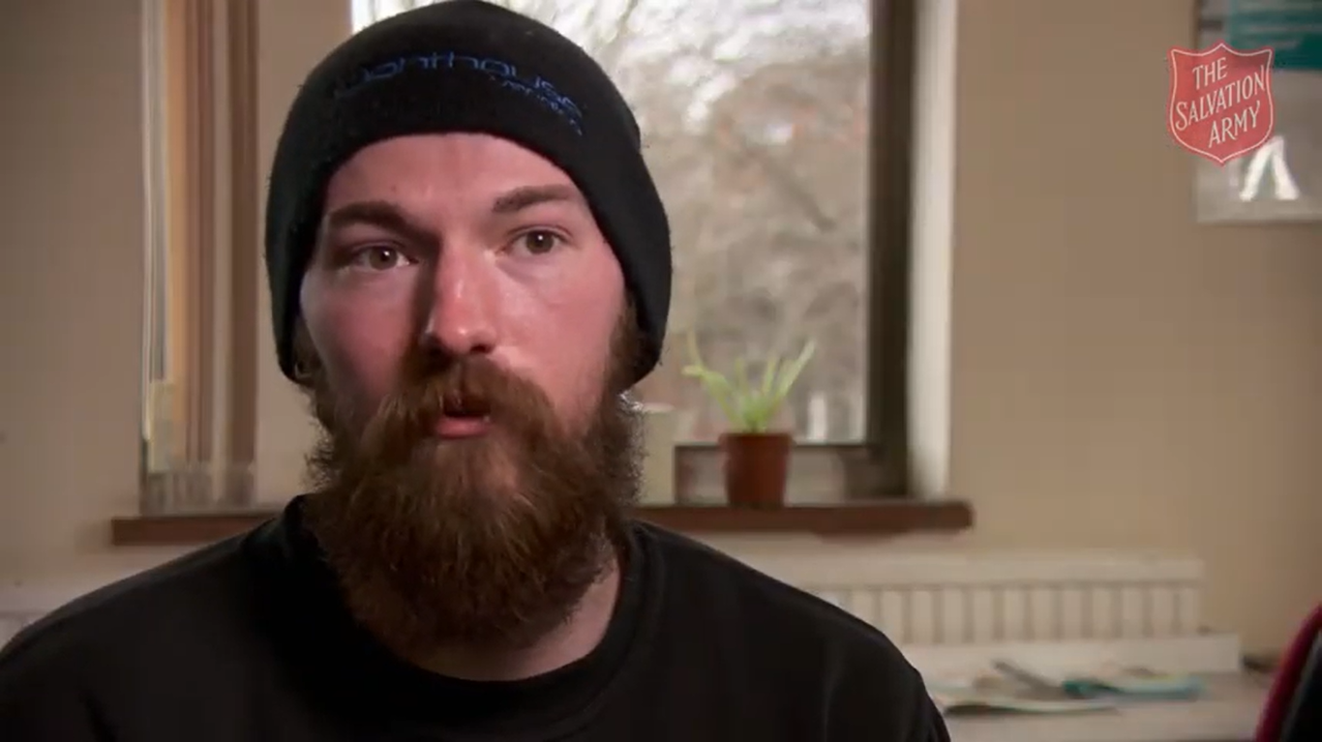
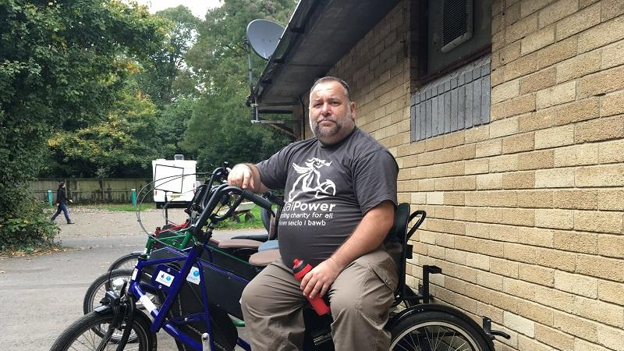
Joe
Cat
Ian
Peter
Employment: Personal stories
Notes:
Joe’s story is hyperlinked

Slide 17
Creativity and employment
Employment: Creativity and employment

Slide 18
Most important skill
CV Writing
CV Writing
CV Writing
Confidence
Confidence
Upskill / Further Education
Confidence
Upskill / Further Education
Upskill / Further Education
Digital
Digital
Digital
Interview Prep
Interview Prep
Interview Prep
Form Filling / Writing
Form Filling / Writing
Form Filling / Writing
Leadership
Leadership
Leadership
Communication
Communication
Communication
Employment: Employability skills

Slide 19
3
things I found out today
2
things that shocked me
1
thing I wish
I knew more about
Employment: Feedback

