Slide 1
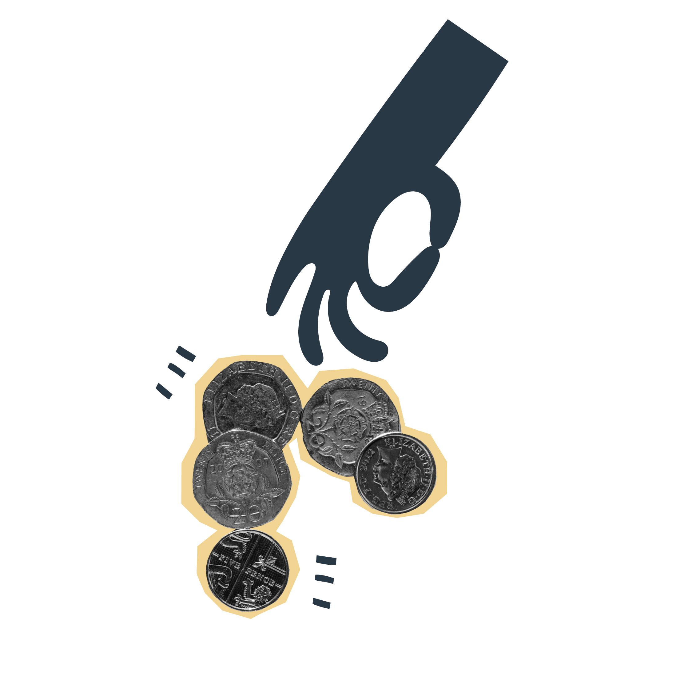
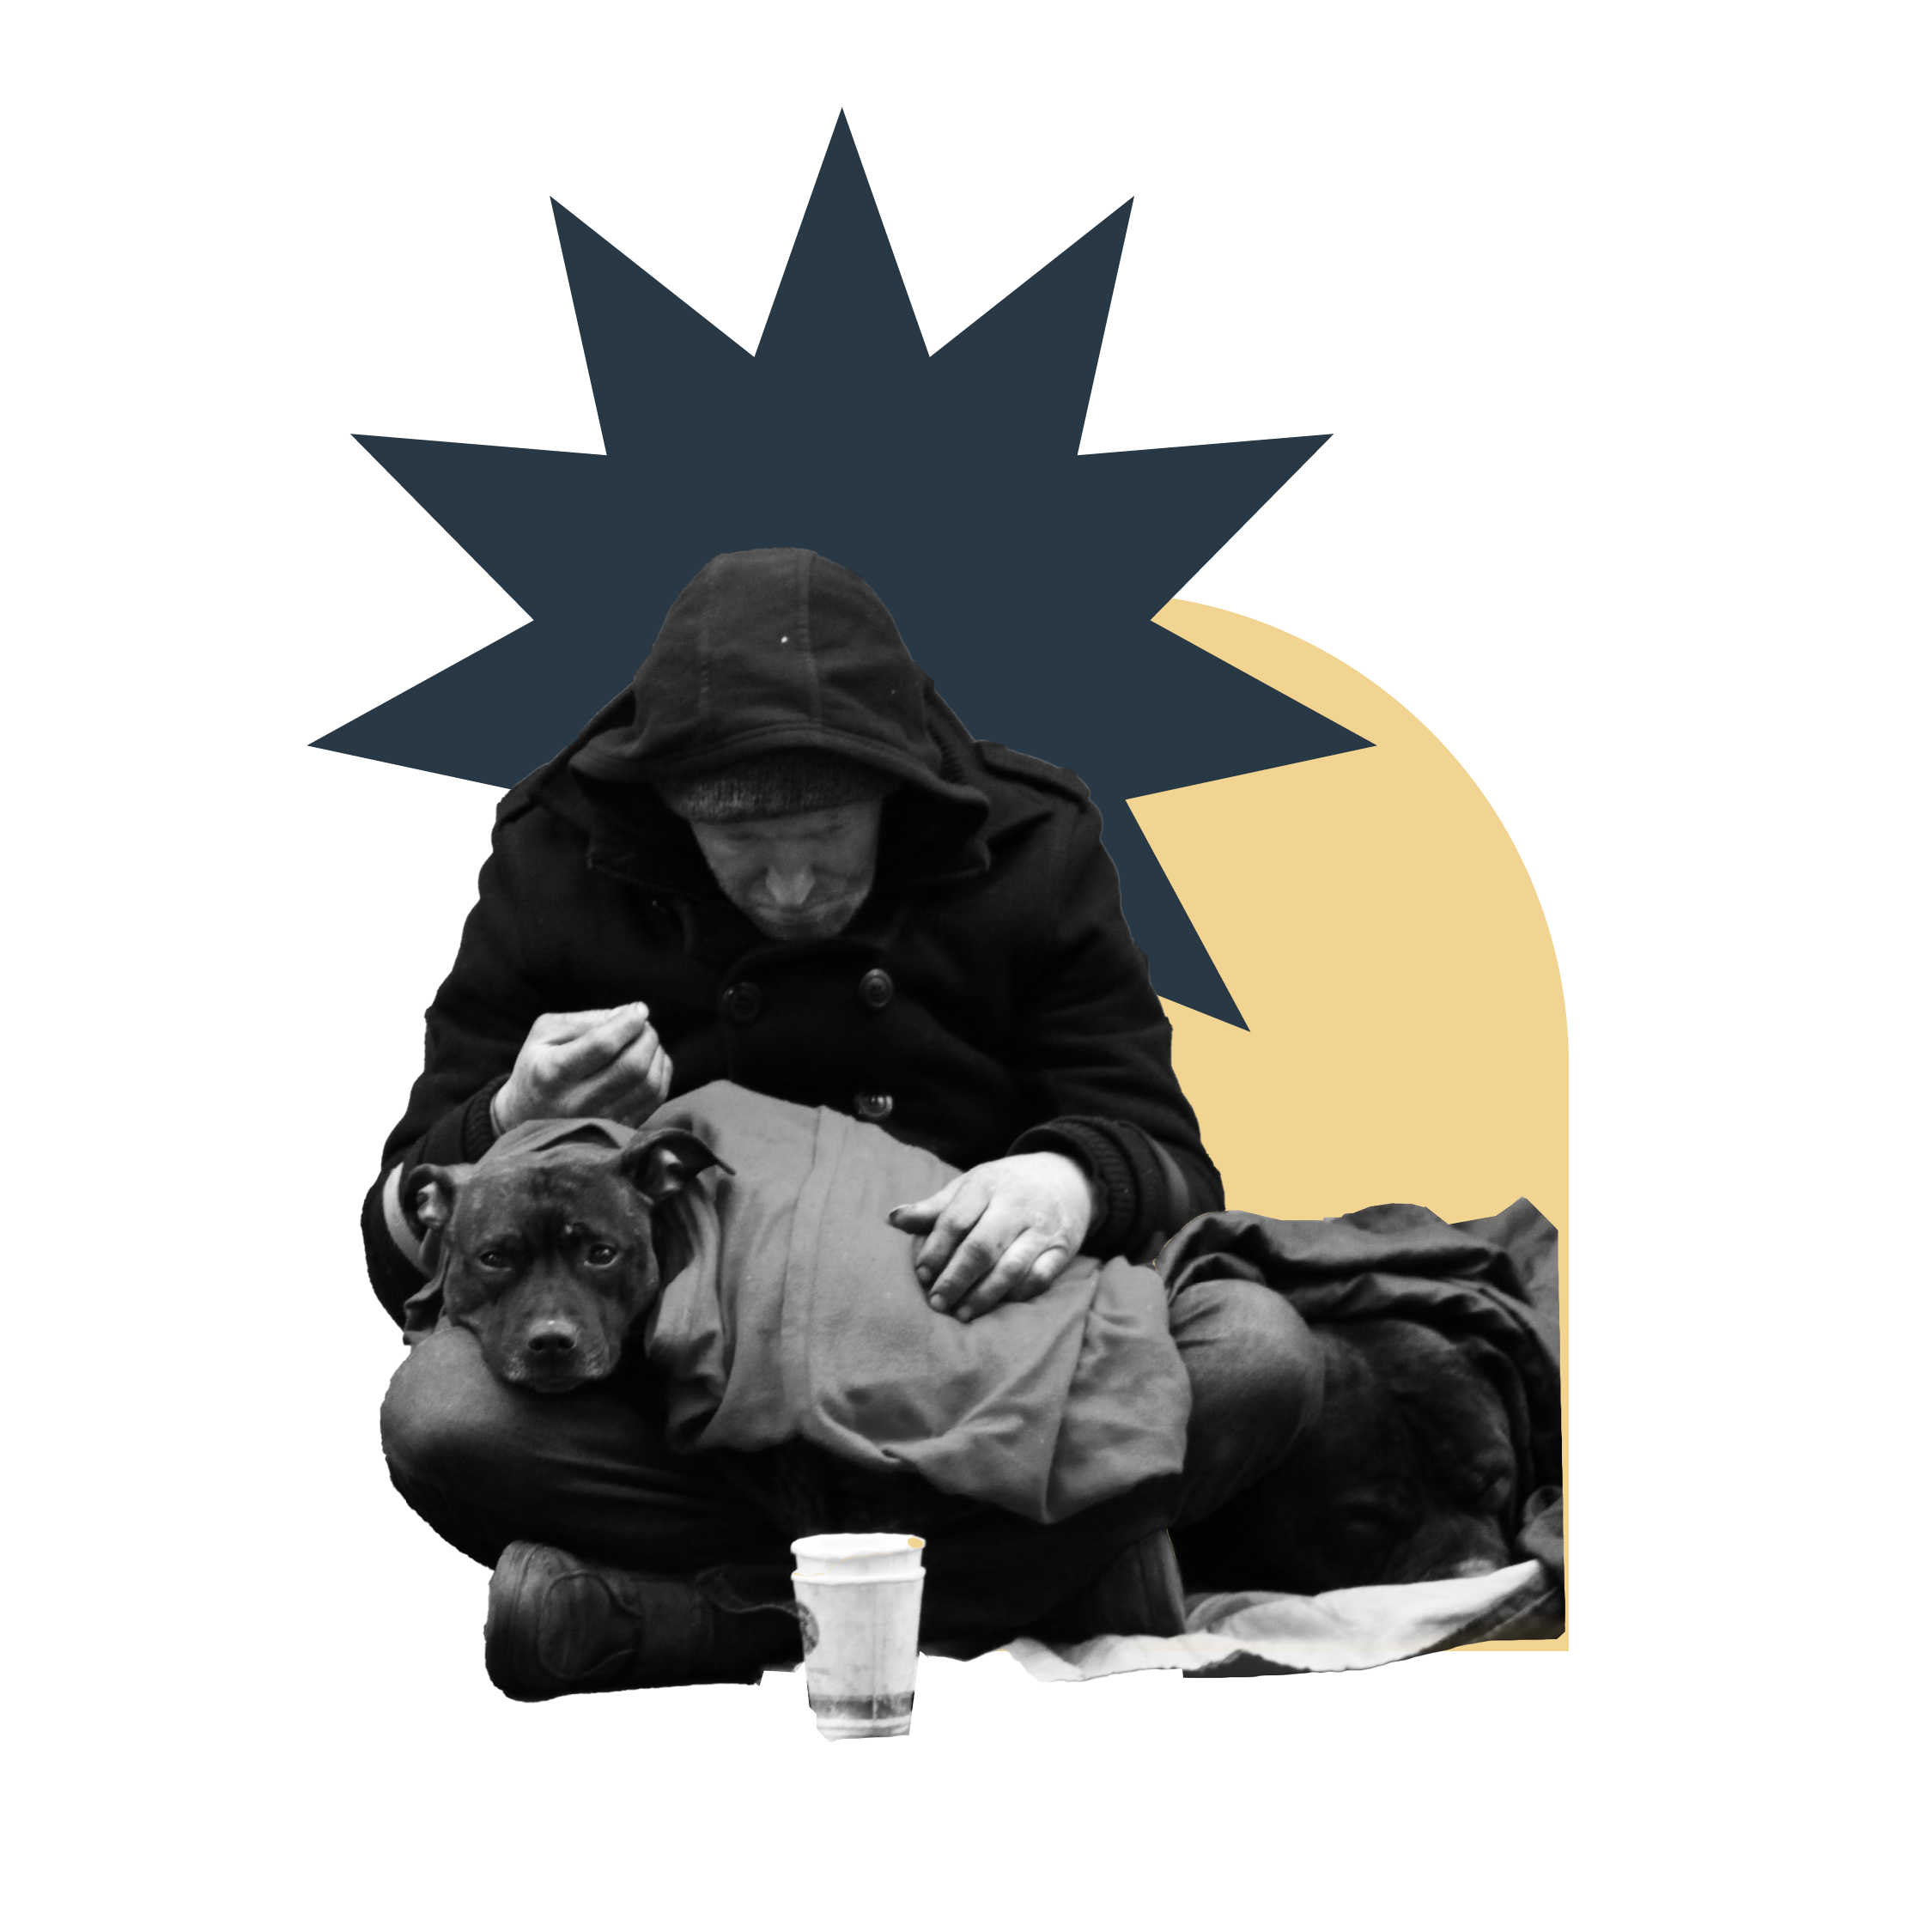
What does it mean to be a homeless person?
You have nowhere to sleep
You live in a moveable structure but have no place to put it
You have a split household and the home is not available for the whole household
It is unreasonable to continue to live at home
You are at risk of violence from any person at home
You can’t secure entry to your accommodation
Homelessness: What is homelessness?

Slide 2
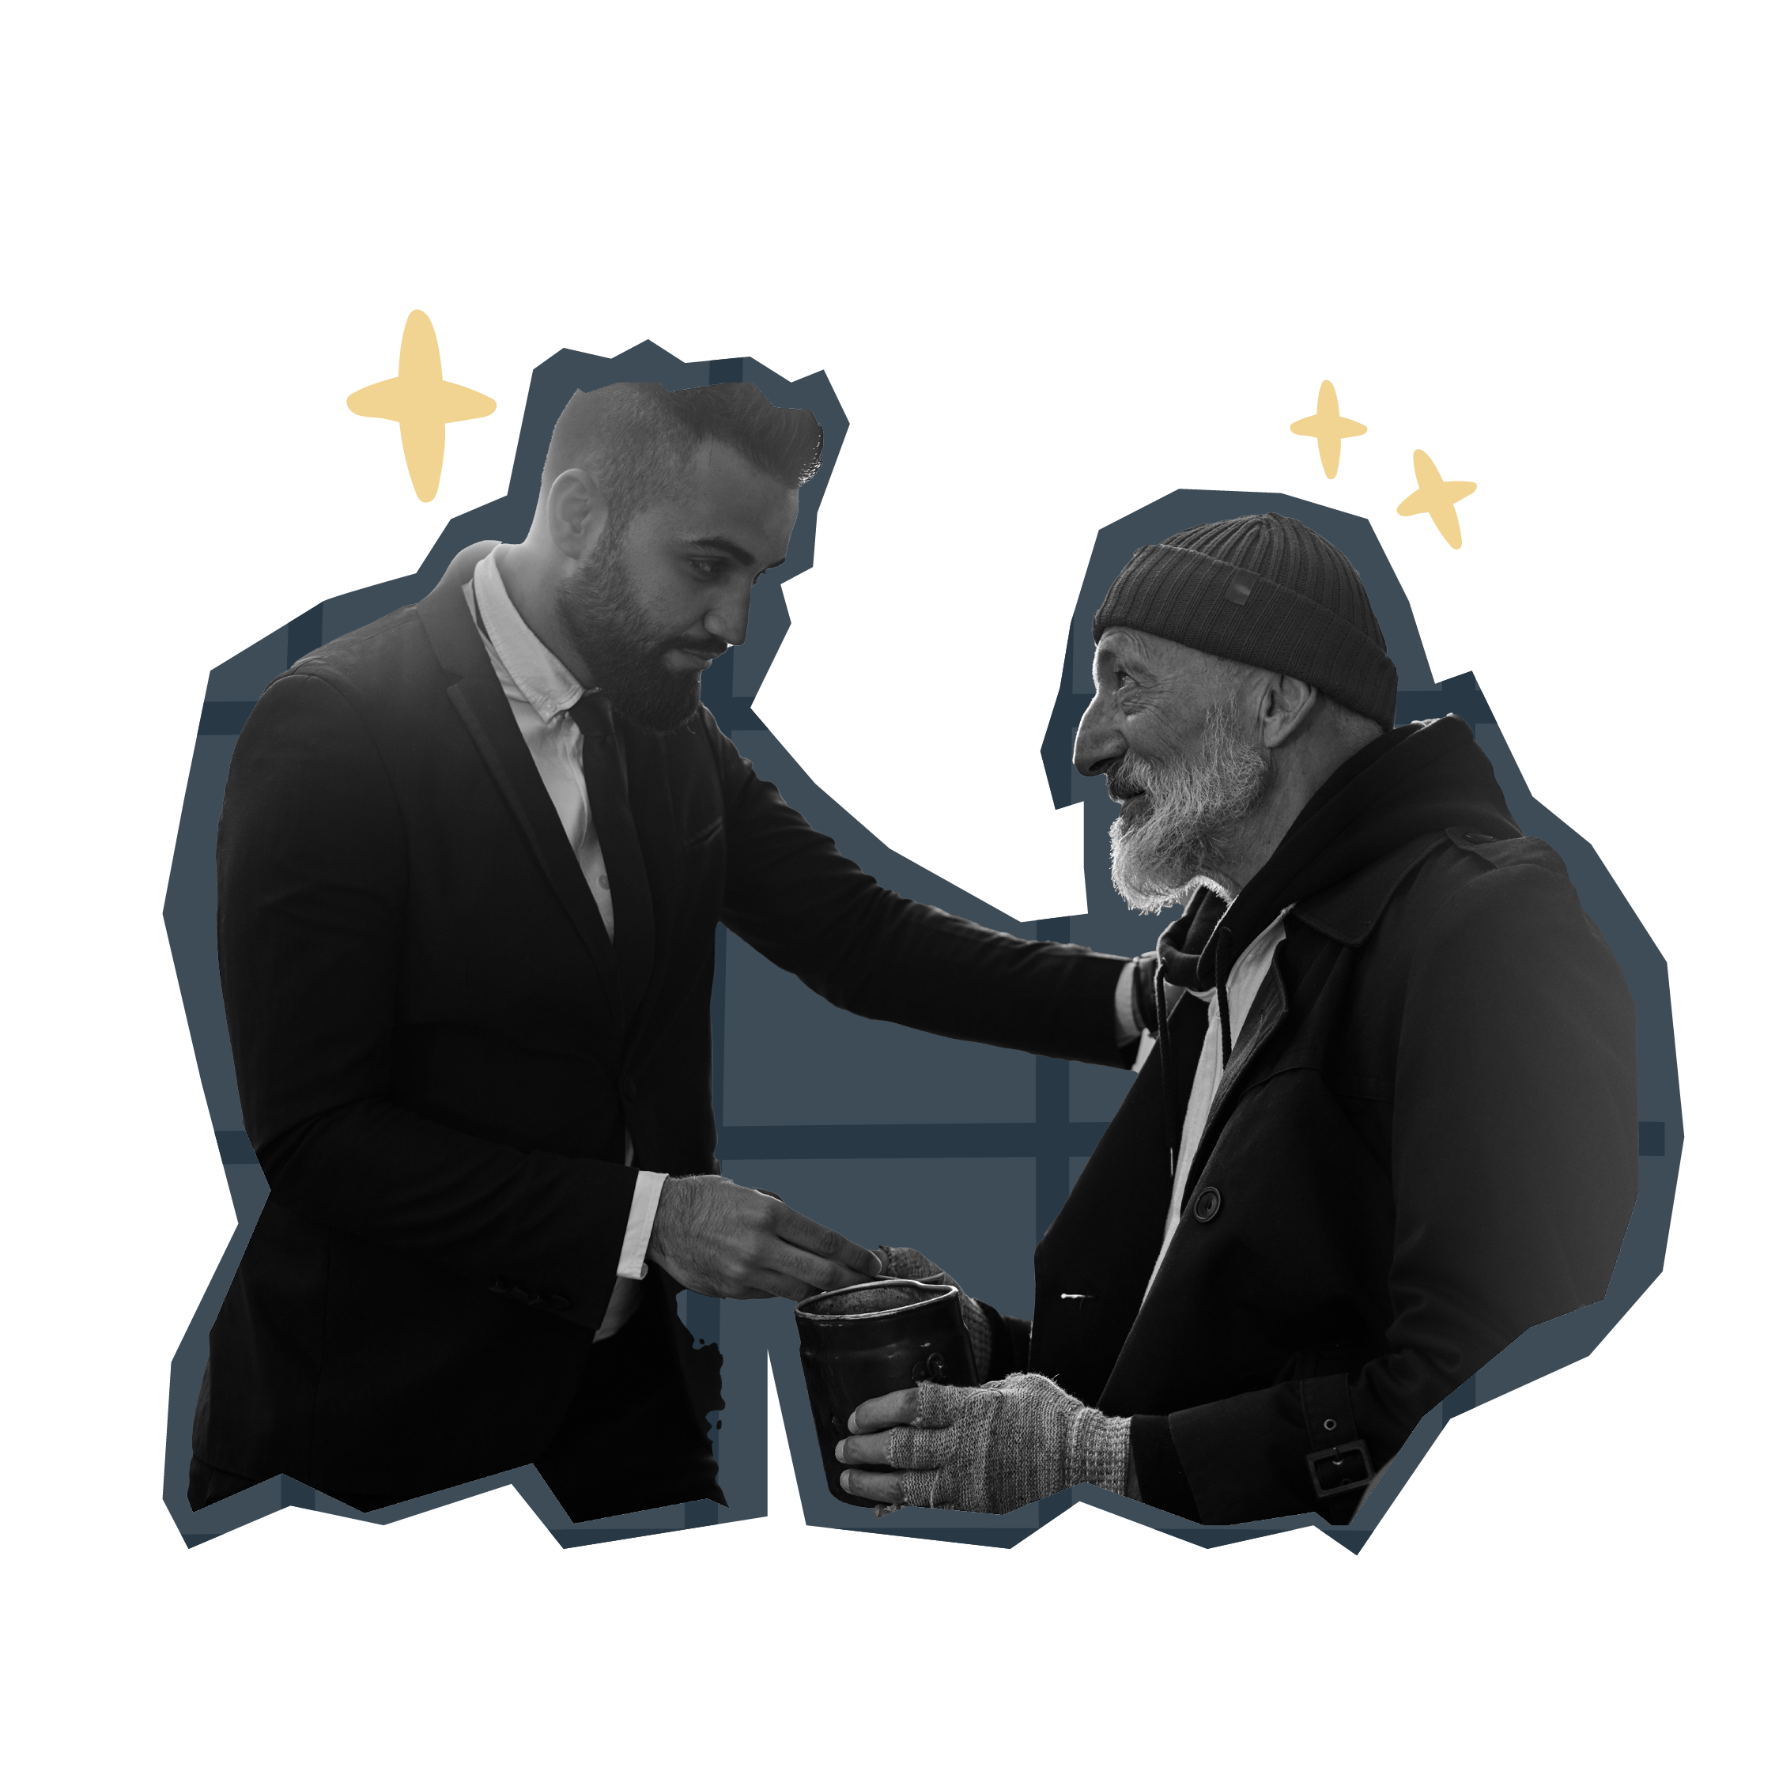
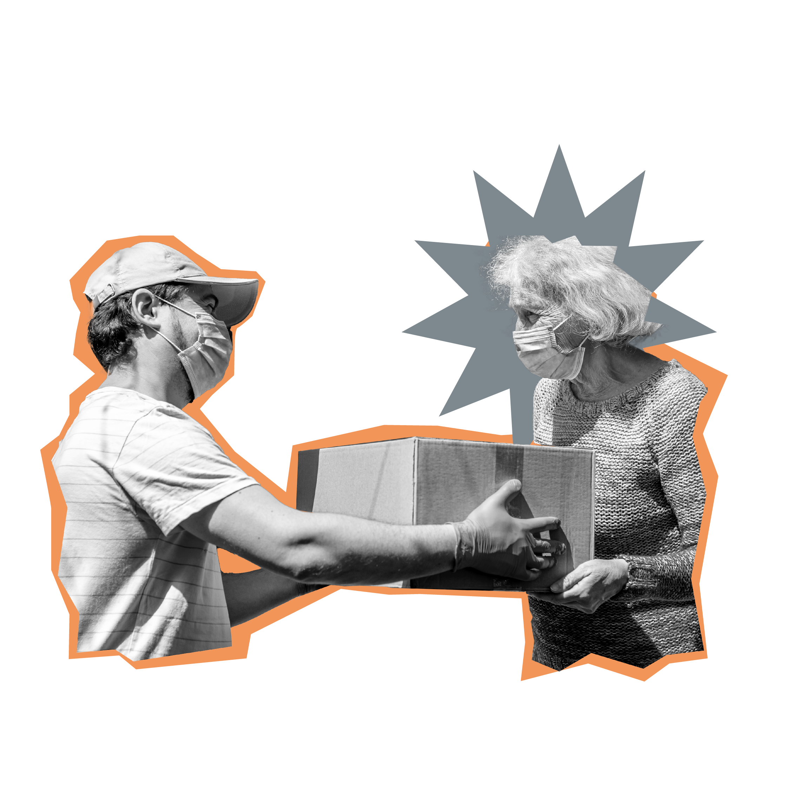
Homelessness
and
The Salvation Army
To explore what
homelessness is
To understand some of the ways The Salvation Army responds to homelessness

Slide 3
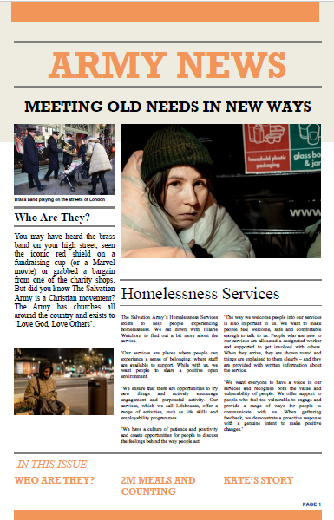
The Salvation Army
The first Salvation Army homeless shelter was set up in 1888.
It was a Christian response to abject poverty.
‘​We are still driven by the
same mission and values
of The Salvation Army
which enable us to see everyone
as a child of God.’
Homelessness: The Salvation Army

Slide 4
Homelessness Services
Homelessness: Homelessness Services

Slide 5
What’s your opinion?
‘The majority of our Lifehouses*
offer a chaplaincy service’
*The Salvation Army’s Lifehouses:
more than just a place to stay and survive, they are a place to grow and thrive.
Homelessness: Opinion slide
Notes:
Ask students to write/speak in pairs a short explanation of their opinion

Slide 6
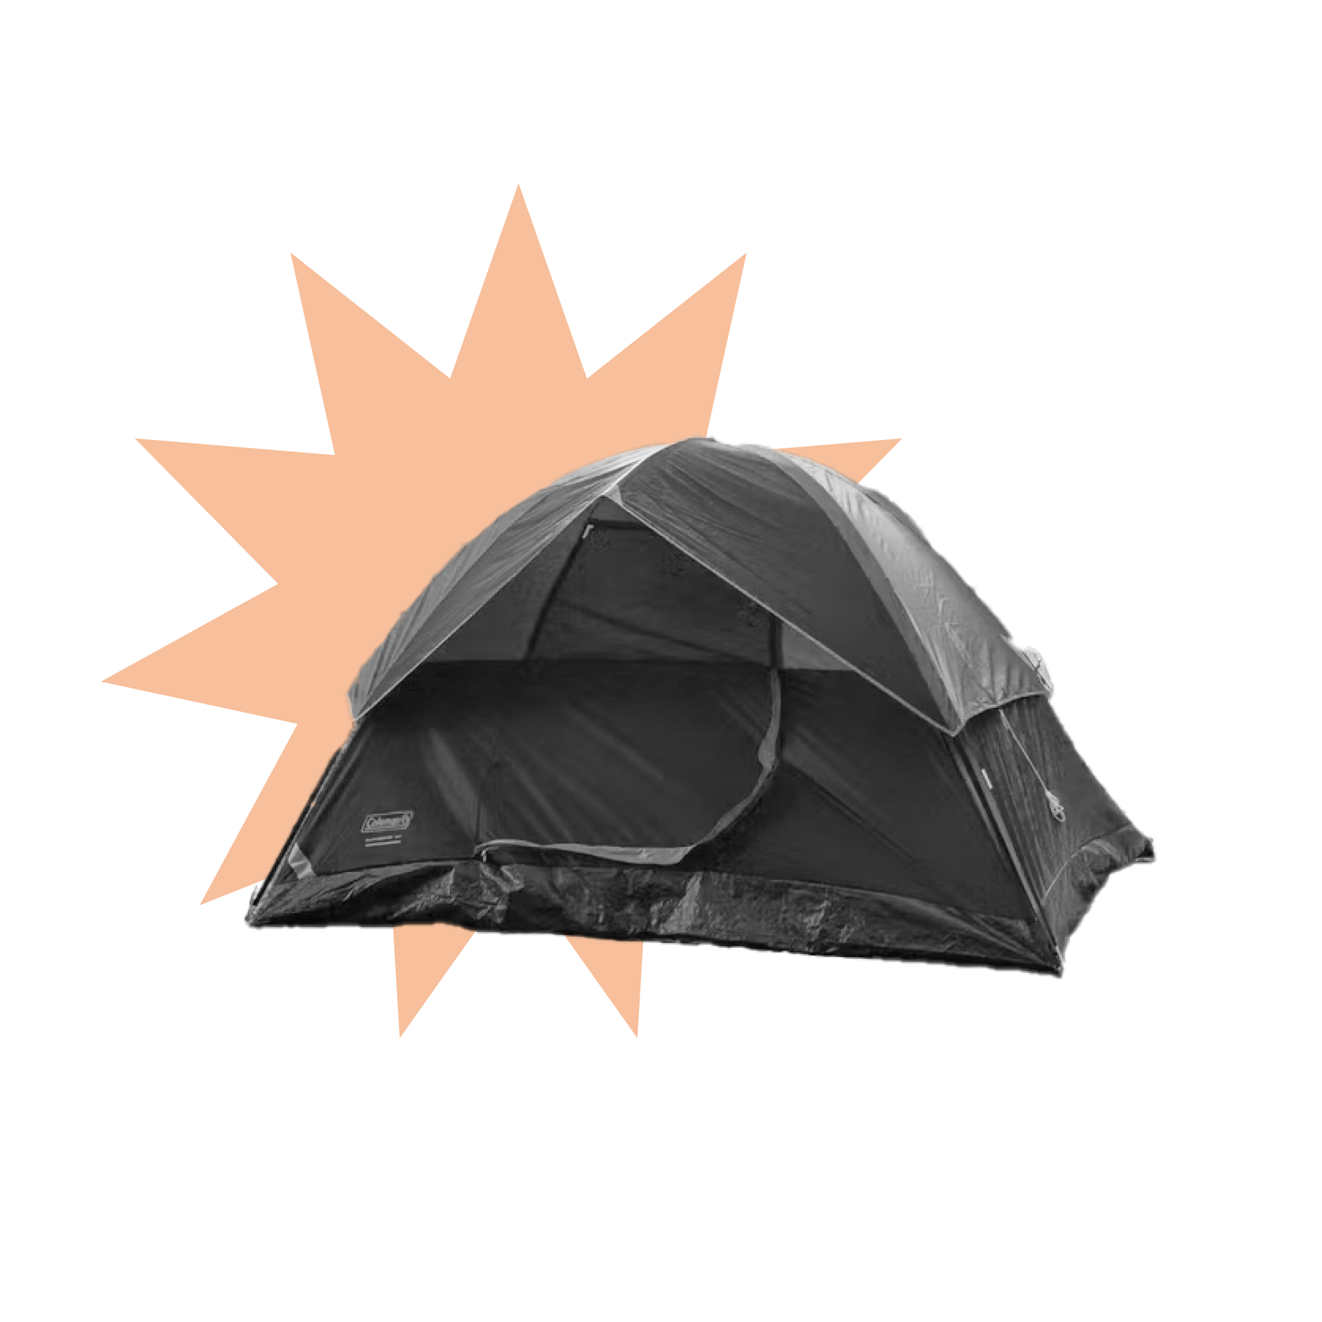
It’s the governments’ job to help homeless people, not mine.
People who are homeless are vulnerable and need protecting.
"I could never become homeless."
"Homelessness could happen to anyone."
If you become homeless it must be your own fault.
"People who are homeless don't want help."
People who are homeless need help rebuilding their lives.
Homelessness: Whose fault is it?

Slide 7
Hierarchy of needs
Family
Rest
Food
Home
Movement
Religion
Homelessness: Hierarchy of needs
Notes:
Based on Maslow’s hierarchy of needs

Slide 8
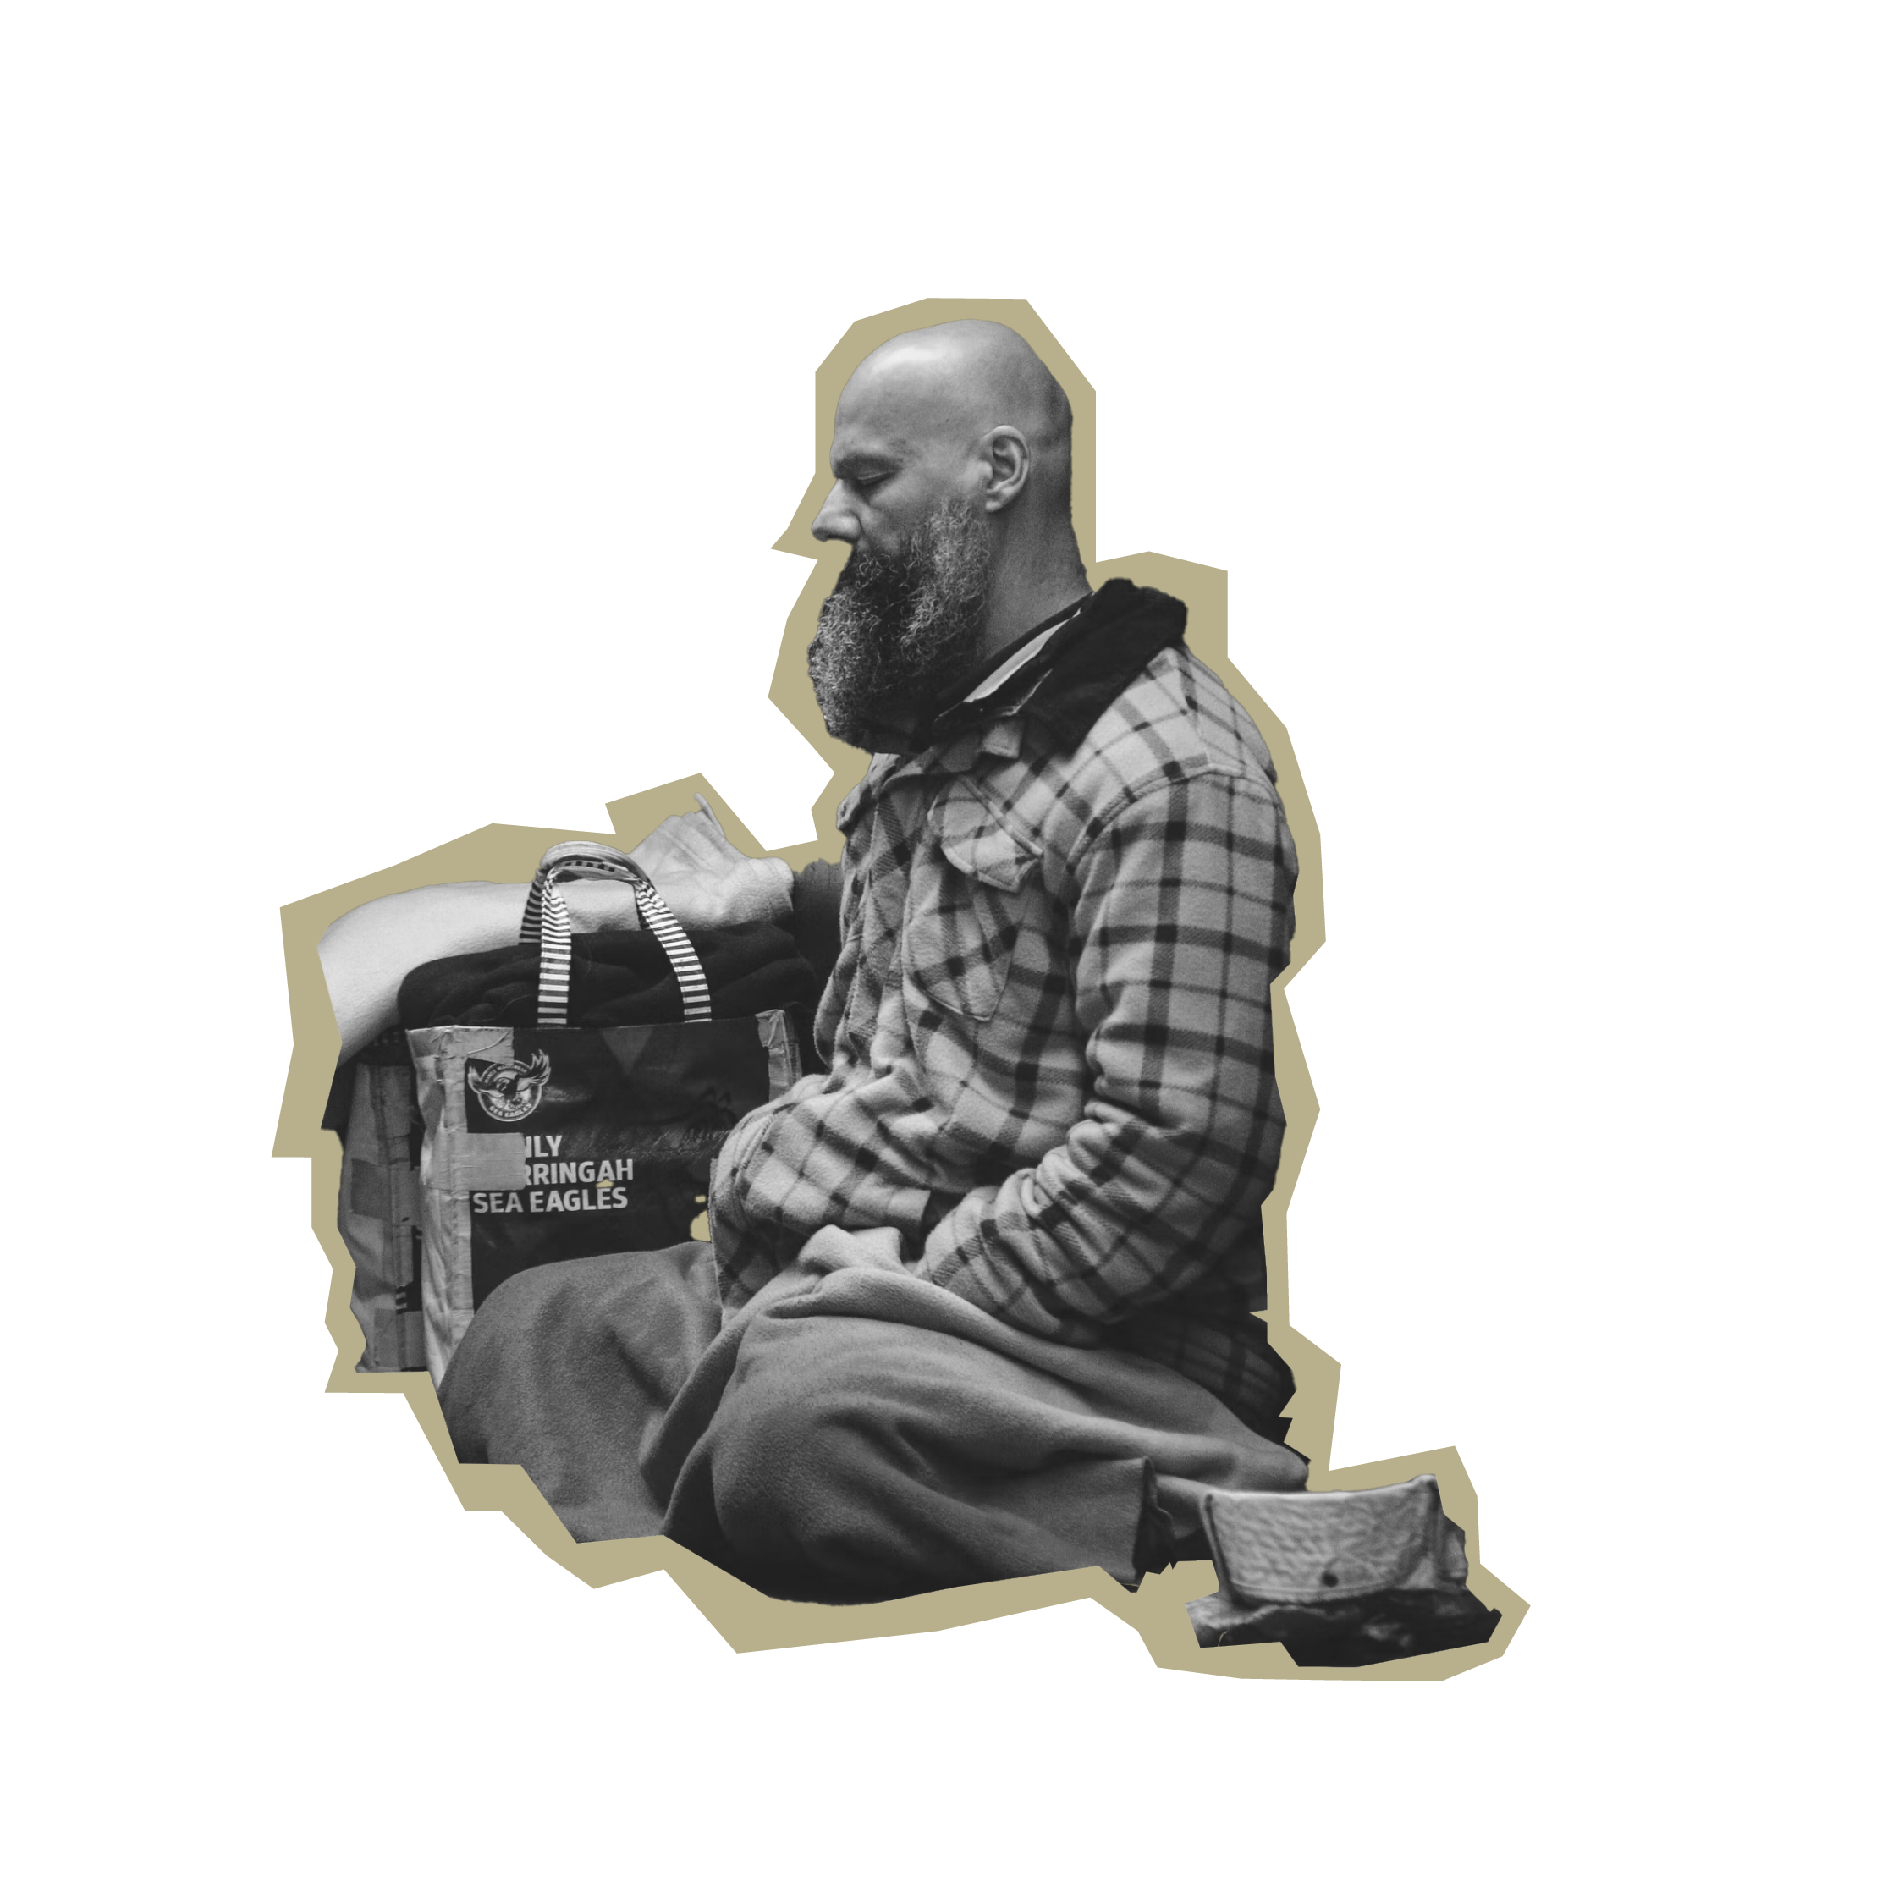
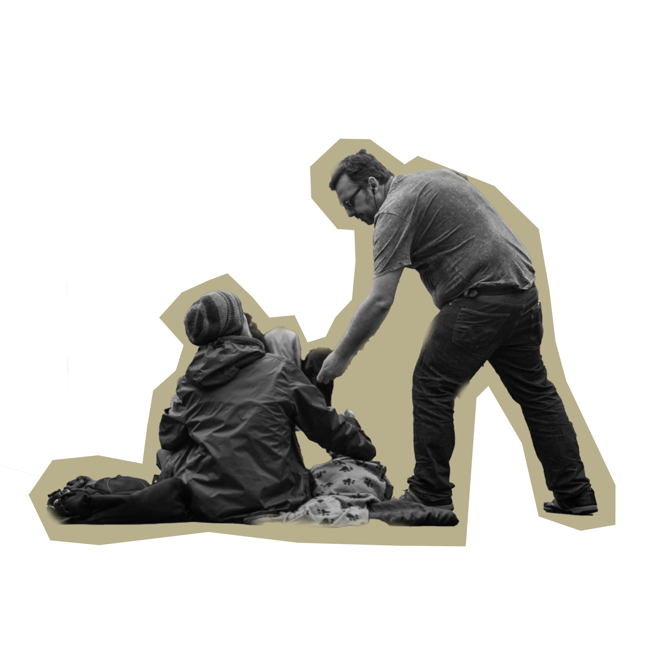
What’s the story?
Evicted Job loss Council referral
Lifehouse Training
Increased cost of living Support
Rough sleeping Chaplain
Homelessness: What’s the story?

Slide 9
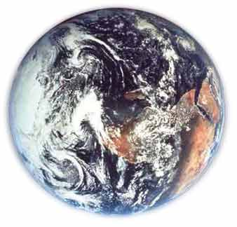
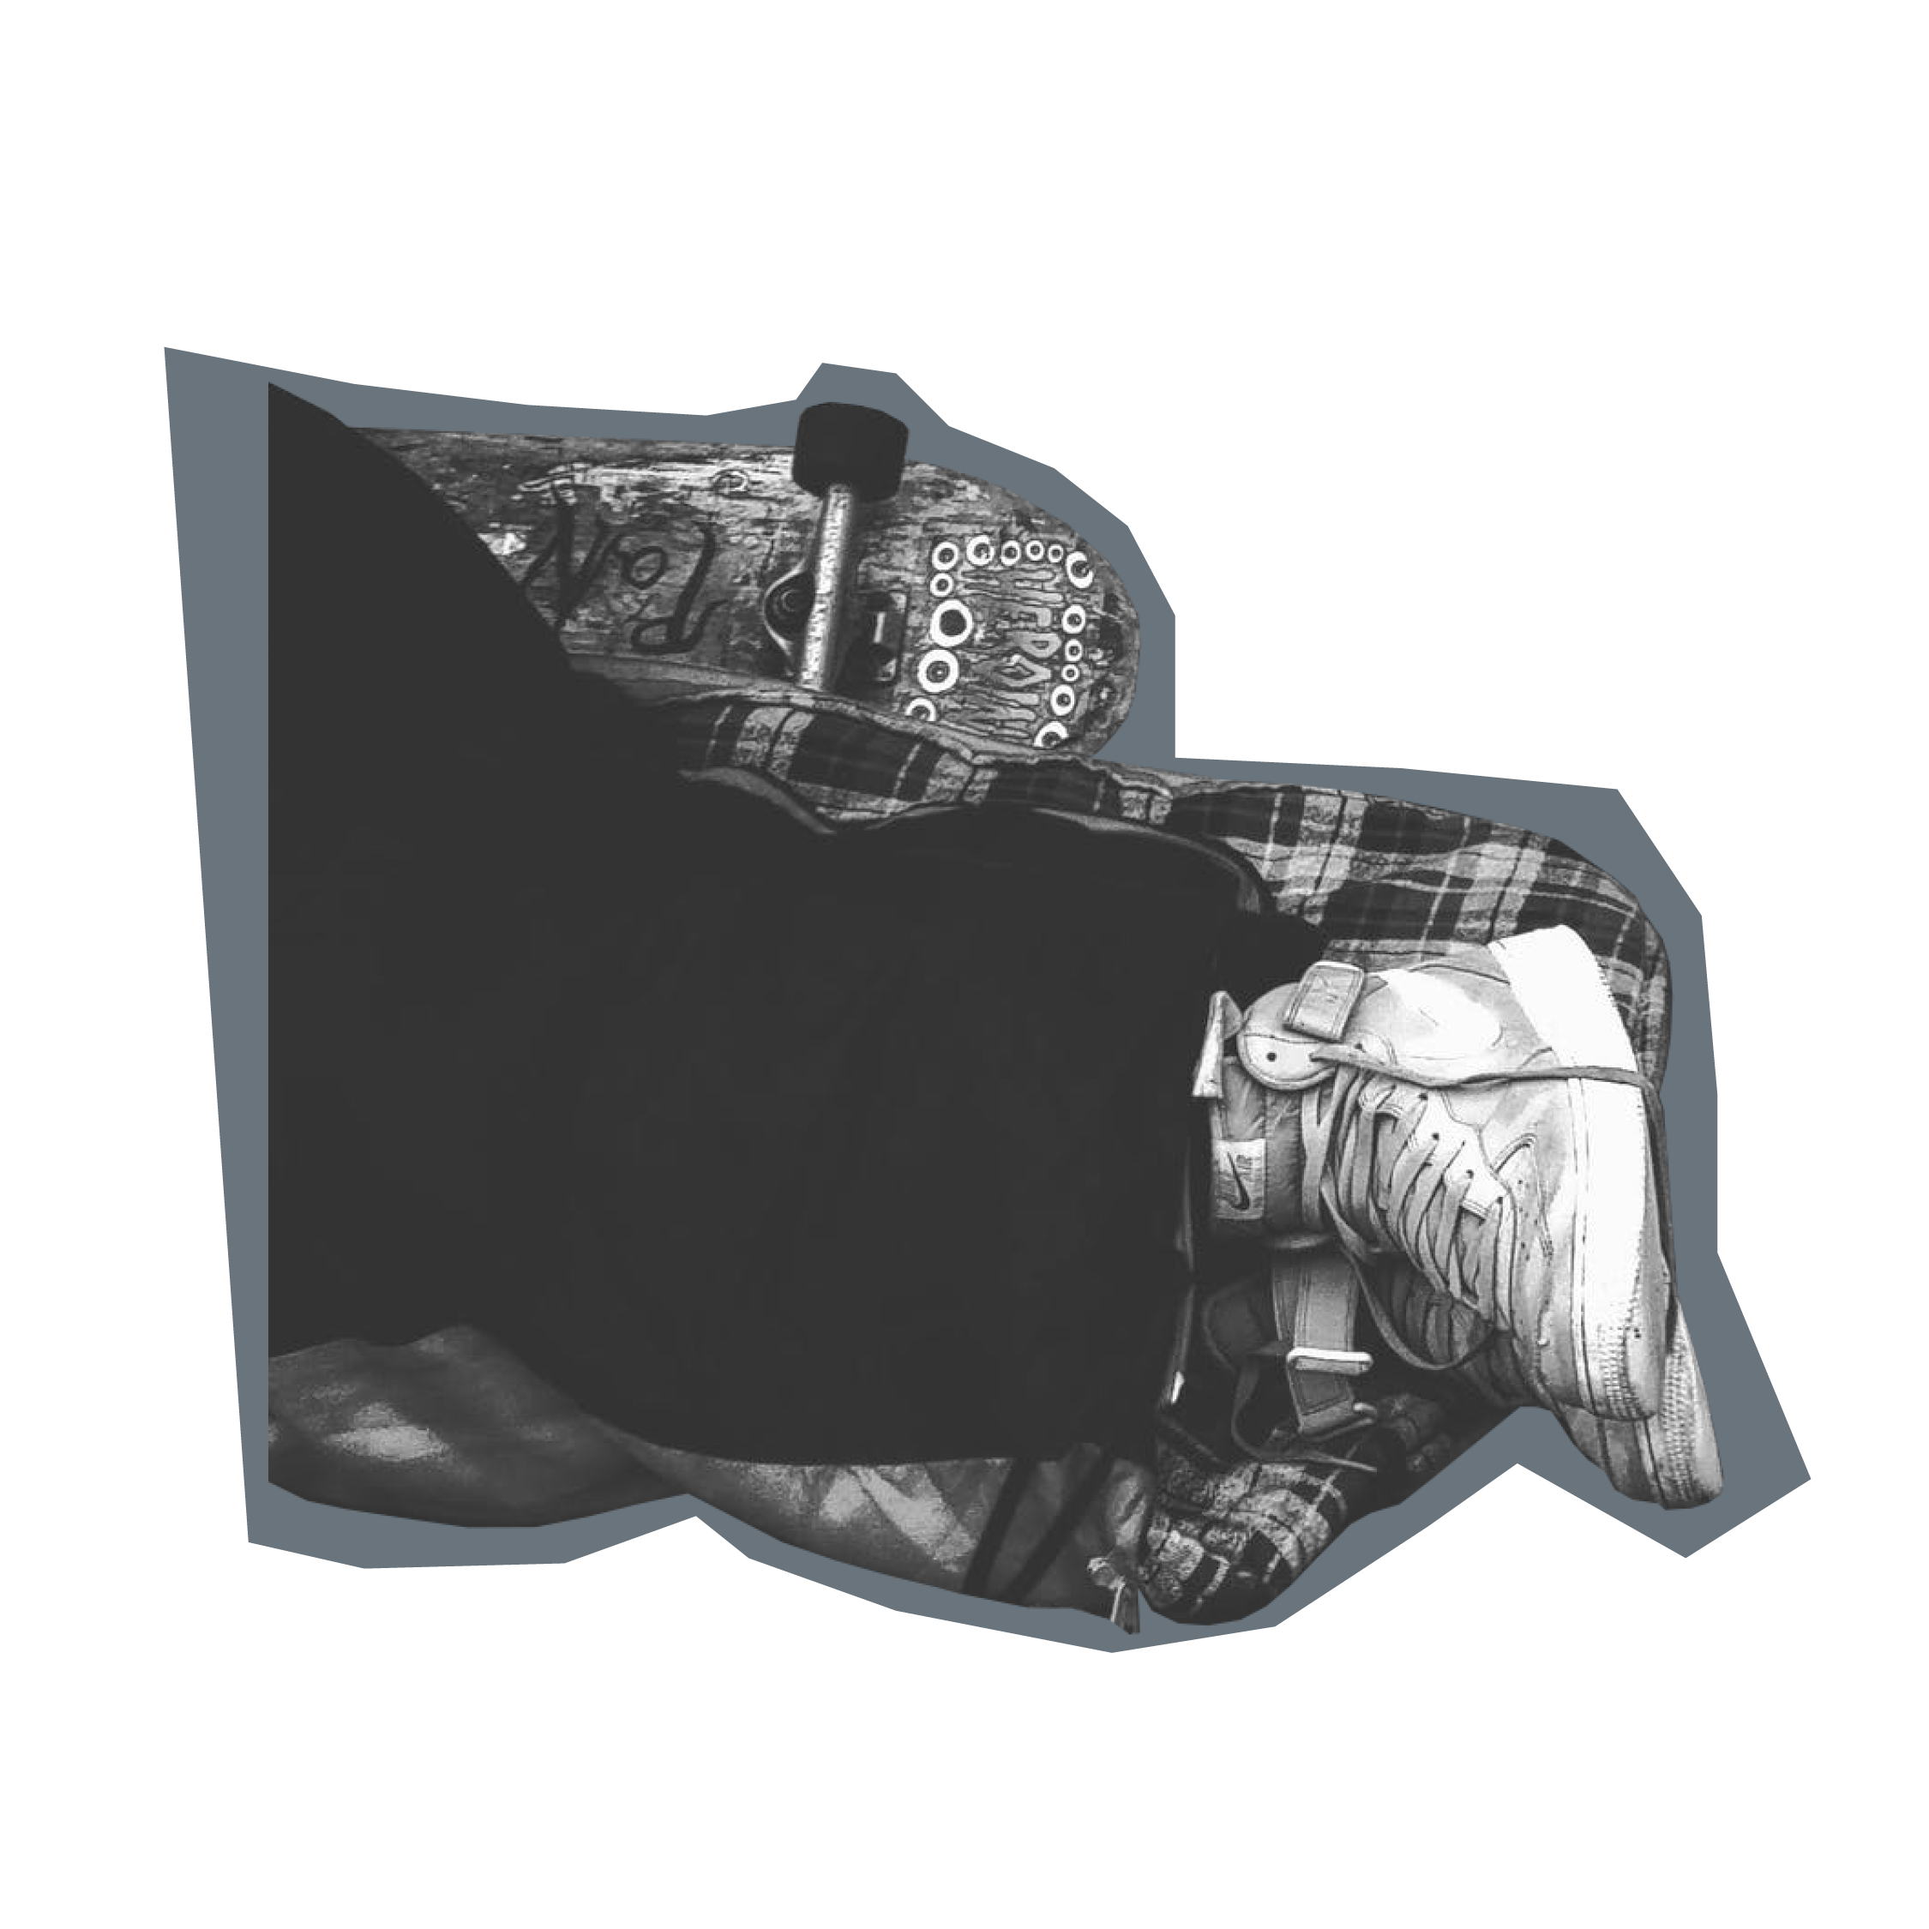
Change the world!
How could what you have learnt today change the world?
In a small, medium or large way?
On a local, national, global scale?
Homelessness: Change the world

