Slide 1
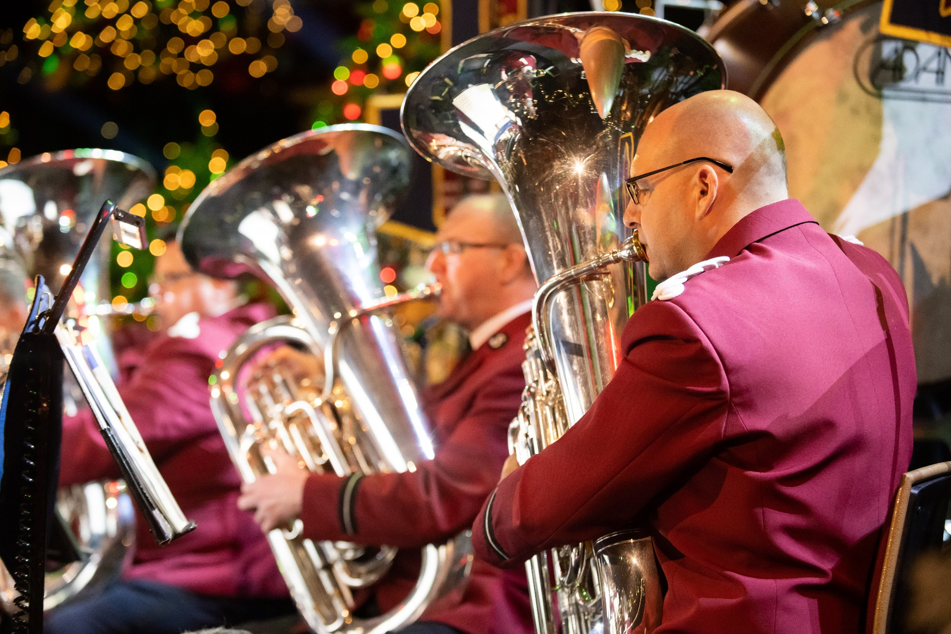
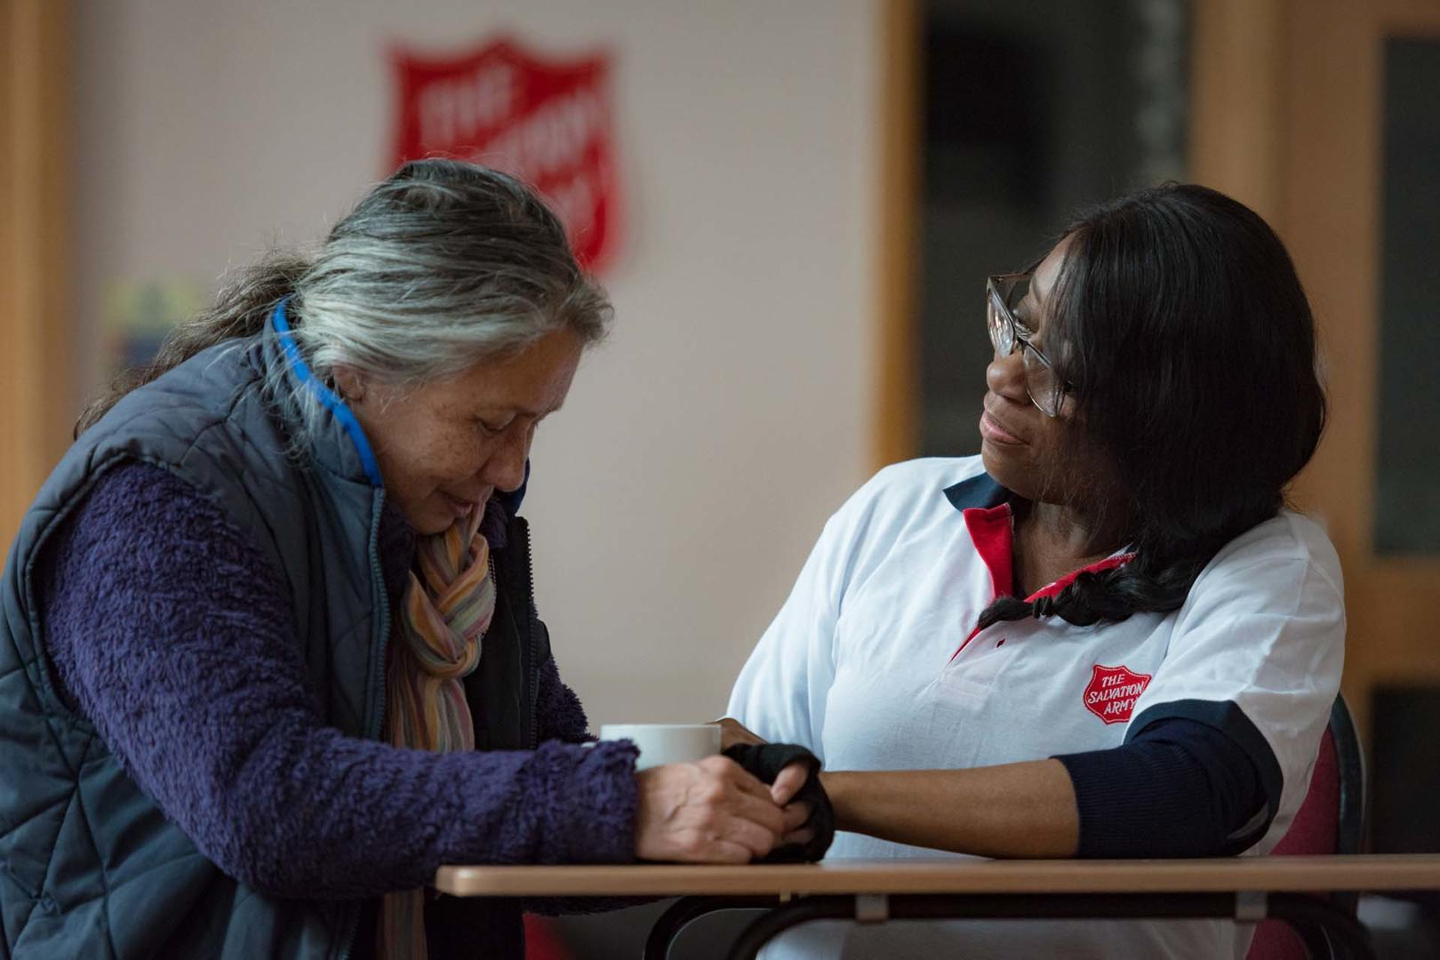
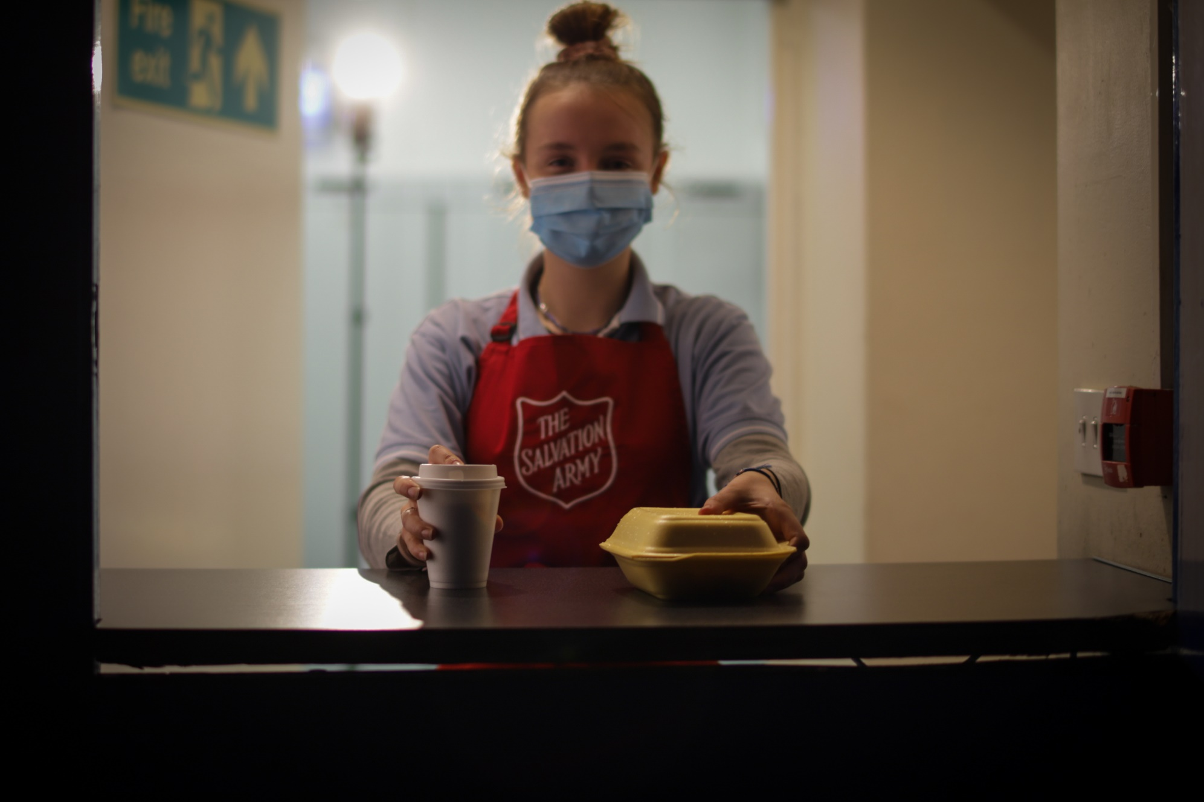
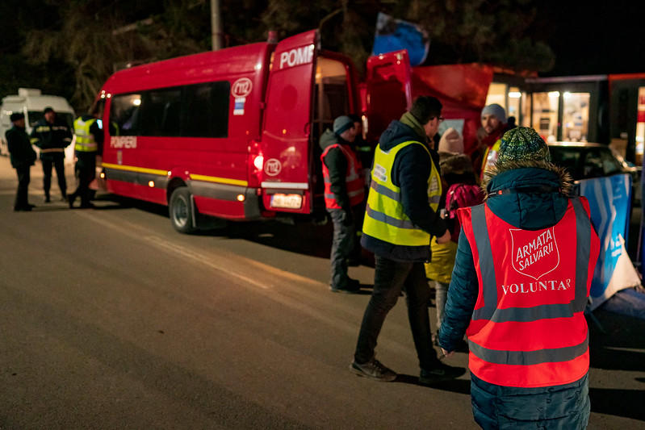
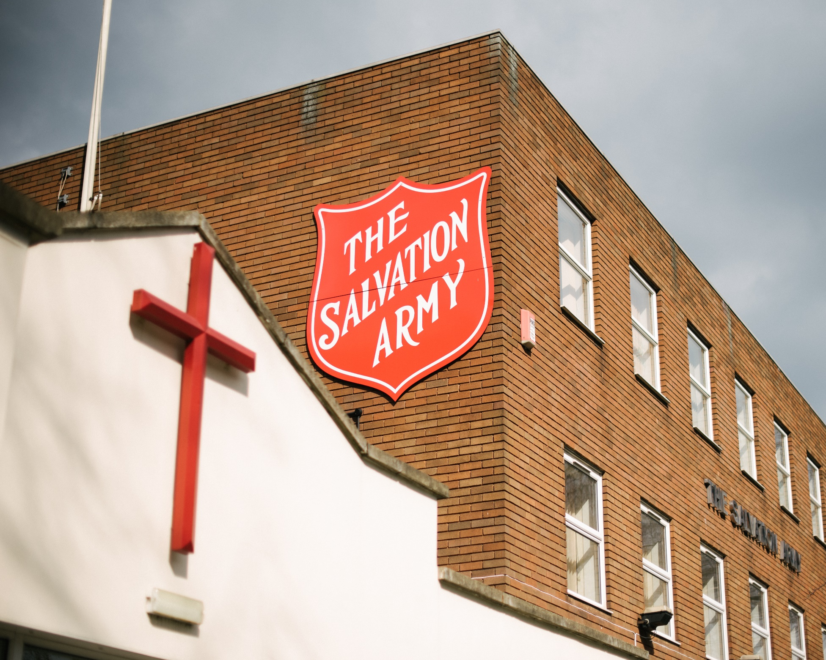
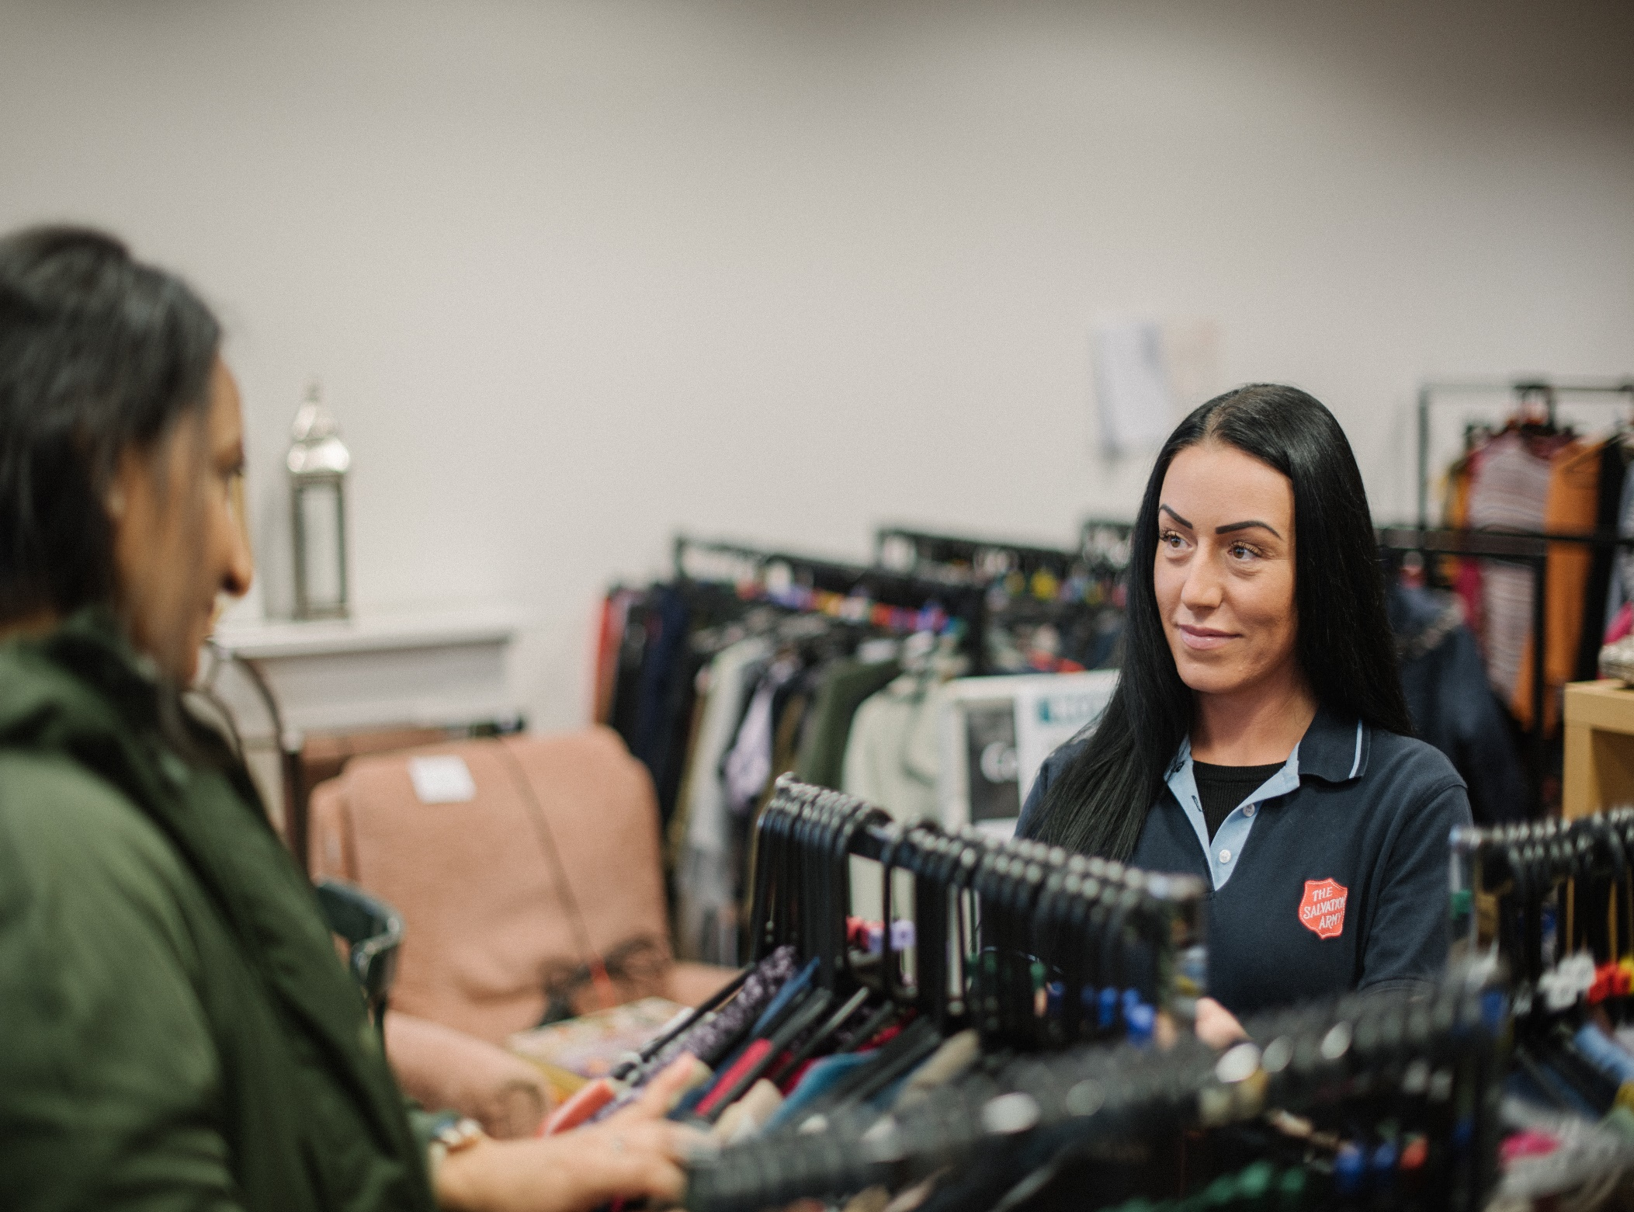
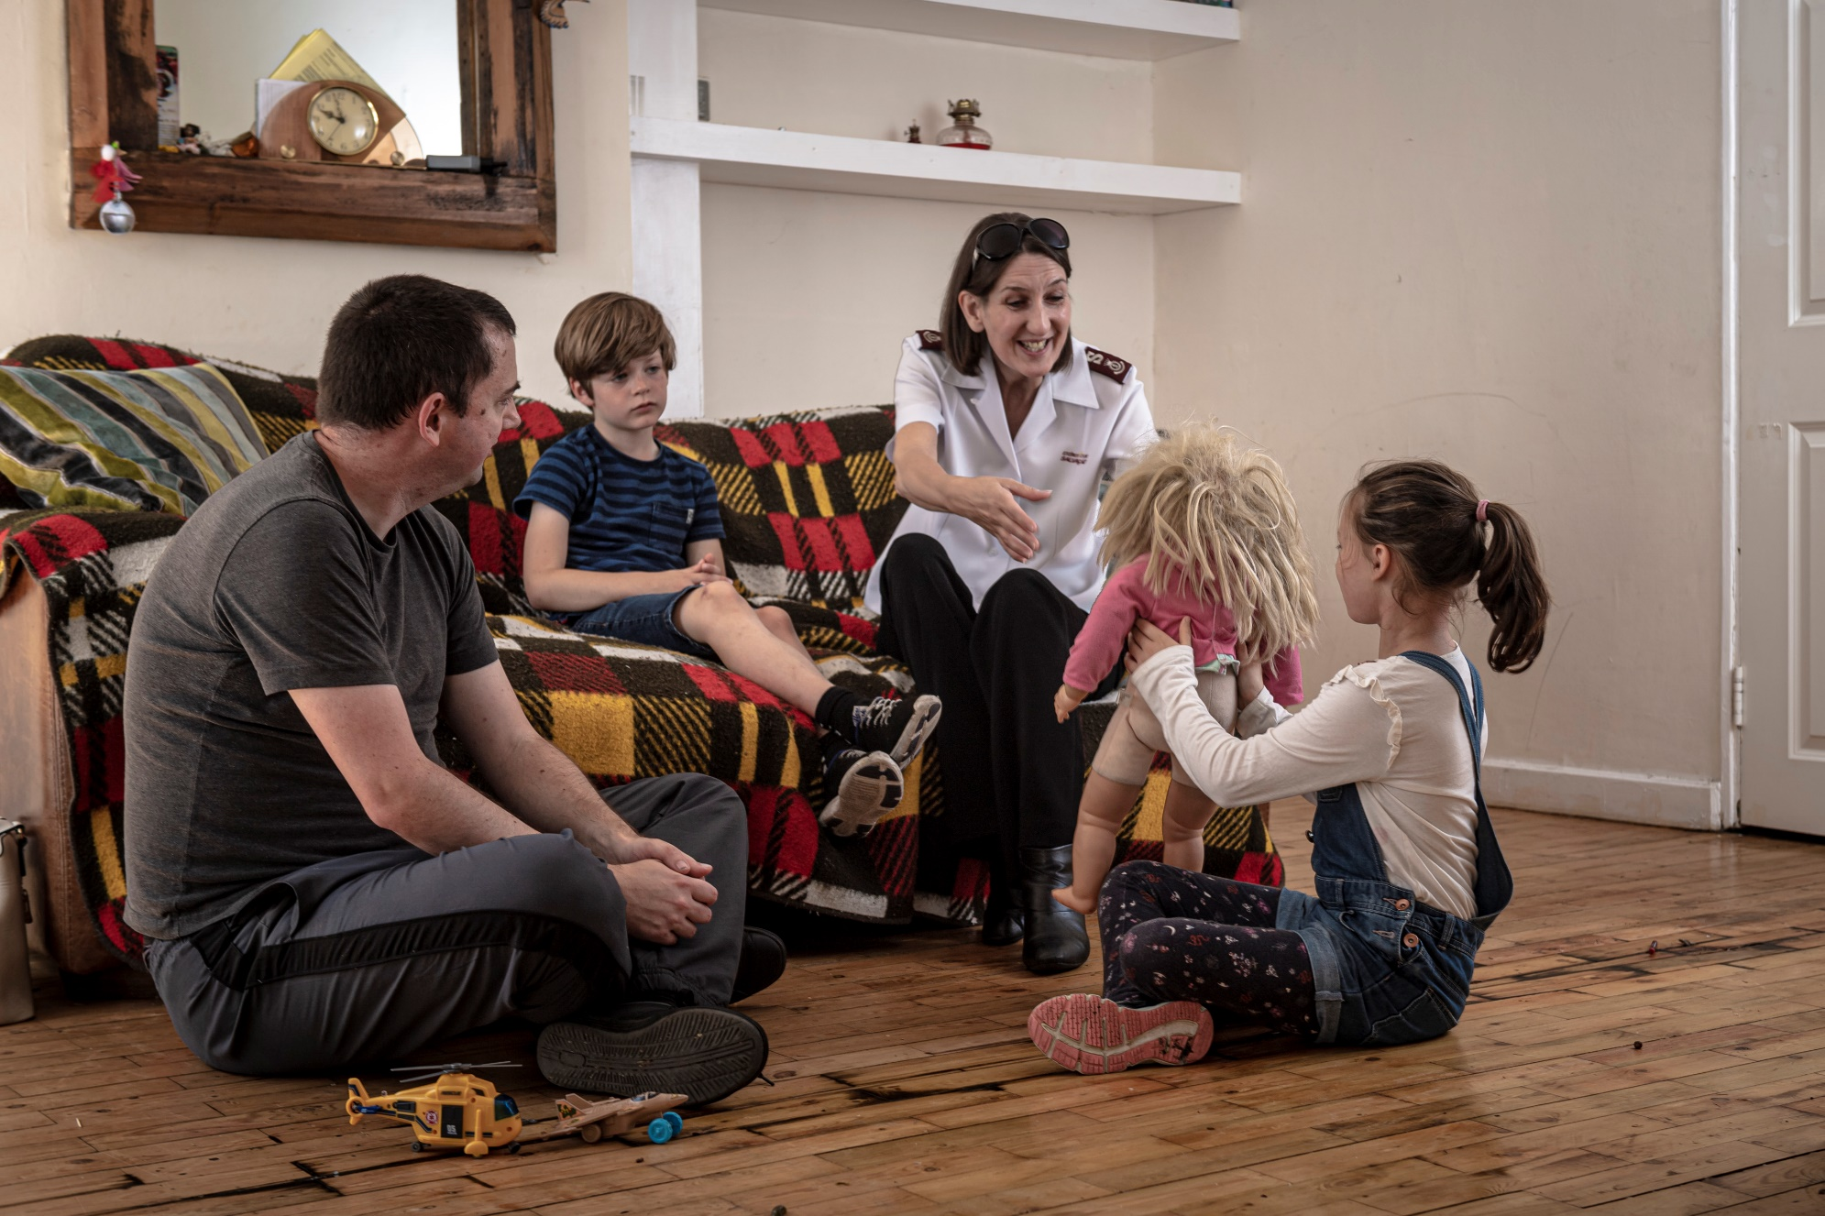
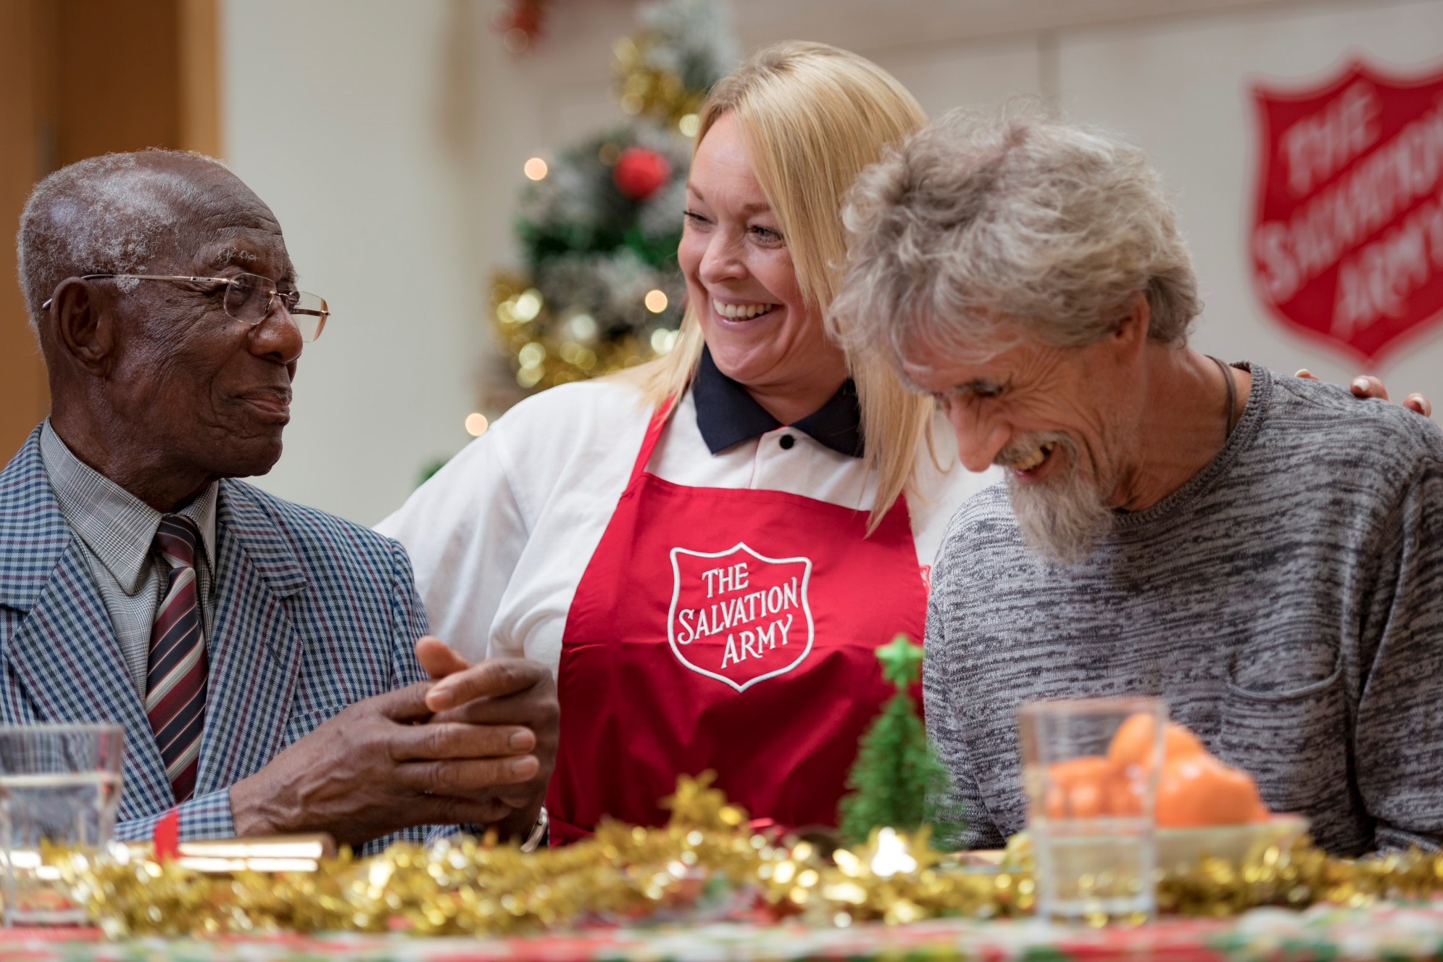
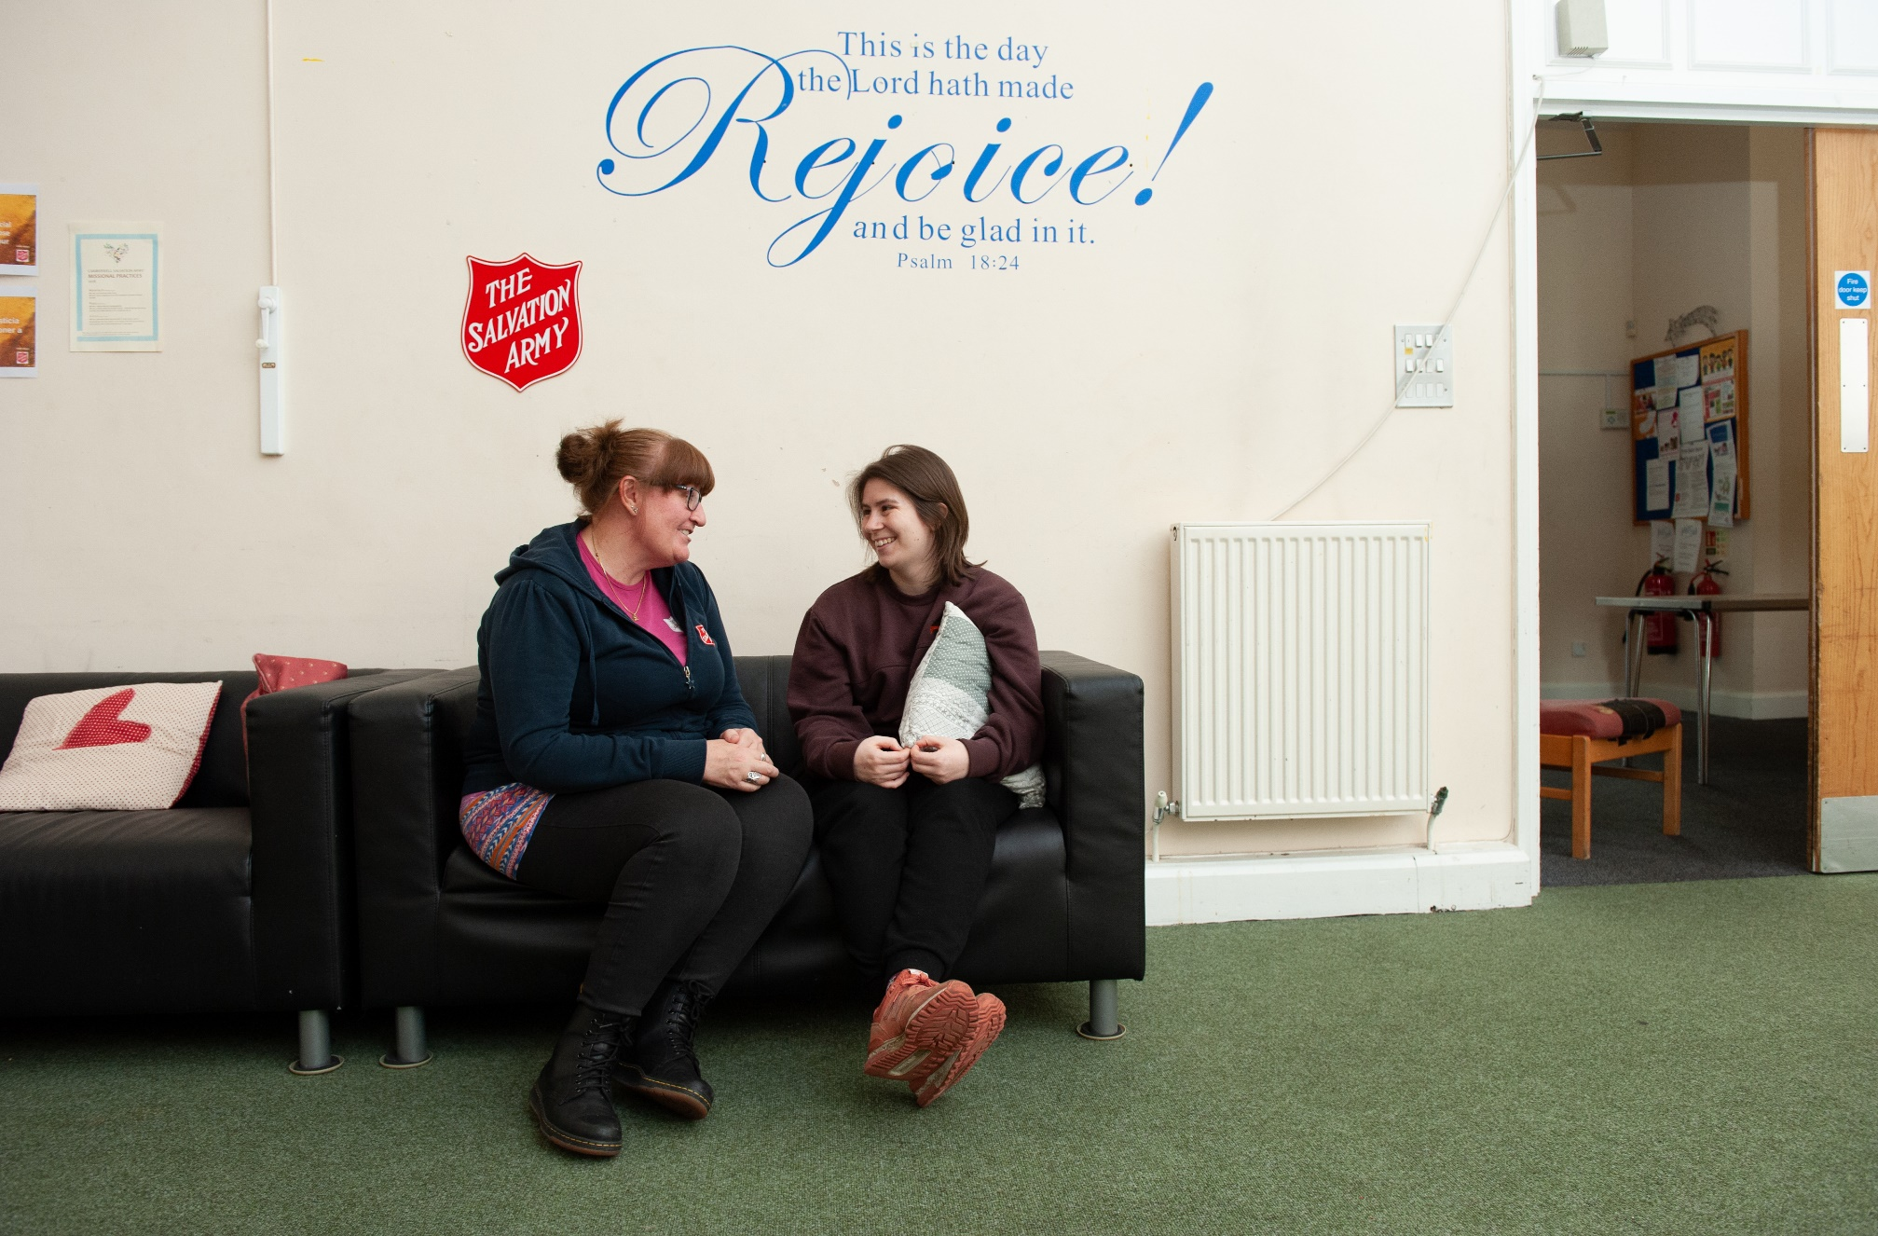
The Salvation Army in pictures
Older People: The Salvation Army in pictures

Slide 2
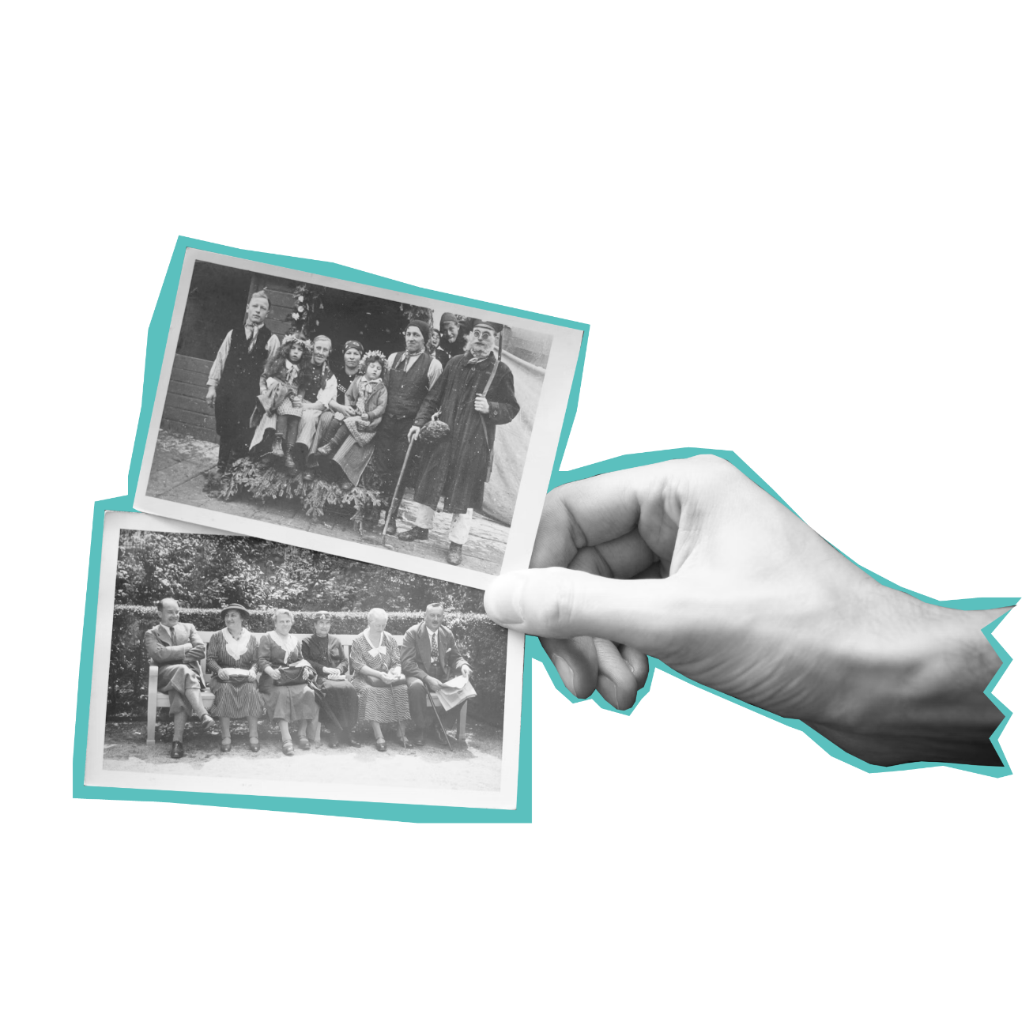
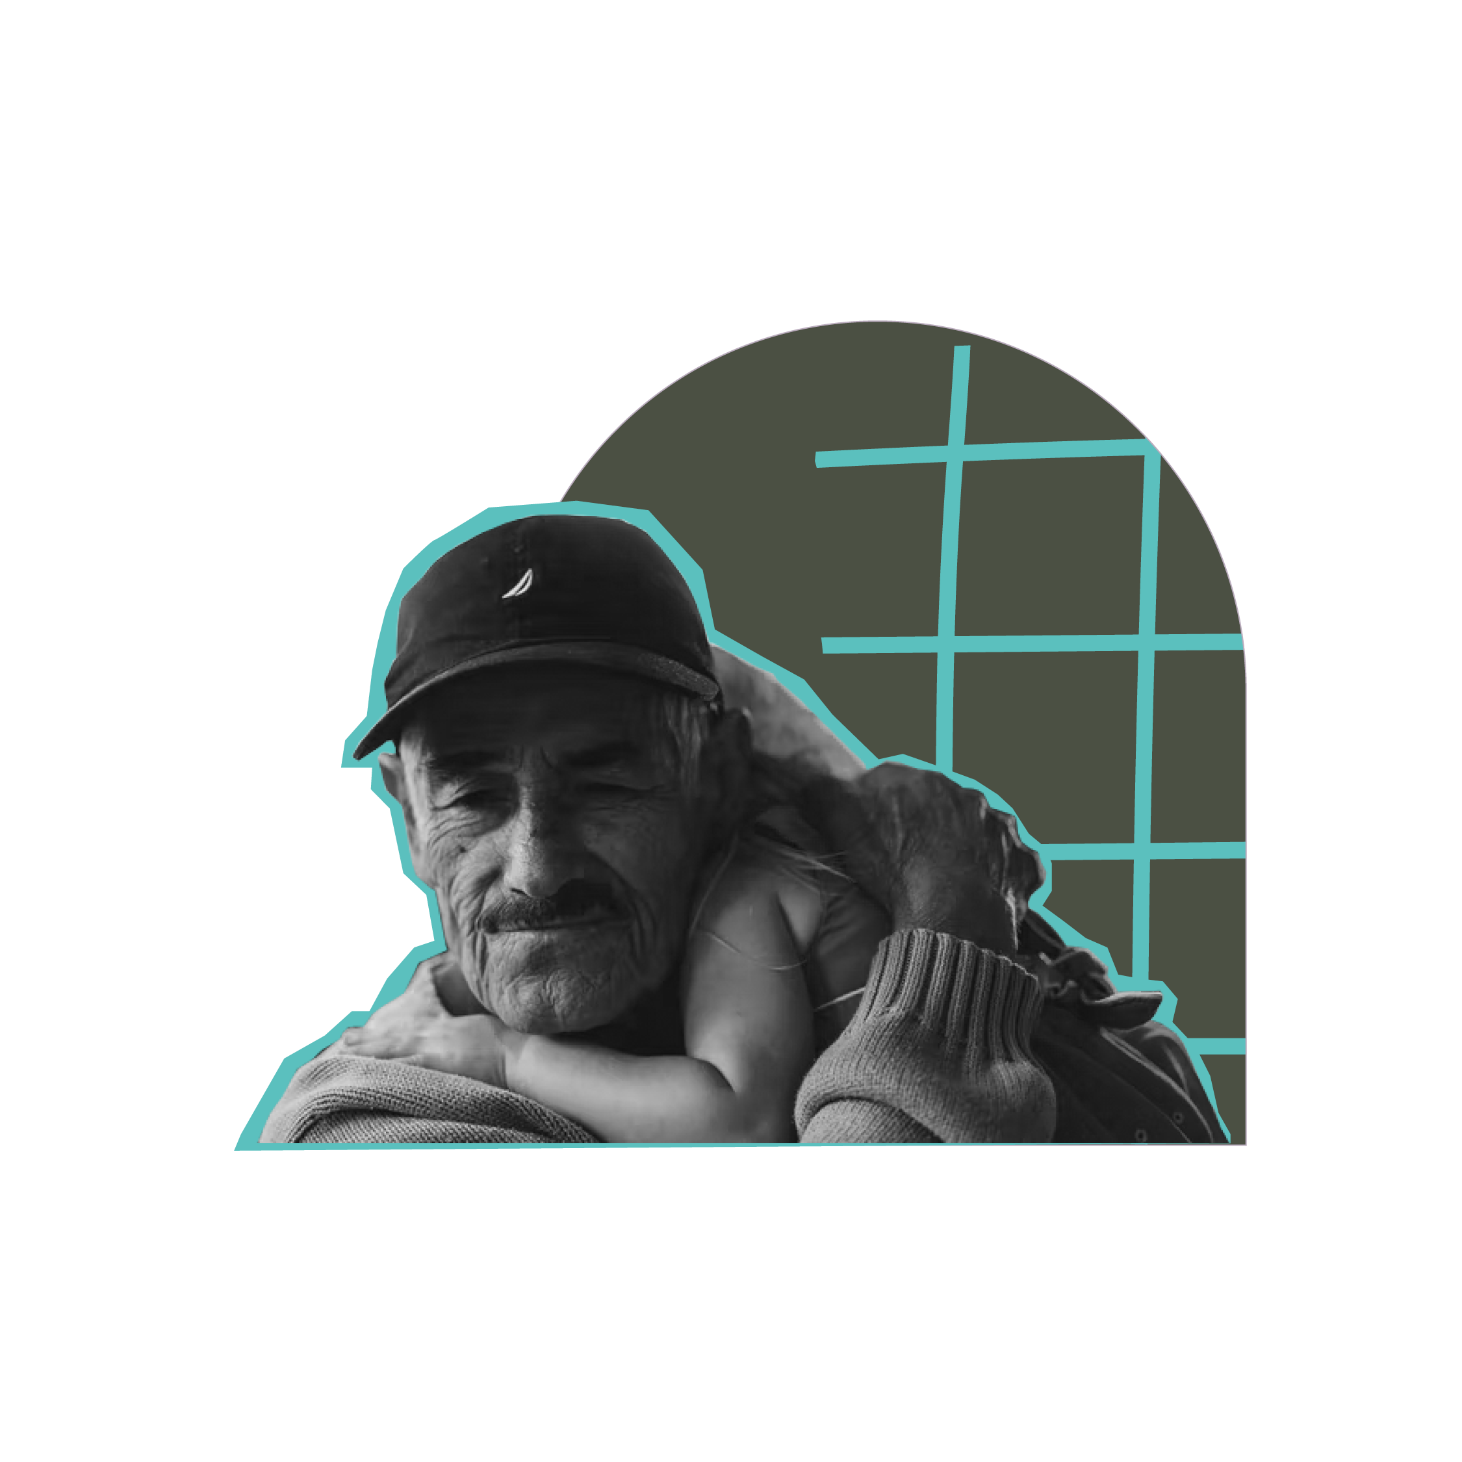
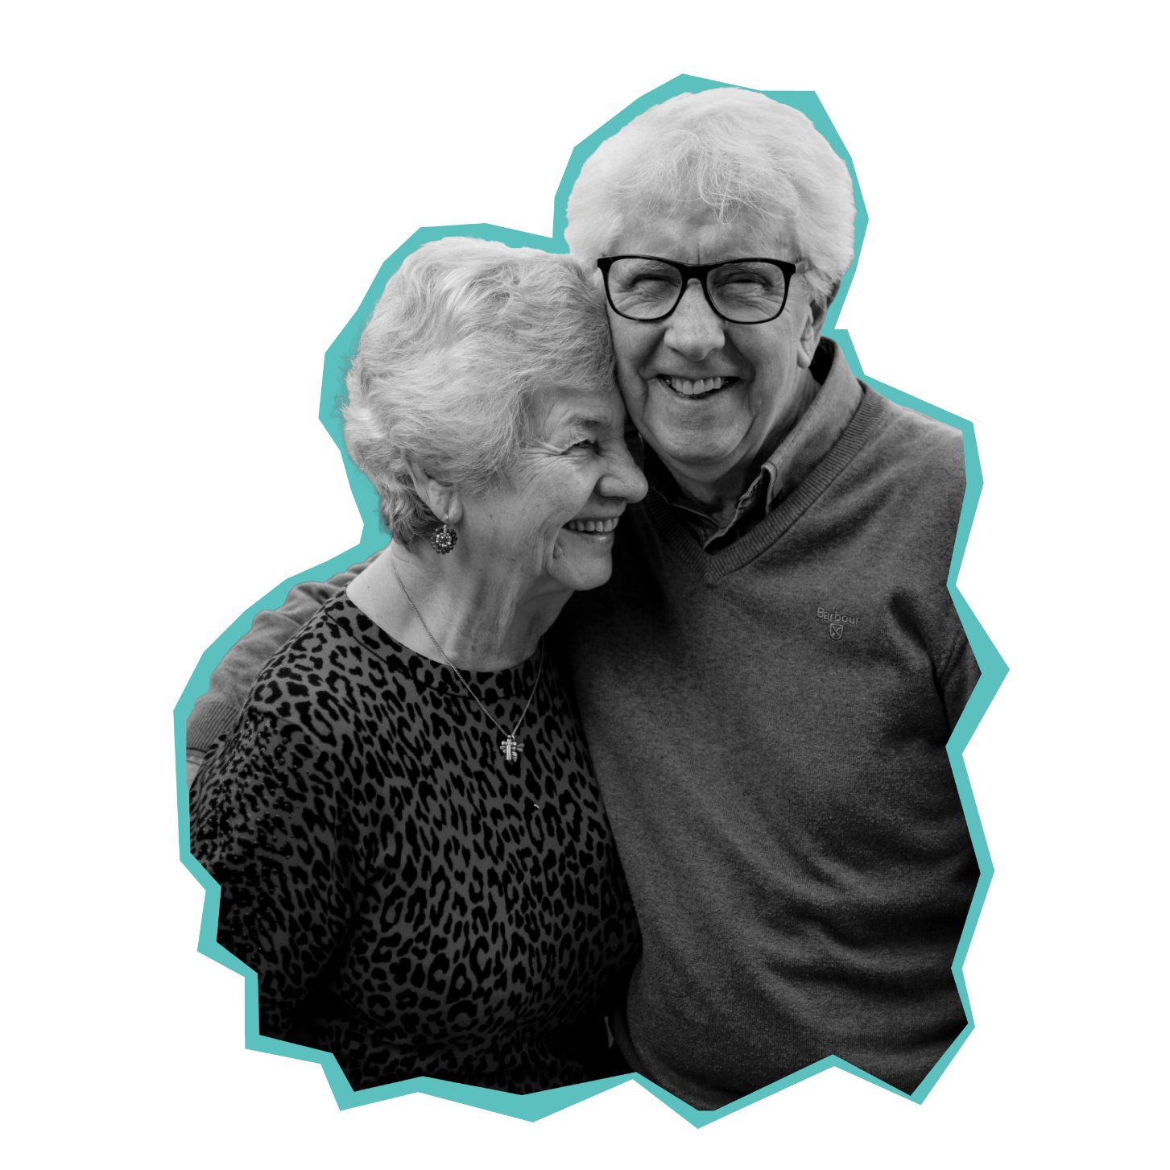
Older people
and
The Salvation Army
To understand how The Salvation Army supports older people
To explore how students can help older people in their community

Slide 3
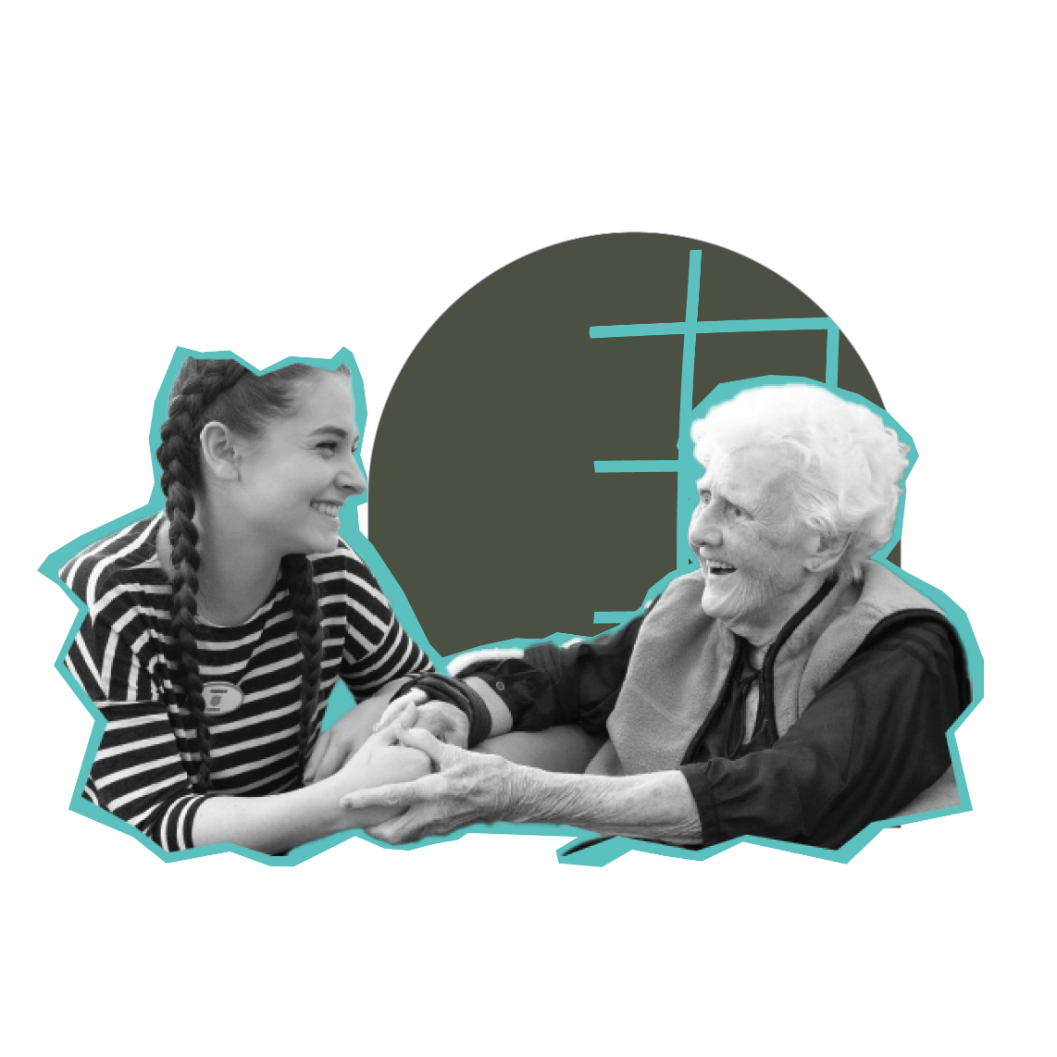
Supporting older people
John 10:10
Some of the corps and community programmes include:
Walking clubs
Intergenerational projects
Lunch Clubs
CAMEO Clubs (Come And Meet Each Other)
Community Choirs
Indoor Bowls & other sports
Health and well-being programmes
Christian Teaching programmes
Hobby based clubs
Singing by Heart (singing groups for people living with Dementia)
Gardening Clubs
Volunteering Opportunities
Awareness Courses (such as Dementia and End of Life planning)
Day Trips & Holidays
Holiday at Home schemes (all the joy of a holiday- but not leaving home)
Older people: Supporting older people

Slide 4
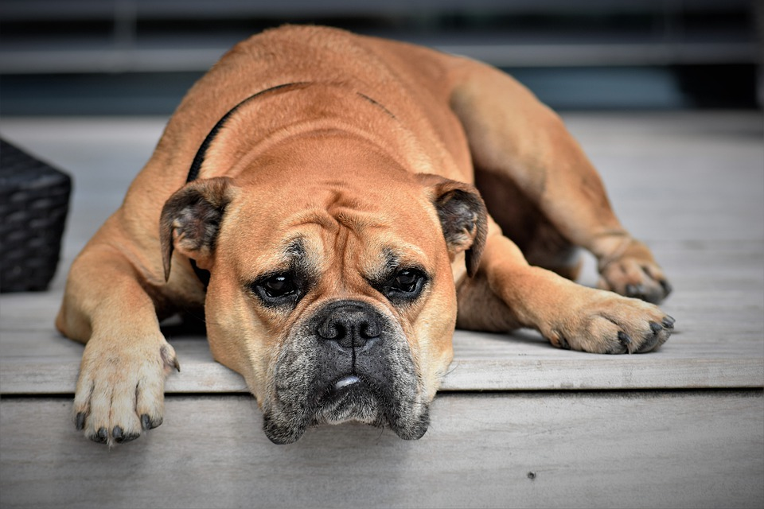
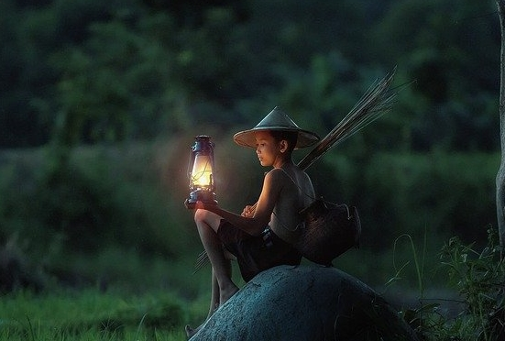
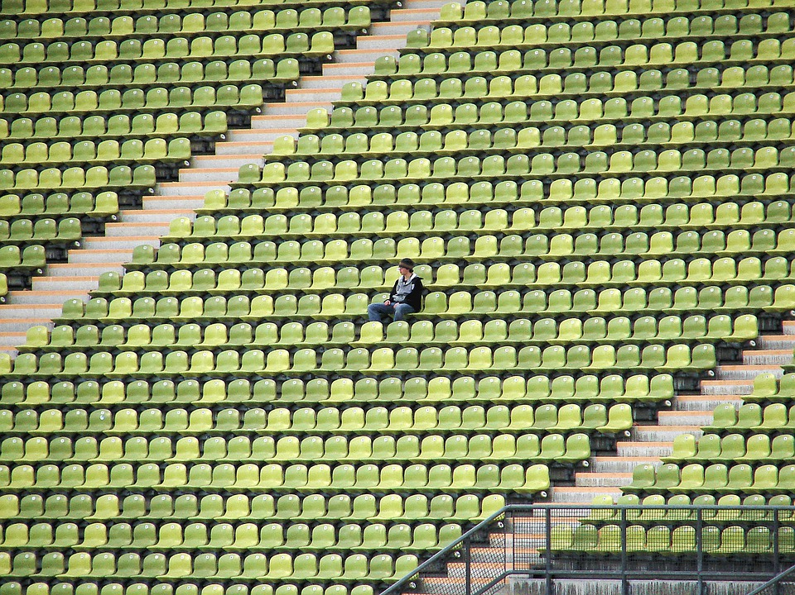
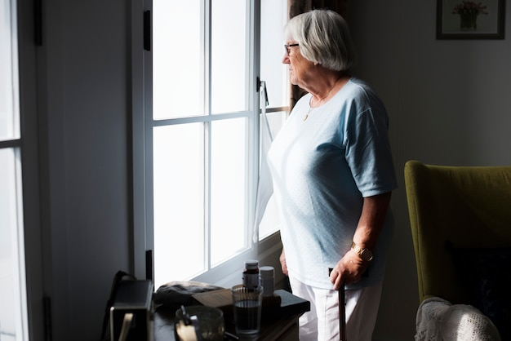
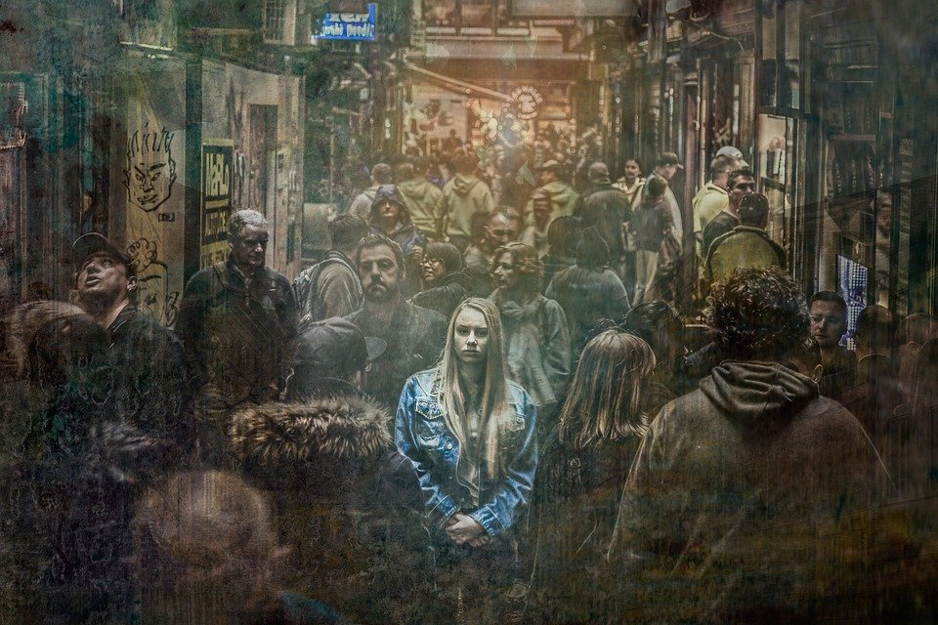
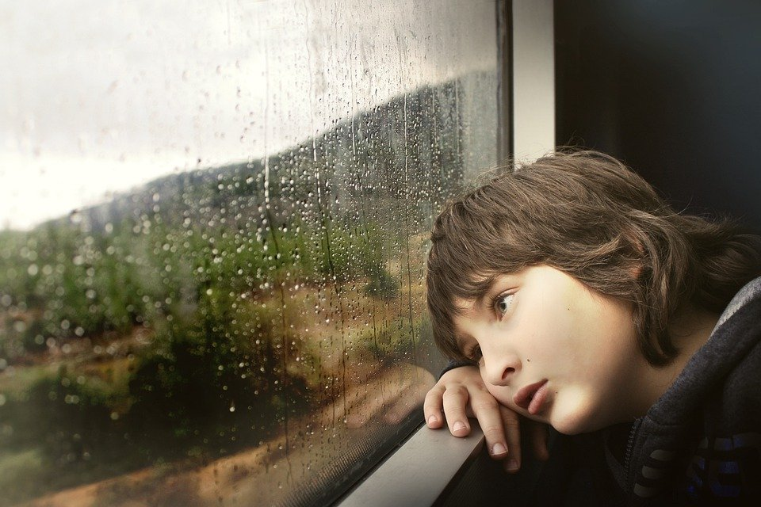
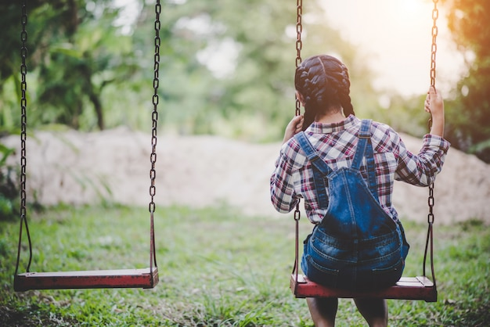
What’s the link?
Older people: What’s the link?

Slide 5
Impact of the pandemic
‘90% of COVID-19 deaths in the UK occurred in those aged over 65’
(Source - ONS Statistics)
Older people: Impact of the pandemic

Slide 6
Supporting older people
Is it important to support older people?
What would happen if we didn’t?
Older people: Is it important?
Notes:
Create class campaign?

Slide 7
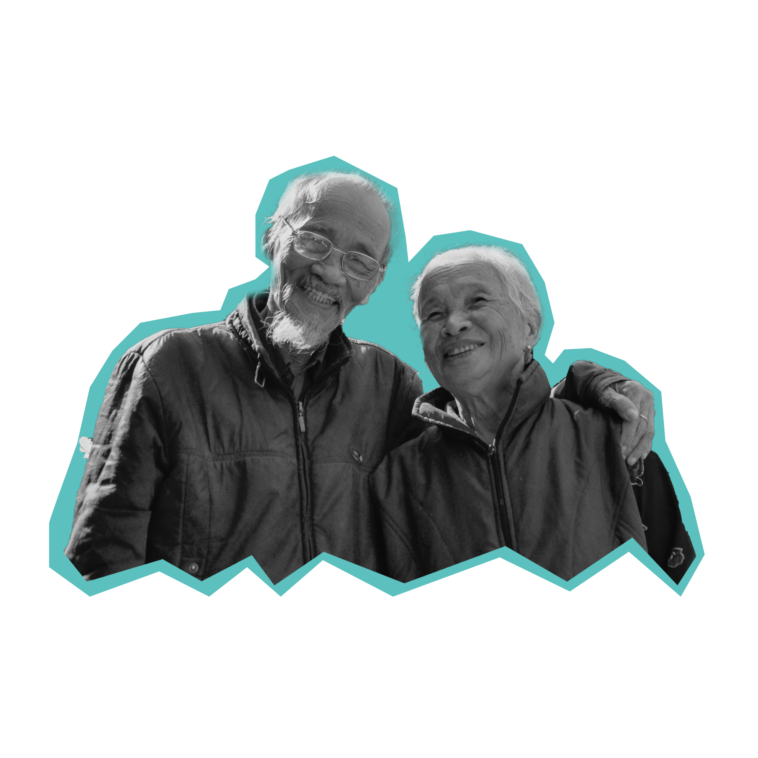
Supporting older people
Older people: Getting involved
Notes:
Create class campaign?

Slide 8
Supporting Older People
Here are just a few ideas to get you started:
Visit your local care homes
Contact your local Salvation Army church (corps)
Invite some older people to your school for afternoon tea
Gardening
Fundraising
Older people: Getting involved
Notes:
The Salvation Army needs everyone to help make a difference, we can’t do this on our own.

Slide 9
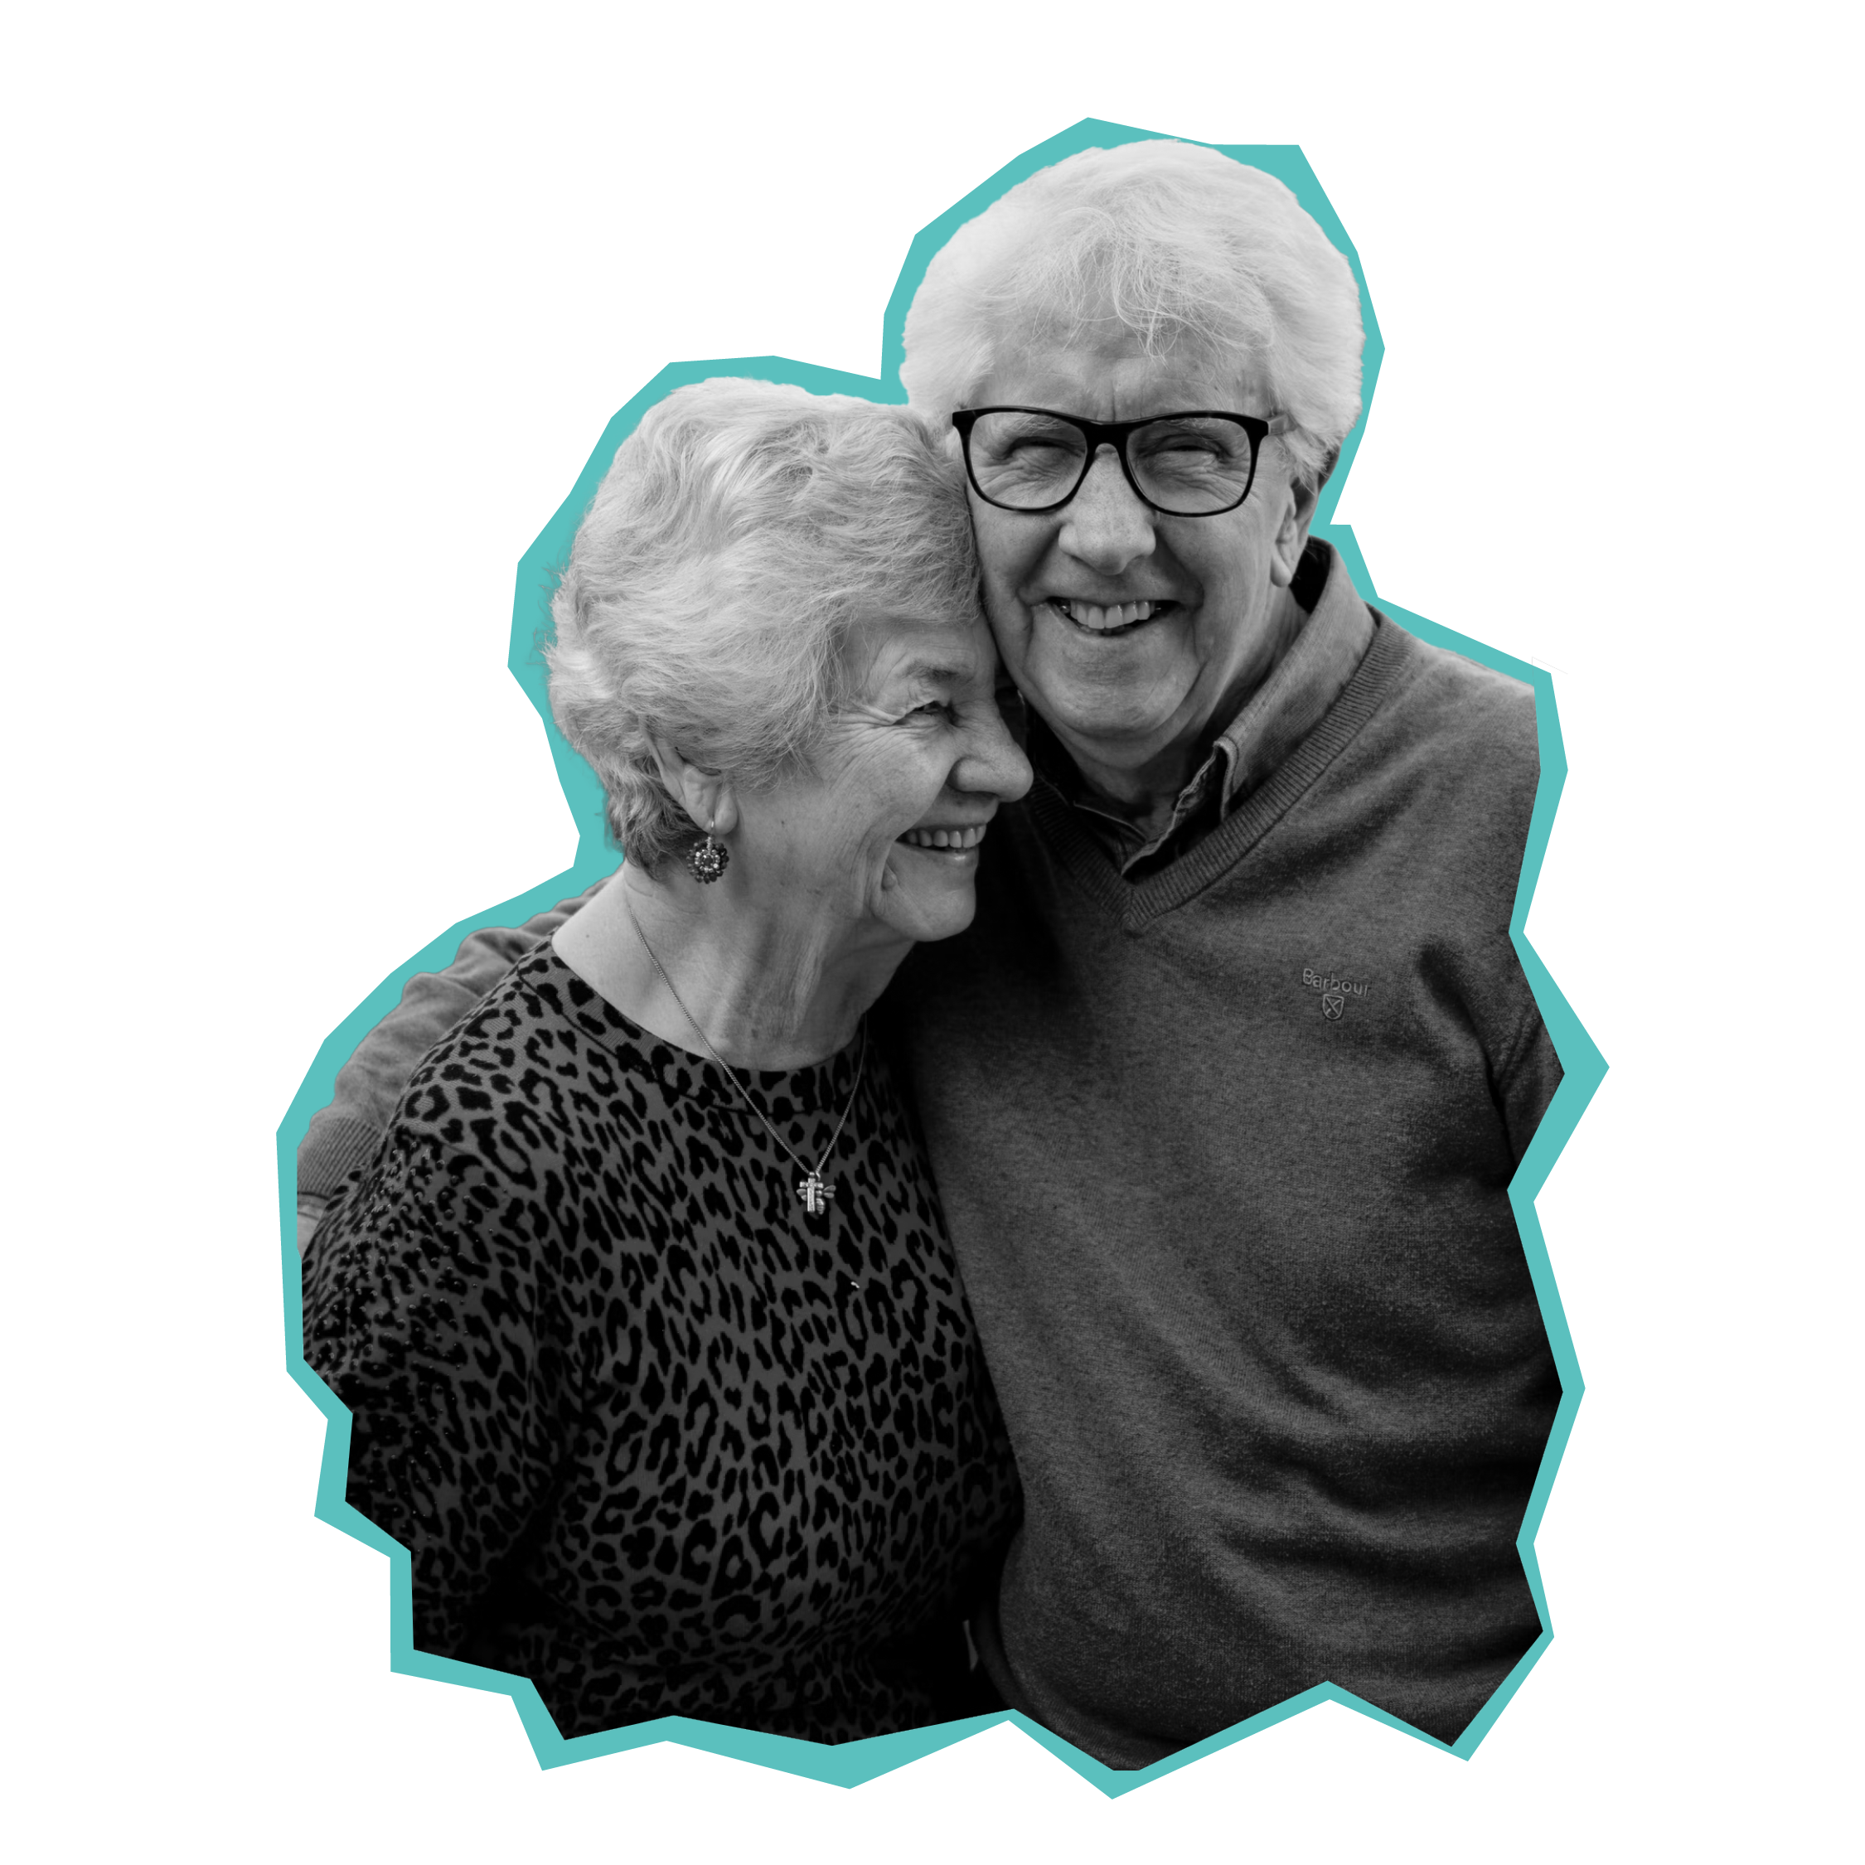
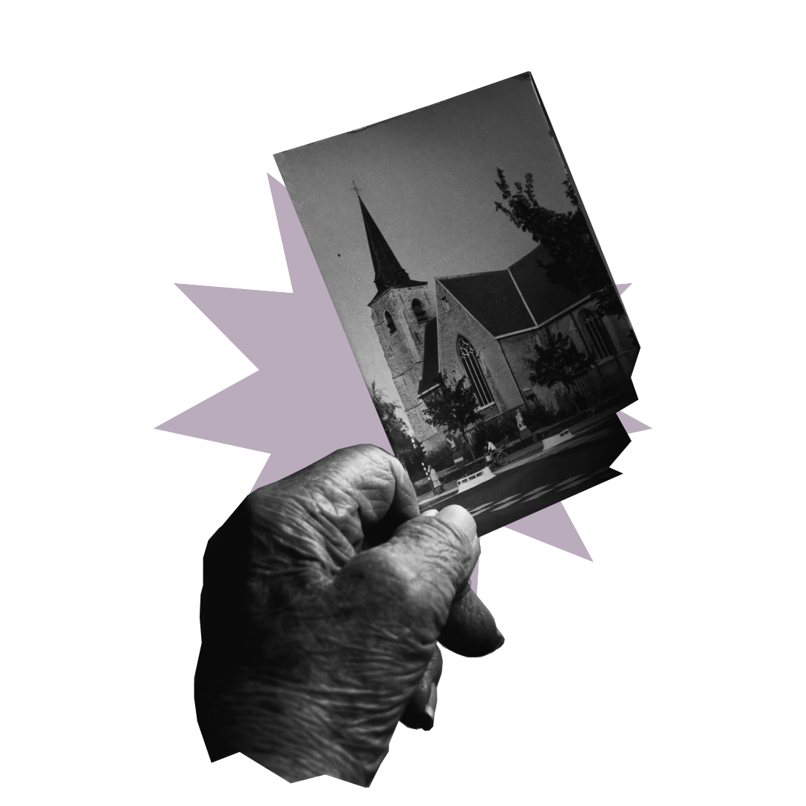
Older people in our community
We can support older people in our community by…
We would need to ask…
The following resources would be useful…
Older people: Supporting older people

Slide 10
Quiz – inbetweeners
Find a word that gives both words on either side a meaning.
EXAMPLE
Chocolate
Hot Egg
Older people: Inbetweeners quiz

Slide 11
Find a word that gives both words on either side a meaning.
Care Work
HOME
Salvation Base
ARMY
TEA
Afternoon Leaf
Full Time
LIFE
Brass Members
BAND
Charity Keeper
SHOP
Older people: Inbetweeners quiz

