Slide 1
Prisons and The Salvation Army
To understand how The Salvation Army supports people in prison
To explore our own attitudes to people in prison

Slide 2
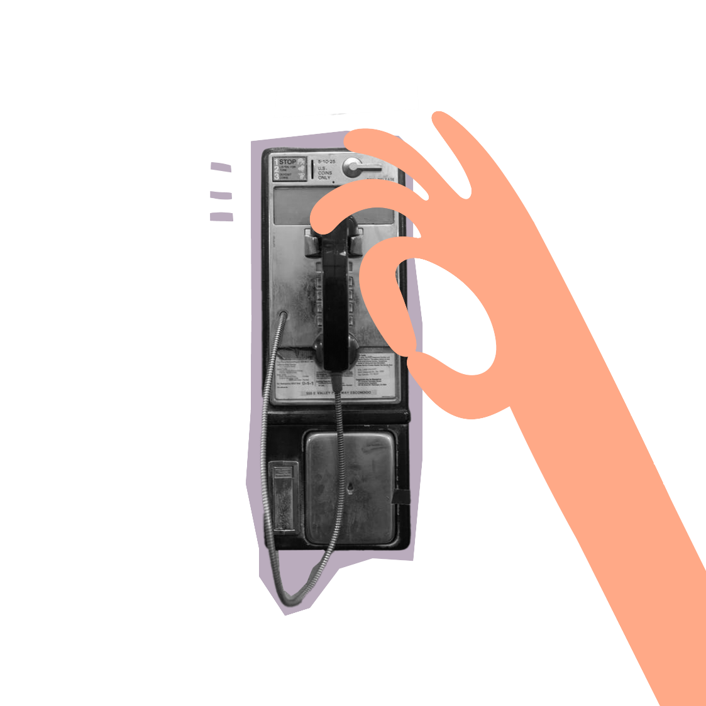
The Salvation Army
Is a place where retired soldiers go
T F
Is a church
T F
Is a charity
T F
Is about 60 years old
T F
Have church services on a Sunday
T F
Only use brass instruments in their services
T F
Only helps people that are Christians
T F
Everyone wears uniform
T F
Prisons: The Salvation Army
Notes:
1. While the ‘Army’ may make you think this is true, Founder William Booth coined the name ‘Salvation Army’ as an indication of how serious the movement was in showing God’s love!
4. 158 years old (The Salvation Army was founded in 1865)
5. As well as midweek events for members and the community
6. You may have seen brass bands associated with The Salvation Army, and while these are still played, we also have choirs and modern music too.
7. We help the community irrespective of age, sex or race as a reflection of Jesus‘ teachings
8. Salvation Army ministers (officers) do as a form of witness – a bit like a priest in other churches. Members (or soldiers) can choose to wear a uniform for church, but they don’t have to.

Slide 3
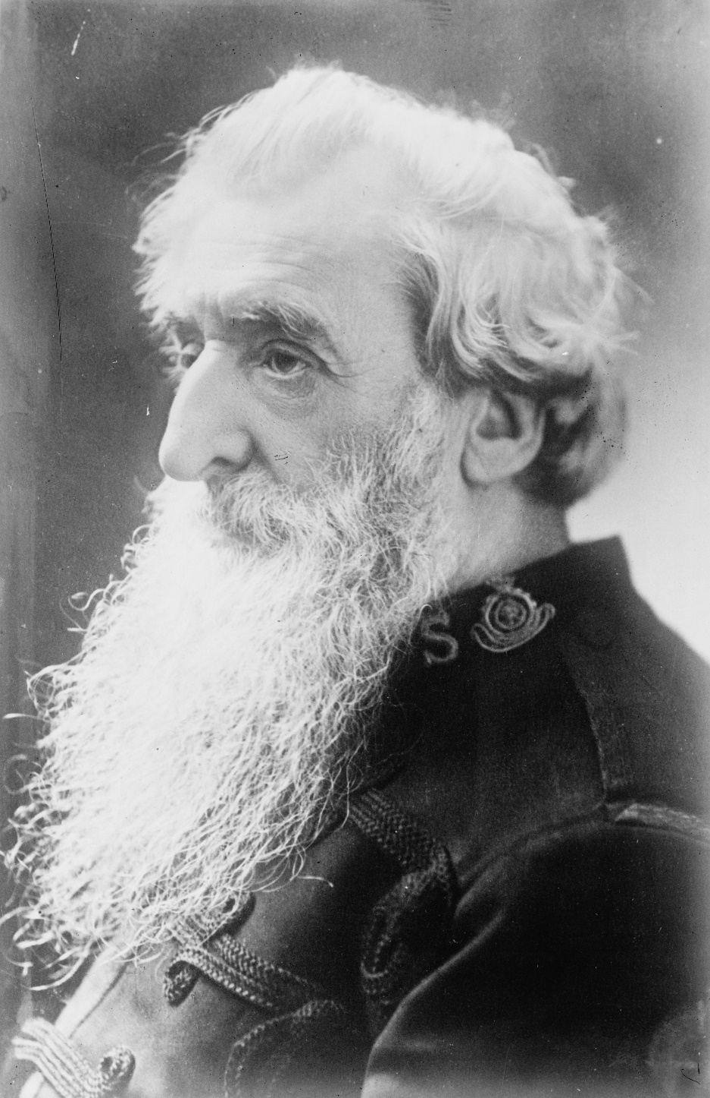
Prisons
​​​​From its earliest days The Salvation Army has been working in prisons.
While men go to prison, in and out, in and out, as they do now, I’ll fight!
Prisons: Why work in prisons?
Debt Advice

Slide 4
Prisons
The Salvation Army also runs CAMEO (Come And Meet Each Other) groups. These typically target elderly prisoners, who are the fastest growing prison demographic. CAMEO is a space for positive transformation, extended learning, and safe community.
The Salvation Army’s prison work is inspired by the words of Jesus when he said, ‘When I was in prison, you came to visit me’.
Chaplains also support prison staff, who work tirelessly in a particularly challenging environment.
Believing that the love of God is unconditional, Salvation Army chaplains come alongside prisoners in Christ’s name in a ministry of practical, non-judgemental caring.
Prisons: Supporting people in prisons
Debt Advice
Notes:
The Salvation Army’s prison work is inspired by the words of Jesus when He said, ‘When I was in prison, you came to visit me’.
Believing that the love of God is unconditional, Salvation Army chaplains come alongside prisoners in Christ’s name in a ministry of practical, non-judgemental caring.
Chaplains also support prison staff, who work tirelessly in a particularly challenging environment.
The Salvation Army also runs CAMEO, ‘Come And Meet Each Other’, groups in a few prisons. These typically target elderly prisoners, who are the fastest growing prison demographic. CAMEO is a space for positive transformation, extended learning, and safe community.

Slide 5
Pandemic in prison
During the pandemic, many people likened lockdown to being in prison, but what about those who were actually in prison?
Would anything have changed?
How might they have been affected?
Prisons: Pandemic in prison
Debt Advice
Notes:
Staffing levels were also an issue, as prison officers would have to shield or self-isolate – one of our Chaplains told me that at one time, there were 150 staff members off work!
“From mid-March 2020 until around February 2021 almost all people in prison in the UK spent 23 hours or more out of every day locked in a cell, typically around 3m by 2m in size. Two-thirds of them have been in conditions that amount to solitary confinement, the other third are sharing a cell, or in dormitory accommodation.” (Prison-the-facts-2022.pdf (prisonreformtrust.org.uk)
Two quotes from prisoners from a gov inquiry: “Covid-19 means all of us are to one extent or another emotionally scarred.” And from another “at weekends we could be in this solitary confinement for 60 hours at a time” (Mental Health in Prison (parliament.uk)).
It is important to know that people in prison generally have worse mental and physical health than people in the community (https://www.rcplondon.ac.uk/news/behind-bars-poor-health-prison-communityCOVID).
It has been particularly difficult to maintain family ties – visits were cancelled for a long time and although ‘Purple visits’ (video visits) have been rolled out across the estate, they of course couldn’t replace real life contact.
Chaplains reported a higher demand for bereavement support, as many prisoners (and members of staff) experienced loss.
Many prisoners due to be released were terrified of returning to the outside world under such unfamiliar circumstances, particularly those who had been in prison for a long period of time.
Prisoners and staff both struggled with anxieties around safety, uncertainty and worrying about their families.

Slide 6
Jesus said to them, ‘It is not the healthy who need a doctor, but the sick. I have not come to call the righteous, but sinners’
MARK 2:17
People in prison don’t deserve help.
Prisons: Friend or foe?
Debt Advice

Slide 7
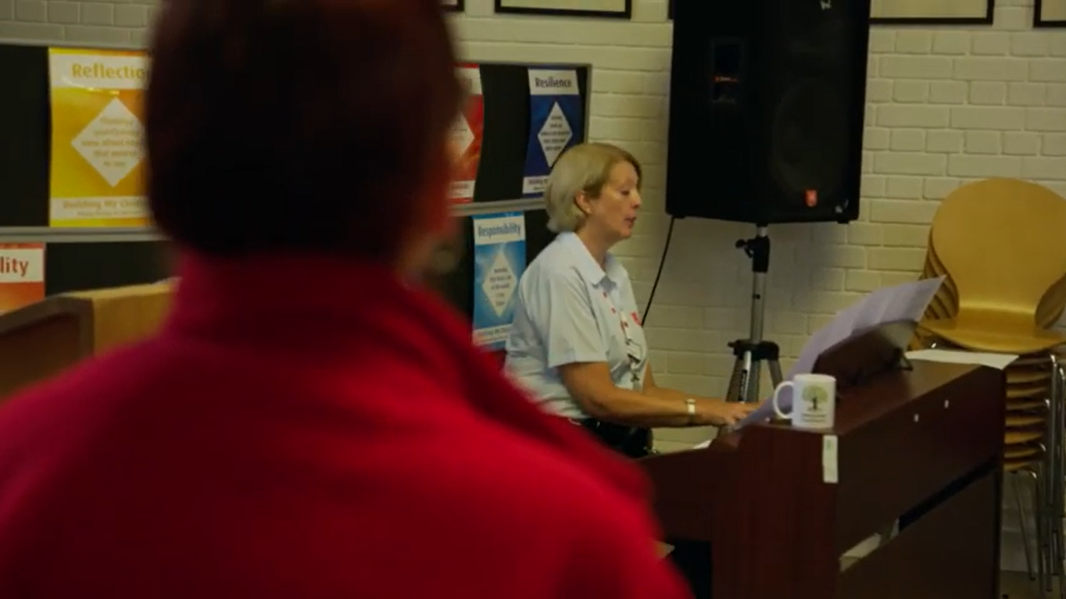
Prison chaplains
Prisons: Prison chaplain video
Debt Advice
Notes:
Only first 3mins 40secs

Slide 8
Prison chaplains
Love to those deemed unlovable…
‘within these walls, we experience some of the worst human consequences of a broken world’. However, within those walls there is also a precious and unique opportunity to reach those often unreachable; to give a message of hope to the hopeless; and to show love to those deemed unlovable.’
It was a privilege to hear his story...
‘There was a man who came over to spend some time in chapel as it was the one year anniversary of his 18 month old daughter’s death. We were able to talk around issues of forgiveness, anger, his grieving. It was a privilege to just sit down and hear his story. He took away daily reading books and a leaflet about living with loss.’
Prisons: Prison chaplains
Debt Advice

Slide 9
No judgment
You spot someone:
Picking their nose
Stealing sweets
Chewing with their mouth open
Getting a pineapple pizza
Littering
Stealing nappies
Addicted to drugs
Prisons: No judgement
Debt Advice
Notes:
When we think about

Slide 10
What else would you like to know?
How?
Where?
Why?
When?
What?
Prisons: Questions
Debt Advice

