Slide 1
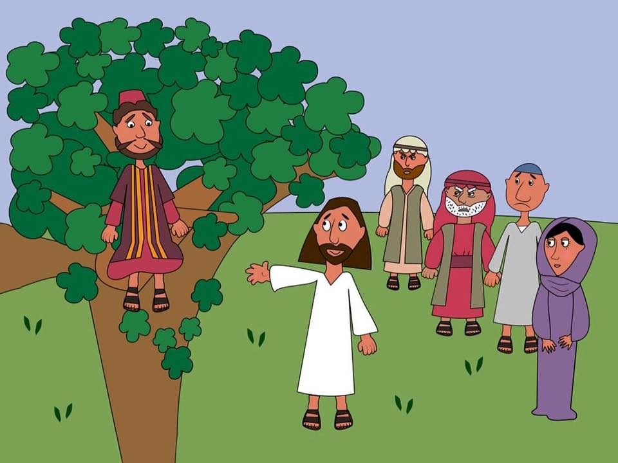
All
Welcome
one
All
National Month of Prayer for
Toddler Groups
JUNE 2023

Slide 2
Our Father God…
Thank you for Christian parent-and-toddler groups and for the leaders and volunteers who help to run them. I pray they will be safe spaces for families to come and learn more about you and your love for them. Amen.
I commit to praying for toddler groups during the month of June 2023
………………………………………………………………………..
Registered charity number in England and Wales 214779, in Scotland SC009359 and in the Republic of Ireland CHY6399

