Slide 1

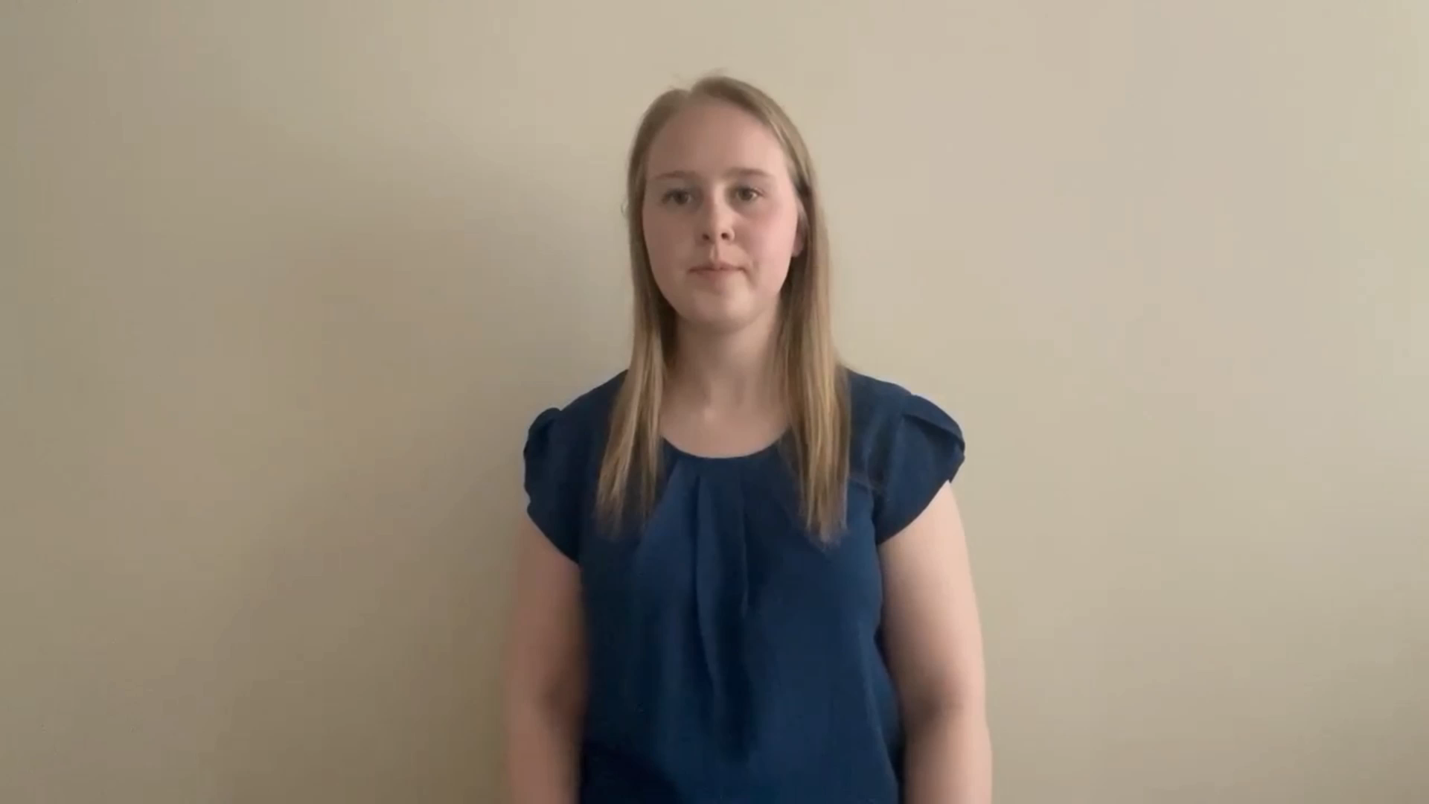
Katie Sephton – Castleford Salvation Army
‘I praise you because you made me in an amazing and wonderful way.
What you have done is wonderful.
I know this very well.’
( Psalm 139:14 ICB)

