Slide 1
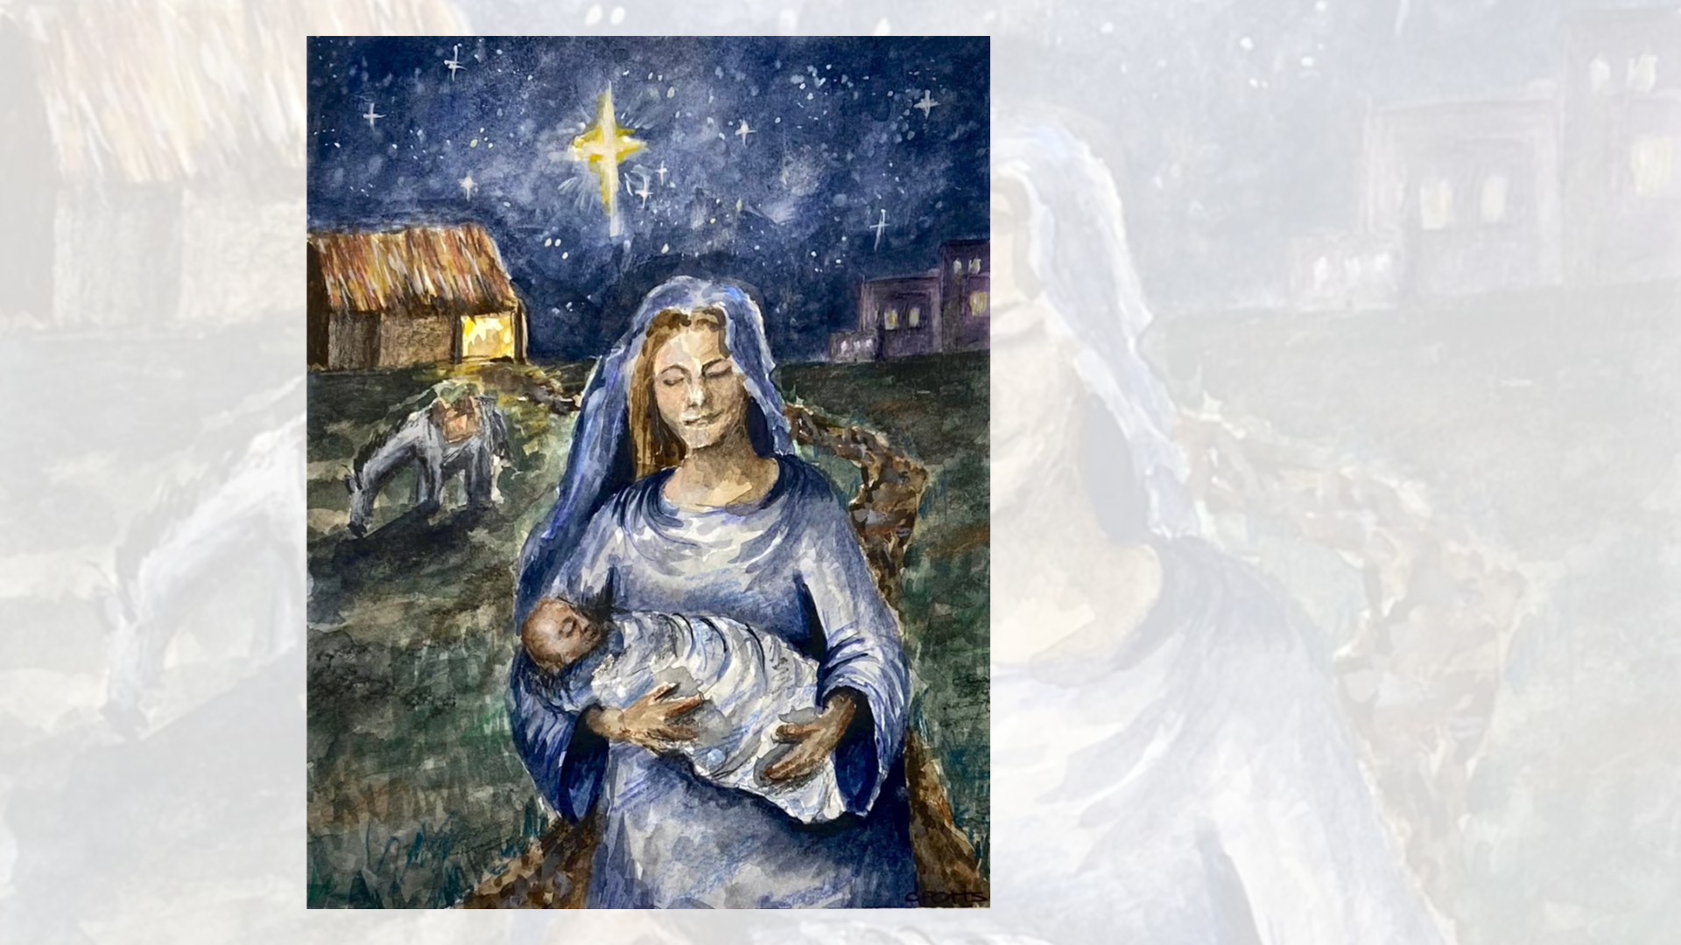

Slide 2
Stop

Slide 3
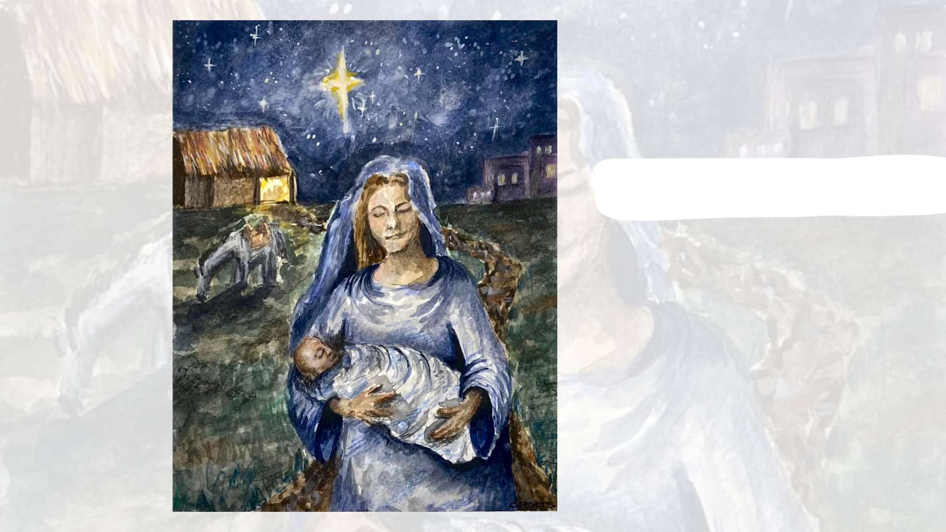
Stop
Read

Slide 4
Stop
Read
Reflect

Slide 5
Stop
Read
Reflect
Respond

