Slide 1
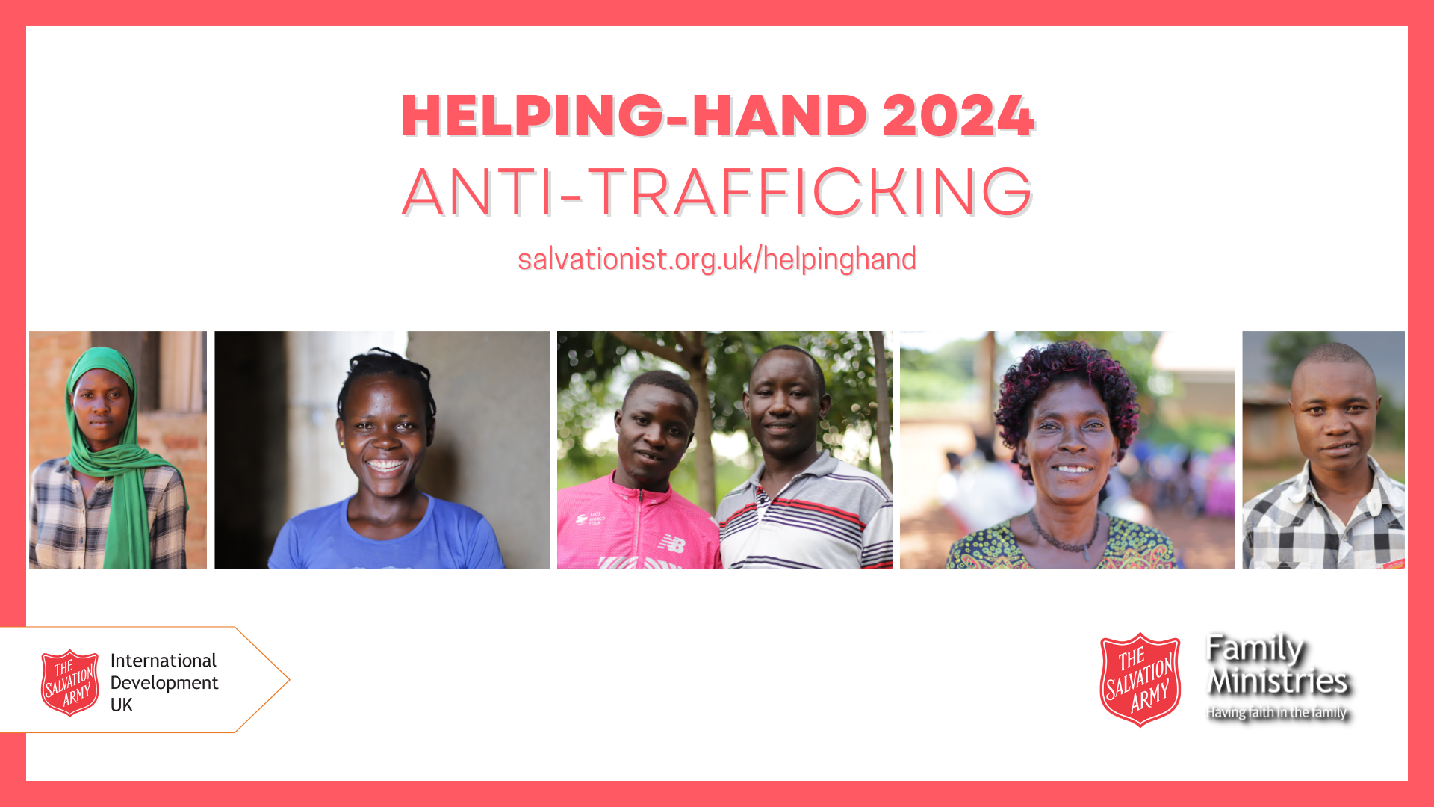
Notes:
Leaders notes: Human trafficking is a crime which impacts people all over the world. Traffickers often target those who are already vulnerable, socially isolated or simply in need of work.
Often, it is the promise of a better life, or the chance to earn money which lures people away from the safety of the places they know and the people they love.

Slide 2
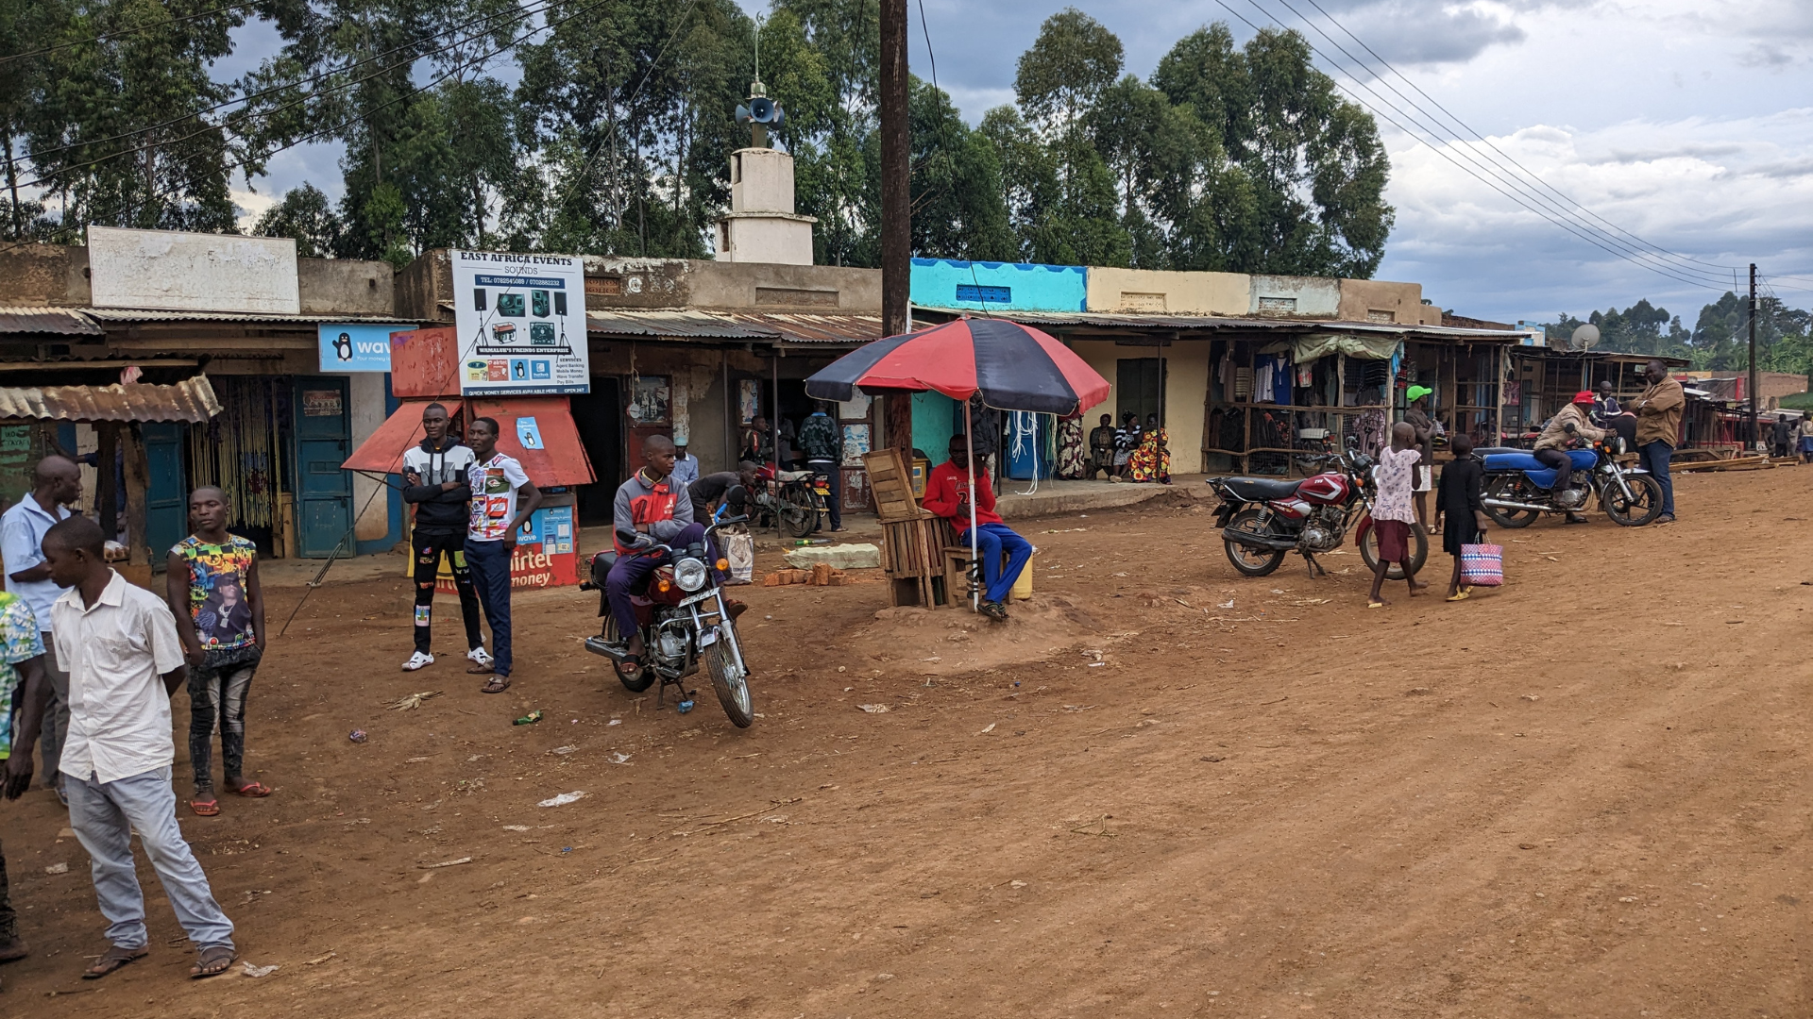
Notes:
In the towns and villages in eastern Uganda it can be hard to earn enough to make ends meet. Traffickers trick people with their lies and false promises. They exploit the porous border with Kenya - and without the proper paperwork, the people who travel with them, become powerless.

Slide 3
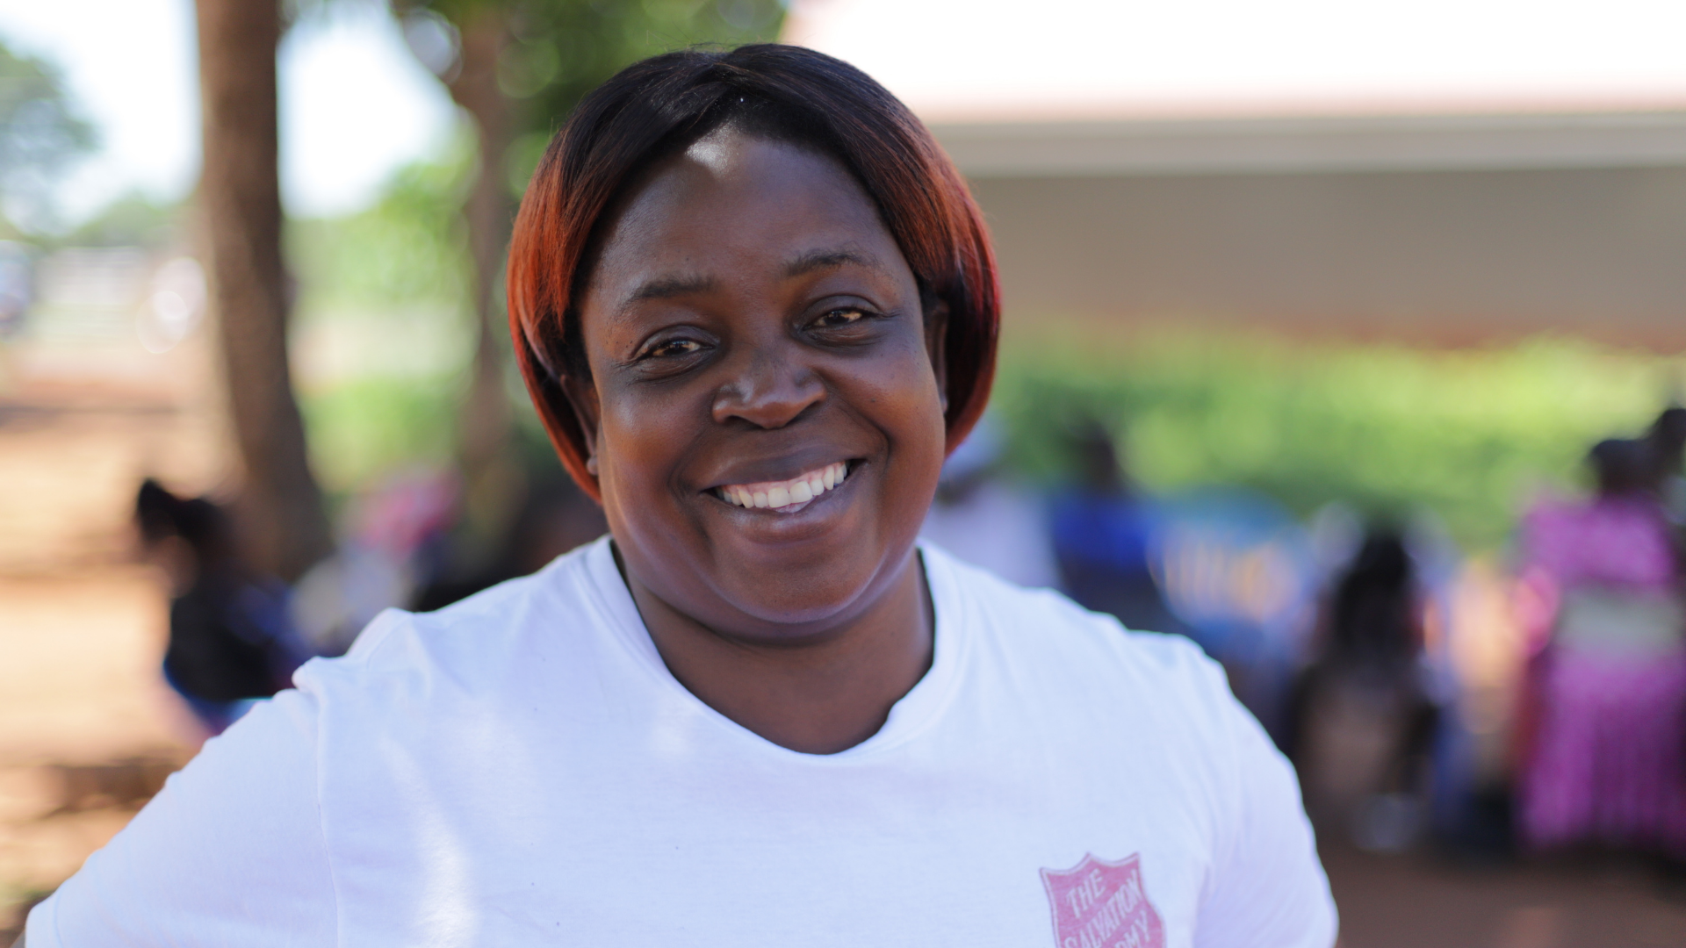
Notes:
Through prevention, protection and partnership, The Salvation Army is working alongside communities to bring human trafficking to an end.

Slide 4
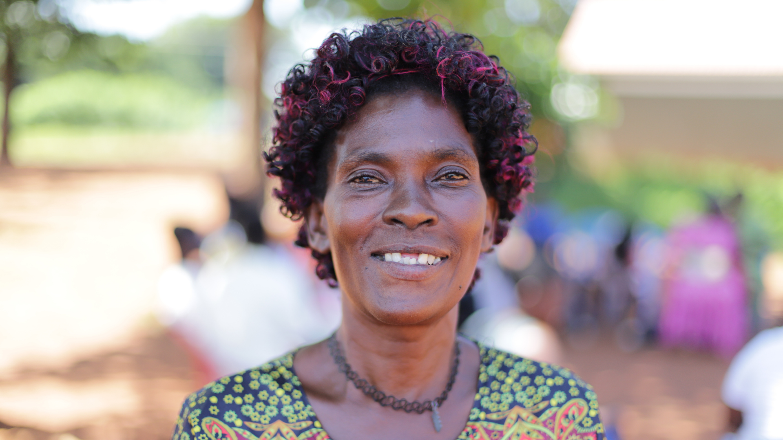
Notes:
They are supporting survivors who’ve returned home…

Slide 5
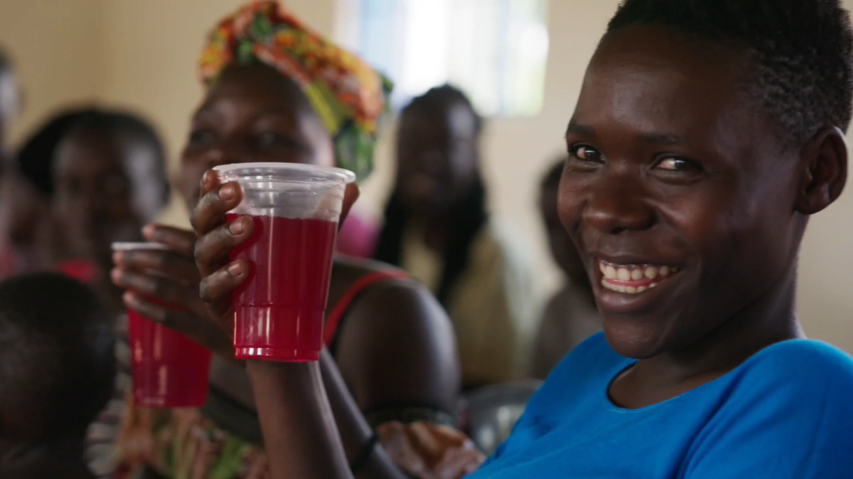
Notes:
helping to strengthen resilience through income generation projects and savings and loans schemes…

Slide 6
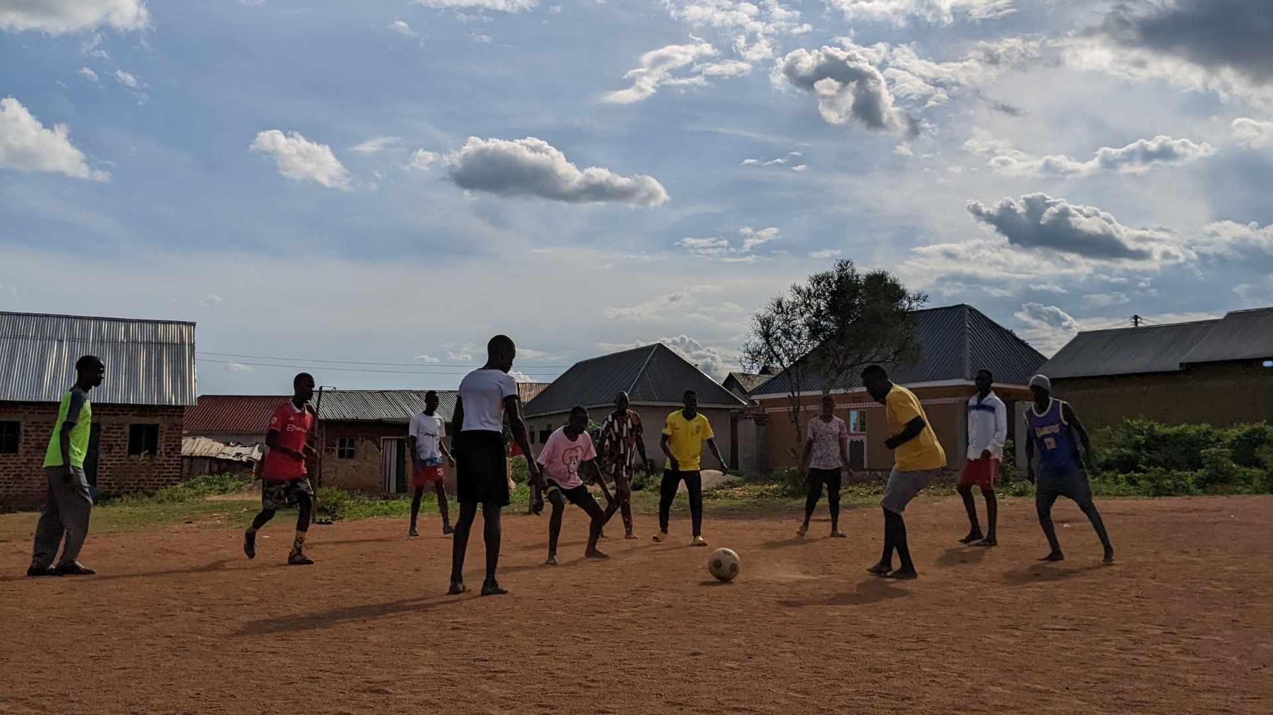
Notes:
and mobilising communities to protect themselves.

Slide 7
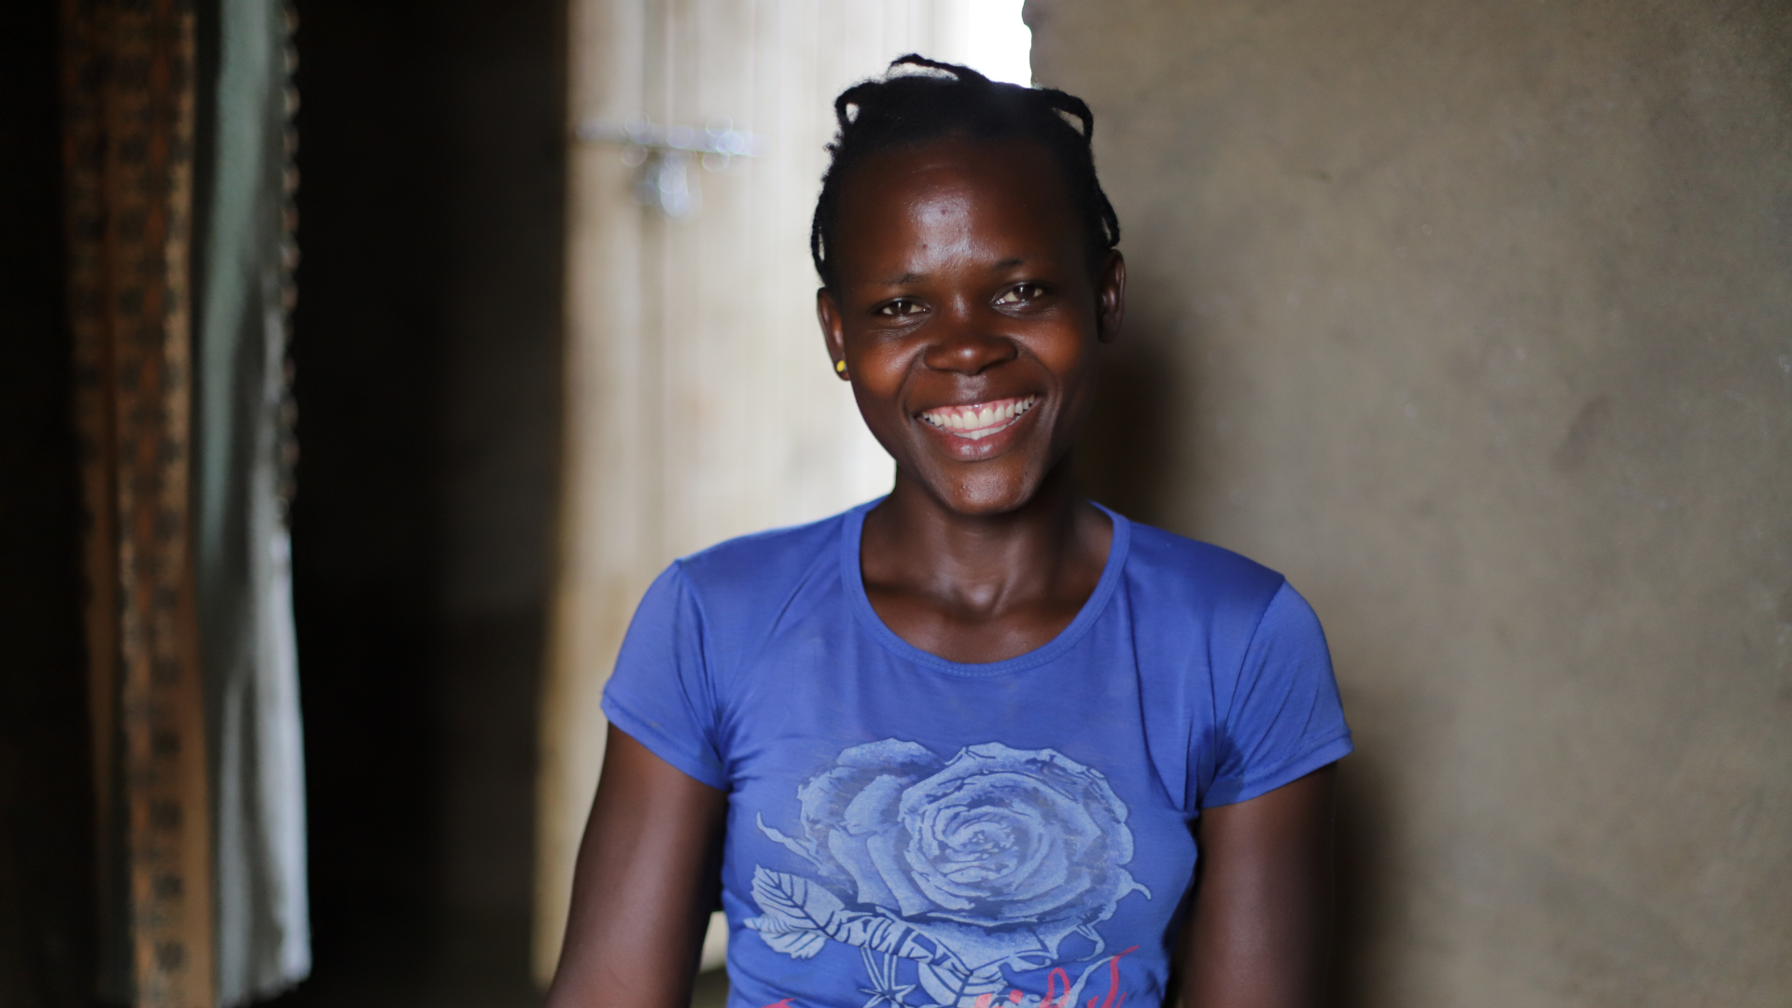
Notes:
We can all play a part in bringing an end to human trafficking.
Together, we can raise awareness…

Slide 8
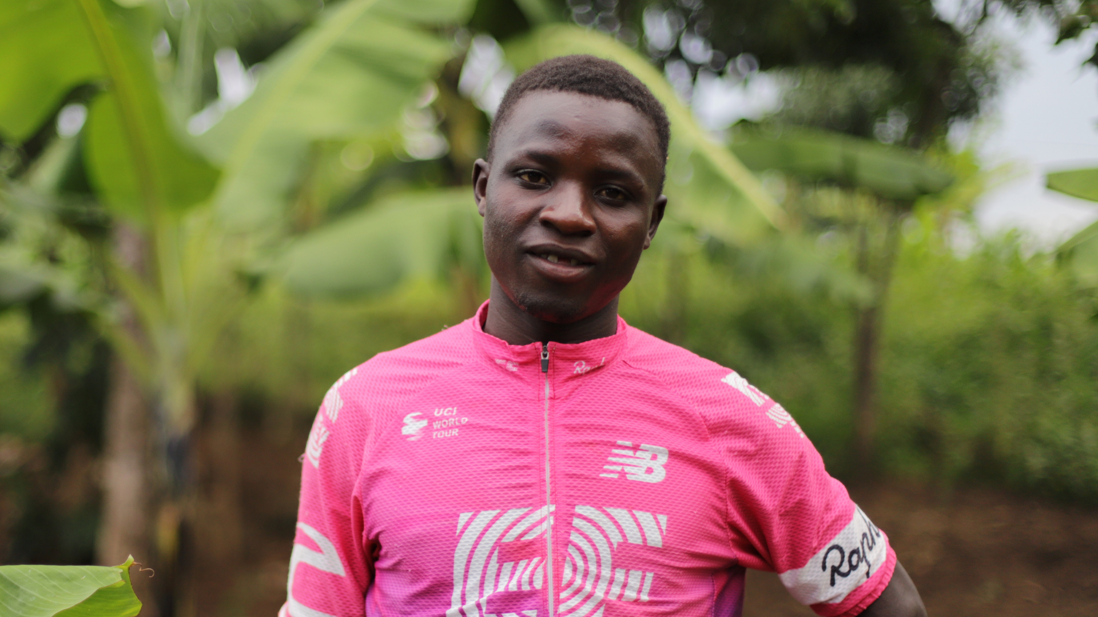
Notes:
Together, we can support survivors.

Slide 9
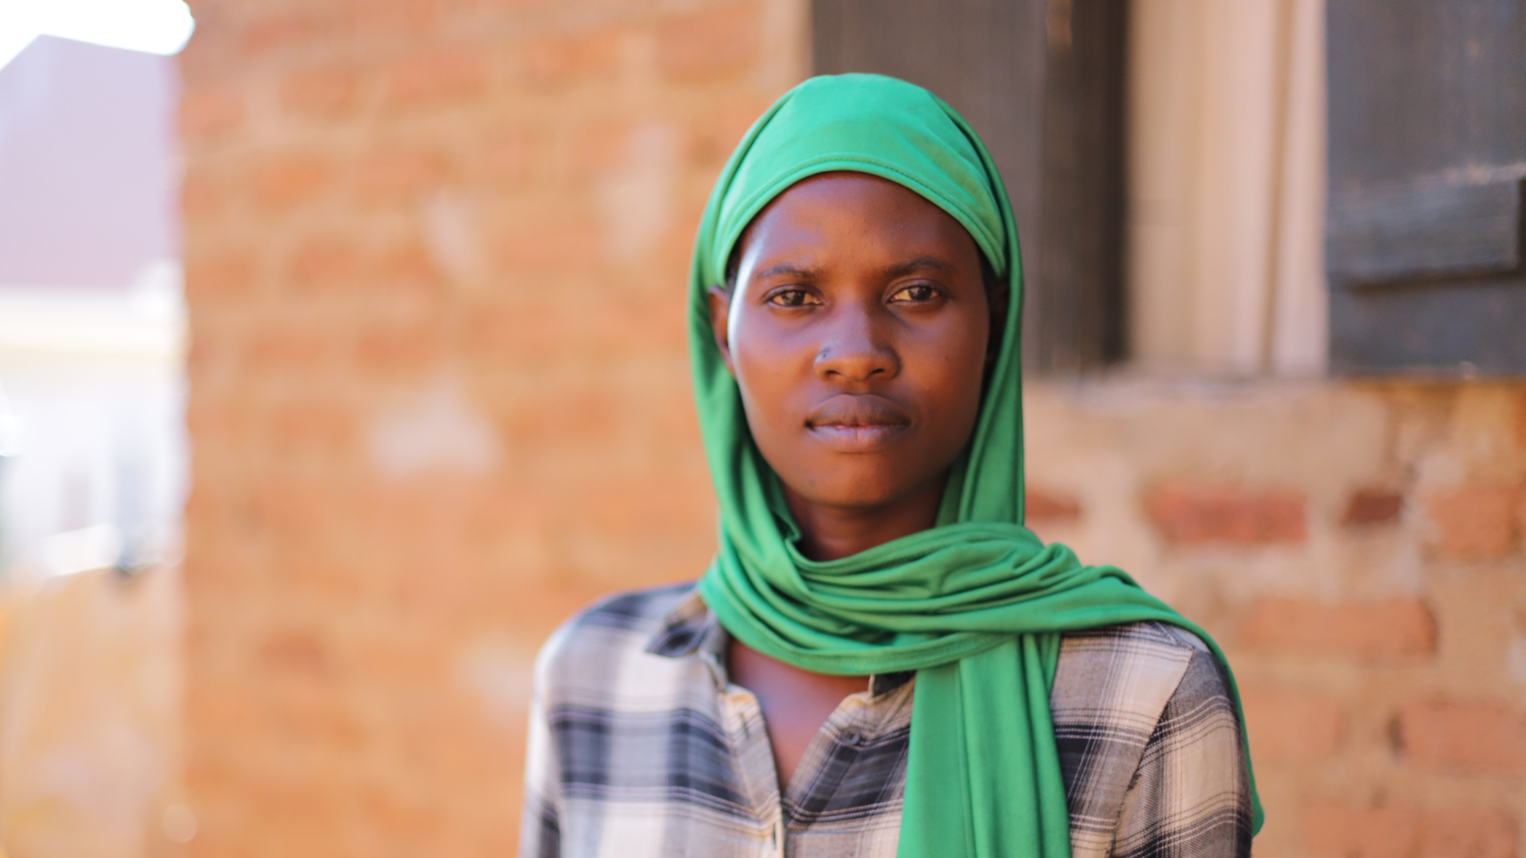
Notes:
Together, we can strengthen resilience.

Slide 10
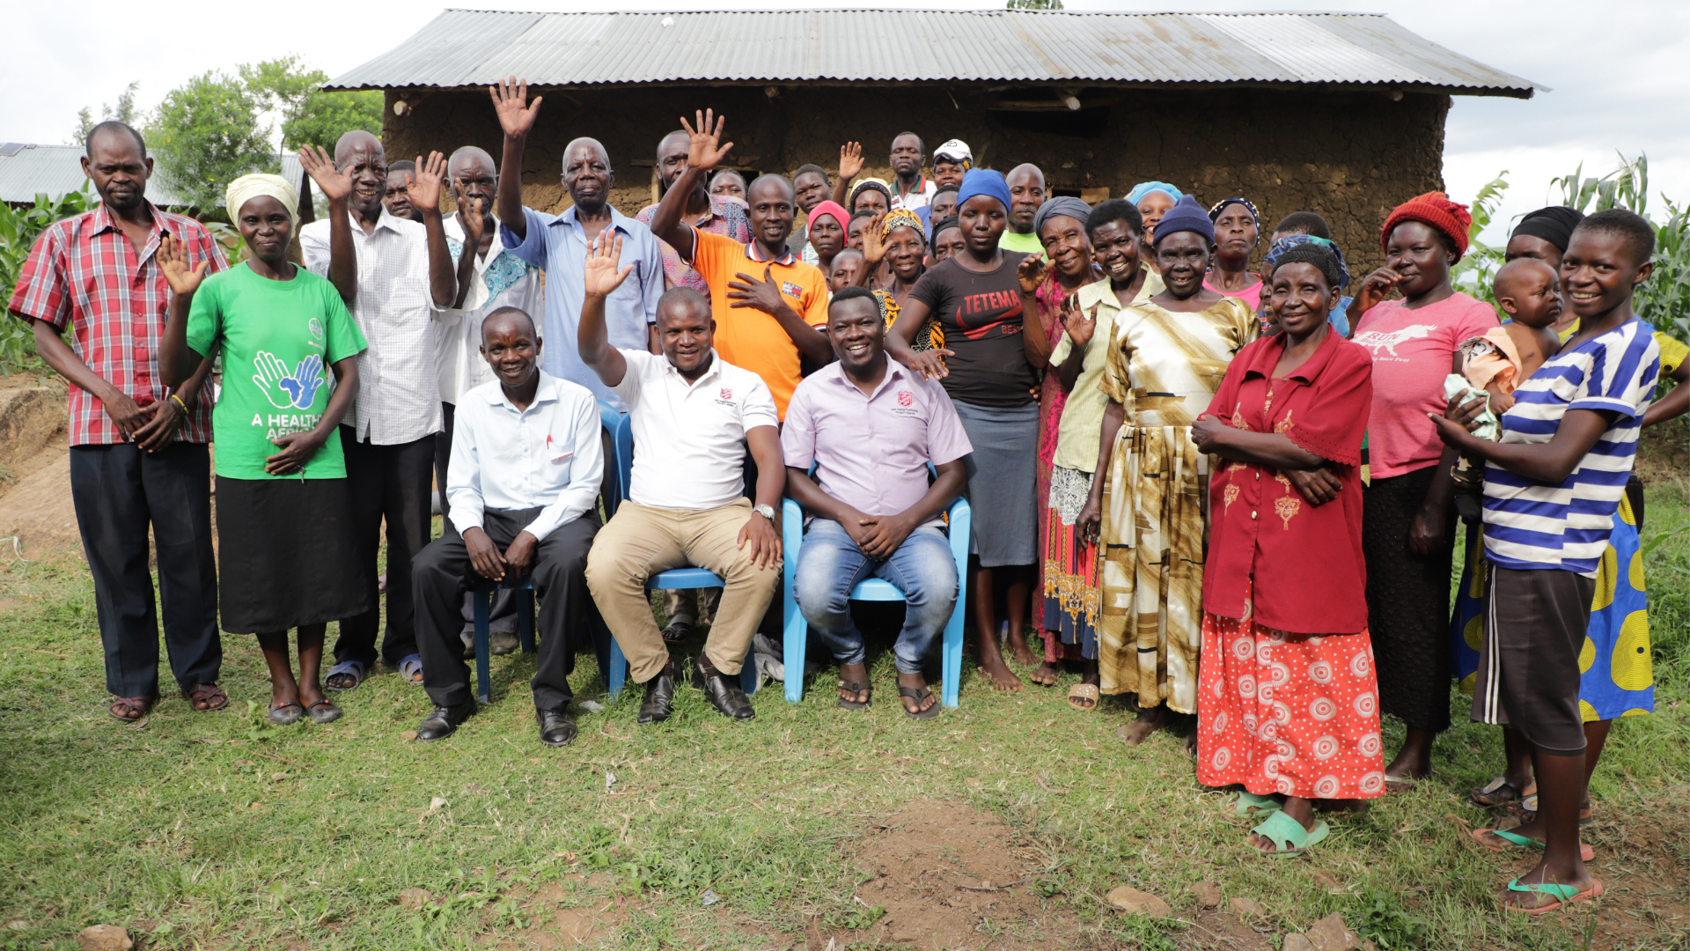
Notes:
Together, we can stop human trafficking!

Slide 11
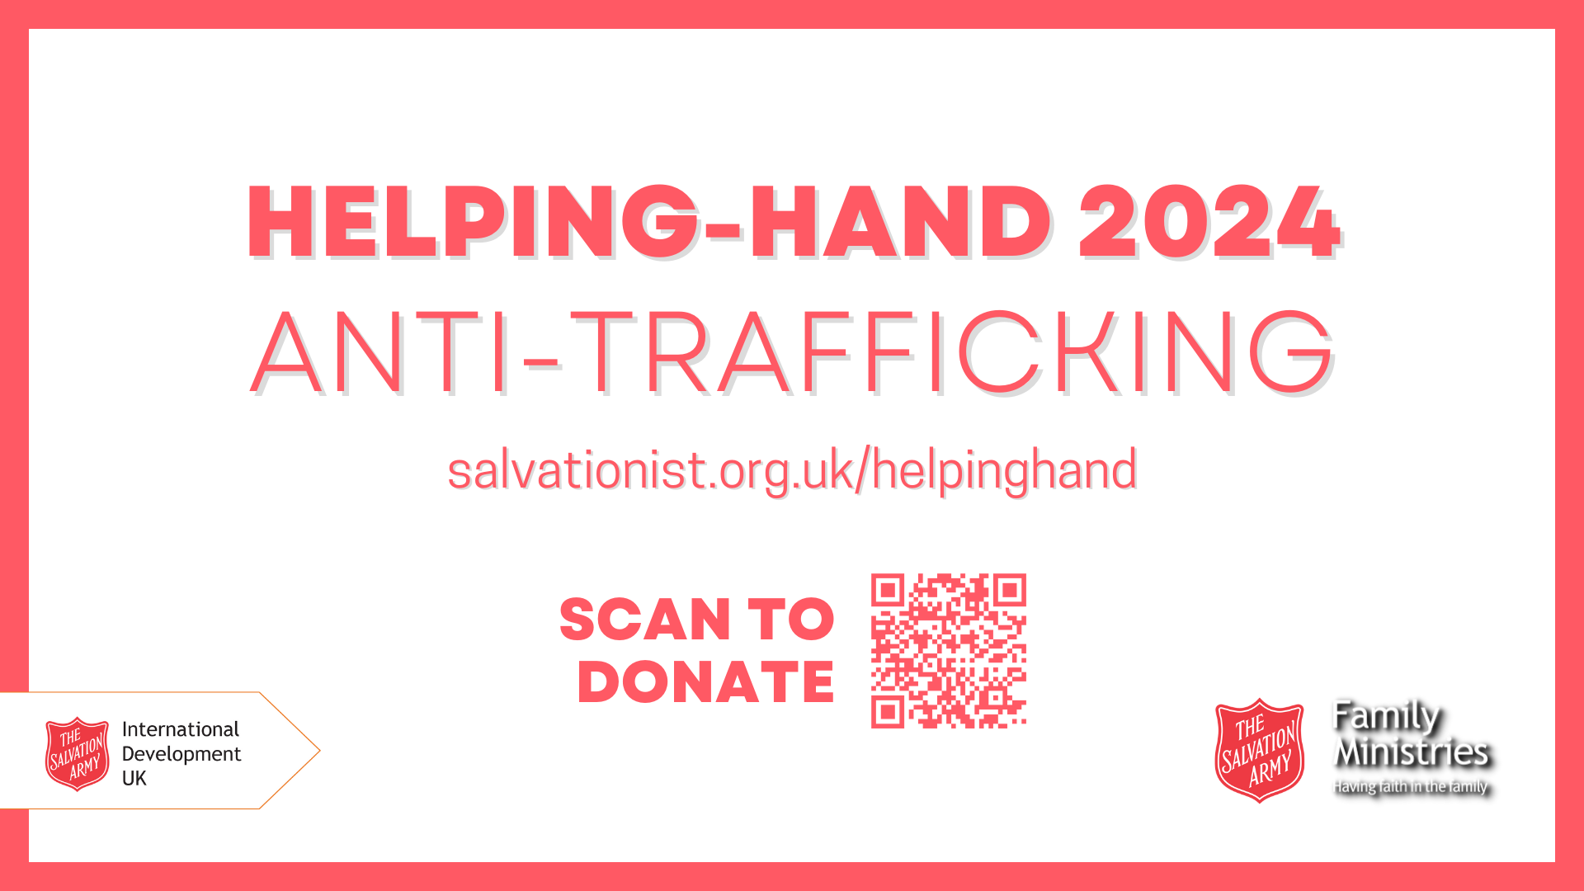
Notes:
If you would like to support the Helping-Hand Appeal, please make a donation:
Online at www.salvationist.org.uk/helpinghand
By scanning the QR code
By giving cash to your local Salvation Army corps

