Slide 1
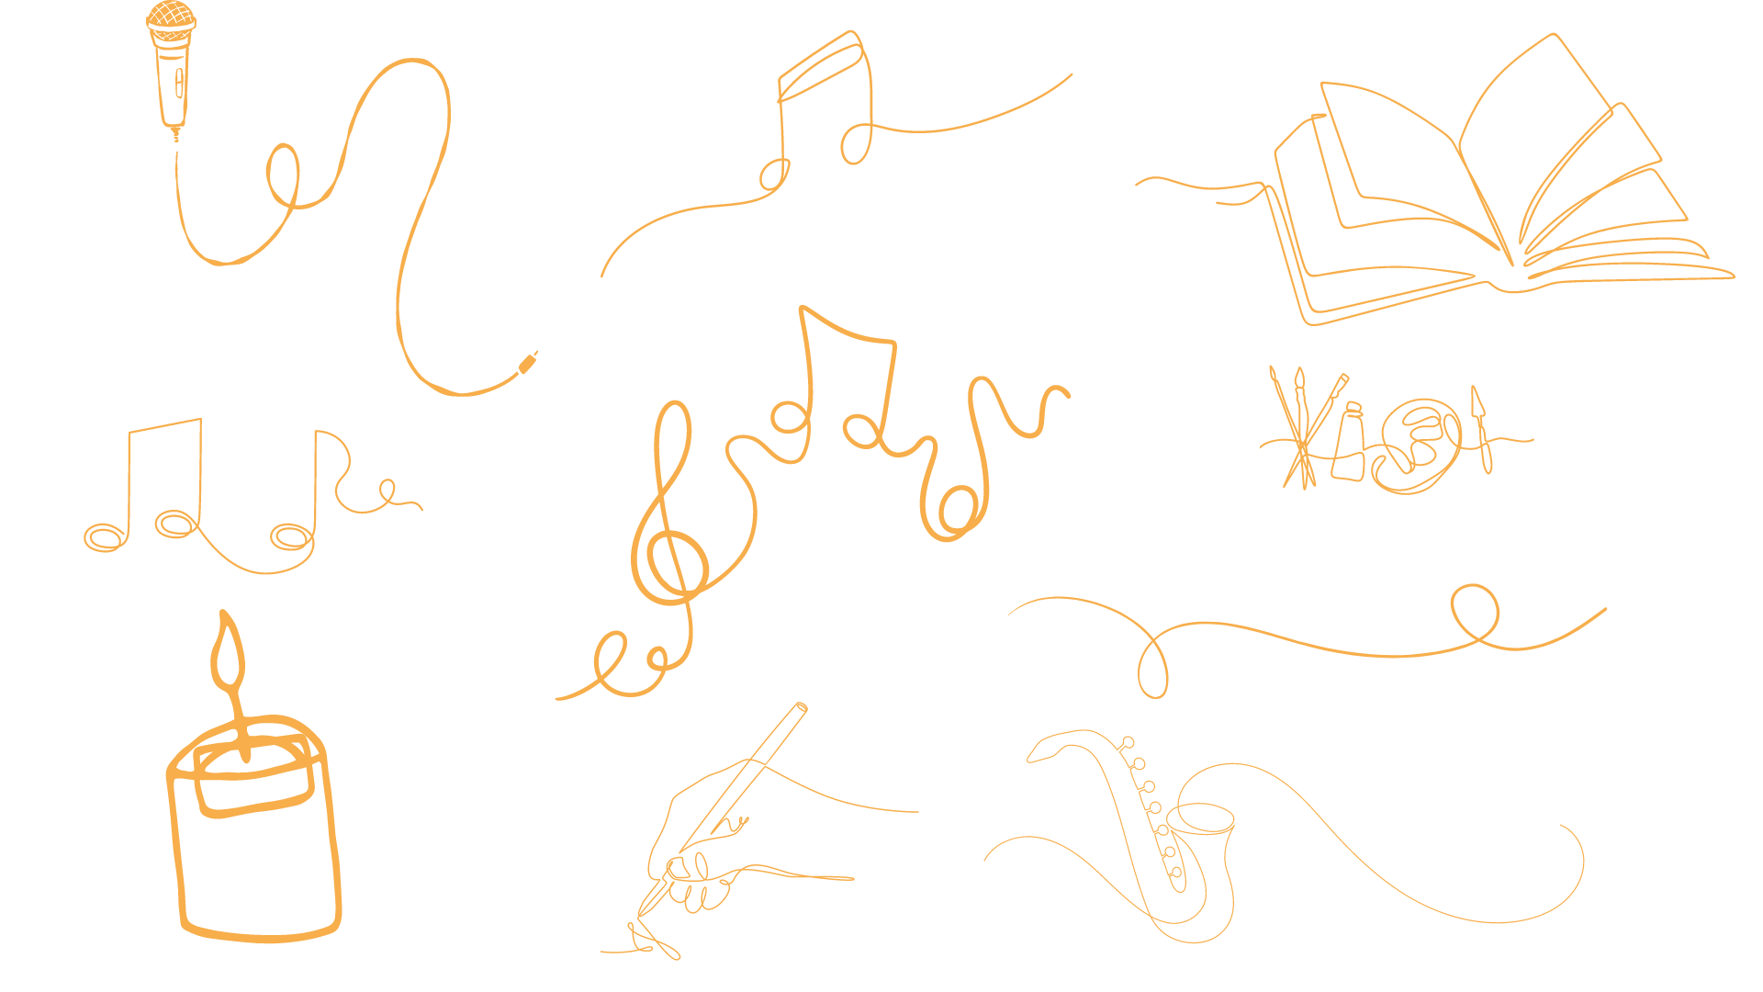


Slide 2
‘But you, O Bethlehem Ephrathah, are only a small village among all the people of Judah.
Yet a ruler of Israel, whose origins are in the distant past, will come from you on my behalf’
Micah 5 : 2, 4 – 5 (NLT)

Slide 3
‘And he will stand to lead his flock with the Lord’s strength, in the majesty of the name of the Lord his God.
Then his people will live there undisturbed, for he will be highly honoured around the world. And he will be the source of peace.’
Micah 5 : 2, 4 – 5 (NLT)

Slide 5
O little town of Bethlehem,
How still we see thee lie!
Above thy deep and dreamless sleep
The silent stars go by.
Yet in thy dark streets shineth
The everlasting light;
The hopes and fears of all the years
Are met in thee tonight.

Slide 6
O morning stars, together
Proclaim the holy birth,
And praises sing to God, the King,
And peace to men on earth.
For Christ is born of Mary;
And, gathered all above,
While mortals sleep, the angels keep
Their watch of wondering love.

Slide 7
How silently, how silently
The wondrous gift is given!
So God imparts to human hearts
The blessings of his Heaven.
No ear may hear his coming;
But in this world of sin,
Where meek souls will receive him, still
The dear Christ enters in.

Slide 8
O holy Child of Bethlehem,
Descend to us, we pray;
Cast out our sin and enter in,
Be born in us today.
We hear the Christmas angels
The great glad tidings tell;
O come to us, abide with us,
Our Lord Immanuel.

Slide 9
Is there stardust among the hay?
Are there angels singing in the corners of the sky?
Is there a glint of polished halos in the sunlight?
Not yet, not yet …
‘Nearly’ by Roddy Hamilton

Slide 10
Are the hungry seated round the tables of the rich?
Are the homeless settled in a stable with others?
Are the powerful worriedly pacing their corridors of power?
Nearly, nearly …
‘Nearly’ by Roddy Hamilton

Slide 11
Is the journey joined?
Is Heaven preparing?
Is Incarnation ready?
Just about, just about …
‘Nearly’ by Roddy Hamilton

Slide 12
Welcome to the fading minutes of the waiting time,
The last of darkening nights;
And know the light will begin to stretch the days once more, for God is on the way.
It’s time to hold your breath and start the rumour.
Soon and very soon God is here – Immanuel
‘Nearly’ by Roddy Hamilton

Slide 14
O come, O come, Immanuel,
And ransom captive Israel
That mourns in lonely exile here
Until the Son of God appear.
Rejoice, rejoice!
Immanuel shall come to thee, O Israel.

Slide 15
O come, O come, thou Lord of might,
Who to thy tribes, on Sinai’s height,
In ancient times didst give the law
In cloud and majesty and awe:
Rejoice, rejoice!
Immanuel shall come to thee, O Israel.

Slide 16
O come, thou Rod of Jesse, free
Thine own from Satan’s tyranny;
From depths of Hell thy people save
And give them victory o’er the grave:
Rejoice, rejoice!
Immanuel shall come to thee, O Israel.

Slide 17
O come, thou Dayspring, come and cheer
Our spirits by thine advent here;
Disperse the gloomy clouds of night,
And death’s dark shadows put to flight:
Rejoice, rejoice!
Immanuel shall come to thee, O Israel.

Slide 18
O come, thou Key of David, come
And open wide our heavenly Home;
Make safe the way that leads on high
And close the path to misery.
Rejoice, rejoice!
Immanuel shall come to thee, O Israel.

Slide 19
How long must we go on walking in the dark,
Every step a stretch of hope,
Reaching for the revelation?

Slide 20
How long must we bear the weight
Of our lingering longings and anxious achings,
Lying in wait for the dry bones to rise?

Slide 21
How long must we be held captive,
A lonely exhale our ransom cry
To punctuate an unfinished sentence?

Slide 22
How long must we sing this song,
Our voices cracked with broken hallelujahs,
A holy harmony of hope in a minor key?

Slide 23
How long must we wait before the dawn?
Not long.
It’s not light yet, but it’s getting there.

Slide 25

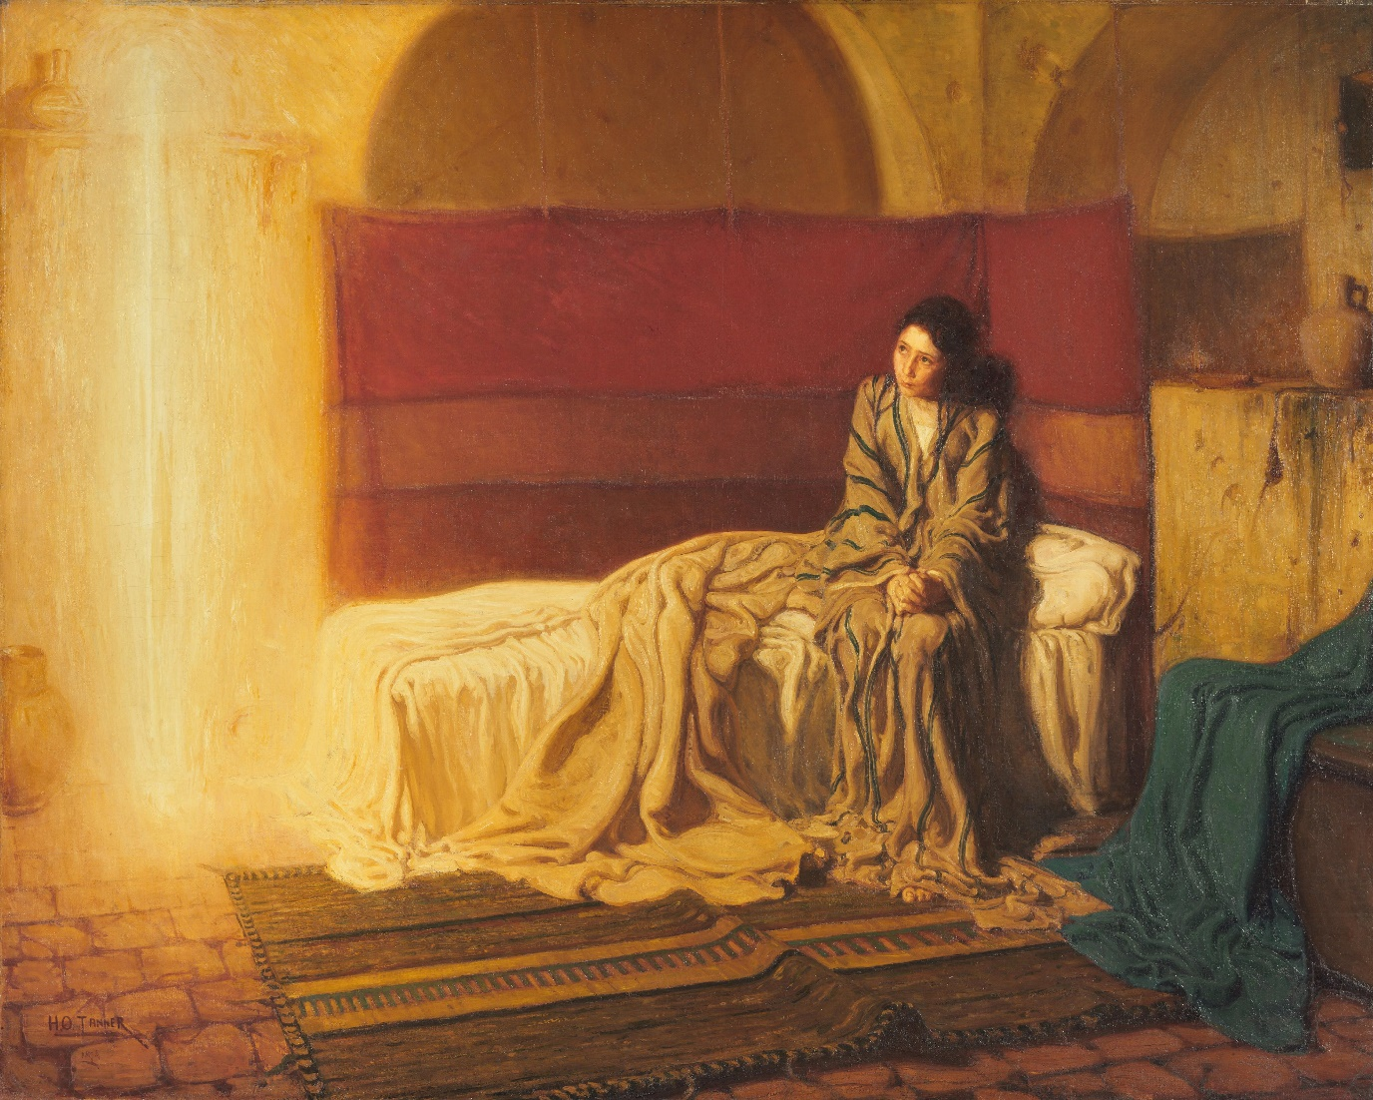
The Annunciation
by Henry Ossawa Tanner
Notes:
Suggested background music (all links are to Spotify):
Sheku Kanneh-Mason – ‘Gabriel’s Message’
Gungor – ‘Let there be’
Grace Eun Hee Kim – ‘To a maid engaged to Joseph’

Slide 26
He will come like last leaf’s fall.
One night when the
November wind has flayed the trees to the bone, and earth wakes choking on the mould, the soft shroud’s folding.
‘Advent Calendar’ by Rowan Williams (Collected Poems, 2021) is reprinted by permission of Carcanet Press, UK.

Slide 27
He will come like frost.
One morning when the shrinking earth opens on mist, to find itself arrested in the net of alien, sword-set beauty.
‘Advent Calendar’ by Rowan Williams (Collected Poems, 2021) is reprinted by permission of Carcanet Press, UK.

Slide 28
He will come like dark.
One evening when the bursting red
December sun draws up the sheet and penny-masks its eye to yield the star-snowed fields of sky.
‘Advent Calendar’ by Rowan Williams (Collected Poems, 2021) is reprinted by permission of Carcanet Press, UK.

Slide 29
He will come, will come, will come like crying in the night, like blood, like breaking, as the earth writhes to toss him free.
He will come like child.
‘Advent Calendar’ by Rowan Williams (Collected Poems, 2021) is reprinted by permission of Carcanet Press, UK.

Slide 31
In the bleak midwinter
Frosty wind made moan,
Earth stood hard as iron,
Water like a stone;
Snow had fallen, snow on snow,
Snow on snow,
In the bleak midwinter,
Long ago.

Slide 32
Our God, Heaven cannot hold him,
Nor earth sustain;
Heaven and earth shall flee away
When he comes to reign:
In the bleak midwinter
A stable-place sufficed
The Lord God Almighty,
Jesus Christ.

Slide 33
Angels and archangels
May have gathered there,
Cherubim and seraphim
Thronged the air;
But only his mother
In her maiden bliss
Worshipped the beloved
With a kiss.

Slide 34
What can I give him,
Poor as I am?
If I were a shepherd
I would bring a lamb;
If I were a wise man
I would do my part;
Yet what I can, I give him:
Give my heart.

Slide 35
‘For all of creation is waiting, yearning for the time when the children of God will be revealed. You see, all of creation has collapsed into emptiness, not by its own choosing, but by God’s.
Romans 8 : 19 – 22
(VOICE TRANSLATION)

Slide 36
Still he placed within it a deep and abiding hope that creation would one day be liberated from its slavery to corruption and experience the glorious freedom of the children of God. For we know that all creation groans in unison with birthing pains up until now.’
Romans 8 : 19 – 22
(VOICE TRANSLATION)

Slide 37
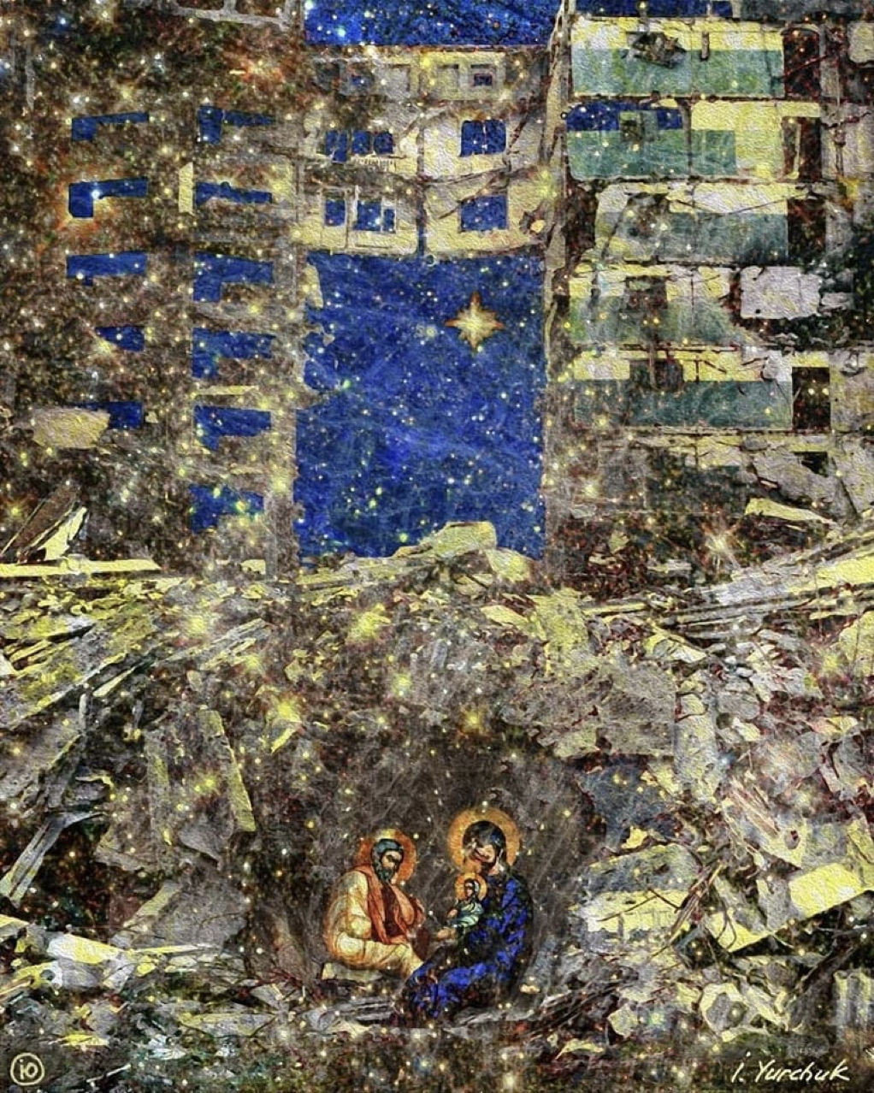
Nativity
by Irenaeus Yurchuk
Notes:
Suggested music (all links are to Spotify):
Amy Grant – ‘Breath of Heaven’ (?)
Over the Rhine – ‘The Trumpet Child’
Alana Levandoski – ‘Behold, I make all things new’ (Alpha)
Lauren Daigle – ‘Light of the World’ – Behold Version
Brittany Hope – ‘Glory in the darkest place’

Slide 38
All creation holds its breath,
A pregnant pause
Before the long-expected light is revealed
In the shape of a God-child.

Slide 39
All Heaven holds its breath,
Waiting in the wings
Before hope is hosted
On hilltops and in hearts
In the shape of a choir of angels.

Slide 40
New parents hold their breath,
Listening for that first cry
Before peace on earth is nurtured
In the shape of sleepless nights.

Slide 41
All of the Godhead holds its breath,
Hovering over the waters
Before exclaiming life
In the shape of everlasting light.

Slide 43
‘The world is waiting. We are in a world pregnant with hope, and we live in the expectation of the coming of God’s Kingdom on earth. As we wait, we also work, cry, pray, and ache; we are the midwives of another world.’
Shane Claiborne

Slide 45
In this light, a call to remember
Those whose lives illumined our own.
King of kings and Lord of lords;
Your light of comfort show,
Your light of comfort show.

Slide 46
By this light, your world finds redemption,
Lives in darkness, fear and despair.
King of kings and Lord of lords;
This light of hope we share,
This light of hope we share.

Slide 47
In this light, the Christ comes with promise;
Hope, joy, love and peace in a babe.
King of kings and Lord of lords;
Be born in us again,
Be born in us again.

Slide 48
A light is dawning –
It’s on the move
Creeping towards the horizon,
The long shadows finally fading
As the light waits to take centre stage.

Slide 49
A flame is flickering –
Holding out against the darkness,
Holding firm against battering winds
And yet not snuffed out.

Slide 50
A spark is reigniting
Hope in the face of hatred,
Joy amongst the injustices,
Peace for the persecuted.

Slide 51
A glow is radiating
In the face of a child,
A royal beauty bright enough
To take down rulers from their thrones.

Slide 52
A light is dawning
Out of the cosmos,
Breaking through the clouds,
Erasing the shadows –
A visible image of glittering gold,
A vibrant harmony
Where light meets life.

Slide 53
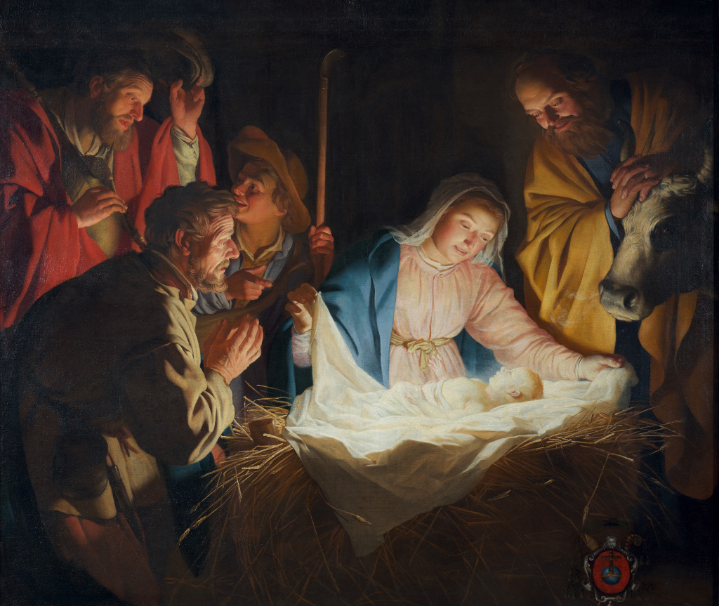
Adoration of the Shepherds
by Gerard van Honthorst
Notes:
Listen to song ‘What Child is This?’ by live musicians or demonstration track

Slide 55
Silent night! Holy night!
All is calm, all is bright
Round the virgin mother and child;
Holy infant, tender and mild,
Rests in heavenly peace.

Slide 56
Silent night! Holy night!
Guiding star, lend thy light.
See, the eastern wise men bring
Gifts and homage to our King,
Jesus Christ is here.

Slide 57
Silent night! Holy night!
Wondrous star, lend thy light.
With the angels let us sing
Hallelujahs to our King,
Jesus Christ is here.

Slide 58
When skin is not enough to contain you and words cannot hold you and religion is too shallow to know you and theology too vague to meet you,
Be born, O Jesus, be born as love among us, for there we meet Immanuel.
‘When Skin is not Enough’ by Roddy Hamilton

Slide 59
When the stable is not big enough and the story too familiar and the season too busy and the time not yet right,
Be born, O Jesus,
Be born as justice among us, for there we meet Immanuel.
‘When Skin is not Enough’ by Roddy Hamilton

Slide 60
When the longing is too great and the waiting too long and the promise too disturbing for our way of living,
Be born, O Jesus,
Be born living among us, for there we meet Immanuel.
‘When Skin is not Enough’ by Roddy Hamilton

