Slide 1
Week One

Slide 2
Insert video here
Notes:
The Self-Denial 2025 videos can be found at https://www.salvationist.org.uk/resources/key-dates/self-denial-resources

Slide 3
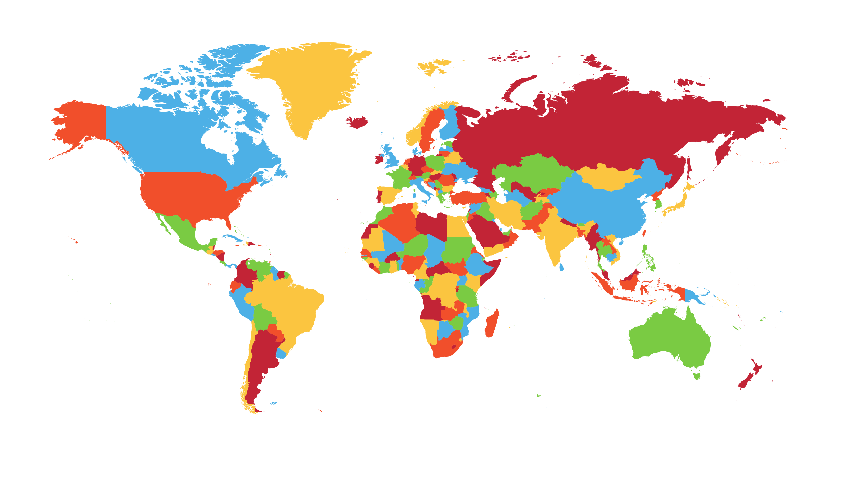
Where is Indonesia?
Notes:
Use a map/globe or the image on screen and ask volunteers to come forward to try and locate Indonesia. The next slide reveals the answer.

Slide 4
Where is Indonesia?
Notes:
Indonesia is the largest country in Southeast Asia (the bright red islands circled) and is made up of over 18,000 islands. Indonesia has a population of around 277.5 million people (2023) making it the fourth most populated country in the world.

Slide 5
Looking back at Self-Denial 2024
Heavenly Father,
As the Self-Denial appeal for 2025 begins, we remember back to last year’s appeal and continue to pray for the stories and lives we learned about.
Our Self-Denial Appeal last year focussed on supporting officers in territories where they face language, financial and other challenges.
Notes:
After the video, use the written prayer on this slide and the next to reflect on last year's appeal and pray as we start this year’s appeal.

Slide 6
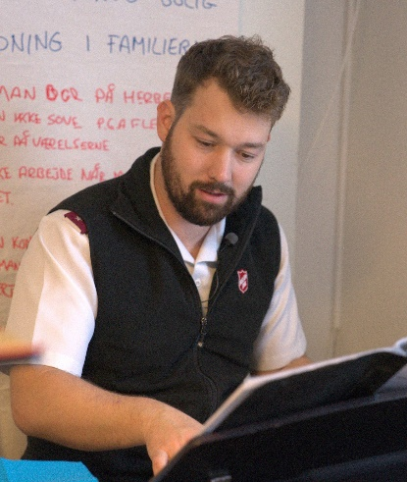
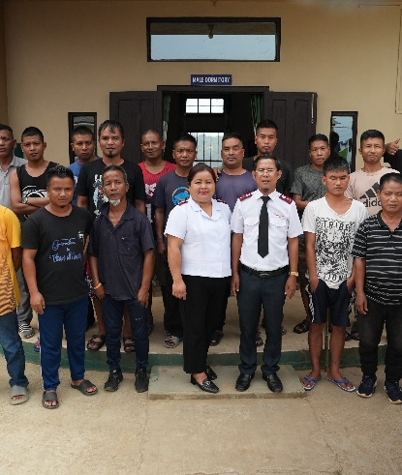
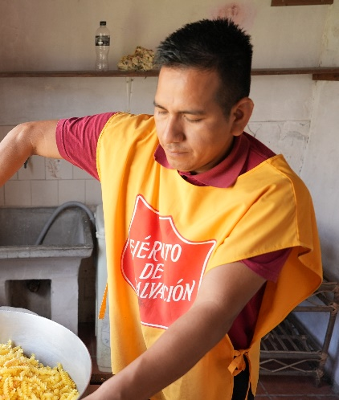
We continue to pray for Captain Nathanael Münch and his family in Greenland’s capital Nuuk.
We continue to pray for Captains Anthony Lalruatfela and Makimi Lalnunkimi in eastern India.
We continue to pray for Lieutenants Kayla and Jose Ortuste in the city of Salto, Uruguay.
May they continue to be rooted in their communities and grow in their faith and service.

Slide 7
Self-Denial Appeal 2025
The Self-Denial Appeal gives us the opportunity to continue growing your mission around the world by giving financially. Lord, help us to recognise the ways in which you have blessed us, and to pass on that blessing by giving generously.
As we learn more about the work of The Salvation Army in Indonesia, help us to understand more about your will for our lives. May we give sacrificially in the knowledge that this money will make a positive impact on individuals around the world.
Lord, continue to bless The Salvation Army and challenge us to remain rooted in our communities and to grow more in faith and service. Amen.

