Slide 1
Week Two

Slide 2
Insert video here
Notes:
The Self-Denial 2025 videos can be found at https://www.salvationist.org.uk/resources/key-dates/self-denial-resources

Slide 3
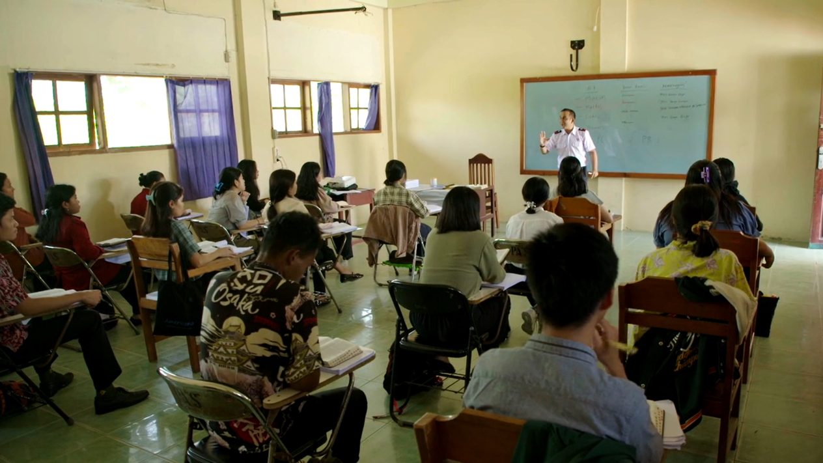
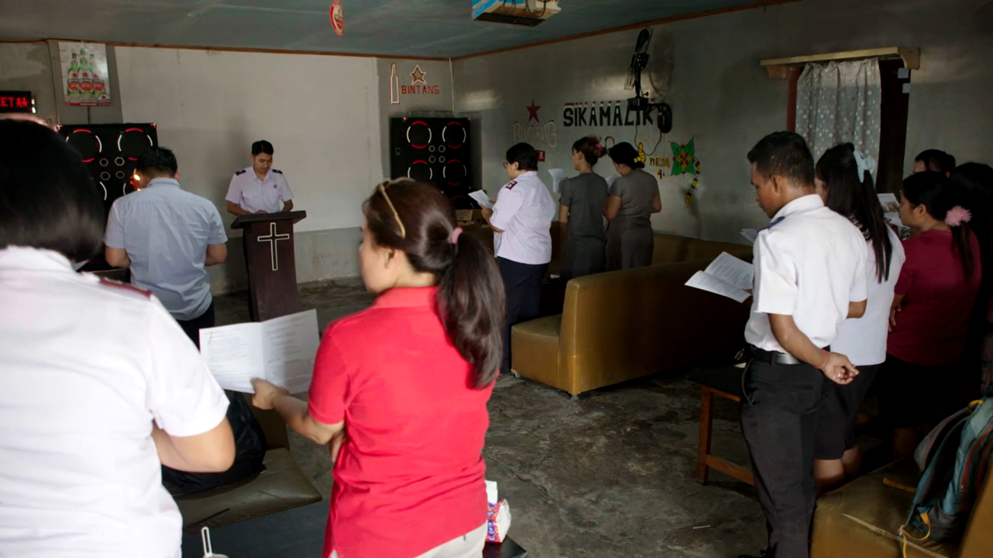
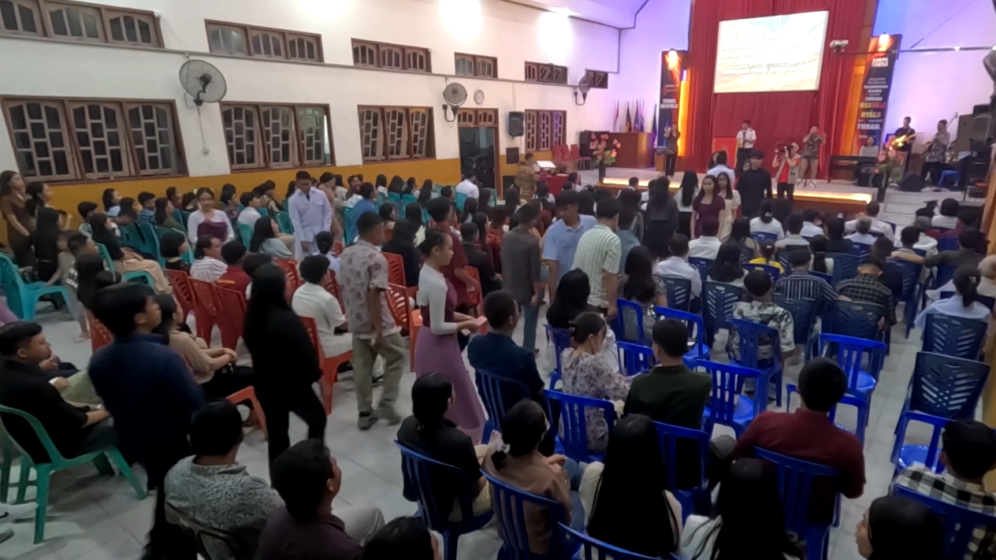
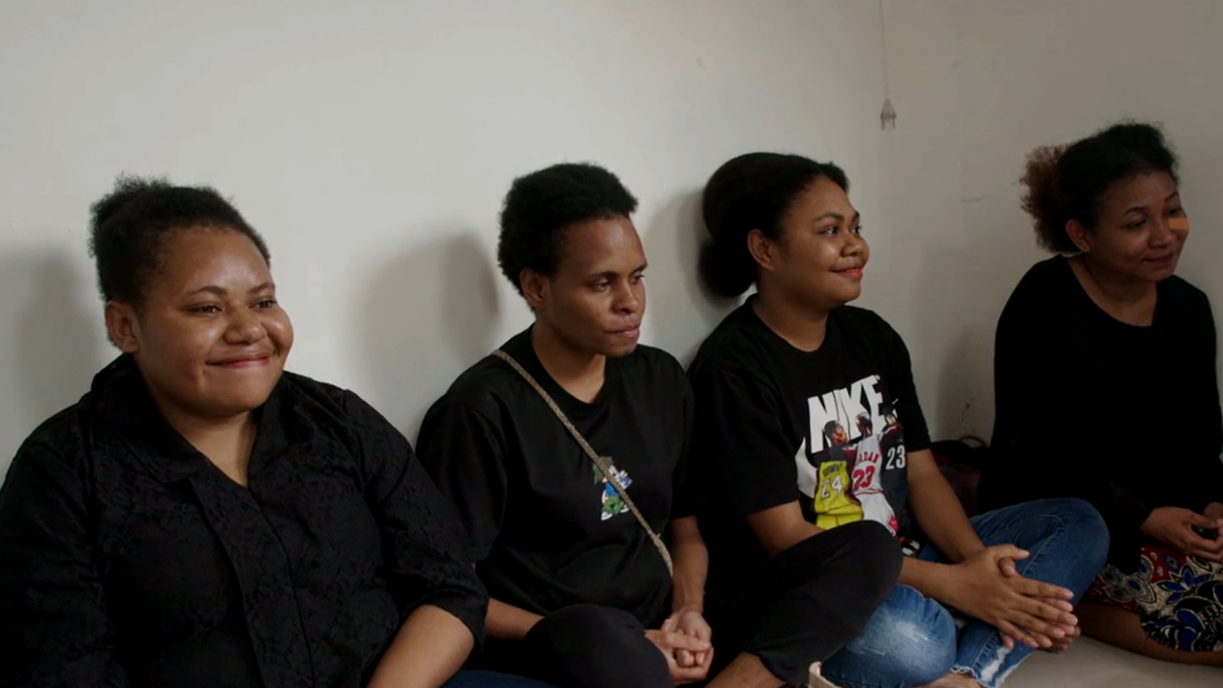

Corps in Indonesia.
Prayer Points
Lecturer and students.
Worship and practical support for sex workers.
Boarding houses for students.
Notes:
In this week’s video, lots of examples are shared highlighting how Salvationists in Indonesia are rooted in communities and growing in their faith and service. Encourage your congregation to pray into the lives and circumstances mentioned; celebrating the new opportunities to worship, learn and rebuild lives across Indonesia.
This time of prayer may be for individuals to pray, for groups to gather in the congregation or left open for everyone to collectively join together in prayer. You may want to encourage people to choose one image/group to focus on, if it has stood out to them.

