Slide 1
Week Three

Slide 2
Insert video here
Notes:
The Self-Denial 2025 videos can be found at https://www.salvationist.org.uk/resources/key-dates/self-denial-resources

Slide 3
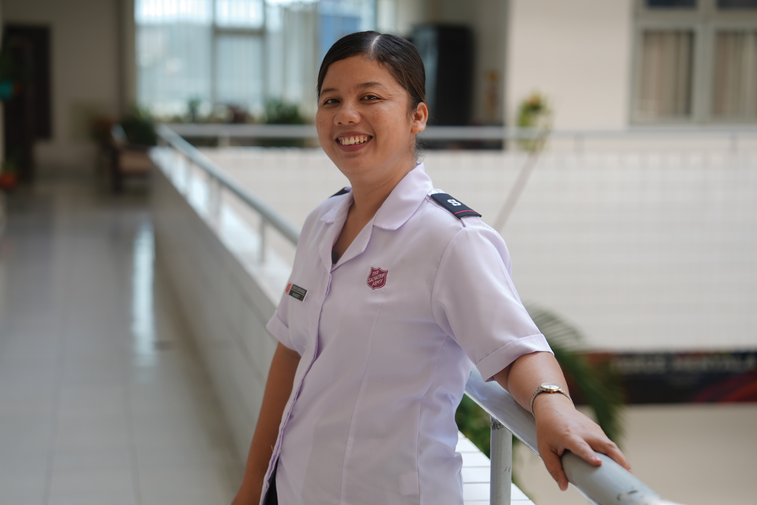
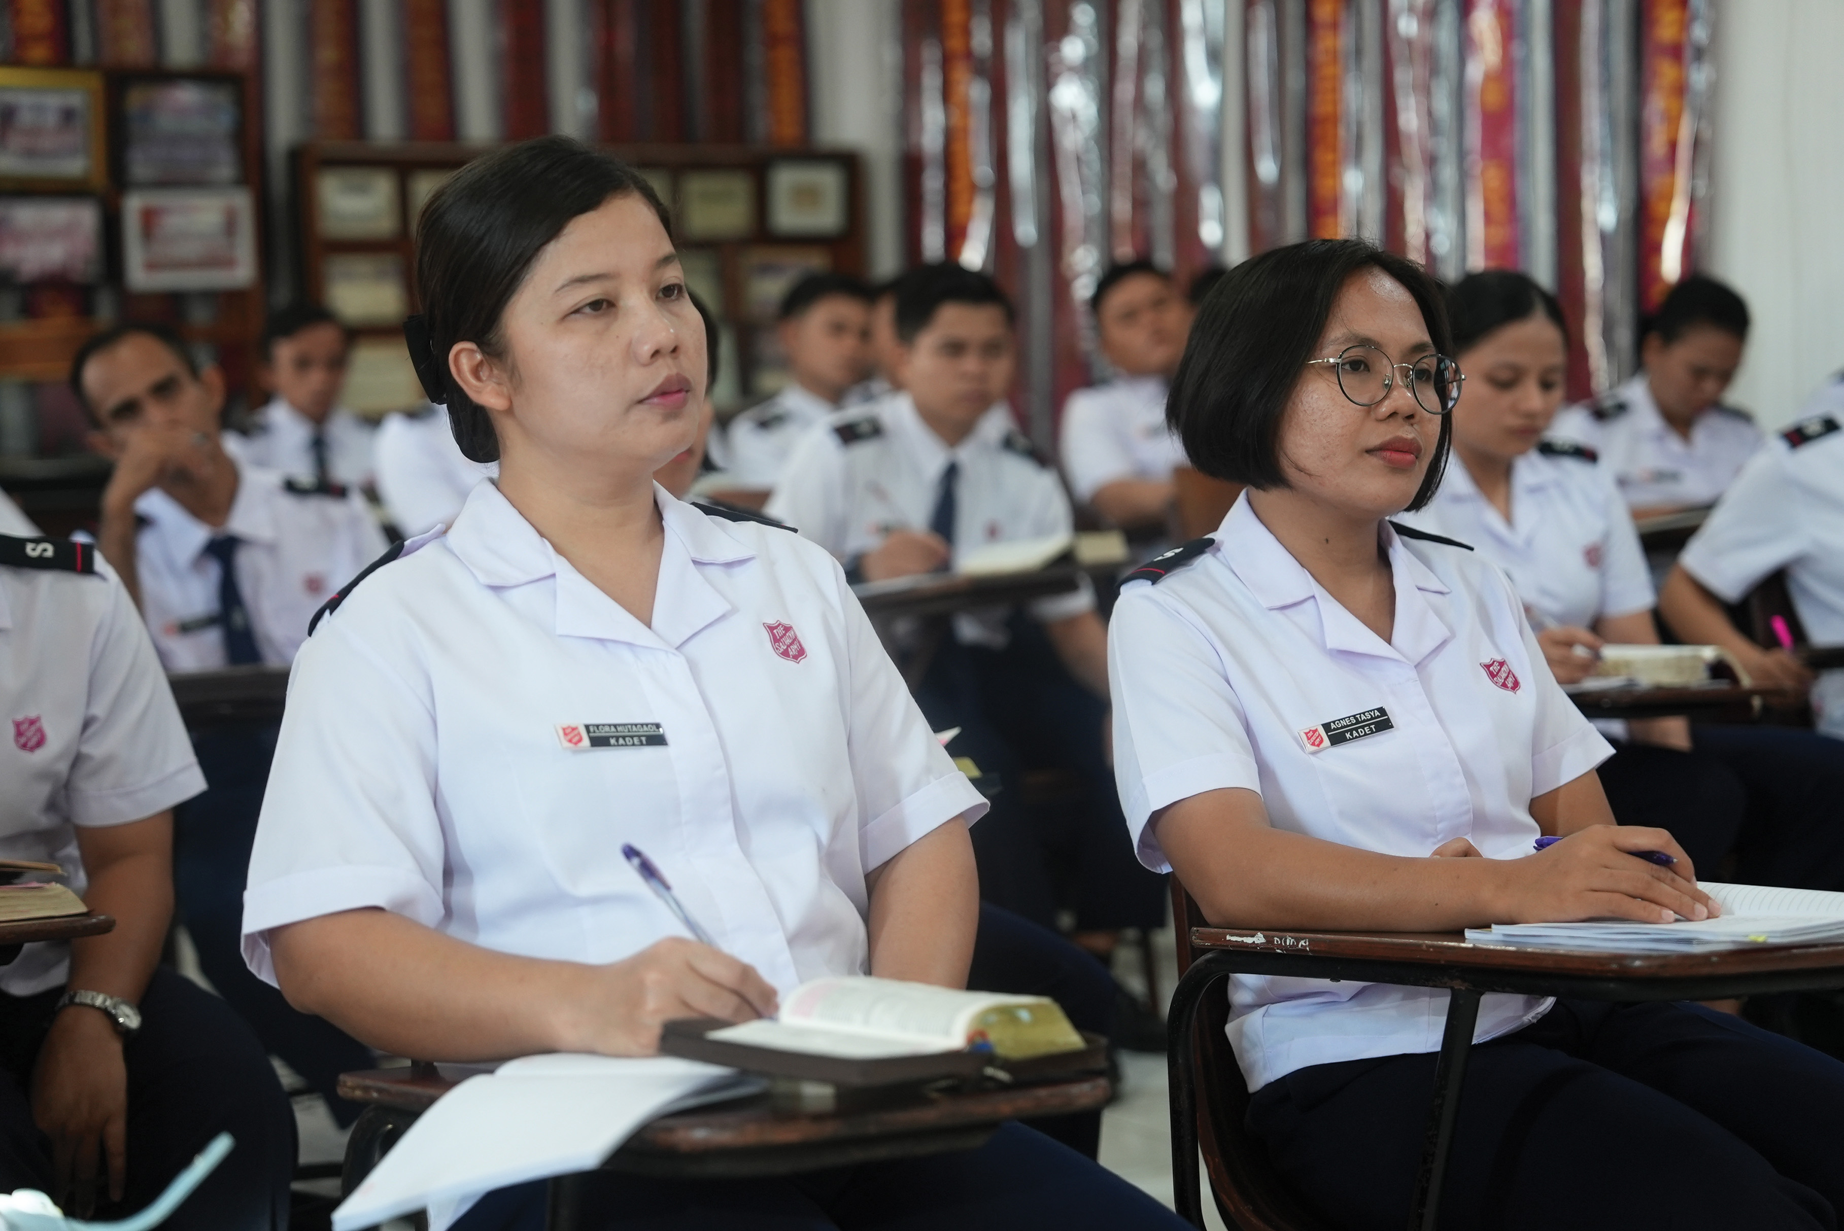
Prayer Points
Pray for Salvation Army cadets training internationally to become officers.
Pray for the leaders in your local area.
Pray for people who are yet to respond to God’s call to follow his plan for their lives.
All: May God continue to guide their education and growth and bless everything they do. Amen.
Notes:
After the video, pray for the groups listed on screen. At the end of the time of prayer, all join and say part of the prayer from the video ‘May God continue to guide their education and growth and bless everything they do. Amen.’

