Slide 1


Father’s
Day

Slide 2
Father’s
Day

Slide 4
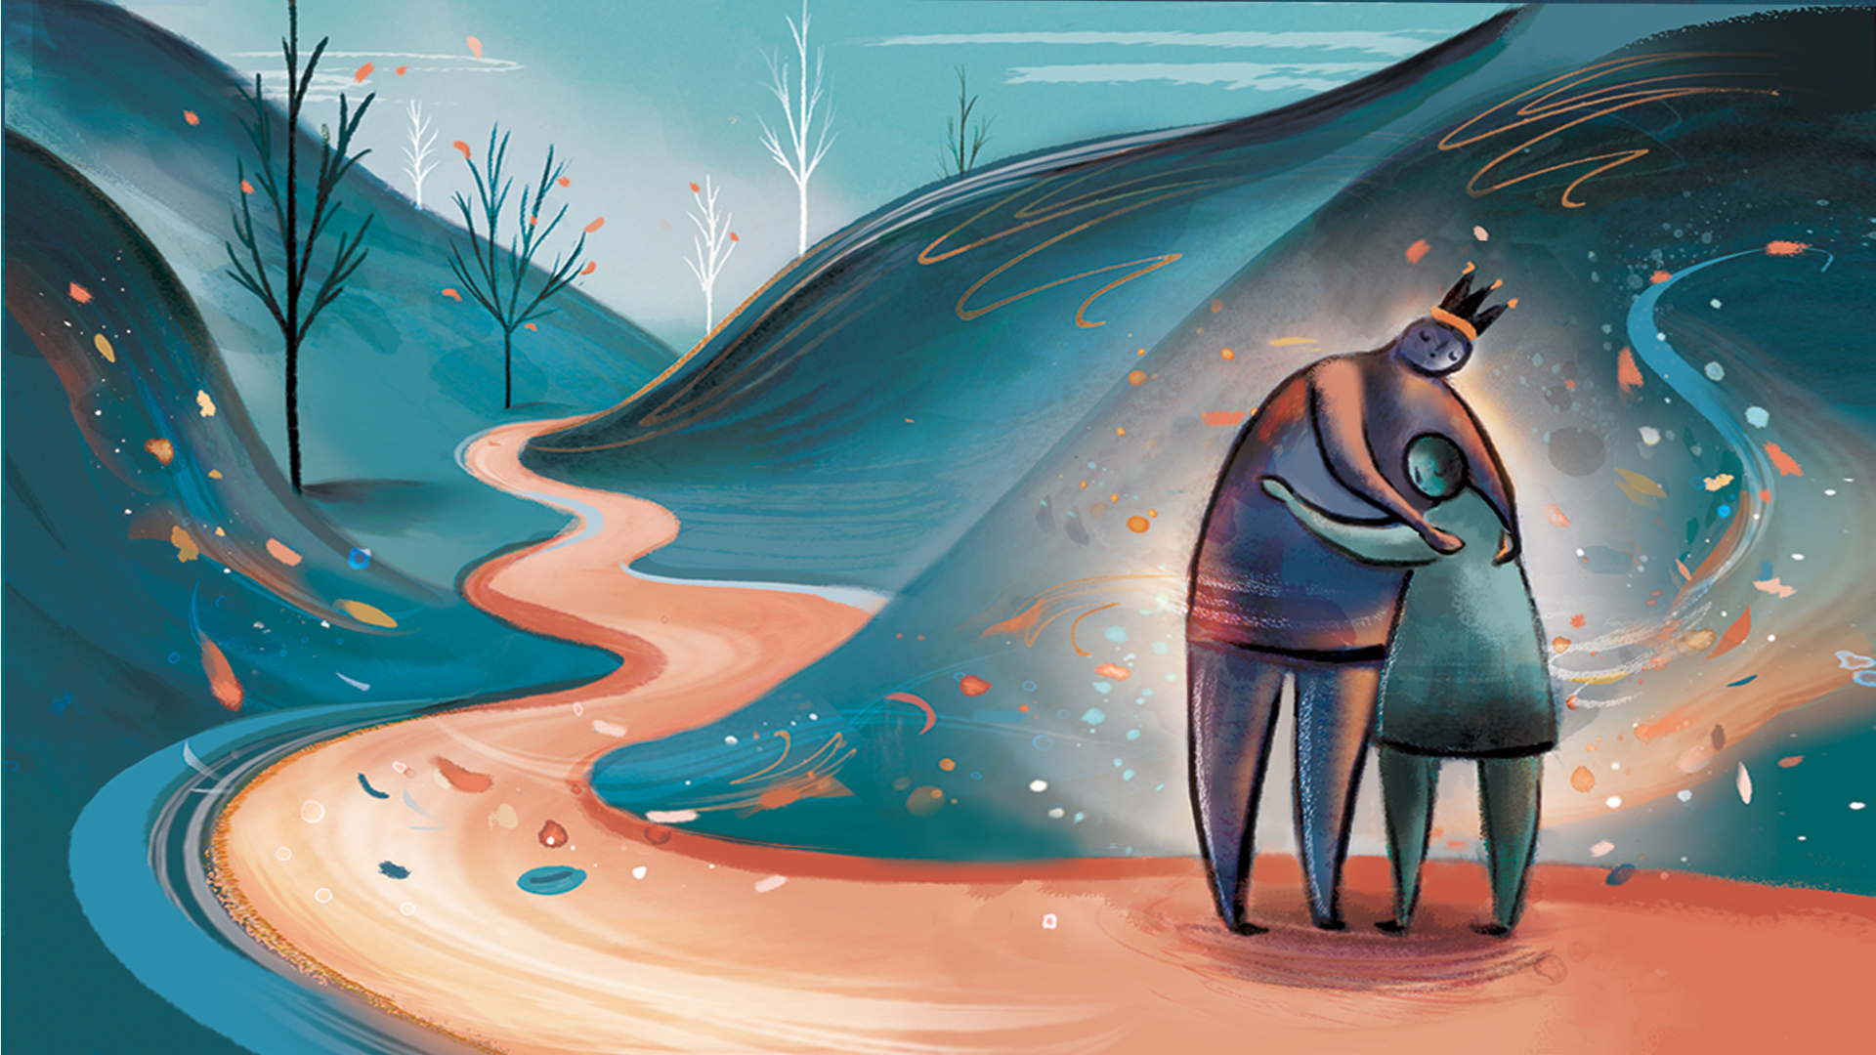

Slide 5
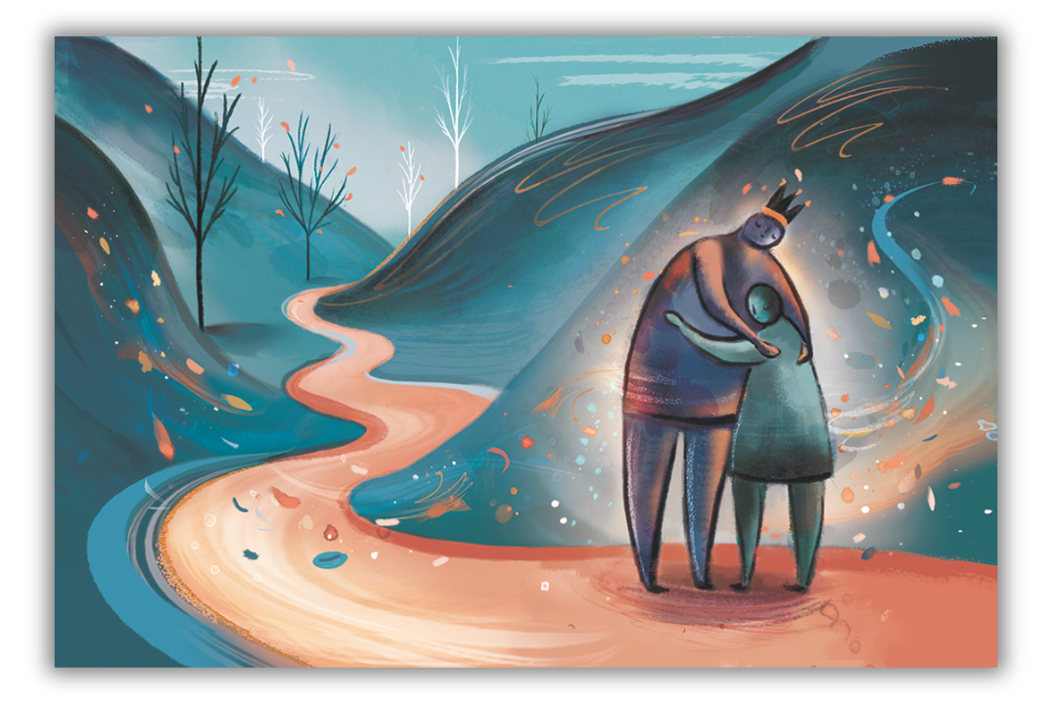
Reflection:
  Who do you interpret both figures to be?
  What story does this tell for you?
  Which figure do you see yourself as?
  What is God saying to you through this?

Slide 6
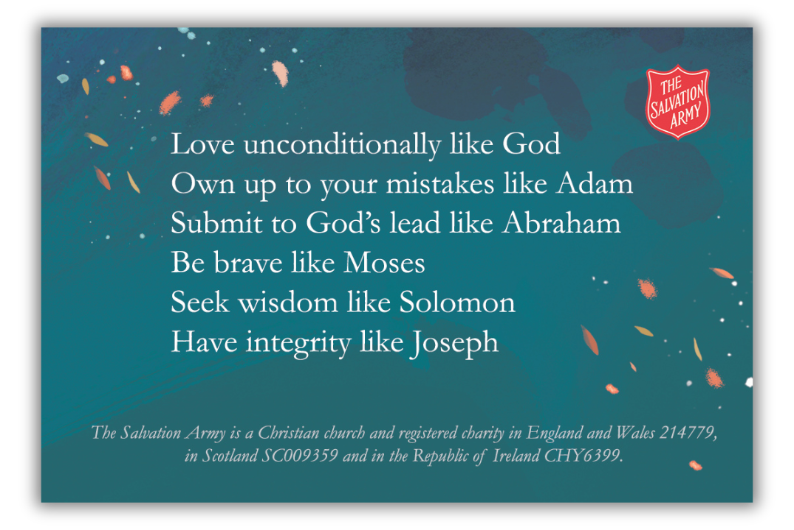
Reflection:
  Which of these examples do you excel in?
  Which do you need God’s help with?
  Take a moment to connect in prayer with your Heavenly Father.

