Slide 1


Artificial Intelligence Guardrails
Keeping us on track

Slide 2
Overview
These AI Guardrails are intended to help keep the UKI Territory on track as artificial intelligence (AI) allows us to travel in new and unanticipated directions.
The scale and pace of technological advancement means that timely support and clear guidance is needed. Instead of setting out a rigid list of dos and don’ts, these AI Guardrails are based on our shared values and are applicable across all areas of Salvation Army influence.
Our ambition is to harness AI to further our God-given mission, embracing its opportunities while carefully managing its risks. Throughout, we affirm and maintain our belief in the supremacy of Scripture for Christian faith and practice.

Slide 3
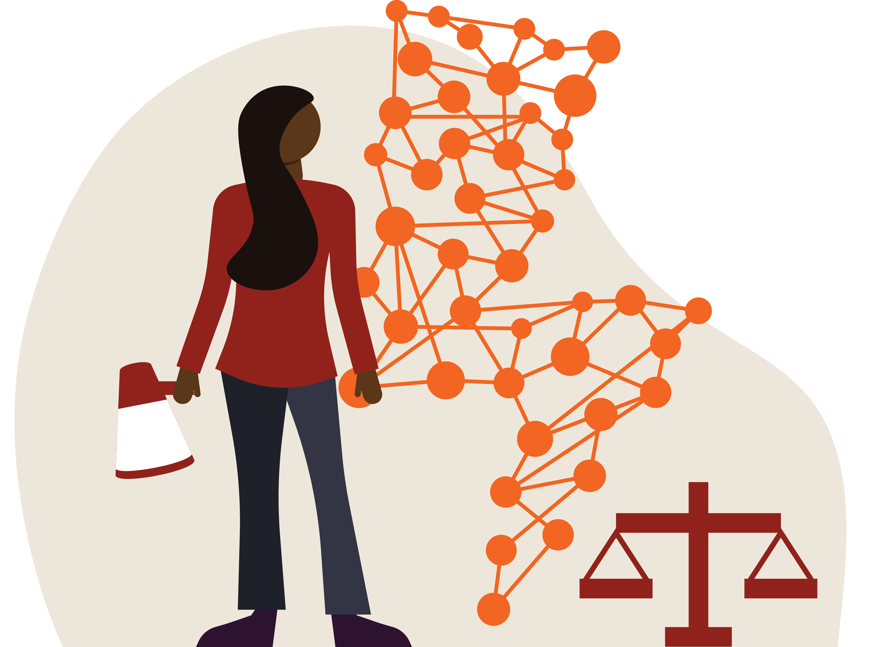
Boldness
We will make space for the creative and innovative use of AI. This means:
rejecting a risk-averse approach and embracing dynamic faith that responds to the Holy Spirit’s leading;
co-creating relational AI solutions with people directly impacted by AI; and
noticing, challenging and dismantling systemic injustice related to AI, in accordance with our prophetic tradition.

Slide 4

Compassion
We will use AI to express the unconditional love of God, with particular attention to people who are living with poverty, marginalisation and climate change. This means:
enabling and advocating for everyone to have access to AI technology;
supporting others in fulfilling their God‑given potential; and
paying attention to and reducing the risk of exploitation, exclusion and environmental concerns.

Slide 5
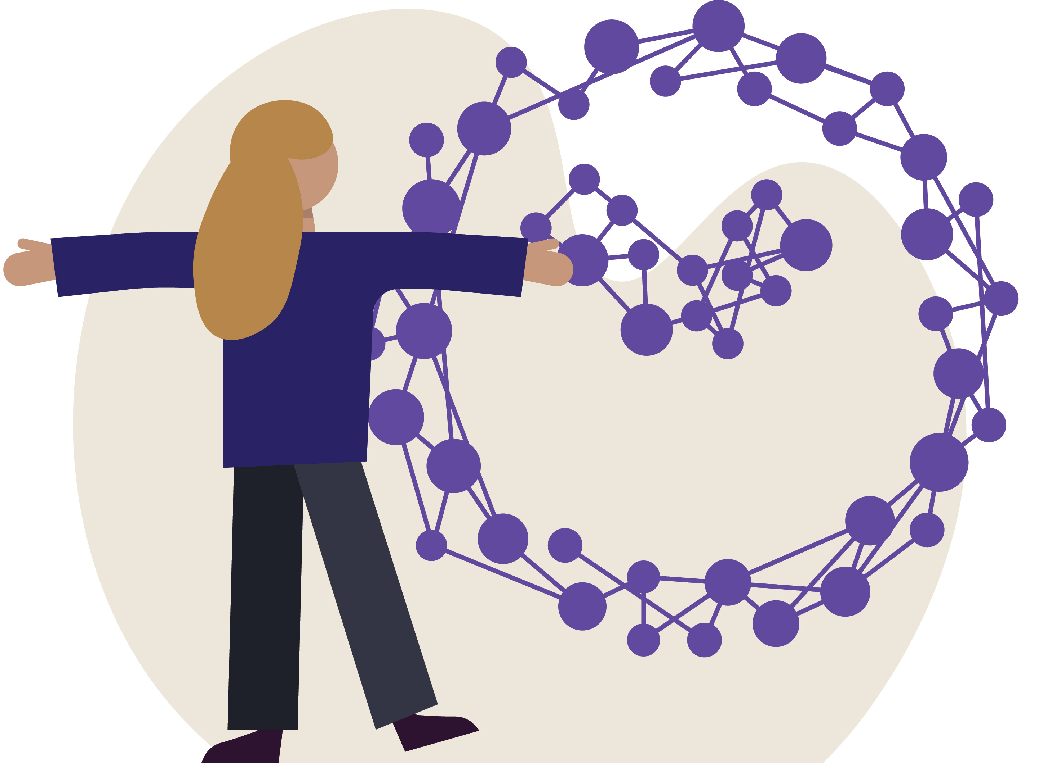
Passion
We will be intentional and optimistic in using AI. This means:
empowering those within the Body of Christ who have interests and skills in AI;
releasing the time, skills and resources necessary to further our mission; and
committing to ongoing learning and development.

Slide 6

Respect
We will maintain the dignity of those created in the image of God. This means:
sensitively and intentionally exploring how AI can empower others to flourish and find fulness of life with Jesus;
treasuring human life and relationships in all we are and do; and
striving for our use of AI to reflect love, joy, peace, patience, kindness, goodness, faithfulness, gentleness and self-control.

Slide 7

Integrity and Mutual
Accountability
We will be honest, transparent, and accountable in all our uses of AI, being open about our motives and agendas. This means:
providing information about when and how AI has been used to inform, generate or enhance our work;
accrediting authorship and content creators appropriately; and
being willing to answer questions and offer a reasoned explanation for the use of AI in our work and ministry.

