Slide 1

Welcome to assembly

Slide 2


Slide 3


What did Lumi see?

Slide 4
What can light represent?

Slide 5
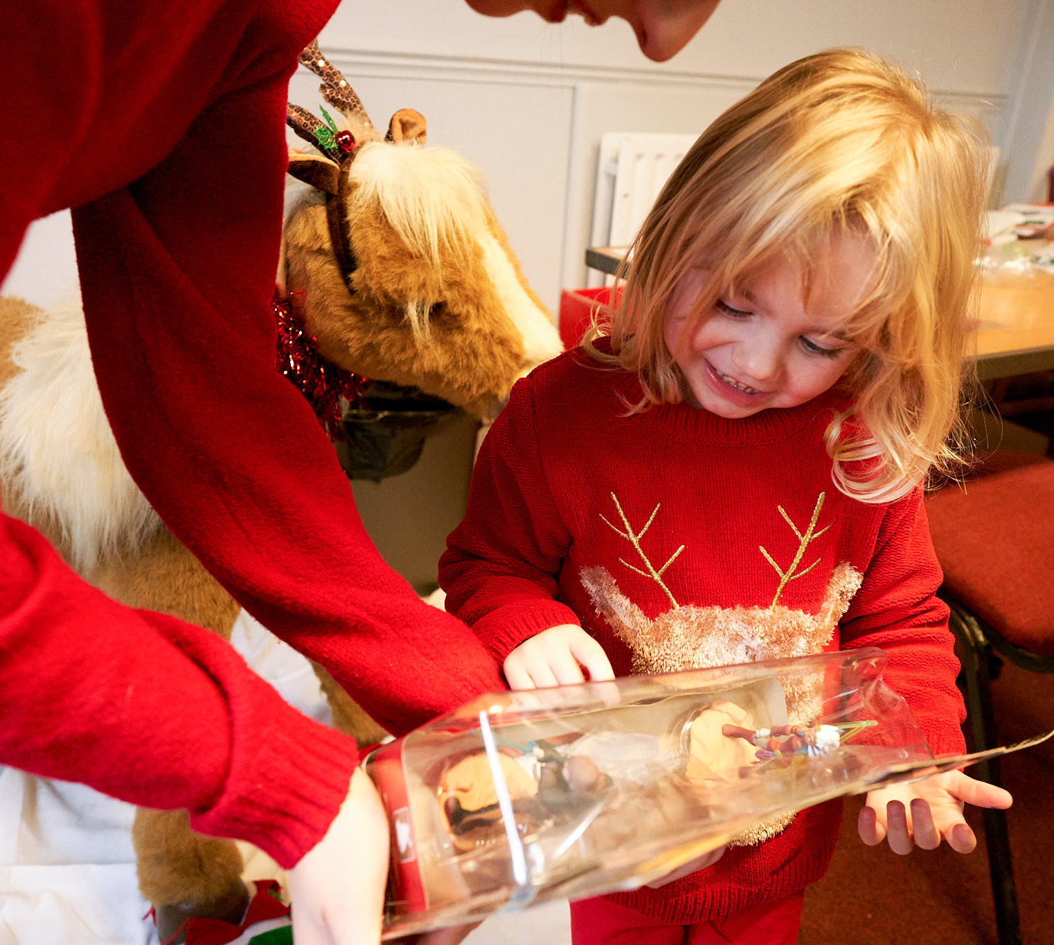
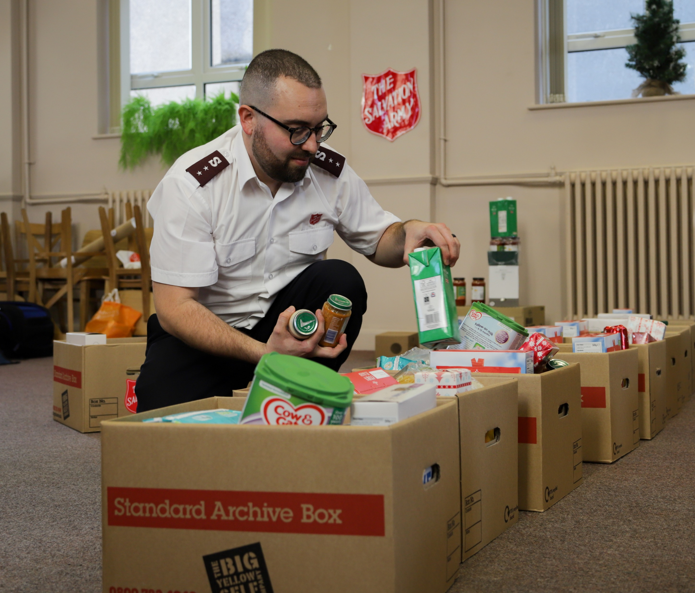

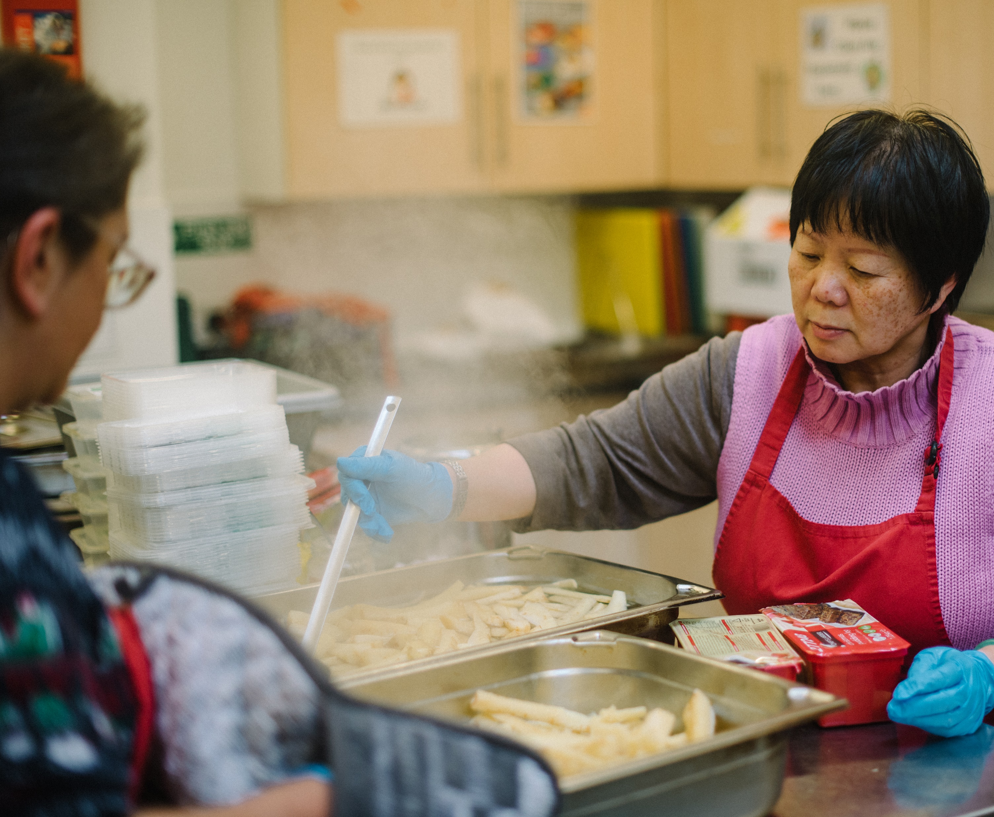
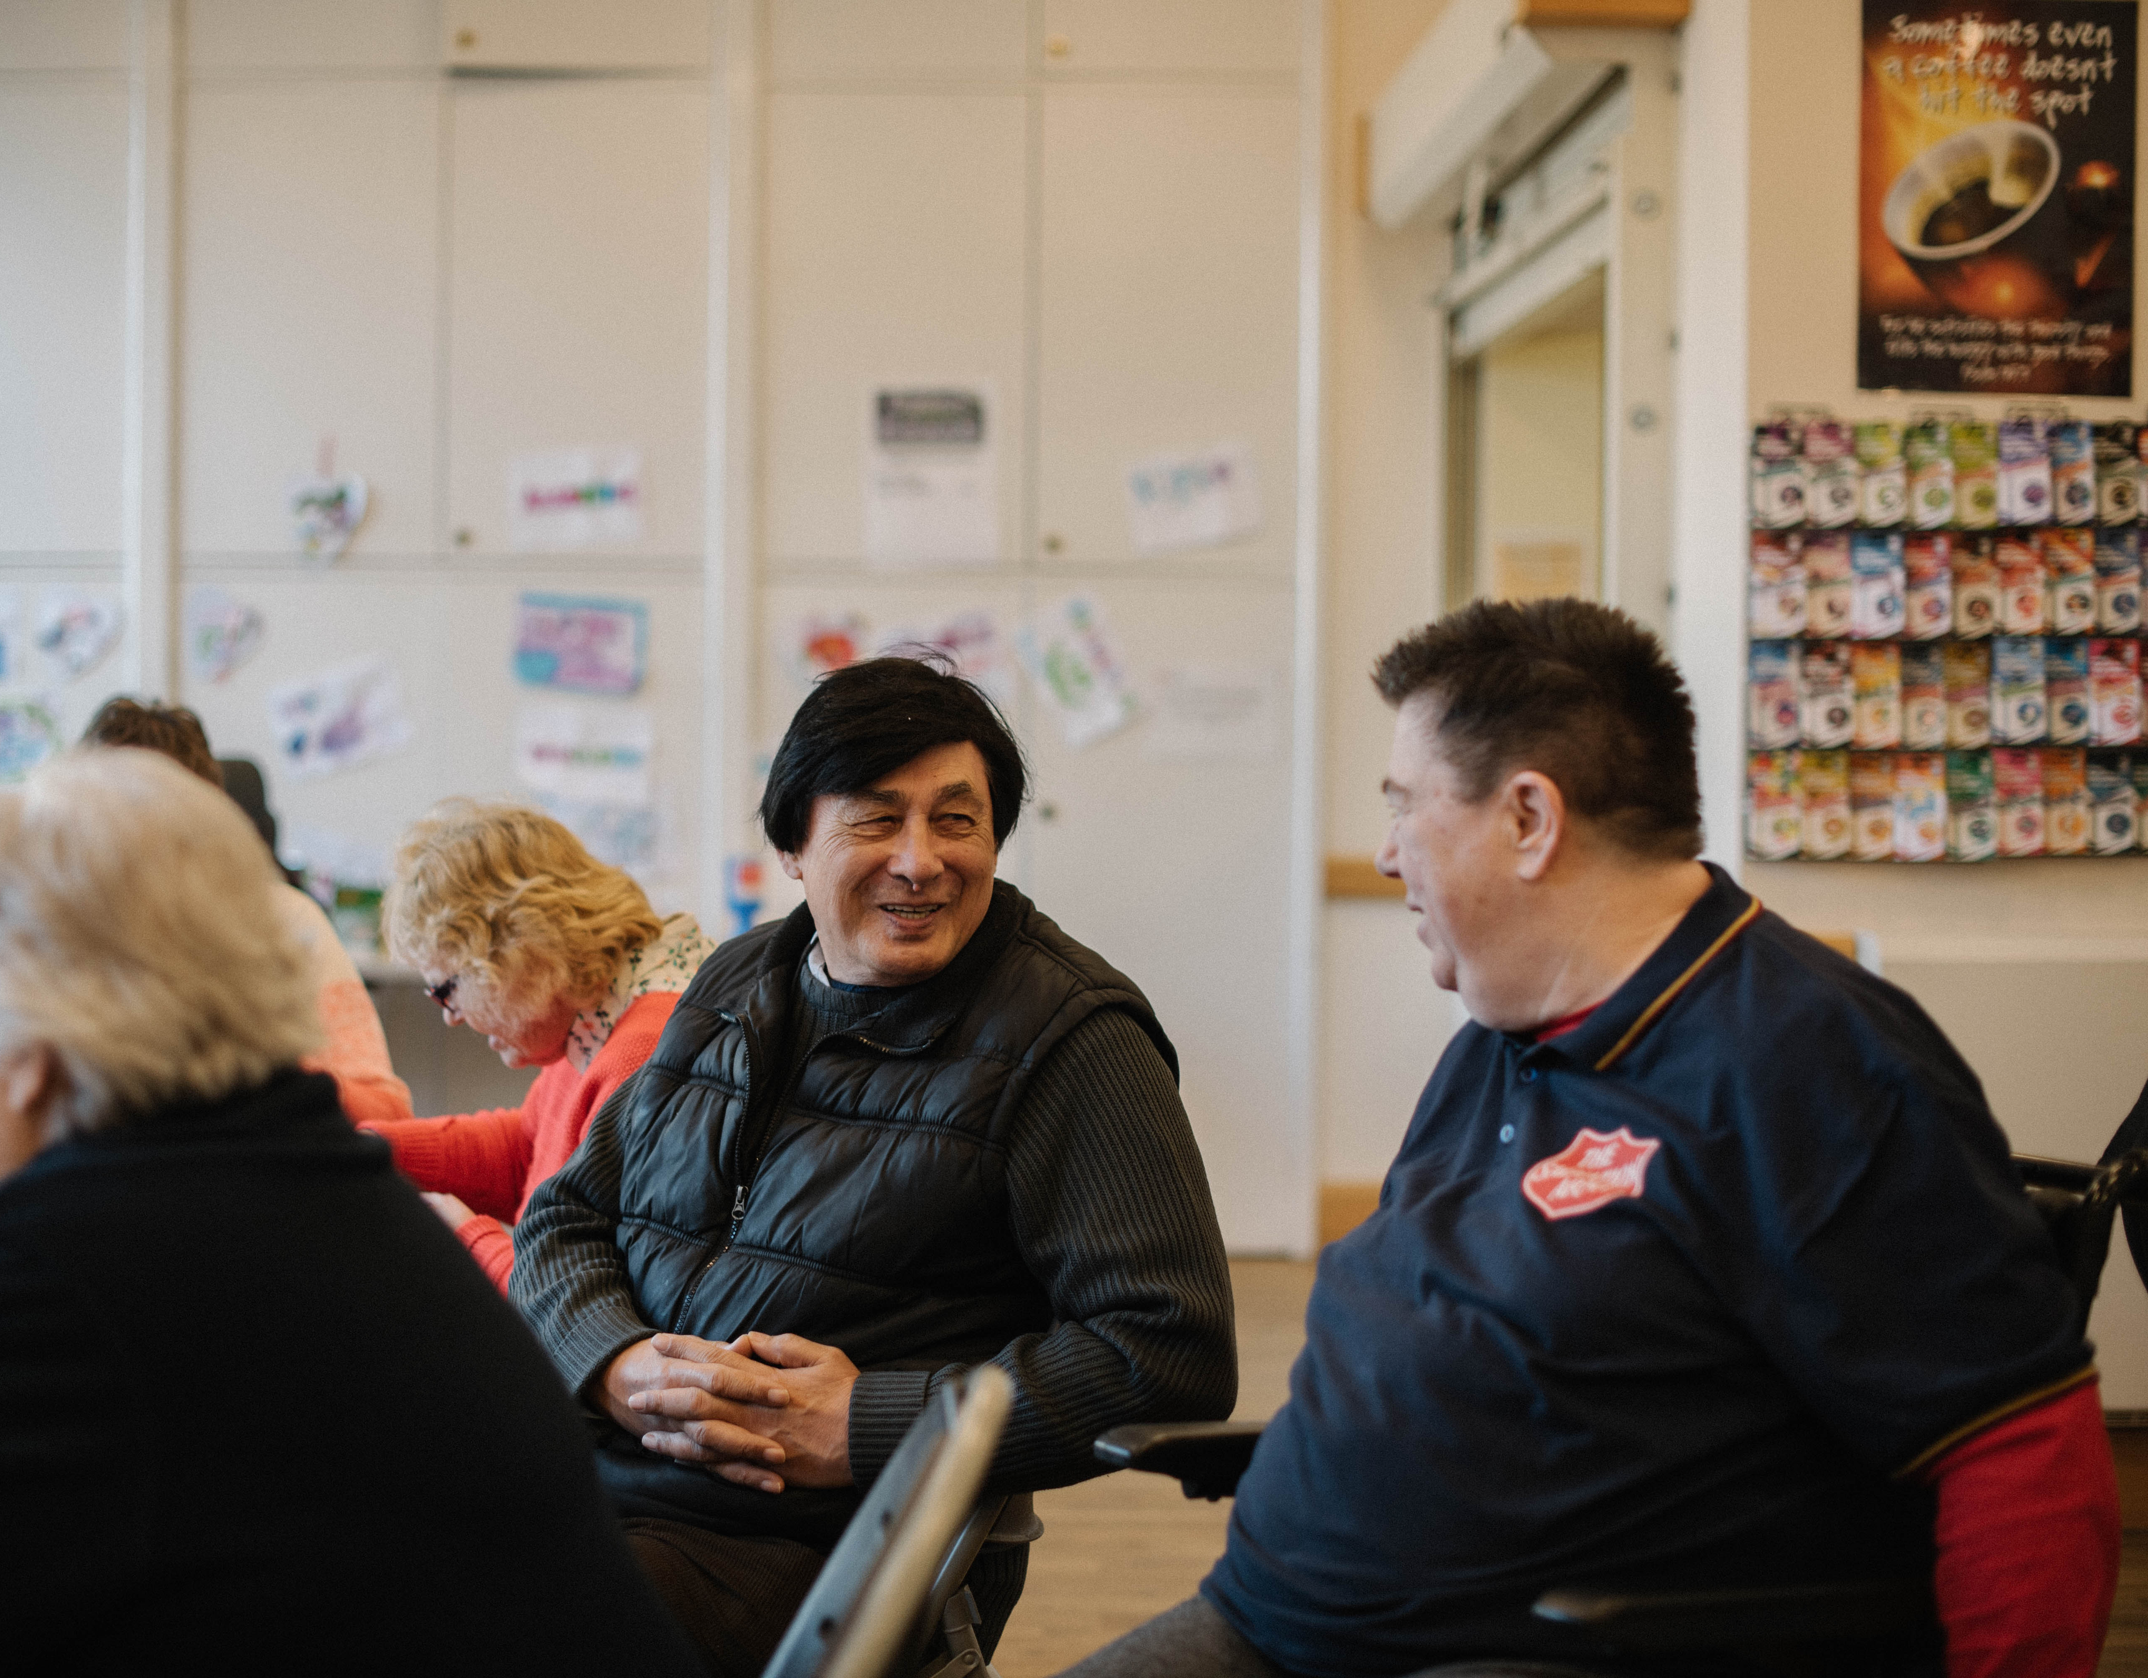

A light to others

Slide 6
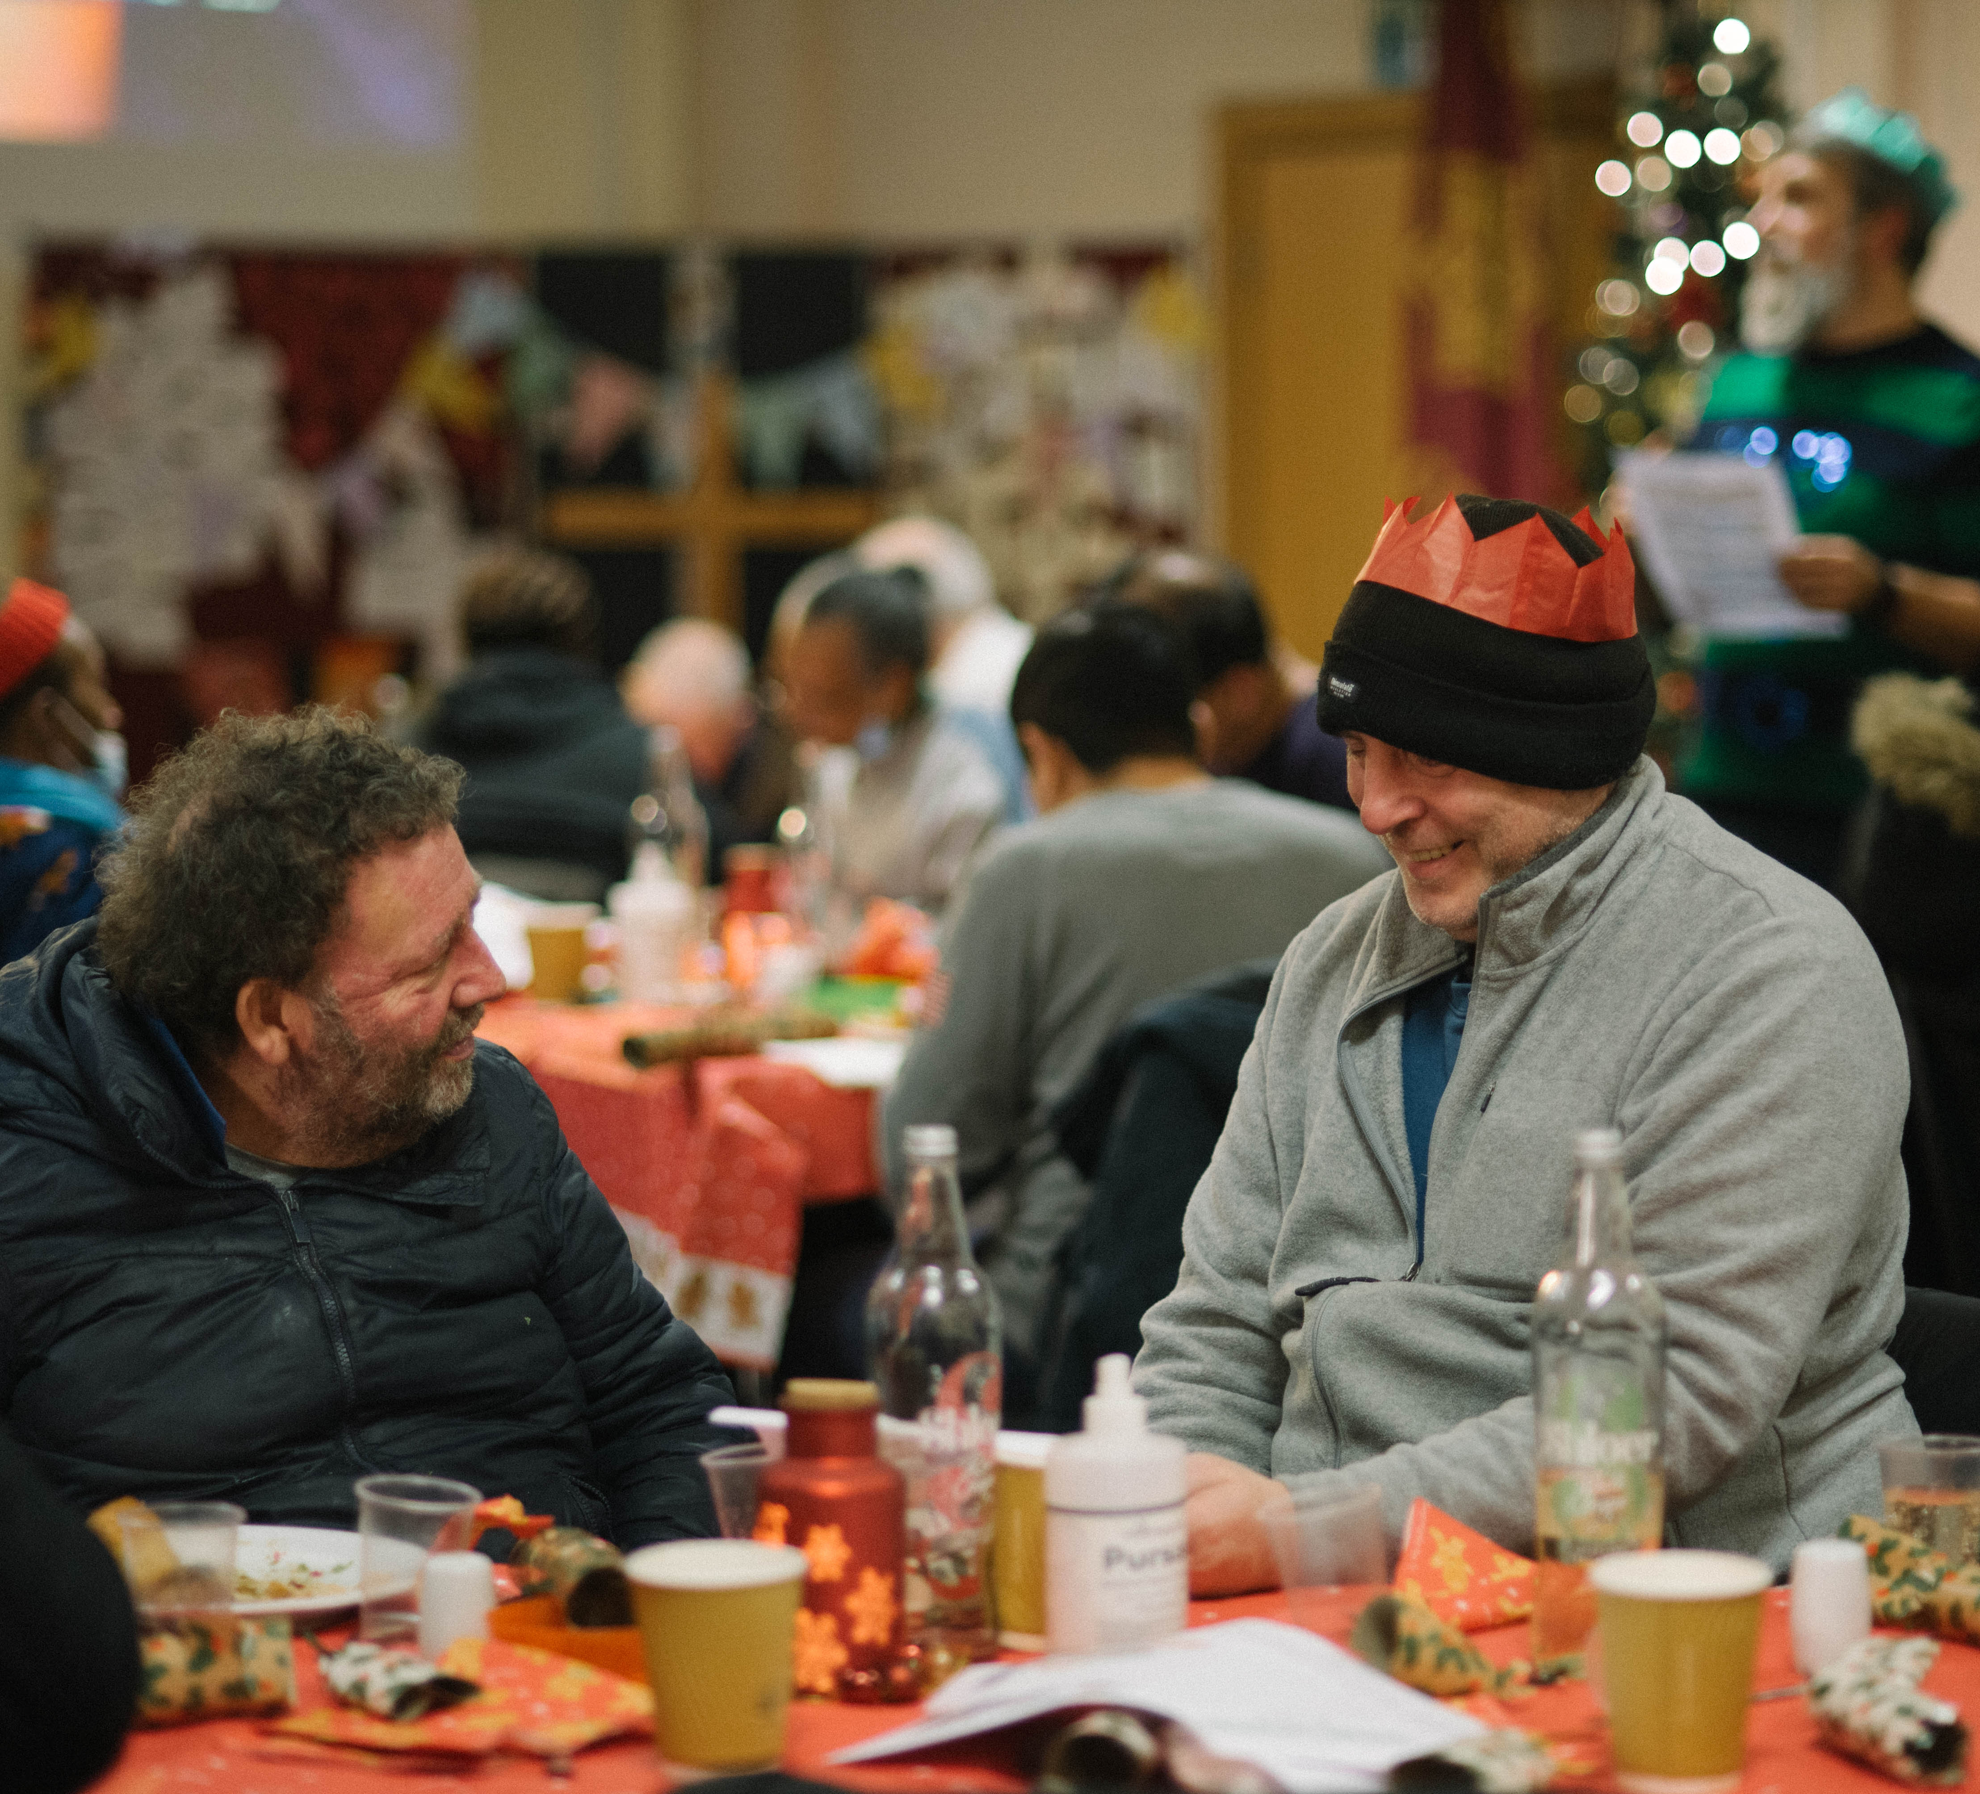
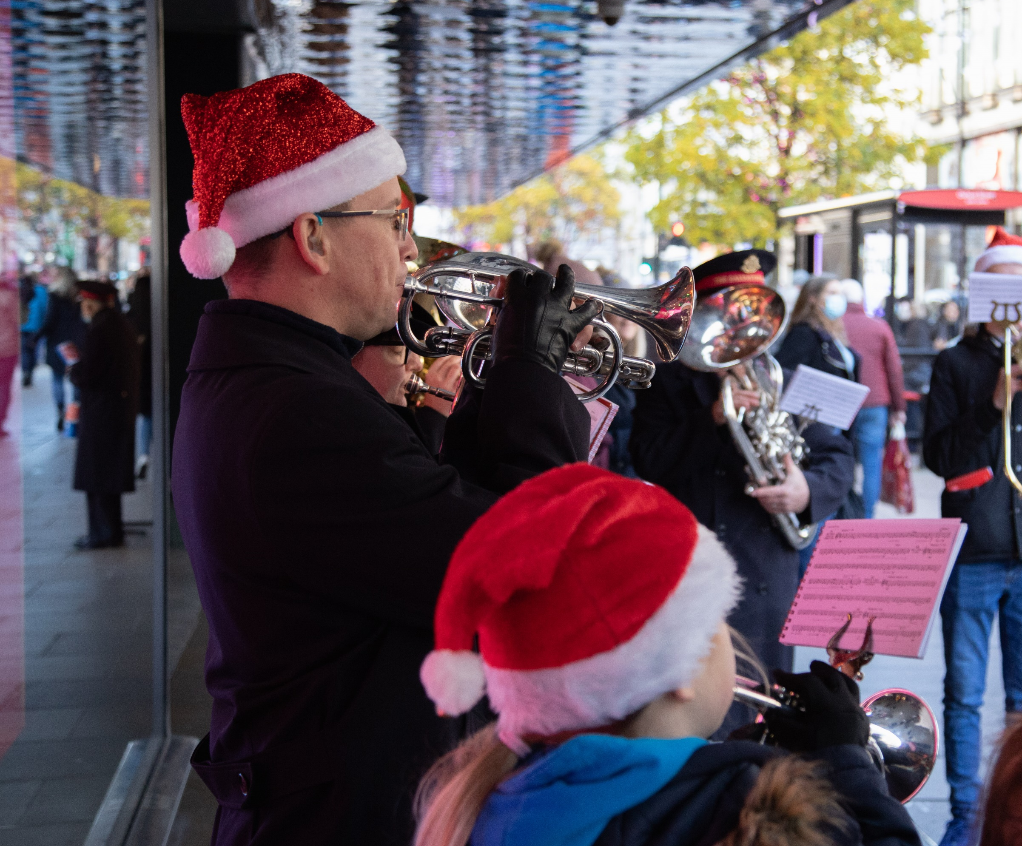
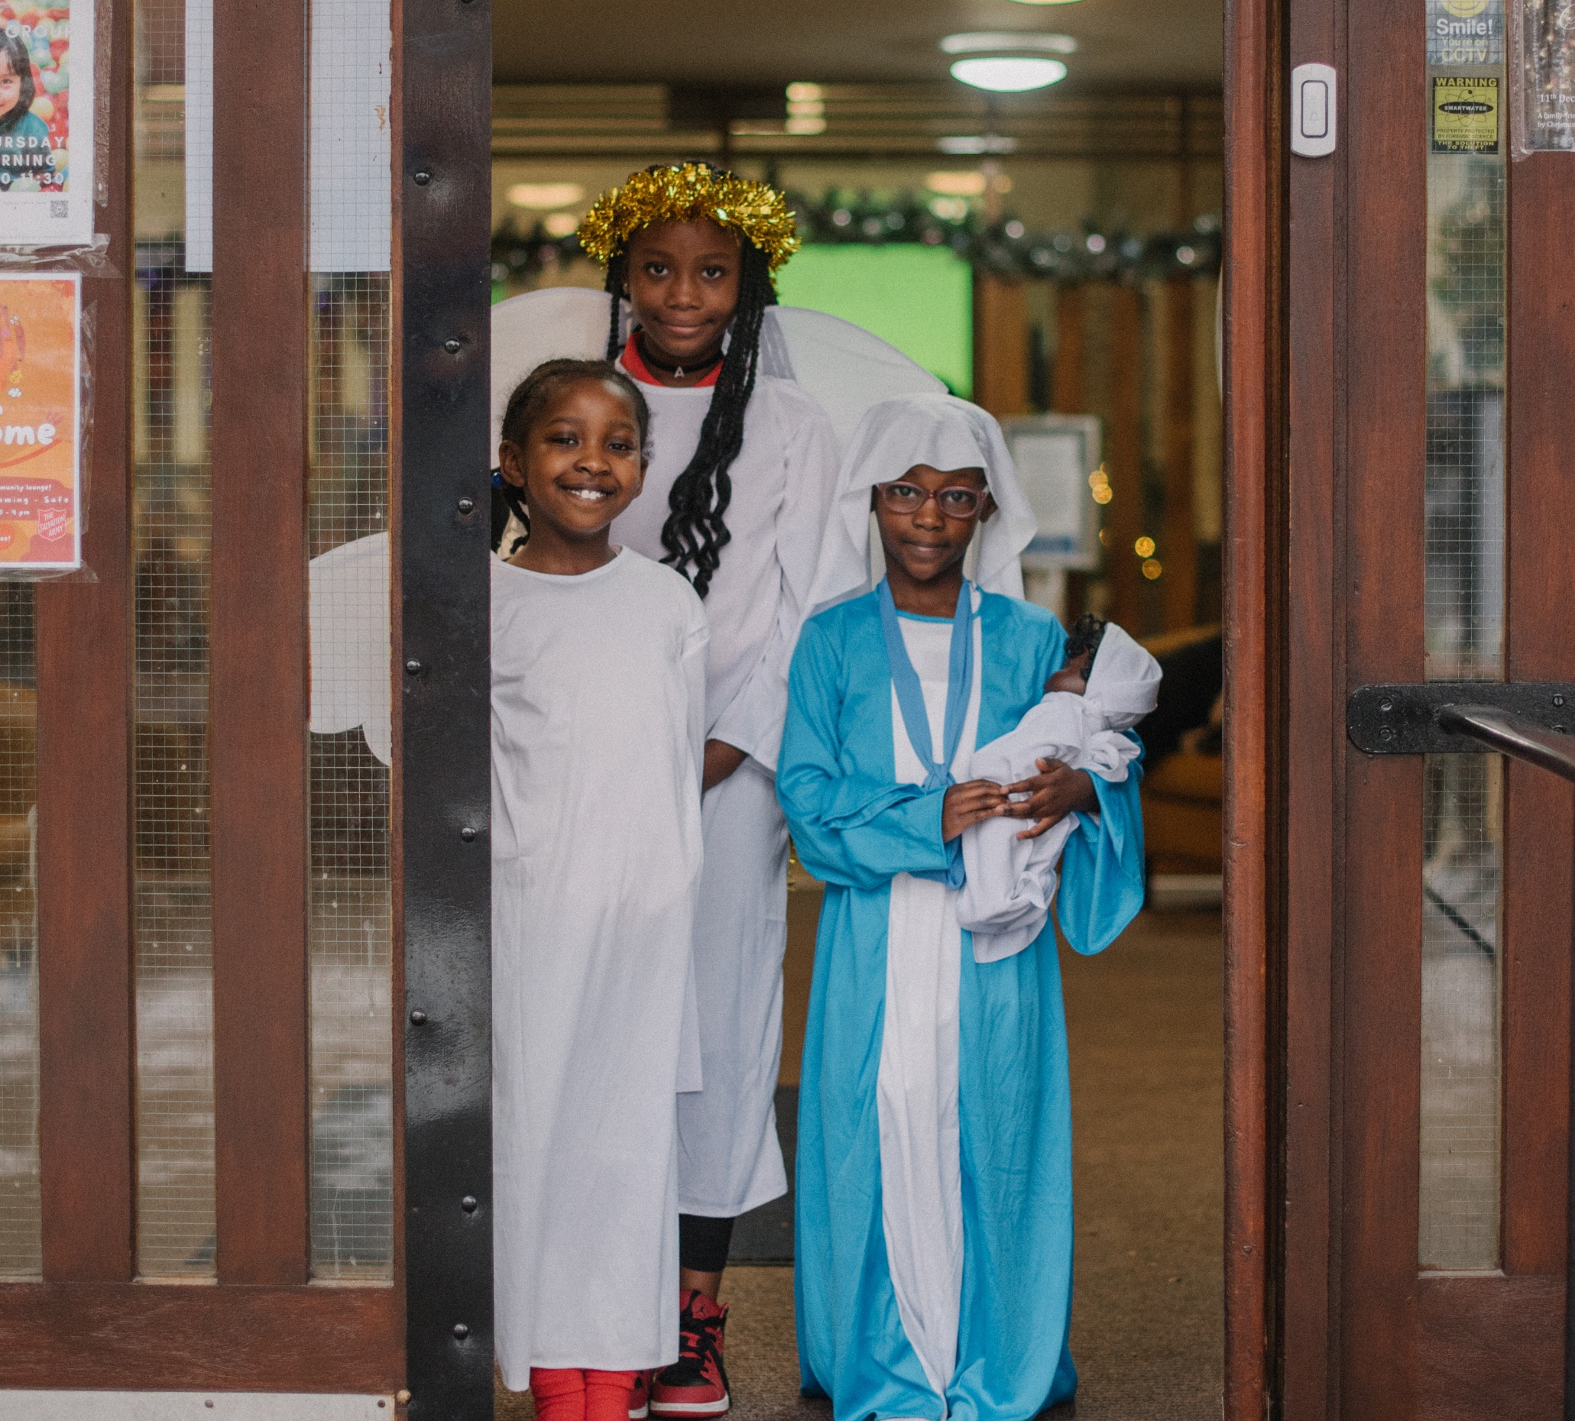
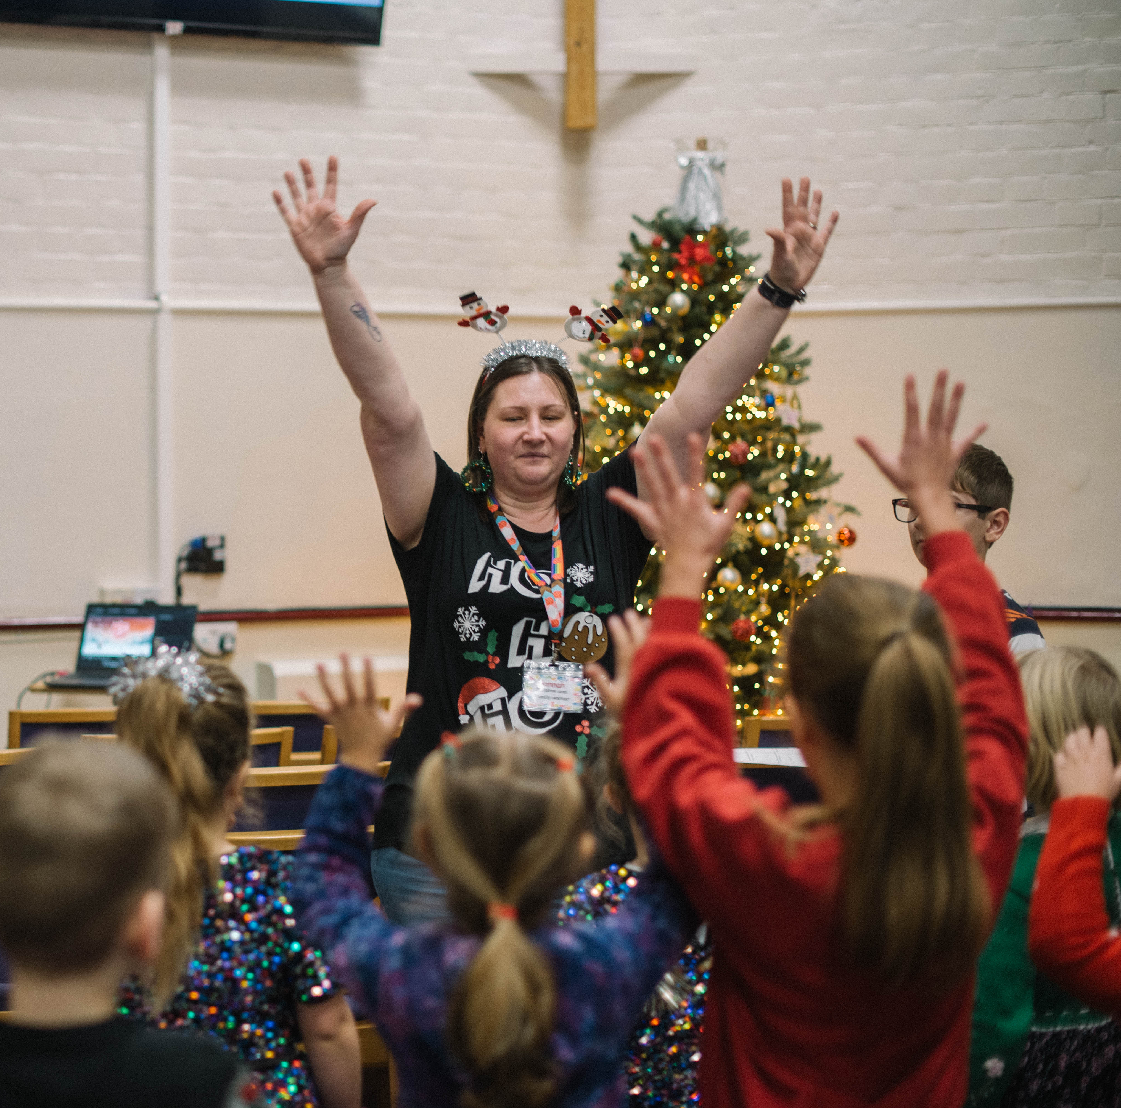
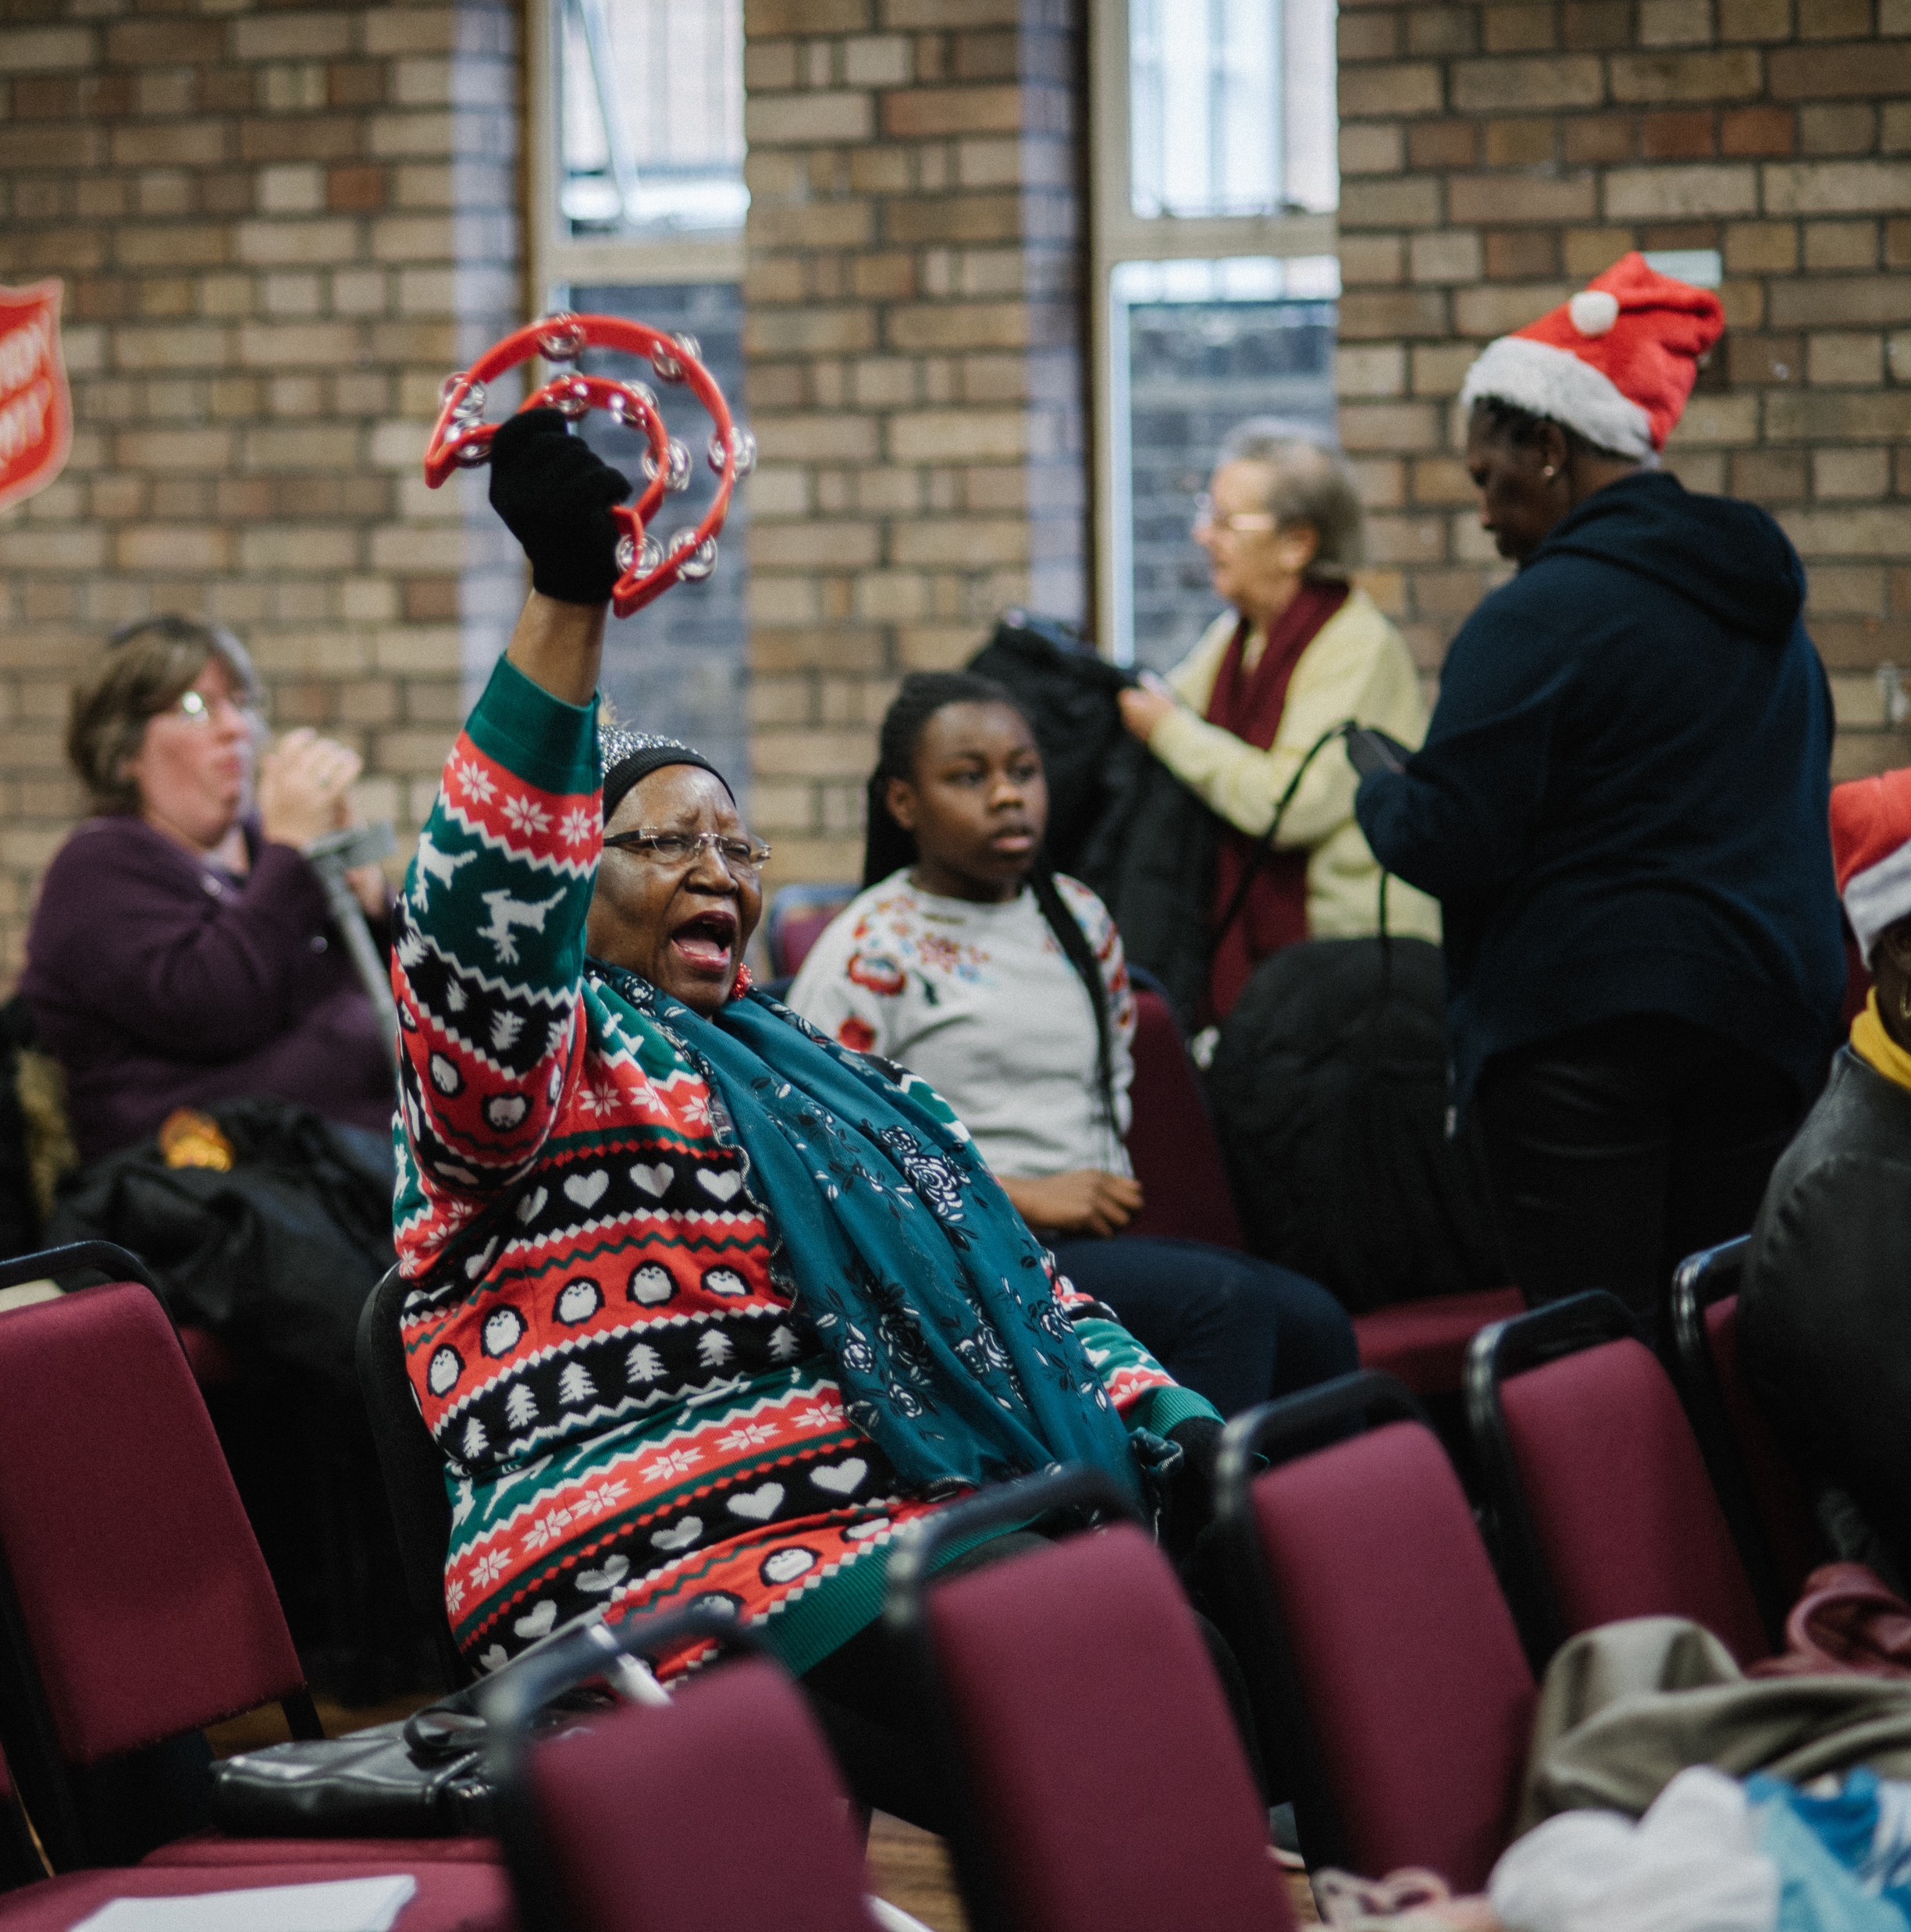
Love God
Love others

Slide 7
Why do you think Lumi sparkled with joy as he thought about everything he had seen?

Slide 8
They called Jesus ‘King of all the world.’ Why?
What kind of king do you think he would be?

Slide 9
How can you be a light to others?

Slide 10
