Slide 1

Rainbowtastic

Slide 2
How many of you have seen a rainbow?
How many of you have seen these kinds of rainbows?

Slide 3
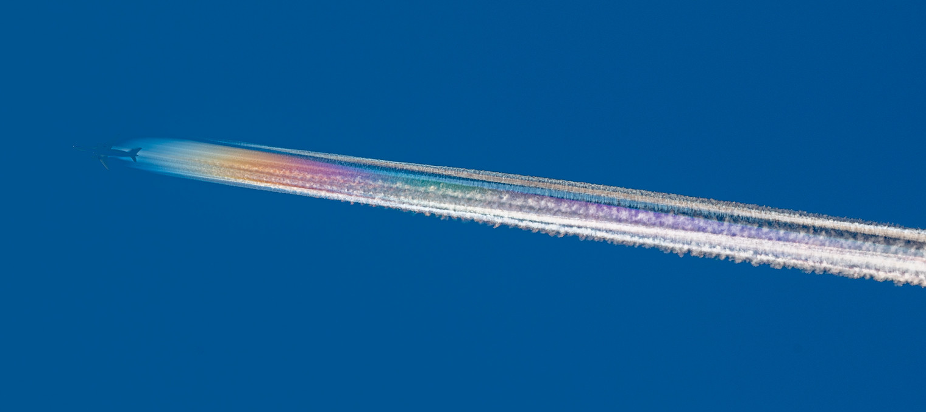
Contrails
Source: Glenn Beltz on Flickr (www.flickr.com/photos/n28307/51427503027)

Slide 4
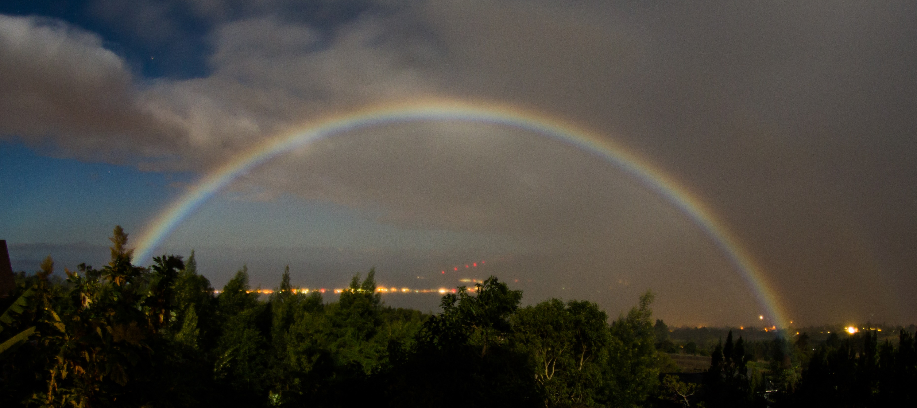
Moonbow
Source: Arne Kaiser on Wikimedia Commons (commons.wikimedia.org/wiki/File:Moonbow,_Kula,_Hawaii..jpg)

Slide 5
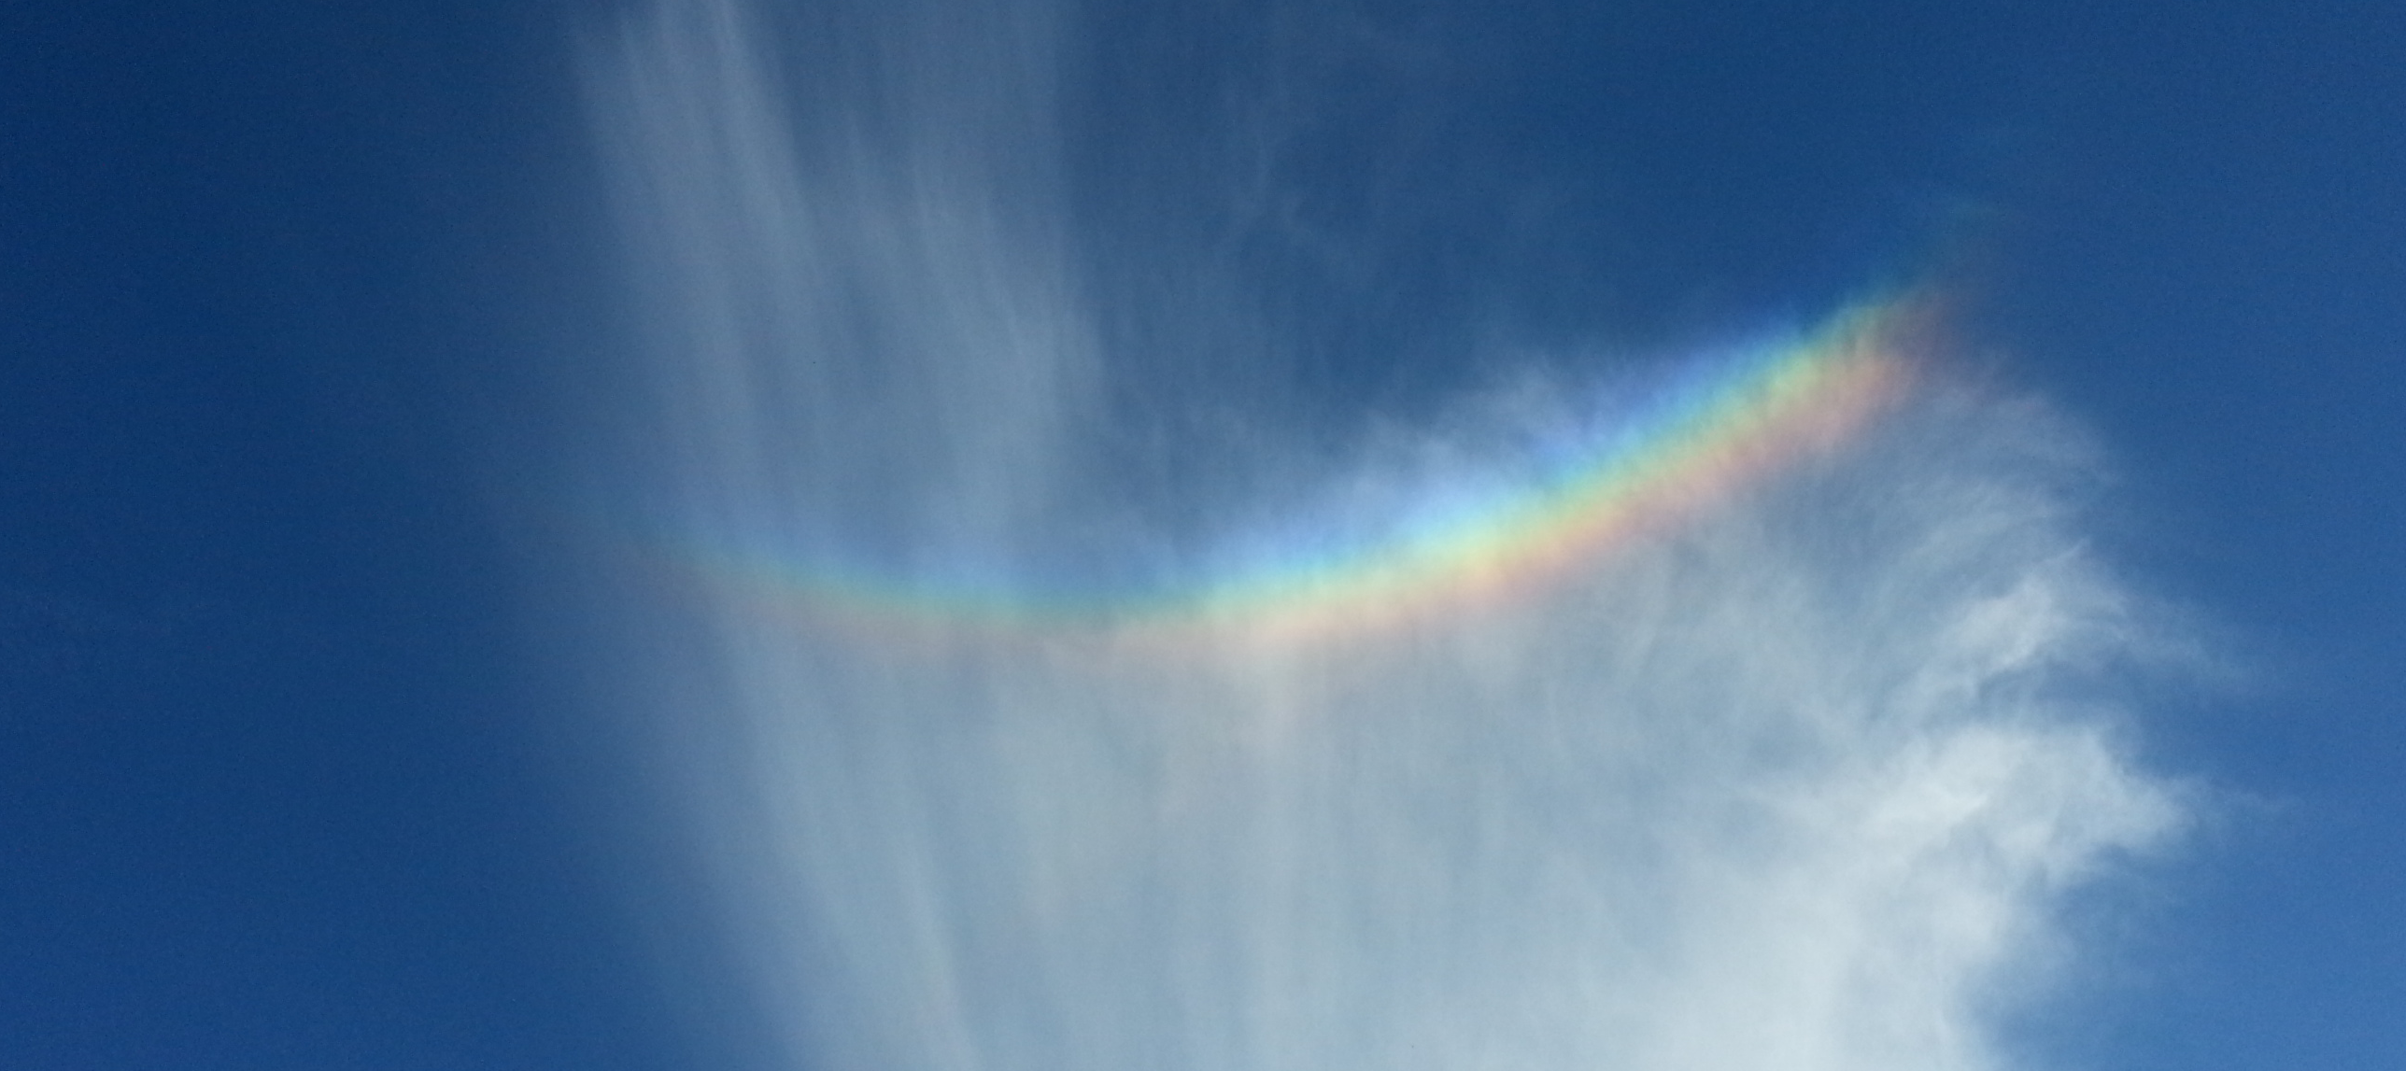
Upside-down rainbow
Source: William Acka on Wikimedia Commons
(commons.wikimedia.org/wiki/File:Circumzenithal_arc_%28upside_down_rainbow%29.jpg)

Slide 6
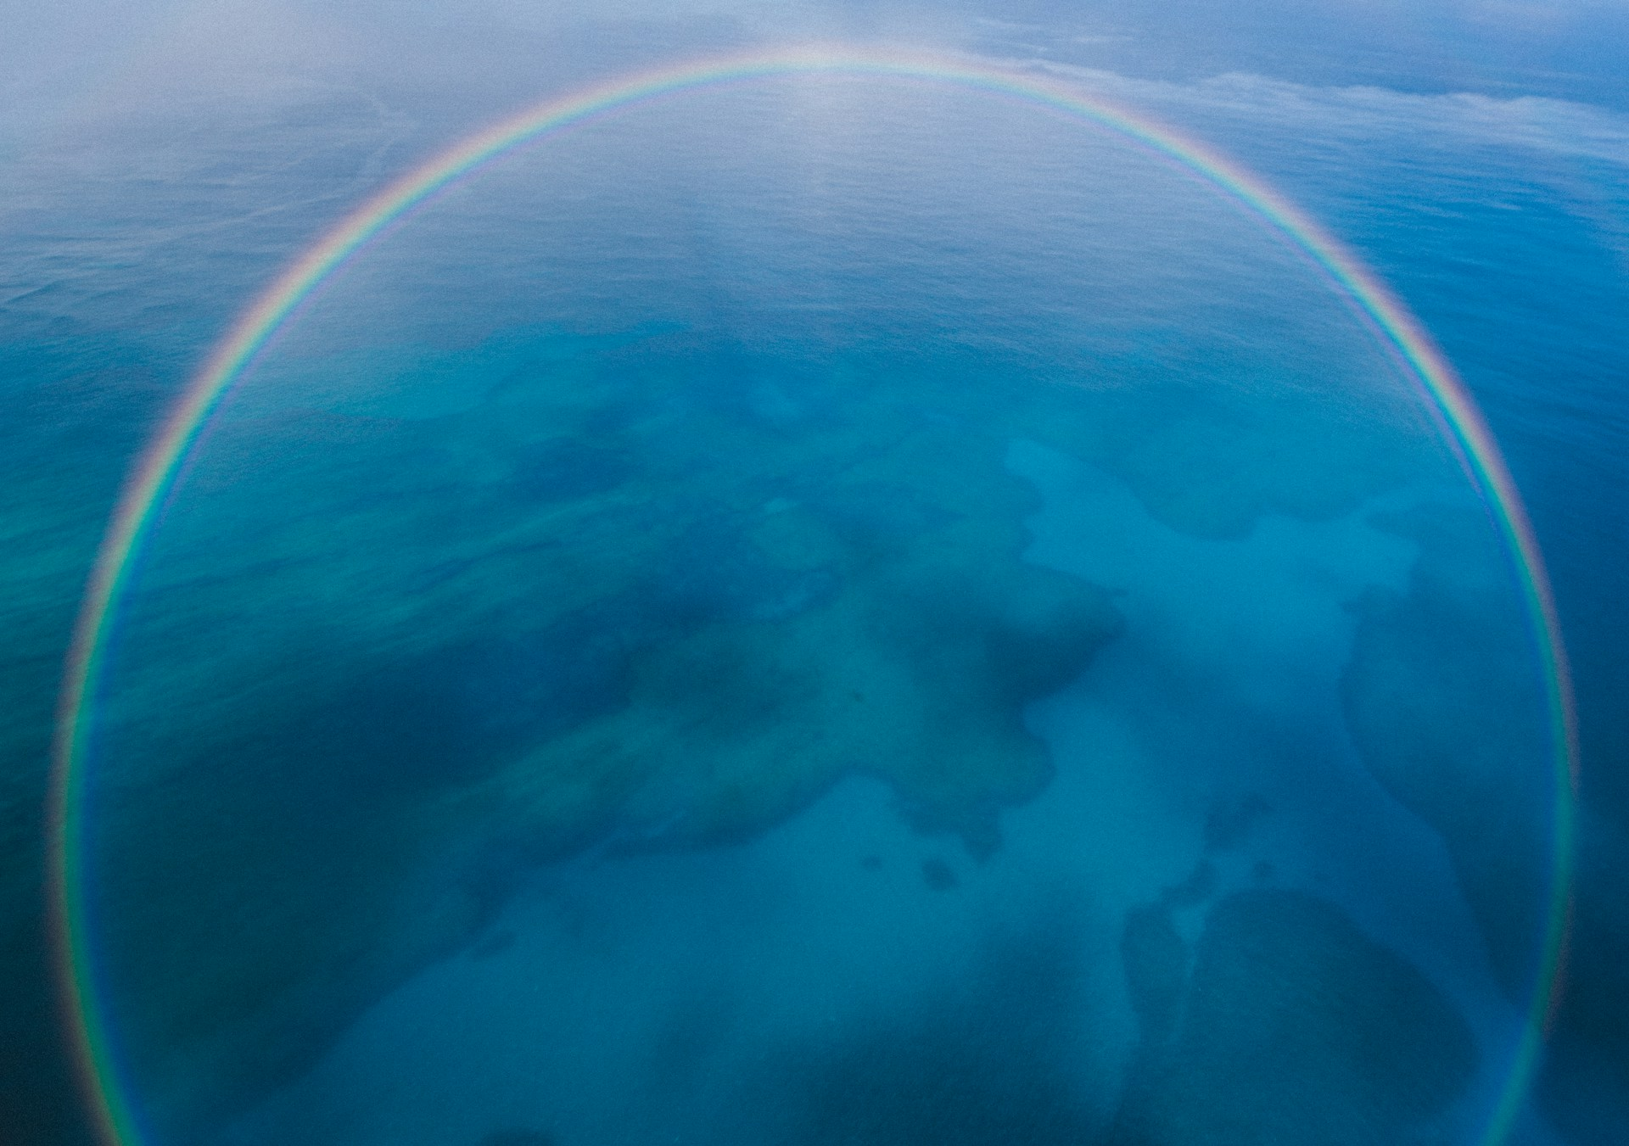
Full circle rainbow
Source: Jakob Owens on Unsplash
(unsplash.com/photos/birdseye-view-photography-of-body-of-water-LjOqMg5ciHw)

Slide 7
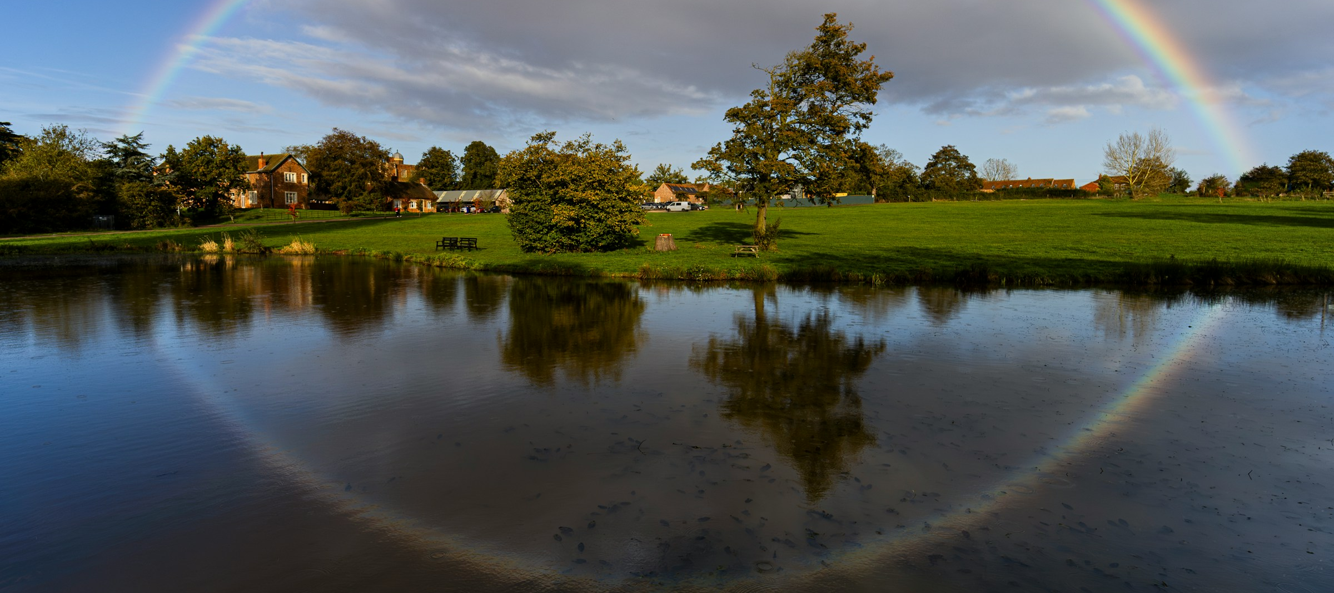
Reflection rainbow
Source: James Smith on Unsplash
(unsplash.com/photos/a-rainbow-is-reflected-in-the-water-of-a-lake-9Ul03OaExMM)

Slide 8
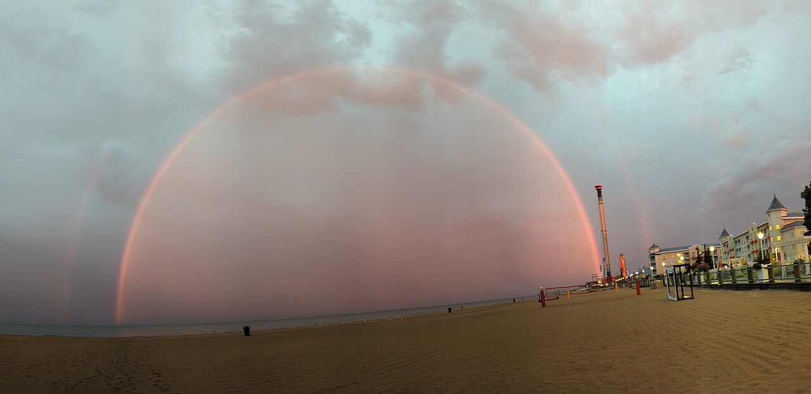
Monochrome rainbow
Source: Hannamyluv Heather Rhoades on Wikimedia Commons
(commons.wikimedia.org/wiki/File:Double_Red_Rainbow.jpg)

Slide 9
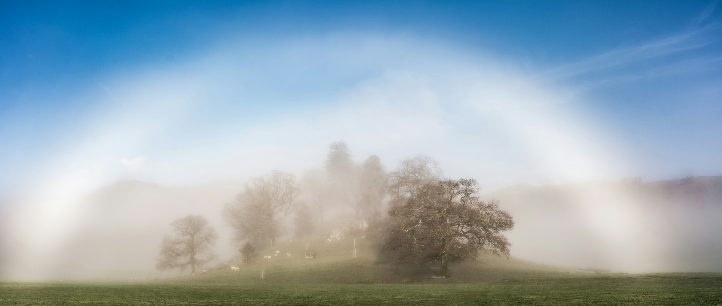
Fogbow
Source: Jason Hudson on Unsplash (unsplash.com/photos/a-foggy-field-with-trees---Wdt-cVTPg)

Slide 10
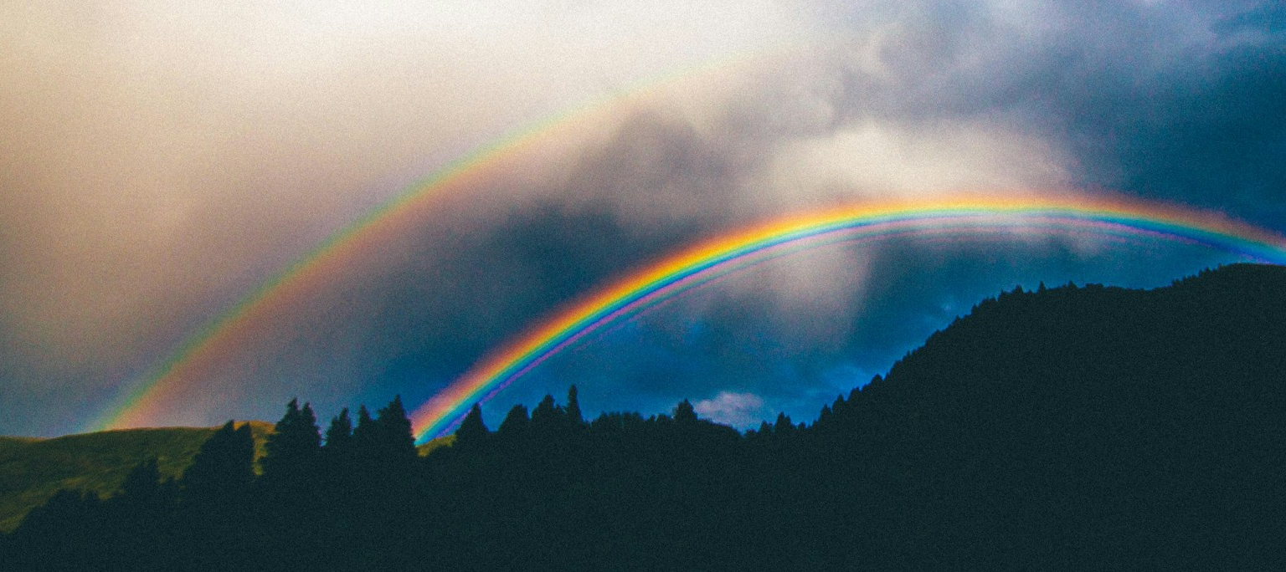
Double rainbow
Source: Abigail Keenan on Unsplash (unsplash.com/photos/rainbow-over-mountain-illustration-hG4qBPj5BJg)

Slide 11
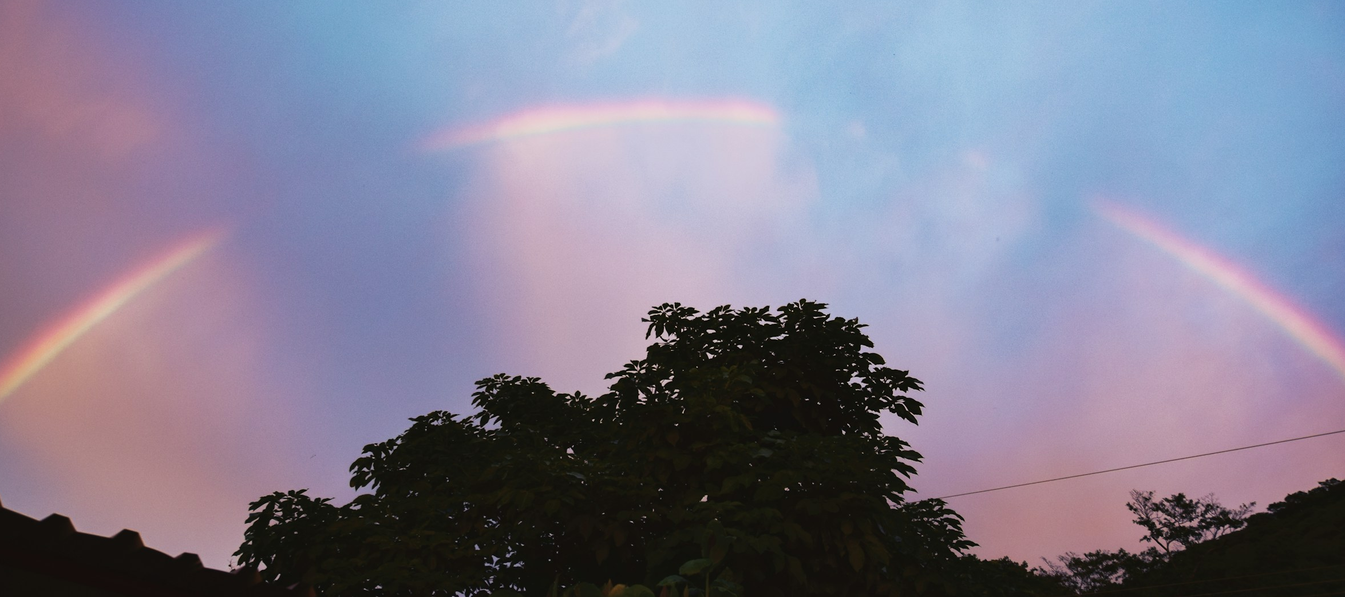
Broken rainbow
Source: Frames For Your Heart on Unsplash
(unsplash.com/photos/green-trees-under-blue-sky-with-rainbow-aT6vJyL1qF8)

Slide 12
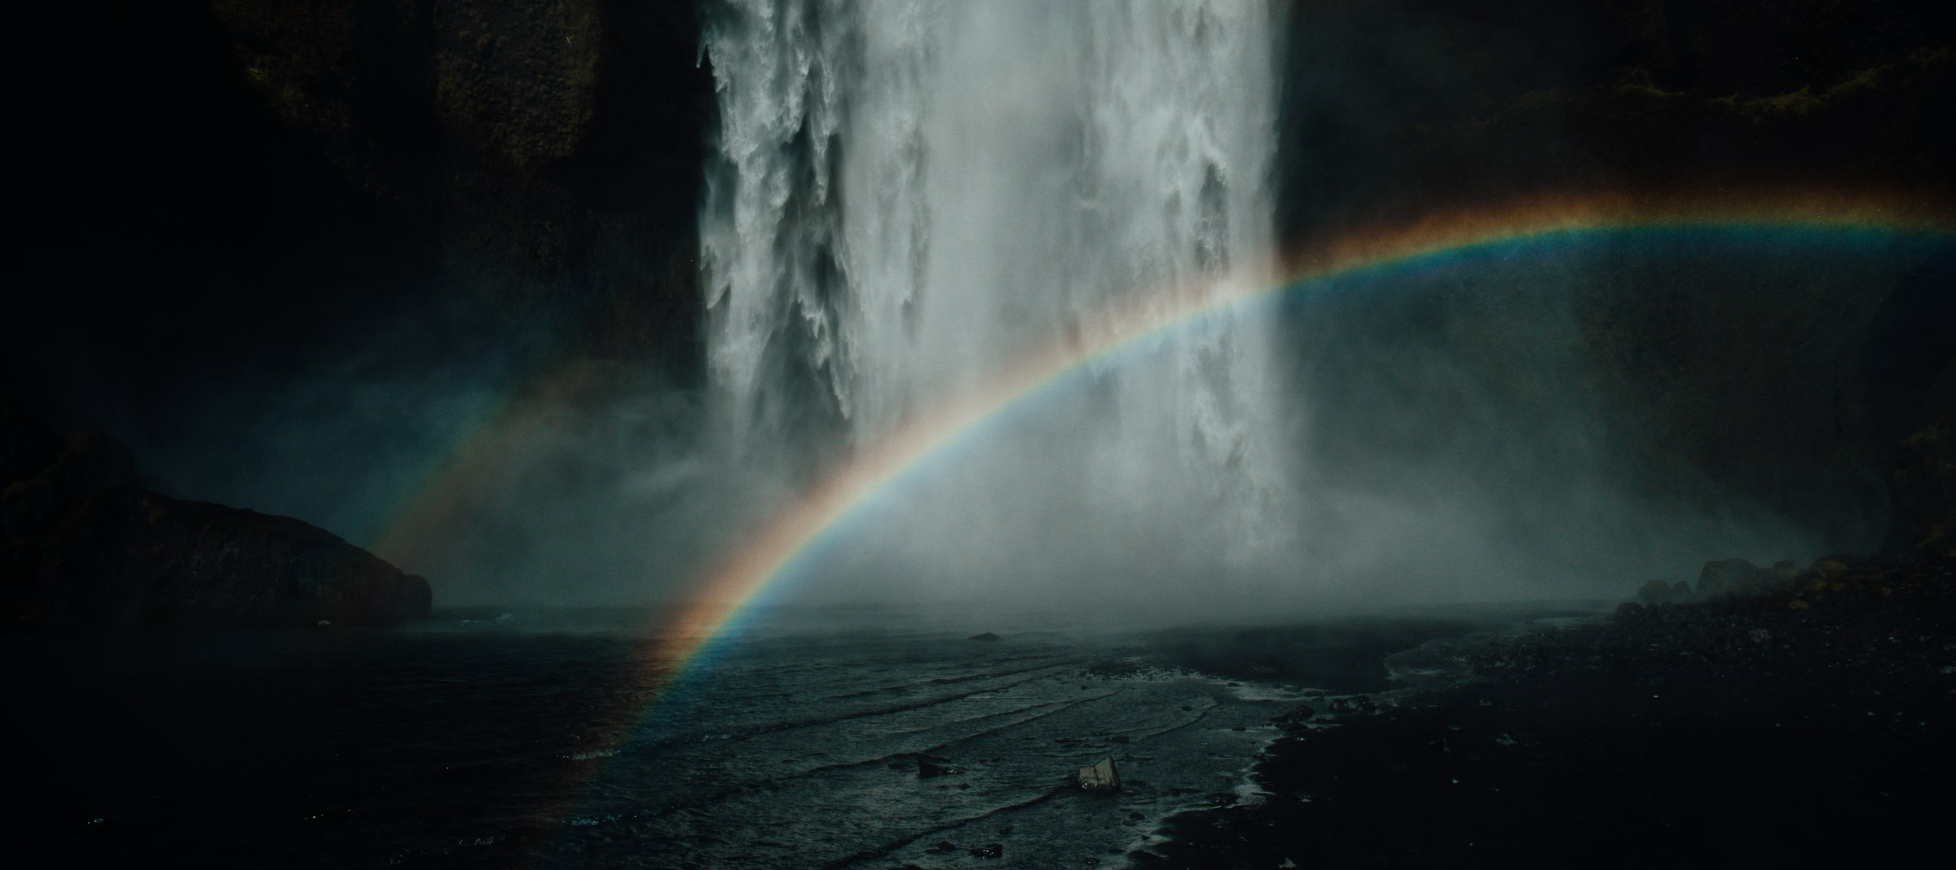
Waterfall rainbow
Source: Kristine Varga on Unsplash (unsplash.com/photos/a-waterfall-with-a-rainbow-KicFN06lsNk)

Slide 13
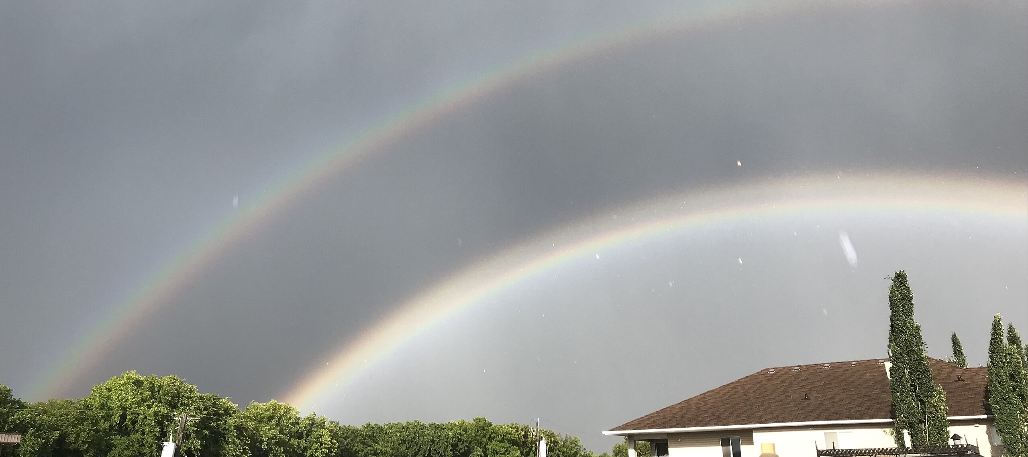
Alexander’s dark band rainbow
Source: Willirememberme on Wikimedia Commons (commons.wikimedia.org/wiki/File:Alexander%E2%80%99s_band_will_1.jpg)

Slide 14
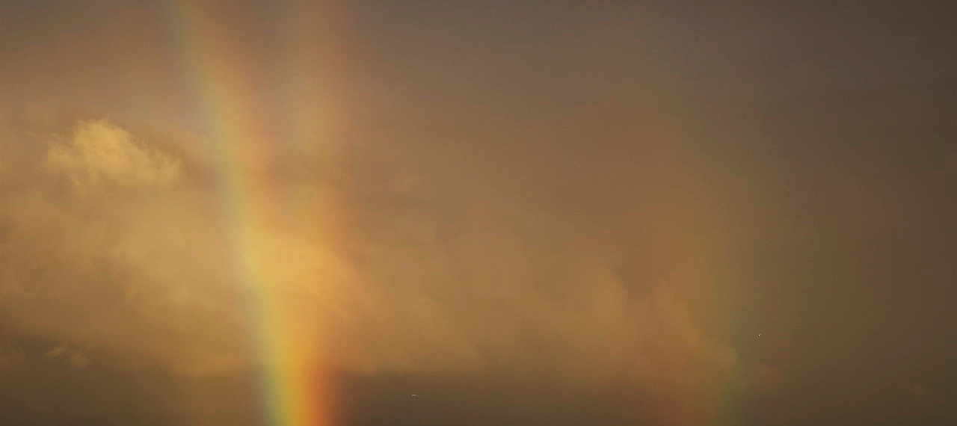
Twinned rainbow
Source: Unukorno on Wikimedia Commons (commons.wikimedia.org/wiki/File:Zwillingsregenbogen_bei_Sassnitz.jpg)

Slide 15
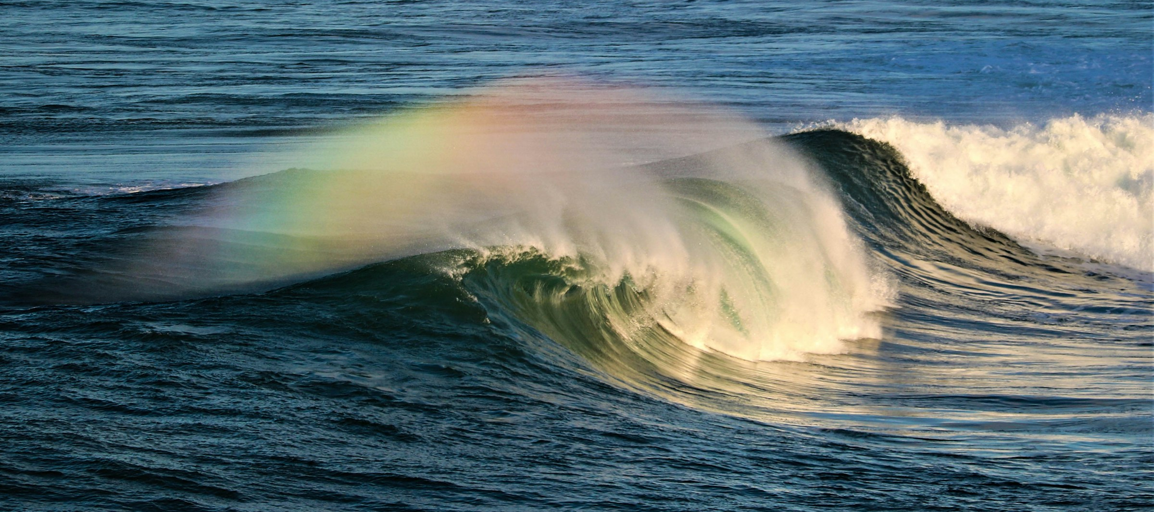
Sea spray rainbow
Source: Mark Vihtelic on Unsplash
(unsplash.com/photos/a-rainbow-appears-over-a-wave-in-the-ocean-ruhVXPygBWM)

Slide 16
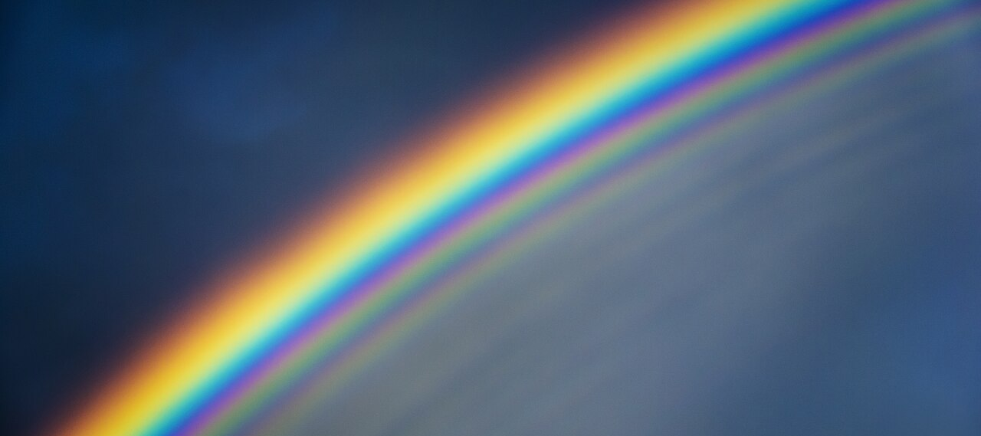
Supernumerary rainbow
Source: Mika-Pekka Markkanen on Wikimedia Commons (commons.wikimedia.org/wiki/File:Supernumerary_Rainbows.jpg)

Slide 17
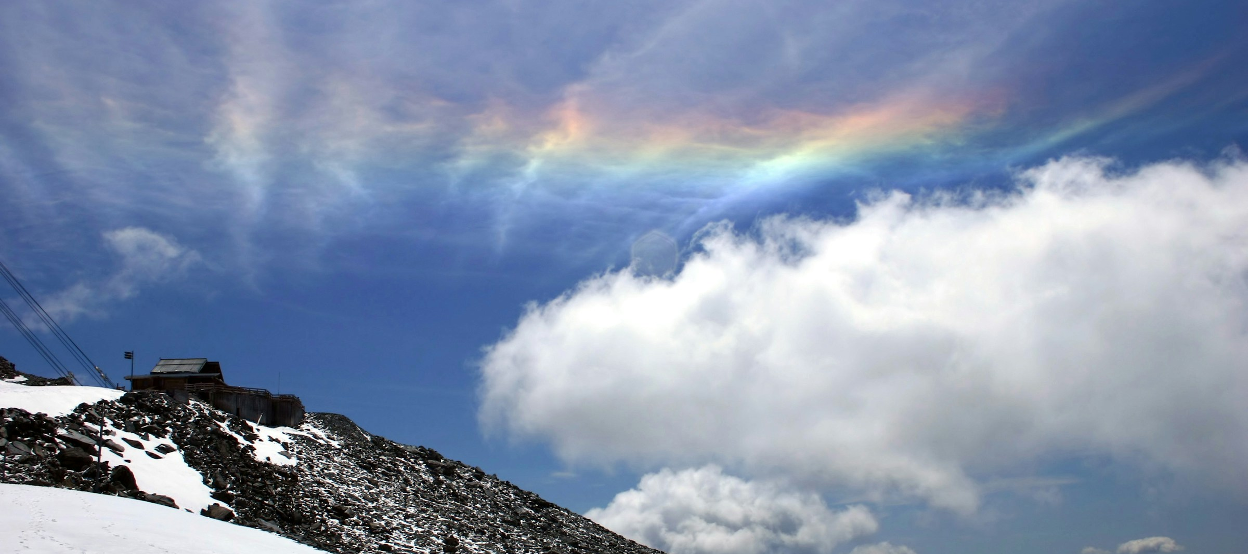
Rainbow cloud
Source: Nadia Ivanova on Unsplash
(unsplash.com/photos/snow-covered-mountain-under-cloudy-sky-during-daytime-fywu_i7DAAk)

