Slide 1

Pastorally Supporting LGBTQ+ Young People

Slide 2

Learning Outcomes
Feel more confident in pastorally supporting LGBTQ+ young people.
Understand that LGBTQ+ matters are a regular part of many young people’s lives, and that issues related to gender and sexuality may be significant for those they care for and support.
Understand and use terminology and acronyms associated with LGBTQ+.
Consider practical issues when working with LGBTQ+ young people.
Better understand the experiences of LGBTQ+ young people in church.

Slide 3

Youth Workers vs.Young People: Exploring Views on LGBTQ+ Topics

Slide 4
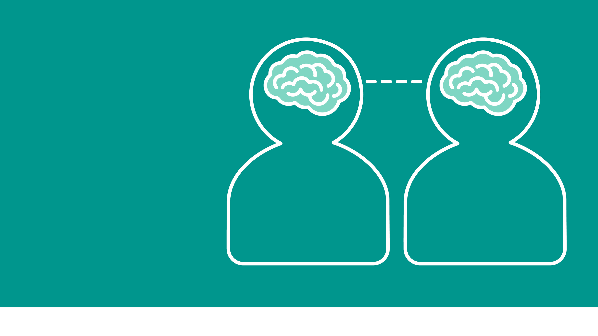
1. Do you have any friends who would identify as LGBTQ+?
70%
Yes
Youth Workers
100%
Yes
Young People

Slide 5
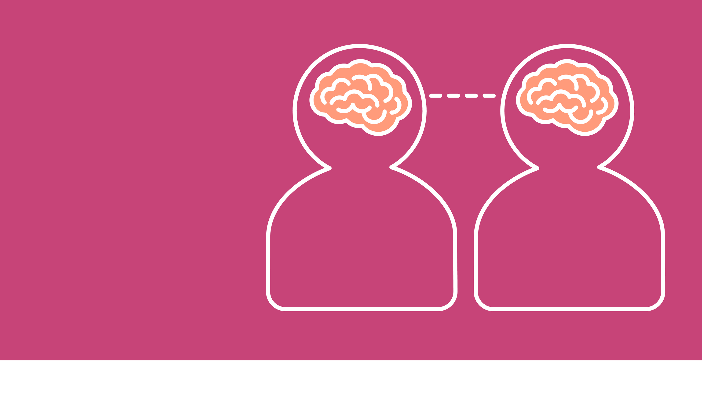
2. Are you aware of LGBTQ+ young people / adults being active members of
your church?
18%
Yes
Youth Workers
45%
Yes
Young People

Slide 6
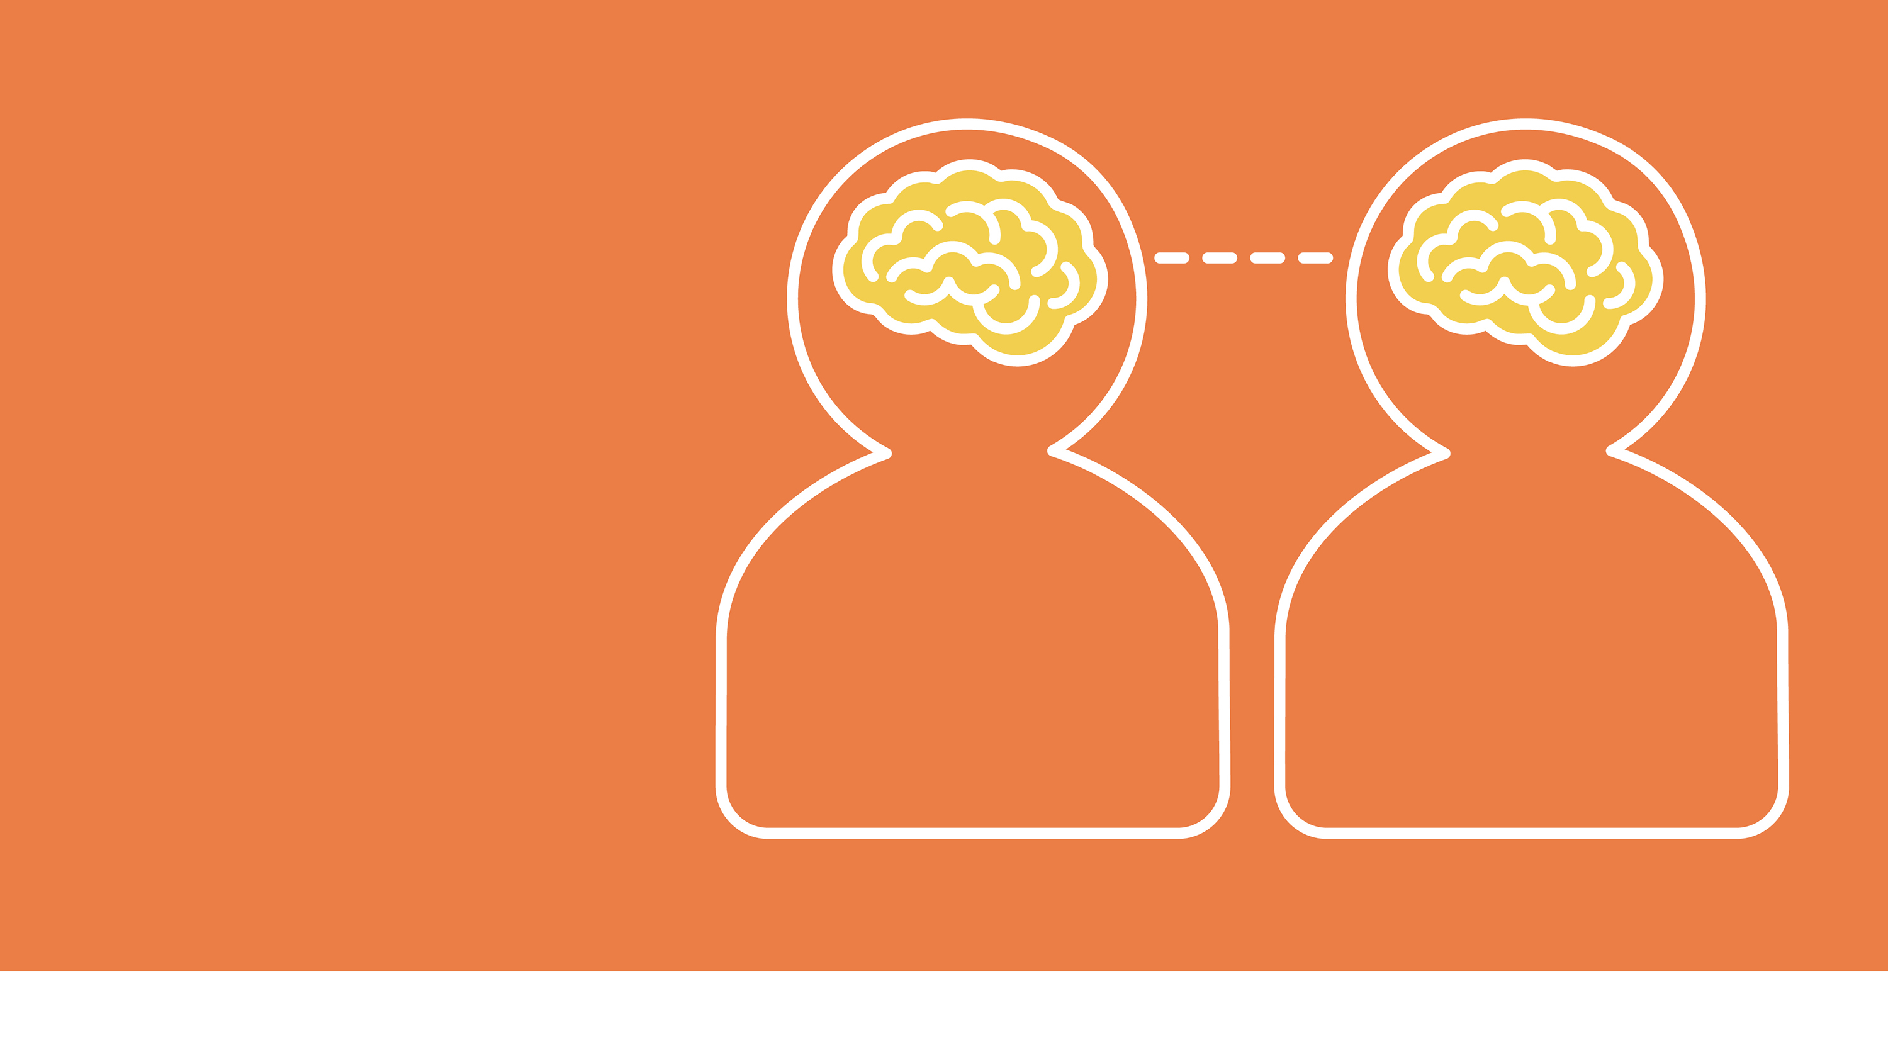
3. Do you feel comfortable having open conversations about LGBTQ+ in church?
94%
Yes
Youth Workers
87%
Yes
Young People

Slide 7
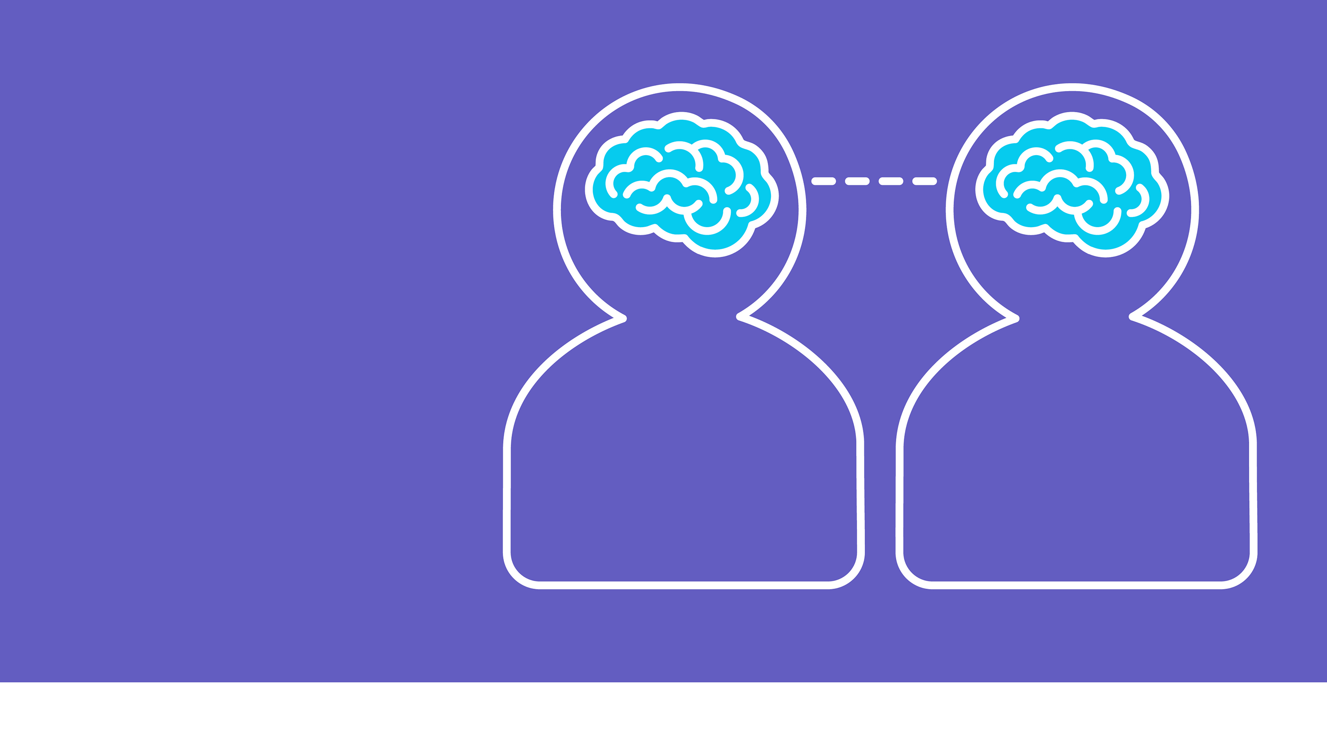
4. Do you feel comfortable having open conversations about LGBTQ+ outside of church?
100%
Yes
Youth Workers
100%
Yes
Young People

Slide 8

Diversity Dice
Gender and
Sexuality Terminology

Slide 9
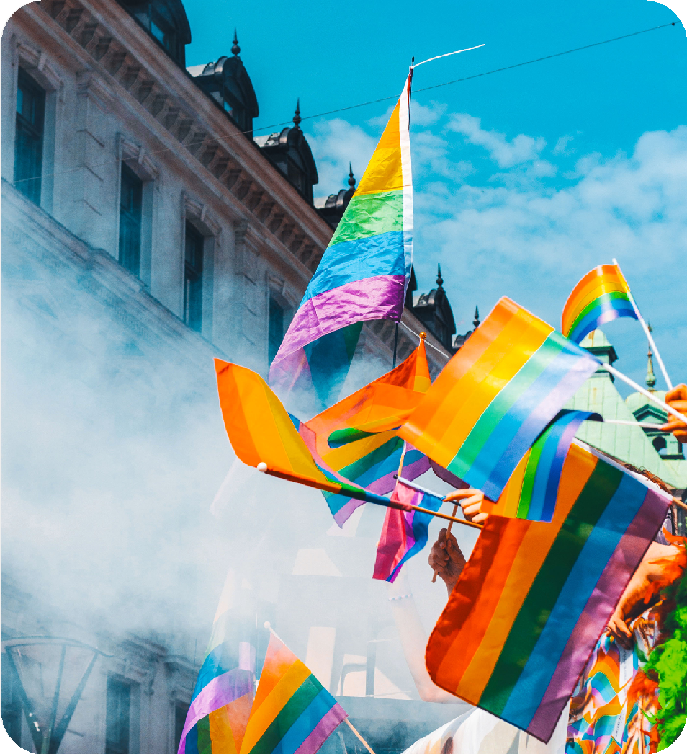
Sex and gender are different.
Sex refers to biology, the anatomy of an individual’s reproductive system and secondary sex characteristics.
Gender refers either to the social roles based on the sex of a person or to a personal identification of a person’s own sense of awareness of their own identity – our inner sense of how we see and feel about ourselves.

Slide 10

Gender Definitions
Transgender (or just trans) – an umbrella term meaning someone’s gender does not match the sex they were assigned at birth. Many people use this term differently. Common uses are:
Trans man – assigned female at birth, but identifies their gender as male.
Trans woman – assigned male at birth, but identifies their gender as female.
Cisgender (or just cis) – a term meaning a person’s gender identity aligns with the sex they were assigned at birth.
Cis man – assigned male at birth and identifies their gender as a man.
Cis woman – assigned female at birth and identifies their gender as a woman.

Slide 11
Gender Definitions
Intersex – may have the biological attributes of both sexes, or biological attributes that do not fit with societal assumptions about what constitutes male or female (genitals, gonads, hormones, chromosomes or reproductive organs). Intersex babies have to be assigned a sex at birth: male or female. Like everyone, they may identify as male, female or non-binary. There are many different variations of how this impacts people. Experts estimate that up to 1.7% of people are born with intersex traits.
Non-binary – a person who does not have a gender identity as male or female. They may recognise attributes of both genders in themselves or may feel as if they have no binary gender. For some people this will lead to medical body changes, but for many it will not.
Don’t assume someone’s gender identity – just ask. It’s fine to ask a young person what pronouns they use (he/him, she/her/, they/them), and you can introduce yourself with your own pronouns to make it easier. If they don’t know what you mean, it likely isn’t important to them; if it is, you’ve started an open conversation about identity.

Slide 12

Sexuality Definitions
Gay - attraction to those of the same sex or gender. People of all genders can use this term.
Lesbian - is also a term used to describe females attracted to other females, and while it is still used by many women, more and more youth language has moved towards the term gay instead.
Bisexual - attraction to more than one gender.
Pansexual - attraction to all genders not limited by gender.

Slide 13
Sexuality Definitions
Heterosexual – attraction to the opposite gender.
Asexual - experience little or no sexual attraction to anyone. We assume all young people are wired for sexual intimacy, but for some this isn’t the case.
Queer - The word queer can be used differently by people from different generations or geography. Whilst historically it has been an offensive derogatory term, in recent years there has been a move towards reclaiming it. A dictionary would define it as an adjective meaning ‘strange or odd’: ‘She had a queer feeling that they were being watched’, or a dated term for being slightly ill: ‘He was feeling rather queer.’ Now many use it in a positive way to reclaim the use of the term
and the pain it was previously used to create. Many reclaim it as an umbrella term – more of a sense of not fitting with, or wanting to be defined by, other labels. However, many people still see this as offensive, so only use it with permission.

Slide 14
Note that:
Terminology related to LGBTQ+ identities evolves as understanding of sexuality and human complexity grows.
The terms used to describe sexual orientation and gender identity have changed over time and are expected to continue developing.
Language is applied differently across individuals, generations and regions.
It is important to maintain cultural awareness in order to interpret the terminology young people use appropriately and to refer to LGBTQ+ young people respectfully.
It is OK to ask a young person to help you to understand how their identity impacts them.

Slide 15

Video Testimonies
Video Testimonies

Slide 16

Five Tips
for Pastorally Supporting LGBTQ+

Slide 17

Summary of the Five Teaching Points
Know your starting point and learn
Listen and let them lead
Affirm and celebrate
Help people find community
Don’t wait until it’s on your doorstep
Take a few minutes to reflect on these five teaching points, considering how they relate to your own youth work practice and setting.
Identify a practical action you can take to strengthen your practice in each area.

Slide 18

Diversity Dice
Gender Identity and Sexuality in Real-Life Contexts

Slide 19

Diversity Dice
Gender Dice – Turquoise
Sexuality Dice – Blue Faith Dice – Lilac Ethnicity Dice – Purple Disability Dice – Orange Relationship Dice – Red Other Dice – Yellow
Roll four dice at the same time and note down your combination.
Recap: What do the terms mean?
What might life be like for this young person? (Consider different contexts such as church, school, university or work.)
How could you, as a youth worker, support them pastorally? What changes might you need to make in your own setting to do so?

Slide 20

Questions

Slide 21

Questions
Type the question here

Slide 22
Questions
Type the question here

Slide 23
Questions
Type the question here

Slide 24

Let’s continue to reflect on what has
been discussed.
One of the most valuable things we can do for LGBTQ+ young people is to keep the conversation going and show a genuine commitment to supporting them in all aspects of their lives.

Slide 25


