Slide 1





Welcome to Assembly

Slide 2
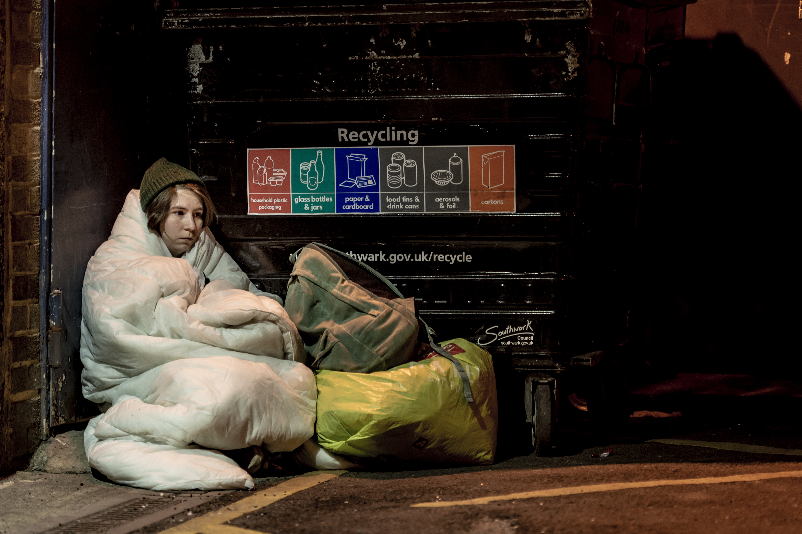

rough sleepers

Slide 3
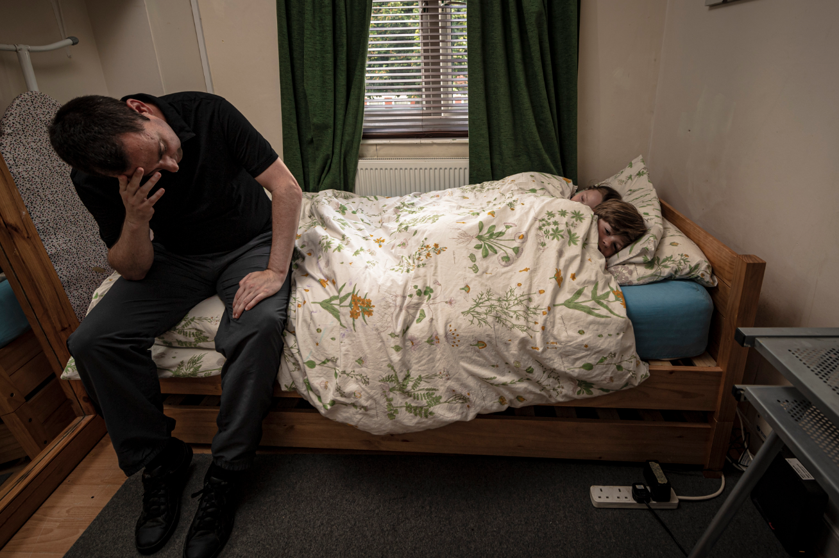

temporary accommodation

Slide 4


hidden homeless

Slide 5


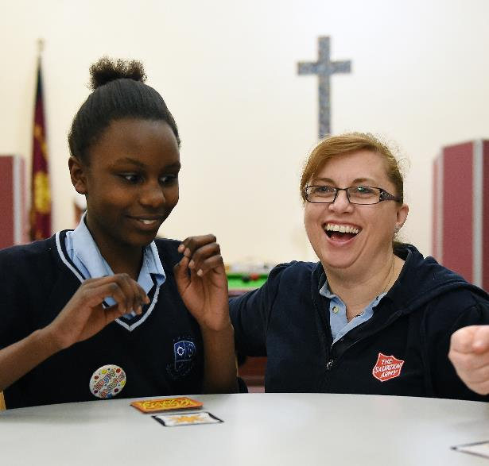
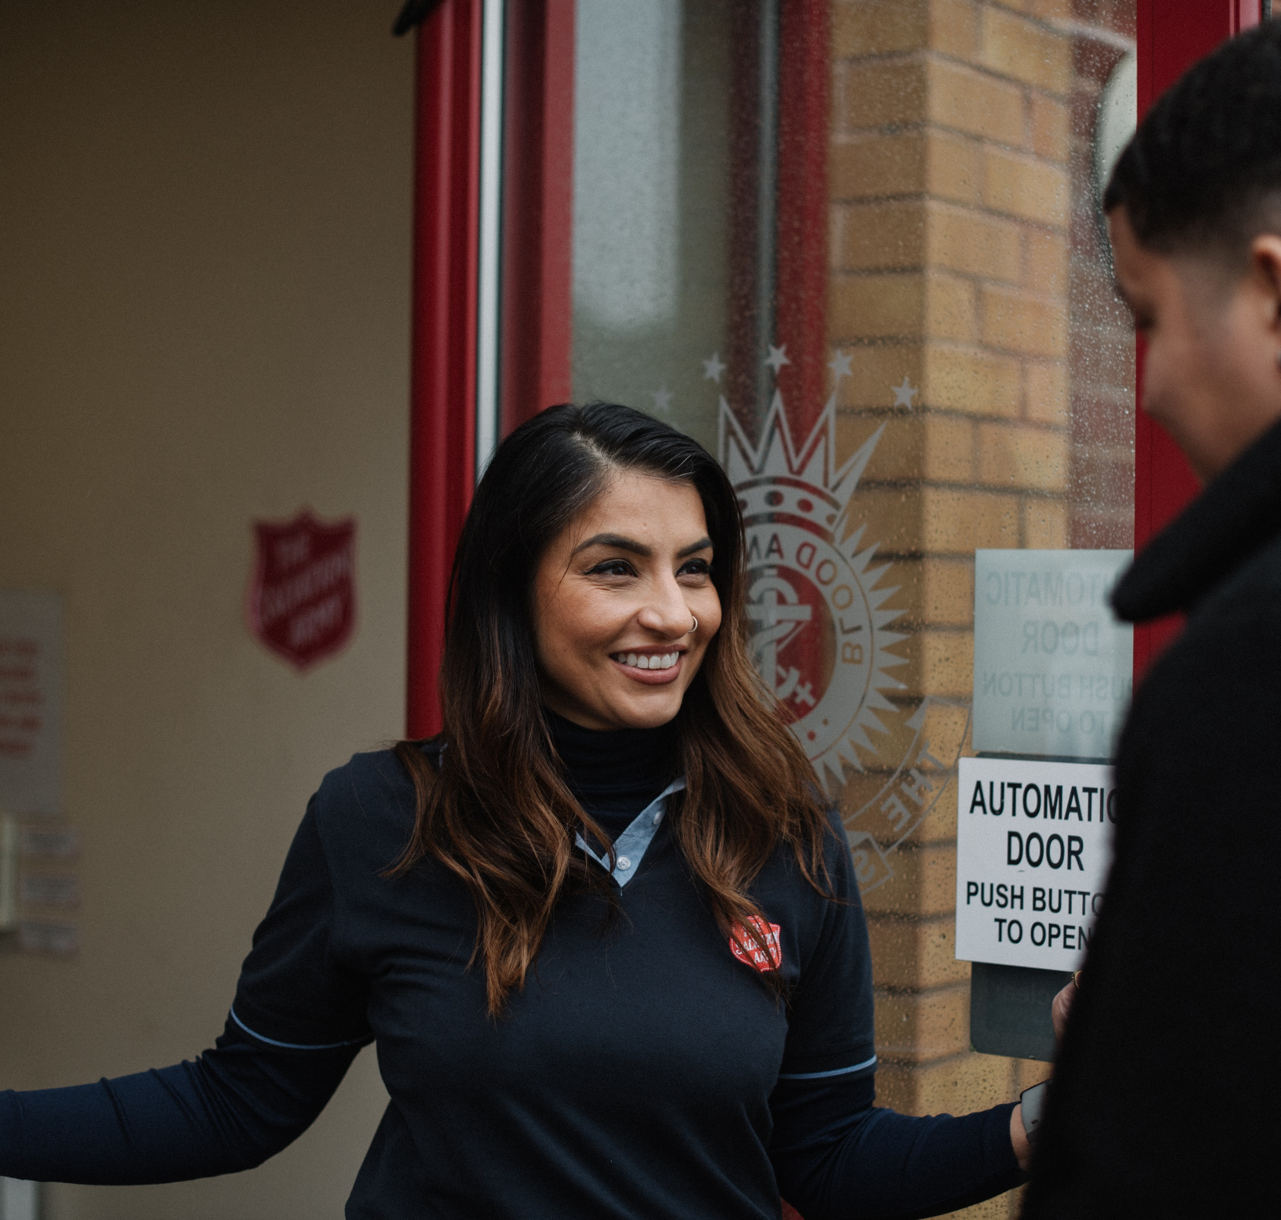
The Salvation Army

Slide 6
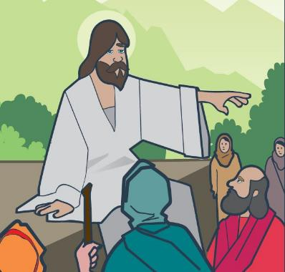






‘I was hungry,
and you gave me food.
I was thirsty,
and you gave me something to drink.
I was alone and away from home,
and you invited me into your house.’
Matthew 25:35

Slide 7
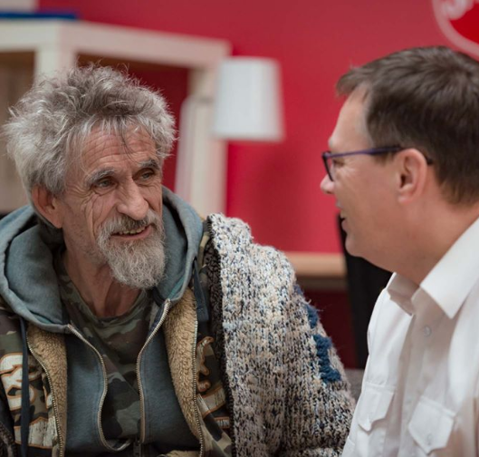
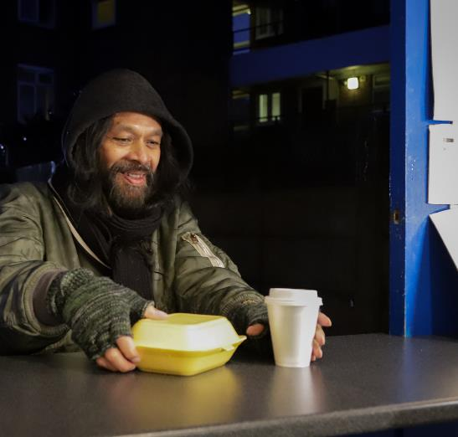
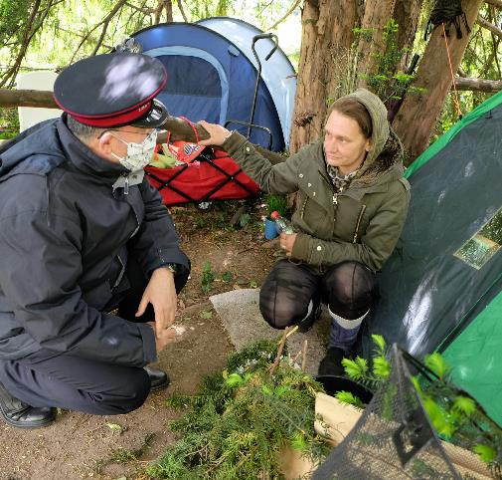
helping rough sleepers

Slide 8
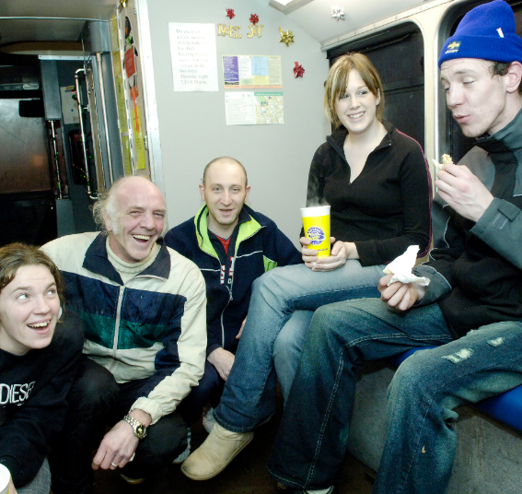

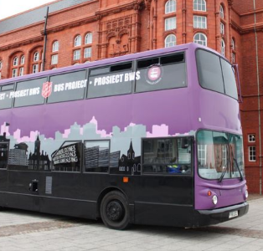
helping rough sleepers

Slide 9

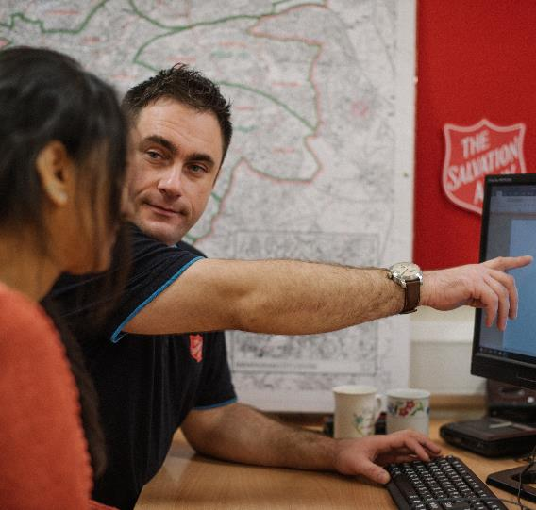
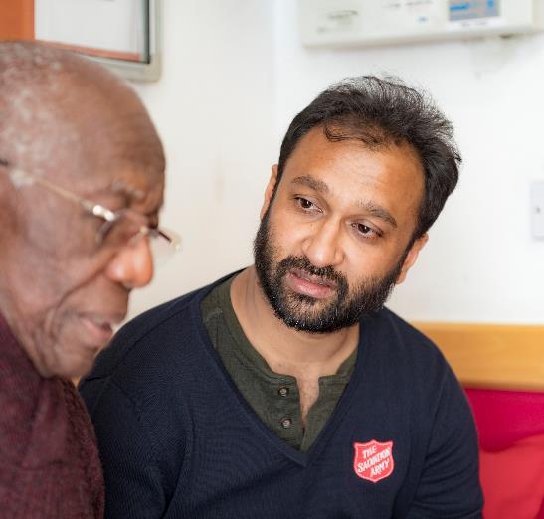
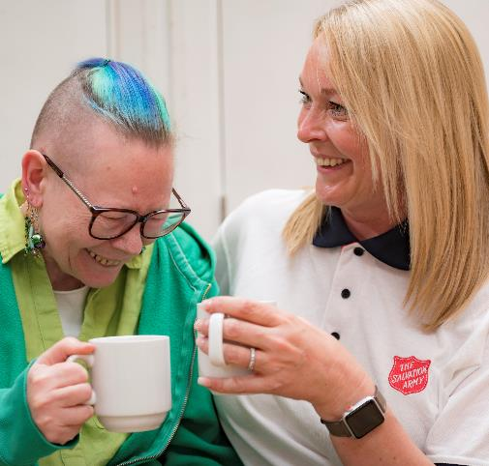
Lifehouses

Slide 10
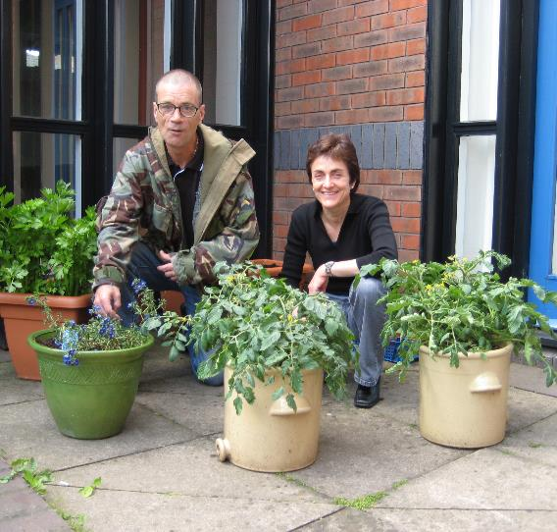
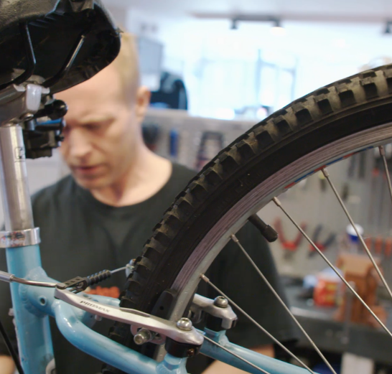

Lifehouses

Slide 11

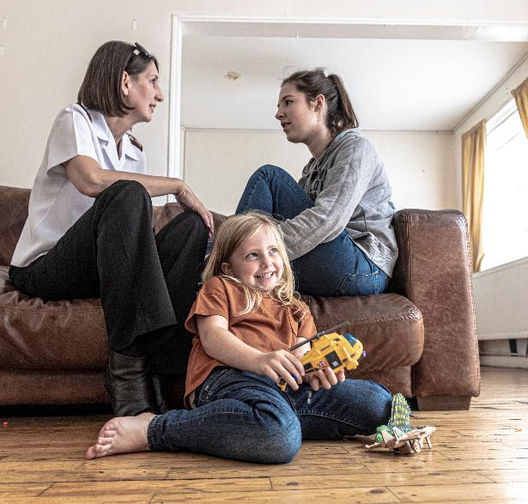
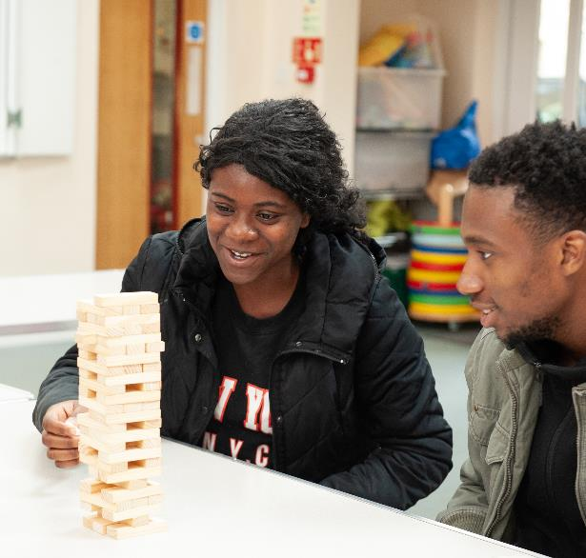
accommodation

Slide 12
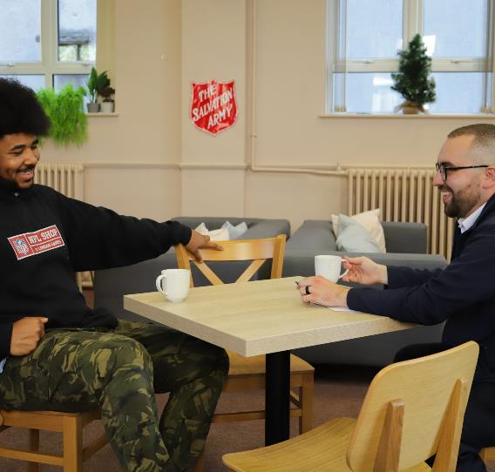
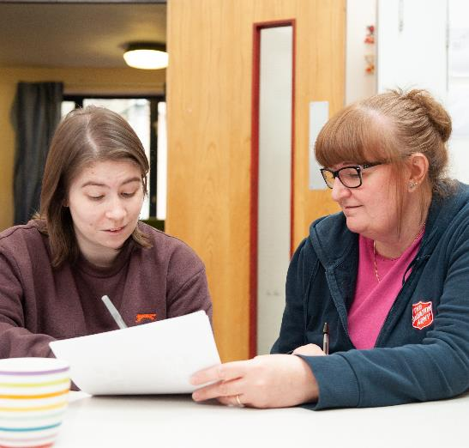
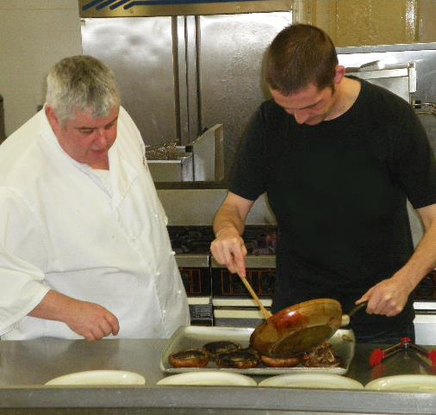
prevention

Slide 13
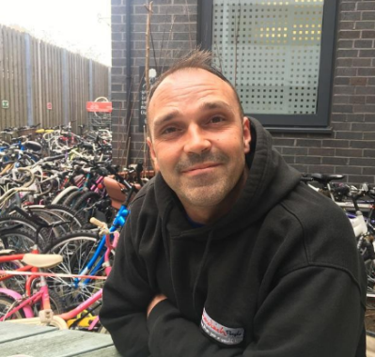



meet Alan
‘While I was homeless
The Salvation Army looked after me.
They gave me food, clothes and sleeping bags.
I now volunteer at the Lifehouse with The Sandwich People.
I really enjoy it because they make me feel so welcome.
They are so helpful and always go the extra mile .
Everyone here makes you feel you’re part of something.’

Slide 14

reflection

Slide 15



