Slide 1


Session 5
Hopes and Dreams
Aim: to consider the importance of balance and how we can support one another to live well and pursue our hopes and dreams.

Slide 2



Slide 3


Slide 4


Slide 5
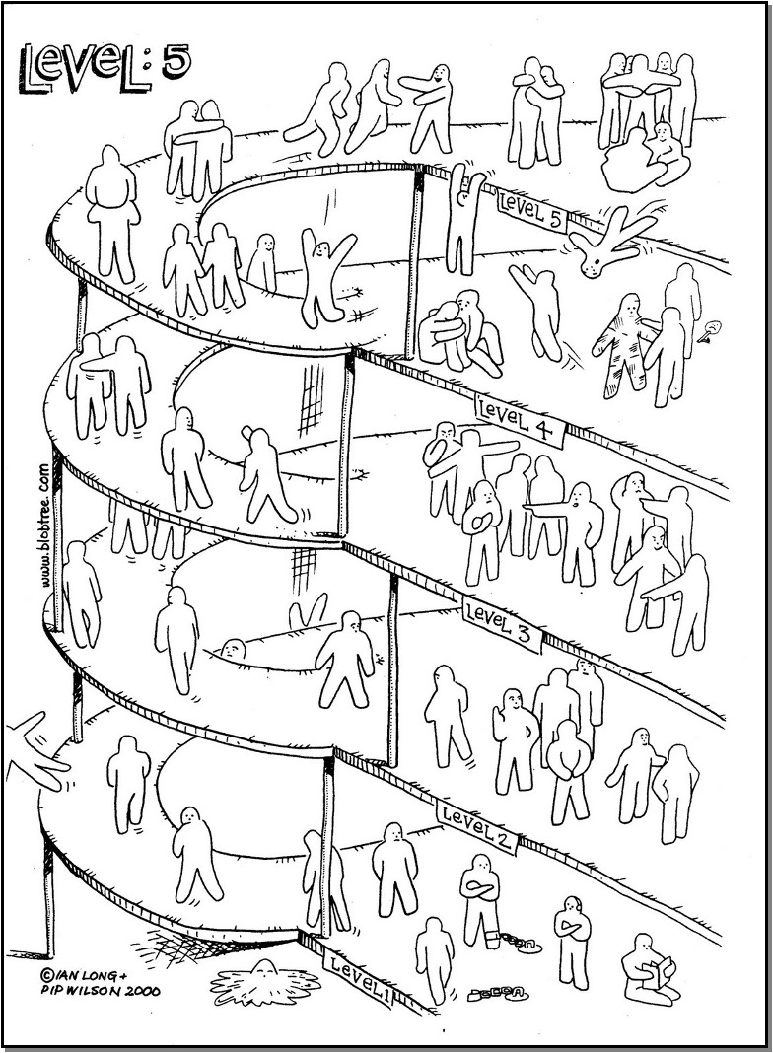
The Blob Tree

Slide 6
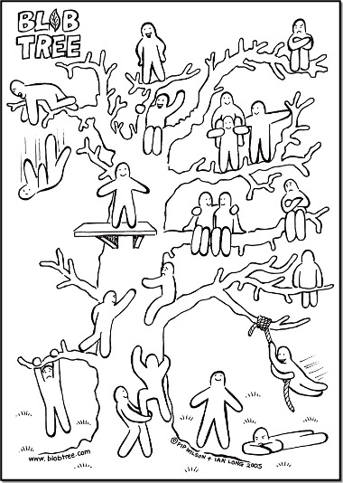
The Blob Tree

Slide 7
Jar Exercise
LEADER: you may want to show this video rather than doing it yourself
https://youtu.be/cPgMeKfQFq8
What do you want to achieve in your week?

Slide 8
Personality Quiz
Complete the quiz and discuss your answers.

Slide 9
The Perfect Day
Discuss the following …
How do you feel when this happens?
What are the changes you made?
What might you be doing differently?
How are you planning to celebrate? A coffee, a walk, a meal, a full-on party?
Who will you invite?
Make a plan to have something to celebrate in a few weeks’ time.
Where do you see yourself and why?
Who/where would you like to be and why?

Slide 10

What went well?
Even better if?
Is there anything else you’d like to say?

Slide 11


Slide 12
Title goes here
Text goes here

