Slide 1
Welcome slide

Slide 2
Praying for Home

Slide 3
God of Abraham and Sarah, you journey with people who are searching for home.
Response: Walk with all who are displaced, vulnerable or without secure housing.
For those sleeping rough tonight,
Response: Lord, be their shelter.
For those in temporary accommodation or unsafe housing,
Response: Lord, be their security.
For families facing eviction, debt or uncertainty,
Response: Lord, be their strength.

Slide 4
For children who long for stability,
Response: Lord, be their peace.
For communities divided by inequality and exclusion,
Response: Lord, bring justice.
For your Church,
Response: Make us a people of hospitality, courage and compassion.
All: Until every person knows dignity, belonging and the possibility of home.
Amen.

Slide 5
Praying for Restoration #1

Slide 6
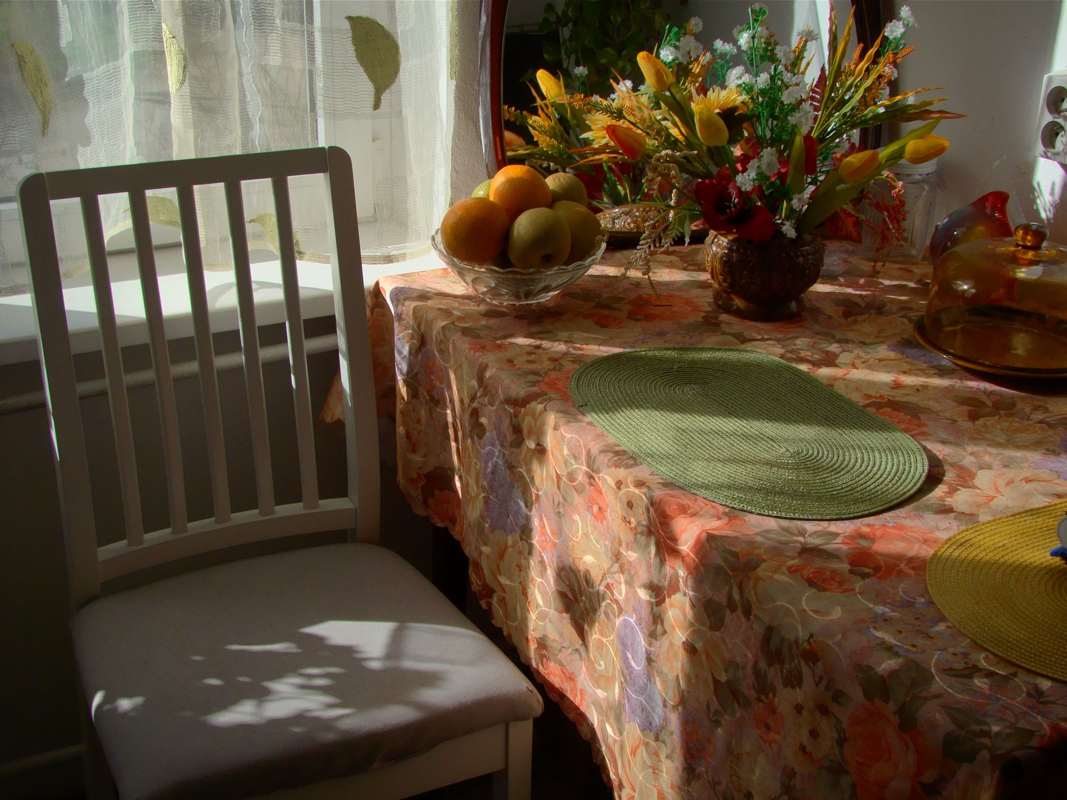

Slide 7
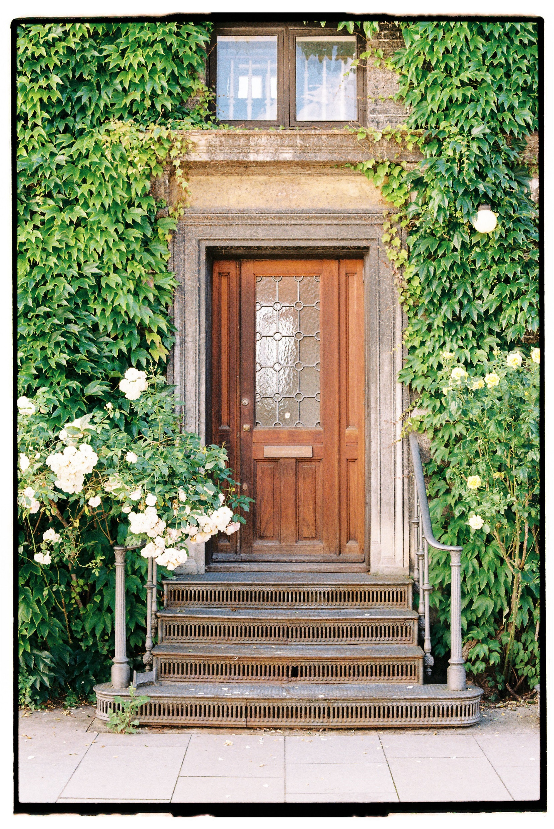

Slide 8


Slide 9


Slide 10
Praying for Restoration #3

Slide 11
The Spirit of the Lord is upon us, because the Lord has anointed his people to bring good news to the poor.
Response: Anoint us again, O God. Make us bearers of good news in places of hardship, exclusion and housing insecurity.
You have sent us to bind up the broken-hearted, to proclaim freedom for the captives, and release from darkness for all who are oppressed.
Response: Where hearts are bruised by poverty, where people live without a place to call home, where families fear eviction and uncertainty, let your freedom come.

Slide 12
Jesus stood in the synagogue and declared, ‘Today this scripture is fulfilled.’ His mission became our calling: a ministry of justice, mercy and reconciliation.
Response: Fulfil your word among us today. Let your justice flow through our streets, and let every person find dignity, welcome and belonging.
God of Isaiah’s vision, you promise a crown of beauty instead of ashes, the oil of joy instead of mourning, and a garment of praise instead of a spirit of despair.
Response: Restore dignity where it has been stripped away. Bring stability where lives have been uprooted. Renew hope for those who long for the safety and security of home.

Slide 13
You know those who sleep rough tonight, those moving from place to place, those in temporary accommodation, and those hidden from view, living with anxiety about where they will stay tomorrow.
Response: Lord, draw near to all who are homeless or at risk of homelessness. Shelter them with your presence and surround them with care and support.
God of good news, you call us not only to proclaim your Kingdom but also to participate in it – to stand alongside those who are unseen, unheard and overlooked.
Response: Make us partners in your healing. Let our compassion be active, our hospitality generous, our advocacy persistent and our welcome sincere.

Slide 14
Where systems wound and structures exclude, where affordable housing is scarce, where poverty deepens, and where people are left without security or belonging, your Spirit cries out for justice.
Response: Teach us to hear that cry. Strengthen us to challenge injustice and to work for communities where everyone has a safe place to call home.
Where relationships are fractured between neighbours, communities and institutions, you call us to the ministry of reconciliation.
Response: Heal what is broken. Bridge what is divided. Restore trust, rebuild community, and renew hope.

Slide 15
God of the oppressed and the overlooked, you plant your people as oaks of righteousness, to rebuild ancient ruins and repair places long devastated.
Response: Plant us, Lord. Root us in your justice, grow us in compassion, and send us to rebuild lives, strengthen communities and create places of welcome and belonging.
Today we remember that your Kingdom is good news for the poor, comfort for the grieving, release for the captive and restoration for all who are displaced.
Response: Make us instruments of that Kingdom. May we open our hearts, our churches and our communities so that all may know the dignity, security and hope you desire for every person.

Slide 16
Spirit of the Lord, anoint us anew.
Response: Send us out to proclaim your favour, to embody your compassion, and to join you in the holy work of justice, reconciliation and restoration,
Until every person finds welcome, dignity and the possibility of home.
Amen.

Slide 17
Praying for Systemic Change

Slide 18
God of justice, we pray not only for individual lives but also for systems and structures that shape those lives:
For housing policies, planning decisions, welfare systems, mental health provision, employment opportunities and support services.
Response: Lord, bring justice and hope.
For national and local leaders,
Response: Lord, bring wisdom and courage.
For housing associations, charities, churches and community organisations,
Response: Lord, strengthen their work.

Slide 19
For those trapped in cycles of poverty,
Response: Lord, make a way forward.
For communities where housing is scarce and insecurity is growing,
Response: Lord, bring restoration.
For a society where everyone has a safe place to call home,
Response: Lord, hear our prayer.
Amen.

Slide 20
Praying for Hope

Slide 21
Homelessness is not God’s final word.
Response: Hope is stronger than despair.
Poverty is not God’s final word.
Response: God’s Kingdom is good news for the poor.
Leader: Isolation is not God’s final word.
Response: We belong to one another.
Brokenness is not God’s final word.
Response: God is making all things new.
Christ is among us.
Response: And his Kingdom is coming.
Amen.

Slide 22
A Prayer of Commissioning

Slide 23
The Spirit of the Lord is upon us, because he has anointed us to bring good news to the poor.
Response: Send us with your good news,
To bind up the broken-hearted.
Response: Send us with your healing,
To proclaim freedom to the oppressed.
Response: Send us with your justice,
To rebuild what has been broken.
Response: Send us with your hope,

Slide 24
To stand alongside those experiencing homelessness and housing insecurity.
Response: Send us with your compassion.
The mission of Christ continues,
All: And we offer ourselves afresh in his service.
Amen.

Slide 25
End slide

